Slide 1
TWG Cultural Fund Photos Pre-TWGCF 1987-1993 TWGCF 1994 – 2004
Created November 5, 2020

Slide 2
The Washington Group Cultural Fund
Our Mission is twofold: to preserve and nurture Ukrainian performing, literary and fine arts,
and to share these cultural treasures with the greater Washington community.
http://www.twgcf.org

Slide 3
TWG Cultural Events before the establishment of TWG Cultural Fund in 1994
Daria Telizyn 1987
Roxolana Armstrong 1987
Virsky Dancers 1988
Antonovych Awards 1988
Oleh Krysa 1989
Antonovych Awards 1989
Movchan, Taniuk, Kornienko 1989
Stefan Maksymjuk 1990
Antonovych Awards 1990
Chornobyl Benefit Concert 1990
Ilona Sochynsky 1991
Volodymyr Hryshko, Roman Terleckyj 1992
Leadership Conference 1993

Slide 4
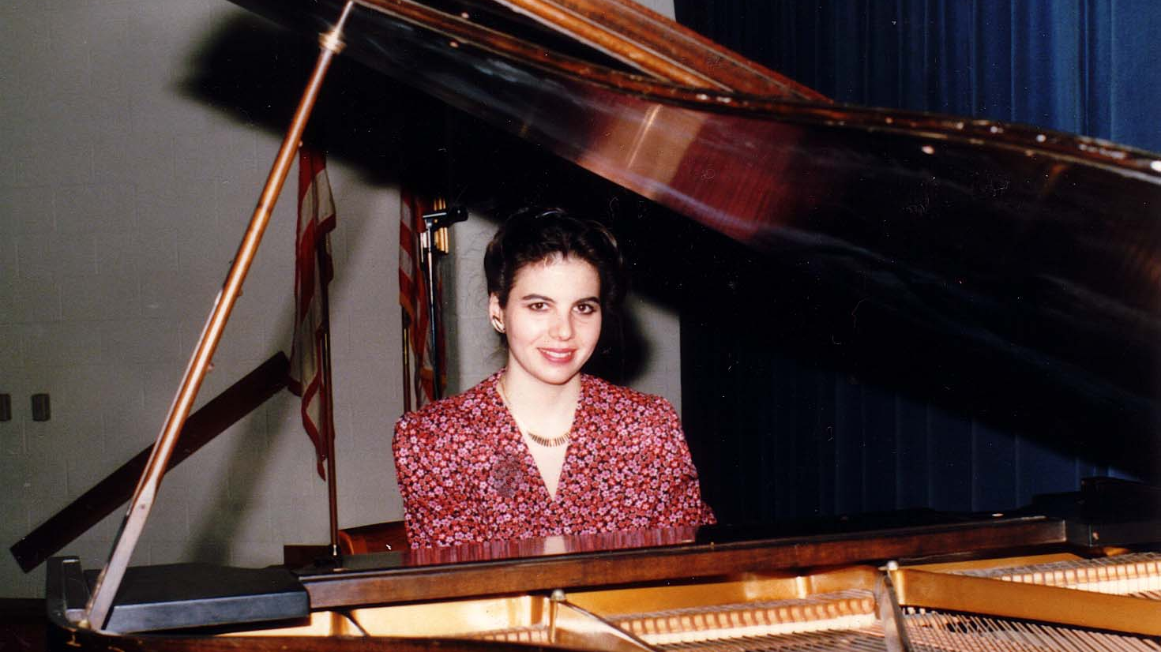
Notes:
TWG_Photo_1987_No_310__Feb_15__Holy_Family_Parish_Center__Fundraiser_for_Daria_Telizyn’s_Concert_Tour_to_Raise_Funds_for_Chornobyl_Victims__Pianist_Daria_Telizyn
See 1987 January TWG NEWS, page 6, February TWG NEWS, page 14, for event announcement, and March TWG NEWS, page 11, for concert coverage

Slide 5
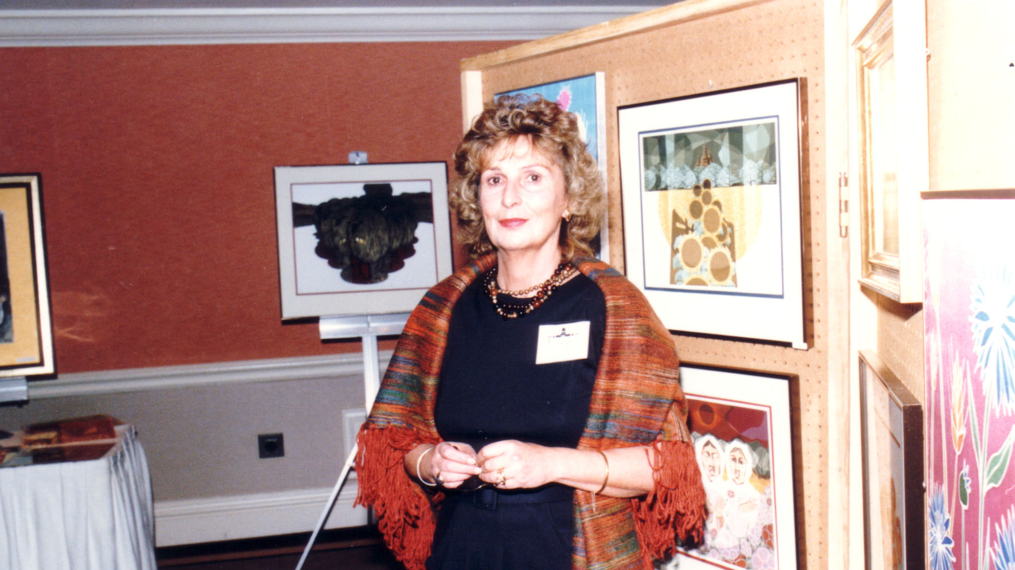
Notes:
TWG_Photo_1987_No_296_Oct__10__Leadership_Conference__Artist_Roxolana_Armstrong
See 1987 October TWG NEWS, page 14

Slide 6
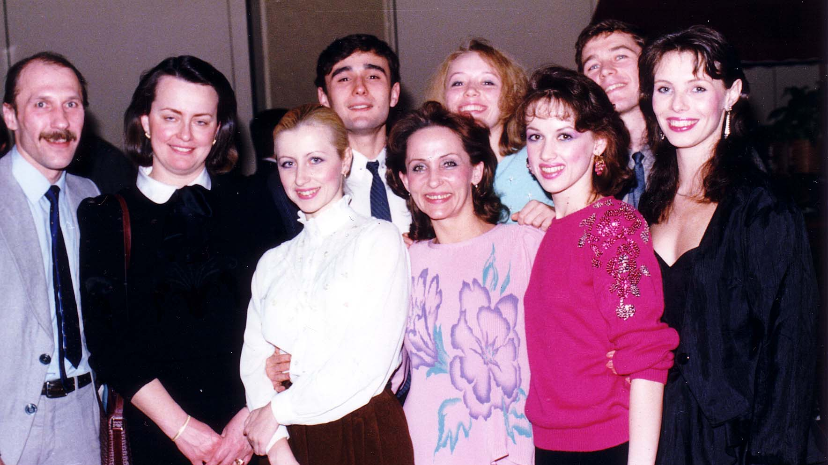
Notes:
TWG_Photo_1988_No_312__Feb_9__Arlington_Hyatt__TWG_Reception_for_Virsky_Dancers__2nd_from_L_TWG_Member_Chrystia_Shashkevych_Oryshkevych
See 1988 January TWG NEWS, page 3, and February TWG NEWS for event announcement and March TWG NEWS, page 4, for event coverage

Slide 7
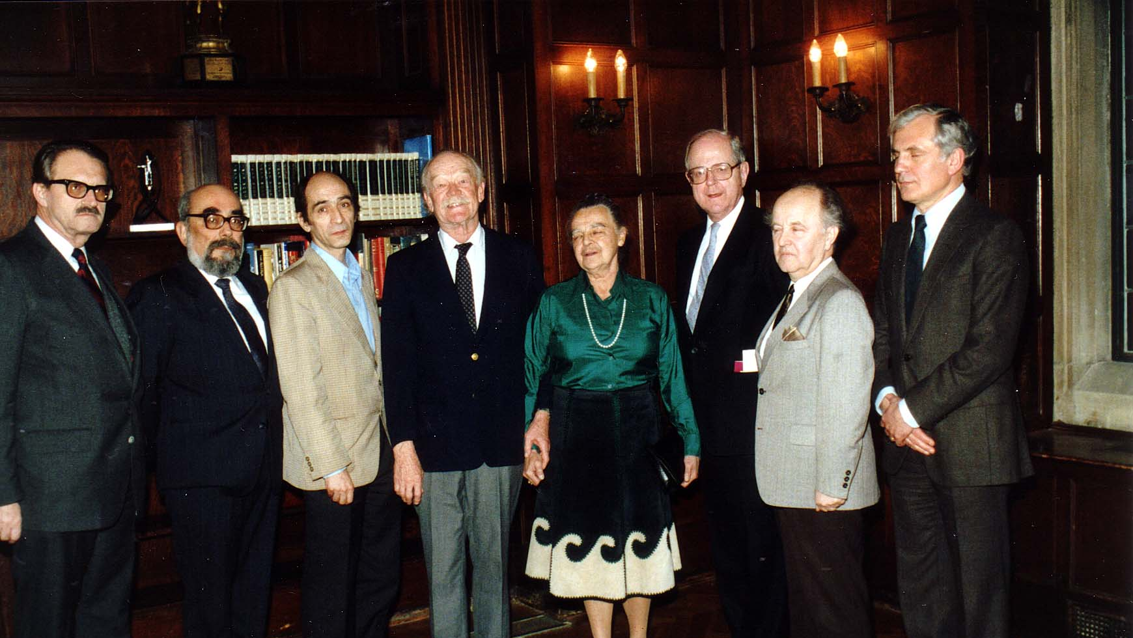
Notes:
TWG_Photo_1988_No_422__March_20__Antonovych_Awards__Jaroslaw_Pelenski__Bohdan_Rubchak__Author_Ekzod_Tarasa_Shevchenka_Leonid_Plyushch__Omelian_and_Tetiana_Antonovych__Author_Harvest_of_Sorrow_Robert_Conquest__Ivan_Fizer__Roman_Szporluk
See 1988 March TWG NEWS, pages 1 and 2 for event announcement and April TWG NEWS, page 12, for event coverage

Slide 8
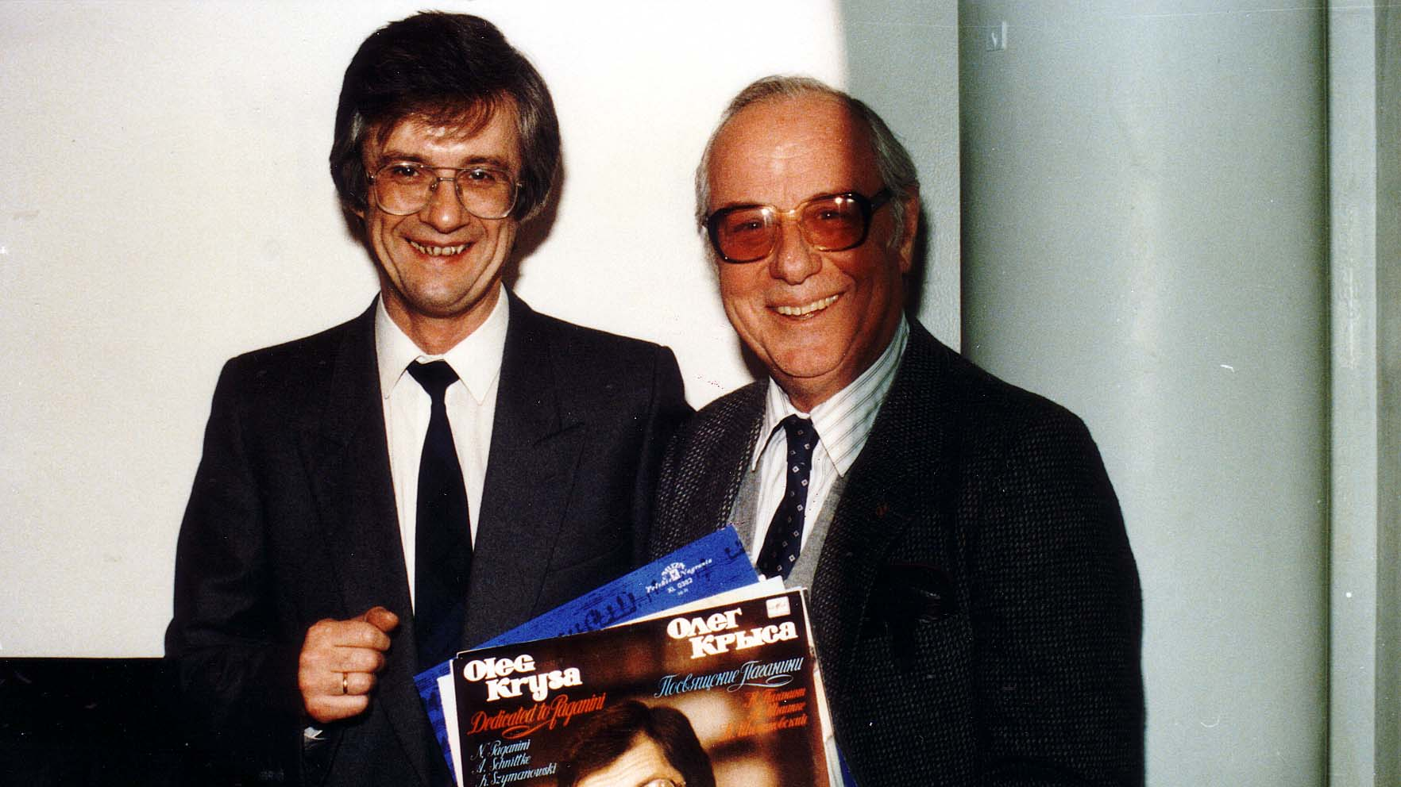
Notes:
TWG_Photo_1989_No_344__Feb_24__Dumbarton_United_Methodist_Church__Violinist_Oleh_Krysa__Discographer_Stefan_Maksymjuk
See 1989 March TWG NEWS, page 5, for event coverage

Slide 9
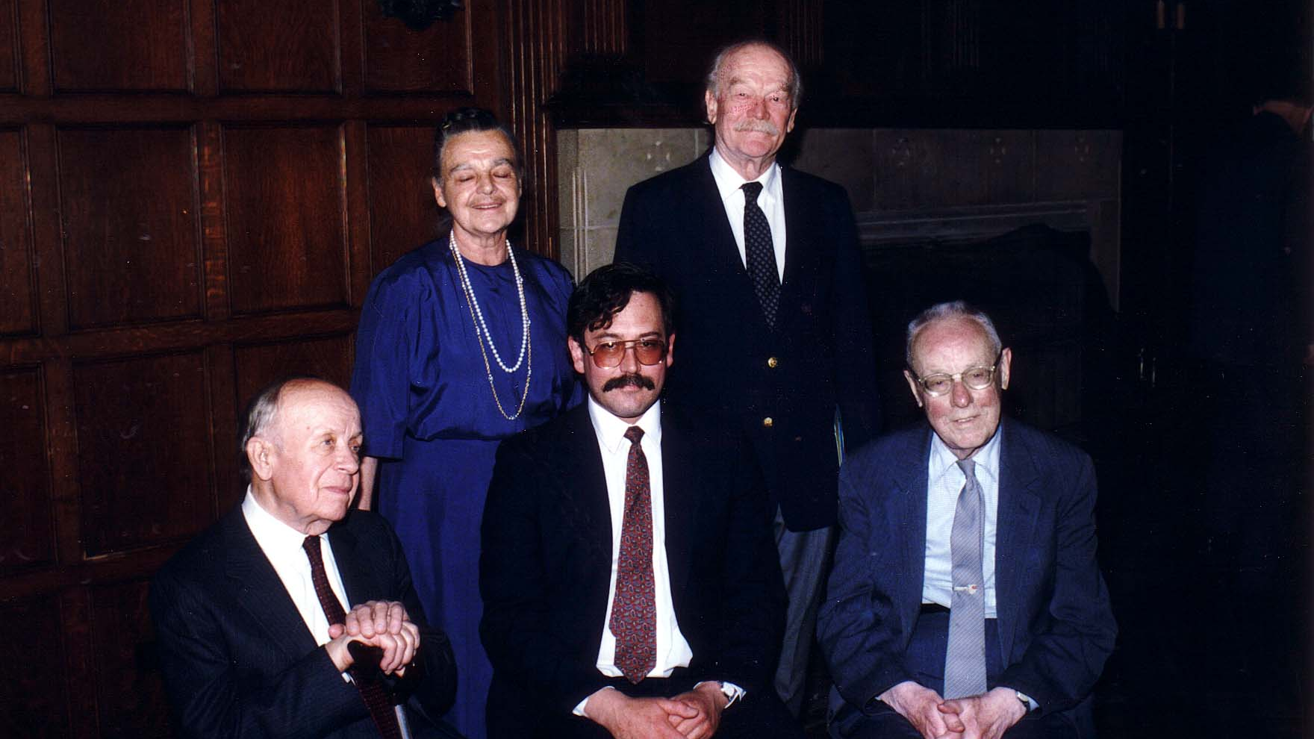
Notes:
TWG_Photo_1989_No_410__May_21__Antonovych_Award_Recipients__Hryhoriy_Kostiuk__John_Paul_Himka__Yuriy_Shevelov__Award_Sponsors_Tetiana_and_Omelian_Antonovych
See 1989 April TWG NEWS, page 1, for event announcement and June TWG NEWS, page 1, for event coverage

Slide 10
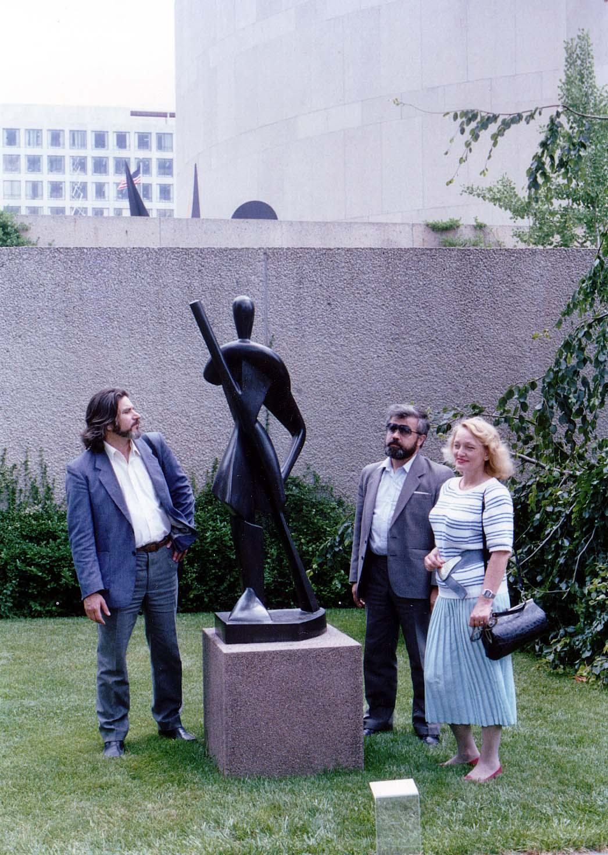
Notes:
TWG_Photo_1989_No_345__July_13__Statue_'Gondolier'_by_Archipenko_Hirshhorn_Sculpture_Garden_Smithsonian__Poet_Pavlo_Movchan__Leader_of_Memorial_Les_Taniuk__his_wife_Union_of_Soviet_Journalists_and_Union_of_Soviet_Theatrical_Activists_Nelli_Kornienko
See 1989 July-August TWG NEWS, page 5, for event coverage

Slide 11
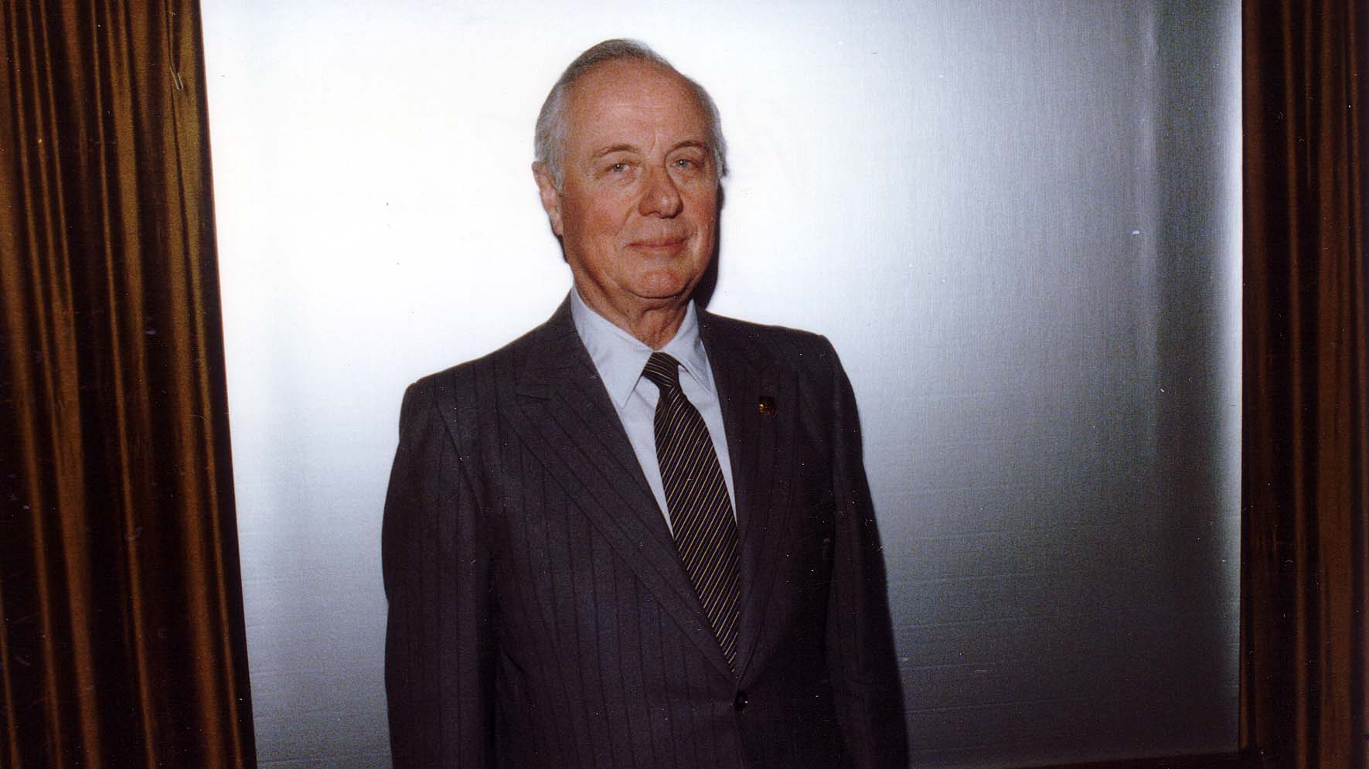
Notes:
TWG_Photo_1990_No_326__March_10__St_Sophia_Religious_Association__Shevchenko_in_early_musical_recordings__Stefan_Maksymjuk
See 1990 February TWG NEWS for event announcement and March TWG NEWS, page 3, for event coverage

Slide 12
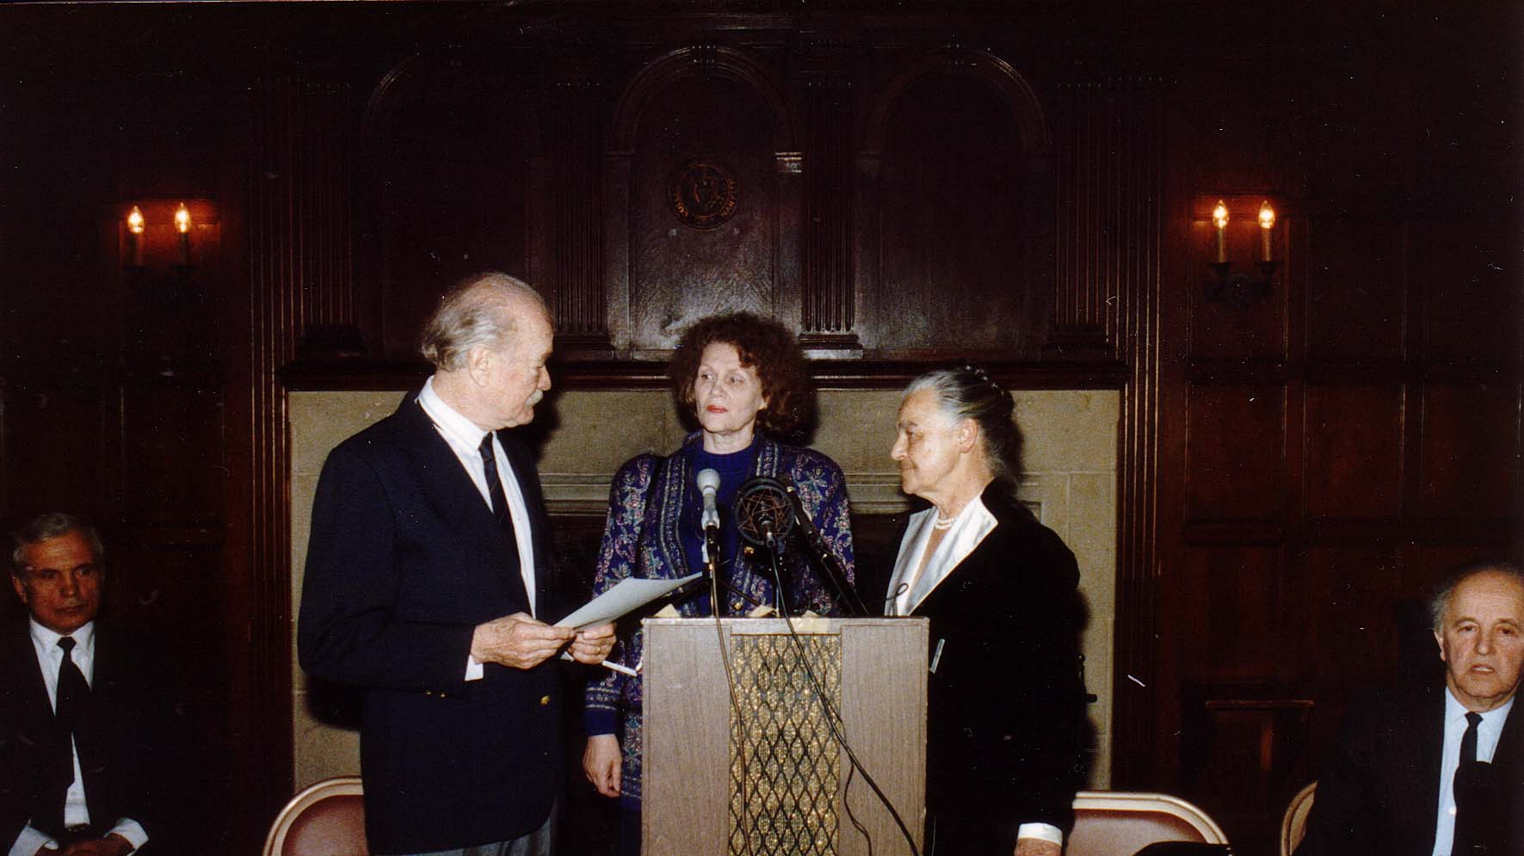
Notes:
TWG_Photo_1990_No_421__March_25__Georgetown_University__Antonovych_Awards__Roman_Szporluk__Omelian_Antonovych___Award_Recipient_Author_Sad_Netanuchnykh_Skulptur_Lina_Kostenko__Tetiana_Antonovych__John_Fizer
See 1990 March TWG NEWS, page 1, for event announcement and April TWG NEWS, page 1, for event coverage

Slide 13
Notes:
TWG_Photo_1990__No_510__Apr_6__British_Embassy__Chornobyl_Benefit_Concert__Ihor_Kiebuzinski__Irena_Stecura__Zhdana_Krawciw_Skalsky__Washington_Opera_Production_and_Stage_Director_Roman_Terleckyj__Laryssa_Chopivsky__Wasyl_Wasylkiwskyj__Danusia_Wasylkiwskyj
See 1990 March TWG NEWS, page 10, for event announcement

Slide 14
Notes:
TWG_Photo_1990__No_511__Apr_6__British_Embassy__Chornobyl_Benefit_Concert__NN__accompanist_Betty_Bullock__soprano_Rosa_Lamoreaux__Laryssa_Chopivsky__Washington_Opera_Production_and _Stage_Director_Roman_Terleckyj__pianist_Daria_Telizyn__NN_NN
See 1990 March TWG NEWS, page 10, for event announcement

Slide 15
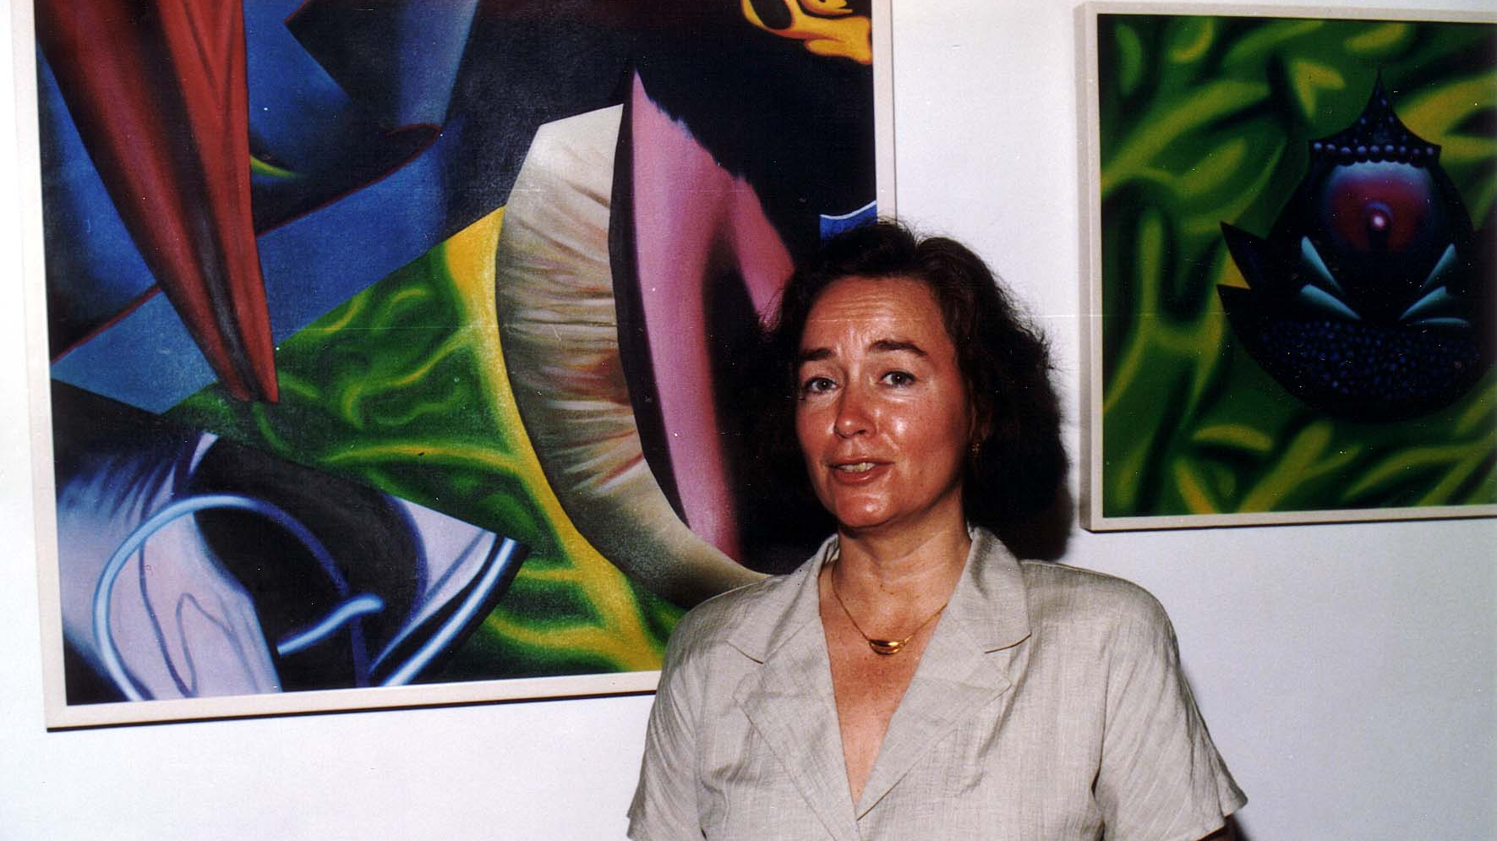
Notes:
TWG_Photo_1991_No_302__May_17__St_Sophia_Religious_Association__Artist_Ilona_Sochynsky
See 1991 April TWG NEWS for event announcement and June TWG NEWS, page 1, for event coverage

Slide 16
Notes:
TWG_Photo_1992_No_510_1_Nov_14_Kennedy_Center_Washington_Opera__Left_Side_Martha_Jarosewich__Larysa_Kurylas__Daria_Stec__Tenor_Volodymyr_Hryshko__TWGCF_Director_Laryssa_Chopivsky__Washington_National_Opera_Stage_and_Production_Director_Roman_Terleckyj
See 1992 December TWG NEWS, page 5, for event coverage

Slide 17
Notes:
TWG_Photo_1992_No_510_2_Nov_14_Kennedy_Center_Washington_Opera__Right_Side__Hanya_Cherniak__Marta_Zielyk__Isha_Pryshlak__Marika_Jurach__Wolodymyr_Bilajiw
See 1992 December TWG NEWS, page 5, for event coverage

Slide 18
Notes:
TWG_Photo_1993_No_265_Oct_9_Leadership_Conference__Fostering_US_Ukraine_Cultural_Ties_Panel___Filmmaker_International_TV_Broadcaster_USIA_Slavko_Nowytski___Director_at_the_Washington_National_Opera_Roman_Terlecky___Moderator_Laryssa_Chopivsky___Managing_Director_Washington_Performing_Arts_Society_Douglas_Wheeler___Cultural_Attaché_Embassy_of_Ukraine_Dmitro_Markov___Artistic_Director_Yara_Arts_Group_Virlana_Tkacz
See 1993 November TWG NEWS, page 10, for event coverage

Slide 19
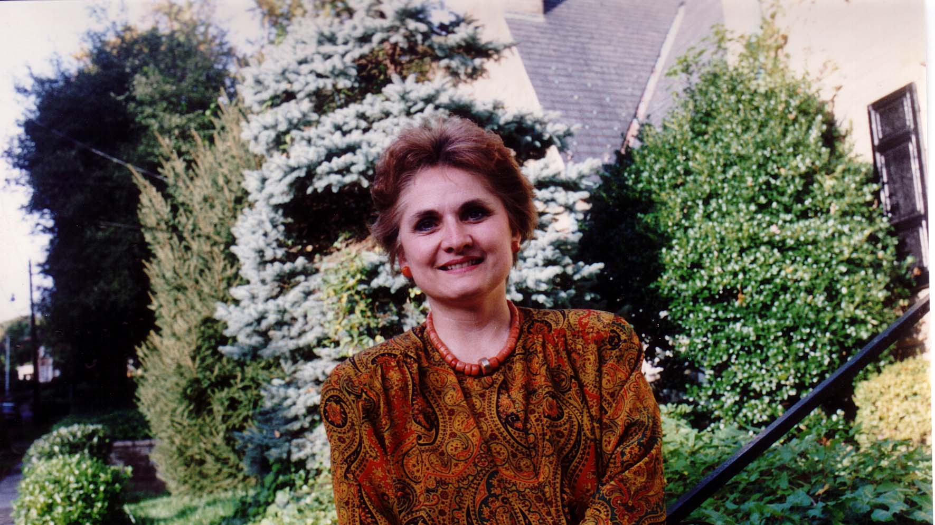
Notes:
TWG_Photo_1993_No_324__Oct_24__Audio_Lecture__Erotic_Symbolism_in_Ukrainian_Songs__Orysia_Tracz

Slide 20
1994 Photos
TWGCF Inaugural Reception
Les Kurbas Young Theater of Lviv
Skoryk and Chmyr
Leadership Conference Reception
Leadership Conference Recital
Olga Hirshhorn

Slide 21
Notes:
TWG_Photo_1994_No_511__June_5__Embassy_of_Ukraine__TWG_Cultural_Fund’s_Inaugural_Reception__TWG_Cultural_Fund_Founding_Director_Laryssa_Lapychak_Chopivsky__Ukraine_Ambassador__Oleh_Bilorus
See 1994 May TWG NEWS, page 1, for event announcement and June-July TWG NEWS, page 1, for event coverage

Slide 22
Notes:
TWG_Photo_1994_No_512__June_5__Embassy_of_Ukraine__TWG_Cultural_Fund’s_Inaugural_Reception__TWG_Cultural_Fund_Founding_Director_Laryssa_Lapychak_Chopivsky__welcomes__US_Ambassador_to_Ukraine_William_Green_Miller
See 1994 May TWG NEWS, page 1, for event announcement and June-July TWG NEWS, page 1, for event coverage

Slide 23
Notes:
TWG_Photo_1994_No_513__June_5__Embassy_of_Ukraine__TWG_Cultural_Fund’s_Inaugural_Reception__TWG_President_Mykola_Babiak__President_Carter’s_NSC_Director_Zbigniew_Brzezinski__TWG_Cultural_Fund_Founding_Director_Laryssa_Lapychak_Chopivsky__Cultural_Attaché_Vasyl_Zorya_behind_Brzezinski
See 1994 May TWG NEWS, page 1, for event announcement and June-July TWG NEWS, page 1, for event coverage

Slide 24
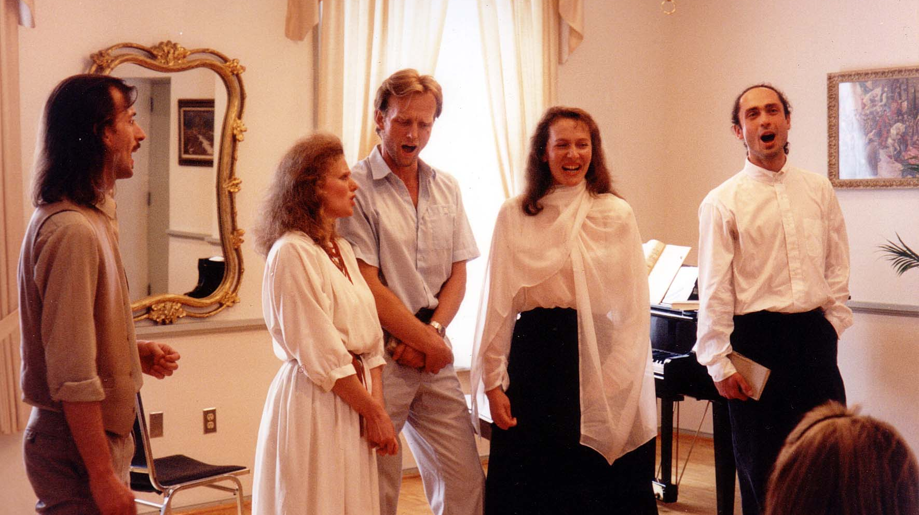
Notes:
TWG_Photo_1994_No_510__Jun_5__Ukrainian_Embassy__Les_Kurbas_Young_Theater_of_Lviv__Volodymyr_Kuchinsky__Tetiana_Kaspruk__Oleh_Drach__Natalka_Polovynka__Andrei_Vodichev
See 1994 May TWG NEWS for event announcement, pages 1 and 11, and June-July TWG NEWS, page 1, for event coverage

Slide 25
Notes:
TWG_Photo_1994_No_520__Sep_26__Charles_Sumner_School_Museum__New_Faces_New_Voices_from_Lviv__TWG_Cultural_Fund_Director_Laryssa_Chopivsky__composer_Myroslav_Skoryk__soprano_Maria_Hirska__pianist_Anna_Klymashivska__below_baritone_Oleh_Chmyr
See 1994 September TWG NEWS, page 10, for event announcement
See Washington Post review (If using “PowerPoint” Go to “Slide Show” pull-down menu and select “play from Current Slide” or if using “Keynote” select the “Play” mode and then click on blue arrow at the bottom right of the photograph)

Slide 26
Notes:
TWG_Photo_1994_No_205__Oct_14__Ukrainian_Embassy__Leadership_Conference__Reception__TWG_First_President_Natalie_Sluzar__Ukrainian_Embassy_Chargé_d’Affaires_Valeriy_Kuchinsky__TWG_Cultural_Fund_Director_Laryssa_Chopivsky__TWG_President_Mykola_Babiak
See 1994 August-September TWG NEWS for event announcement and November-December TWG NEWS, page 3, for event coverage

Slide 27
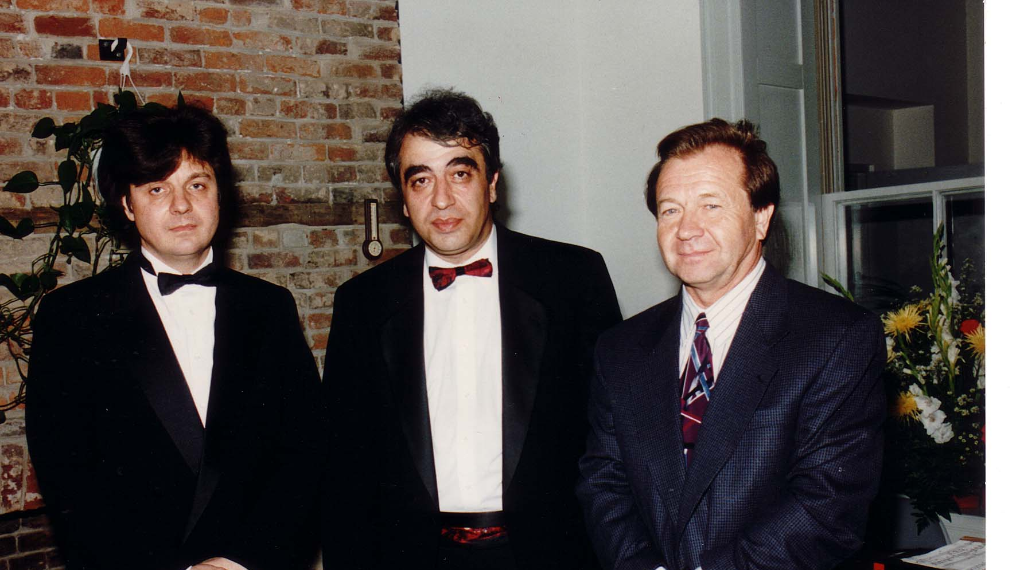
Notes:
TWG_Photo_1994_No_520__Oct_16__Ukrainian_Embassy__Leadership_Conference__Pianist_Volodymyr_Vynnytsky__Cellist_Vagram_Saradjian__Ukrainian_Embassy_Chargé_d'Affaires_Valeriy_Kuchinsky
See 1994 August-September for event announcement and November-December TWG NEWS, page 6 and 9, for event coverage

Slide 28
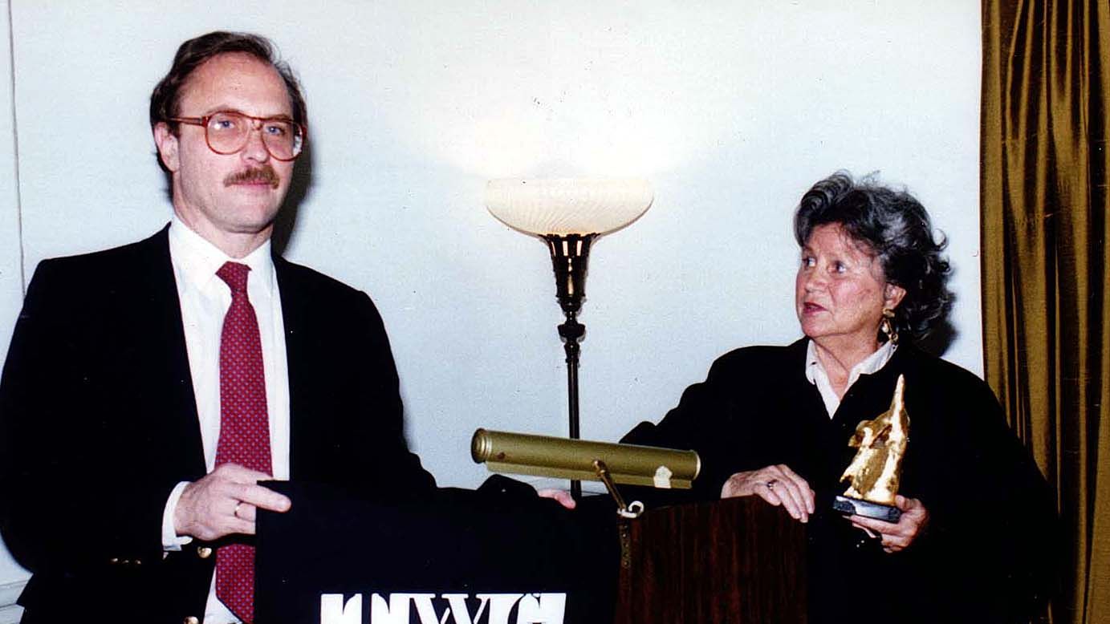
Notes:
TWG_Photo_1994_No_530__Dec_8__St_Sophia_Religious_Association__TWG_President_Mykola_Babiak__Modern_Art_Collector_and_Museum_Benefactor_Olga_Hirshhorn
See 1995 January TWG NEWS, page 3, for event coverage

Slide 29
Notes:
TWG_Photo_1994_No_531__Dec 8__St_Sophia_Religious_Association__Slavko_Martyniuk__TWG_Cultural_Fund_Director_Laryssa_Chopivsky__Modern_Art_Collector_and_Museum_Benefactor_Olga_Hirshhorn__Stefan_Maksymjuk
See 1995 January TWG NEWS, page 3, for event coverage

Slide 30
1995 Photos
Shevchenko Celebration
Berkeley Chamber Chorus
Leadership Conference - John Stetch
Juliana Osinchuk

Slide 31
Notes:
TWG_Photo_1995_No_512__Mar_26__Ukrainian_Embassy__TWG_Cultural_Fund_Director_Laryssa_Chopivsky__introduces__Sculptor_Ruslan_Naida__who_donated_his_Kobzar_sculpture_to_the_Ukrainian_Embassy
See 1995 February TWG NEWS, page 11, for event announcement and March-April TWG NEWS, page 5, for event coverage

Slide 32
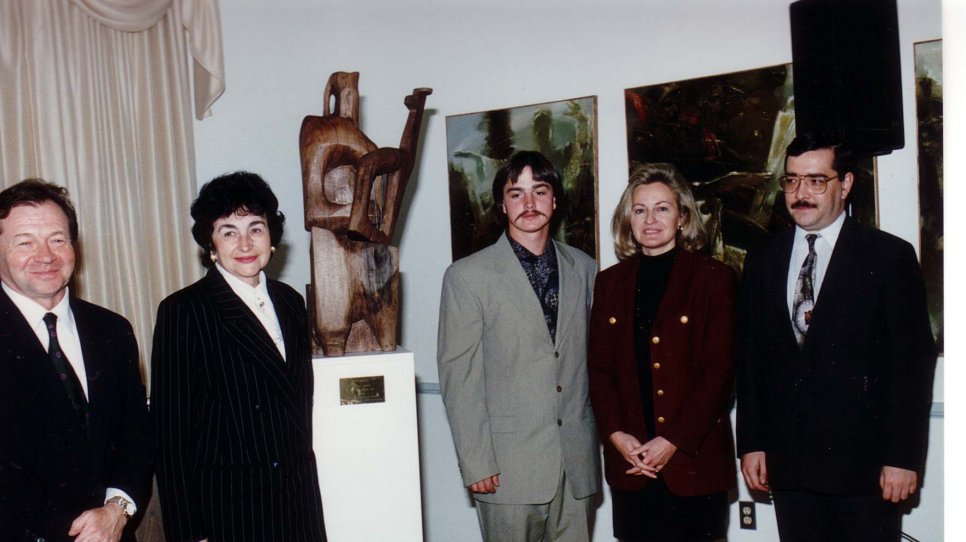
Notes:
TWG_Photo_1995_No_511__Mar_26__Ukrainian_Embassy__Sculpture_Gift_To_Embassy__Valeriy_Kuchinsky__Maria_Shcherbak__Sculptor_Ruslan_Naida__Laryssa_Lapychak_Chopivsky__Yaroslav_Voitko
See 1995 February TWG NEWS, page 11, for event announcement and March-April TWG NEWS, page 5, for event coverage

Slide 33
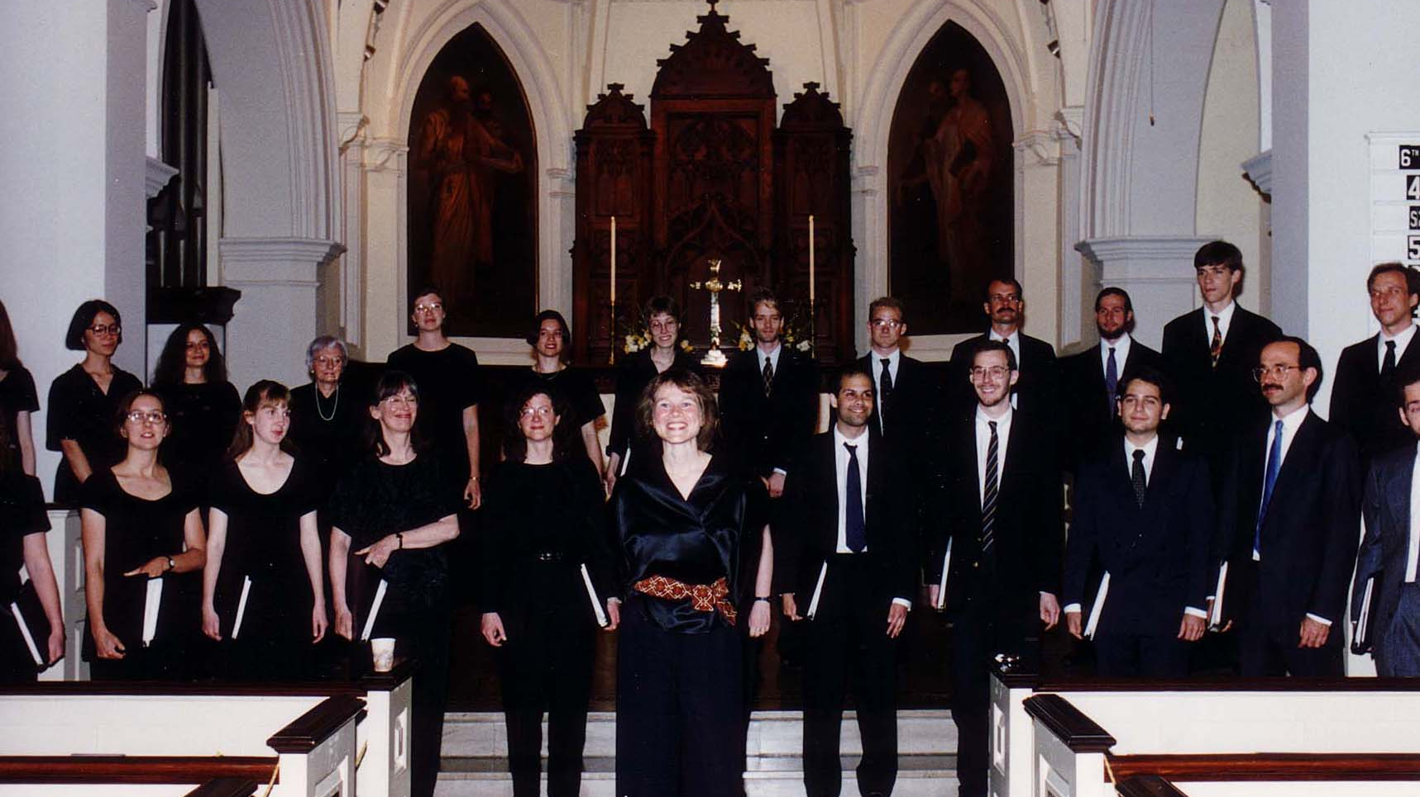
Notes:
TWG_Photo_1995_No_522__May_21__St_John's_Episcopal_Church_WDC__California's_Berkeley_Chamber_Chorus_directed_by_Marijka_Kuzma
See 1995 March-April TWG NEWS, page 7, for event announcement and May TWG NEWS, page 1, for event coverage

Slide 34
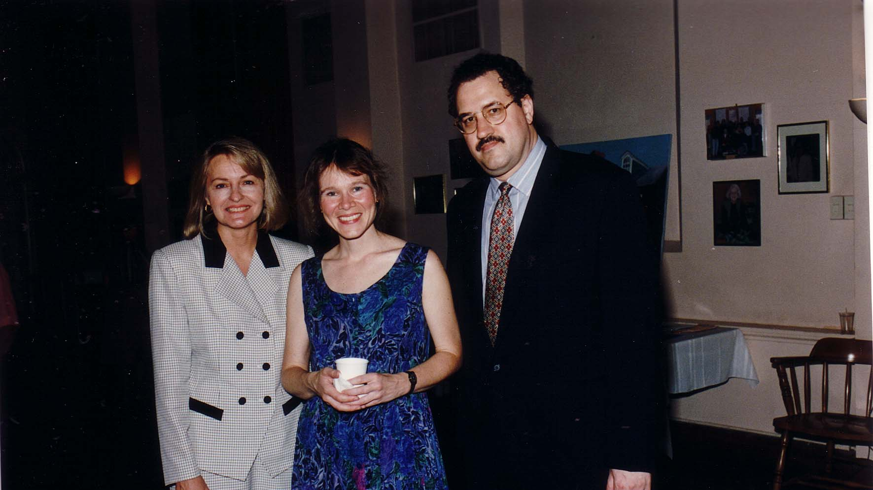
Notes:
TWG_Photo_1995_No_521__May_21__St_John's_Episcopal_Church_WDC__TWG_Cultural_Fund_Director_Laryssa_Lapychak_Chopivsky__California's_Berkeley_University_Chamber_Chorus_Director_Marijka_Kuzma__TWG_President_George_Masiuk
See 1995 March-April TWG NEWS, page 7, for event announcement and May TWG NEWS, page 1, for event coverage

Slide 35
Notes:
TWG_Photo_1995_No_523__May_21__St_John's_Episcopal_Church_WDC__TWG_Cultural_Fund_Director_Laryssa_Lapychak_Chopivsky__California's_Berkeley_University_Chamber_Chorus_Director_Marijka_Kuzma__at_left__Nadia_Diuk_at_right__Oxana_Horodecka
See 1995 March-April TWG NEWS, page 7, for event announcement and May TWG NEWS, page 1, for event coverage

Slide 36
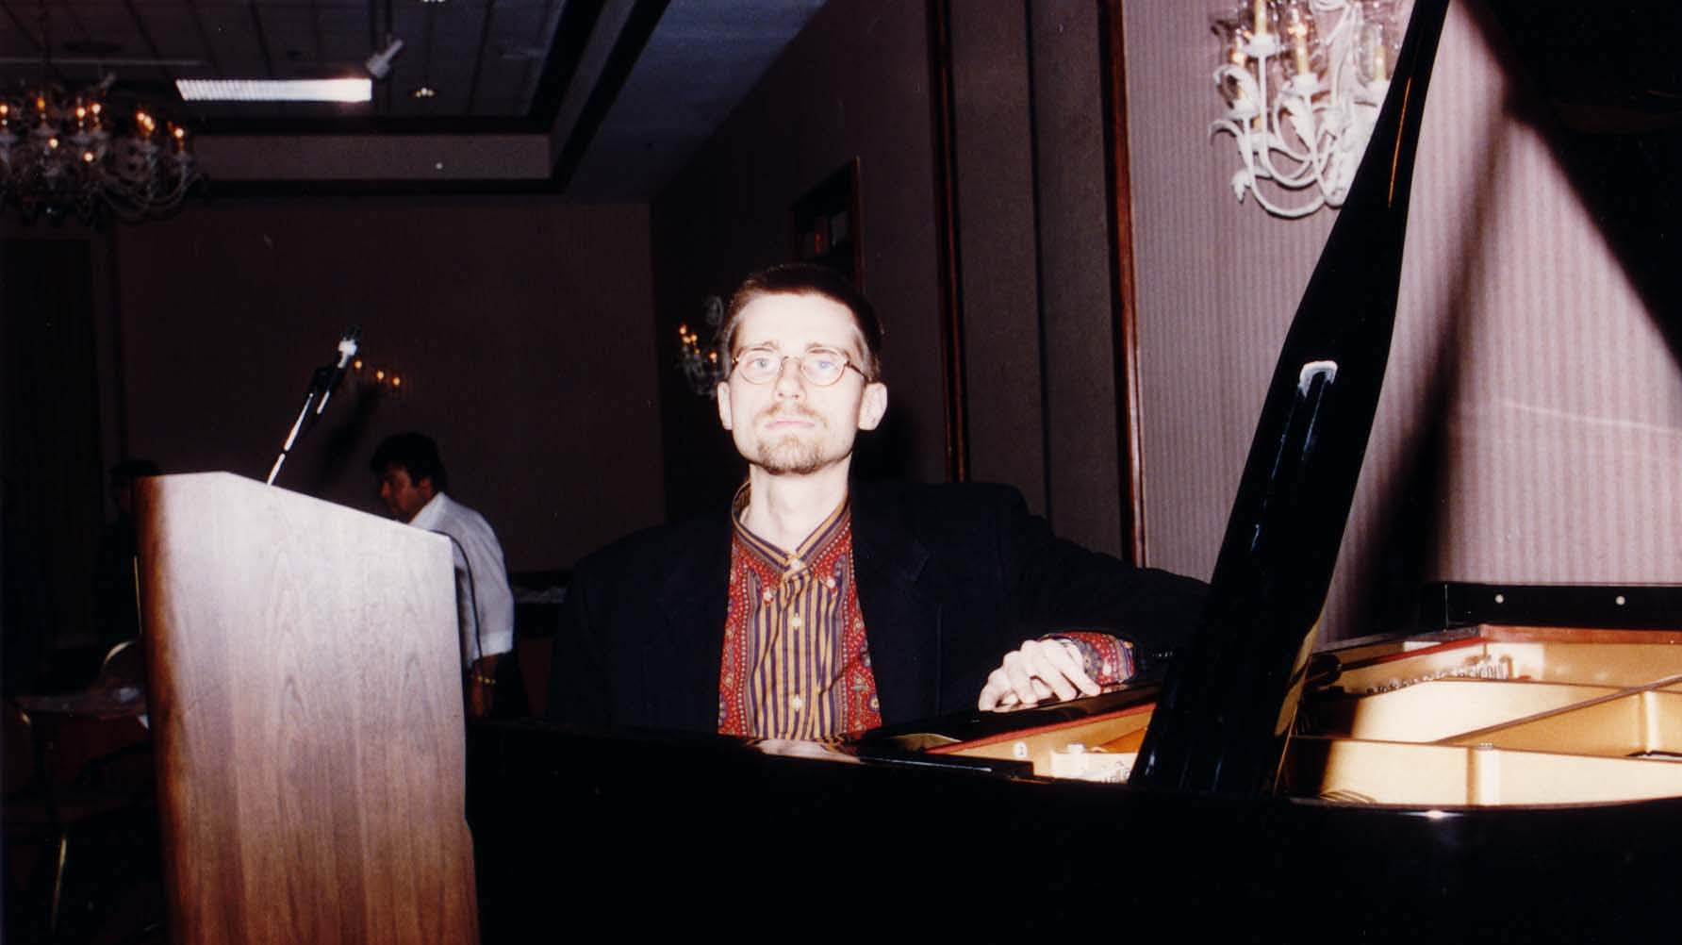
Notes:
TWG_Photo_1995_No_534__Oct_8__Leadership_Conference__Pianist_John_Stetch
See 1995 Summer TWG NEWS, page 5, for event announcement and October TWG NEWS, page 12, for event coverage

Slide 37
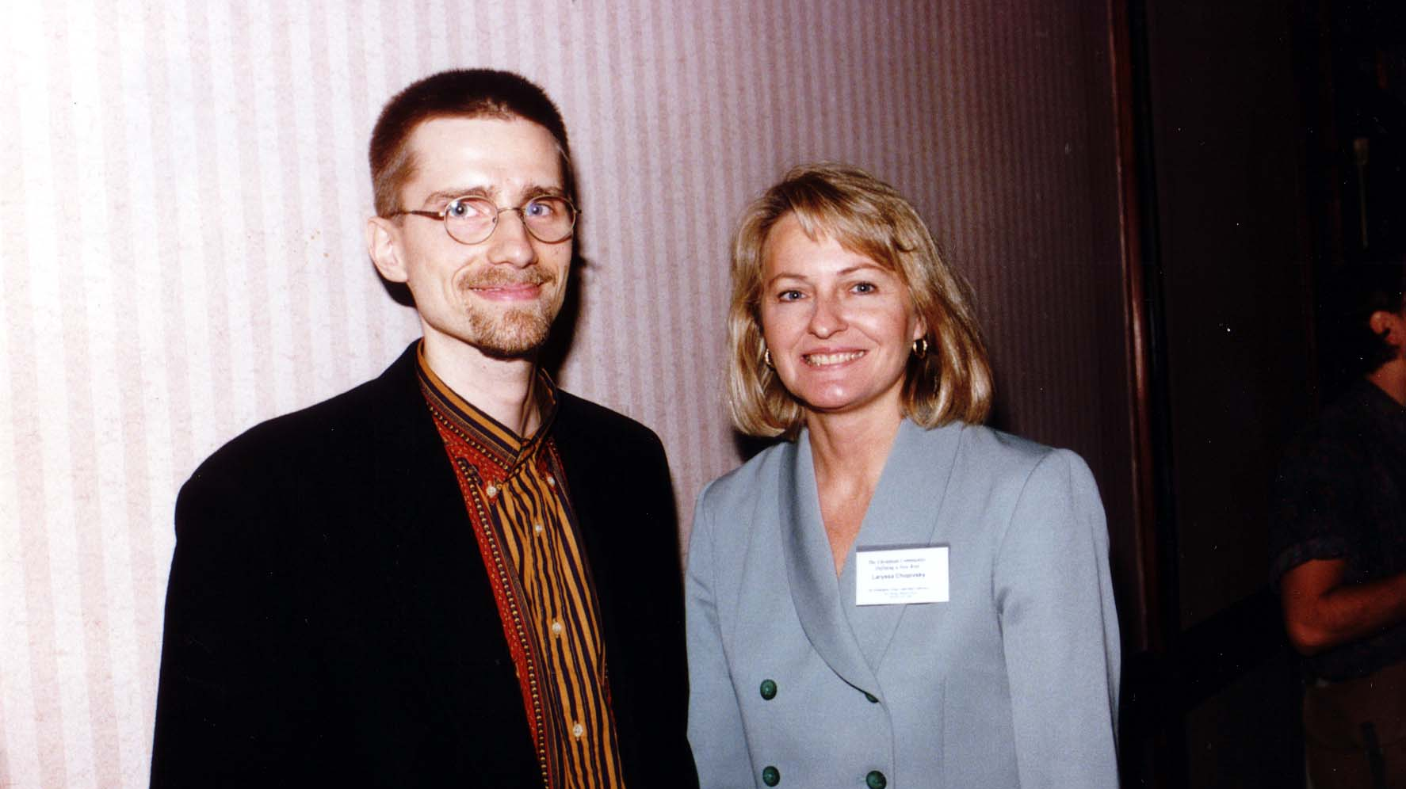
Notes:
TWG_Photo_1995_No_533__Oct_8__Leadership_Conference__Pianist_John_Stetch__TWG_Cultural_Fund_Director_Laryssa_Lapychak_Chopivsky
See 1995 Summer TWG NEWS, page 5, for event announcement and October TWG NEWS, page 12, for event coverage

Slide 38
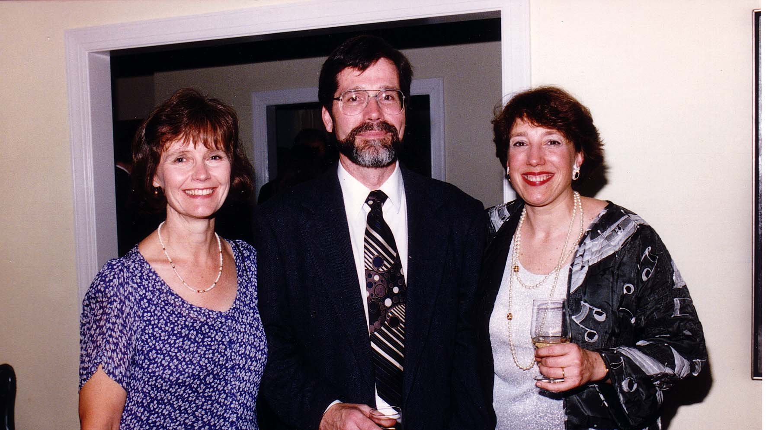
Notes:
TWG_Photo_1995_No_544_Oct_27__Reception_for_Juliana_Osinchuk__Gail_Coray_and_Alaskan_Composer_Craig_Coray_and_Juliana_0sinchuk_after_her_concert_at_the_Kennedy_Center
See 1995 September TWG NEWS, page 7, for event announcement and 1996 January TWG NEWS, page 5, for event coverage

Slide 39
Notes:
TWG_Photo_1995_No_545__October__WDC_Restaurant__WETA_classical_music_host_Judy_Gruber__pianist_Juliana_Osinchuk_with_husband_Mark_Dawson__Maria_Rudensky__Laryssa_Chopivsky
Note: Photo taken within days of Juliana Osinchuk’s October 27 concert at the Kennedy Center

Slide 40
1996 Photos
Horowitz Competition Winners
Chornobyl Commemoration Concert Reception
Chornobyl Commemoration White House Reception

Slide 41
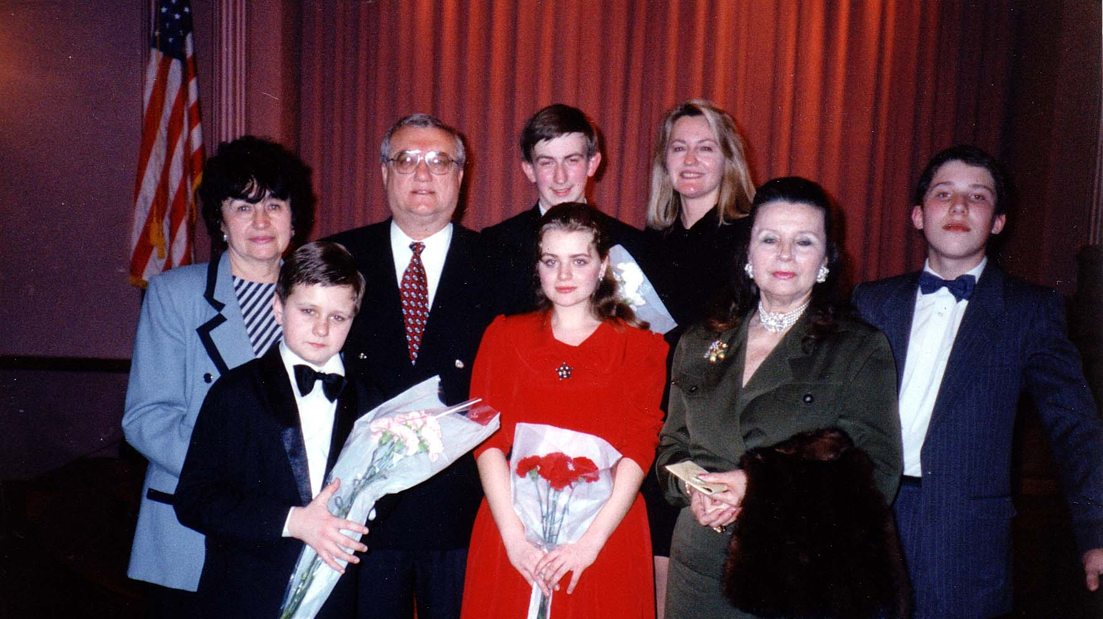
Notes:
TWG_Photo_1996_No_511-1__Mar_15__Charles_Sumner_School_of_Music__Kyiv_Horowitz_Piano_Competition_Winners_(1995)__In_Front__Pianist_Oleksiy_Yemtsov__Pianist_Olena_Ivanenko_(unverified)_NN_NN
See 1996 February TWG NEWS, page 13, for event announcement and March TWG NEWS, page 6, for event coverage; also see the Horowitz Competition website: http://horowitzv.org/

Slide 42
Notes:
TWG_Photo_1996_No_511_2__Mar_15__Charles_Sumner_School_of_Music__Kyiv_Horowitz_Piano_Competition_Winners_(1995)__In_Back_Row_Maria_Shcherbak__Amb_Yuriy_Shcherbak__Pianist_Oleksiy_Koltakov__TWG_Cultural_Fund_Director_Laryssa_Lapychak_Chopivsky
See 1996 February TWG NEWS, page 13, for event announcement and March TWG NEWS, page 6, for event coverage; also see the Horowitz Competition website: http://horowitzv.org/

Slide 43
Notes:
TWG_Photo_1996__No_512__Apr_28__John_F._Kennedy_Center_for_the_Performing_Arts__10th_Anniversary_Chornobyl_Commemoration_Concert_and_Reception__NSC_staffer_Victoria_Reznik__Odessa_Philharmonic_Conductor_Hobart_Earle__Assistant_to_President_and_Chief_of_Staff_to_the_First_Lady_Melanne_Verveer
Note: The reception after the concert was held at the Watergate Hotel
See 1996 March-April TWG NEWS, page 1, and The Ukrainian Weekly 1996-18, page 10, for event coverage

Slide 44
Notes:
TWG_Photo_1996__No_513__Apr_28__John_F._Kennedy_Center_for_the_Performing_Arts__10th_Anniversary_Chornobyl_Commemoration_Concert_and_Reception__TWG_Cultural_Fund_Director_Laryssa_Chopivsky__Composer_Mykola_Kolessa__Odessa_Philharmonic_Conductor_Hobart_Earle__Ukrainian_Ambassador_Yuri_Shcherbak
Note: The reception after the concert was held at the Watergate Hotel
See 1996 March-April TWG NEWS, page 1, and The Ukrainian Weekly 1996-18, page 10, for event coverage

Slide 45
Notes:
TWG_Photo_1996__No_514__Apr_28__John_F._Kennedy_Center_for_the_Performing_Arts__10th_Anniversary_Chornobyl_Commemoration_Concert_and_Reception__WPAS_Managing_Director_Douglas_Wheeler__TWGCF_Director_and WPAS_Board_Member_Laryssa_Chopivsky__Odessa_Philharmonic_Conductor_Hobart_Earle__Ukrainian_Ambassador_Yuri_Shcherbak
Note: The reception after the concert was held at the Watergate Hotel
See 1996 March-April TWG NEWS, page 1, and The Ukrainian Weekly 1996-18, page 10, for event coverage

Slide 46
Notes:
TWG_Photo_1996_No_515_1__May_1__White_House_East_Room__Chornobyl_Commemoration_Hosted_by_First_Lady_Hillary_Rodham_Clinton__Front_Row__Assistant_to_V.P._Al_Gore_Leon_Fuerth__Odessa_Philharmonic_Conductor_Hobart_Earle__TWG_Cultural_Fund_Director_Laryssa_Chopivsky__Special_Assistant_To_President_Clinton_Coit_ Blacker
See The Ukrainian Weekly 1996-19, page 1, for event coverage including full transcript of remarks by First Lady Hillary Rodham Clinton and Vice-President Al Gore, page 11
(If using PowerPoint go to “Slide Show” pull-down menu and select “play from Current Slide” or if using “Keynote” select the “Play” mode, and then click on blue arrow at the bottom right of the photograph --- coverage starts on page 1)

Slide 47
Notes:
TWG_Photo_1996_No_515_2__May_1__White_House_East_Room__Chornobyl_Commemoration_Hosted_by_First_Lady_Hillary_Rodham_Clinton__Second_Row__Carlos_Pascual_US_Ambassador_to_Ukraine_(2000-2003)__Victoria_Reznik_NSC_Staff_for_Russia_Ukraine_Eurasia__George_Chopivsky
See The Ukrainian Weekly 1996-19, page 1, for event coverage including full transcript of remarks by First Lady Hillary Rodham Clinton and Vice-President Al Gore, page 11
(If using PowerPoint go to “Slide Show” pull-down menu and select “play from Current Slide” or if using “Keynote” select the “Play” mode, and then click on blue arrow at the bottom right of the photograph --- coverage starts on page 1)

Slide 48
1997 Photos
Bandura Chorus
Horowitz Competition Winners

Slide 49
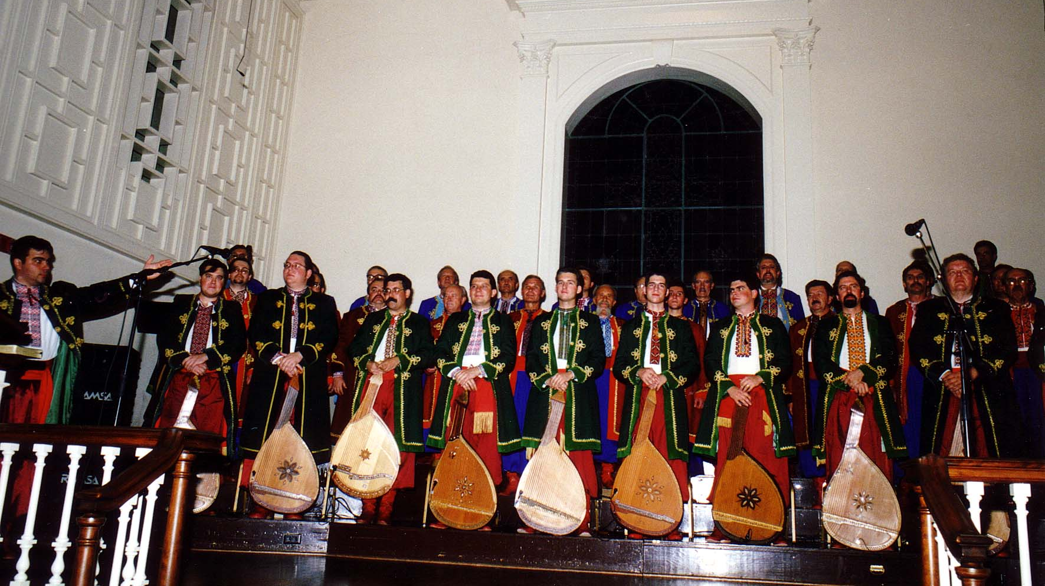
Notes:
TWG_Photo_1997_No_511__Oct_4__Fourth_Presbyterian_Church_Bethesda_MD__Ukrainian_Bandurist_Chorus
See 1998 January-February TWG NEWS, page 1, for event coverage

Slide 50
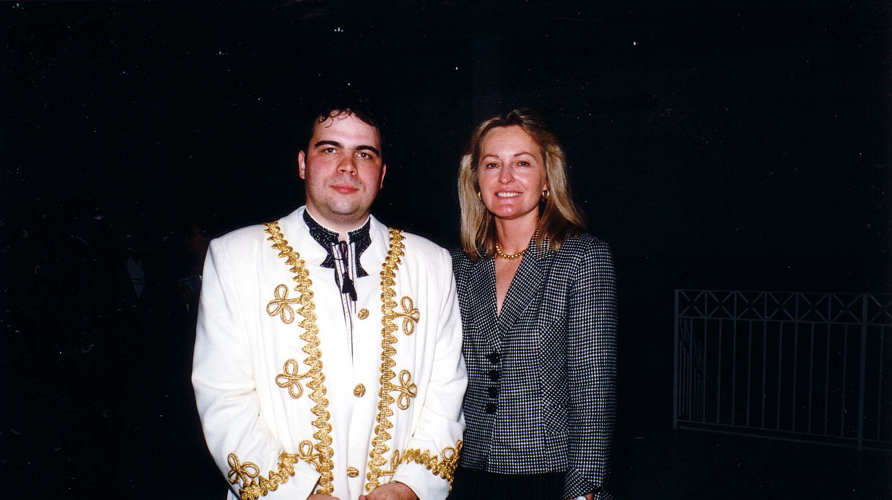
Notes:
TWG_Photo_1997_No_512__Oct_4__Fourth_Presbyterian_Church_Bethesda_MD__Bandurist_Victor_Mishalow__TWGCF_Director_Laryssa_Lapychak_Chopivsky
See 1997 November-December TWG NEWS, page 1, for event coverage

Slide 51
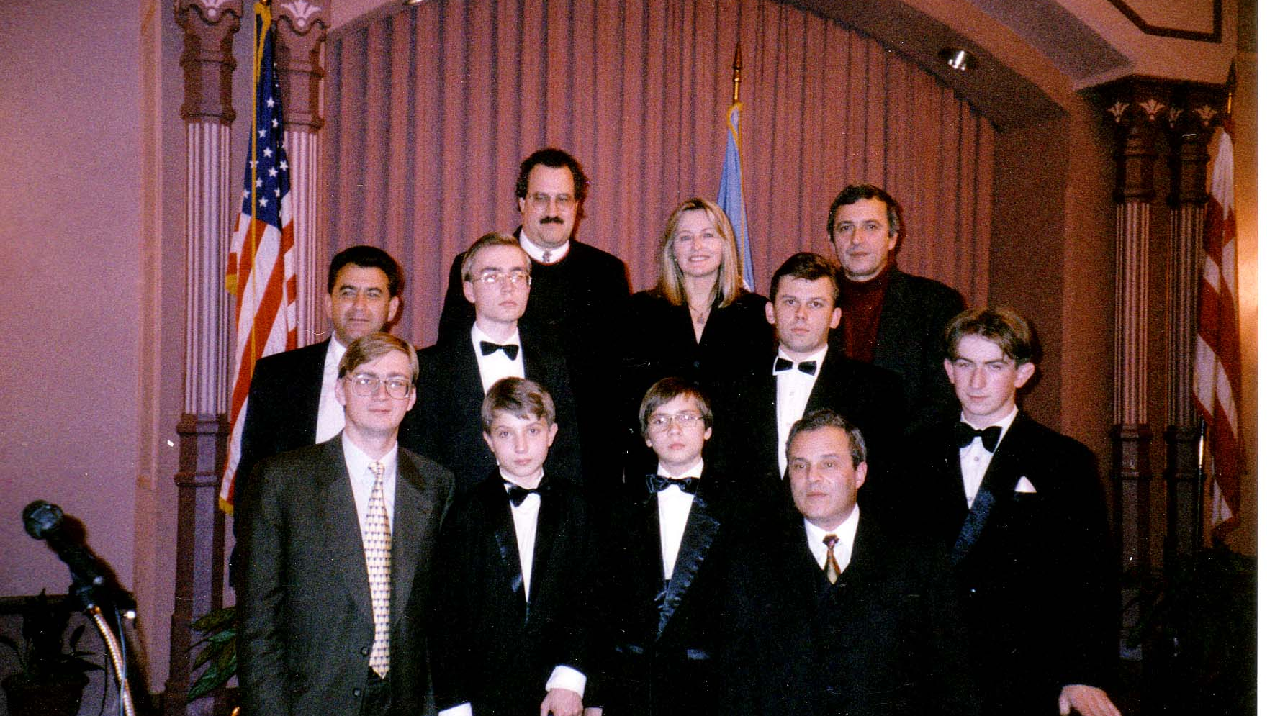
Notes:
TWG_Photo_1997_No_521_1__Oct_23__Charles_Sumner_School_of_Music__Kyiv_Horowitz_Piano_Competition_Winners__First_Row__Ukrainian_Embassy_Cultural_Attaché_Vasyl_Zorya__Pianist_Oleksandr_Havryliuk__Pianist_Oleksandr_Hryniuk__Yuri_Zilberman
See 1998 January-February TWG NEWS, page 1, for event coverage; also see the Horowitz Competition website: http://horowitzv.org/

Slide 52
Notes:
TWG_Photo_1997_No_521_2__Oct_23__Charles_Sumner_School_of_Music__Kyiv_Horowitz_Piano_Competition_Winners__Middle_Row__Music_Professor_from_Kharkiv__Pianist_Bryan_Wallic__Pianiast_Vitalij_Baran__Pianist_Oleksij_Koltakov
See 1998 January-February TWG NEWS, page 1, for event coverage; also see the Horowitz Competition website: http://horowitzv.org/

Slide 53
Notes:
TWG_Photo_1997_No_521_3__Oct_23__Charles_Sumner_School_of_Music__Kyiv_Horowitz_Piano_Competition_Winners__Back_Row__TWG_President_George_Masiuk__TWGCF_Director_Laryssa_Lapychak_Chopivsky__Composer_Ivan_Karabyts
See 1998 January-February TWG NEWS, page 1, for event coverage; also see the Horowitz Competition website: http://horowitzv.org/

Slide 54
Notes:
TWG_Photo_1997_No_530__Dec_21__National_Cathedral__Kyiv_Chamber_Choir_directed_by_Mykola_Hobdych
See 1997 November-December TWG NEWS, page 1, for event coverage

Slide 55
Notes:
TWG_Photo_1997_No_531__Dec_21__National_Cathedral__Post_Kyiv_Chamber_Choir_Performance__NN__Mykola_Hobdych__TWGCF_Director_Laryssa_Chopivsky__NN__Cultural_attaché_Vasyl_Zorya
See 1997 November-December TWG NEWS, page 1, for event coverage

Slide 56
1998 Photos
Juliana Osinchuk
Myroslav Skoryk

Slide 57
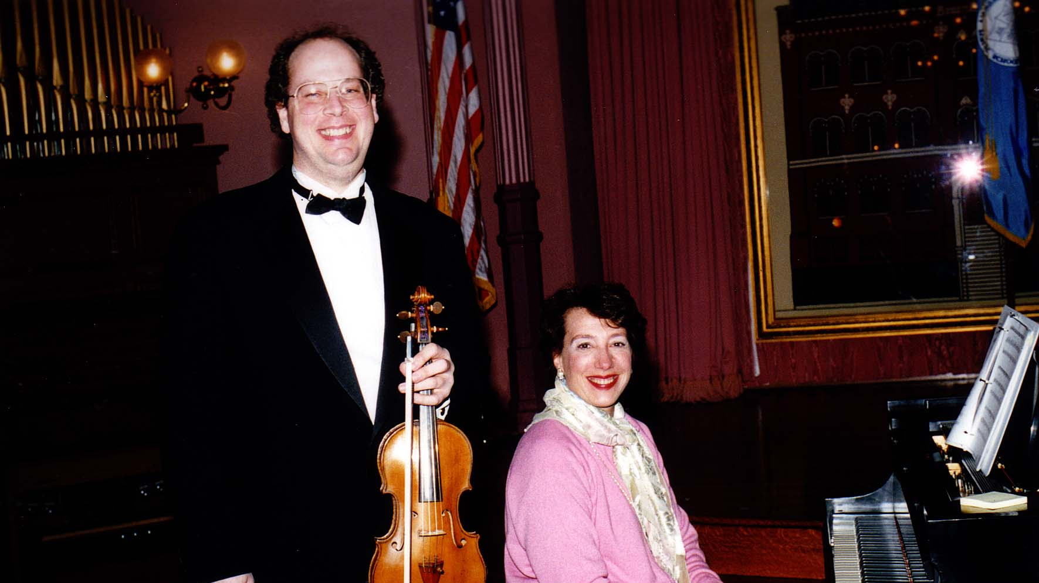
Notes:
TWG_Photo_1998_No_520__Mar_24__Sumner_School_WDC__Lee_Wilkins__Juliana_Osinchuk_Concert
See 1998 January-February TWG NEWS, page 1, for event announcement and March-April TWG NEWS, page 7, for event coverage

Slide 58
Notes:
TWG_Photo_1998_No_530__Oct_30__Dumbarton_Methodist_Church_in_Georgetown__TWGCF_Director_Laryssa_Lapychak_Chopivsky__introduces__Kyiv_Camerata
See 1998 July-September TWG NEWS, page 6, for event announcement and October-November TWG NEWS, page 1, for event coverage

Slide 59
Notes:
TWG_Photo_1998_No_540__Nov_1___Alla_Rogers_Gallery___Alla_Rogers__artist_Volodymyr_Makarenko__TWGCF_Director_Laryssa_Chopivsky__Slavko_Martyniuk
See October-November TWG NEWS, page 5, for event coverage

Slide 60
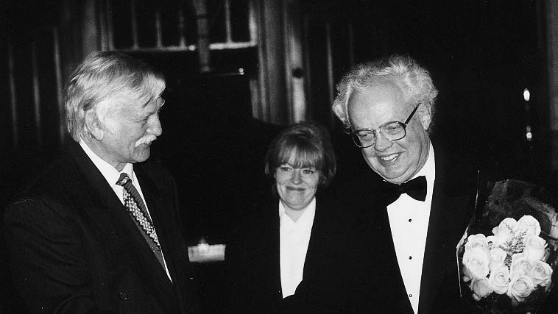
Notes:
TWG_Photo_1998_No_530__Nov_21__Dumbarton_Methodist_Church__Chairman_of_the_Ukrainian_Commission_on_the_Restitution_of_Cultural_Treasures_Oleksandr_Fedoruk__Ukrainian_Embassy_Press_Attaché_Natalia_Zarudna__Composer_Myroslav_Skoryk
See 1998 July-September TWG NEWS, page 6, for event announcement and October-November TWG NEWS, page 1, for event coverage

Slide 61
1999 Photos
Kochan and Kytasty
Horowitz Competition Winners
Icon Exhibit

Slide 62
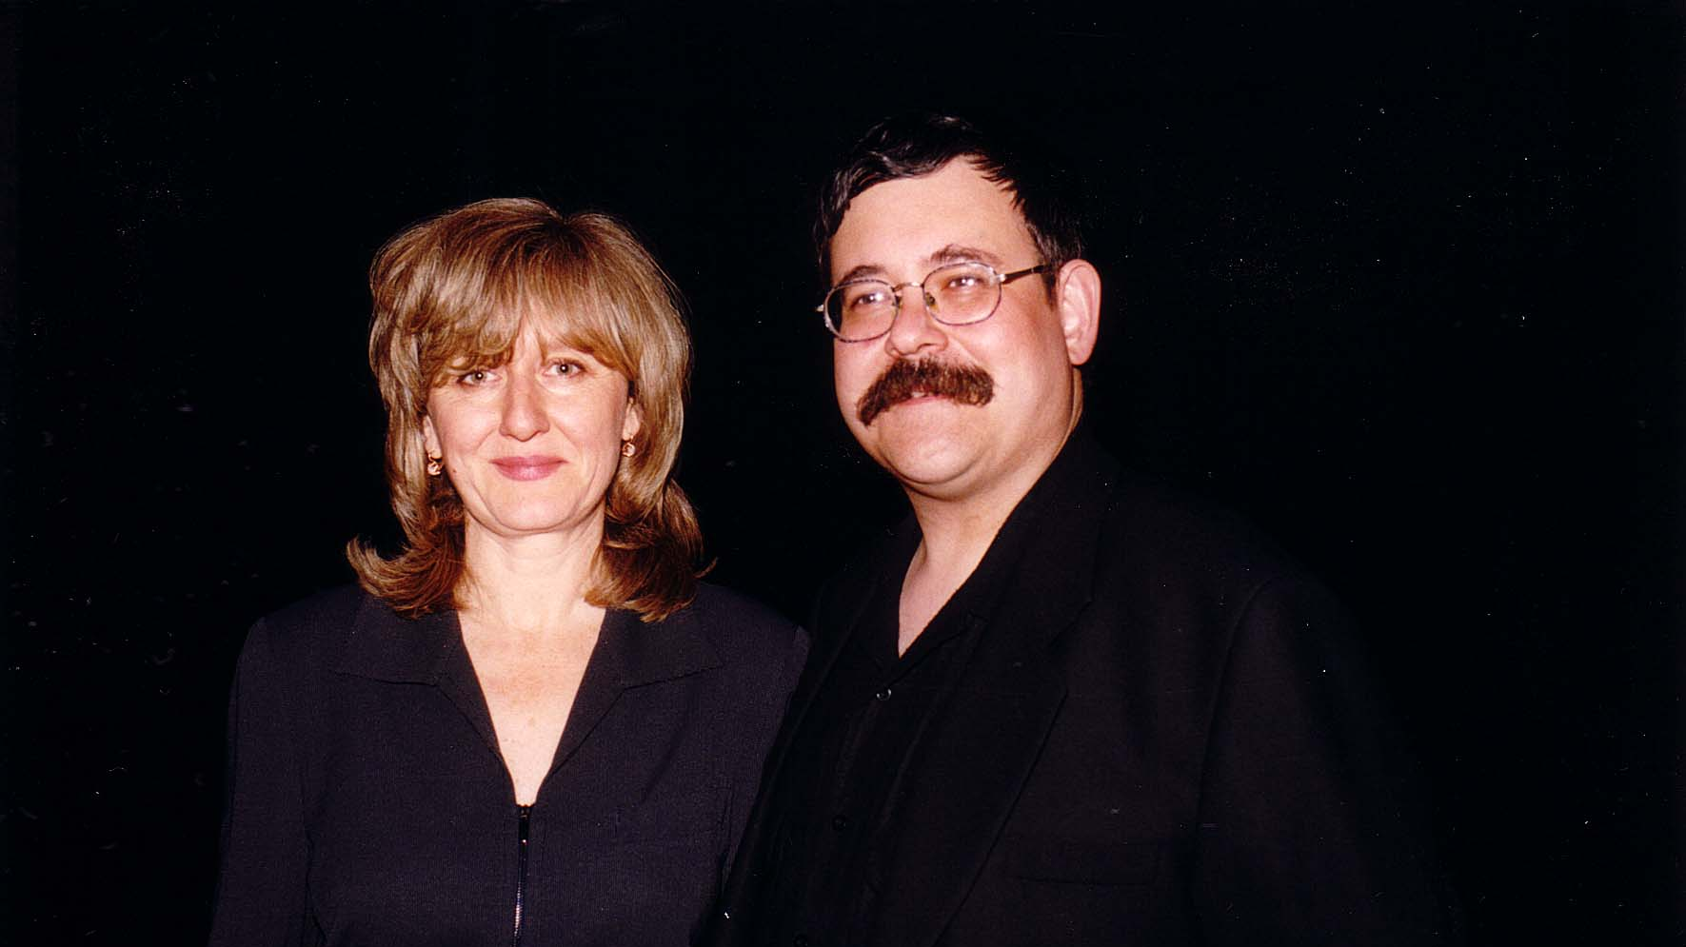
Notes:
TWG_Photo_1999_No_510__Apr_29__Embassy_of_France__"Paris_to_Kyiv"__Vocalist_Alexis_Kochan__Bandurist_Julian_Kytasty
See 1999 January-February TWG NEWS, page 3, for event announcement and Summer TWG NEWS, page 14, for event coverage

Slide 63
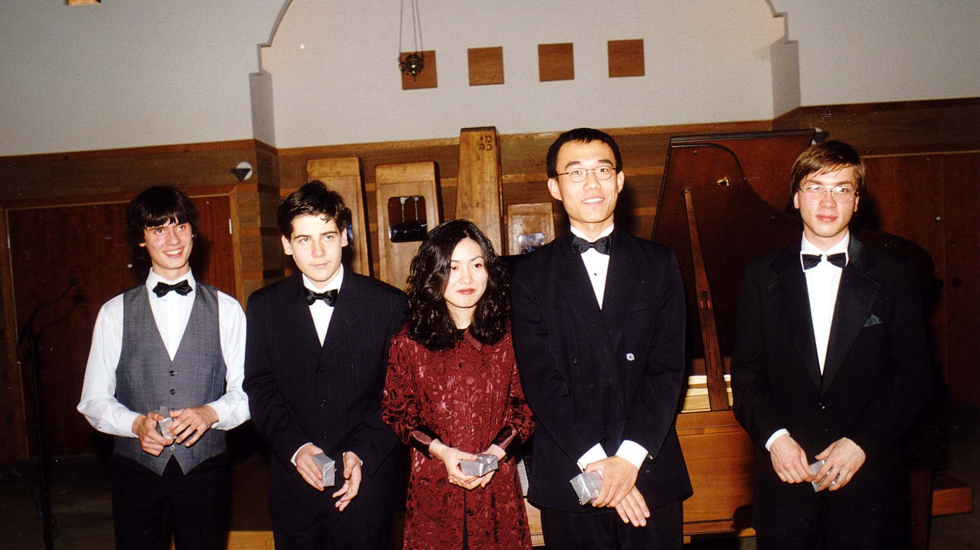
Notes:
TWG_Photo_1999_No_520__Oct_14__Temple_Micah_WDC__Kyiv_Horowitz_Competition_Winners__Daniil_Shleyenkov_(Belarus)__Vadym_Kholodenko_(Ukraine)__Seiko_Tsukamoto_(Japan)__Jian_Liu_(USA)__Oleksiy_Hrynyuk_(Ukraine)
See 1999 September-October TWG NEWS, page 9, for event announcement and November-December TWG NEWS, page 7, for event coverage

Slide 64
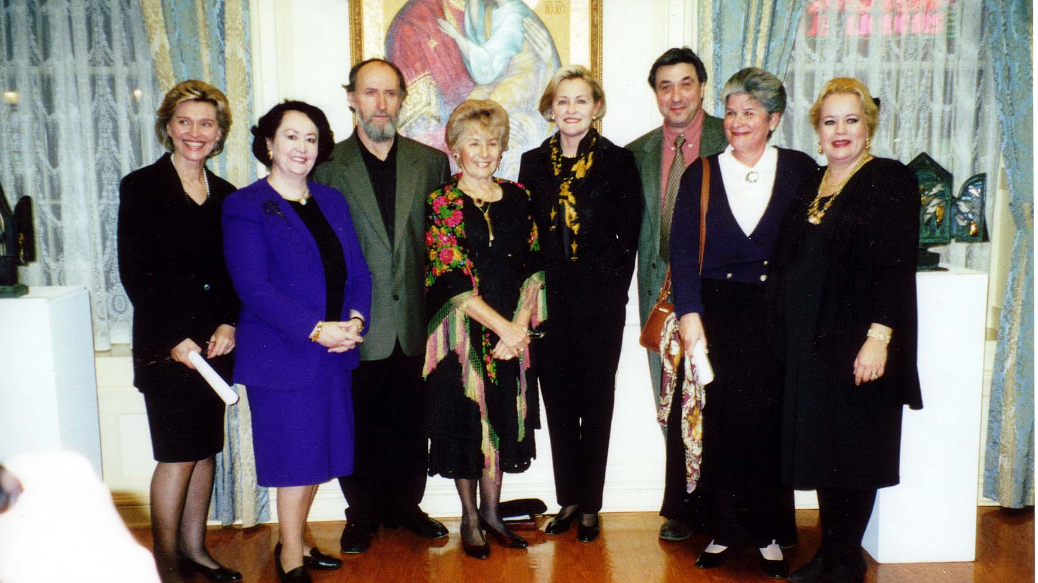
Notes:
TWG_Photo_1999_No_530__Dec_2__Embassy_of_Ukraine__Icon_Exhibit__Katya_Bowers__Lydia_Piaseckyj__Ivan_Mitsyk__Christina_Dochwat__TWGCF_Director_Laryssa_Chopivsky__Yevhen_Prokopov__Vera_Senchuk__Victoria_Varvariv
See 1999 November-December TWG NEWS, page 5, for event announcement and 2000 Summer TWG NEWS, page 17, for event coverage

Slide 65
2000 Photos
Solomiya Soroka
Volodymyr Vynnytsky
Solomiya Ivakhiv
TWGCF Cultural Committee

Slide 66
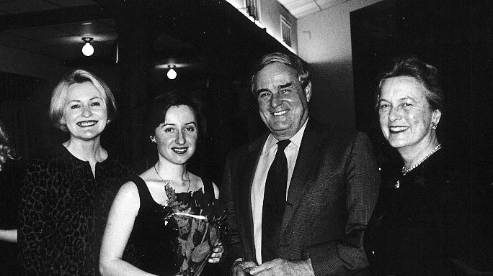
Notes:
TWG_Photo_2000_No_510__Feb_23__Chevy_Chase_Women's_Club__Laryssa_Lapychak_Courtney__Violinist_Solomiya_Soroka__Amb_WIlliam_Miller__Suzanne_Miller
See 2000 January-February TWG NEWS, page 1, for event coverage
For Washington Post coverage (If using PowerPoint go to “Slide Show” pull-down menu and select “play from Current Slide” or if using “Keynote” select the “Play” mode, and then click on blue arrow at the bottom right of the photograph)

Slide 67
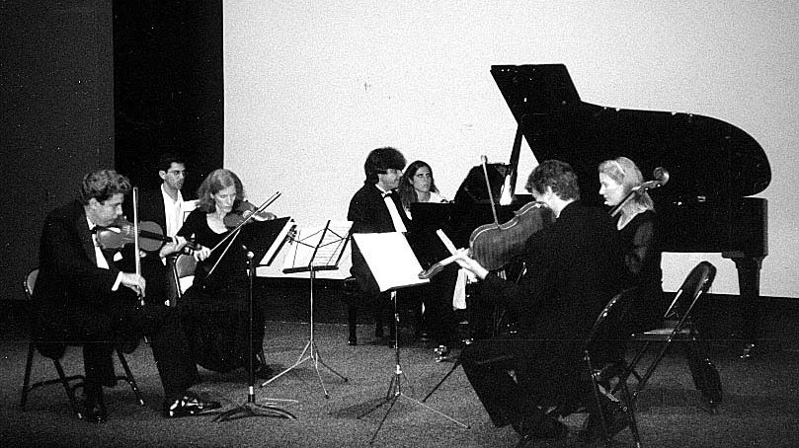
Notes:
TWG_Photo_2000_No_520__Oct_3__Rosslyn_Spectrum_Theater__Benefit_Concert__Pianist_Volodymyr_Vynnytsky__Violinists_Zino_Bogachek_and_Joan_Hurley__Violist_Uri_Wassertzug__Cellist_Liz_Davis__Drummer_John_Spirtas
See 2000 November-December TWG NEWS, page 1, for event coverage

Slide 68
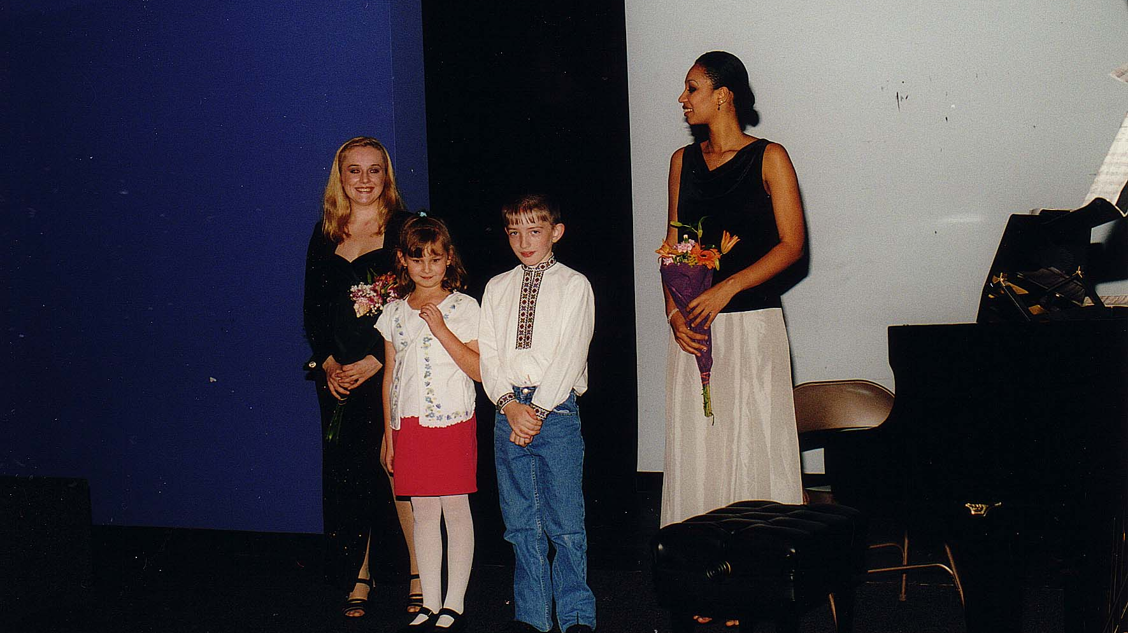
Notes:
TWG_Photo_2000_No_530__Oct_16__Rosslyn_Spectrum_Theater__Violinist_Solomiya_Ivakhiv__Pianist_Anum_Derhuso
See 2000 November-December TWG NEWS, page 1, for event coverage

Slide 69
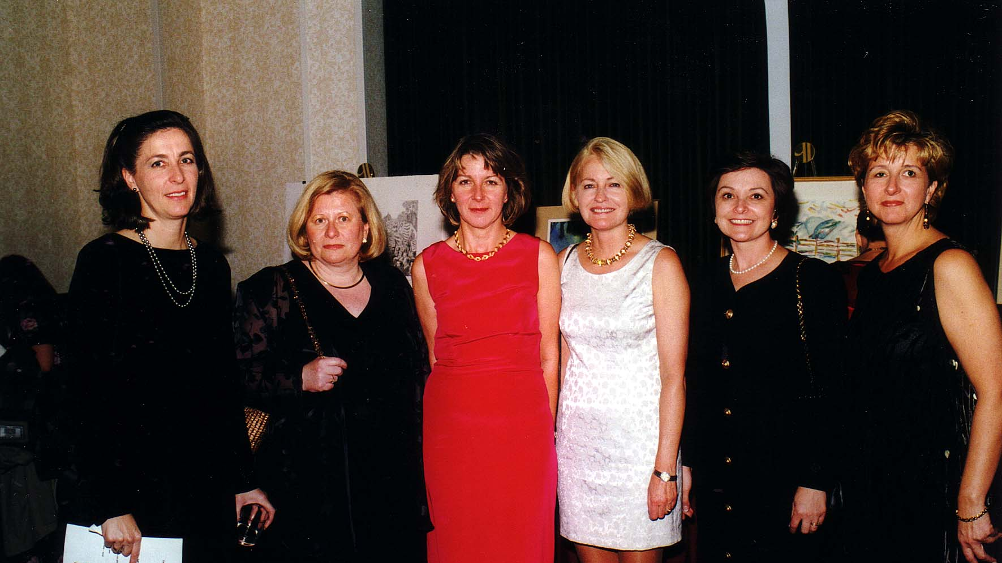
Notes:
TWG_Photo_2000_No_540__Oct_7__Key_Bridge_Marriott__TWG_Leadership_Conference__Cultural_Commitee__Larysa_Kurylas__Daria_Stec__Nadia_Diuk__Laryssa_Lapychak_Courtney__Rosalie_Norair__Marta_Zielyk

Slide 70
2001 Photos
Oksana Krovytska and Volodymyr Vynnytsky
Stefania Dovhan
Olga Hirshhorn

Slide 71
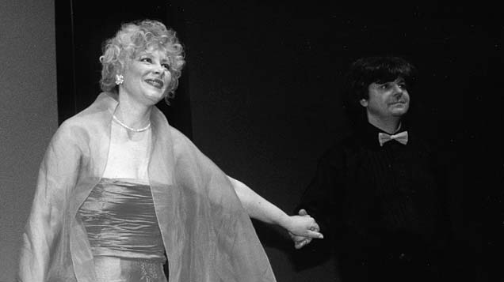
Notes:
TWG_Photo_2001_No_510_Apr_23__Rosslyn_Spectrum_Theater__Opera_Diva_Oksana_Krovytska__Pianist_Volodymyr_Vynnytsky
See 2001 Fall-Winter TWG NEWS, pages 5, 8, and 10 for event coverage

Slide 72
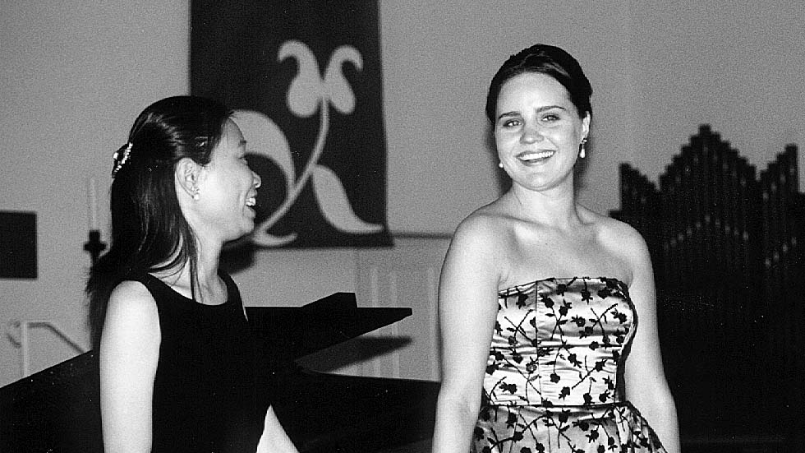
Notes:
TWG_Photo_2001_No_520__May_12__Dumbarton_Methodist_Church__Soprano_Stefania_Dovhan__Accompanist_Pin-Huey_Wang
See 2001 Fall-Winter TWG NEWS, pages 3, 6, 8,and 11 for event coverage

Slide 73
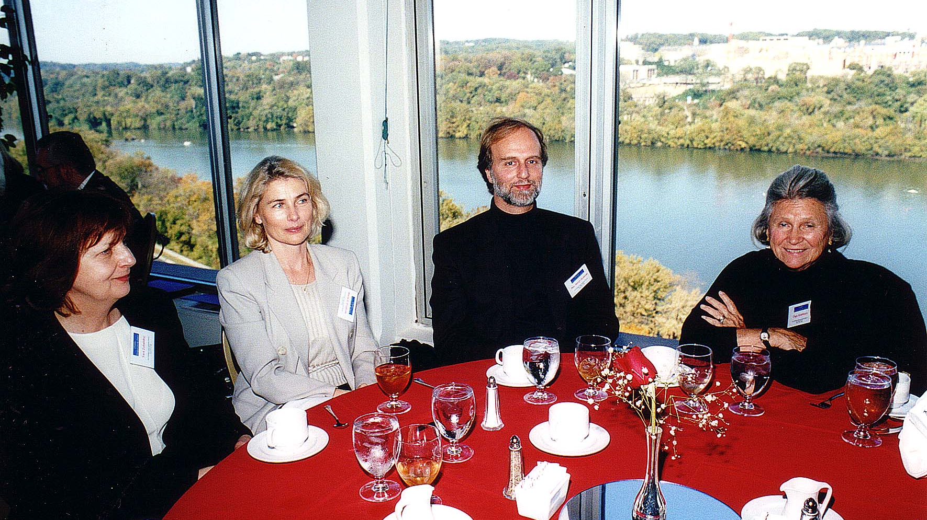
Notes:
TWG_Photo_2001_No_530__Oct_20__Key_Bridge_Marriott_Hotel_Arlington_VA__Leadership_Conference_Lunch__Yara_Zubalskyj__Maria_Pryshlak__Rev_Borys_Gudziak__Modern_Art_Collector_Olga_Hirshhorn

Slide 74
2002 Photos
Konstantin Akinsha and Patricia Grimsted

Slide 75
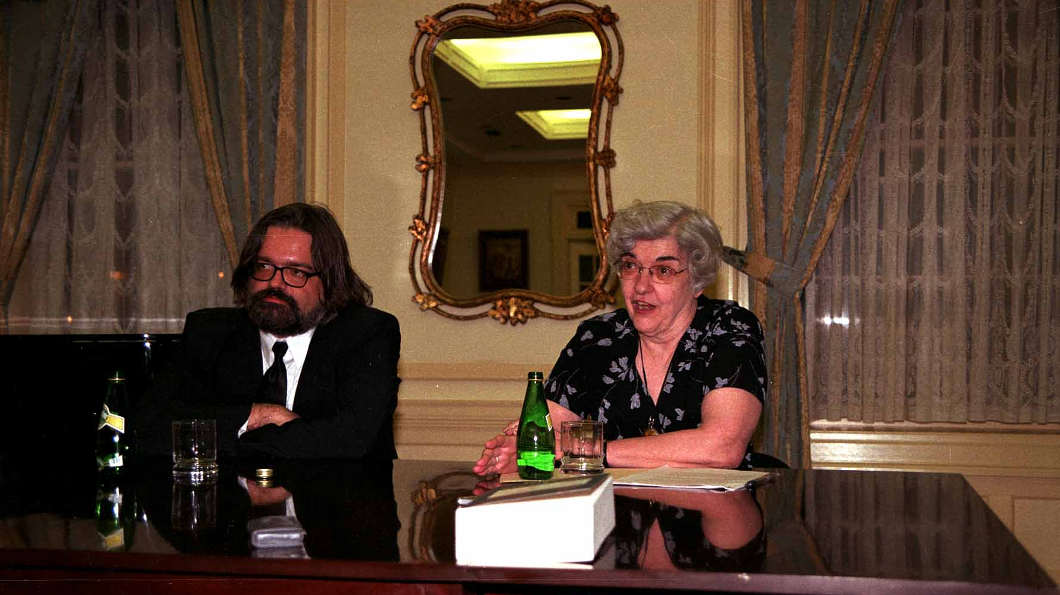
Notes:
TWG_Photo_2002_No_401__Ukrainian_Embassy__Author_Beautiful_Loot_Soviet_Plunder_of_Europe's_Art_Treasures_Konstantin_Akinsha__Historian_focused_on_Dispossession_and_Restitution_of_Cultural_Materials_during_and_after_WWII_Patricia_Grimsted
See 2002 Summer TWG NEWS, page 8, for event coverage

Slide 76
2003 Photos
Maria Guleghina Reception
Leontovych Quartet
Stepan Szkafarowsky
Lydia Artymiw
Fashion Show
Vynnytsky and Khoma
Slavko Nowytski

Slide 77
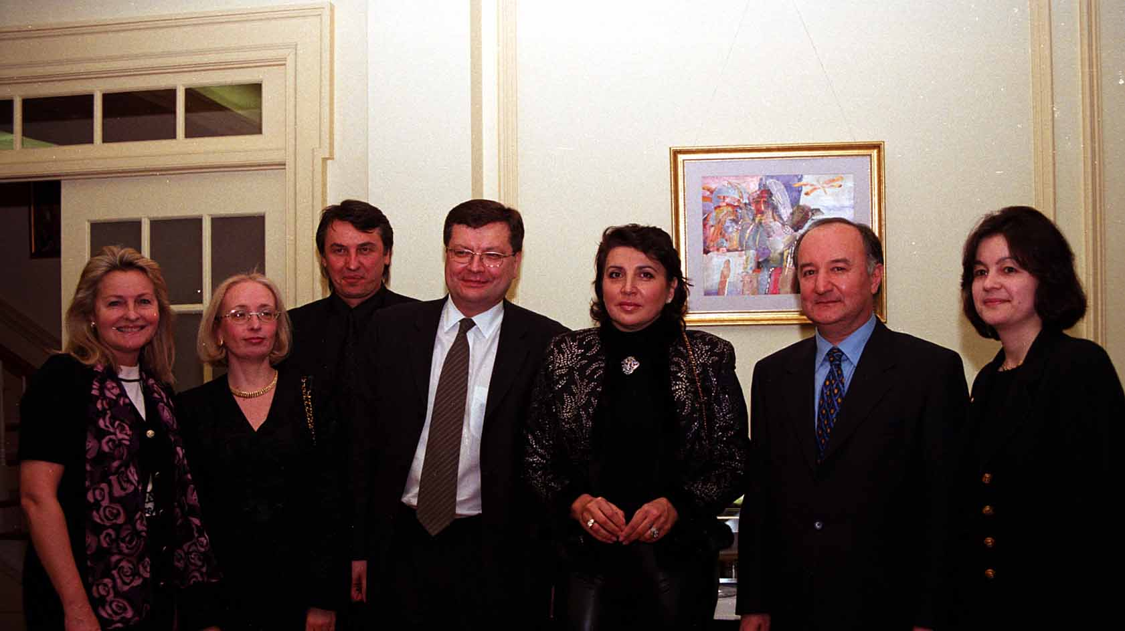
P 14
Notes:
TWG_Photo_2003_No_590__March_4__Ukrainian_Embassy_Reception_for_Soprano_Opera_Singer_Maria_Guleghina__L_to_R__Laryssa_Lapychak_Courtney_Natalia_Gryshchenko_NN__Amb_Kostyantyn_Gryshchenko__Maria_Guleghina__NN__NN
See The Ukrainian Weekly 2003-11, page 14 (If using PowerPoint go to “Slide Show” pull-down menu and select “play from Current Slide” or if using “Keynote” select the “Play” mode, and then click on blue arrow at the bottom right of the photograph --- scroll to page 14)

Slide 78
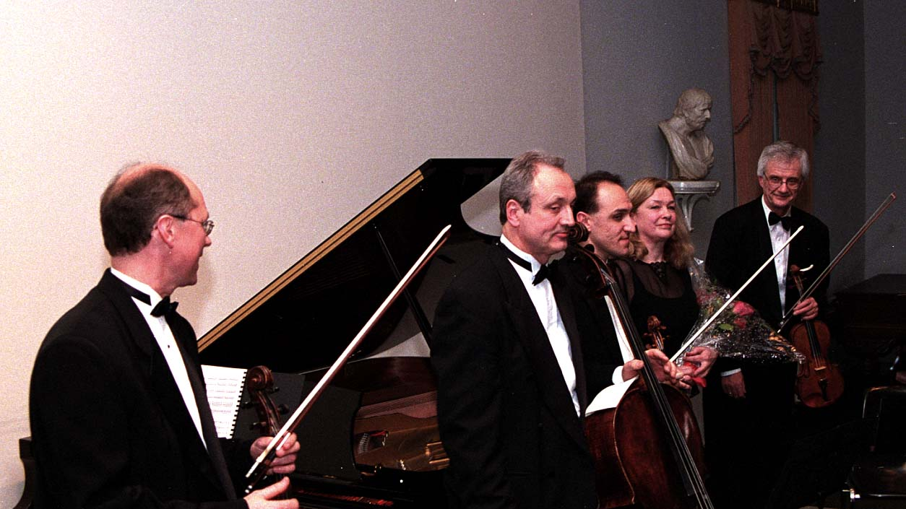
P 14
Notes:
TWG_Photo_2003_No_510__Mar_9__Alexandria_VA_Lyceum__Leontovych_Quartet_with_Pianist_Tatiana_Tchekina__Borys_Deviatov__Vladimir_Panteleyev__Jassen_Todorov__Tatiana_Tchekina_and_Oleh_Krysa
Note: Oleh Krysa and Tatiana Tchekina were husband and wife. Tatiana died in a car accident in 2013.
See The Ukrainian Weekly 2003-14, page 14 (If using PowerPoint go to “Slide Show” pull-down menu and select “play from Current Slide” or if using “Keynote” select the “Play” mode, and then click on blue arrow at the bottom right of the photograph --- scroll to page 14)

Slide 79
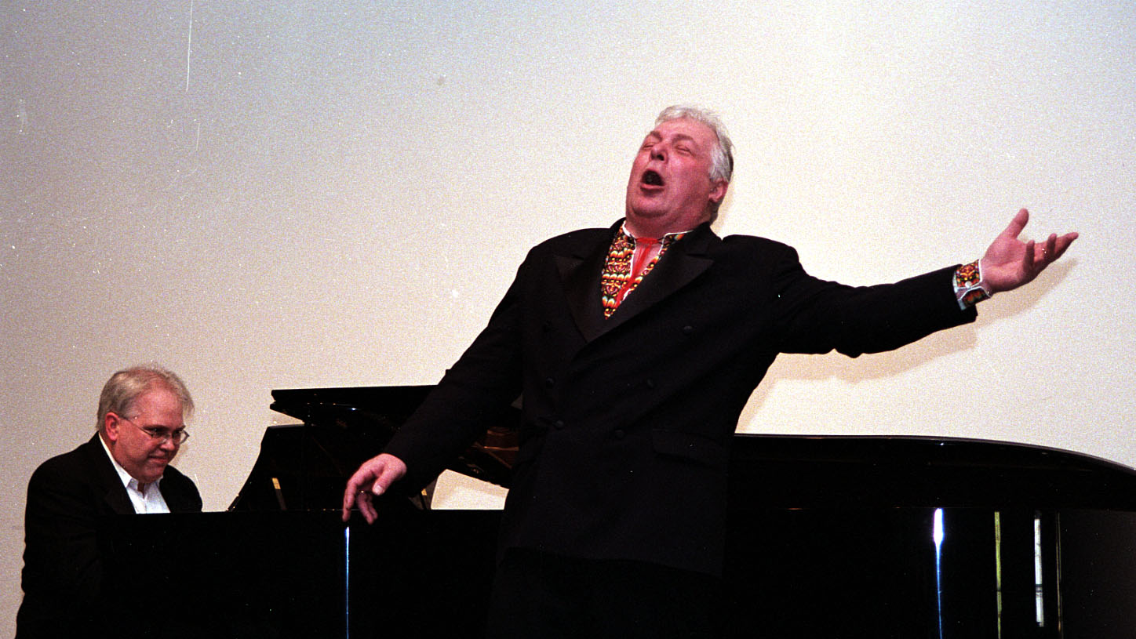
P 12
Szkafarowsky Link
Notes:
TWG_Photo_2003_No_520__Apr_6__Alexandria_VA_Lyceum__Metropolitan_Opera_Soloist_Bass_Stepan_Szkafarowsky__and_Accompanist_Gary_Hammond
See The Ukrainian Weekly 2003-17, page 12 (Go to “Slide Show” pull-down menu and select “play from Current Slide” or if using “Keynote” select the “Play” mode, then click on blue arrow at the bottom right of the photograph)

Slide 80
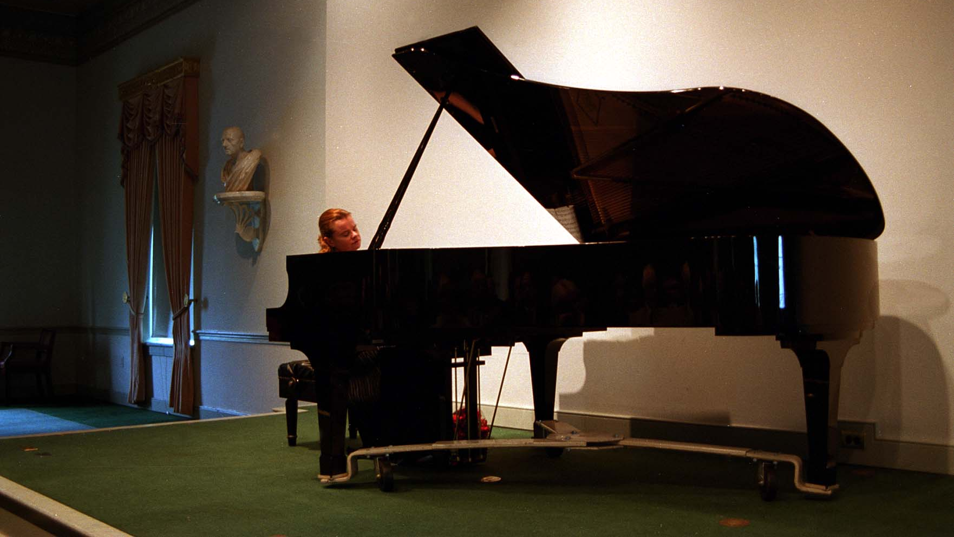
P 13
Notes:
TWG_Photo_2003_No_530__May_18__Alexandria_VA_Lyceum__Pianist_Lydia_Artymiw
See The Ukrainian Weekly 2003-24, page 13 (If using PowerPoint go to “Slide Show” pull-down menu and select “play from Current Slide” or if using “Keynote” select the “Play” mode, and then click on blue arrow at the bottom right of the photograph – scroll to page 13)

Slide 81
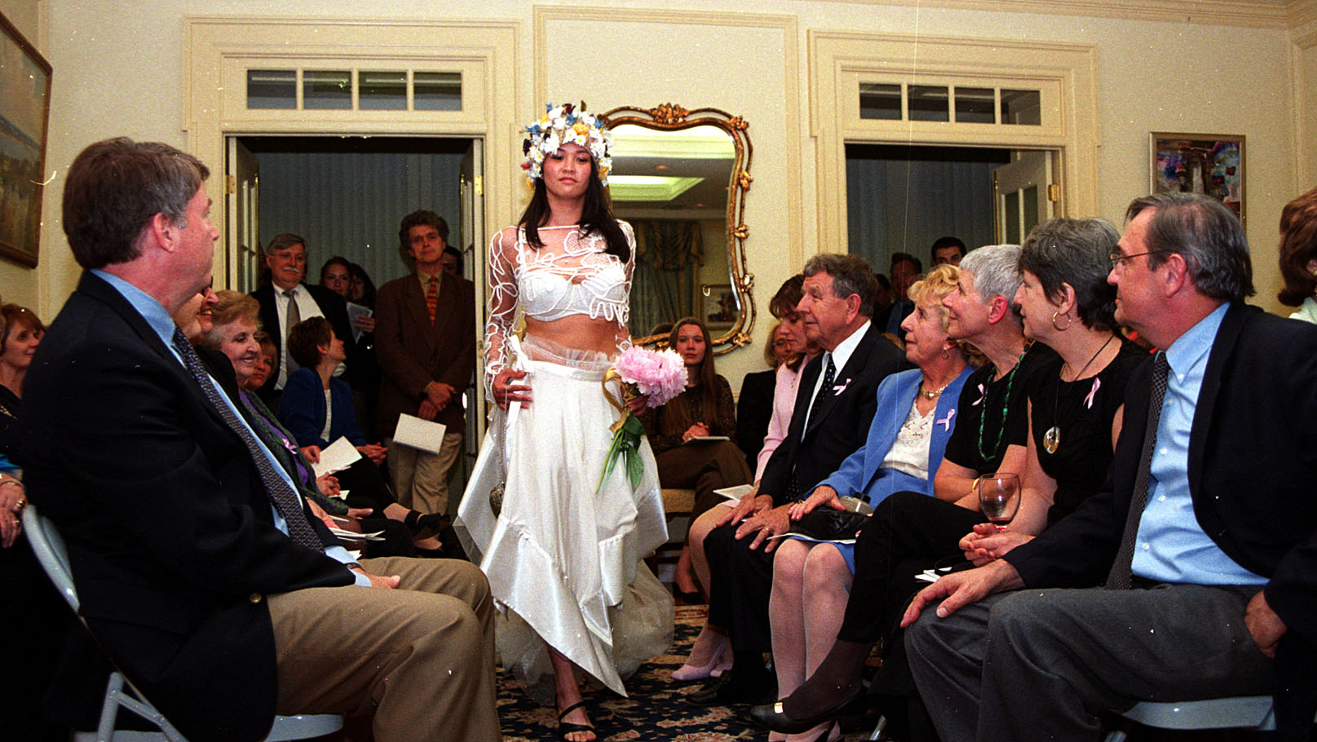
Notes:
TWG_Photo_2003_No_540__Jun_5__Ukrainian_Embassy__Benefit_Fashion_Show

Slide 82
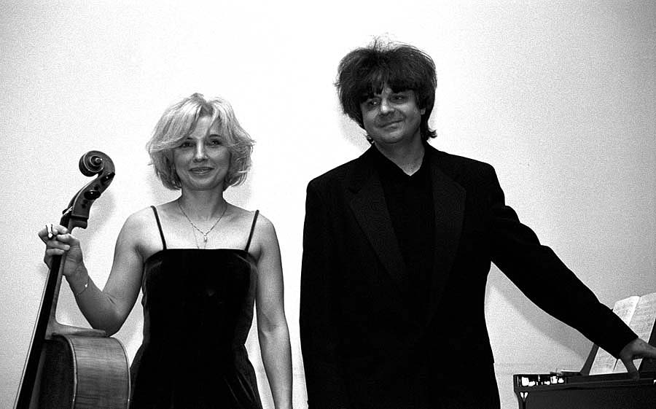
P 14
Notes:
TWG_Photo_2003_No_550__Nov_16__Alexandria_VA_Lyceum__Cellist_Natalia_Khoma__Pianist_Volodymyr_Vynnytsky
See The Ukrainian Weekly 2003-49, page 14 (If using PowerPoint go to “Slide Show” pull-down menu and select “play from Current Slide” or if using “Keynote” select the “Play” mode, and then click on blue arrow at the bottom right of the photograph – scroll to page 14)

Slide 83
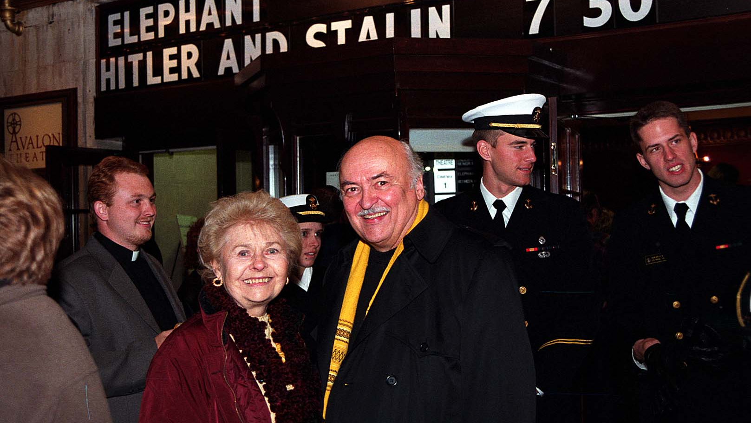
P 15
Notes:
TWG_Photo_2003_No_560__Dec_3__Avalon_Theater__Nowytski_Film_Between_Hitler_and_Stalin
See The Ukrainian Weekly 2003-52, page 15 (If using PowerPoint go to “Slide Show” pull-down menu and select “play from Current Slide” or if using “Keynote” select the “Play” mode, and then click on blue arrow at the bottom right of the photograph – scroll to page 15)

Slide 84
2004 Photos
Valentina Lisitsa
Maryna Rogozhyna and Oleksandr Abayev

Slide 85
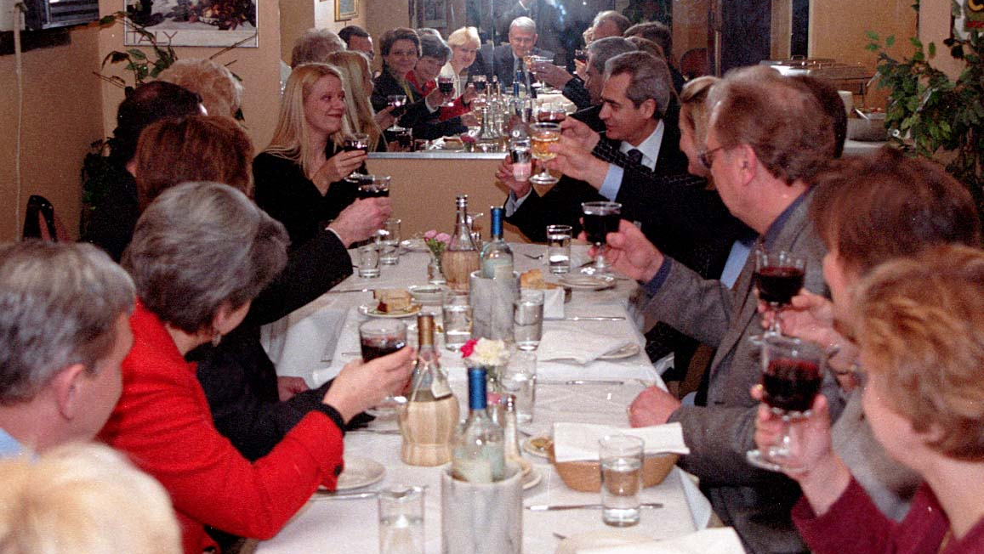
P 15
Notes:
TWG_Photo_2004_No_510__Mar_14__Reception_for_Valentina_Lisitsa_after_her_Concert_at_the_Lyceum_in_Alexandria_VA__At_End_of_Table__Pianist_Valentina_Lisitsa__Amb_Mykhailo_Reznik
See The Ukrainian Weekly 2004-15, page 15 (If using PowerPoint go to “Slide Show” pull-down menu and select “play from Current Slide” or if using “Keynote” select the “Play” mode, and then click on blue arrow at the bottom right of the photograph – scroll to page 15)

Slide 86
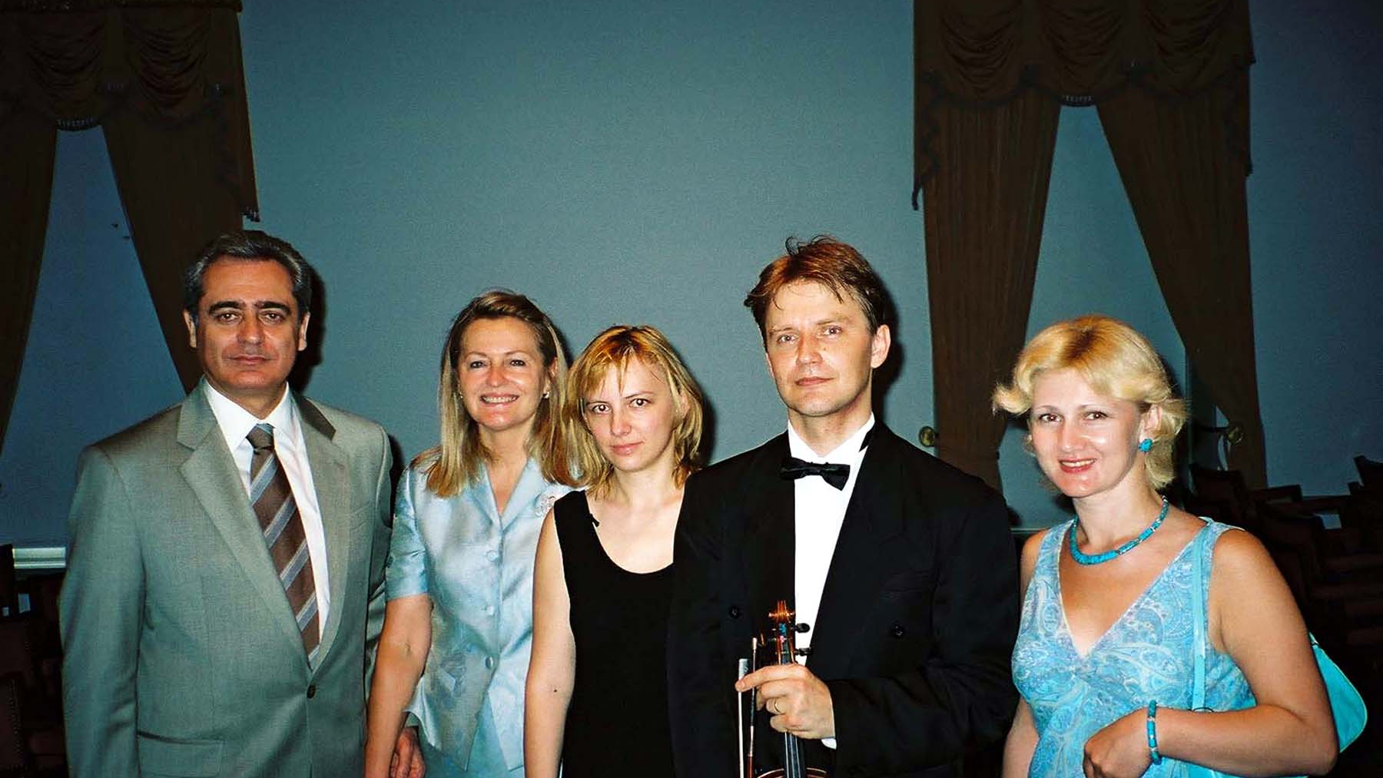
P 12
Notes:
TWG_Photo_2004_No_520__May_23__Alexandria_VA_Lyceum__Amb_Mykhailo_Reznik__TWGCF_Director_Laryssa_Lapychak_Courtney__Pianist_Maryna_Rogozhyna__Violinist_Oleksandr_Abayev__Cultural_Attaché_Natalia_Holub
See The Ukrainian Weekly 2004-24, page 12 (If using PowerPoint go to “Slide Show” pull-down menu and select “play from Current Slide” or if using “Keynote” select the “Play” mode, and then click on blue arrow at the bottom right of the photograph – scroll to page 12)

