Slide 1
TWG Photos 1984
Created October 24, 2020

Slide 2
1984 300 TWG Events
Edward Derwinski, Eugene Iwanciw

Slide 3
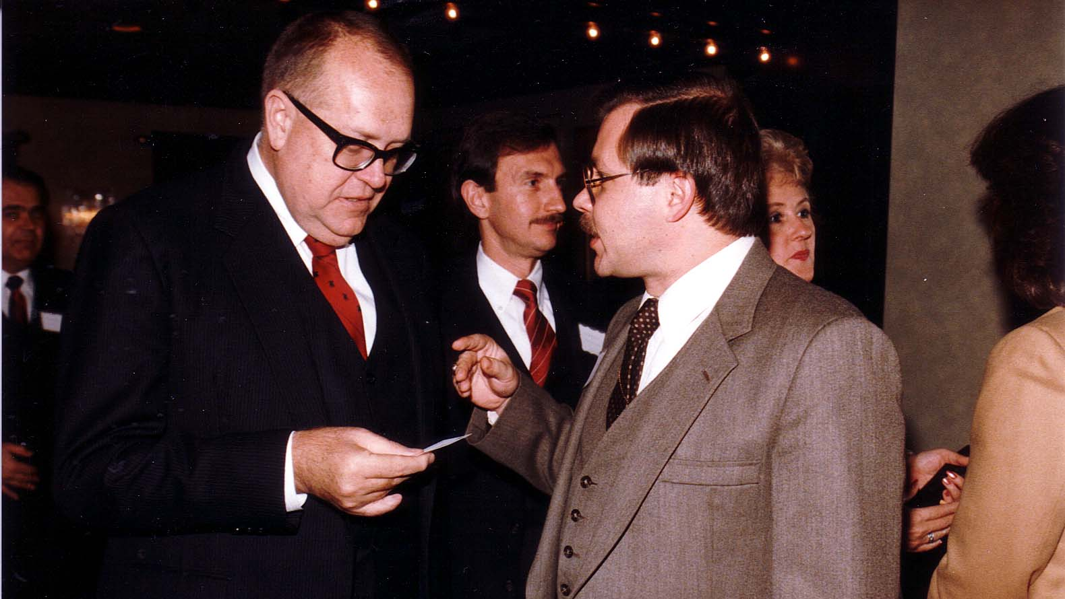
Notes:
TWG_Photo_1984_No_310__Dec_6__Monocle_107_D_St_NE_WDC__Distinguished_Speaker_Series__Counselor_to_State_Department_Edward_Derwinski_in_conversation_with__TWG_NEWS_Editor_Eugene_Iwanciw__Wololodymyr_Sulzynsky_looking_on
See 1984 November TWG NEWS for event announcement

Slide 4
1984 600 Social Events
Capitol Hill Party: Victoria Varvariv, Ihor Kotlarchuk, Marta Procinsky
Christmas Party

Slide 5
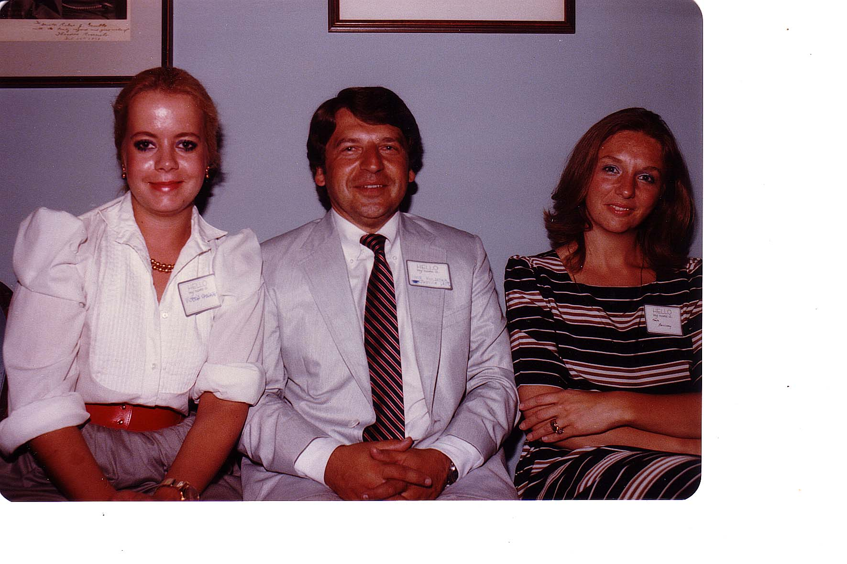
Notes:
TWG_Photo_1984_No_641__Capitol_Hill__First_TWG_Party__Victoria_Varvariv__Ihor_Kotlarchuk__Marta_Procinsky

Slide 6
1984 620 TWG Christmas Party Social Room Van Ness East Building 2939 Van Ness St, WDC, NW December 13 Photographs
Eugene Iwanciw, Marta Procinsky
Eugene Iwanciw, Ella Ostapenko Lichtenberg, Ihor Gawdiak
George Hnatiw, Eugene Kaspruk
George Sajewych
Hlib Taran
Inna Deychakiwsky, Orest Deychakiwsky, Anna Worobij, Pat Onufrak, Hlib Taran
Michael Kowalysko
Thomas Mack, Hanja Cherniak-Mack
Jurij Petrenko
Wolodymyr Sulzynsky

Slide 7
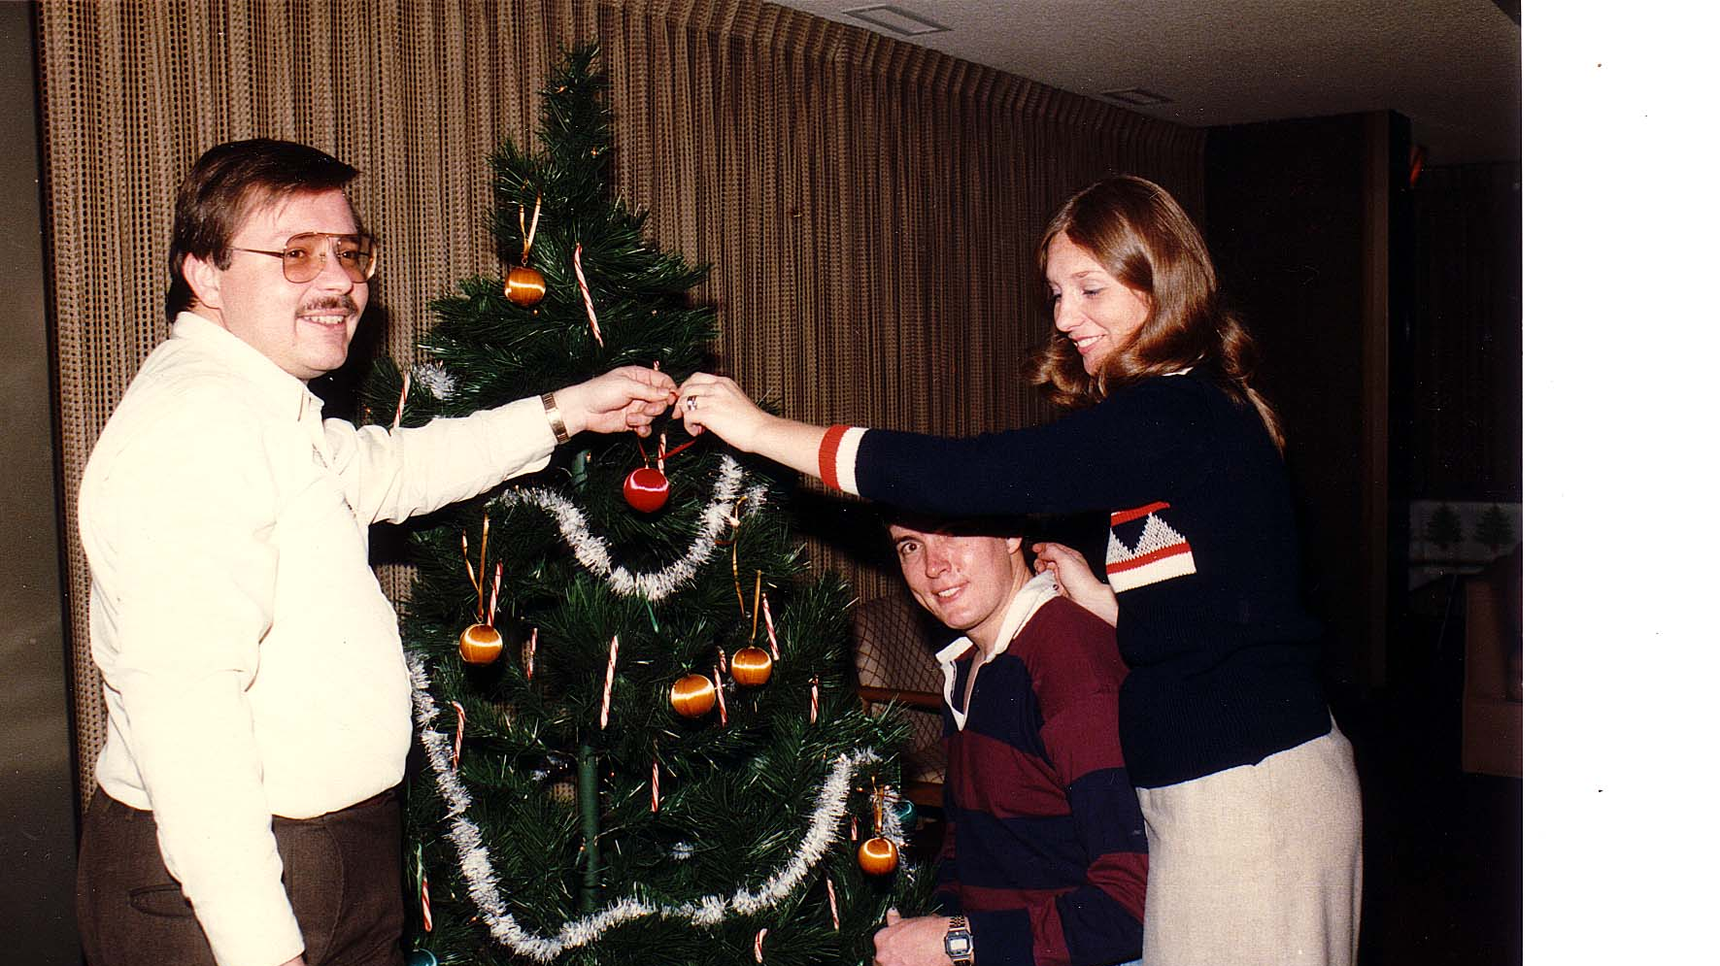
Notes:
TWG_Photo_1984_No_621__Dec_13__Van_Ness_East__Christmas_Party__Eugene_Iwanciw__Marta_Procinsky__Hlib_Taran
See 1984 November TWG NEWS for event announcement

Slide 8
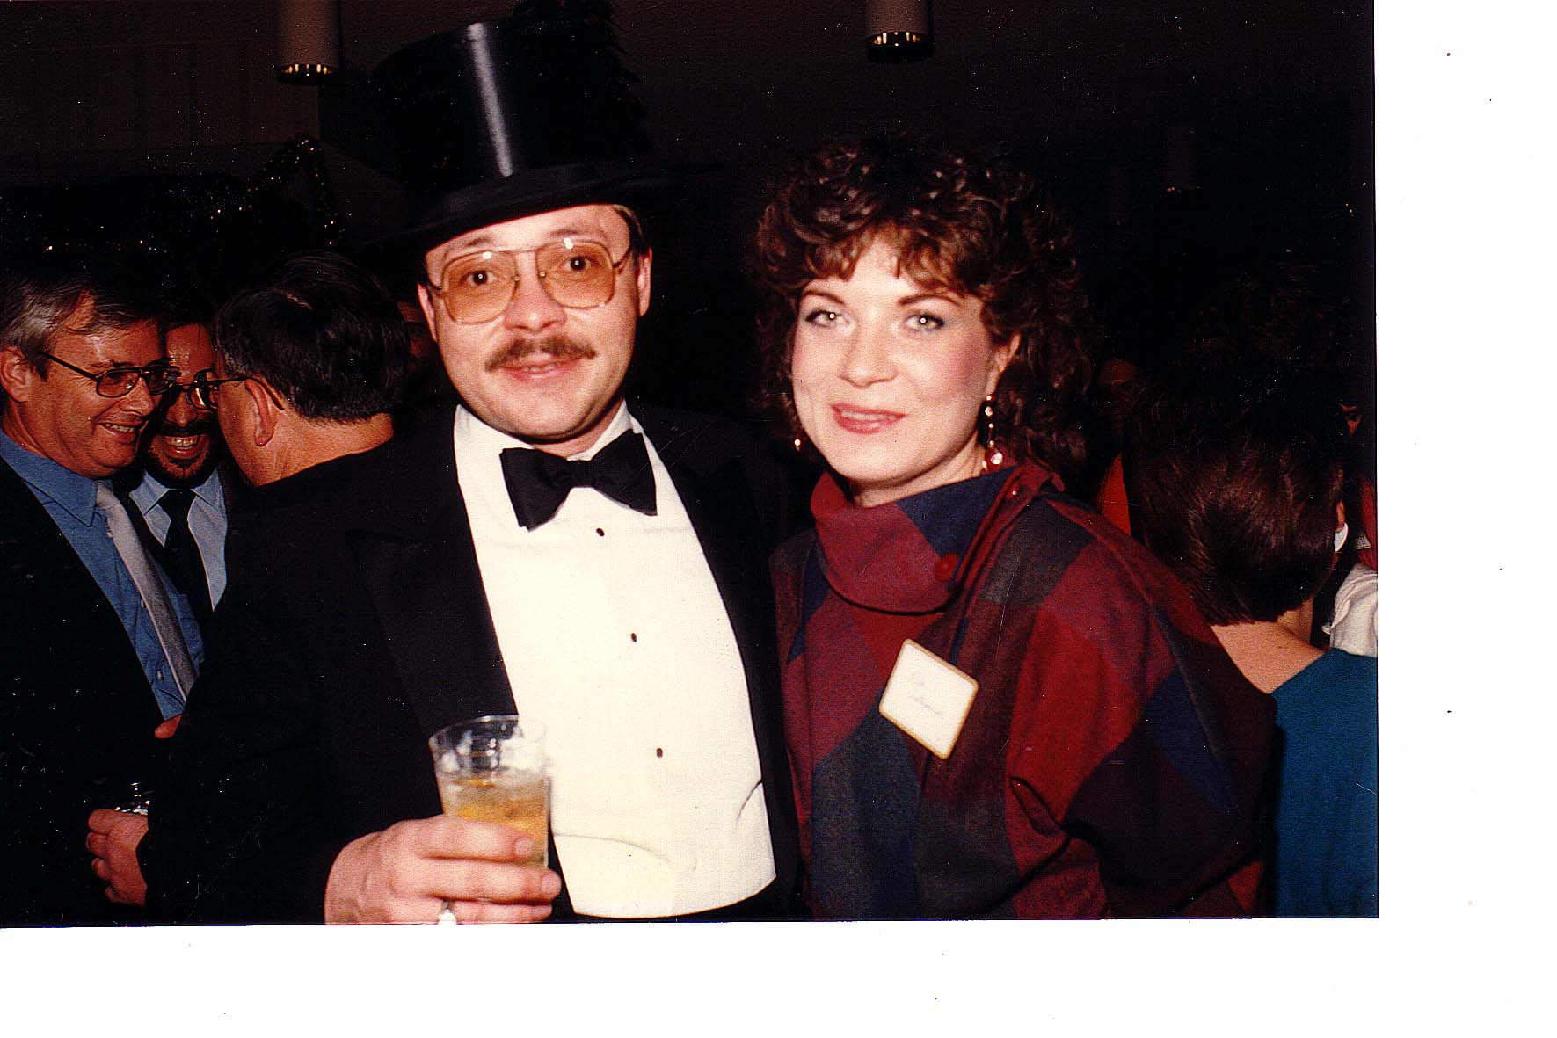
Notes:
TWG_Photo_1984_No_622__Dec_13__Van_Ness_East__Christmas_Party__Eugene_Iwanciw__Ella_Ostapenko_Lichtenberg__Ihor_Gawdiak_in_white_tie
See 1984 November TWG NEWS for event announcement

Slide 9
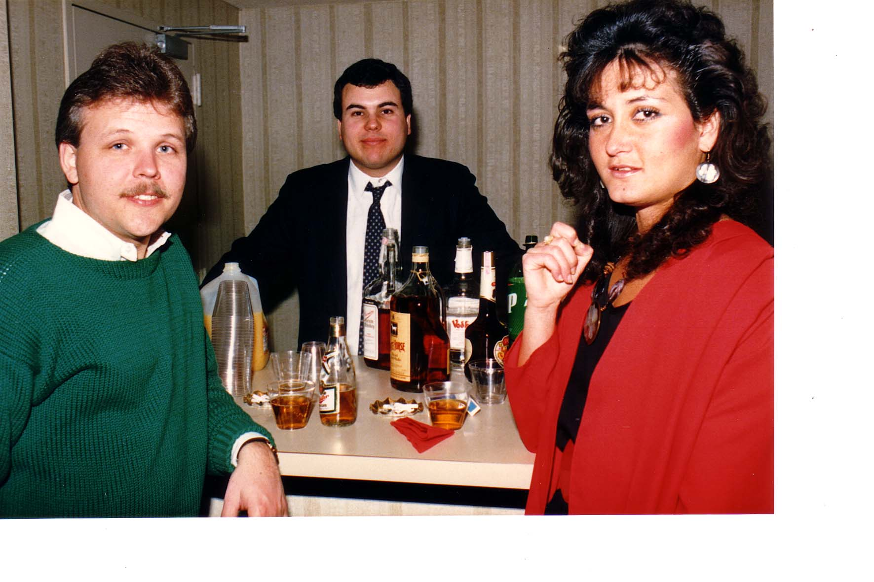
Notes:
TWG_Photo_1984_No_623__Dec_13__Van_Ness_East__Christmas_Party__George_Hnatiw__Eugene_Kaspruk__NN
See 1984 November TWG NEWS for event announcement

Slide 10
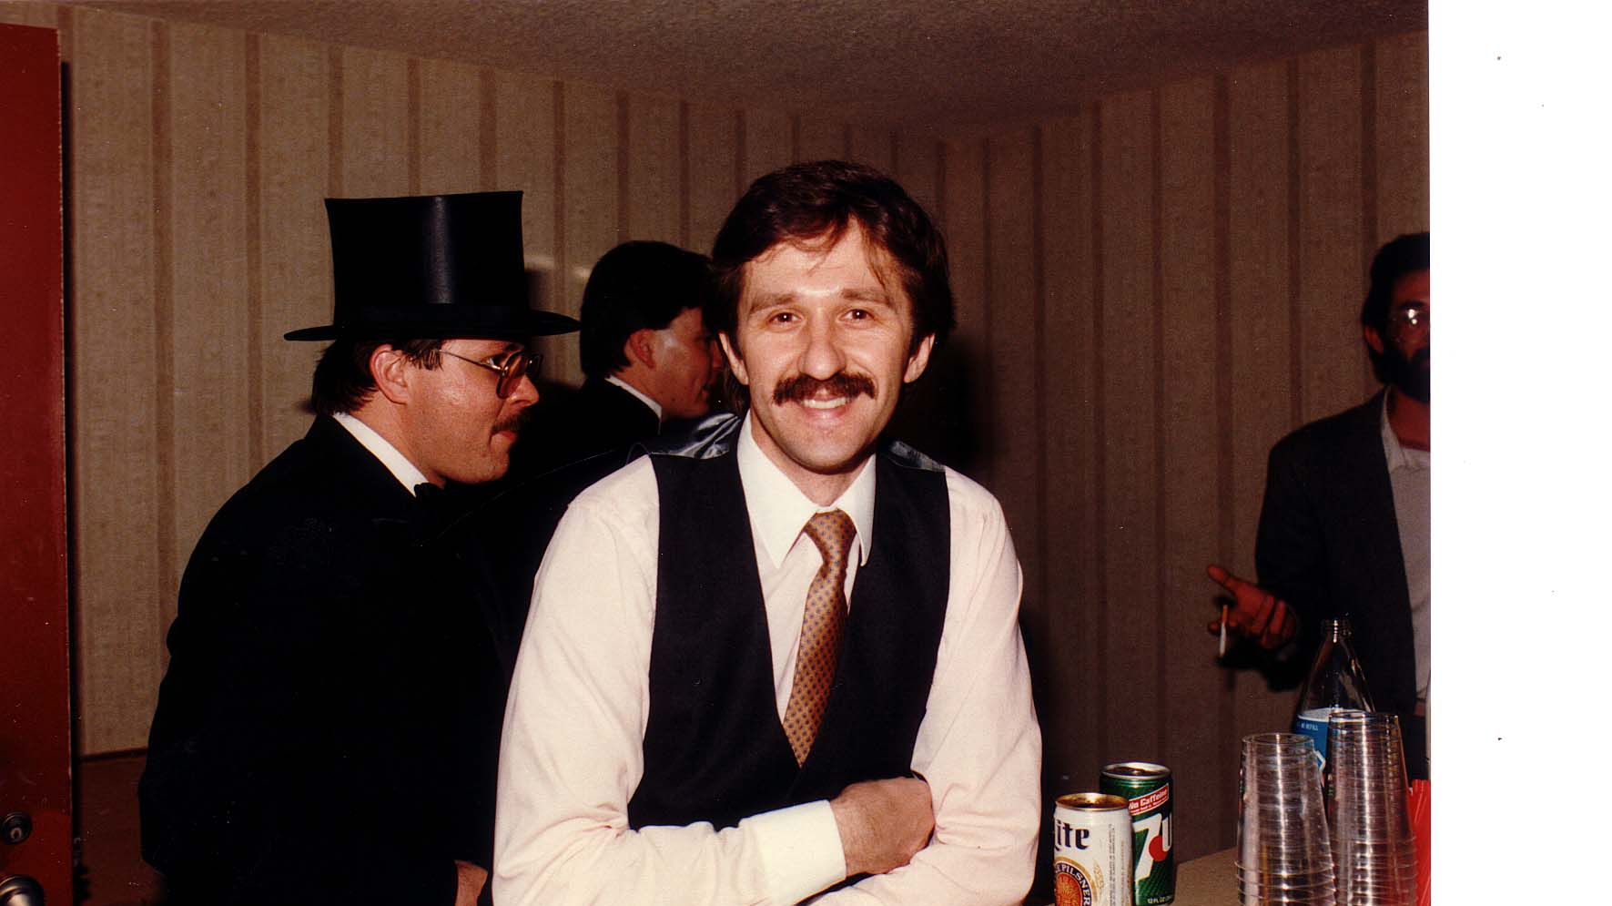
Notes:
TWG_Photo_1984_No_624__Dec_13__Van_Ness_East__Christmas_Party__George_Sajewych
See 1984 November TWG NEWS for event announcement

Slide 11
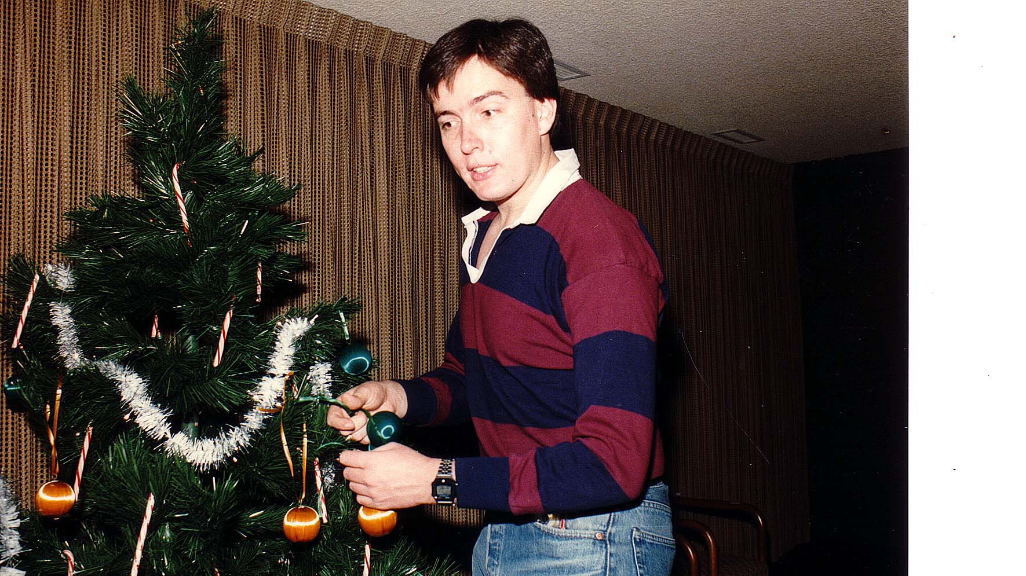
Notes:
TWG_Photo_1984_No_625__Dec_13__Van_Ness_East__Christmas_Party__Hlib_Taran
See 1984 November TWG NEWS for event announcement

Slide 12
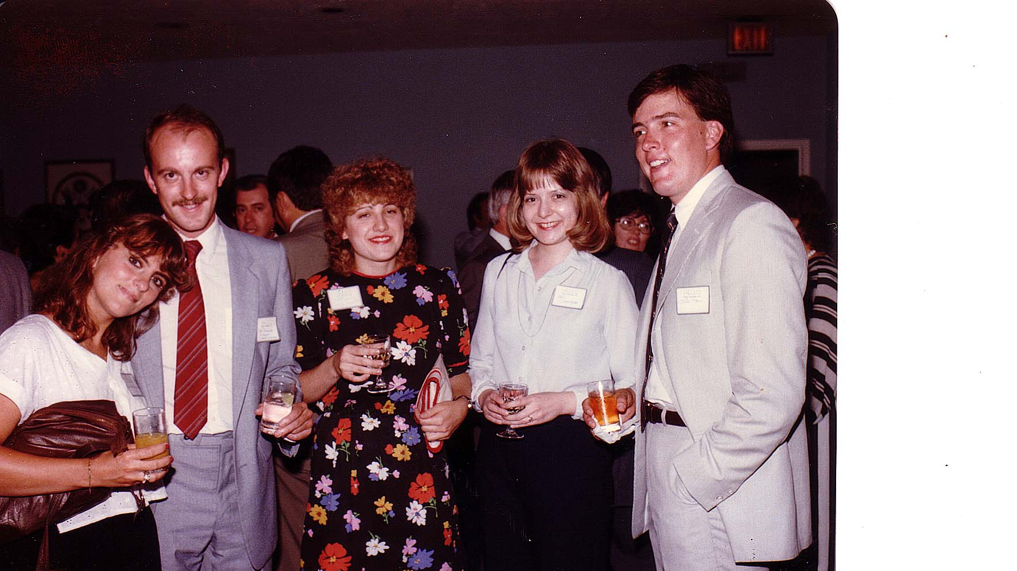
Notes:
TWG_Photo_1984_No_626__Dec_13__Van_Ness_East__Christmas_Party__Inna_Deychakiwsky__Orest_Deychakiwsky__Anna_Worobij__Pat_Onufrak__Hlib_Taran
See 1984 November TWG NEWS for event announcement

Slide 13
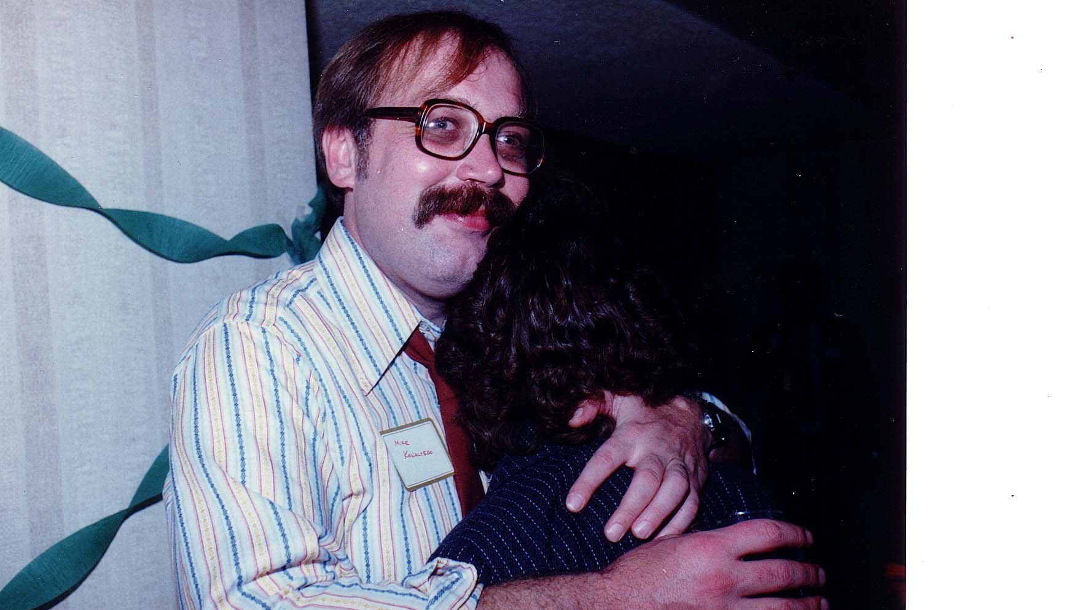
Notes:
TWG_Photo_1984_No_627__Dec_13__Van_Ness_East__Christmas_Party__Michael_Kowalysko
See 1984 November TWG NEWS for event announcement

Slide 14
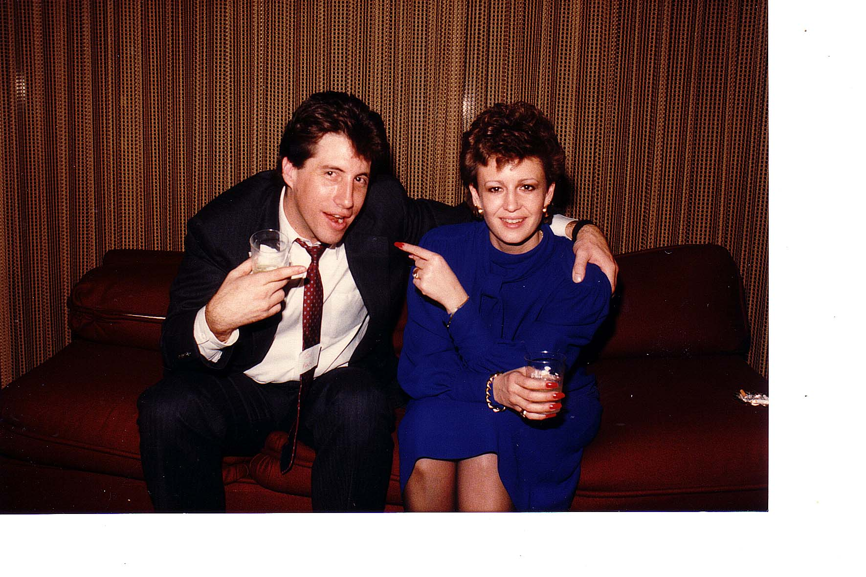
Notes:
TWG_Photo_1984_No_628__Dec_13__Van_Ness_East__Christmas_Party__Thomas_Mack__Hanja_Cherniak-Mack
See 1984 November TWG NEWS for event announcement

Slide 15
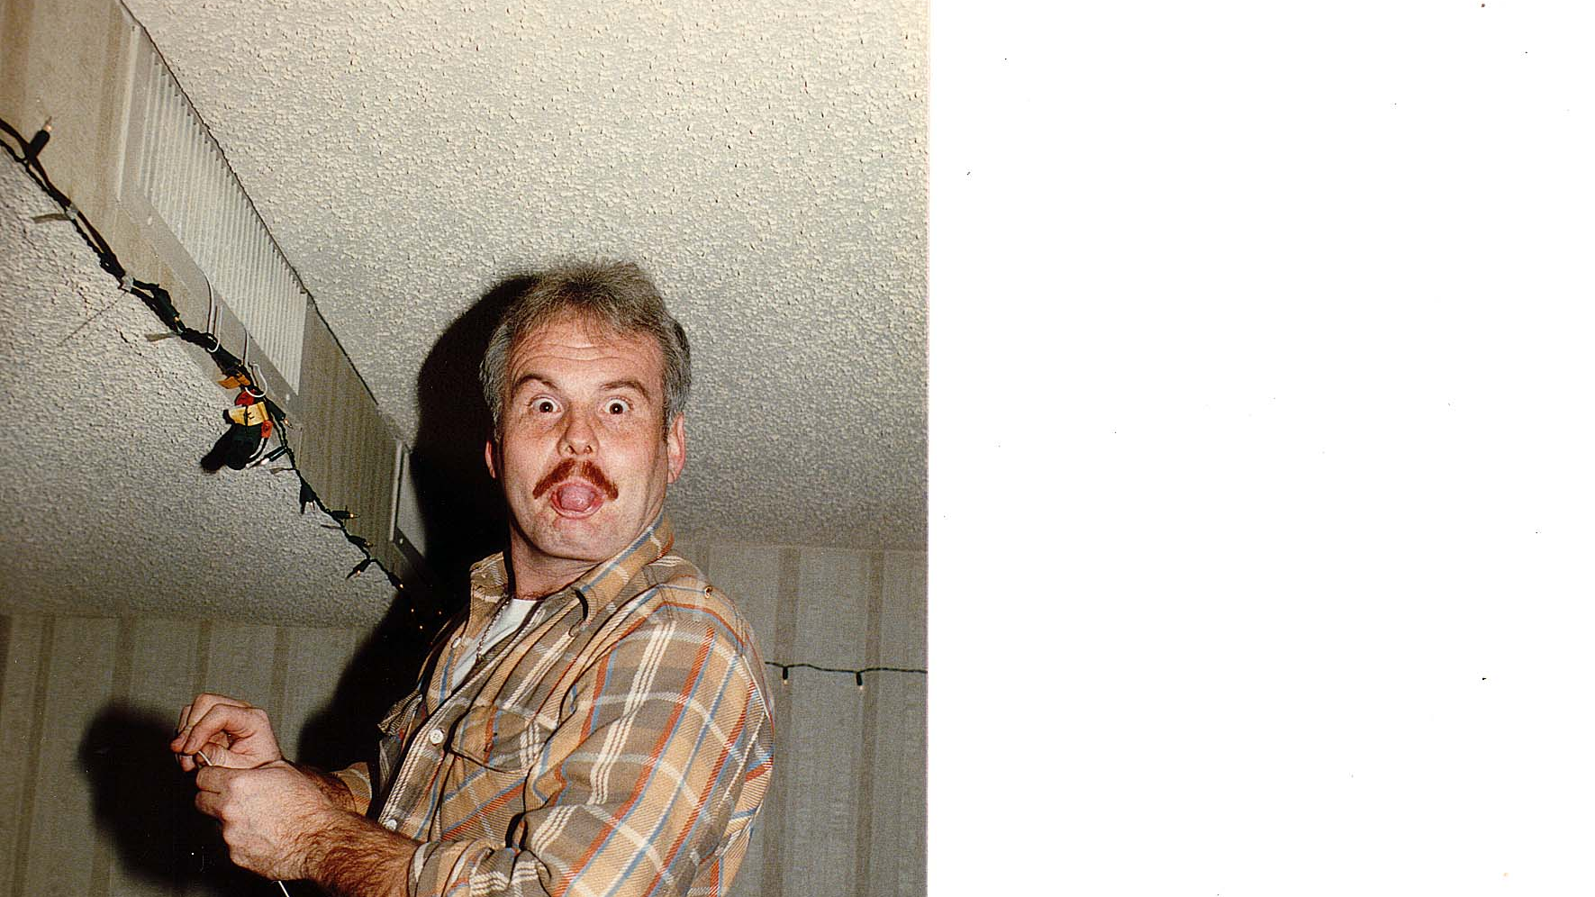
Notes:
TWG_Photo_1984_No_629__Dec_13__Van_Ness_East__Christmas_Party__Jurij_Petrenko
See 1984 November TWG NEWS for event announcement

Slide 16
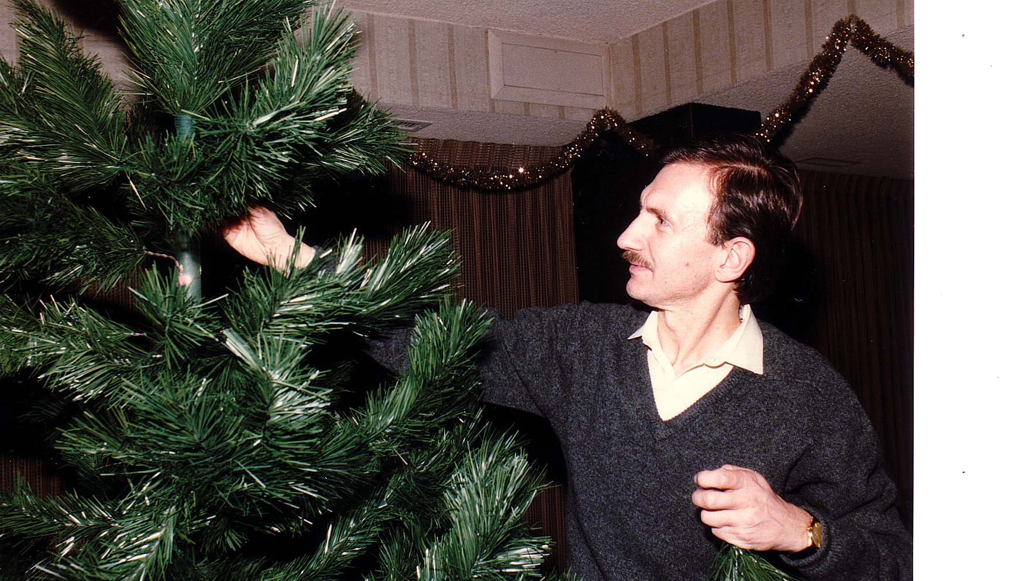
Notes:
TWG_Photo_1984_No_630__Dec_13__Van_Ness_East__Christmas_Party__Wolodymyr_Sulzynsky
See 1984 November TWG NEWS for event announcement

