Slide 1
TWG Photos 1985
Created October 24, 2020

Slide 2
1985 100 TWG Annual Meeting Washington Marriott Hotel September 27 Photographs
A semi-annual meeting was held on April 17, 1985. See 1985 May TWG NEWS.
Please See 1985 August and September TWG NEWS for Annual Meeting Planning and 1985 October TWG NEWS for Annual Meeting Coverage. Elected to the Board:
Natalie Sluzar – President; Ihor Gawdiak – Vice-President; Marta Pereyma – Secretary; Yaroslav Bihun – Treasurer; Halyna Breslawec – Membership Director; Patricia Filipov – Events Director
Auditing Committee: Daria Stec, Jurij Petrenko, Orest Deychakiwsky
Annual Meeting Chairman – Ihor Vitkovitsky; Vice-Chairman – Daniel King; Secretary – Marta Cehelsky
Others in photos: Ross Chomiak, Marta Mostovych, Eugene Iwanciw

Slide 3
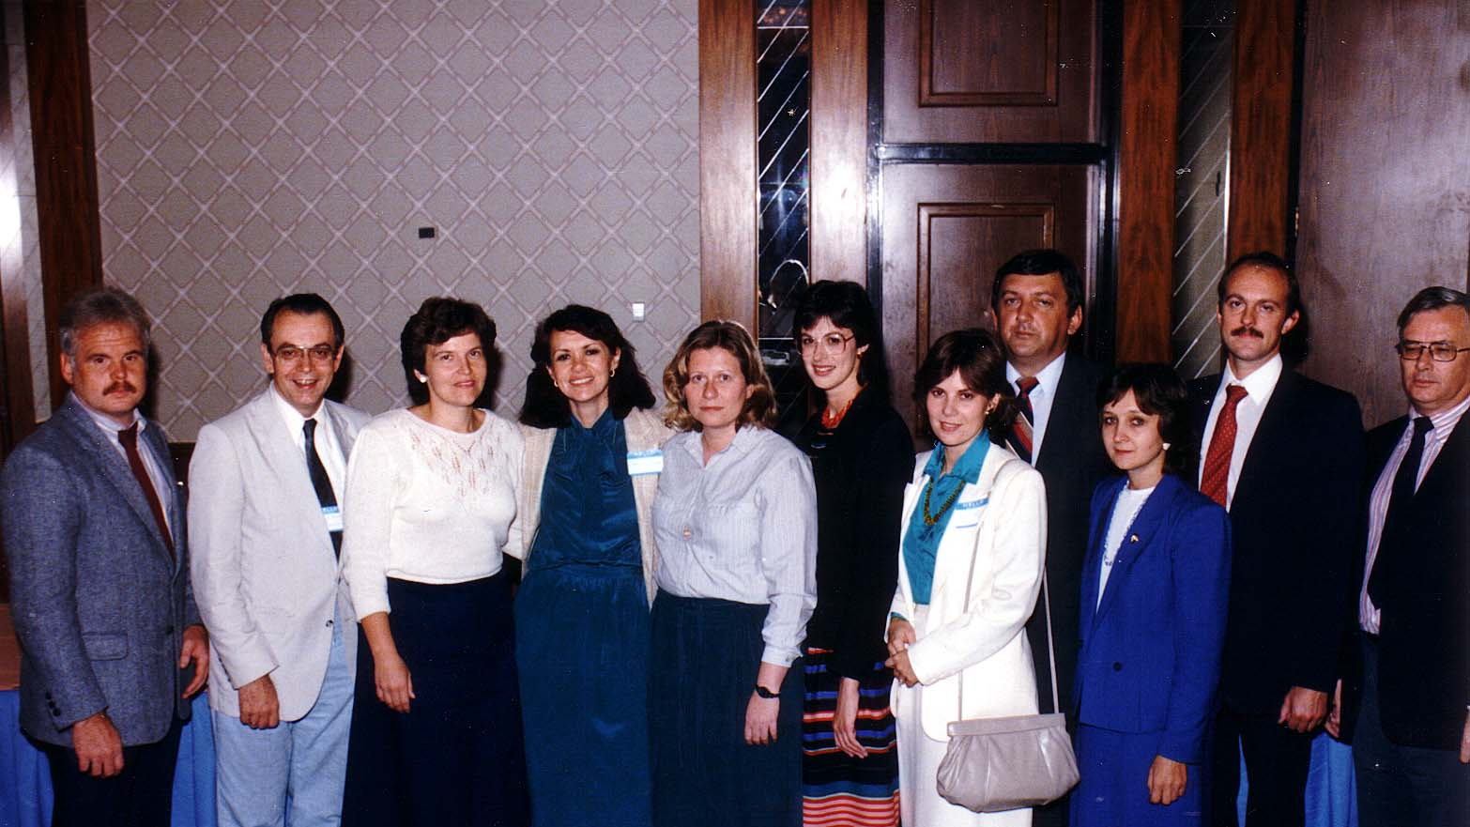
Notes:
TWG_Photo_1985_No_101__Sep_27__Annual_Mtg__Jurij_Petrenko_Ross_Chomiak_Patricia_Filipov_TWG_President_Natalie_Sluzar_Daria_Stec_Halyna_Breslawec_Marta_Mostovych_Yaro_Bihun_Marta_Pereyma_Orest_Deychakiwsky_Ihor_Gawdiak
See 1985 August and September TWG NEWS for Annual Meeting Planning and 1985 October TWG NEWS for Annual Meeting Coverage

Slide 4
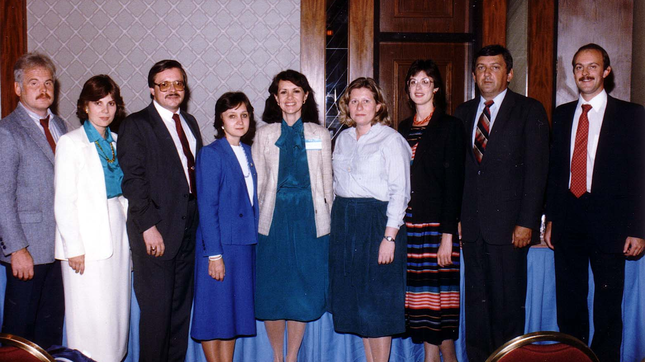
Notes:
TWG_Photo_1985_No_102__Sep_27__First_Board_of_Directors__Jurij_Petrenko__Marta_Mostovych__Eugene_Iwanciw__Marta_Pereyma__TWG_President_Natalie_Sluzar__Daria_Stec__Halyna_Breslawec__Yaroslav_Bihun__Orest_Deychakiwsky
See 1985 August and September TWG NEWS for Annual Meeting Planning and 1985 October TWG NEWS for Annual Meeting Coverage

Slide 5
1985 300 TWG Events Photographs
Christianity in Ukraine: Bohdan Bociurkiw
Holodomor: Marko Carynnyk
Holodomor: Slavko Nowytski
Religious Freedom: Andrew Sorokowski
Millennium of Christianity Celebration: Roman Procyk

Slide 6
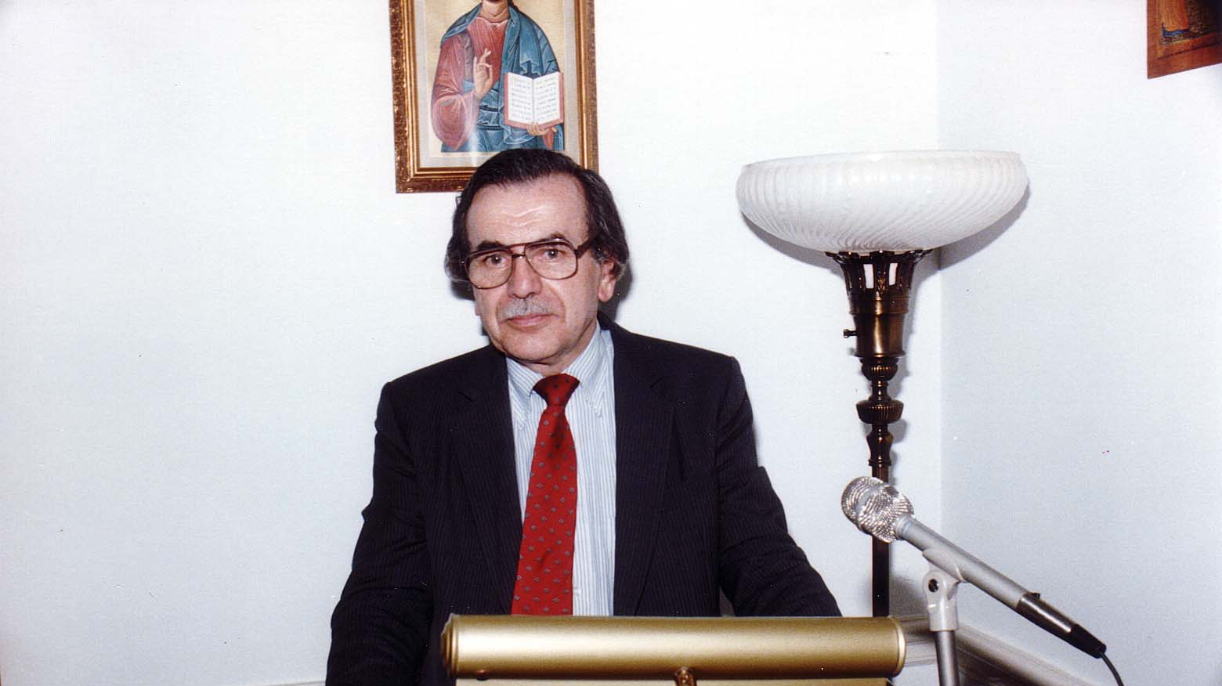
Notes:
TWG_Photo_1985_No_310__March_29__St._Sophia_Religious_Association__Friday_Evening_Forum__History_of_Christianity_in_Ukraine_and_Issues_Involved_with_Celebrating_Millennium_of_Christianity_in_Ukraine__Bohdan_Bociurkiw
See 1985 May TWG NEWS, page 1, for event coverage,

Slide 7
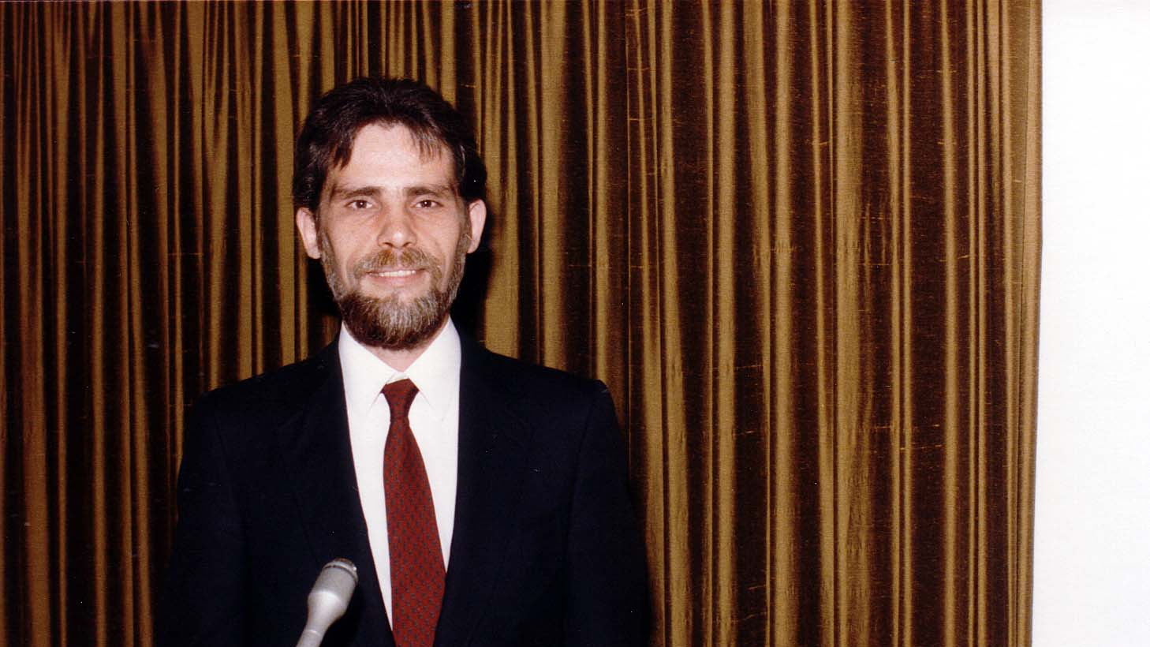
Notes:
TWG_Photo_1985_No_320__May_17__Friday_Evening_Forum__Holodomor_Researcher_Marko_Carynnyk
See 1985 May TWG NEWS for event announcement and 1985 June TWG NEWS, page 6, for event coverage

Slide 8
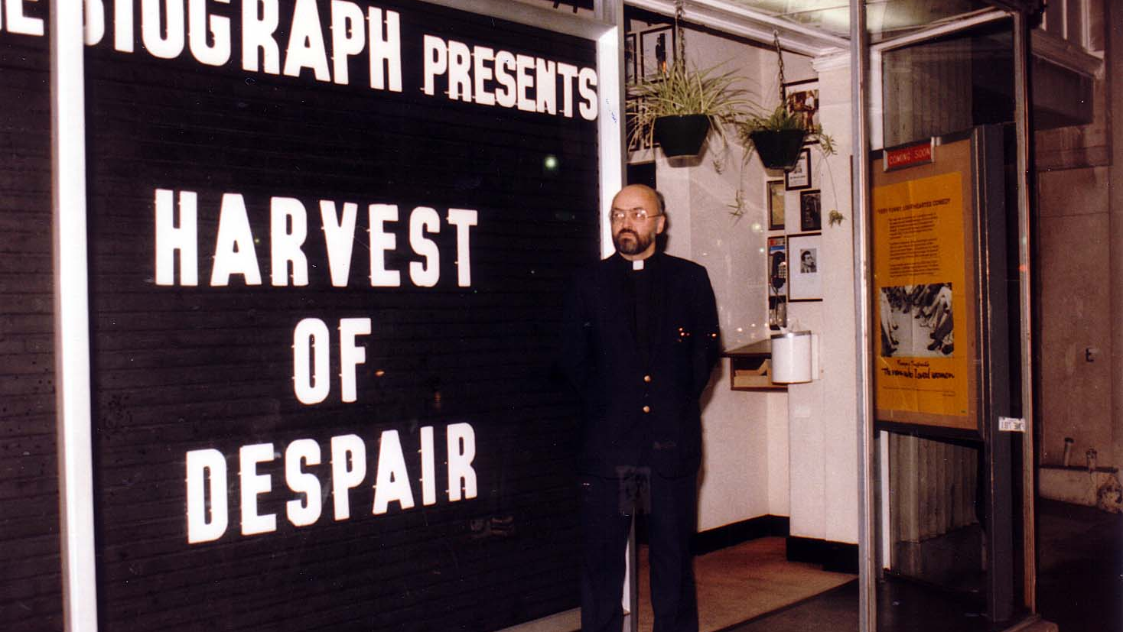
Notes:
TWG_Photo_1985_No_330__Nov_26__Film_Director_Producer_of_Film_Harvest_of_Despair_a_Documentary_on_Ukrainian_Famine_Slavko_Nowytski
See 1985 November TWG NEWS for event announcement and December 1985 TWG NEWS, page 12, for event coverage

Slide 9
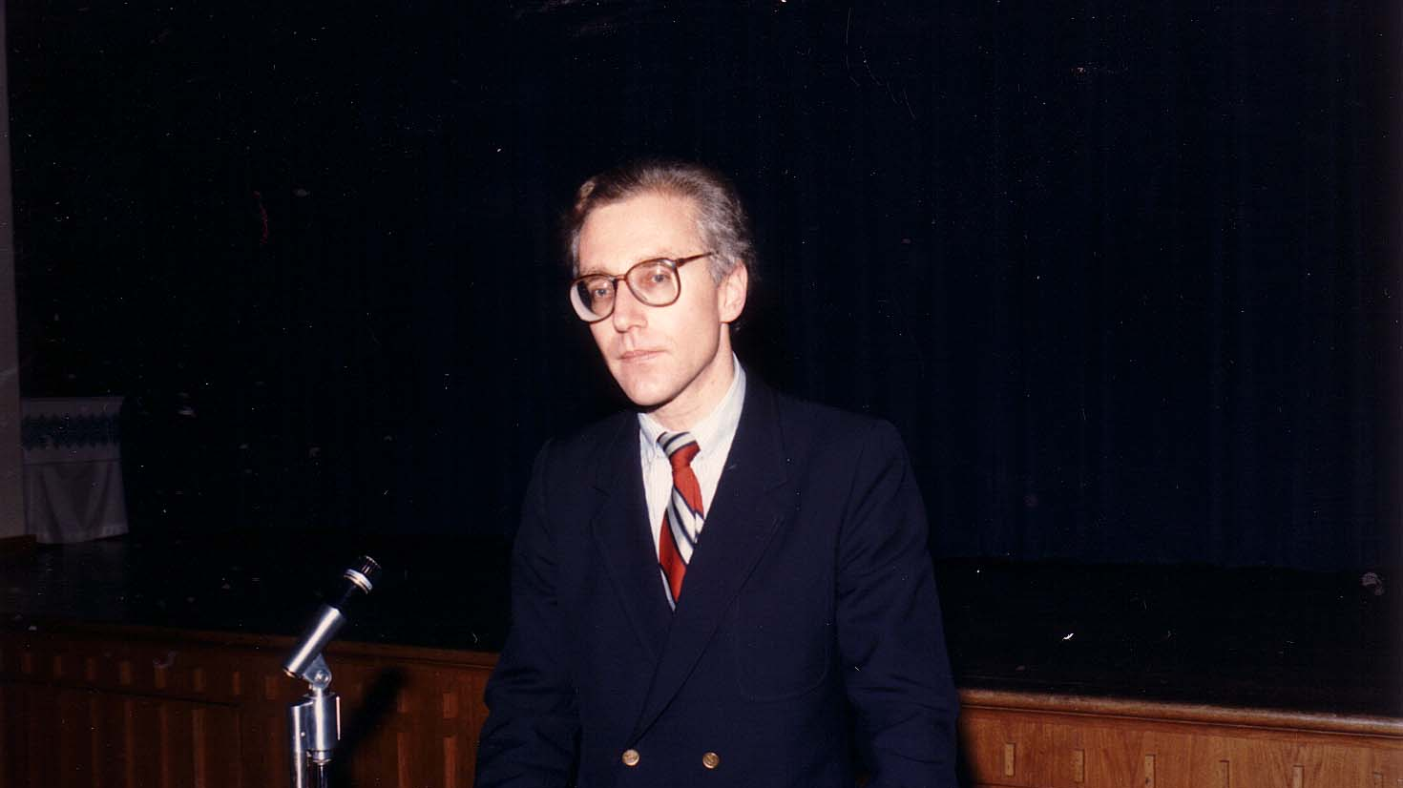
Notes:
TWG_Photo_1985_No_340__Dec_7__Holy_Family_Parish_Center__Andrew_Sorokowski__Religious_Freedom_in_Ukraine_Lecture
See 1985 December TWG NEWS for event announcement and January 1986 TWG NEWS, page 1, for event coverage

Slide 10
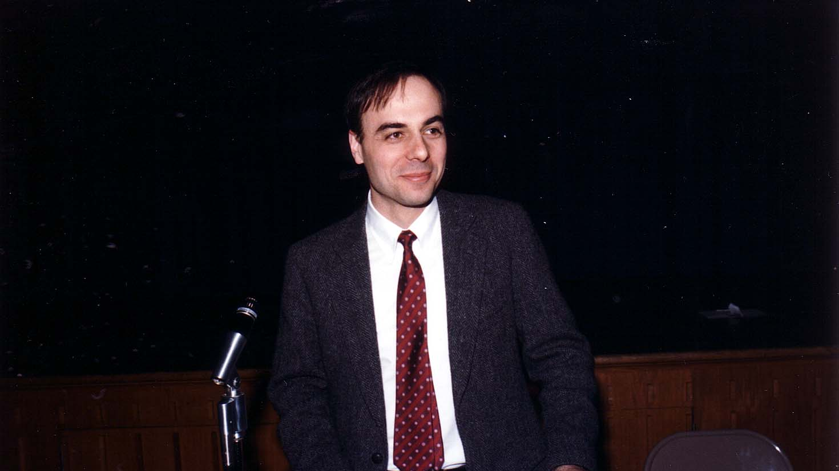
Notes:
TWG_Photo_1985_No_341__Dec_7__Ukrainian_Studies_Fund_Development_Specialist_Roman_Procyk_explains_the_Harvard_Project_to_Publicize_Millennium_of_Christianity_in_Ukraine
See 1985 December TWG NEWS for event announcement and January 1986 TWG NEWS, page 1, for event coverage

Slide 11
1985 400 TWG Co-sponsored Events Photographs
Ukrainian-American Army Officers Ukrainian Independence Day Celebration
TWG UABA Gala

Slide 12
1985 410 TWG Co-sponsor of Ukrainian-American Army Officers Ukrainian Independence Day Celebration Fort Myer Officers’ Club January 31 Photographs
Roman Andrychyk, Orest Hawryluk, Yaromyr Koropecky, Yurko Kowch, Orest Kaczmarskyj, Bohdan Dombchewskyj, Ihor Procinsky, Jurij Petrenko, Leonid Kondratiuk, Yaromyr Oryshkevych, Hlib Taran, Taras Masnyk, (unnamed) Military physician
Natalie Sluzar, Michael Yarymovych, Vera Garber, Vitalij Garber

Slide 13
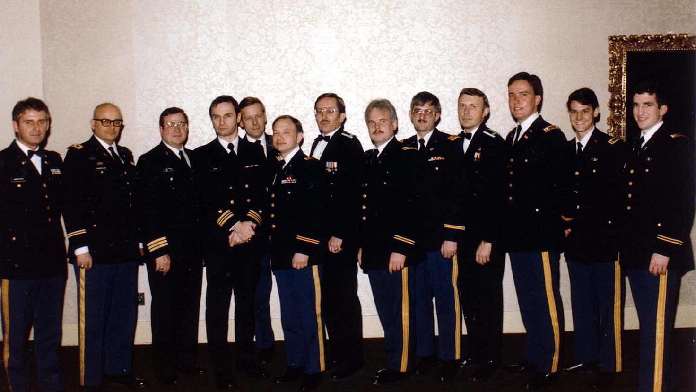
TWG_Photo_1985_No_411_Jan_31_Ukr_Independ_Roman_Andrychyk_Orest_Hawryluk_Yaromyr_Koropecky_(_Can_)_Yurko_Kowch_Orest_Kaczmarskyj_Bohdan_Dombchewskyj_Ihor_Procinsky_Jurij_Petrenko_Leonid_Kondratiuk_Yaromyr_Oryshkevych_Hlib_Taran_Taras_Maskyk_Mil_Phys
Notes:
TWG_Photo_1985_No_411_Jan_31_Ukrainian_Independence_Roman_Andrychyk_Orest_Hawryluk_Yaromyr_Koropecky_(_Can_)_Yurko_Kowch_Orest_Kaczmarskyj_Bohdan_Dombchewskyj_Ihor_Procinsky_Jurij_Petrenko_Leonid_Kondratiuk_Yaromyr_Oryshkevych_Hlib_Taran_Taras_Masnyk_NN-(Military_Physician)
See 1984 November TWG NEWS for event announcement and The Ukrainian Weekly 1985-06 for event coverage

Slide 14
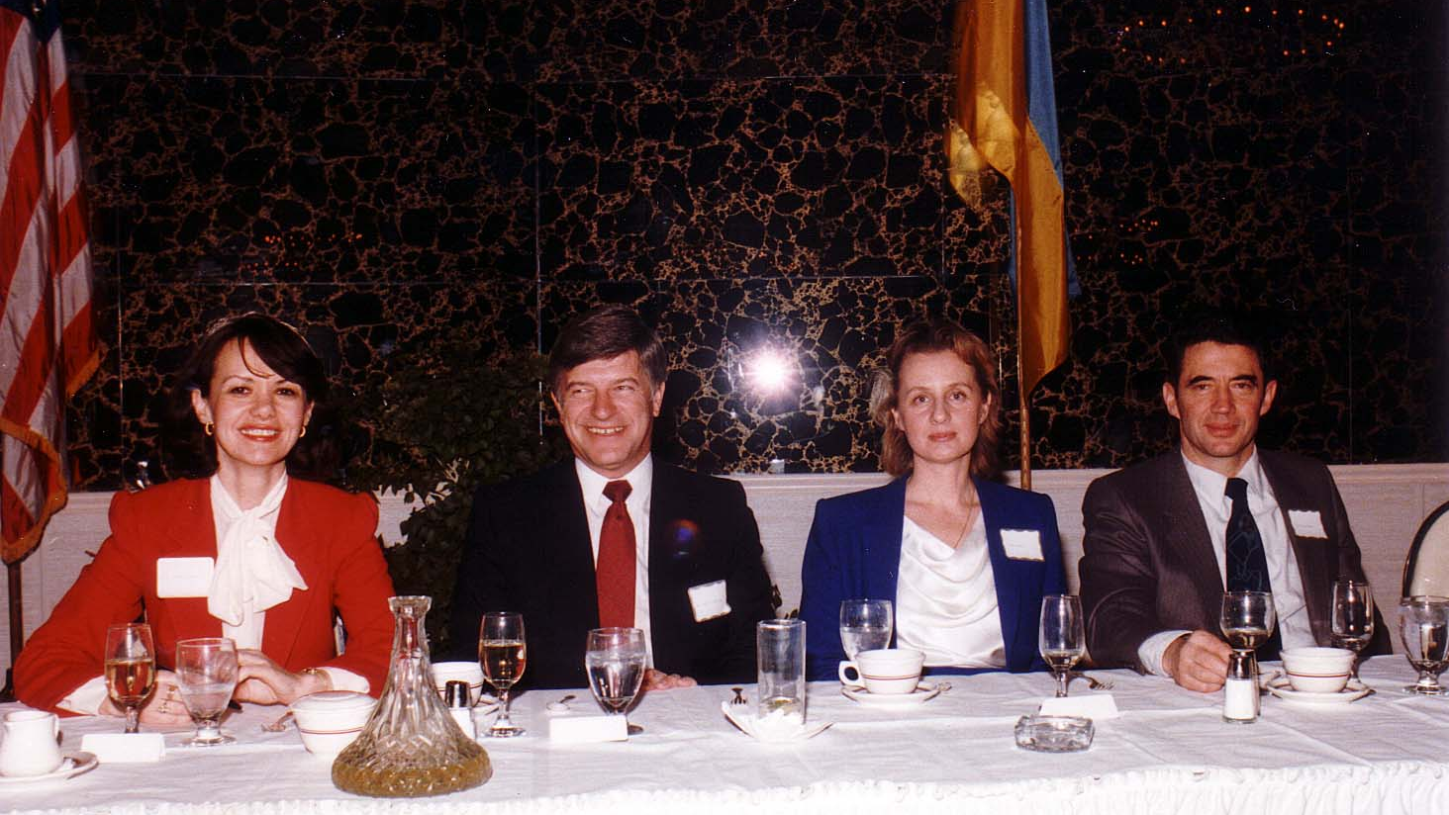
Notes:
TWG_Photo_1985_No_412__Jan_31__Ukrainian_Independence_Day__TWG_President_Natalie_Sluzar__Former_Director_of_NATO_Research_and_Technology_Org_Michael_Yarymovych__Dr_Vera_Garber__Former_Assistant_Secrerary_General_at_NATO_for_Defense_Support_Vitalij_Garber
See 1984 November TWG NEWS for event announcement and The Ukrainian Weekly 1985-06 for event coverage

Slide 15
1985 430 TWG UABA Gala/Banquet Capital Hilton October 19 Photographs
William Bradford Reynolds

Slide 16
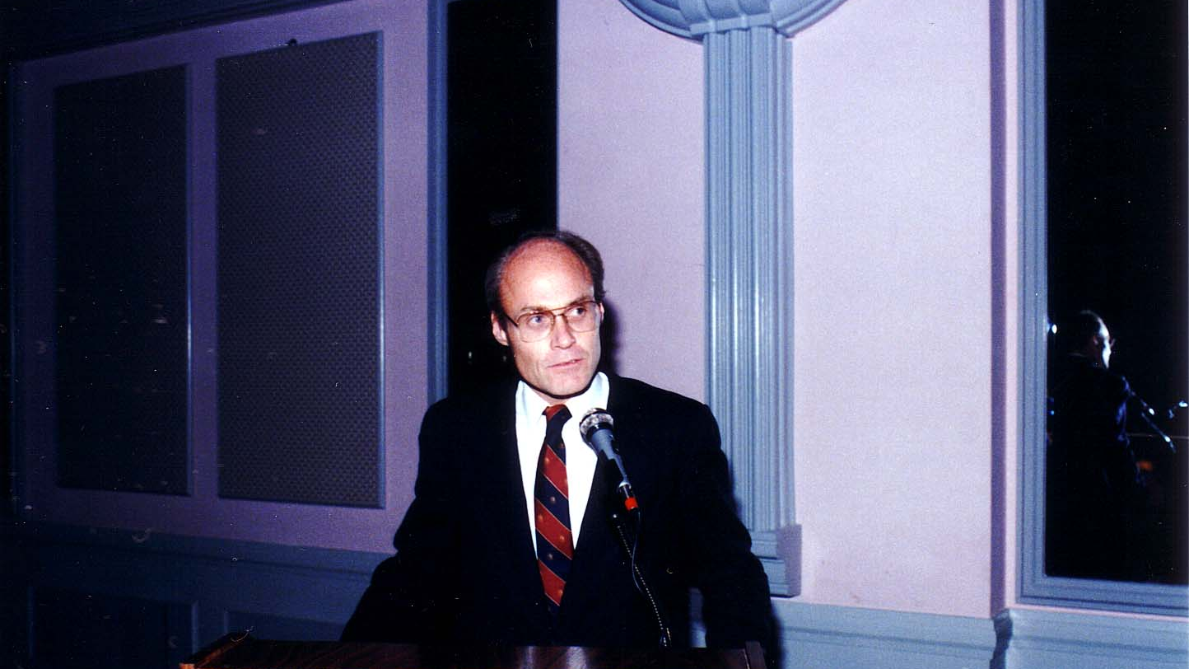
Notes:
TWG_Photo_1985_No_431__October_19__Capital_Hilton__TWG_UABA_Gala___Assistant_Attorney_General_William_Bradford_Reynolds
See 1985 October TWG NEWS for Event Announcement and November TWG NEWS for Event Coverage

