Slide 1
TWG Photos 1986
Created October 24, 2020

Slide 2
1986 100 TWG Annual Meeting DuPont Plaza Hotel September 26
Please See 1986 September TWG NEWS for Annual Meeting Planning and 1986 October TWG NEWS for Annual Meeting Coverage. Elected to the Board:
Daria Stec – President; Rostyk Chomiak – Vice-President; Darian Diachok – Secretary; George Hnatiw – Treasurer; Al Kapusta - Public relations; Halyna Breslawec – Membership Director; Marta Pereyma – Special Projects; Julia Tereshchuk – Events Director
Auditing Committee: Natalie Sluzar, Ihor Vitkovitsky, Andrew Rylyk

Slide 3
1986 200 TWG Leadership Conference at Capital Hilton October 17-19 Photographs
See 1986 July, August, September, October TWG NEWS for Leadership Conference Planning
See TWG_1986_Leadership_Conference_Booklet for Leadership Conference Program and Speaker Biographies
See 1986 November TWG NEWS for Leadership Conference Coverage
See The Ukrainian Weekly coverage of the Leadership Conference: The_Ukrainian_Weekly_1986-43

Slide 4
1986 201 TWG Leadership Conference Opening Reception McLean Gardens WDC October 17 Photographs
TWG Birthday Party:
Natalie Sluzar, Daria Stec
Valentina Limonczenko, Roman Ferencevych, Marta Pereyma

Slide 5
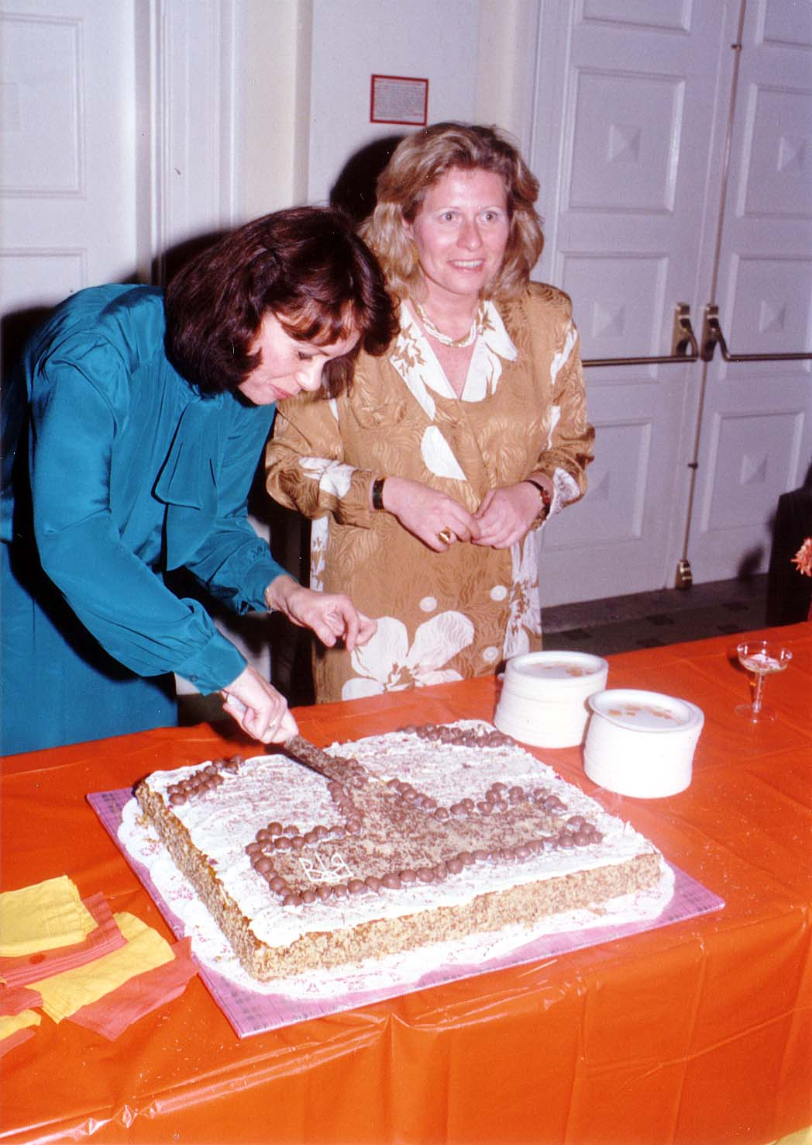
Notes:
TWG_Photo_1986_No_202__Oct_17__Leadership_Conference_TWG_Birthday_Party__McLean_Gardens_WDC__First_TWG_President_Natalie_Sluzar_and_TWG_President_Daria_Stec__Cake_Cutting
See 1986 October TWG NEWS, page 4, for TWG Birthday Party announcement

Slide 6
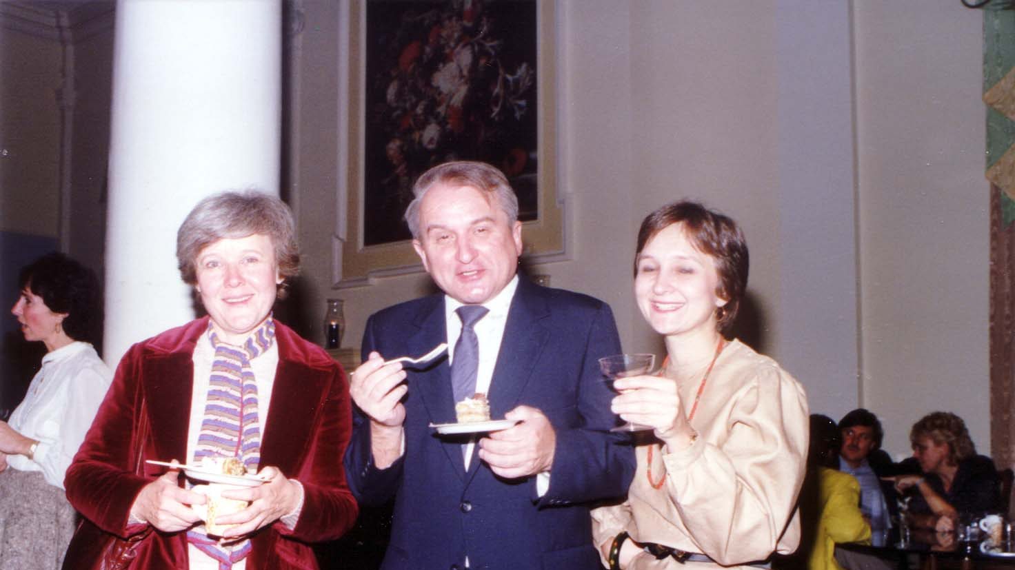
Notes:
TWG_Photo_1986_No_203__Oct_17__Leadership_Conference_TWG_Birthday_Party__McLean_Gardens_WDC__US_Information_Agency_Valentina_Limonczenko__Voice_of_America_Roman_Ferencevych__US_Information_Agency_Marta_Pereyma
See 1986 October TWG NEWS, page 4, for TWG Birthday Party announcement

Slide 7
1986 210 TWG Leadership Conference Opening Addresses October 18 Photographs
Michael Novak

Slide 8
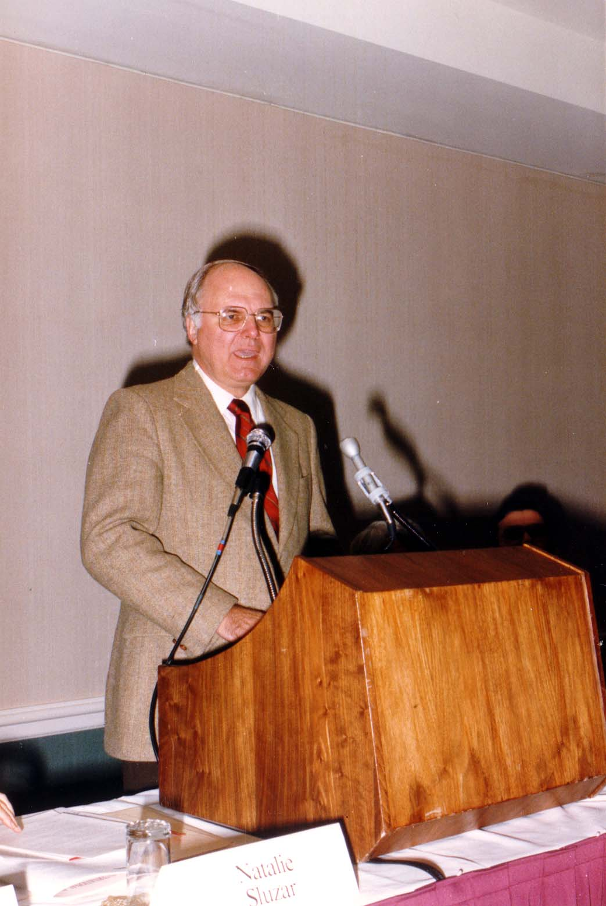
Notes:
TWG_Photo_1986_No_210__Oct_18__Leadership_Conference_Opening_Session_Speaker__American_Author_and_Theologian_Michael_Novak
See 1986 November TWG NEWS, page 12, for an excerpt from this speech

Slide 9
1986 220 TWG Leadership Conference Luncheon October 18 Photographs
Zbigniew Brzezinski

Slide 10
Notes:
TWG_Photo_1986_No_221__Oct_18__Leadership_Conference_Luncheon_Speaker_delivering_the_Keynote_Address__President_Carter's_National_Security_Advisor_Zbigniew_Brzezinski
See 1986 November TWG NEWS, page 1, for extensive coverage of this speech

Slide 11
1986 300 TWG Events Photographs
Discography: Dick Spottswood, Stefan Maksymjuk
Cultural Exchanges: Marta Bohachevsky-Chomiak
Genealogy: Alvin Kapusta
Holodomor Research: Jim Mace
Diplomacy: William Courtney, Pat Filipov, Krul, Orysia Lonchyna
Art: Orest Poliszczuk
Chornobyl Research: David Marples, Daria Stec, Marta Pereyma
Cultural Exchanges: Ross Chomiak, William Courtney, Marta Pereyma, Zenon Kohut

Slide 12
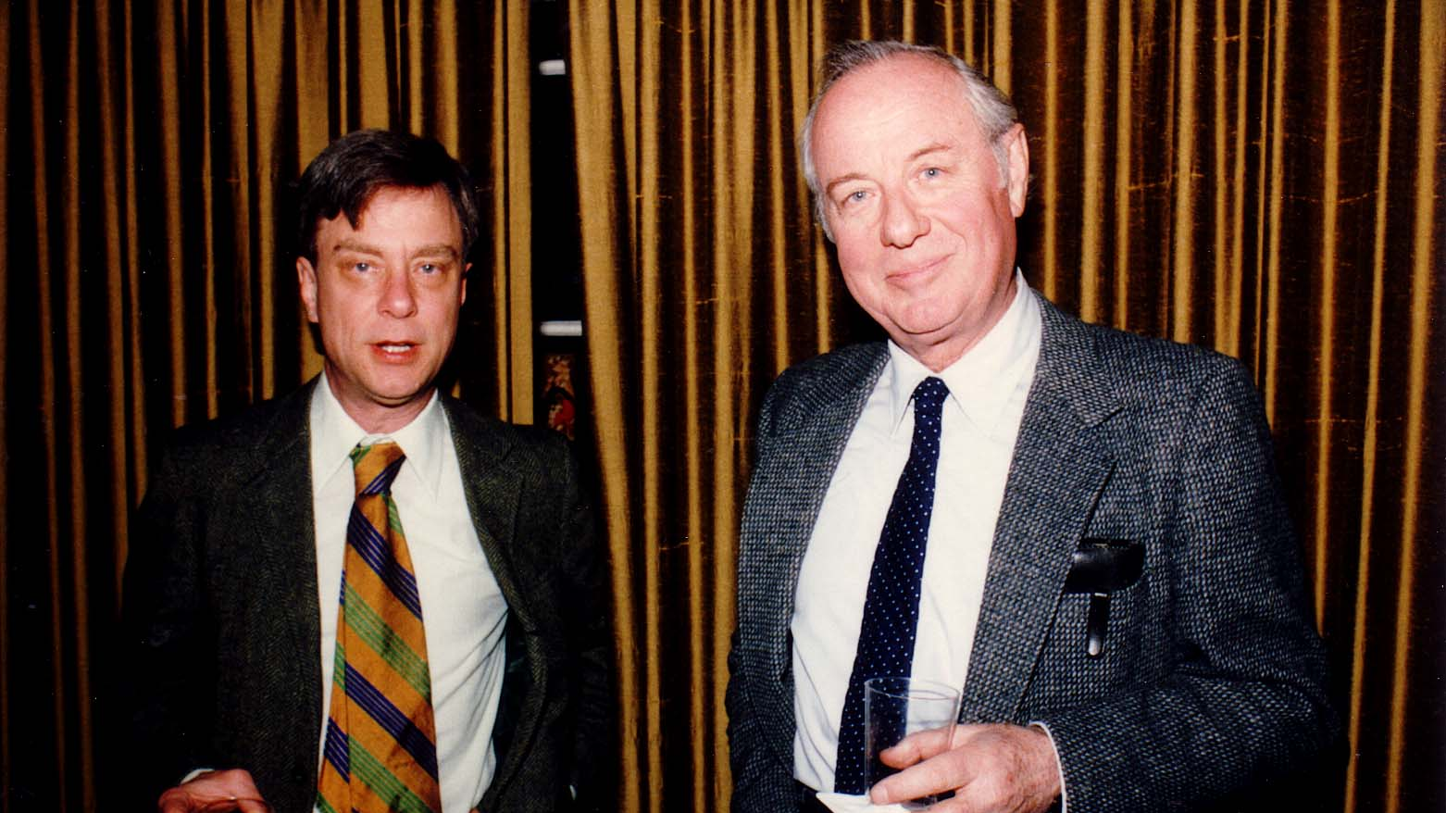
Notes:
TWG_Photo_1986_No_310__Jan_24__St_Sophia_Religious_Association__TWG_Friday_Evening_Forum__Discographers_Dick_Spottswood_and_Stefan_Maksymjuk
See 1986 January TWG NEWS for event announcement and March 1986 TWG NEWS, page 5 and page 10, for event coverage

Slide 13
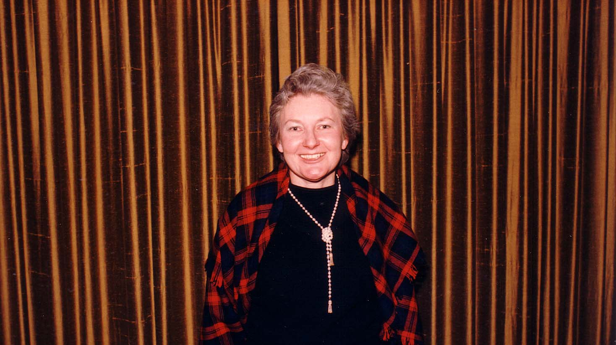
Notes:
TWG_Photo_1986_No_312__Feb_21_St_Sophia_Religious_Association__Historian_Marta_Bohachevsky-Chomiak_speaking_on_Ukraine_US_Cultural_Exchanges
See 1986 February TWG NEWS for event announcement and March TWG NEWS, page 3, for event coverage

Slide 14
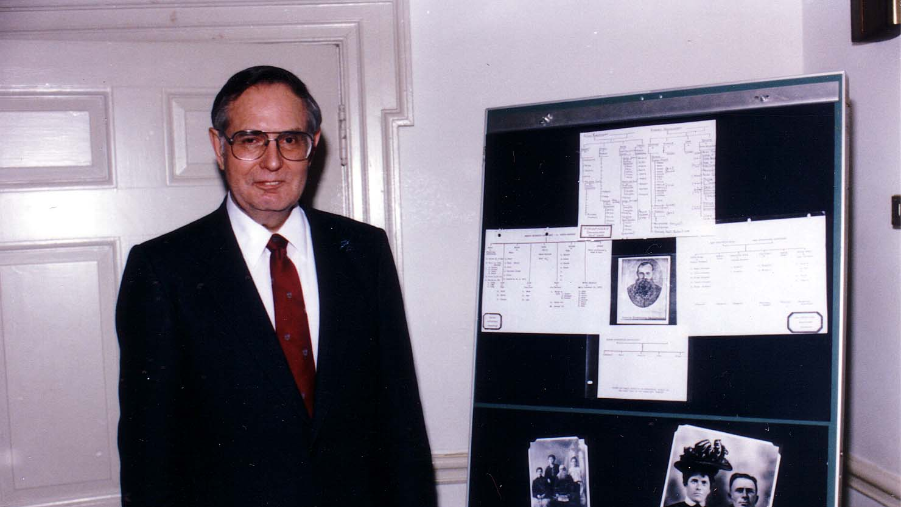
Notes:
TWG_Photo_1986_No_315__Mar_14__St_Sophia_Religious_Association__Friday_Evening_Forum__Soviet_Nationalities_Specialist_and_TWG_Advisor_Alvin_Kapusta
See 1986 March TWG NEWS for event announcement and June TWG NEWS, page 10, for event coverage

Slide 15
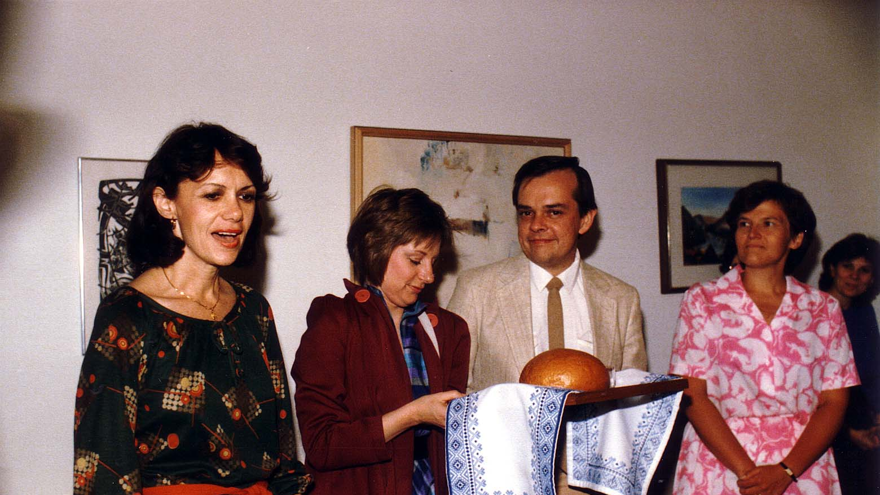
Notes:
TWG_Photo_1986_No_320__April_18__St_Sophia_Religious_Association__Welcome_to_DC__TWG_President_Natalie_Sluzar__Gloria_y'Edynak__Executive_Director_Ukrainian_Famine_Commission_Jim_Mace__Patricia_Filipov__Marta_Mostovych
See 1986 April TWG NEWS for event announcement and May TWG NEWS, page 9, for event coverage

Slide 16
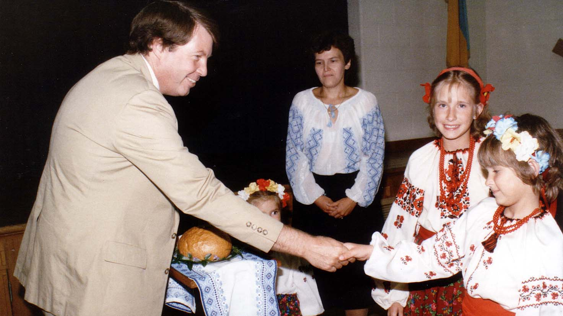
Notes:
TWG_Photo_1986_No_325__May_8__Holy_Family_Parish_Center__Welcome_for_Consul_General_Designate_William_Courtney__Pat_Filipov__NN__Ksenia_or_Marichka_Krul__Orysia_Lonchyna
See 1986 May TWG NEWS, page 1, for interview, and page 11 for event announcement, and June TWG NEWS, page 3, for event coverage

Slide 17
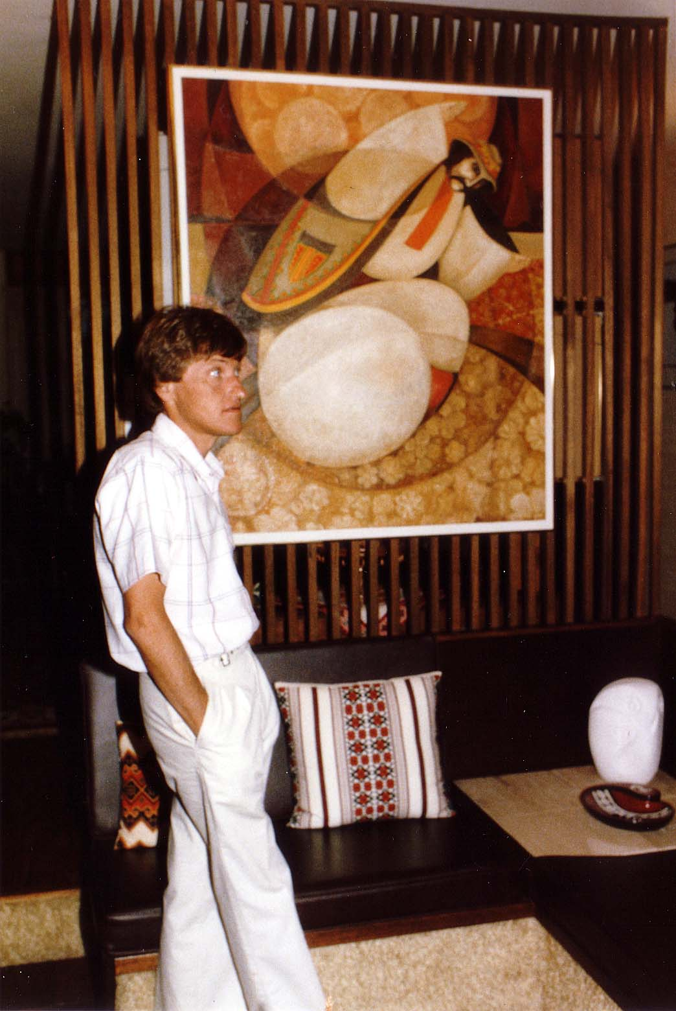
Notes:
TWG_Photo_1986_No_330__July_19__TWG_Afternoon_at_an_Artist's_Studio__Artist_Orest_Poliszczuk
See 1986 July TWG NEWS for event announcement and August TWG NEWS, page 5, for event coverage

Slide 18
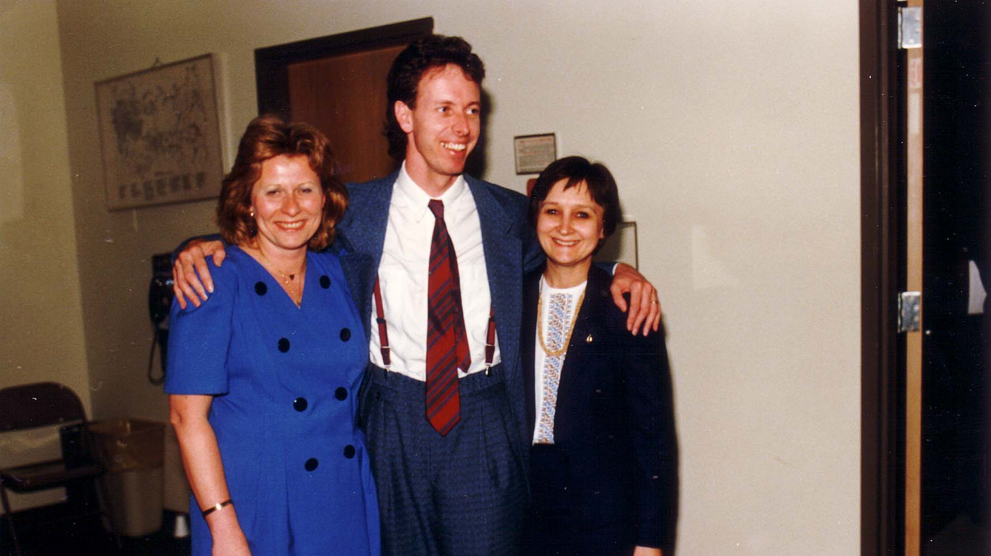
Notes:
TWG_Photo_1986_No_335__Dec_10__St_Sophia_Religious_Association__TWG_President_Daria_Stec__Research_Associate_at_Canadian_Institute_of_Ukrainian_Studies_at_University_of_Alberta_David_Marples__Marta_Pereyma
See 1986 November TWG NEWS for event announcement, December TWG NEWS for Marples’s book promotion, and January 1987 TWG NEWS, page 1, for event coverage

Slide 19
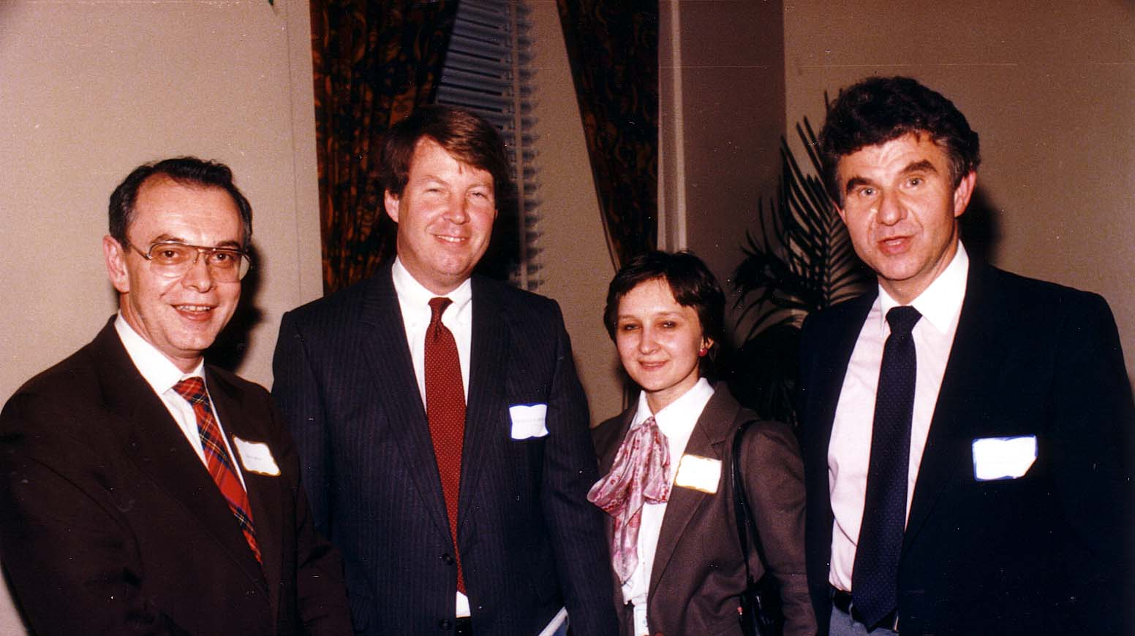
Notes:
TWG_Photo_1986_No_340__Dec_11__State_Department_US_Information_Agency_Press_Service_Africa_Ross_Chomiak__Consul_General_Designate_William_Courtney__US_Information_Agency_Cultural_Exchange_Marta_Pereyma__Historian_Zenon_Kohut
See 1987 January TWG NEWS, page 1, for event coverage

Slide 20
1986 400 TWG Co-sponsored or Related Events Photographs
Ukrainian Independence Day Celebration

Slide 21
1986 410 TWG Co-sponsor of Ukrainian-American Army Officers Ukrainian Independence Day Celebration Fort McNair January 22 Photographs
Yaromyr Koropecky, Hlib Taran, Military Physician, Jurij Petrenko, Leonid Kondratiuk, Bohdan Dombchewskyj, Ihor Procinsky, Yaromyr Oryshkevych, Dr Novosivskyj, Orest Hawryluk
Fred Ickles

Slide 22
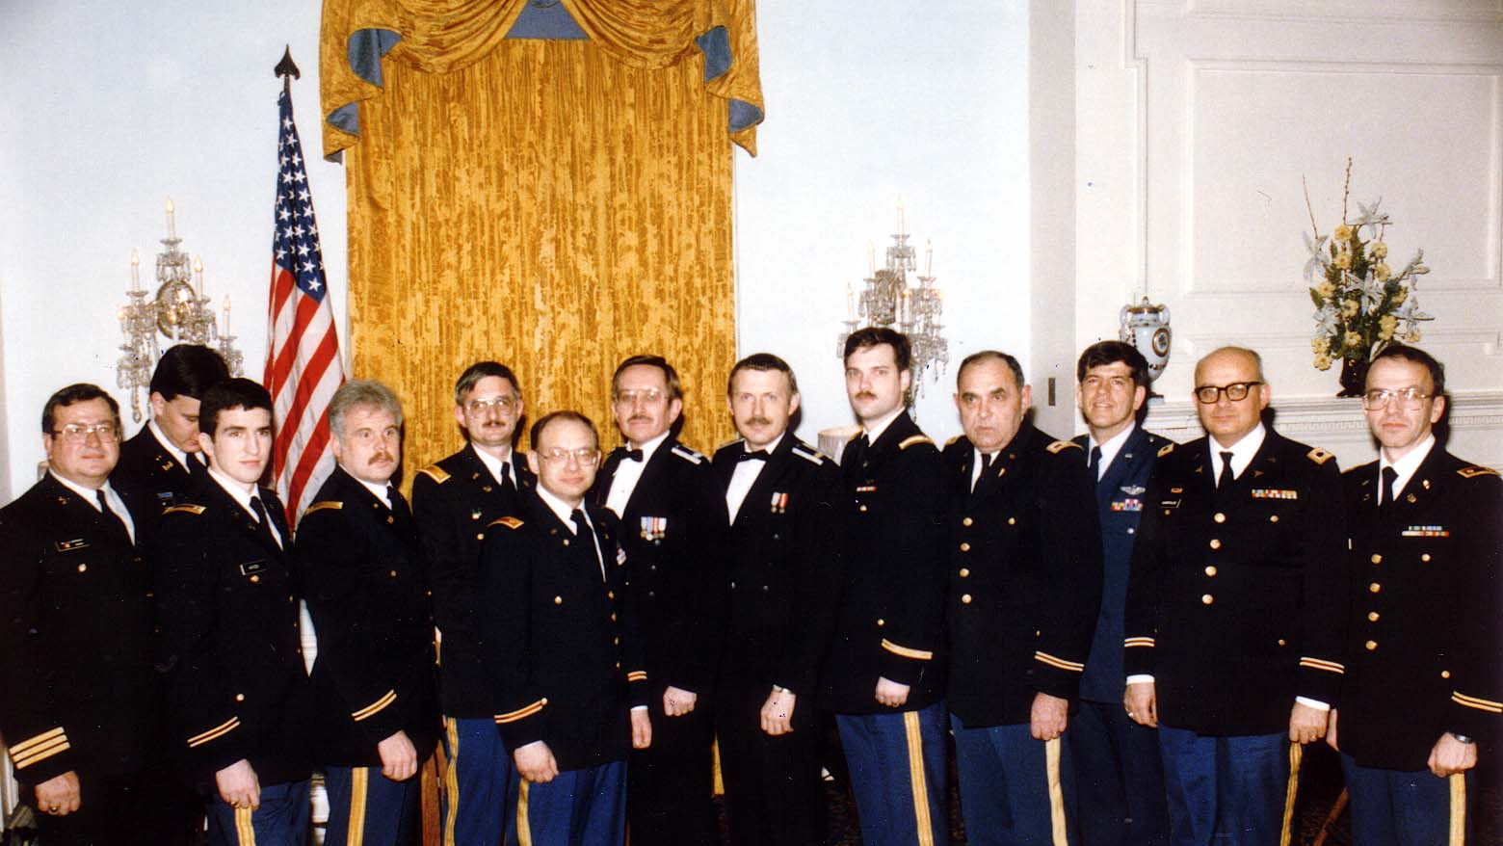
Notes:
TWG_Photo_1986_No_411_Jan_22__Ukr_Independence_Day__Yaromyr_Koropecky_(_Can_)__Hlib_Taran__Mil_Phys__Jurij_Petrenko__Leonid_Kondratiuk__Bohdan_Dombchewskyj__Ihor_Procinsky__Yaromyr_Oryshkevych_NN_Dr_Novosivskyj_NN_Orest_Hawryluk_NN
See 1985 December TWG NEWS for Event announcement and 1986 February TWG NEWS, page 1, for Event Coverage

Slide 23
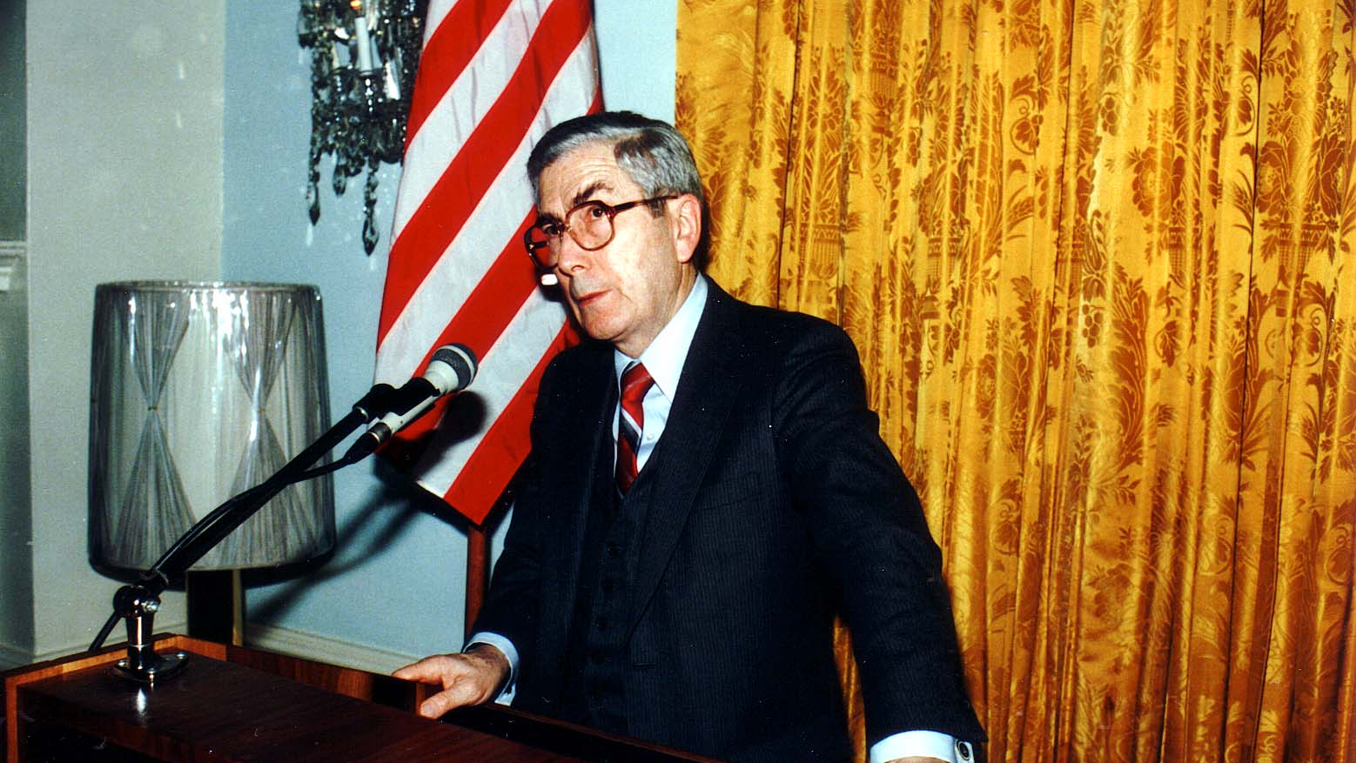
Notes:
TWG_Photo_1986_No_412__Jan_22__Ft_McNair_Officers'_Club__Ukrainian_Independence_Day__Keynote_Speaker_Under_Secretary_of_Defense_for_Policy__Fred_Ickles
See 1985 December TWG NEWS for Event announcement and 1986 February TWG NEWS, page 1, for Event Coverage

Slide 24
1986 600 TWG Social Events Photographs
Blobs Park: Halyna Breslawec Levine, Arthur Levine, Maria Rudensky, Diane Pabst, Pat Filipov, Andrew Hruszkewycz, Christine Hruszkewycz, Mike Hoobchaak, Oksana Hoobchaak, Nila Zynjuk Iwaskiw, Peter Fedynsky, Maksym Wasyluk, Daria Stec, Andree Filipov
Christmas Party: George Hnatiw, Ross Chomiak, TWG President Daria Stec, George Masiuk, Natalie Sluzar, Darian Diachok, Marta Pereyma, Julia Tereshchuk Romaniuk, Maria Rudensky

Slide 25
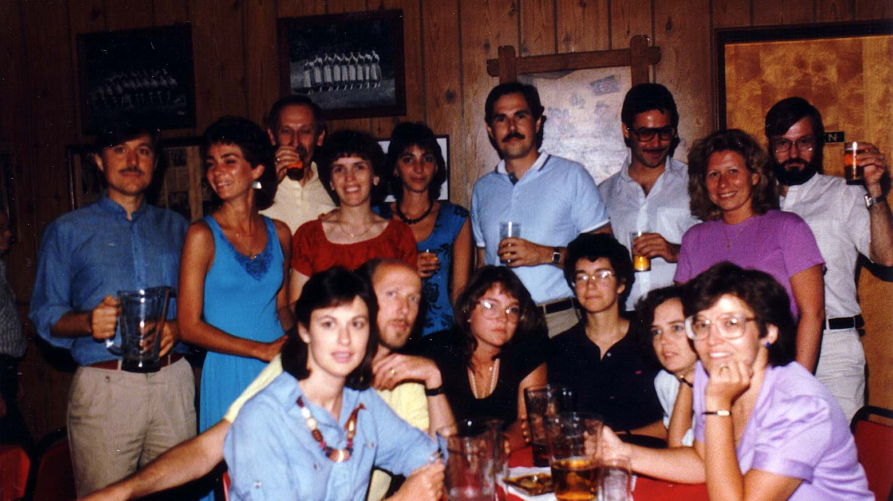
Notes:
TWG_Photo_1986_No_610_July_19__Blobs_Park__Halyna_Breslawec_Levine__Arthur_Levine__NN__Maria_Rudensky__Diane_Pabst__Pat_Filipov__Andrew&Christine_Hruszkewycz__Mike&Oksana_Hoobchaak__Nila_Zynjuk_Iwaskiw__Peter_Fedynsky__Maksym_Wasyluk__Daria_Stec__Andree_Filipov
See 1986 July TWG NEWS for event announcement

Slide 26
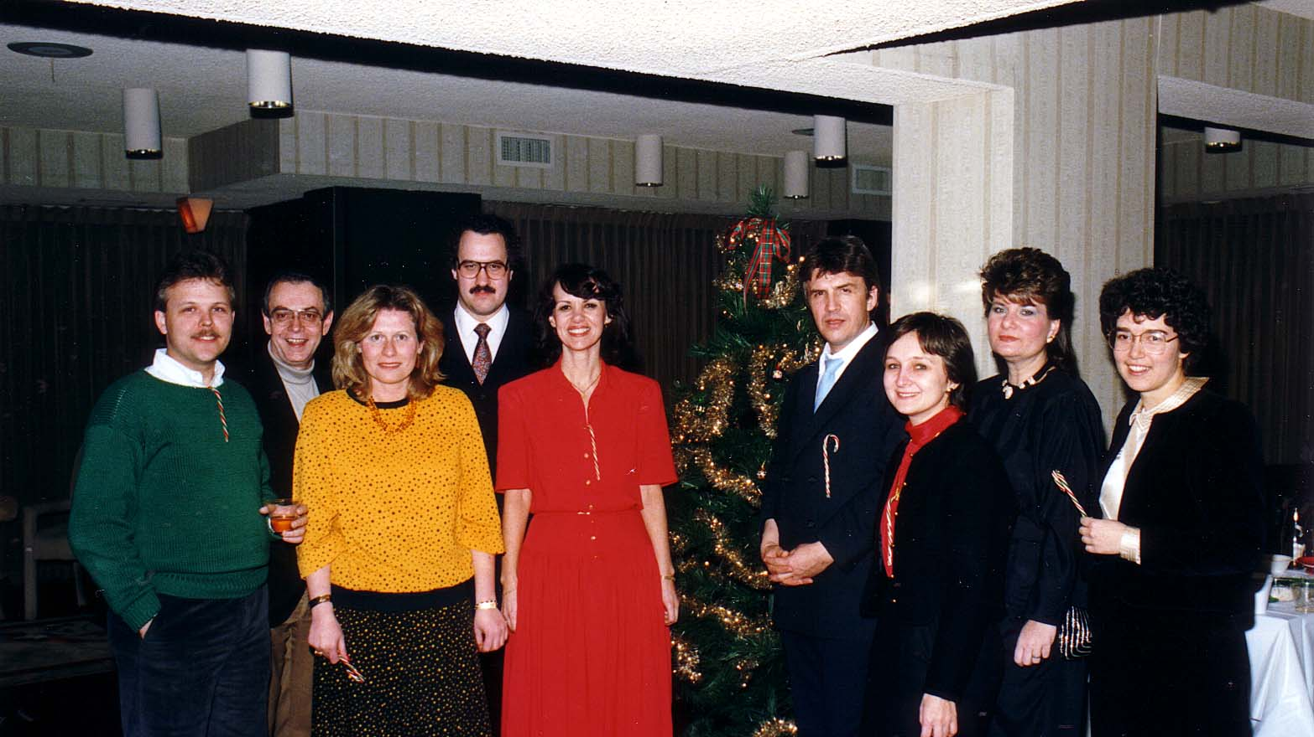
Notes:
TWG_Photo_1986_No_621__Dec_13__Van_Ness_East__Christmas_Party__George_Hnatiw__Ross_Chomiak__TWG_President_Daria_Stec__George_Masiuk__Natalie_Sluzar__Darian_Diachok__Marta_Pereyma__Julia_Tereshchuk_Romaniuk__Maria_Rudensky
See 1986 December TWG News for event announcement and 1987 January TWG NEWS, page 3, for event coverage

