Slide 1
TWG Photos 1987
Created October 24, 2020

Slide 2
1987 100 TWG Annual Meeting Washington Marriott Hotel September 25 Photographs
See 1987 May TWG News for coverage of the April 10 TWG semi-annual meeting
See 1987 July-August TWG NEWS, page 3, and September TWG NEWS, page 1, for Annual Meeting Announcement and October TWG NEWS for Annual Meeting coverage.
Elected to the Board: Daria Stec – President; R.L. Chomiak – Vice President; Helen Chaikovsky - Secretary; Julia Tereshchuk – Treasurer; Mark Bilowus – Events Director; Lydia Chopivsky - Public Relations; Andrew Rylyk – Membership Director; Marta Pereyma - Special Projects
Auditing Committee: Jurij Dobczansky, Larissa Fontana, Natalie Sluzar
Nominating Committee: Adrian Kerod, Anna Worobij, Christine Zinjuk
Others in photos: Viktor Maykowsky, Bohdan Dombchewskyj

Slide 3
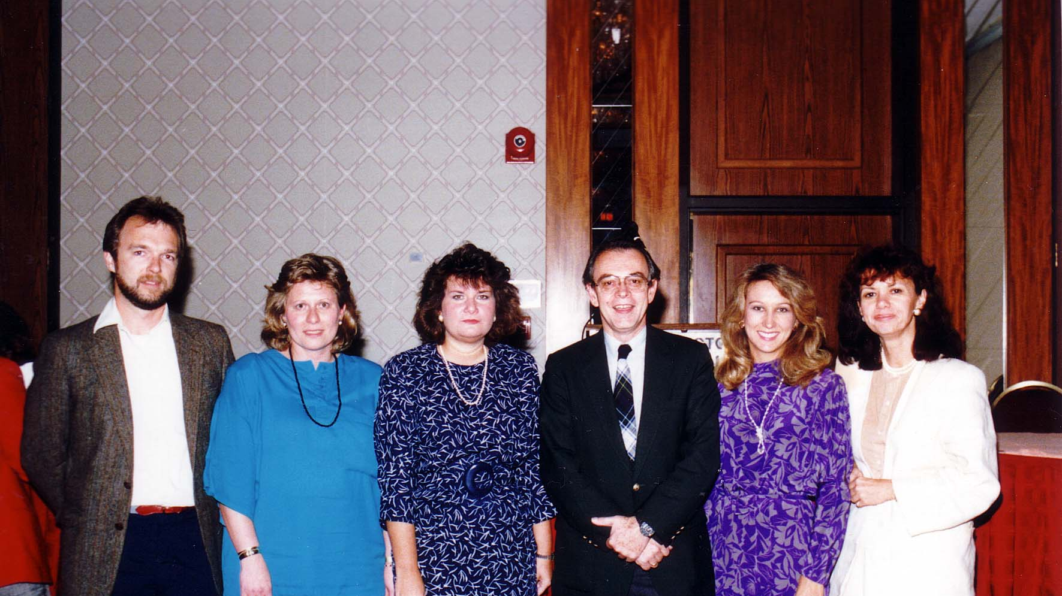
Notes:
TWG_Photo_1987_No_101__Sep_25__Board_of_Directors__Auditing_Committee_Jurij_Dobczansky__TWG_President_Daria_Stec__TWG_Treasurer_Julia_Tereshchuk_Romaniuk__TWG_VP_Ross_Chomiak__TWG_PR_Lydia_Chopivsky__TWG_First_President_Natalie_Sluzar
See 1987 July-August TWG NEWS, page 3, and September TWG NEWS, page 1, for Meeting Announcement and October TWG NEWS for Meeting coverage

Slide 4
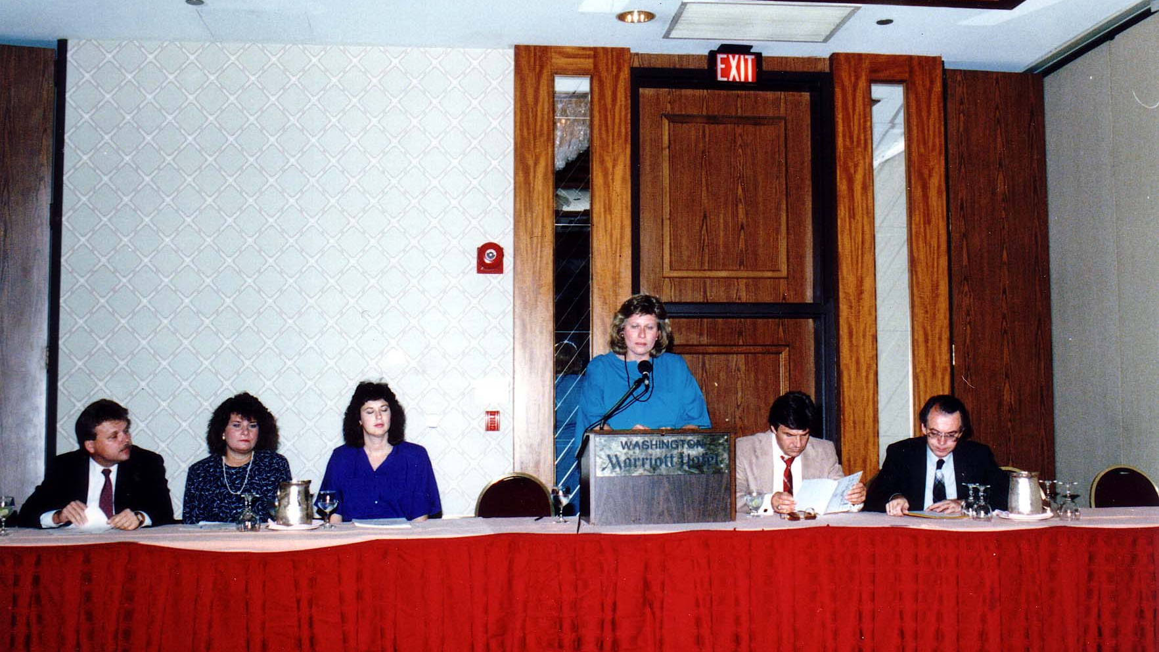
Notes:
TWG_Photo_1987_No_102__Sep_25__Annual_mtg__George_Hnatiw__Julia_Tereshchuk_Romaniuk__Halyna_Breslawec__TWG_President_Daria_Stec__Darian_Diachok__Ross_Chomiak
See 1987 July-August TWG NEWS, page 3, and September TWG NEWS, page 1, for Meeting Announcement and October TWG NEWS for Meeting coverage

Slide 5
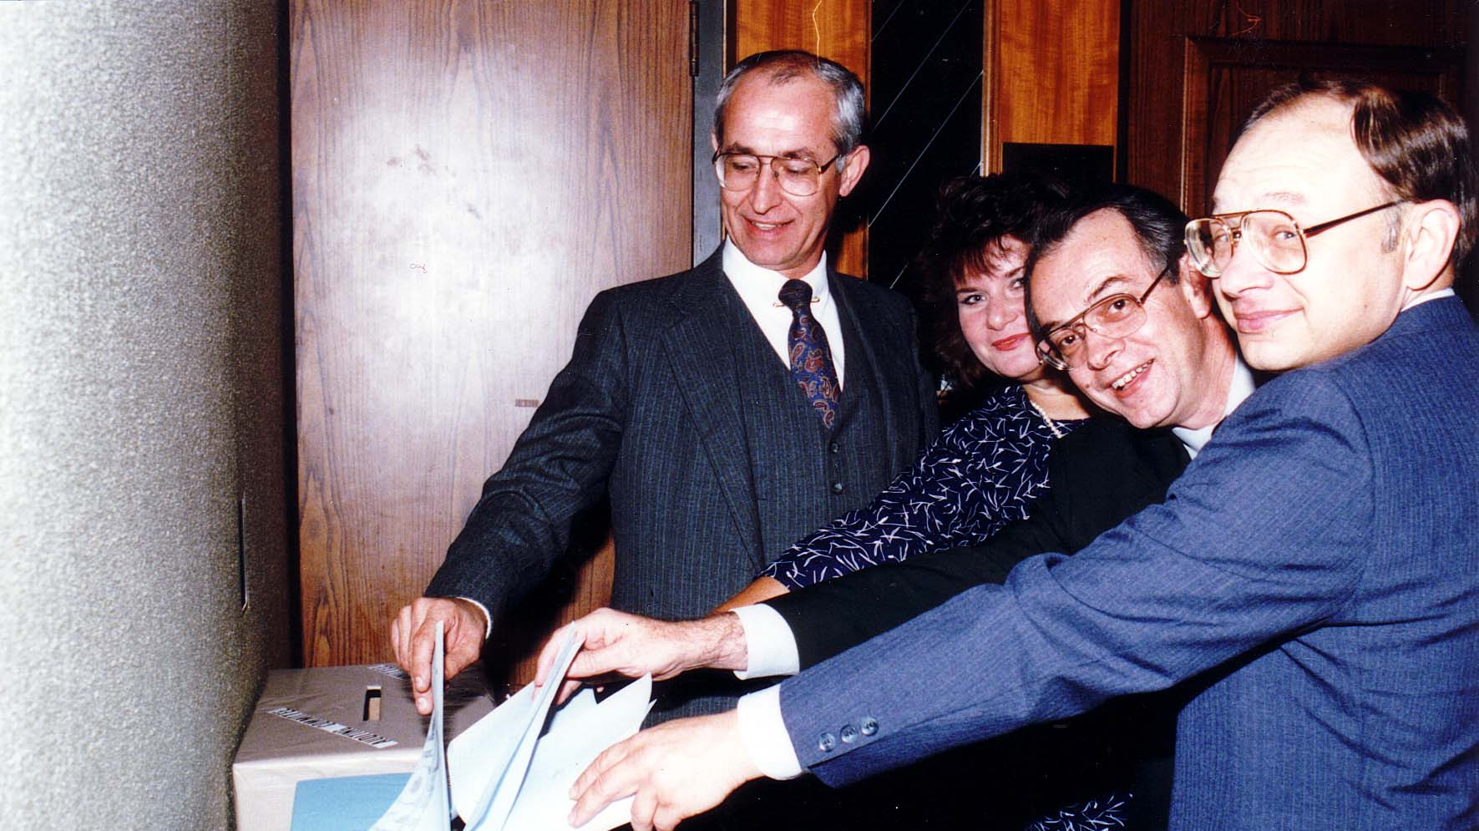
Notes:
TWG_Photo_1987_No_103__Sep_25__Annual_mtg__Voting__Viktor_Maykowsky__Julia_Tereshchuk_Romaniuk__Ross_Chomiak__Bohdan_Dombchewskyj
See 1987 July-August TWG NEWS, page 3, and September TWG NEWS, page 1, for Meeting Announcement and October TWG NEWS for Meeting coverage

Slide 6
1987 200 TWG Leadership Conference Mayflower Hotel October 9-11 Photographs
See Leadership Conference Announcement in 1987 May TWG NEWS
See Leadership Conference Planning in 1987 June, July-August, September, and October TWG NEWS
See TWG_1987_Leadership_Conference_Booklet for Conference Program and Speaker Biographies
See 1987 November TWG NEWS for Leadership Conference Coverage
See TWG Leadership Conference coverage by The Ukrainian Weekly: The_Ukrainian_Weekly_1987-42

Slide 7
1987 210 TWG Leadership Conference Opening Address October 10 Photographs
Victor Malarek

Slide 8
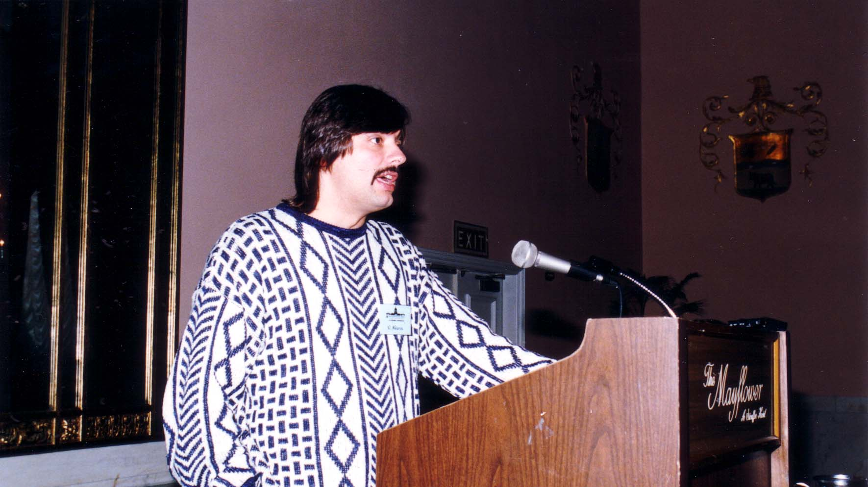
Notes:
TWG_Photo_1987_No_211_Oct__10__Leadership_Conference__Senior_Writer_for_Toronto_Globe_and_Mail_Victor_Malarek
See 1987 September TWG NEWS, page 1, for event announcement and November TWG NEWS, pages 4, 5,12 for event coverage

Slide 9
1987 220 TWG Leadership Conference Luncheon October 10 Photographs
Katia Chumachenko
Amb. Richard Schifter
Daria Stec

Slide 10
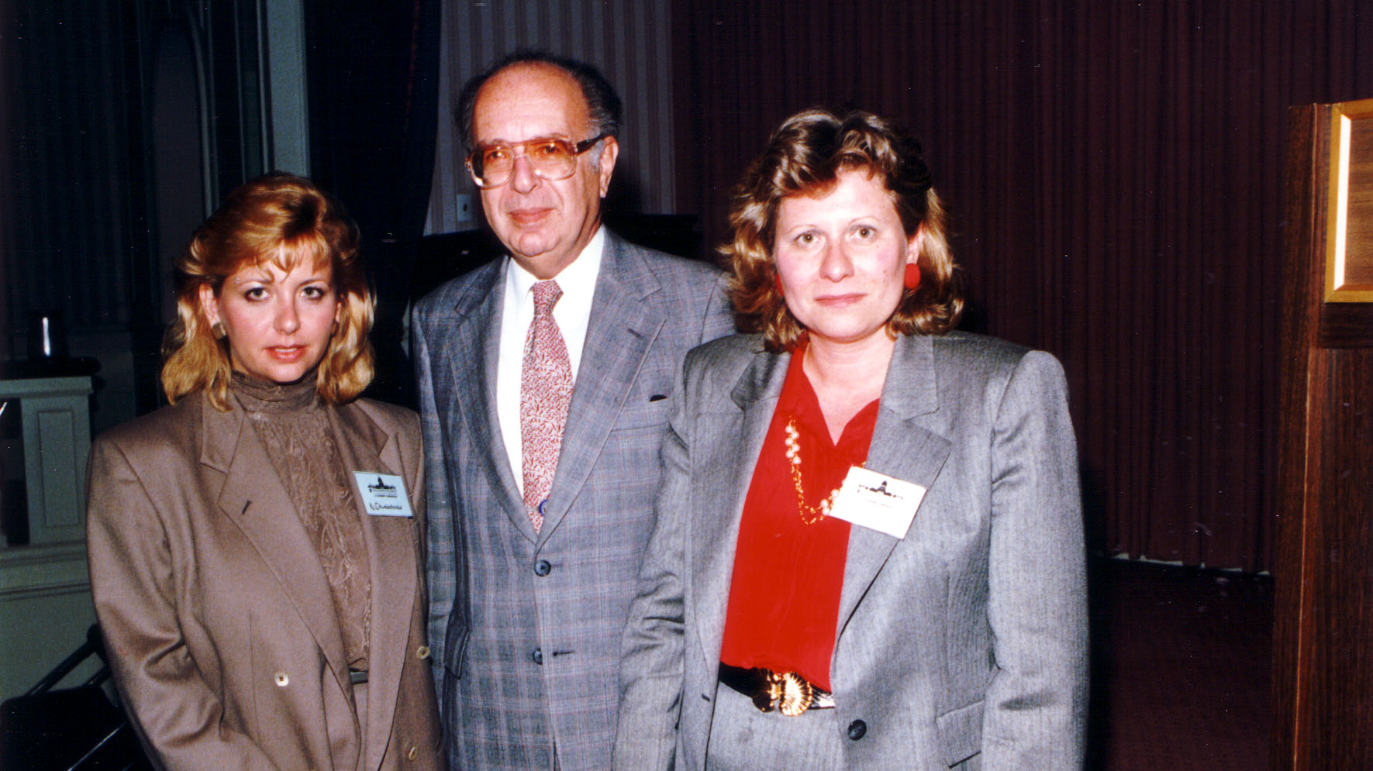
Notes:
TWG_Photo_1987_No_222__Oct_10__Leadership_Conference__Assistant_to_Amb_Schifter_Katia_Chumachenko__Luncheon_Speaker_Assisstant_Secretary_of_State_for_Human_Rights_Amb_Richard_Schifter__TWG_President_Daria_Stec
See 1987 October TWG News, page 1, for event announcement and November TWG NEWS, page 5, for event coverage

Slide 11
1987 230 TWG Leadership Conference TWG-UABA Gala October 10 Photographs
Ivan Shandor

Slide 12
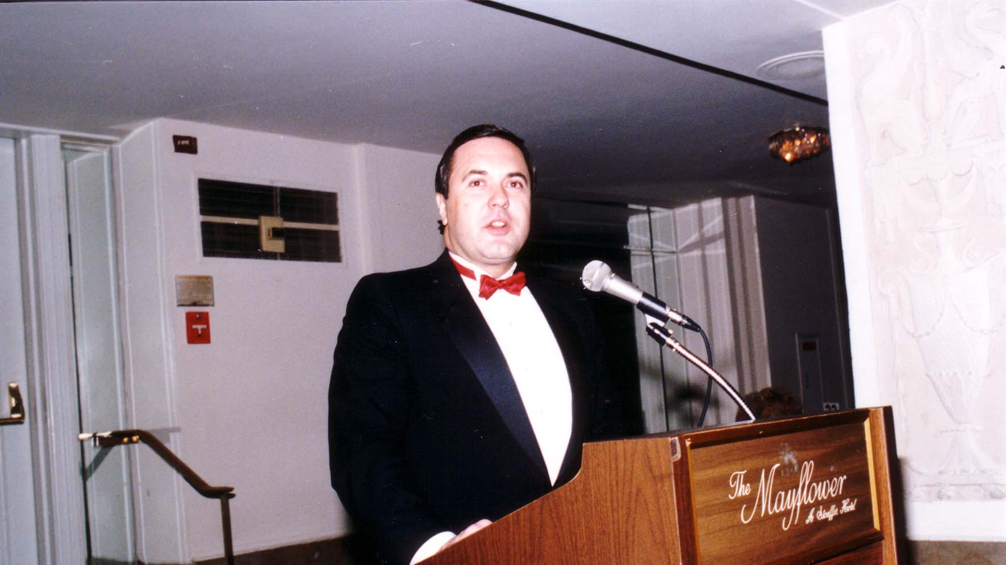
Notes:
TWG_Photo_1987_No_231__Oct_10__Leadership_Conference__TWG_UABA_Gala__UABA_Scholarship_Committee_Chairman_Attorney_Ivan_Shandor

Slide 13
1987 240 TWG Leadership Conference Panel Discussion: How Non-Ukrainians See Ukrainians October 10 Photographs
Orest Jejna
Patience Huntwork

Slide 14
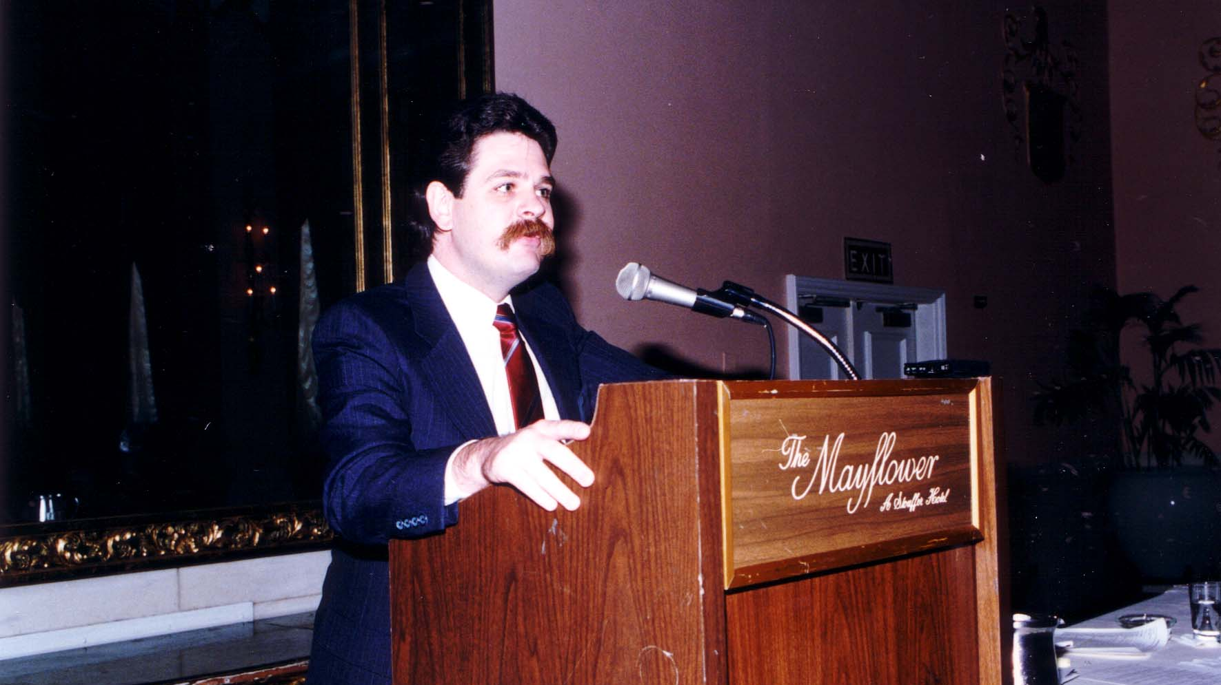
Notes:
TWG_Photo_1987_No_241__Oct_10__Leadership_Conference__Independent_Task_Force_on_ABA_Soviet_Relations_Attorney_Orest_Jejna
See 1987 November TWG NEWS, page 4, 5

Slide 15
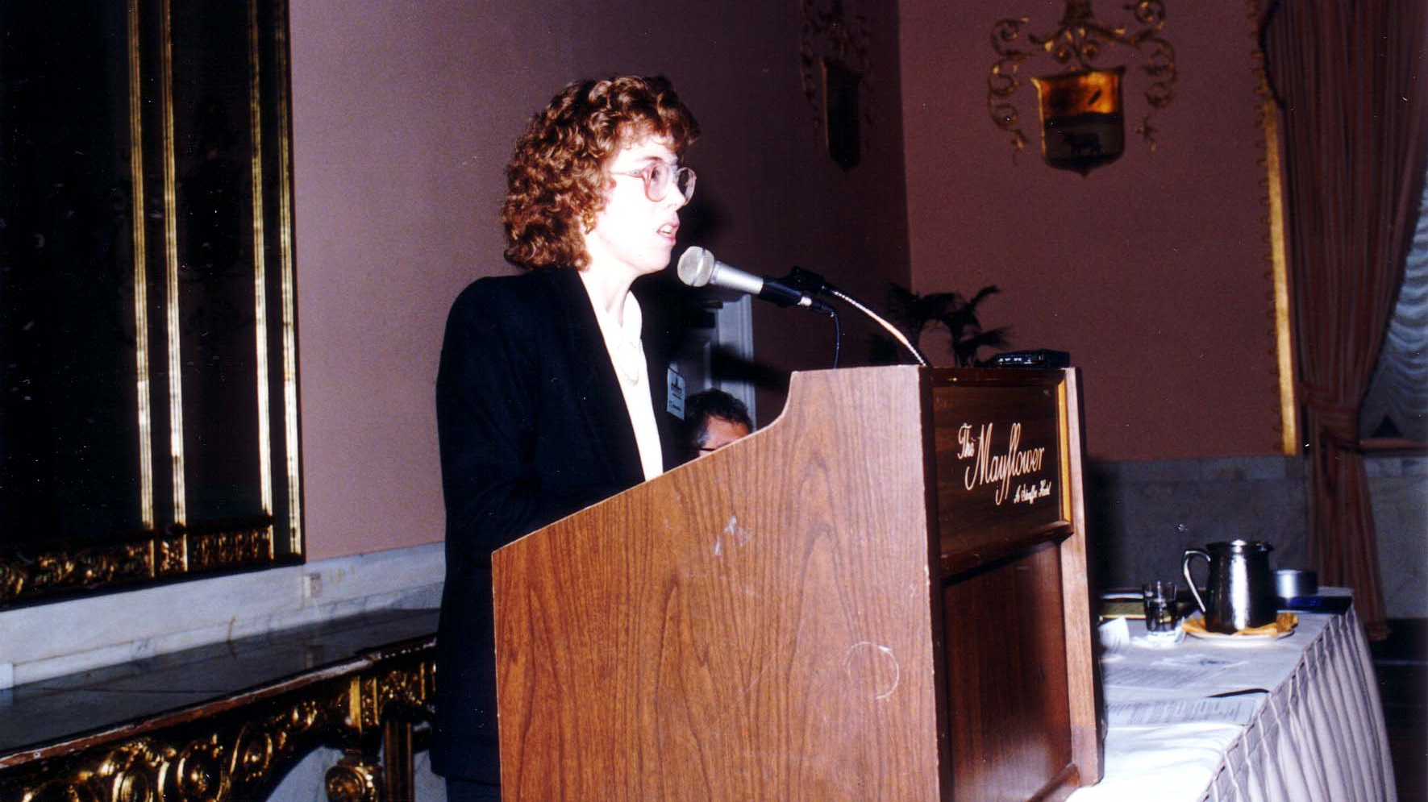
Notes:
TWG_Photo_1987_No_242__Oct_10__Leadership_Conference__Independent_Task_Force_on_ABA_Soviet_Relations_Attorney_Patience_Huntwork
See 1987 November TWG NEWS, page 4, 5

Slide 16
1987 295 TWG Leadership Conference Exhibitions October 10-11 Photographs
Roxolana Armstrong

Slide 17
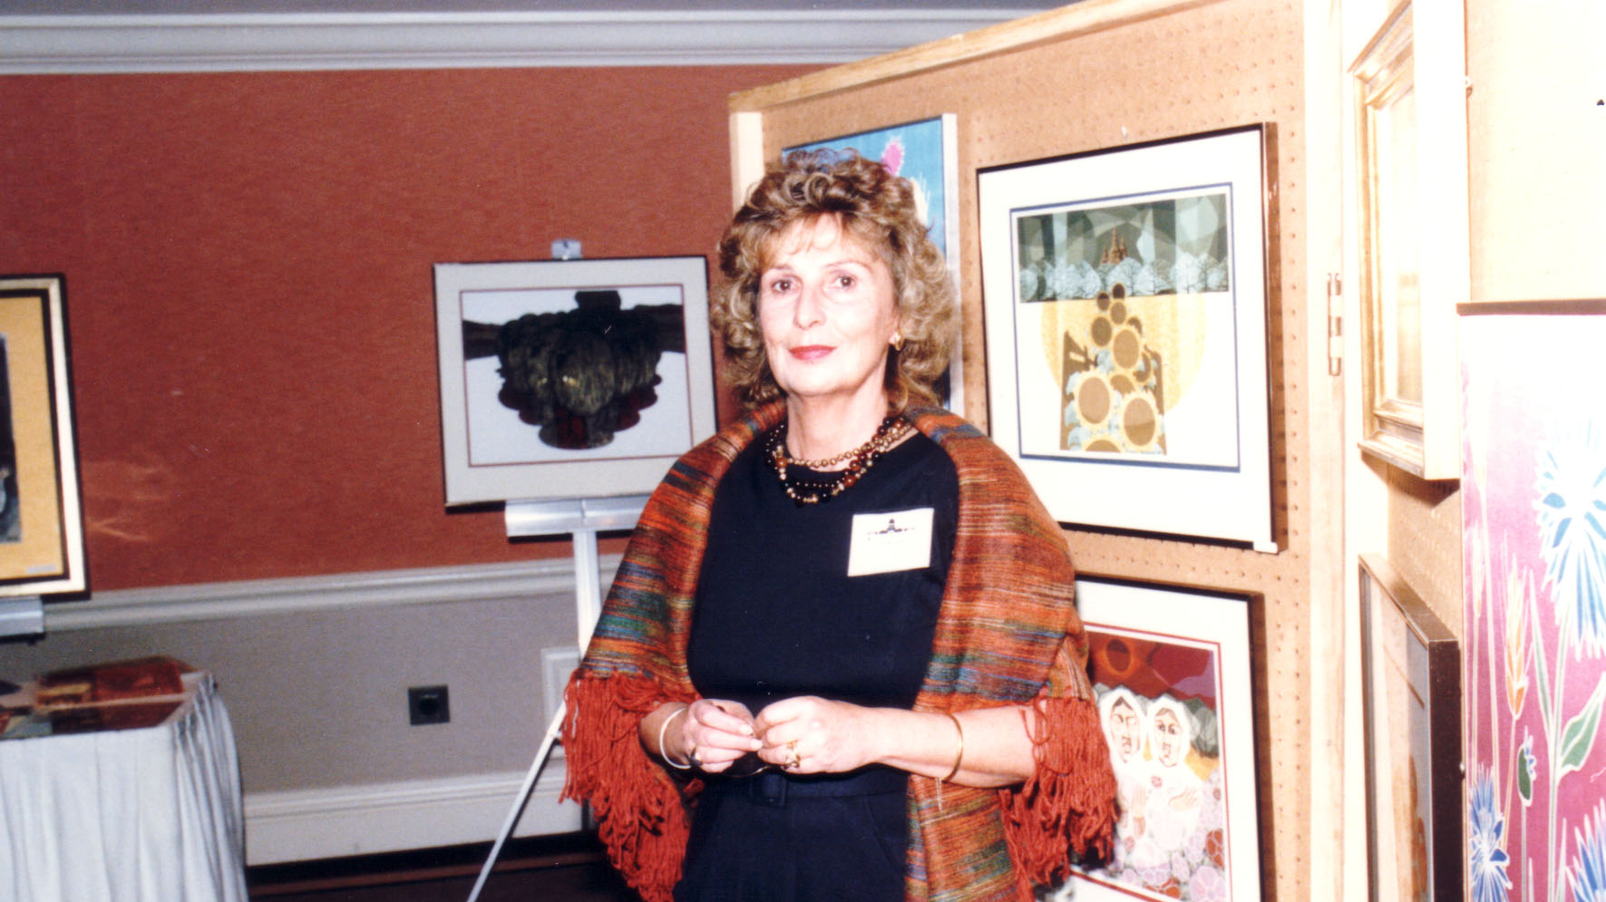
Notes:
TWG_Photo_1987_No_296_Oct__10__Leadership_Conference__Artist_Roxolana_Armstrong
See 1987 October TWG NEWS, page 14

Slide 18
1987 300 TWG Events Photographs
Chornobyl Fundraiser: Daria Telizyn
Recent Travels in Ukraine: Michael Edwards
Mixed Marriage Discussion: Myrtle (Pereira) Diachok, Daria (Hentesh) King, Darian Diachok, Dan King, Natalka (Mason) Gawdiak, Ihor Gawdiak
Matlock speech: Orest Deychakiwsky, Ambassador Jack Matlock
Sobibor Film Protest: Larissa Fontana, TWG President Daria Stec, Marta Pereyma, Rev Joseph Denischuk, Judge Gordon Malick, Valentina Limonczenko, Professor Petro Odarchenko, Anthony Luck
Shumuk speech: George Sajewych, Danylo Shumuk
Soviet-American Exchanges:
Amb. Stephen Rhinesmith
Marta Pereyma, Zenon Kohut, Greg Guroff, George Masiuk

Slide 19
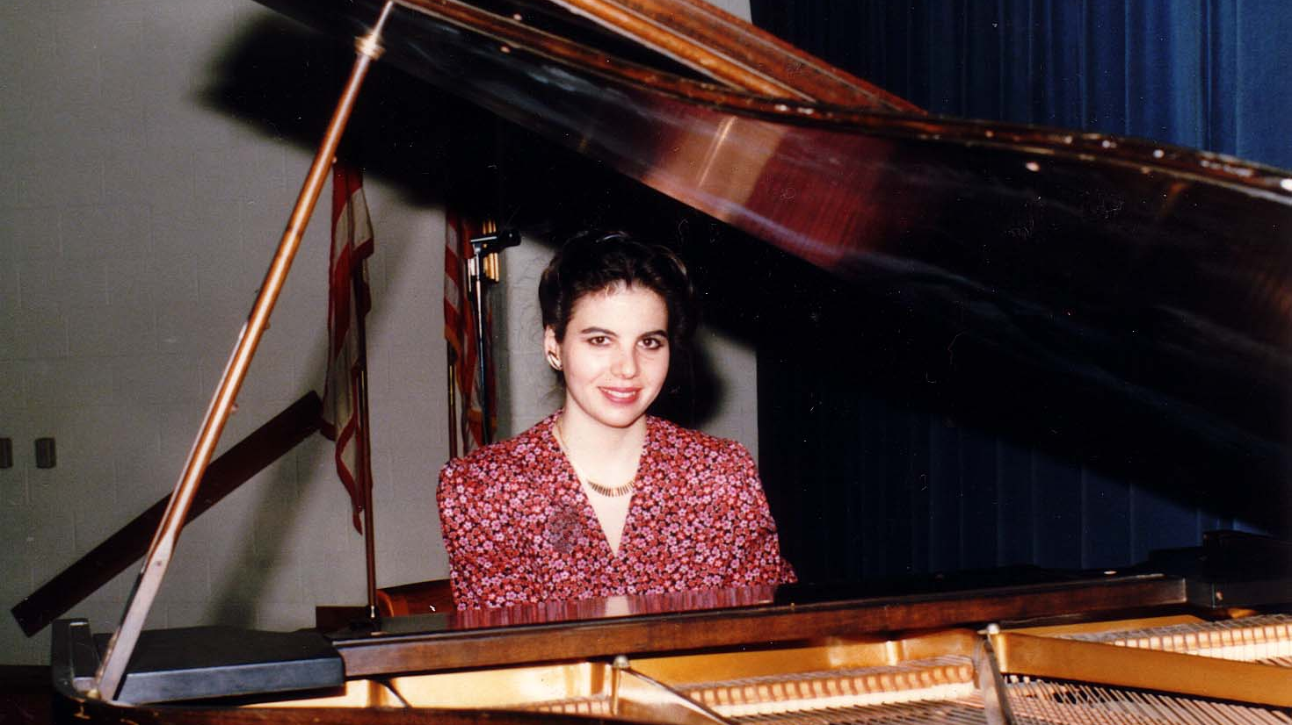
Notes:
TWG_Photo_1987_No_310__Feb_15__Holy_Family_Parish_Center__Fundraiser_for_Daria_Telizyn’s_Concert_Tour_to_Raise_Funds_for_Chornobyl_Victims__Pianist_Daria_Telizyn
See 1987 January TWG NEWS, page 6, and February TWG NEWS, page 14, for event announcement, and March TWG NEWS, page 11, for concert coverage

Slide 20
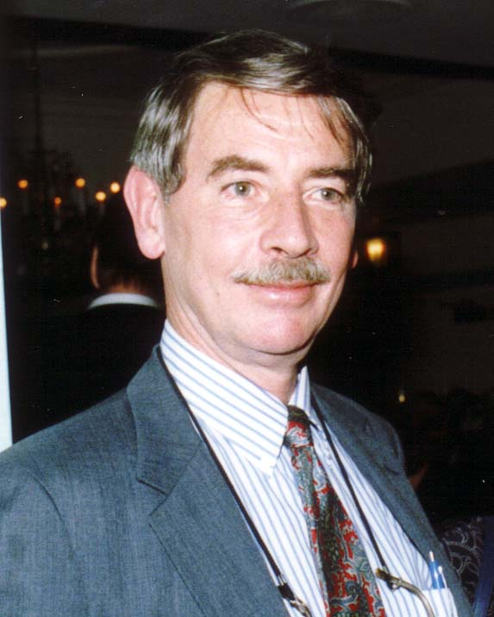
Notes:
TWG_Photo_1987_No_320__Feb_27__St_Sophia_Religious_Association__Recent_Travels_in_Ukraine__National_Geographic_Senior_Editor__Michael_Edwards
See 1987 February TWG NEWS for event announcement and March TWG NEWS, page 5, for coverage; also see May TWG NEWS, page 2

Slide 21
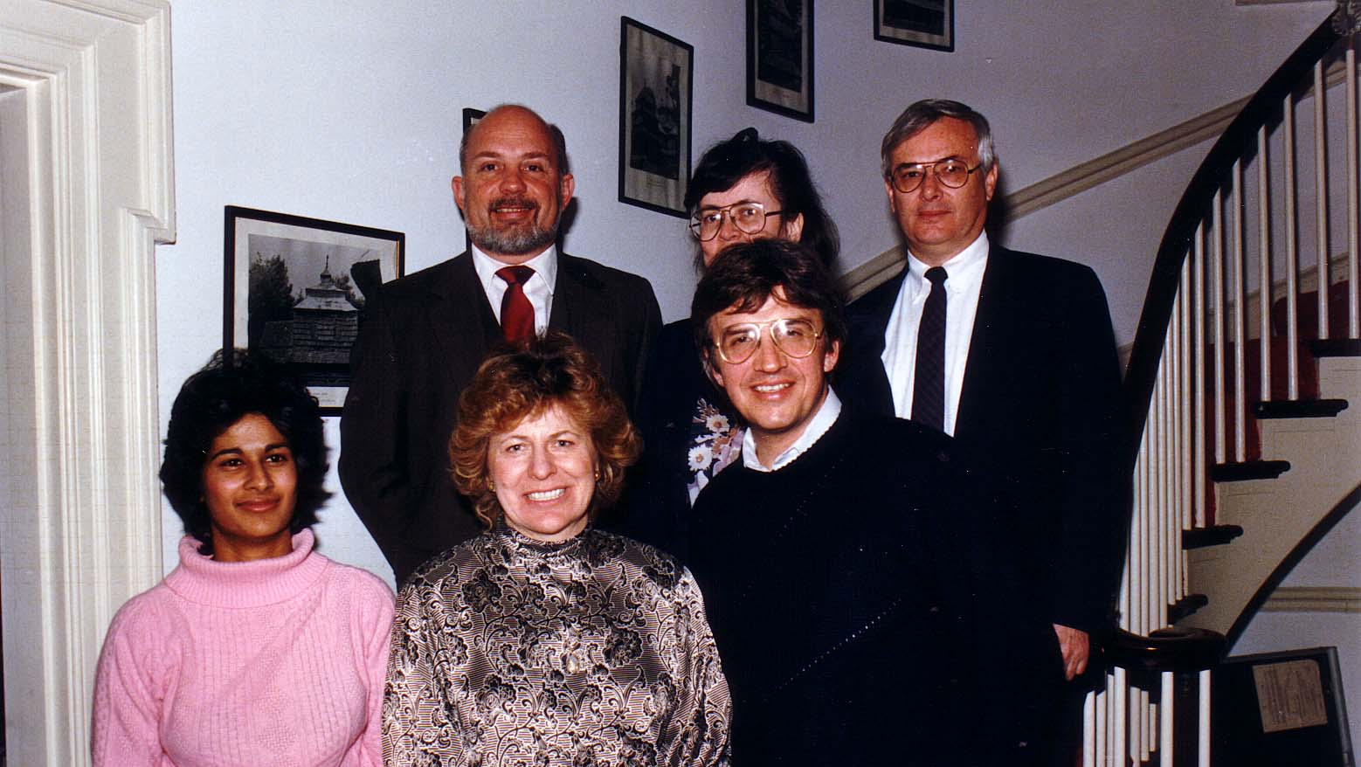
Notes:
TWG_Photo_1987_No_330__Mar_15__St_Sophia_Religious_Association__Mixed_Marriages_Discussion__Myrtle_(Pereira)_Diachok__Daria_(Hentesh)_King__Darian_Diachok__Dan_King__Natalka_(Mason)_Gawdiak__Ihor_Gawdiak
See 1987 March TWG NEWS for event announcement and April TWG NEWS, page 4, for event coverage

Slide 22
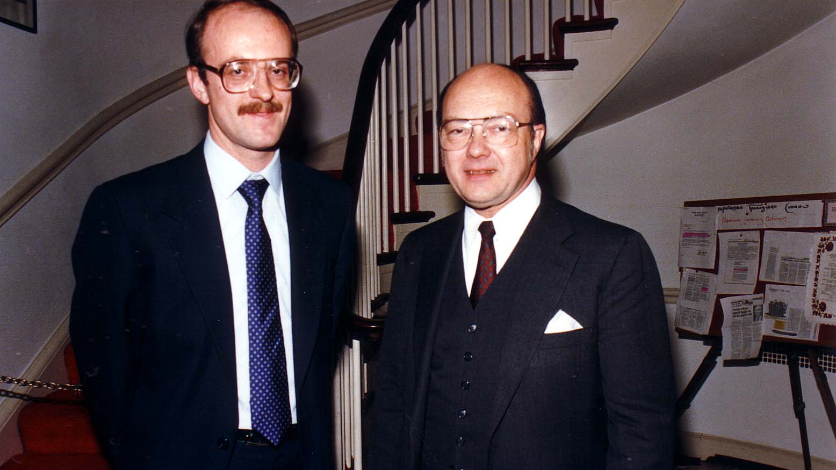
Notes:
TWG_Photo_1987_No_340__Mar_18__St_Sophia_Religious_Association__Policy_Advisor_US_Helsinki_Commission_Orest_Deychakiwsky__Ambassador_to_Soviet_Union_Jack_Matlock
See 1987 April TWG NEWS, page 11, for event coverage

Slide 23
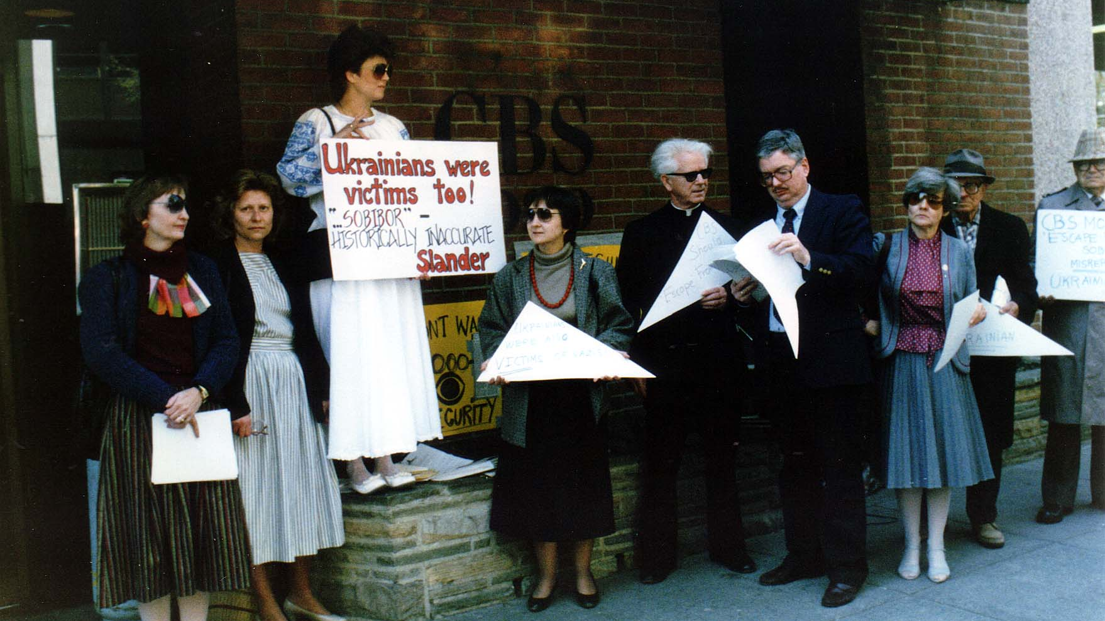
Notes:
TWG_Photo_1987_No_360__Apr_10__CBS_TV_WUSA_Ch9__Sobibor_Film_Protest__Larissa_Fontana__TWG_President_Daria_Stec__NN__Marta_Pereyma__Rev_Joseph_Denischuk__Judge_Gordon_Malick__Valentina_Limonczenko__Professor_Petro_Odarchenko__Anthony_Luck
See 1987 April TWG NEWS, page1, and May TWG NEWS, page 9

Slide 24
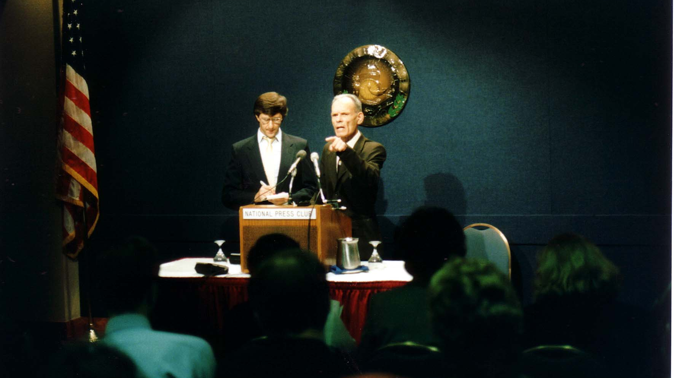
Notes:
TWG_Photo_1987_No_390__Oct_21__National_Press_Club__Interpreter_George_Sajewych__Former_Political_Prisoner_Danylo_Shumuk
See 1987 October TWG NEWS for event announcement, and November TWG NEWS, page 1, for event coverage

Slide 25
1987 395 TWG Event St Sophia Religious Association Soviet-American Exchanges April 8 Photographs
Amb. Stephen Rhinesmith
Marta Pereyma, Zenon Kohut, Greg Guroff, George Masiuk

Slide 26
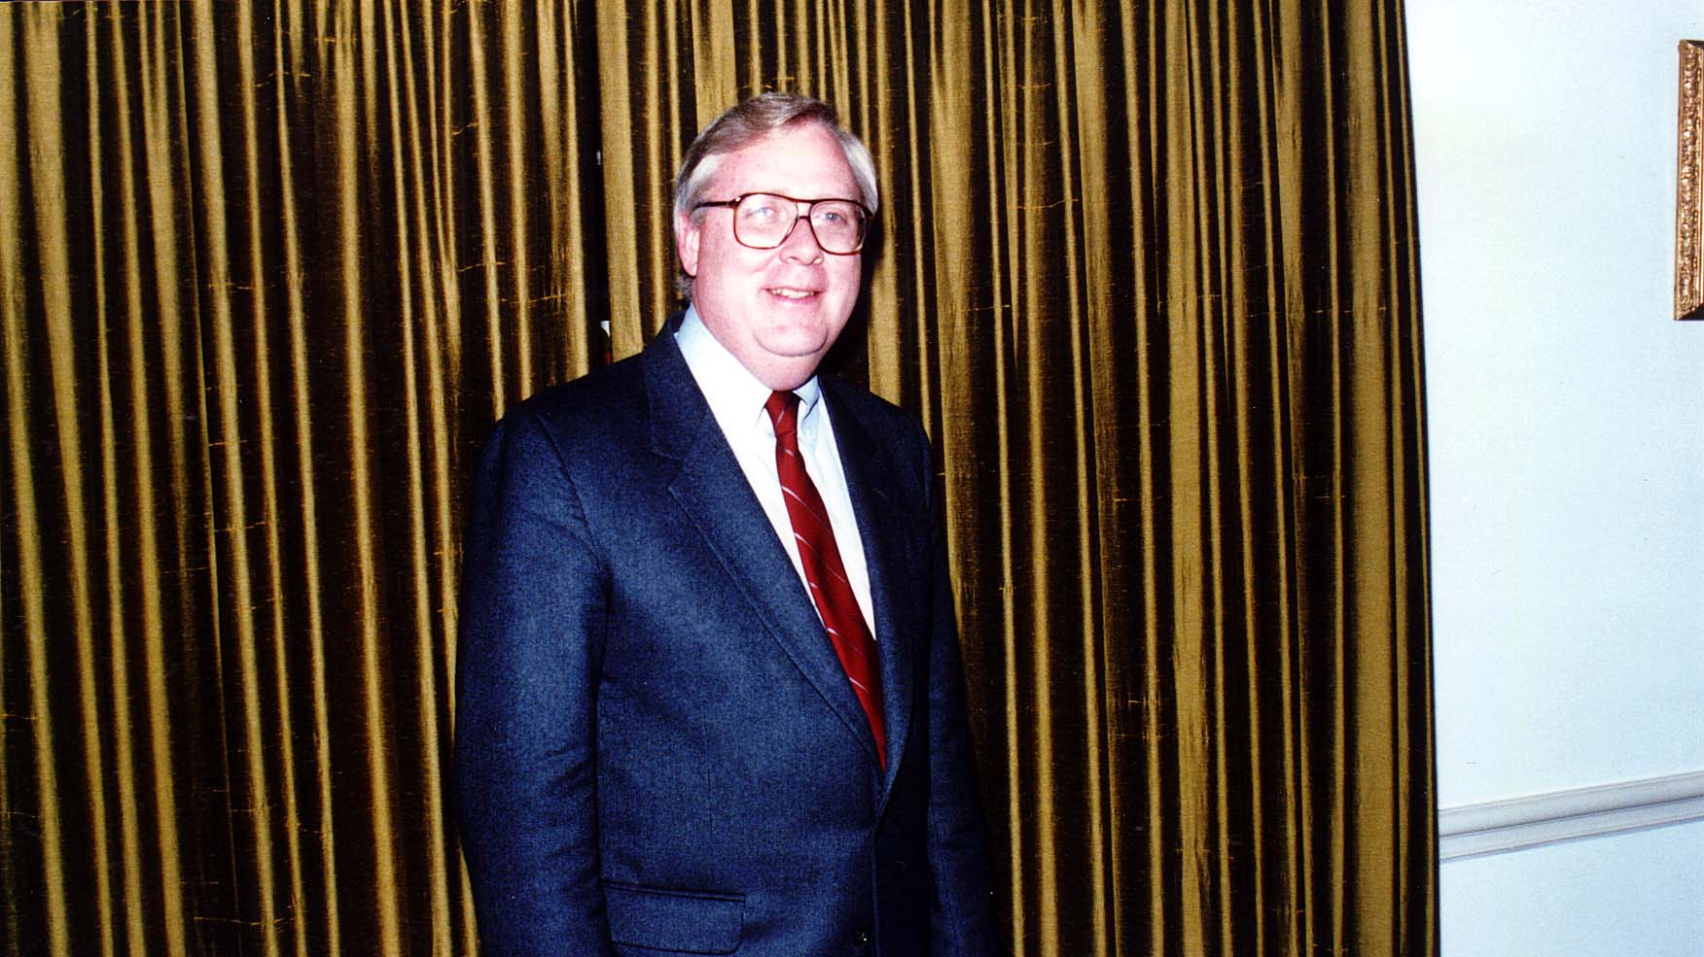
Notes:
TWG_Photo_1987_No_396__Apr_8__St_Sophia_Religious_Association__Head_of_President's_Initiative_on_Soviet_American_Exchanges_Amb_Stephen_Rhinesmith
See 1987 March and April TWG NEWS for event announcement, and May TWG NEWS, page 1, for event coverage

Slide 27
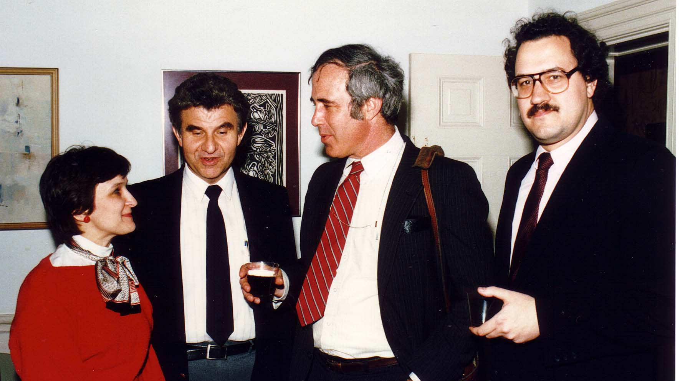
Notes:
TWG_Photo_1987_No_397__Apr_8__St_Sophia_Religious_Association__Soviet_American_Exchanges__USIA_Marta_Pereyma__Historian_Zenon_Kohut__Deputy_to_the_Head_of_President's_Inititiative_on_Soviet_American_Exchanges_Greg_Guroff__George_Masiuk
See 1987 March and April TWG NEWS for event announcement, and May TWG NEWS, page 1, for event coverage

Slide 28
1987 400 TWG Co-sponsored Event Photographs
Chornobyl Symposium

Slide 29
1987 420 TWG Chornobyl Symposium Photographs
George Kuzmych
Olexa Bilaniuk, David Marples, Robert Taylor, George Kuzmych

Slide 30
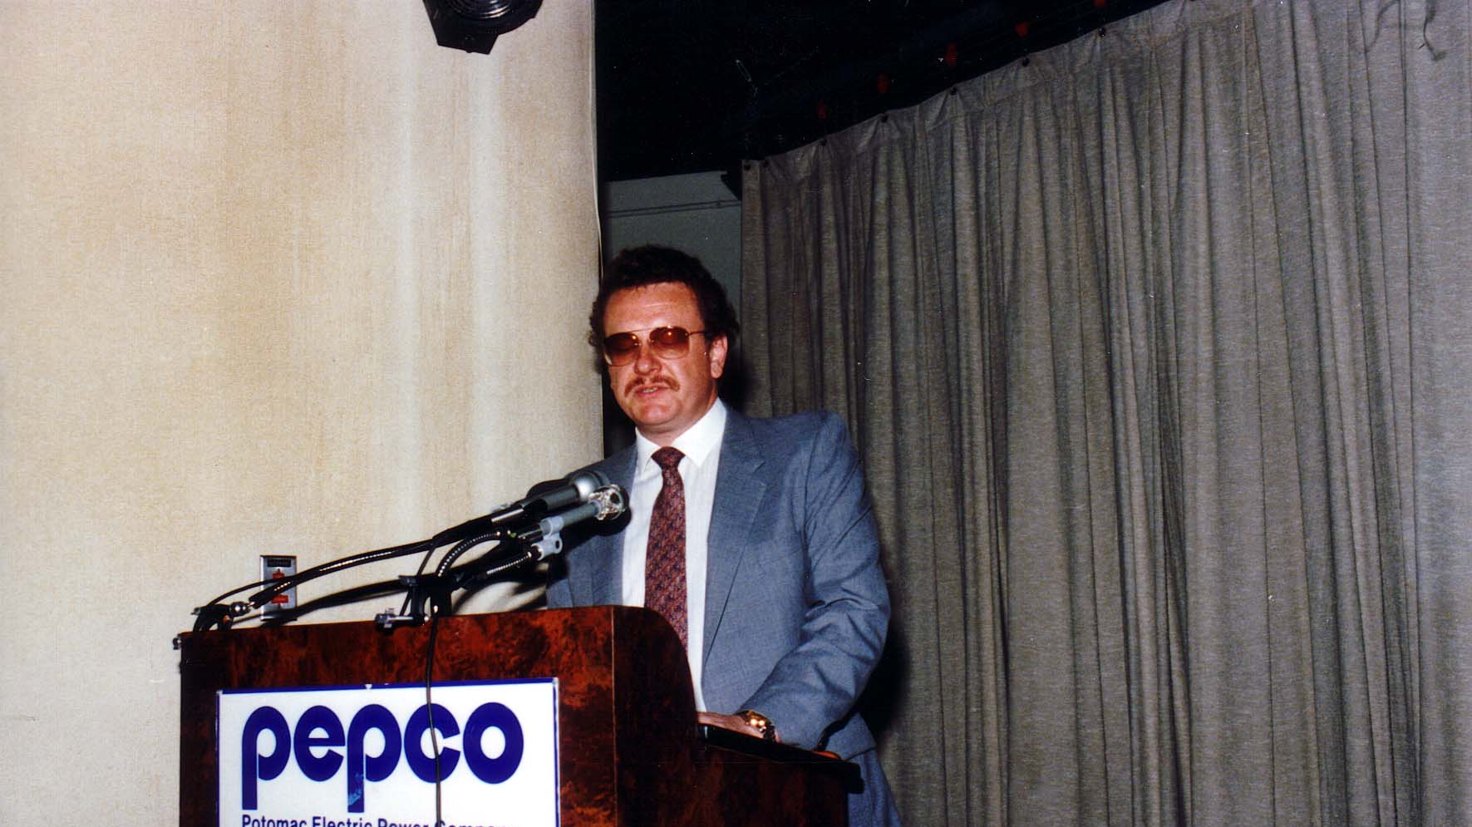
Notes:
TWG_Photo_1987_No_421_Apr__21__PEPCO_Auditorium__Chornobyl_Symposium__Department_of_Commerce_Office_of_Technology_and_Policy_Analysis_Nuclear_Engineer_George_Kuzmych
See 1987 April TWG NEWS for event announcement, and May TWG NEWS, page 10, for event coverage

Slide 31
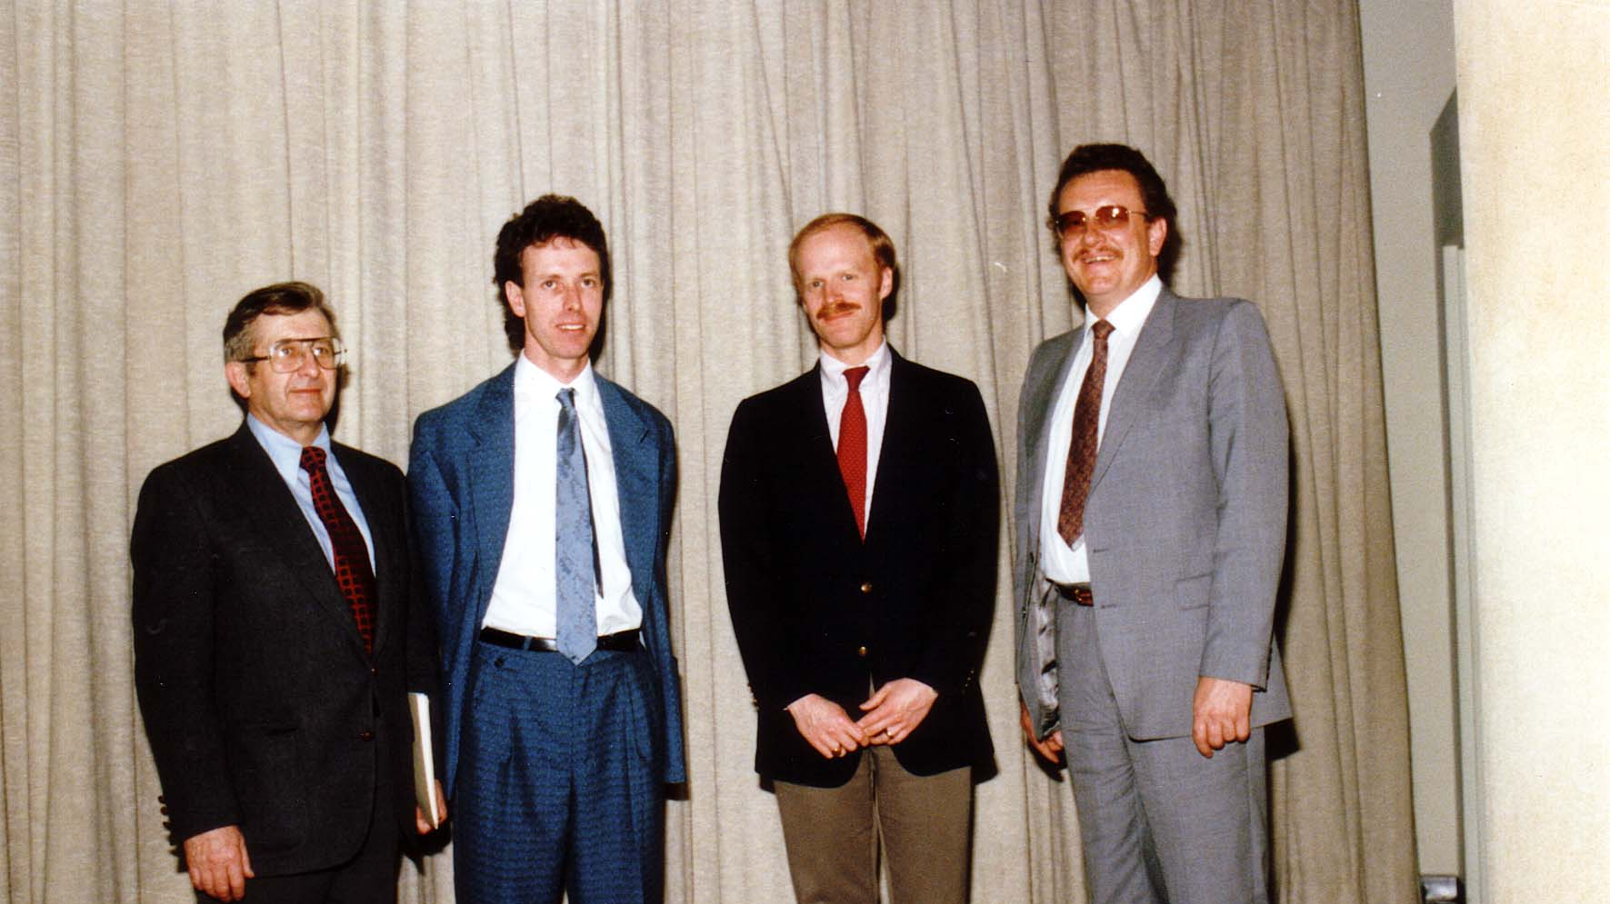
Notes:
TWG_Photo_1987_No_422_Apr_21_PEPCO_Auditorium_Chornobyl_Symposium_Physicist_Swarthmore_College_Professor_Olexa_Bilaniuk_Historian_and_Chornobyl_Researcher_David_Marples_Bone_Marrow_Transplant_Specialist_Robert_Taylor_Commerce_Department_George_Kuzmych
See 1987 April TWG NEWS for event announcement, and May TWG NEWS, page 10, for event coverage

Slide 32
1987 600 TWG Social Events Photographs
Pool Party: Jean (Ivan) Lehkyj, Darian Diachok, Oksana Lehkyj, Adrian Kerod, Daria Stec, Walter Pechenuk
TWG Tabir

Slide 33
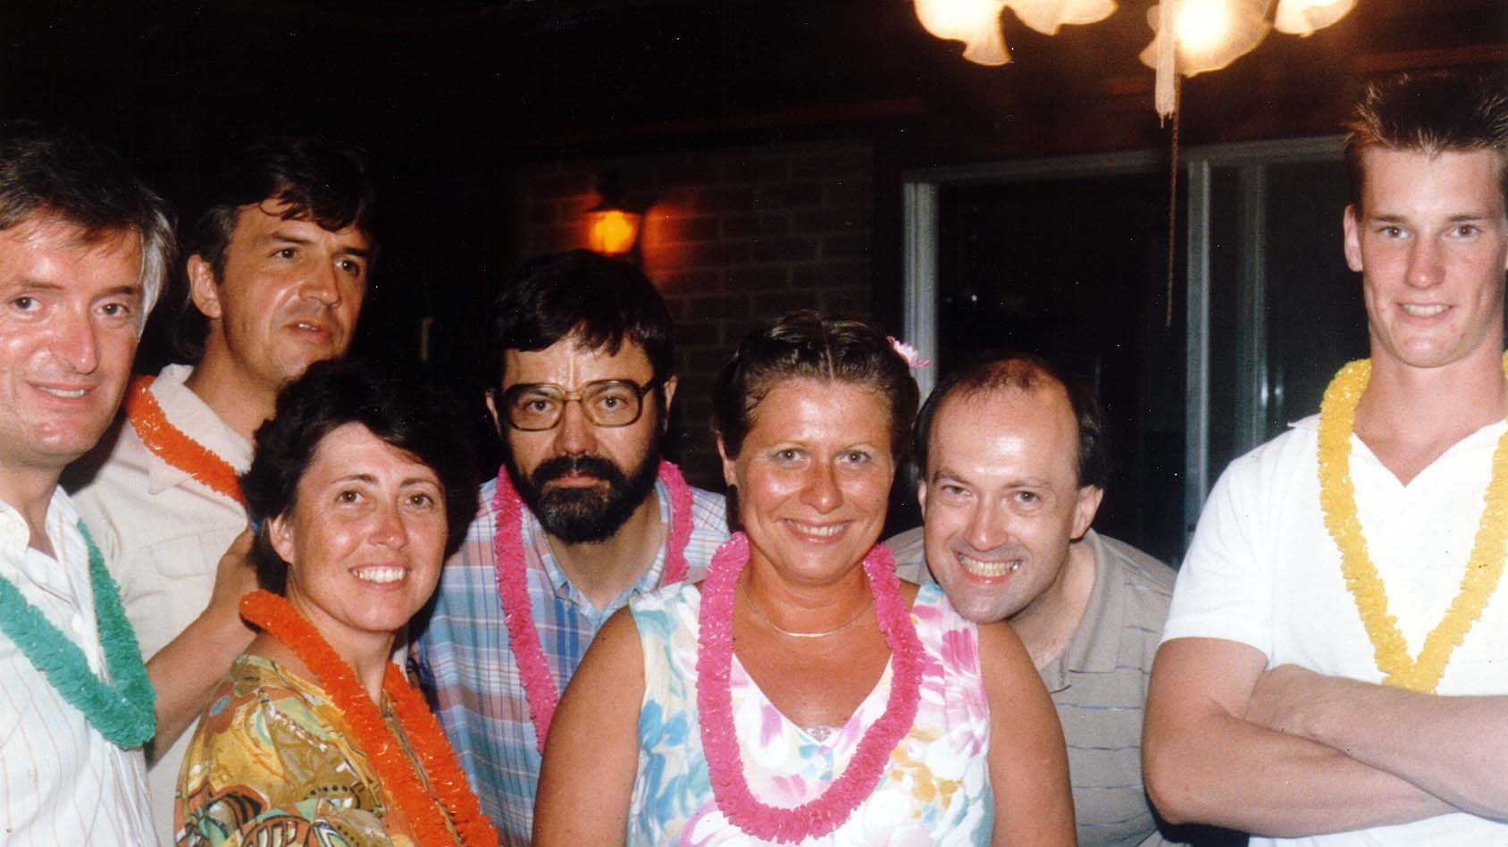
Notes:
TWG_Photo_1987_No_620__Aug_22__Pool_Party__Jean_(Ivan)_Lehkyj__Darian_Diachok__Oksana_Lehkyj__Adrian Kerod__TWG_President_Daria_Stec__Walter_Pechenuk_NN
See 1987 July-August TWG NEWS, page 10, for event announcement

Slide 34
1987 610 TWG Tabir 1987 Photographs
TWG Tabir 1: Larysa Kurylas, Julia Tereshchuk Romaniuk, Oleh Hudyma, Marta Mostovych, Andrew Mostovych, Orest Deychakiwsky; kids: Hanna Deychakiwsky, Natalie Deychakiwsky, and Jesse Deychakiwsky
TWG Tabir 2: Marta Mostovych, Andrew Mostovych, Andrij Pryshlak, Lydia Sushko, Oleh Hudyma, Michael Hoobchaak, Oksana Hoobchaak, Larysa Kurylas, Isha Pryshlak, Julia Tereshchuk Romaniuk, Lesia Kopka

Slide 35
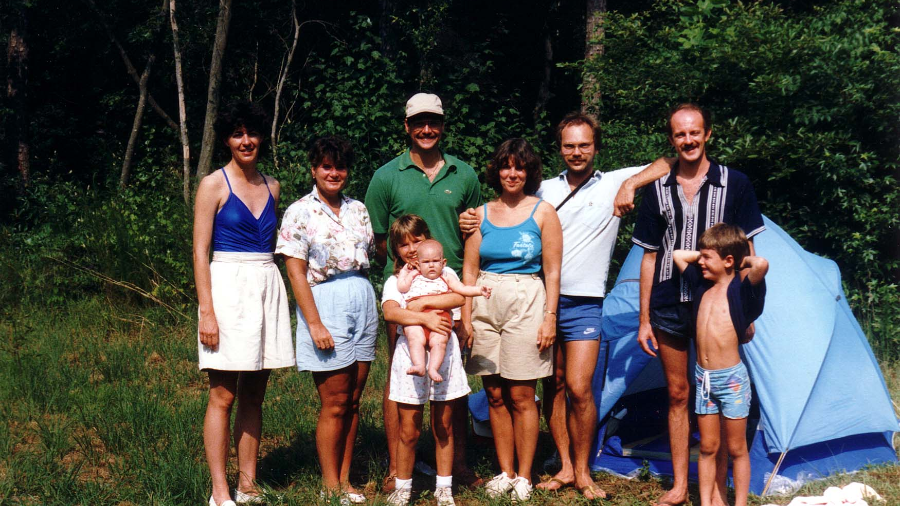
Notes:
TWG_Photo_1987_No_611__Aug_1_2__Willards_MD__Tabir__Larysa_Kurylas__Julia_Tereshchuk_Romaniuk__Oleh_Hudyma__Marta&Andrew_Mostovych__Orest_Deychakiwsky_kids_Hanna__Natalie__and__Jesse_Deychakiwsky
See 1987 July-August TWG NEWS, page 10, for event announcement

Slide 36
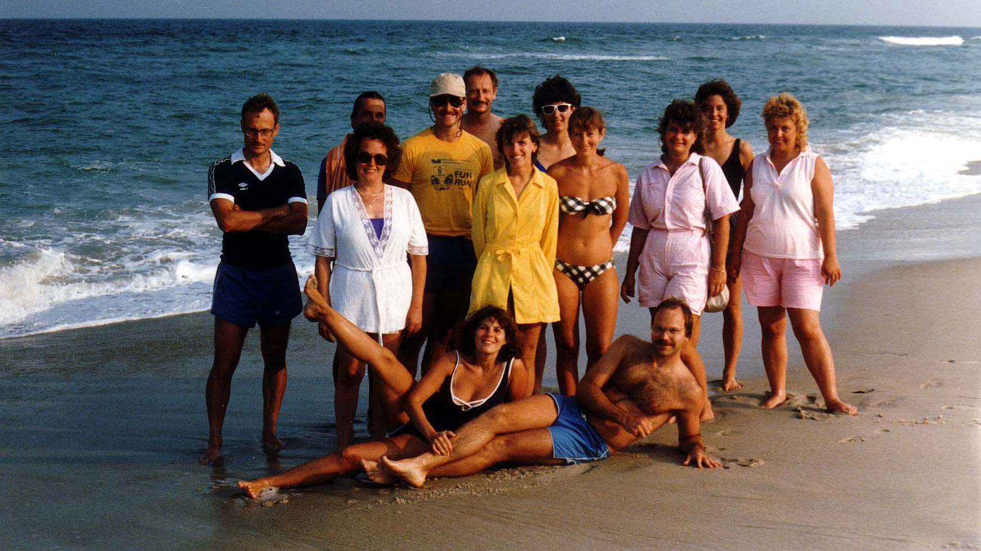
Notes:
TWG_Photo_1987_No_612__Aug_1_2__Willards_MD__Tabir_by_Ocean__In_Front_Marta&Andrew_Mostovych_In_Back_Andrij_Pryshlak_Lydia_Sushko_NN_Oleh_Hudyma_Michael_Hoobchaak_Oksana_Hoobchaak_Larysa_Kurylas_Isha_Pryshlak_Julia_Tereshchuk_Romaniuk_Lesia_Kopka_NN
See 1987 July-August TWG NEWS, page 10, for event announcement

