Slide 1
TWG Photos 1988
Created October 24, 2020

Slide 2
1988 110 TWG Annual Meeting Georgetown Holiday Inn September 23 Photographs
See 1988 April TWG NEWS for planning of semi-annual meeting that was held April 22 at Van Ness East
See 1988 August TWG NEWS, page 3, and September TWG NEWS, page 1, for event planning and October TWG NEWS, page 1, for Annual Meeting coverage
Elected to the Board: Yaro Bihun – President; Lydia Chopivsky – Vice President; Orest Deychakiwsky - Secretary; Helen Chaikovsky – Treasurer; Orysia Pylyshenko – Events Director; Marta Zielyk - Public Relations; Andrew Rylyk – Membership Director; Laryssa Chopivsky - Special Projects
Auditing Committee: Leonid Kondratiuk, Daria Stec, Natalie Sluzar
Others In Photo: Ihor Vitkovitsky

Slide 3
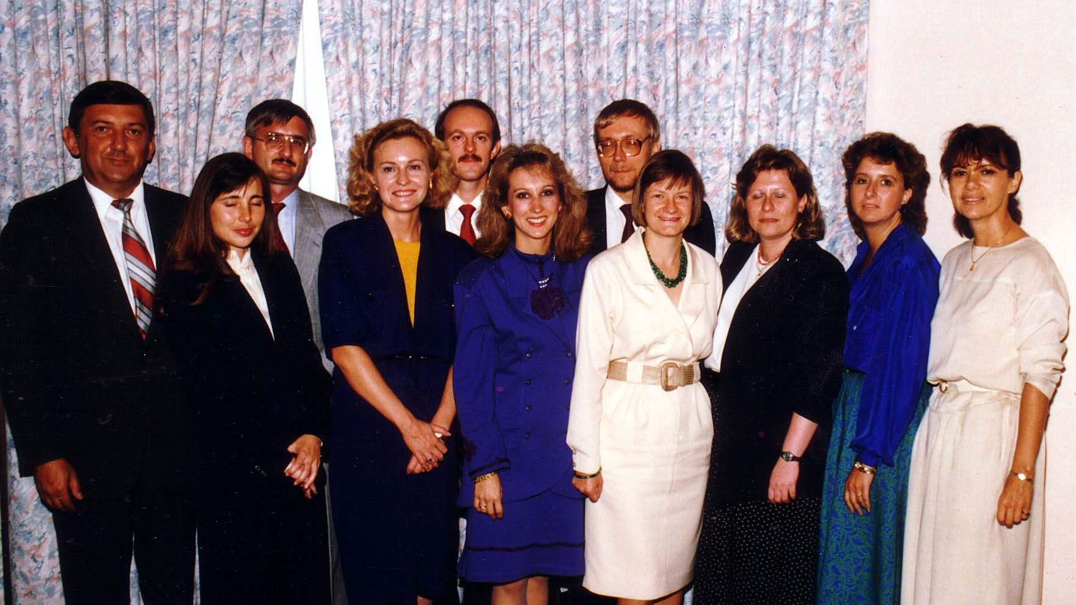
Notes:
TWG_Photo_1988_No_111__Sep_23__Annual_mtg__Board__TWG_President_Yaro_Bihun__Orysia_Pylyshenko_Leonid_Kondratiuk_Laryssa_Chopivsky_Orest_Deychakiwsky_Lydia_Chopivsky_Andy_Rylyk_Helen_Chaikovsky_Daria_Stec_Marta_Zielyk_Natalie_Sluzar
See 1988 August TWG NEWS, page 3, and September TWG NEWS, page 1, for event planning and October TWG NEWS, page 1, for event coverage

Slide 4
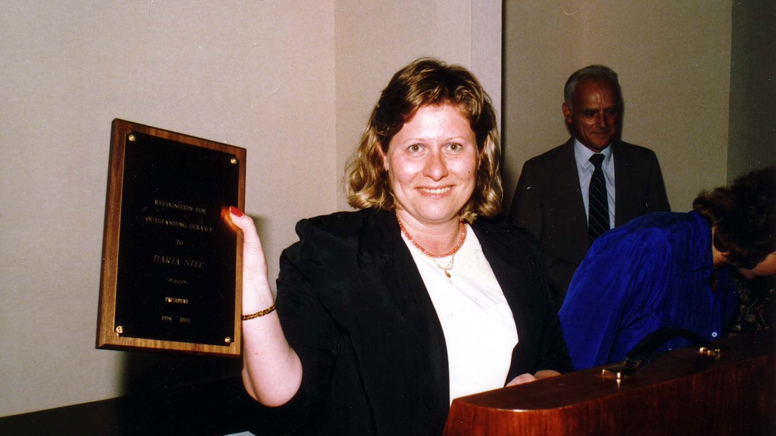
Notes:
TWG_Photo_1988_No_112__Sep_23__Georgetown_Holiday_Inn__TWG_Annual_Meeting__Award_to_Daria_Stec__Ihor_Vitkovitsky
See 1988 August TWG NEWS, page 3, and September TWG NEWS, page 1, for event planning and October TWG NEWS, page 1, for event coverage

Slide 5
1988 120 TWG Summit Cozy Inn Thurmond MD August 27 Photographs
Helen Chaikovsky, Andy Rylyk, Irene Jarosewich, Anna Worobij, Marta Pereyma, Walter Pechenuk, Wasyl Kornylo
Ross Chomiak, Walter Pechenuk, Daria Stec, Natalie Sluzar, Marta Pereyma, Anna Worobij, Maria Rudensky, Marta Zielyk, Yaro Bihun, Andy Rylyk, Andrij Masiuk, George Masiuk, Roman Rytaczka, Irene Jarosewich, Helen Chaikovsky, Wasyl Kornylo, Larissa Fontana
Wasyl Kornylo, Marta Zielyk, Yaro Bihun

Slide 6
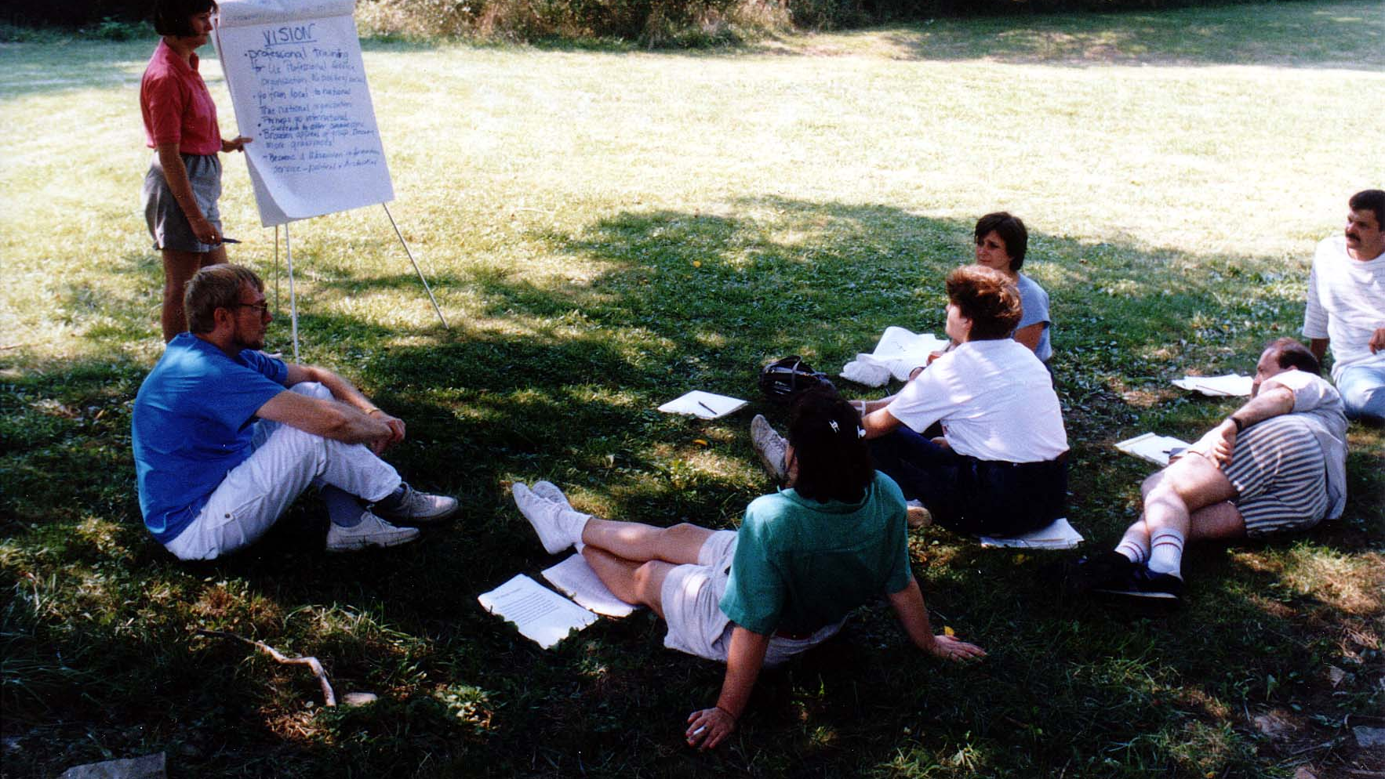
Notes:
TWG_Photo_1988_No_121__Aug_27__Summit__Helen_Chaikovsky__Andy_Rylyk__Irene_Jarosewich__Anna_Worobij__Marta_Pereyma__Walter_Pechenuk__Wasyl_Kornylo
See 1988 August TWG NEWS, page 1, for event planning and September TWG NEWS, page 1, for event coverage

Slide 7
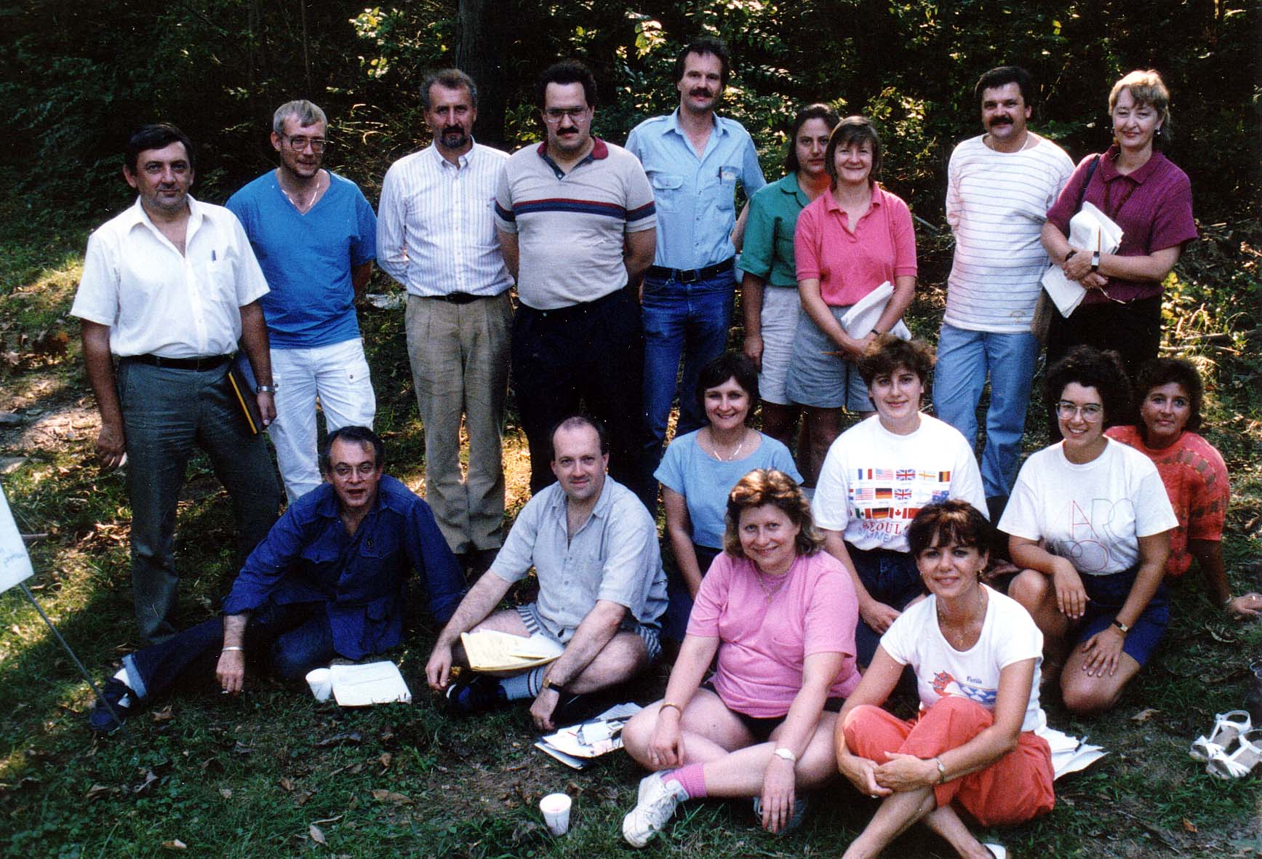
Notes:
TWG_Photo_1988_No_122_1__Aug_27__Summit__Sitting_Row_1__Ross_Chomiak__Walter_Pechenuk__TWG_President_Daria_Stec__Natalie_Sluzar__Sitting_Row_2__Marta_Pereyma__Anna_Worobij__Maria_Rudensky__Marta_Zielyk
See 1988 August TWG NEWS, page 1, for event planning and September TWG NEWS, page 1, for event coverage

Slide 8
Notes:
TWG_Photo_1988_No_122_2__Aug_27__Summit__Standing__Yaro_Bihun__Andy_Rylyk__Andrij_Masiuk__George_Masiuk__Roman_Rytaczka__Irene_Jarosewich__Helen_Chaikovsky__Wasyl_Kornylo__Larissa_Fontana
See 1988 August TWG NEWS, page 1, for event planning and September TWG NEWS, page 1, for event coverage

Slide 9
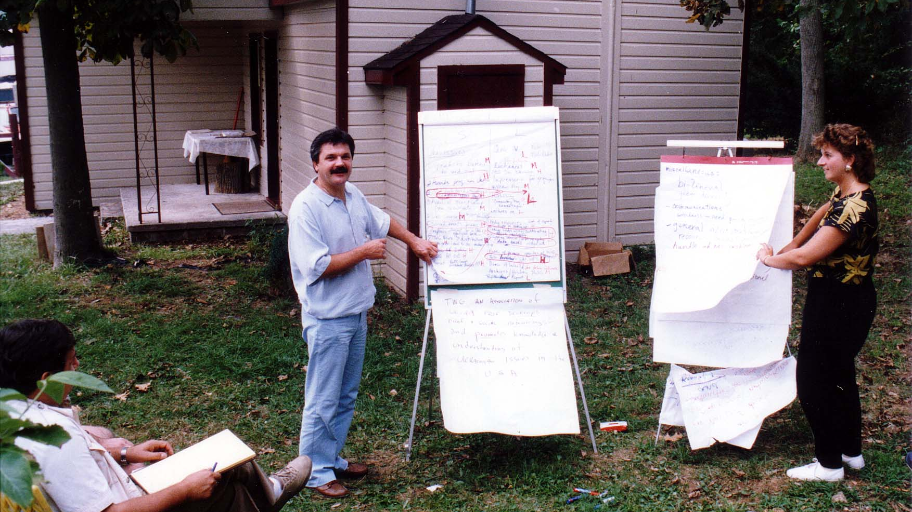
Notes:
TWG_Photo_1988_No_123__Aug_27__Summit__Wasyl_Kornylo__Marta_Zielyk__Yaro_Bihun_taking_notes
See 1988 August TWG NEWS, page 1, for event planning and September TWG NEWS, page 1, for event coverage

Slide 10
1988 300 TWG Events Photographs
Holodomor: Jim Mace, Marta Zielyk
Ukrainian – Polish Ties: Khrystyna Mokry, Marta Pereyma, Wolodymyr Mokry, Daria Stec, Ross Chomiak
Fellowship Award: Adrian Karmazyn, Andrew Mostovych, Peter Melnycky

Slide 11
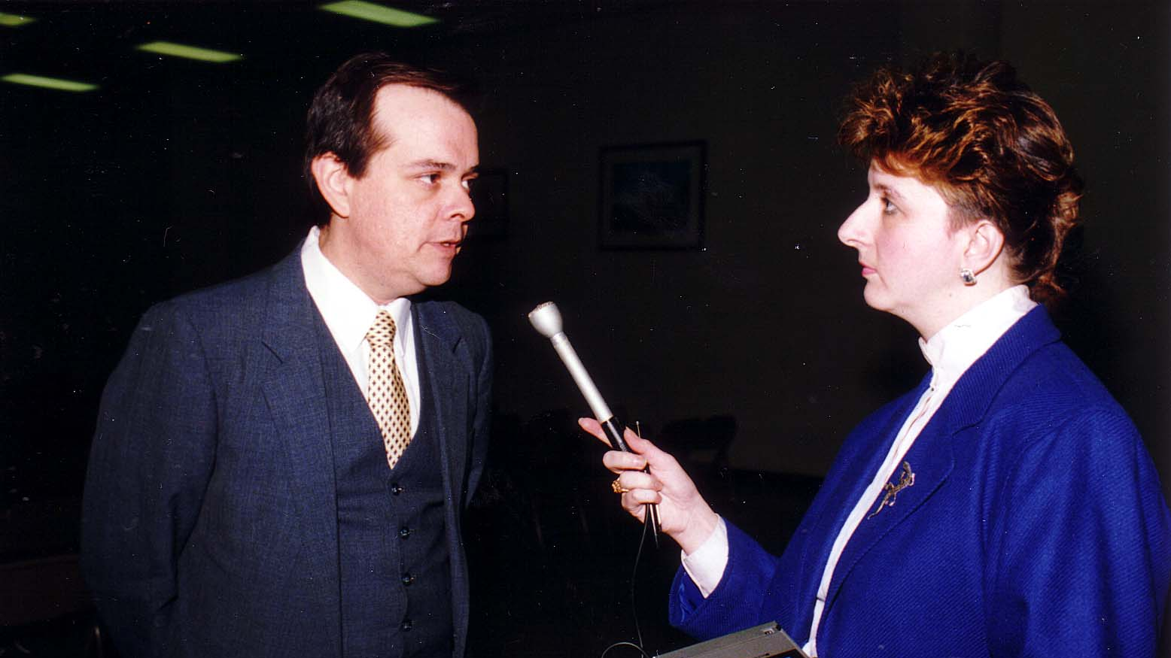
Notes:
TWG_Photo_1988_No_320__Feb_28__Holy_Family_Parish_Center__Executive_Director_US_Commission_on_Ukraine_Famine___Jim_Mace__Radio_Free_Europe_Radio_Liberty_Correspondent_Marta_Zielyk
See 1988 February TWG NEWS for event announcement, and March TWG NEWS, page 8, for event coverage

Slide 12
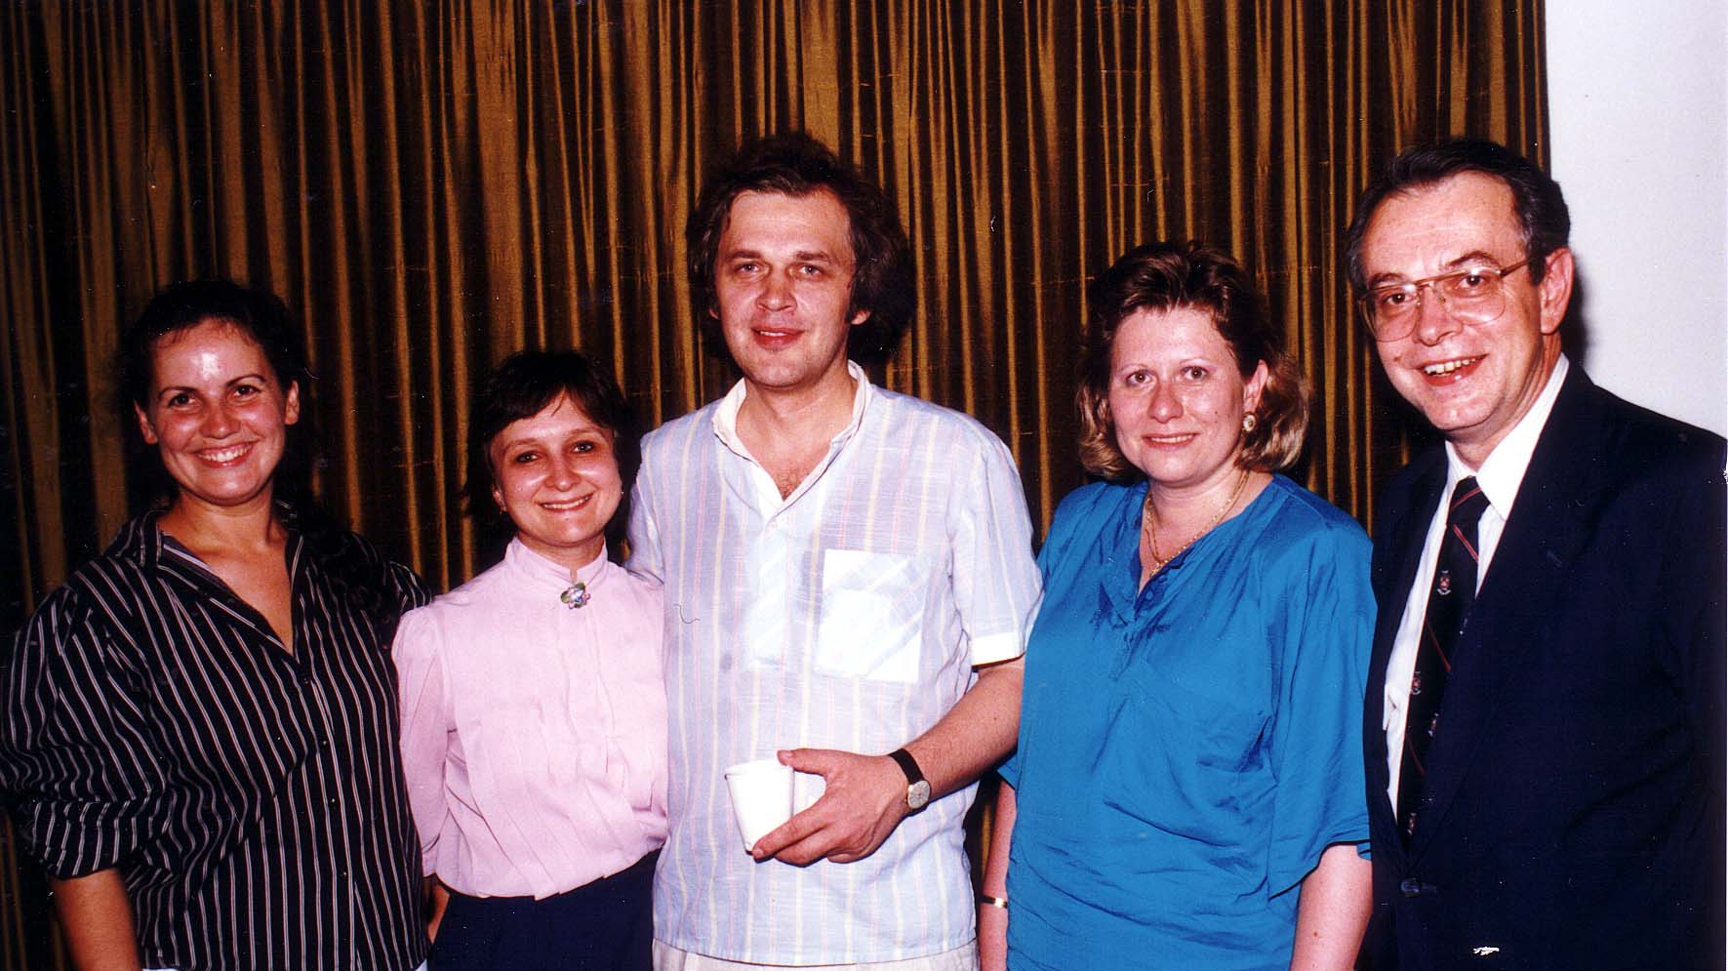
Notes:
TWG_Photo_1988_No_330__Aug_24__St_Sophia_Religious_Association__TWG_Forum__Ukrainian_Polish_Ties__Khrystyna_Mokry__Marta_Pereyma__Jagellonian_University_Professor_Wolodymyr_Mokry__TWG_President_Daria_Stec__Ross_Chomiak
See related article in 1988 August TWG NEWS, page 3, and event announcement in calendar of events and September TWG NEWS, page 4, for event coverage

Slide 13
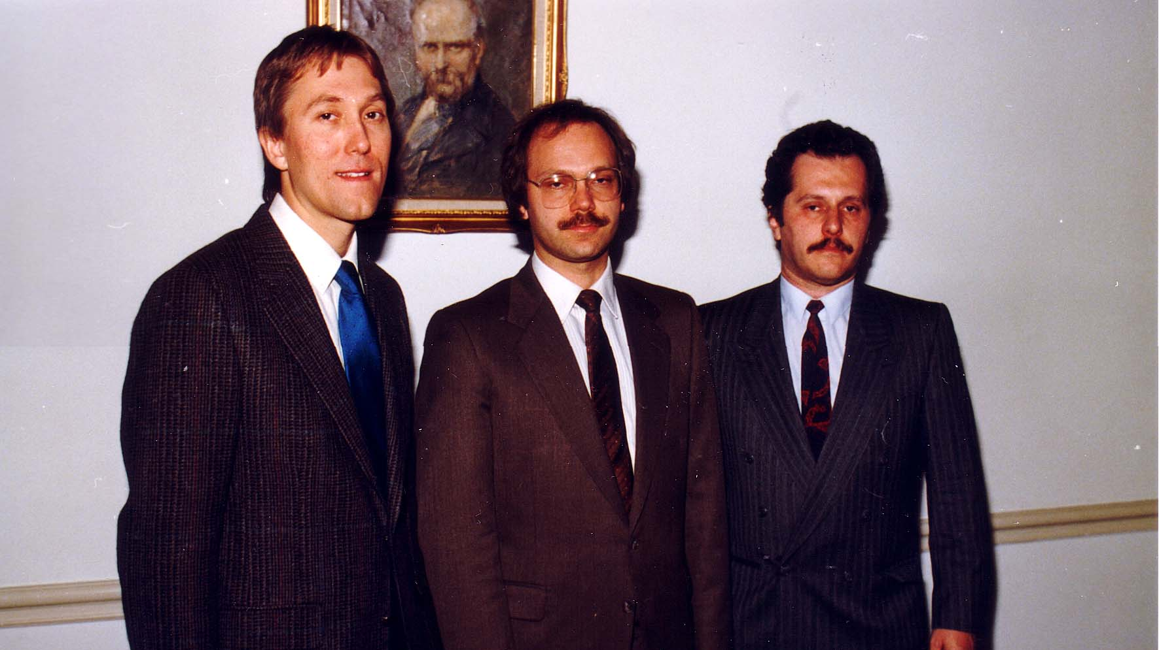
Notes:
TWG_Photo_1988_No_340__Nov_11__St_Sophia_Religious_Association__1987_Fellowship_Award_Recipient_Adrian_Karmazyn__Fellowship_Project_Director_Andrew_Mostovych__1987_Fellowship_Award_Recipient_Peter_Melnycky
See 1988 October TWG NEWS, page 1, for event announcement and November TWG NEWS, page 1, for event coverage

Slide 14
1988 310 TWG Events Virsky Dancers Welcome Arlington Hyatt February 9 Photographs
Yaro Bihun, Natalie Sluzar
Chrystia Shashkevych Oryshkevych
Daria Stec, Marta Pereyma, Myroslav Vantukh

Slide 15
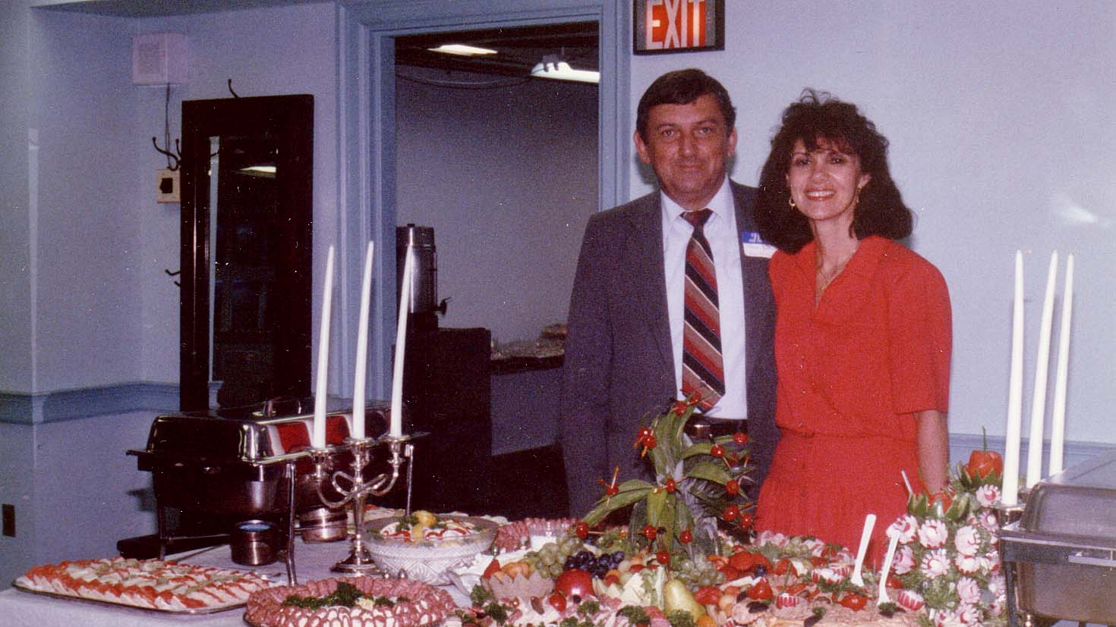
Notes:
TWG_Photo_1988_No_311__Feb_9__Arlington_Hyatt__Reception_for_Virsky_Dancers__Yaro_Bihun__Natalie_Sluzar
See 1988 January TWG NEWS, page 3, and February TWG NEWS for event announcement and March TWG NEWS, page4, for event coverage

Slide 16
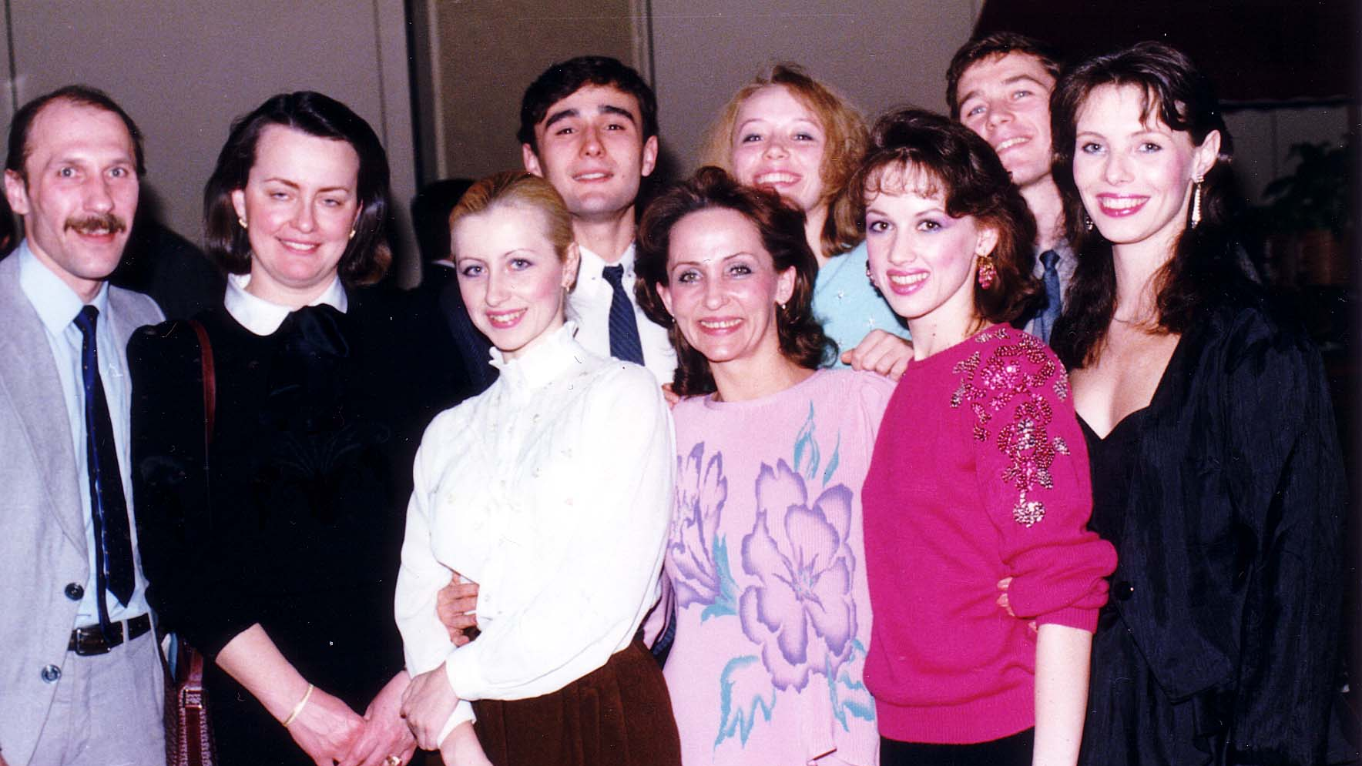
Notes:
TWG_Photo_1988_No_312__Feb_9__Arlington_Hyatt__TWG_Reception_for_Virsky_Dancers__2nd_from_L_TWG_Member_Chrystia_Shashkevych_Oryshkevych
See 1988 January TWG NEWS, page 3, and February TWG NEWS for event announcement and March TWG NEWS, page 4, for event coverage

Slide 17
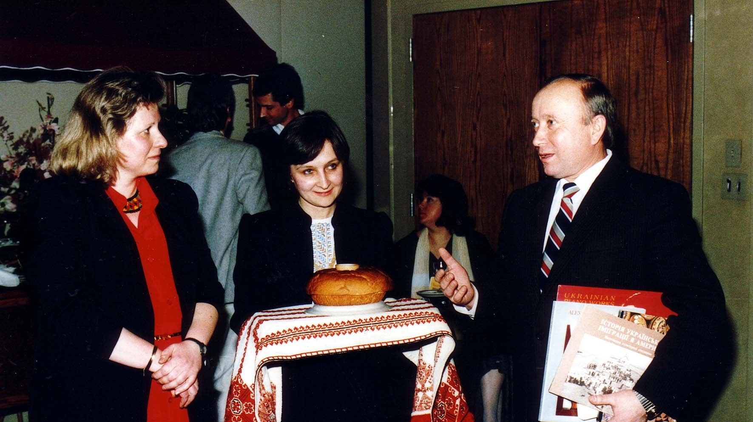
Notes:
TWG_Photo_1988_No_313__Feb_9__Arlington_Hyatt__Virsky_Welcome__TWG_President_Daria_Stec__Marta_Pereyma__Virsky_Dancers'_Director_Myroslav_Vantukh
See 1988 January TWG NEWS, page 3, and February TWG NEWS for event announcement and March TWG NEWS, page 4, for event coverage

Slide 18
1988 400 TWG Co-sponsored Event Photographs
Antonovych Awards

Slide 19
1988 420 TWG Co-sponsor of Antonovych Awards Georgetown University Copley Formal Lounge March 20 Photographs
Robert Conquest
Jaroslaw Pelenski, Bohdan Rubchak, Leonid Plyushch, Omelian Antonovych, Tetiana Antonovych, Robert Conquest, Ivan Fizer, Roman Szporluk
Leonid Plyushch, Marta Chomiak

Slide 20
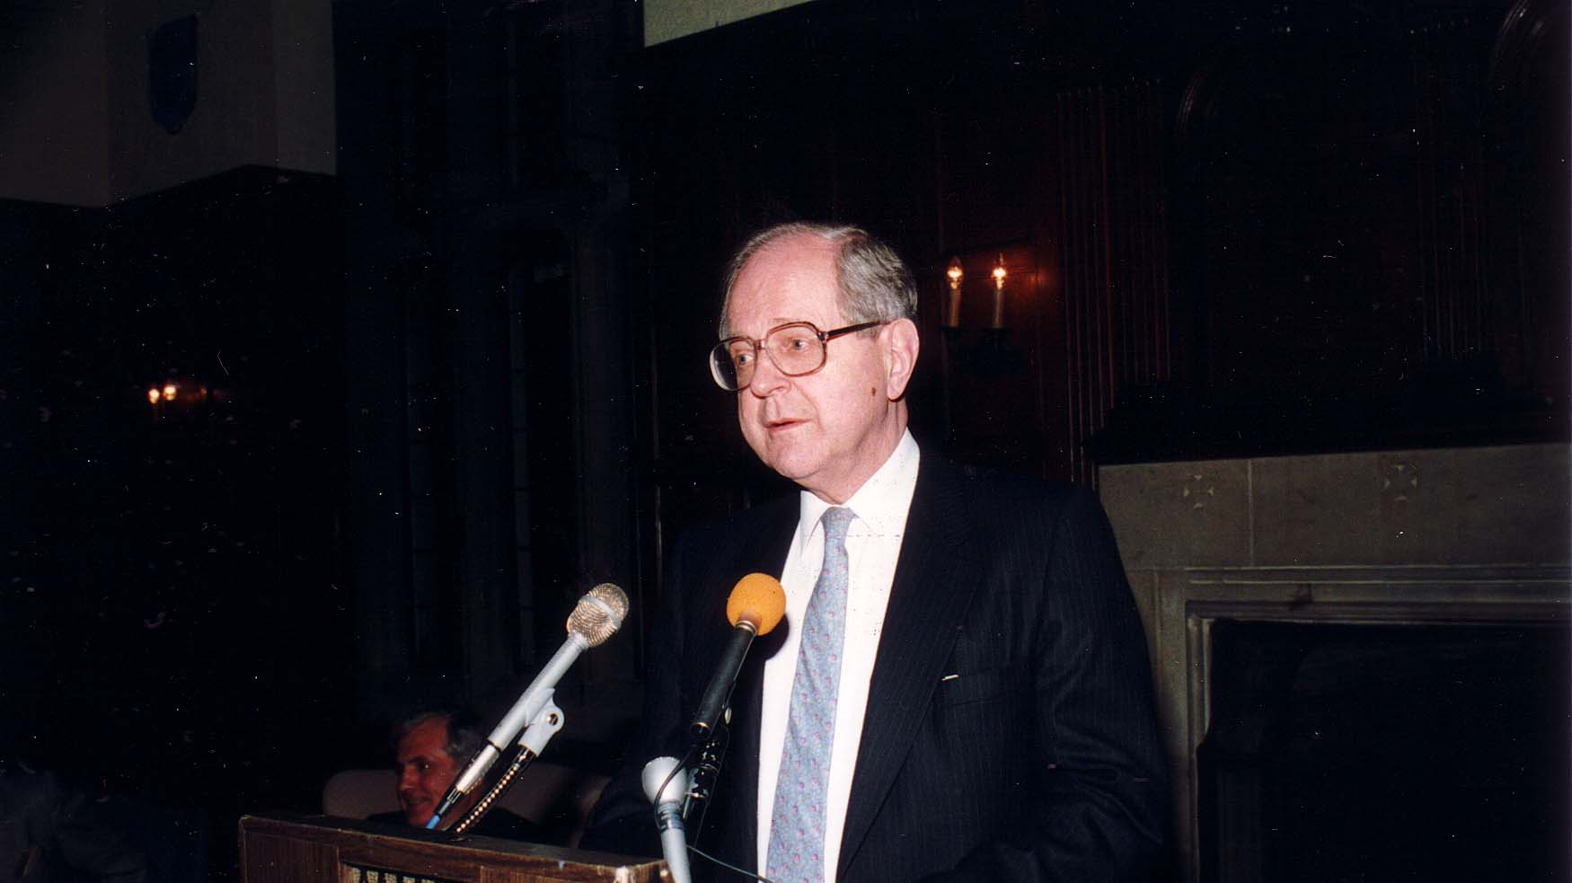
Notes:
TWG_Photo_1988_No_421__March_20__Georgetown_University__Antonovych_Awards__Award_Recipient_Author_Harvest_of_Sorrow_Robert_Conquest
See 1988 March TWG NEWS, pages 1 and 2 for event announcement and April TWG NEWS, page 12, for event coverage

Slide 21
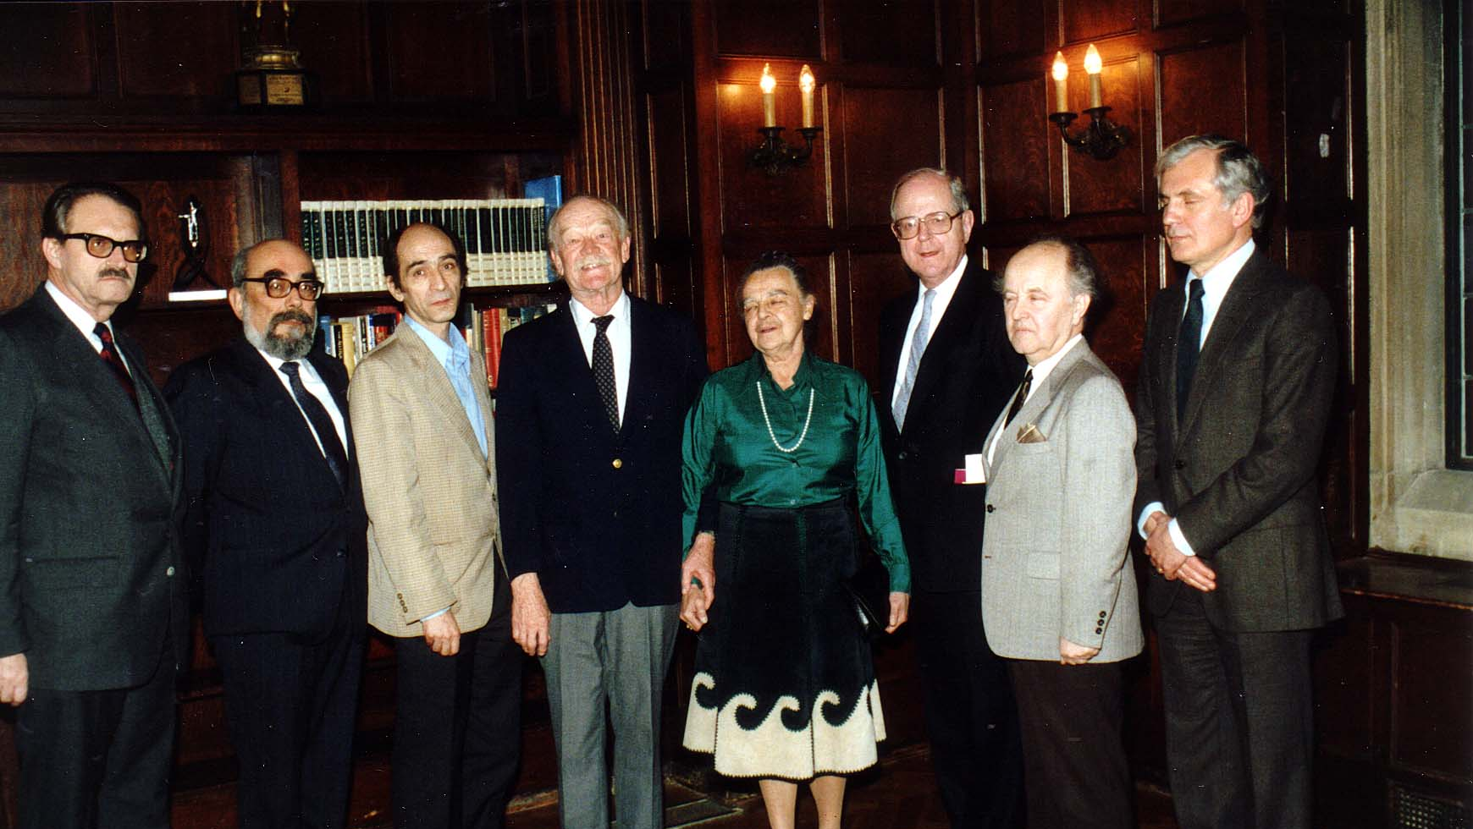
Notes:
TWG_Photo_1988_No_422__March_20__Georgetown_University__Antonovych_Awards__Jaroslaw_Pelenski__Bohdan_Rubchak__Author_Ekzod_Tarasa_Shevchenka_Leonid_Plyushch__Omelian_and_Tetiana_Antonovych__Author_Harvest_of_Sorrow_Robert_Conquest__Ivan_Fizer__Roman_Szporluk
See 1988 March TWG NEWS, pages 1 and 2 for event announcement and April TWG NEWS, page 12, for event coverage

Slide 22
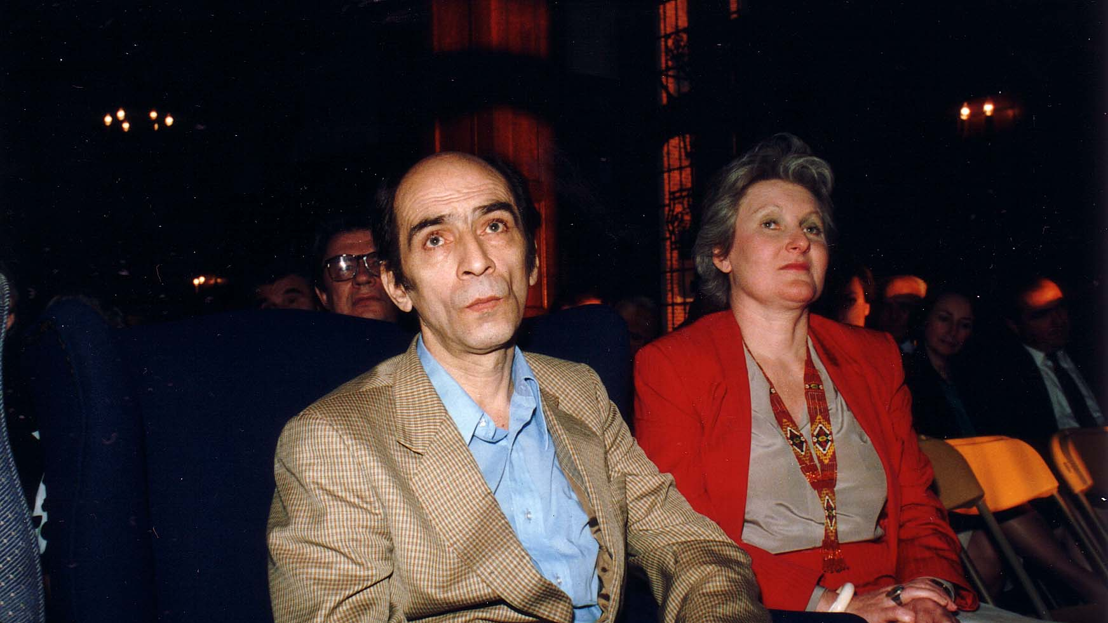
Notes:
TWG_Photo_1988_No_423__March_20__Georgetown_University__Antonovych_Awards__Award_Recipient_Author_Ekzod_Tarasa_Shevchenka_Leonid_Plyushch__Marta_Chomiak
See 1988 March TWG NEWS, pages 1 and 2 for event announcement and April TWG NEWS, page 12, for event coverage

Slide 23
1988 600 TWG Social Events Photographs Christmas Party Van Ness East December 17 Photographs
Orest Deychakiwsky, Ihor Mychkowsky
Orysia Pylyshenko, Lydia Chopivsky, Orest Deychakiwsky, Yaro Bihun, Daria Stec, Maria Rudensky, Anna Worobij

Slide 24
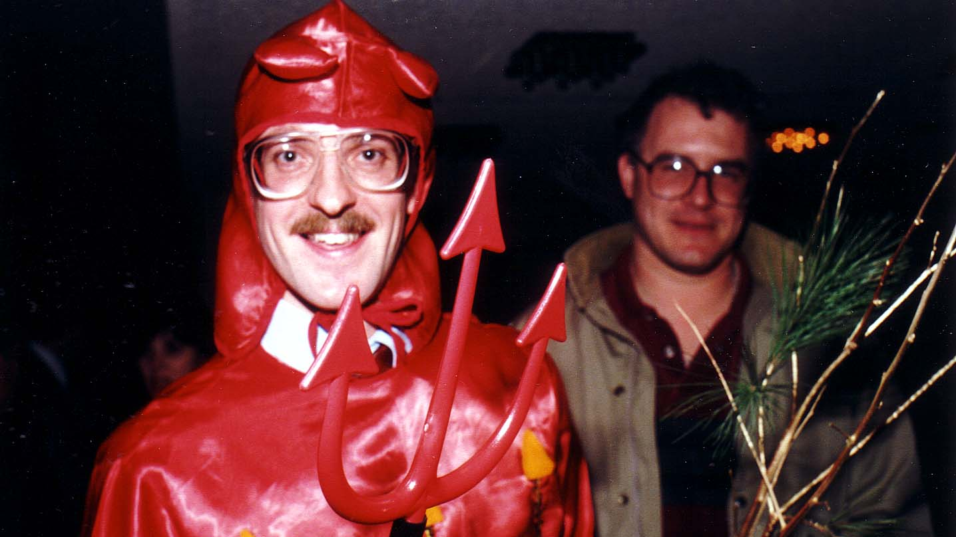
Notes:
TWG_Photo_1988_No_611__Dec_17__Christmas_Party__Chortyk_Orest_Deychakiwsky__Ihor_Mychkowsky
See 1988 December TWG NEWS, page 1, for event announcement and 1989 January TWG NEWS, page 1, for event coverage

Slide 25
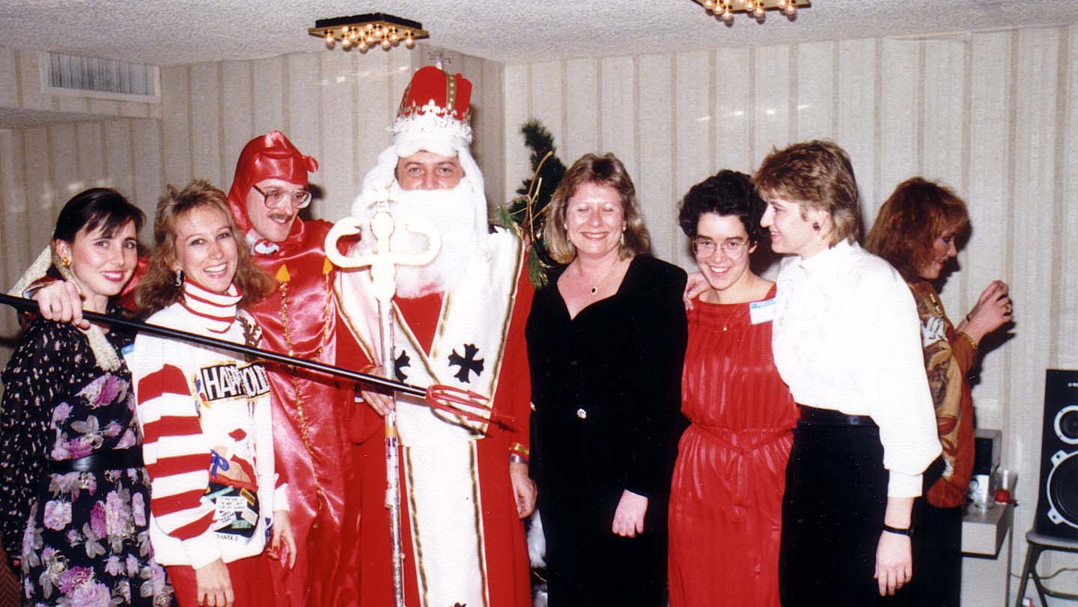
Notes:
TWG_Photo_1988_No_612__Dec_17__Christmas_Party__Orysia_Pylyshenko__Lydia_Chopivsky__Chortyk_Orest_Deychakiwsky__St_Nicholas_Yaro_Bihun__Daria_Stec__Maria_Rudensky__Anna_Worobij
See 1988 December TWG NEWS, page 1, for event announcement and 1989 January TWG NEWS, page 1, for event coverage

