Slide 1
TWG Photos 1989
Created October 24, 2020

Slide 2
1989 100 TWG Annual Meeting Georgetown Holiday Inn November 17 Photographs
TWG Semi-annual Meeting held 1989 April 7, see May TWG NEWS for coverage
See 1989 October TWG NEWS, page 1, and November TWG NEWS, page 1, for event announcement and December TWG NEWS for event coverage
Elected to the Board: Yaro Bihun – President; Lydia Chopivsky – Vice President; Marianne Woloschuk - Secretary; Olha Holoyda – Treasurer; Orysia Pylyshenko – Events Director; Marta Zielyk - Public Relations; Adrian Kerod – Membership Director; Alexandra Ivanchuk Bibbee - Special Projects
Auditing Committee: Ihor Kotlarchuk, Larissa Taran, Oksana Dackiw
Presidium: Marta Bohachevsky-Chomiak, Stephen Daisak, Darian Diachok
In photo: Maria Rudensky, Daria Chapelsky, Zoya Hayuk, Laryssa Chopivsky

Slide 3
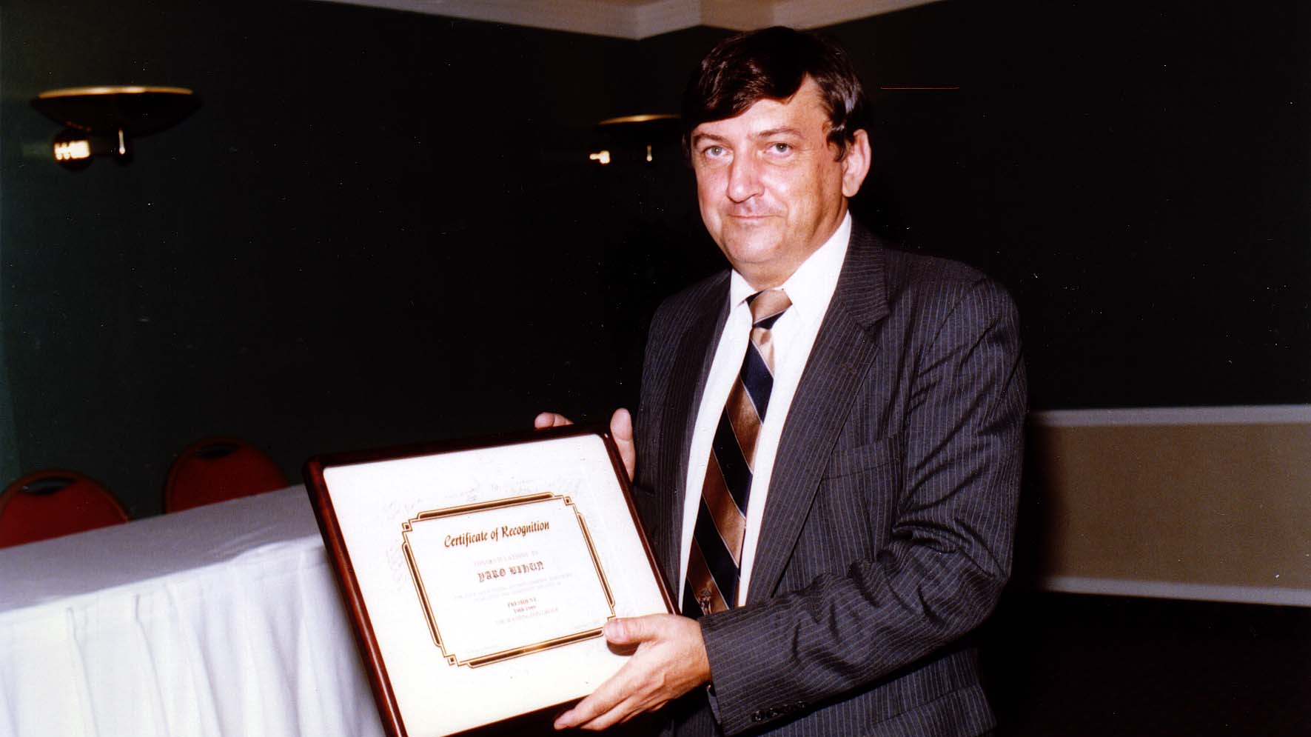
Notes:
TWG_Photo_1989_No_111__Nov_17__Annual_mtg__Award_Recipient_Yaro_Bihun
See 1989 October TWG NEWS, page 1, and November TWG NEWS, page 1, for event announcement and December TWG NEWS for event coverage

Slide 4
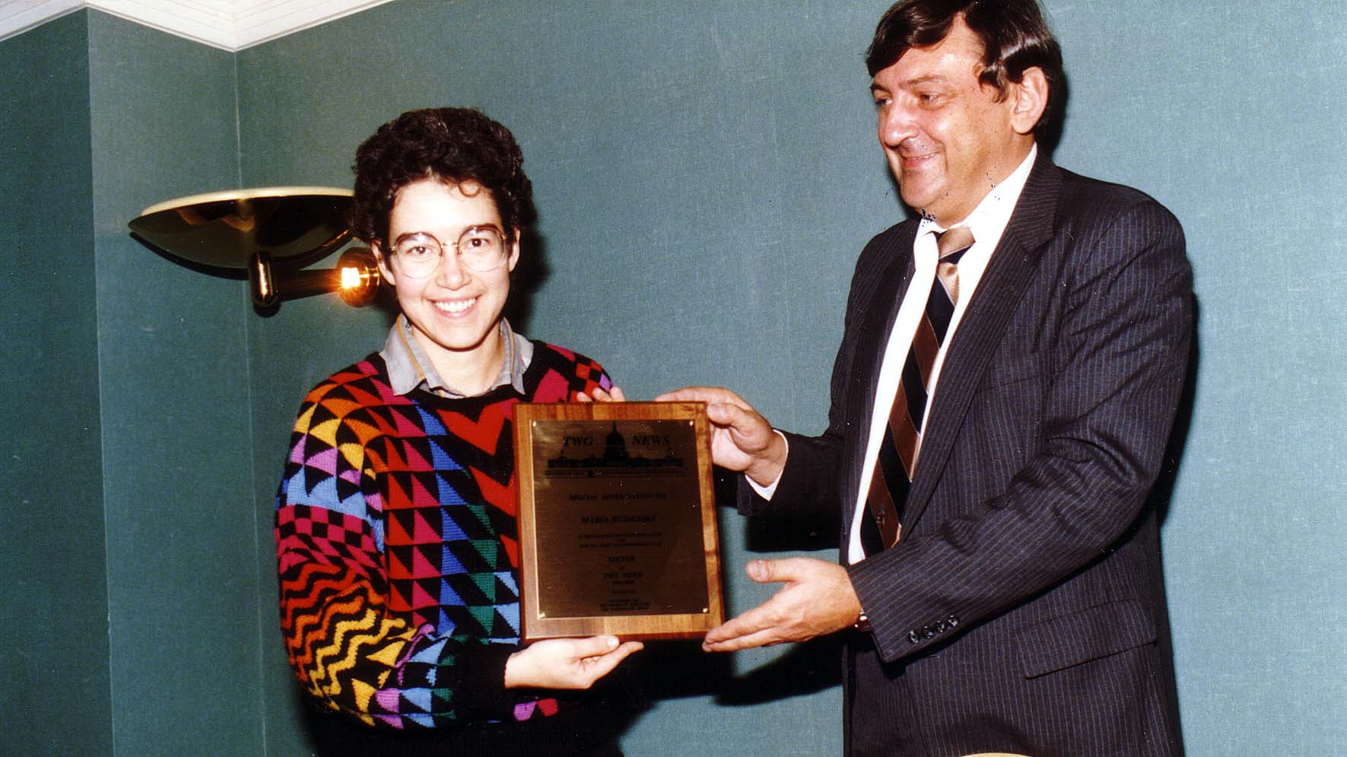
Notes:
TWG_Photo_1989_No_112__Nov_17__Annual_mtg__Award_Recipient_Maria_Rudensky
See 1989 October TWG NEWS, page 1, and November TWG NEWS, page 1, for event announcement and December TWG NEWS for event coverage

Slide 5
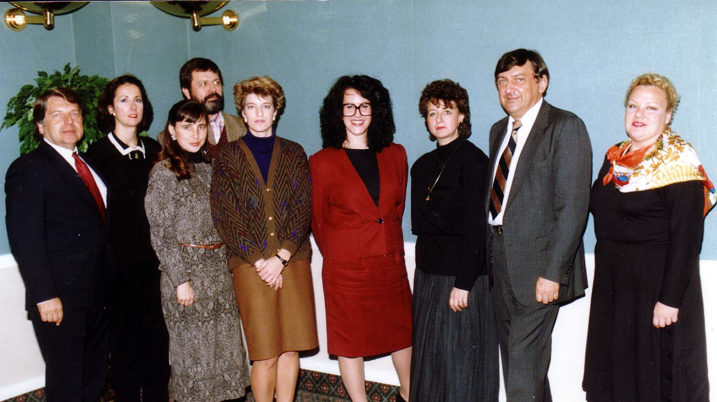
Notes:
TWG_Photo_1989_No_121_Nov_17_Board_of_Directors__Audit_Ihor_Kotlarchuk_and_Oksana_Dackiw__Events_Orysia_Pylyshenko__Membership_Adrian_Kerod__Daria_Chapelsky__Secretary_Marianne_Woloschuk__PR_Dir_Marta_Zielyk__TWG_President_Yaro_Bihun__Treasurer_Olya_Holoyda
See 1989 October TWG NEWS, page 1, and November TWG NEWS, page 1, for event announcement and December TWG NEWS for event coverage

Slide 6
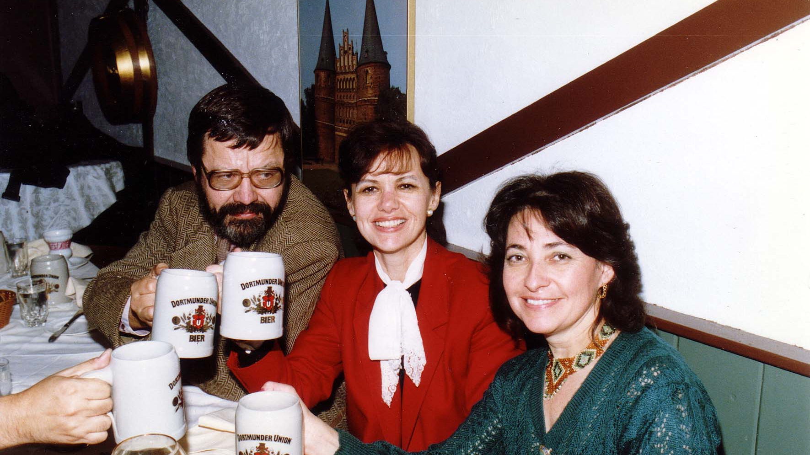
Notes:
TWG_Photo_1989_No_122__Nov_17__Old_Europe_Ratskeller__Post_Annual_Meeting_Celebration__Adrian_Kerod__Natalie_Sluzar__Zoya_Hayuk
See 1989 October TWG NEWS, page 1, and November TWG NEWS, page 1, for event announcement and December TWG NEWS for event coverage

Slide 7
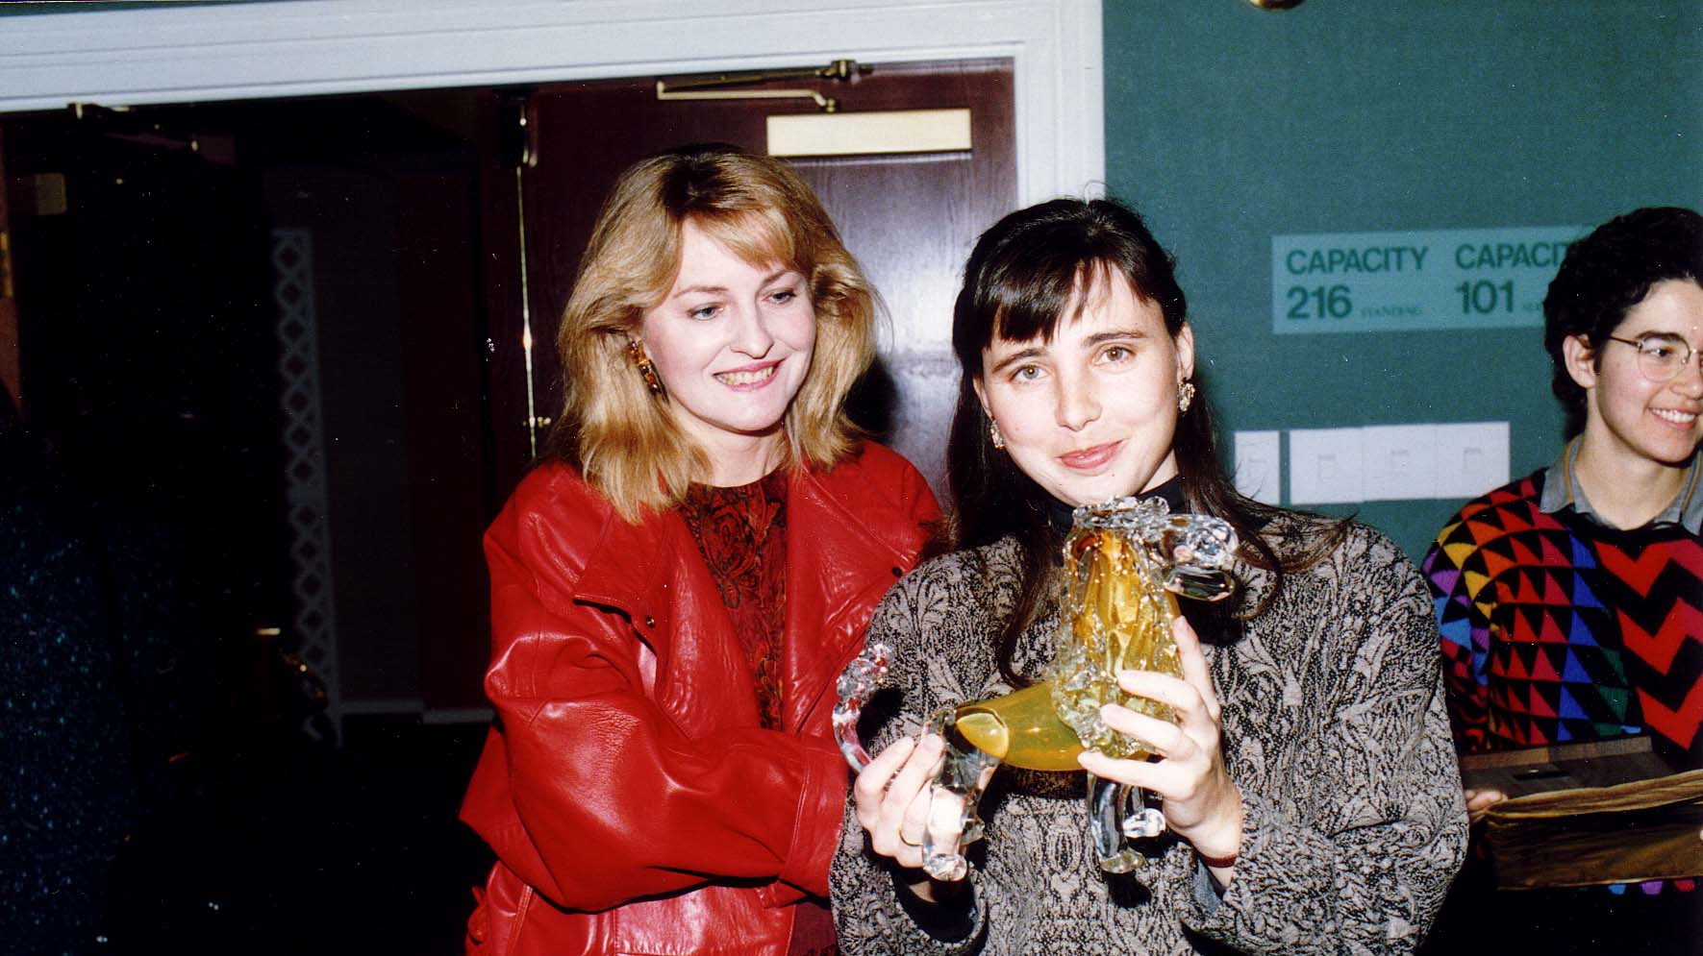
Notes:
TWG_Photo_1989_No_123__Nov_17__Post_Annual_Meeting__Laryssa_Chopivsky__Orysia_Pylyshenko_displaying_her_TWG_Award_a_glass_sculpture_of_a_Lion__symbol_of_Lviv__Maria_Rudensky
See 1989 October TWG NEWS, page 1, and November TWG NEWS, page 1, for event announcement and December TWG NEWS for event coverage

Slide 8
Notes:
TWG_Photo_1989_No_124__Nov_17__Old_Europe_Ratskeller__Post_Annual_Meeting_Celebration__Ihor_Kotlarchuk__Zoya_Hayuk__Laryssa_Chopivsky__Yaro_Bihun
See 1989 October TWG NEWS, page 1, and November TWG NEWS, page 1, for event announcement and December TWG NEWS for event coverage

Slide 9
1989 200 TWG Leadership Conference Hotel Washington October 6-8 Photographs
See Leadership Conference Announcement in 1989 May TWG NEWS, page 9
See Leadership Conference Planning in 1989 June, July-August, September, and October TWG NEWS
See TWG_1989_Leadership_Conference_Booklet for Conference Program and Speaker Biographies
See 1989 November TWG NEWS for Leadership Conference Coverage
See TWG Leadership Conference coverage by The Ukrainian Weekly: The_Ukrainian_Weekly_1989-42

Slide 10
1989 201 TWG Leadership Conference Reception Hotel Washington October 6 Photographs
Yaro Bihun, Laryssa Chopivsky
Yaro Bihun, Laryssa Chopivsky, Daria Stec, Marta Zielyk

Slide 11
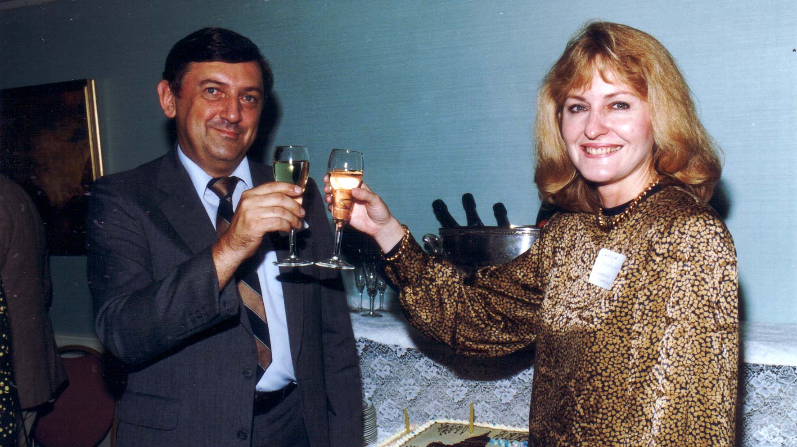
Notes:
TWG_Photo_1989_No_203__Oct_6__Leadership_Conference_Reception__TWG_5th_Birthday__TWG_President_Yaro_Bihun__Laryssa_Chopivsky
See 1989 October TWG NEWS, page 4, for event announcement

Slide 12
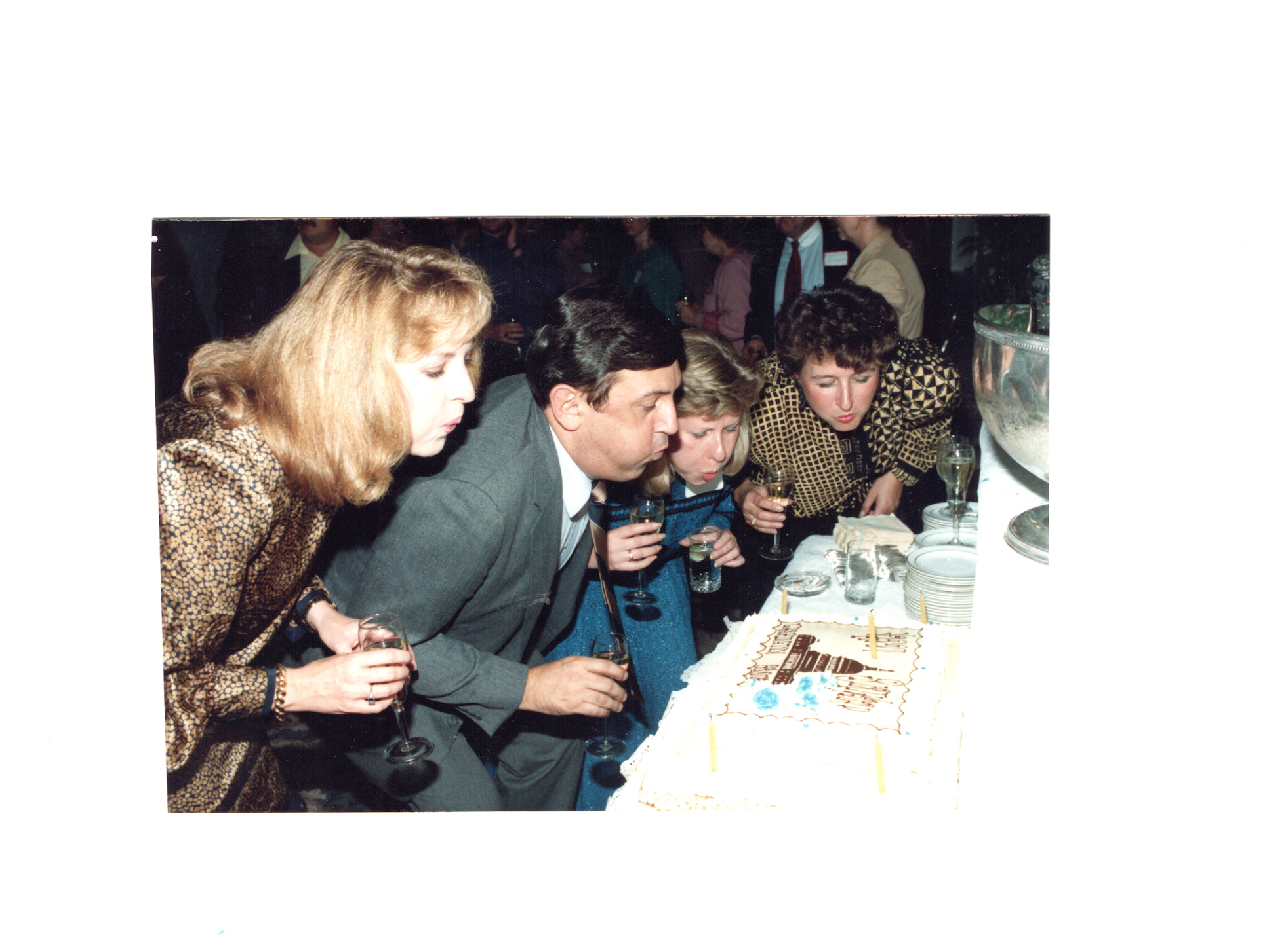
Notes:
TWG_Photo_1989_No_204__Oct_6__Leadership_Conference_Reception__TWG_5th_Birthday__Leadership_Conference_Chair_Laryssa_Chopivsky__TWG_President_Yaro_Bihun__Past_President_Daria_Stec__Public_Relations_Director_Marta_Zielyk
See 1989 October TWG NEWS, page 4, for event announcement

Slide 13
1989 210 TWG Leadership Conference Opening Address October 10 Photographs
Steny Hoyer, Laryssa Chopivsky
Steny Hoyer

Slide 14
Notes:
TWG_Photo_1989_No_214__Oct_7__Leadership_Conference__Leadership_Conference_Chair_Laryssa_Chopivsky__introduces__Keynote_Speaker_US_Representative_and_Co_Chairman_Commission_on_Security_and_Cooperation_in_Europe_(Helsinki_Commission)_Steny_Hoyer
See 1989 November TWG NEWS, page 9 and The Ukrainian Weekly 1989-42, page 11 for event coverage

Slide 15
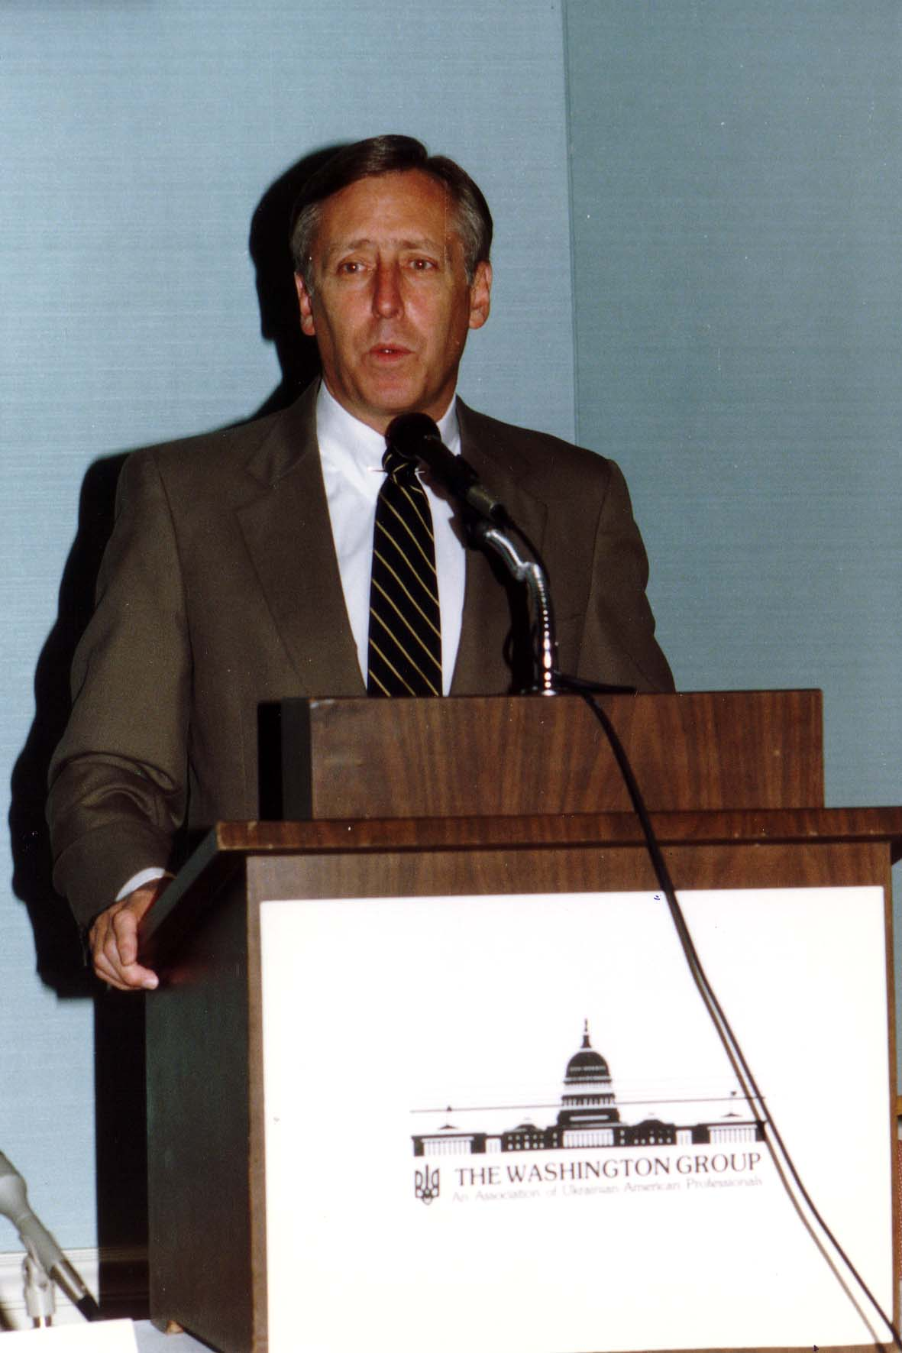
Notes:
TWG_Photo_1989_No_215__Oct_7__Leadership_Conference__Keynote_Address__US_Representative_and_Co_Chairman_Commission_on_Security_and_Cooperation_in_Europe_Helsinki_Commission_Steny_Hoyer
See 1989 November TWG NEWS, page 9 and The Ukrainian Weekly 1989-42, page 11

Slide 16
1989 230 TWG Leadership Conference Banquet October 7 Photographs
Volodymyr Yavorivsky
Metropolitan Mstyslav, Wolodymyr Pylyshenko
Roma Hadzewycz, David Marples

Slide 17
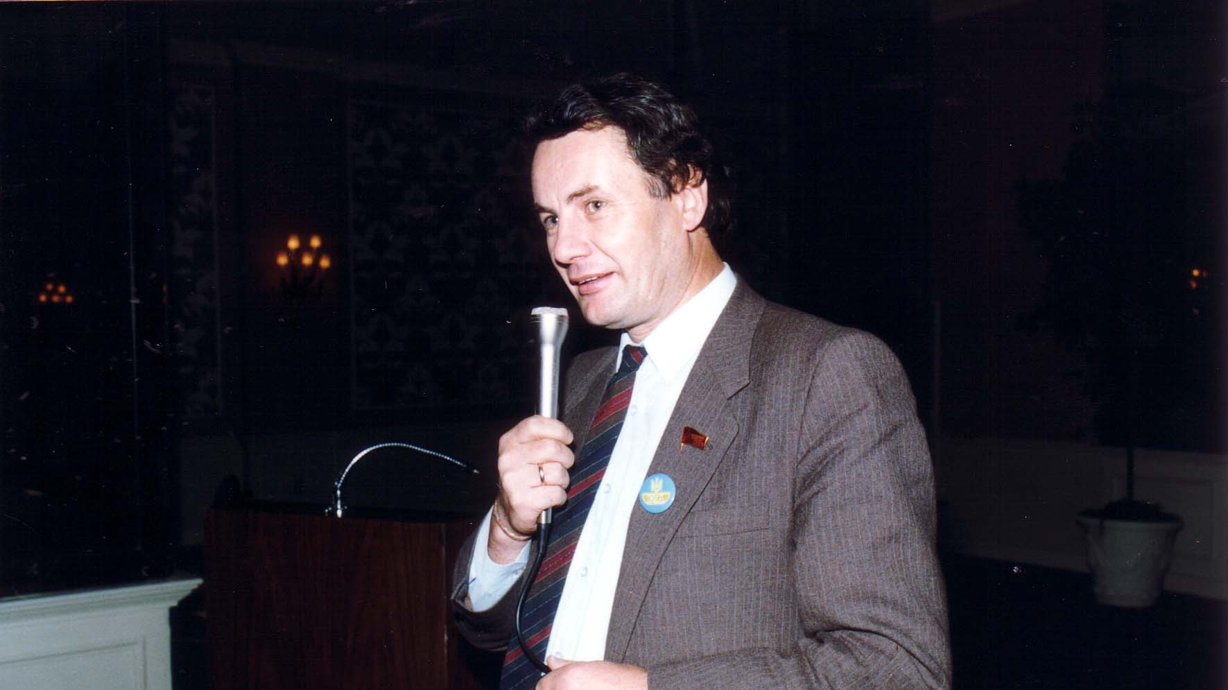
Notes:
TWG_Photo_1989_No_231__Oct_7__Leadership_Conference__Representative_to_Soviet_Congress_of_People's_Deputies_and_Leader_of_Popular_Movement_for_Perebudova_Rukh_Volodymyr_Yavorivsky
See 1989 November TWG NEWS, pages 1, 2, 5, 6; see The Ukrainian Weekly 1989-42, page 8 for transcript

Slide 18
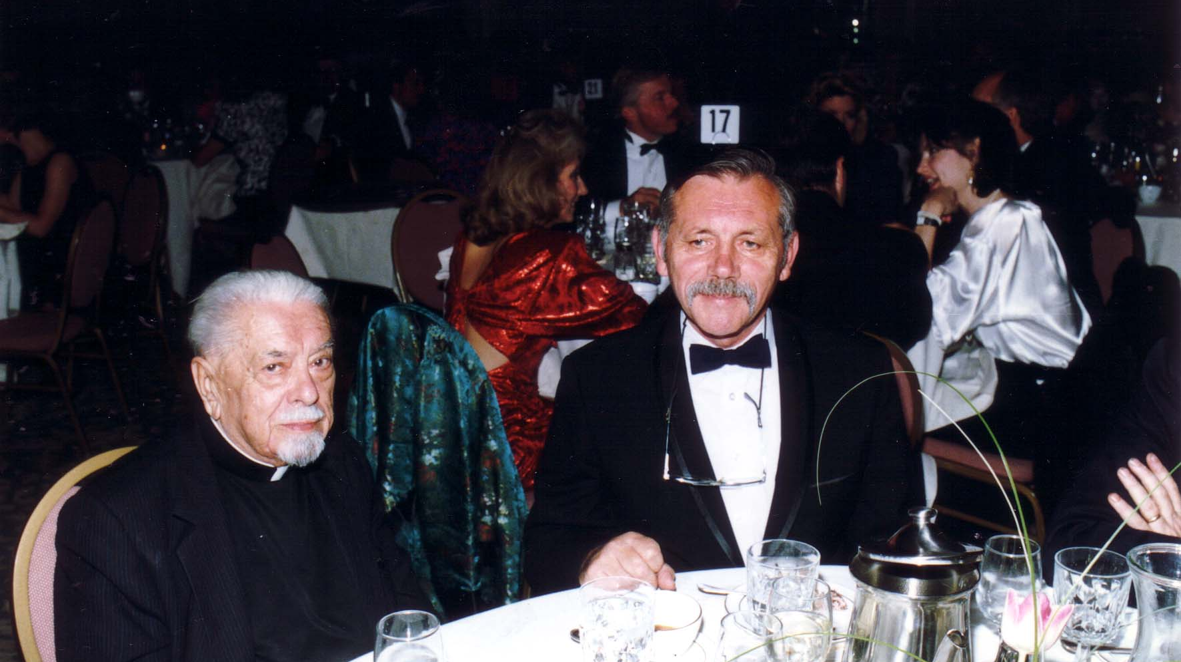
Notes:
TWG_Photo_1989_No_235__Oct_7__Leadership_Conference_Banquet__Metropolitan_Mstyslav__Wolodymyr_Pylyshenko
See 1989 November TWG NEWS, page 2, 5

Slide 19
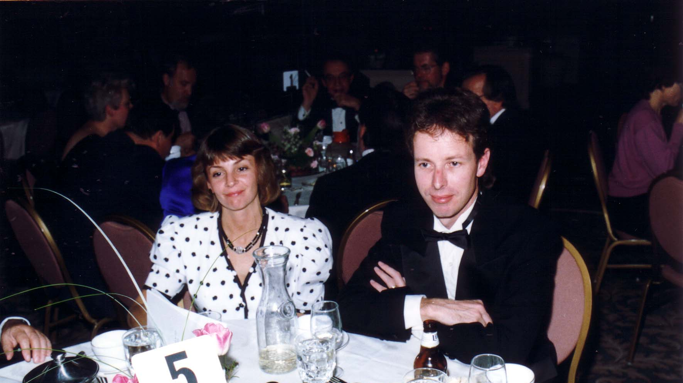
Notes:
TWG_Photo_1989_No_236__Oct_7__Leadership_Conference__Editor_in_Chief_Ukrainian_Weekly_Roma_Hadzewycz__Historian_and_Chornobyl_Researcher_at_University_of_Alberta_Dr_David_Marples
See 1989 November TWG NEWS, pages 1, 9, 10 for coverage of Dr. Marples; See The Ukrainian Weekly 1989-42 for Roma Hadzewycz coverage of the TWG Leadership Conference

Slide 20
1989 240 TWG Leadership Conference Session 1: Changes in Ukraine October 7 Photographs
Mykola Horbal
Mykola Rudenko
Paula Dobriansky

Slide 21
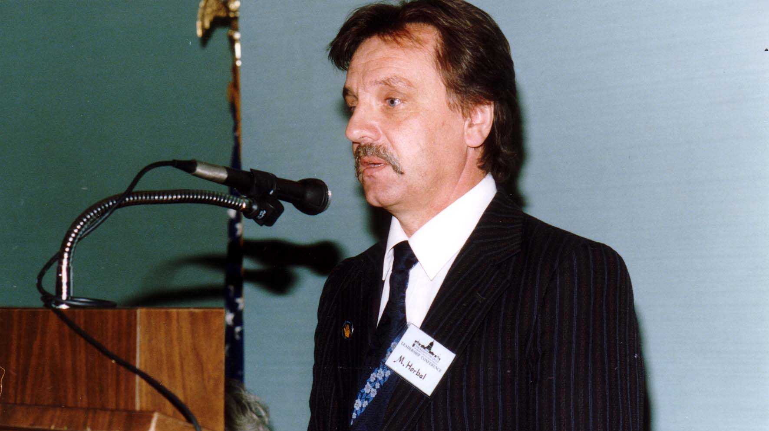
Notes:
TWG_Photo_1989_No_241_Oct__7__Leadership_Conference__Poet_Former_Political_Prisoner_Member_of_Rukh_Coordinating_Committee_Member_of_Helsinki_Union_Mykola_Horbal
See 1989 November TWG NEWS, page 6, for coverage of Horbal’s remarks to the conference, also see The Ukrainian Weekly 1989-42, page 4, for Horbal’s same day speech at the Shevchenko jubilee celebration (unofficial part of TWG Conference)

Slide 22
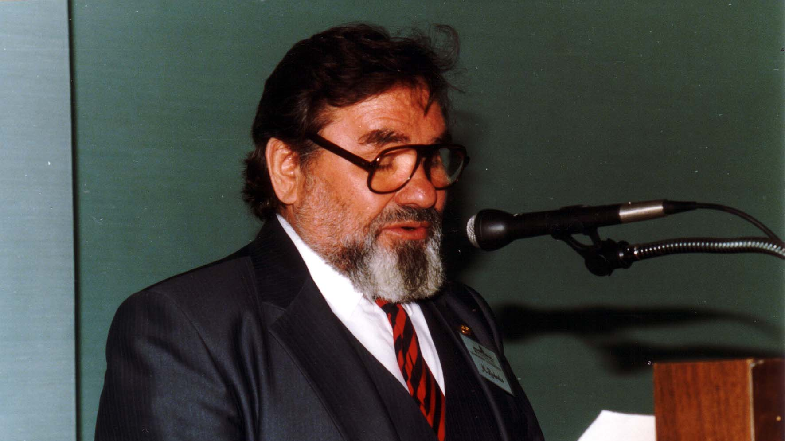
Notes:
TWG_Photo_1989_No_242__Oct_7__Leadership_Conference_Former_Soviet_Political_Prisoner_First_President_of_Ukrainian_Helsinki_Group_Head_of_its_External_Representation_Mykola_Rudenko
See 1989 November TWG NEWS, page 9

Slide 23
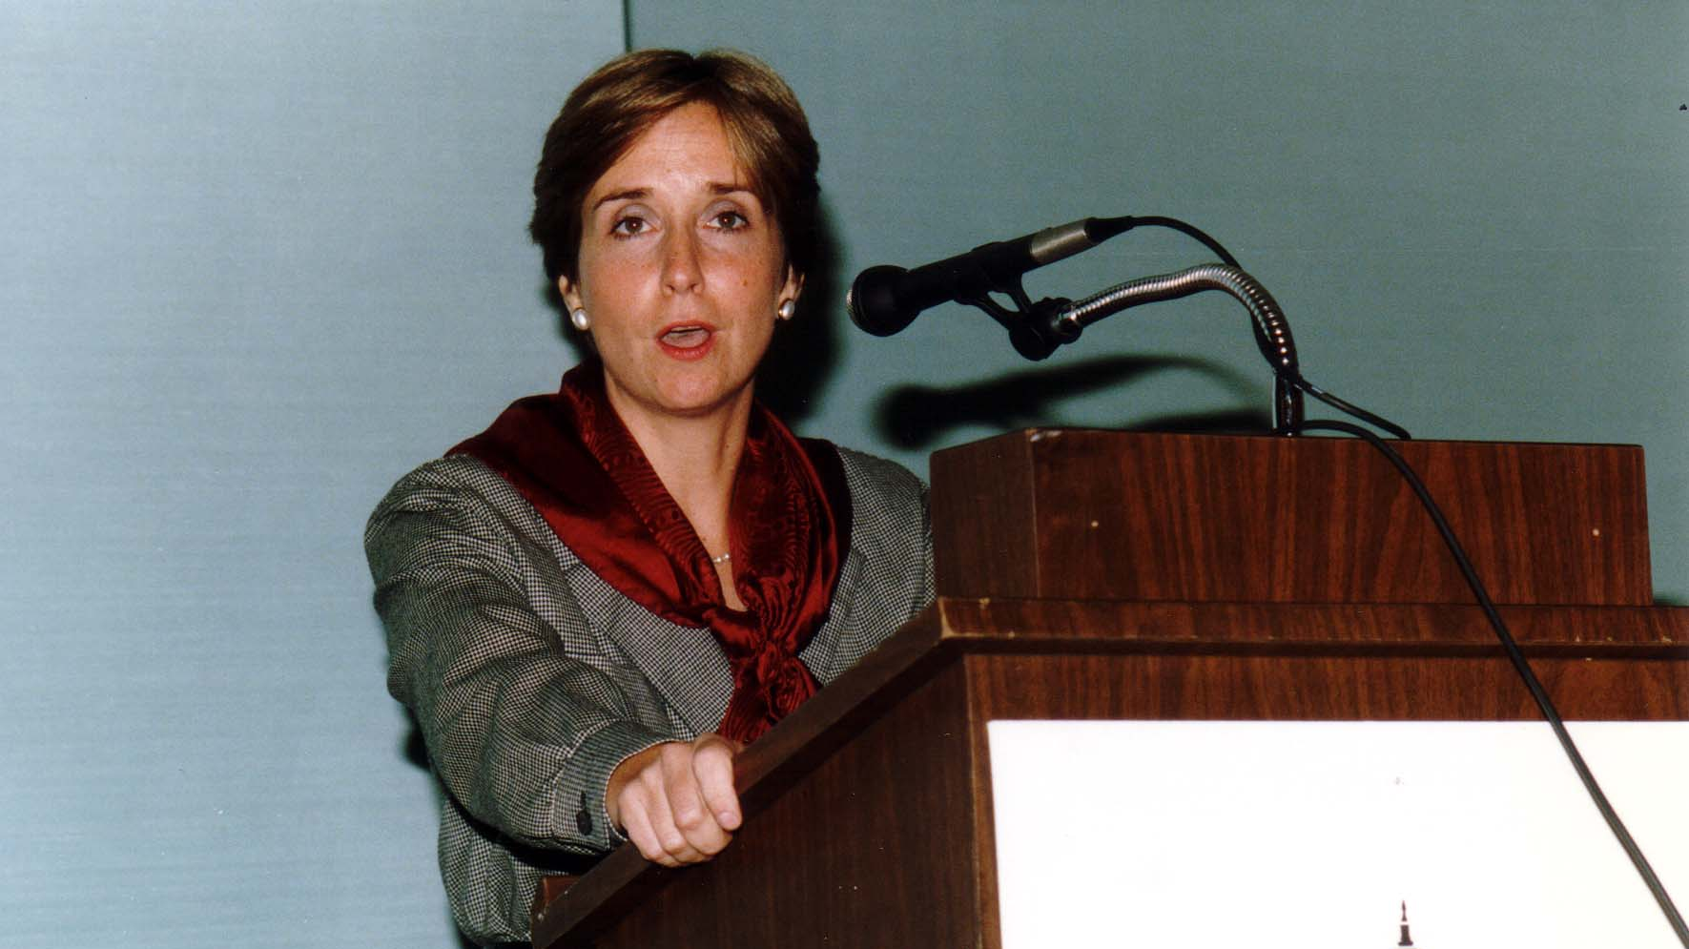
Notes:
TWG_Photo_1989_No_243__Oct_7__Leadership_Conference__Deputy_Assistant_Secretary_of_State_Paula_Dobriansky
See 1989 November TWG NEWS, page 9

Slide 24
1989 250 TWG Leadership Conference Session 2: Relations with Ukraine October 7 Photographs
Virko Baley

Slide 25
Notes:
TWG_Photo_1989_No_251__Oct_7__Leadership_Conference__Music_Director_and_Conductor_Las_Vegas_Symphony_Orchestra_Virko_Baley
See 1989 November TWG NEWS, page 10

Slide 26
1989 260 TWG Leadership Conference Session 3 "Issues" October 8 Photographs
Placeholder for future Photographs

Slide 27
1989 300 TWG Events Photographs
Soviet reforms: Vitaliy Korotych
Helsinki Process: Orest Deychakiwsky, Ron McNamara, John Finerty
Ukrainian Historians: Zenon Kohut, Orest Subtelny
Krysa Concert: Oleh Krysa, Stefan Maksymjuk
Situation in Ukraine: Pavlo Movchan, Les Taniuk, Nelli Kornienko

Slide 28
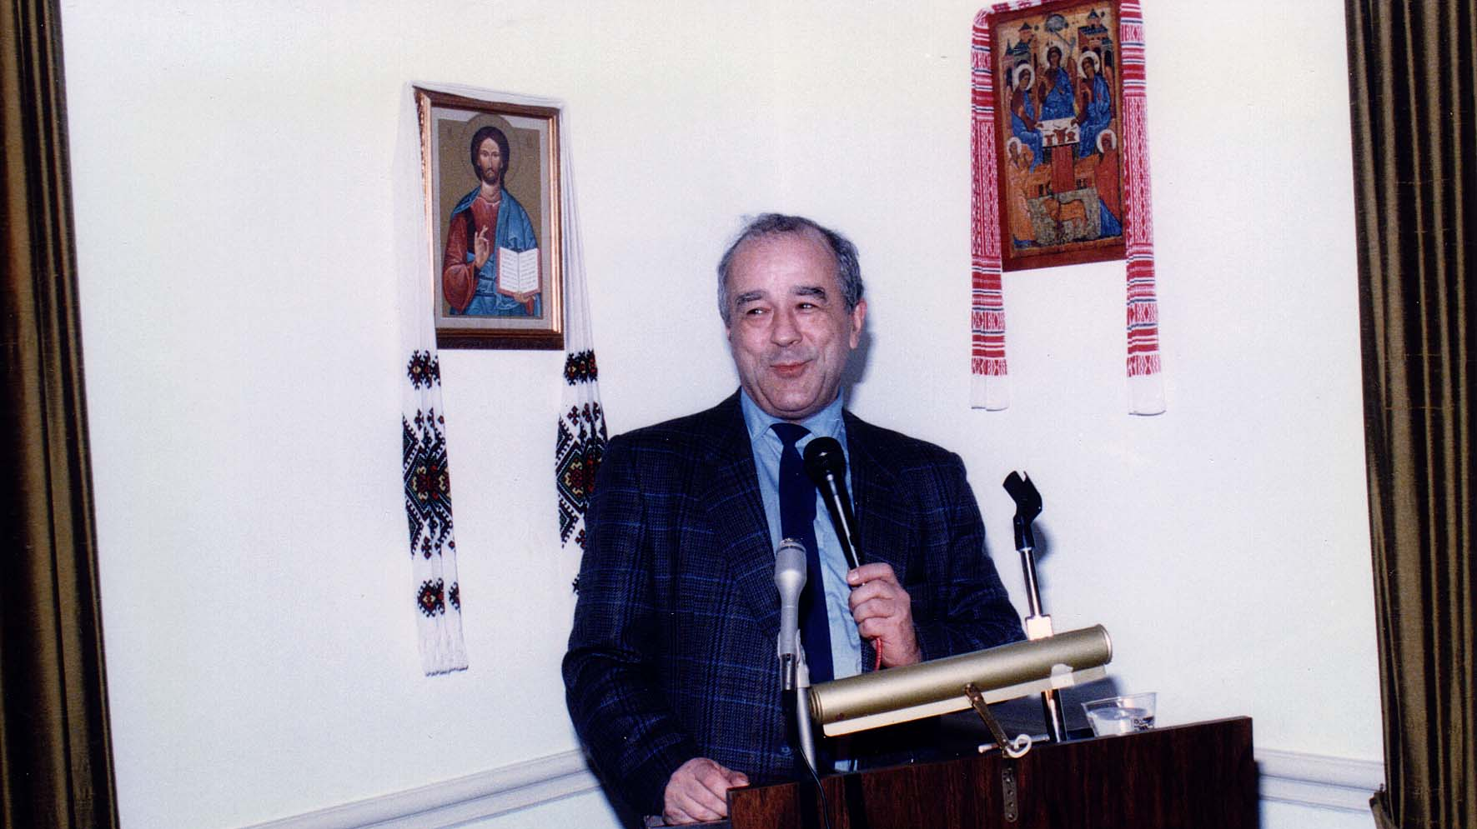
Notes:
TWG_Photo_1989_No_341_Jan__25__St_Sophia_Religious_Association__Ogonyok_Editor_Vitaliy_Korotych
See 1989 February TWG NEWS, page 1, for event coverage

Slide 29
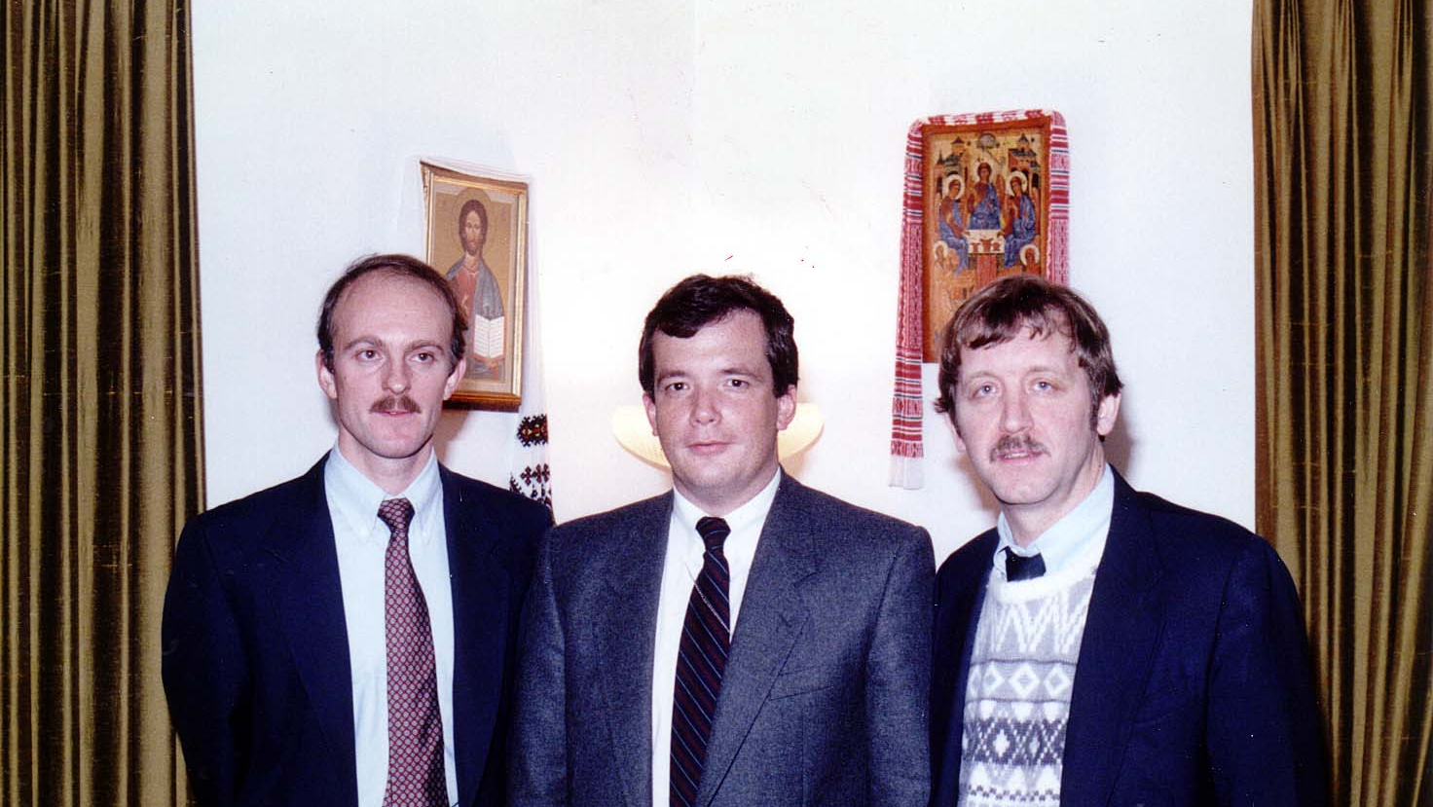
Notes:
TWG_Photo_1989_No_342__Feb_3__St_Sophia_Religious_Association__Policy_Advisors_Helsinki_Commission__Orest_Deychakiwsky__Ron_McNamara__John_Finerty
See 1989 January TWG NEWS for event announcement and February TWG NEWS, page 2, for event coverage

Slide 30
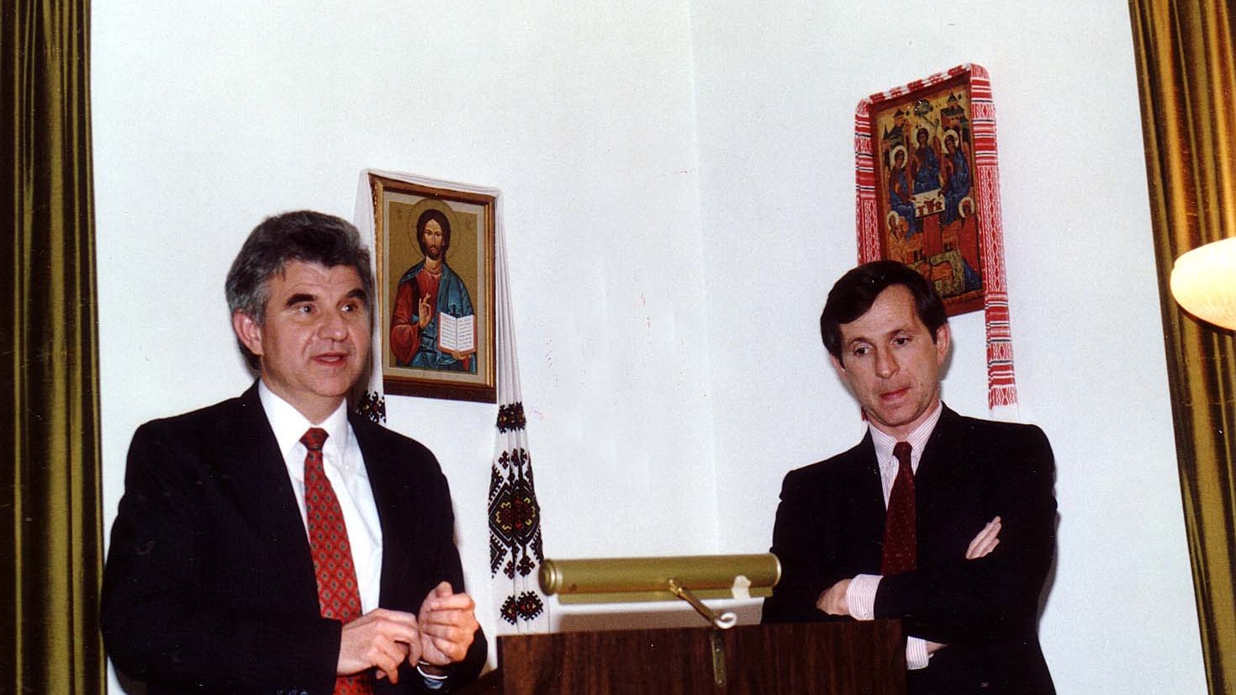
Notes:
TWG_Photo_1989_No_343__Feb_17__St_Sophia_Religious_Association__Historian_Zenon_Kohut__Historian_Orest_Subtelny
See 1989 February TWG NEWS, page 1, for event announcement and March TWG NEWS, page 1, for event coverage

Slide 31
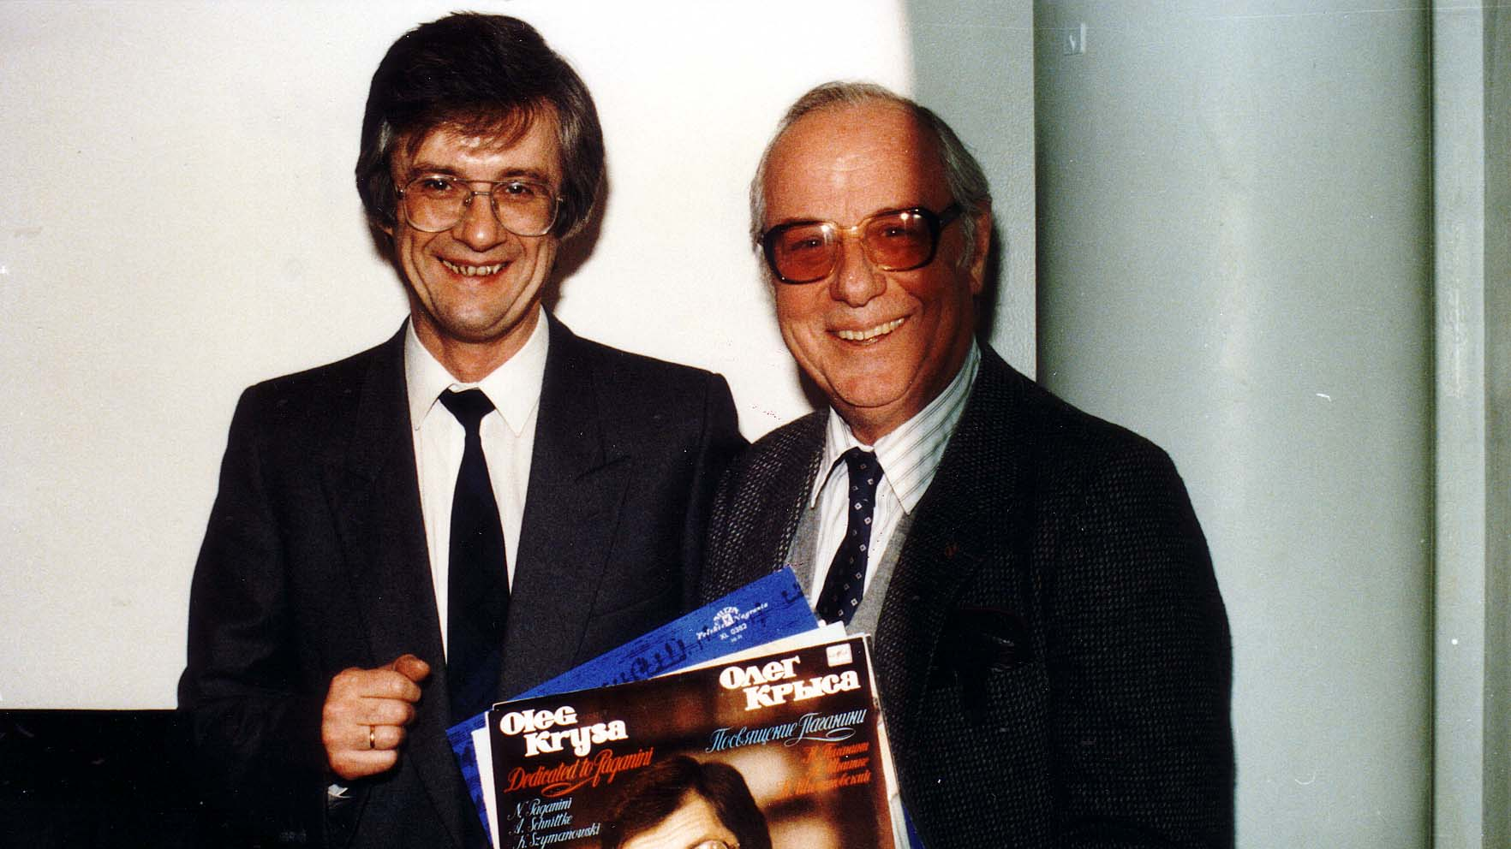
Notes:
TWG_Photo_1989_No_344__Feb_24__Dumbarton_United_Methodist_Church__Violinist_Oleh_Krysa__Discographer_Stefan_Maksymjuk
See 1989 March TWG NEWS, page 5, for event coverage

Slide 32
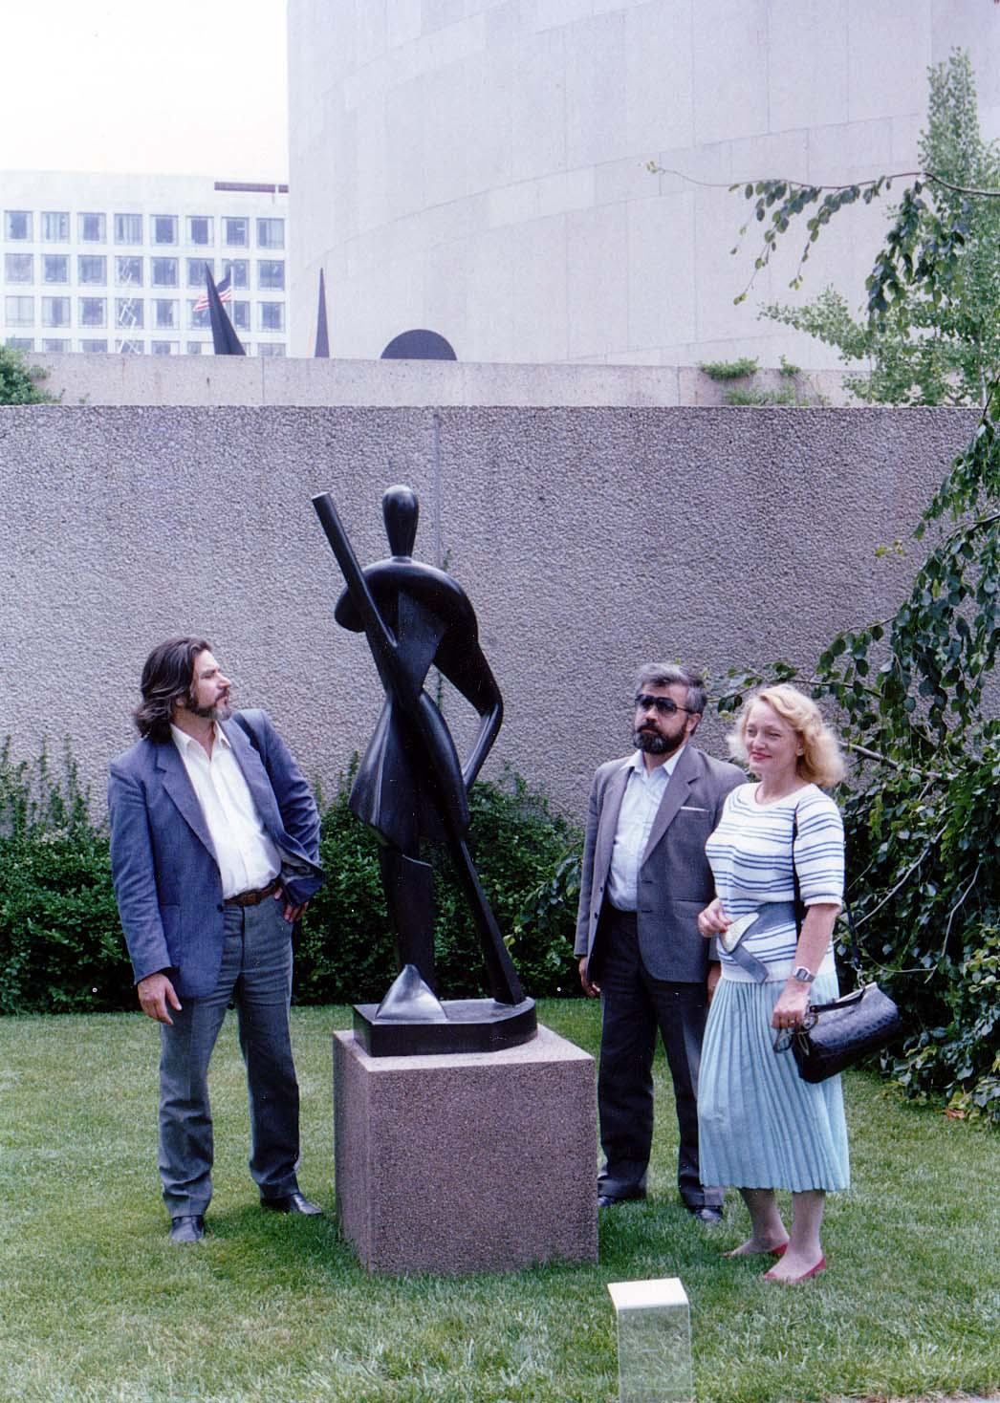
Notes:
TWG_Photo_1989_No_345__July_13__Statue_'Gondolier'_by_Archipenko_Hirshhorn_Sculpture_Garden_Smithsonian__Poet_Pavlo_Movchan__Leader_of_Memorial_Les_Taniuk__his_wife_Union_of_Soviet_Journalists_and_Union_of_Soviet_Theatrical_Activists_Nelli_Kornienko
See 1989 July-August TWG NEWS, page 5, for event coverage

Slide 33
1989 330 TWG Evening with Ivan Dziuba, Ihor Rymaruk, Raisa Ivanchenko, and Mykola Zhulynsky Holy Family Parish Center March 28 Photographs
Ivan Dziuba
Raisa Ivanchenko
Mykola Zhulynsky
Ihor Rymaruk

Slide 34
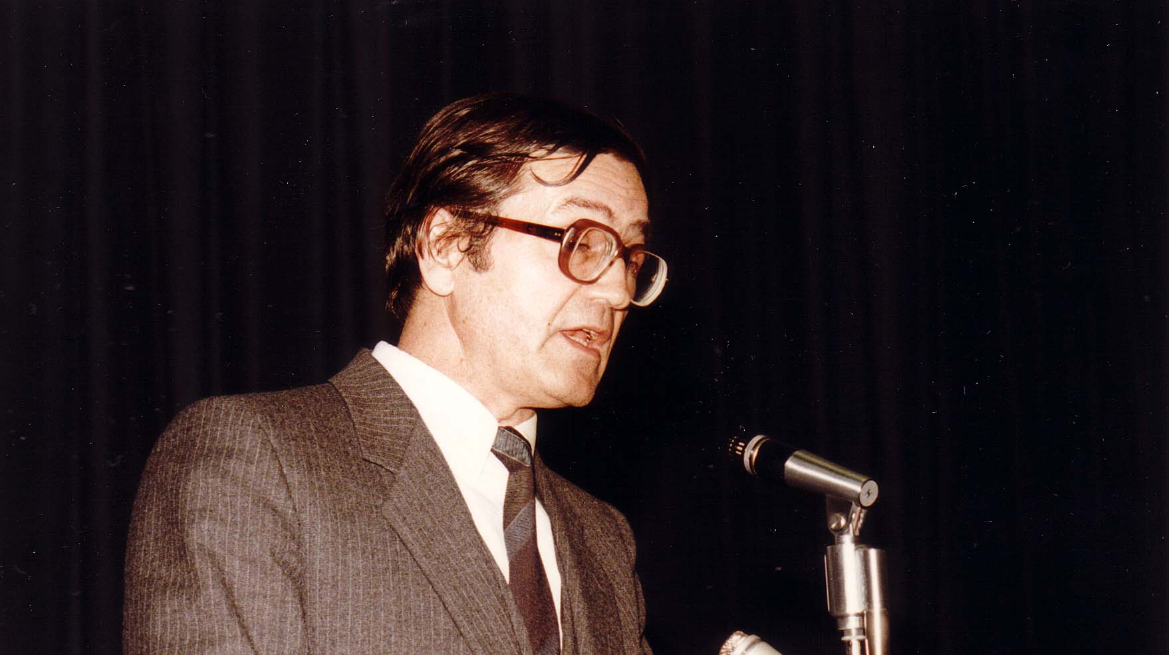
Notes:
TWG_Photo_1989_No_331__March_28__Holy_Family_Parish_Center__Author_of_Internationalism_or_Russification_Ivan_Dziuba
See March TWG NEWS, page 1, for event announcement and April TWG NEWS, page 1, for event coverage

Slide 35
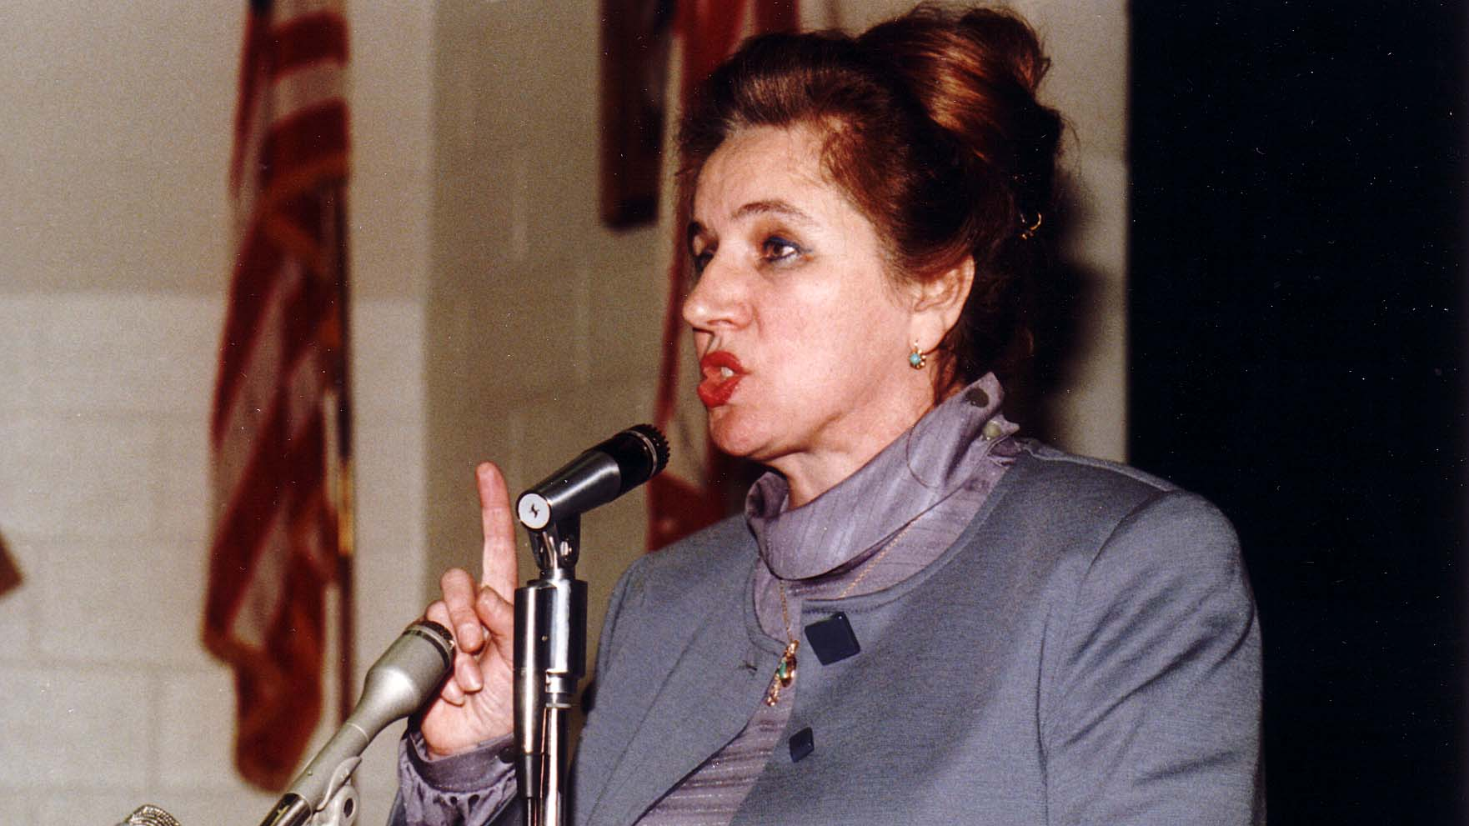
Notes:
TWG_Photo_1989_No_332__March_28__Holy_Family_Parish_Center__Novelist_and_Historian_Raisa_Ivanchenko
See March TWG NEWS, page 1, for event announcement and April TWG NEWS, page 1, for event coverage

Slide 36
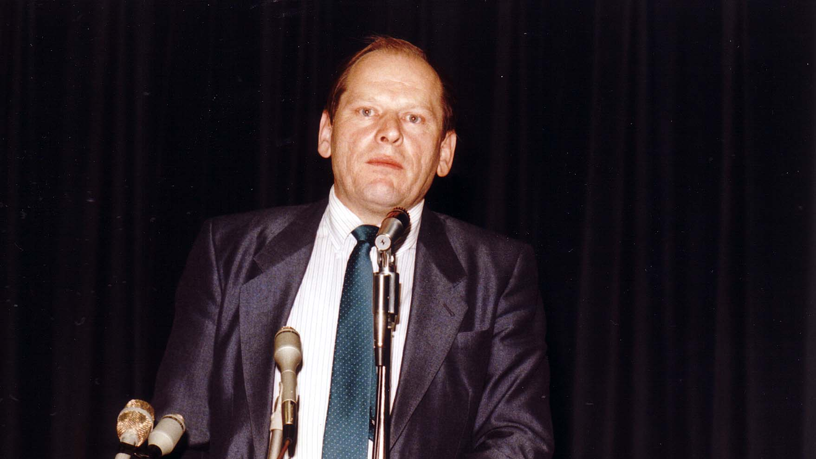
Notes:
TWG_Photo_1989_No_333__March_28__Holy_Family_Parish_Center__Literary_Critic_Mykola_Zhulynsky
See March TWG NEWS, page 1, for event announcement and April TWG NEWS, page 1, for event coverage

Slide 37
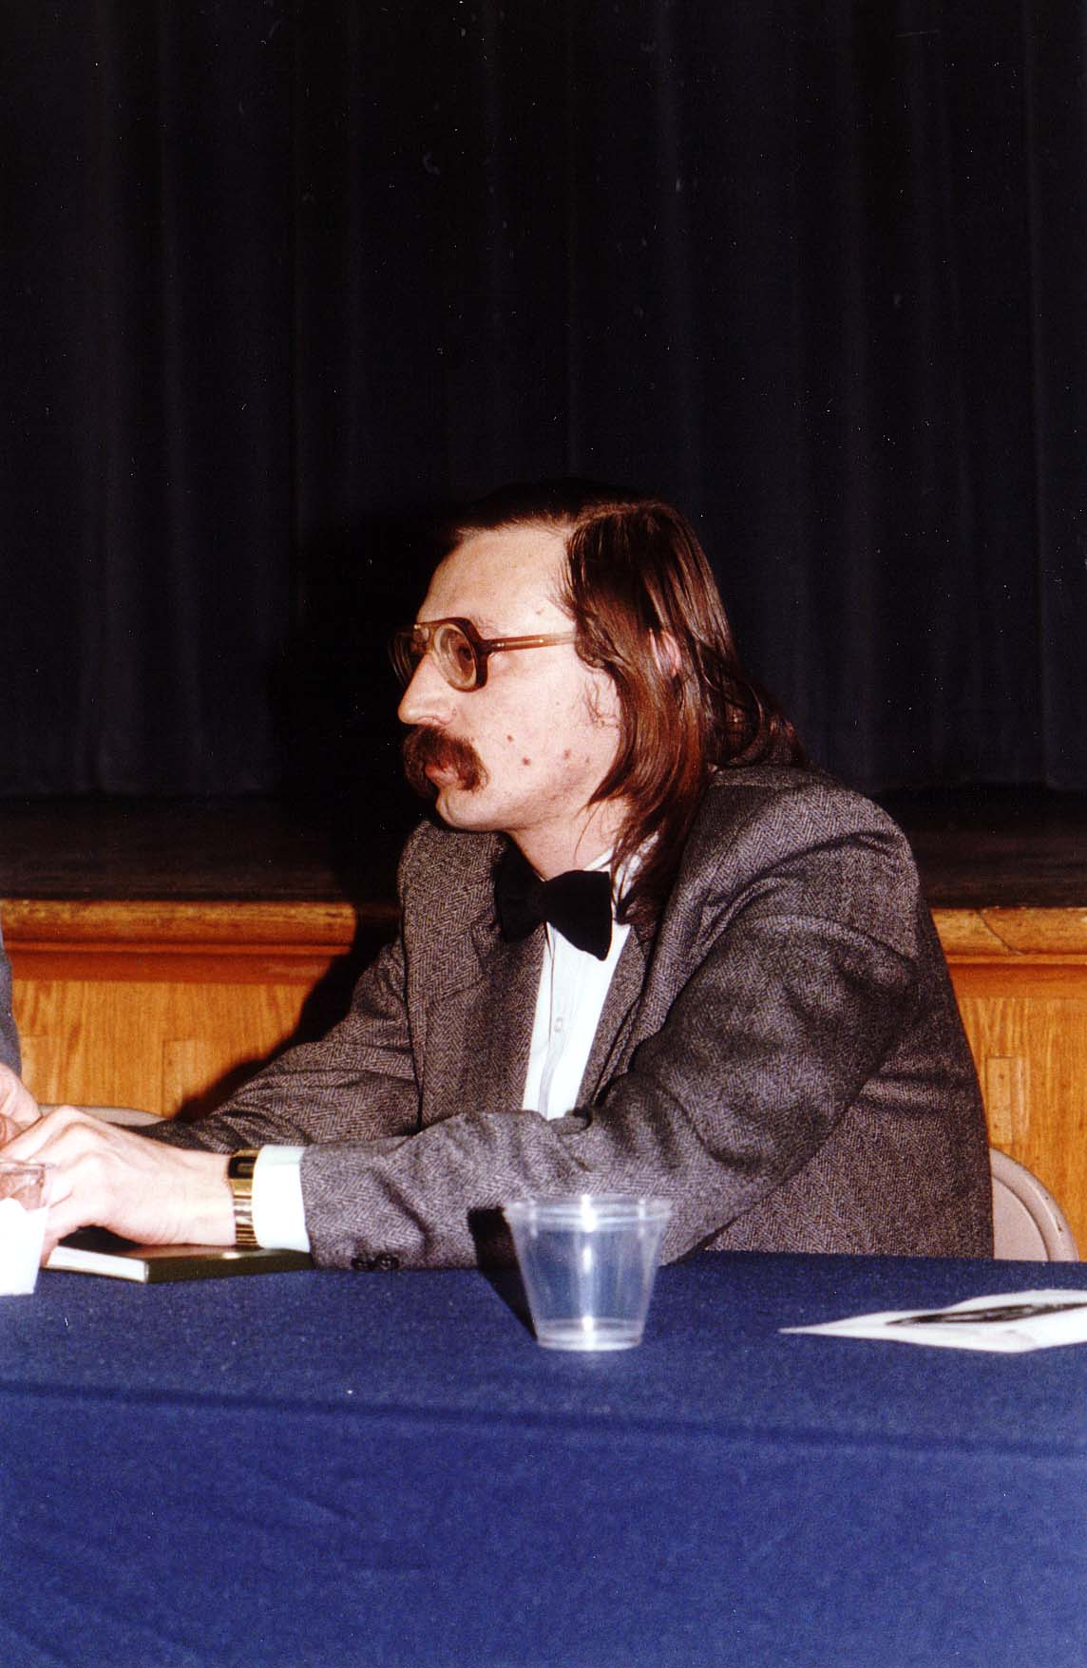
Notes:
TWG_Photo_1989_No_334__March_28__Holy_Family_Parish_Center__Poet_Ihor_Rymaruk
See March TWG NEWS, page 1, for event announcement and April TWG NEWS, page 1, for event coverage

Slide 38
1989 390 TWG evening BIZNEX Washington Chinatown August 11 Photographs
Tereshka Ben, Laryssa Chopivsky, Valentina Limonczenko, Kostyk Ben, George Masiuk, Serhiy Berezovenko, Arthur George, Yaro Bihun
Yaro Bihun, Lydia Chopivsky-Benson, Orysia Pylyshenko, John Hewko, Serhiy Berezevenko, Andriy Bihun, Serhiy Mischenko, Vitaly Voloshin
Valentyn Zabijaka, Serhiy Mischenko, Lydia Chopivsky-Benson, Sophia Chopivsky, Marika Jurach, Oksana Dackiw, John Hewko

Slide 39
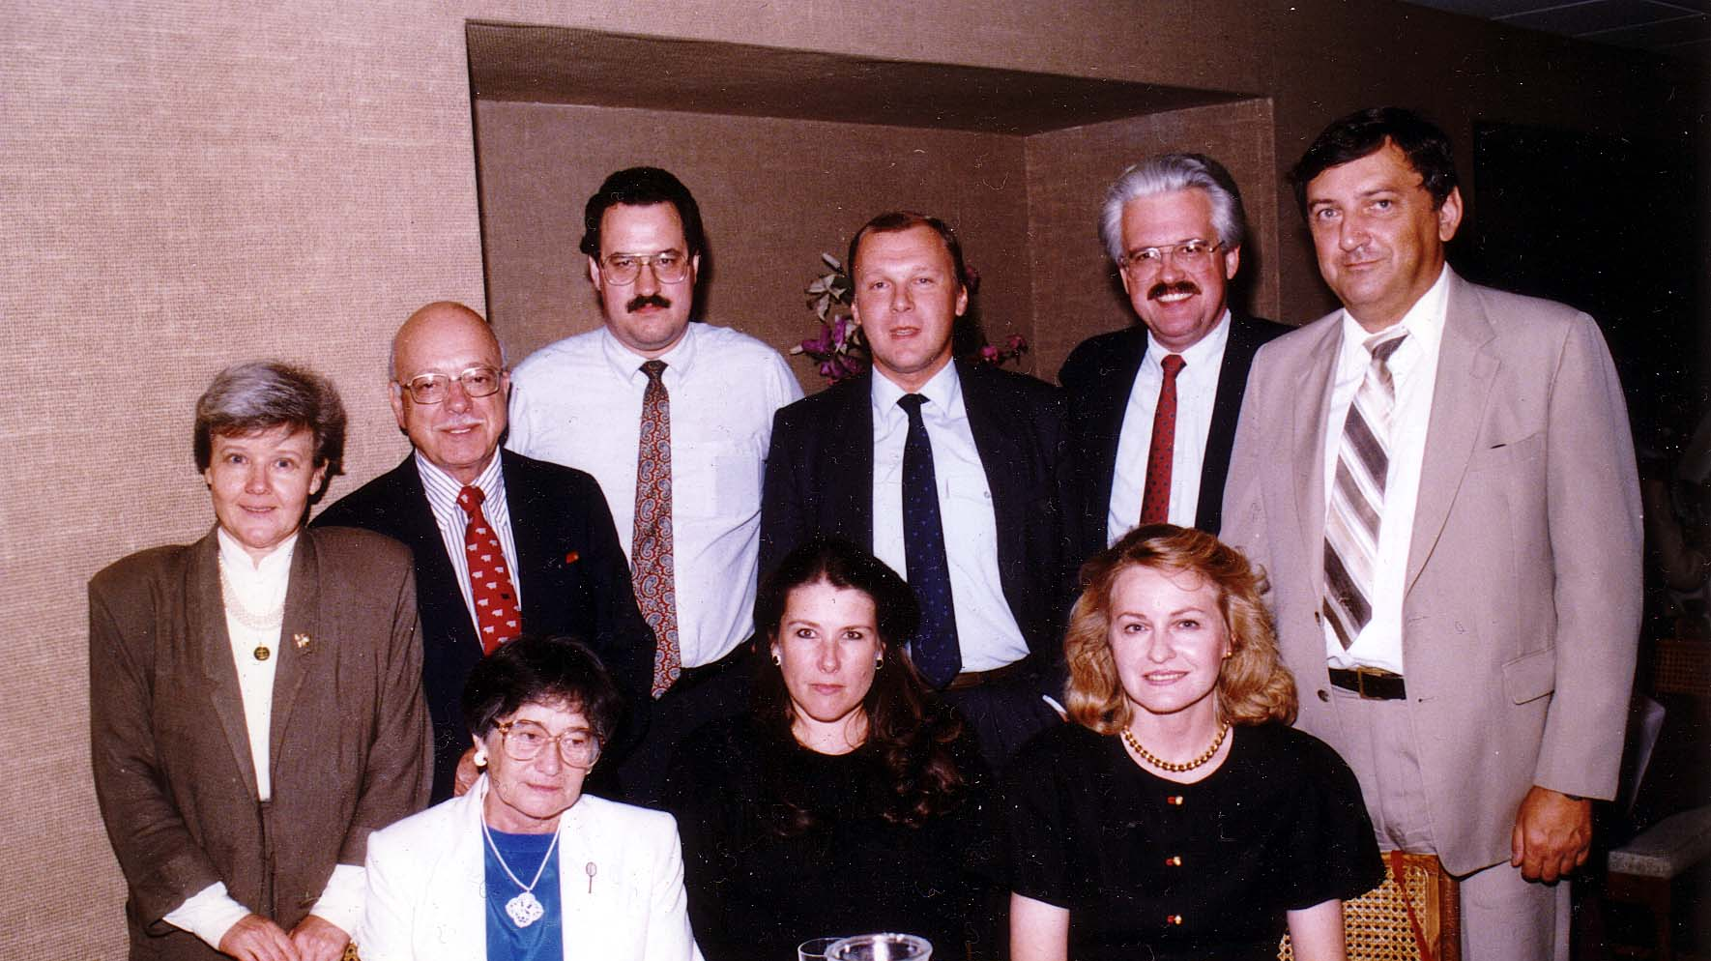
Notes:
TWG_Photo_1989_No_391__Aug_11__Washington_Chinatown__Biznex__front__Tereshka_Ben_NN_Laryssa_Chopivsky__back__Valentina_Limonczenko__Kostyk_Ben__George_Masiuk__Chairman_of_Biznex_Serhiy_Berezovenko__Arthur_George__TWG_President_Yaro_Bihun
See 1989 July-August, page 1, for event announcement and September TWG NEWS, page 5, for event coverage

Slide 40
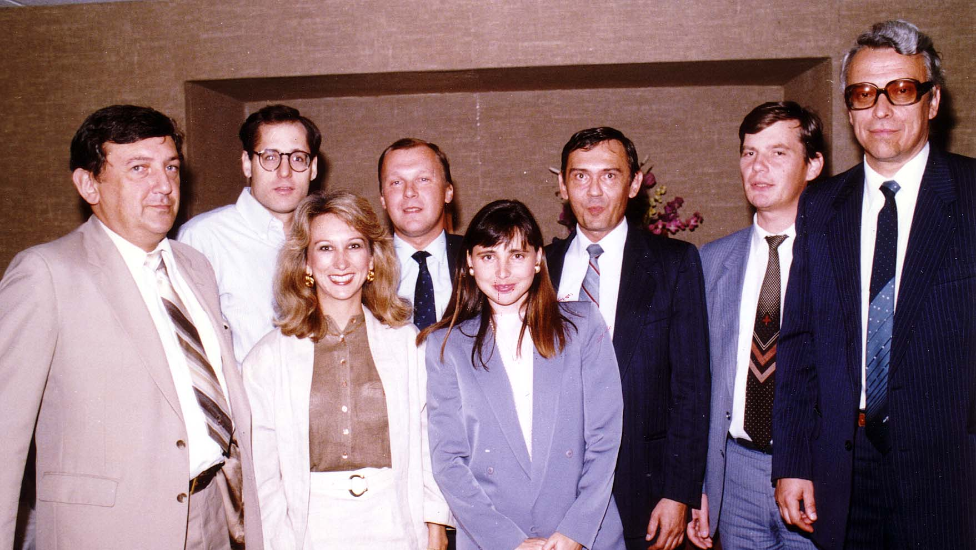
Notes:
TWG_Photo_1989_No_392_Aug_11_Washington_Chinatown_Biznex_front__Yaro_Bihun__Lydia_Chopivsky_Benson__Orysia_Pylyshenko__bk_John_Hewko_Chairman_Serhiy_Berezevenko__Andriy_Bihun__Deputy_Chairman_Serhiy_Mischenko__International_Economic_Relations_Vitaly_Voloshin
See 1989 July-August, page 1, for event announcement and September TWG NEWS, page 5, for event coverage

Slide 41
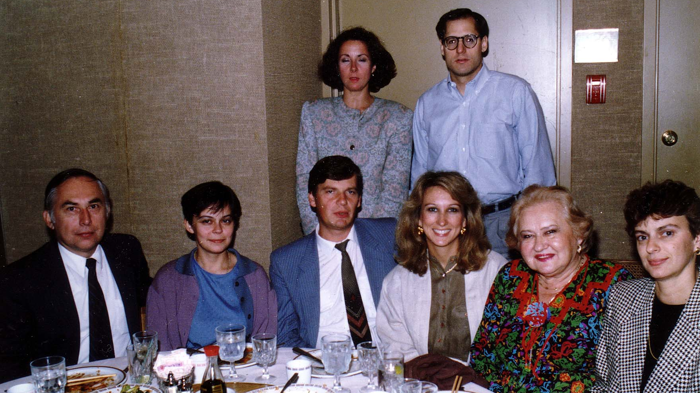
Notes:
TWG_Photo_1989_No_393__Aug_11__Biznex__front__Valentyn_Zabijaka_unknown__Deputy_Chairman_and_Researcher_Ukrainian_Academy_of_Sciences_Serhiy_Mischenko__Lydia_Chopivsky_Benson__Sophia_Chopivsky__Marika_Jurach__back__Oksana_Dackiw__John_Hewko
See 1989 July-August, page 1, for event announcement and September TWG NEWS, page 5, for event coverage

Slide 42
1989 400 TWG Co-sponsor of Antonovych Awards Georgetown University May 21 Photographs
Hryhoriy Kostiuk, John-Paul Himka, Yuriy Shevelov, Omelian Antonovych, Tetiana Antonovych
Yuriy Shevelov
Hryhoriy Kostiuk

Slide 43
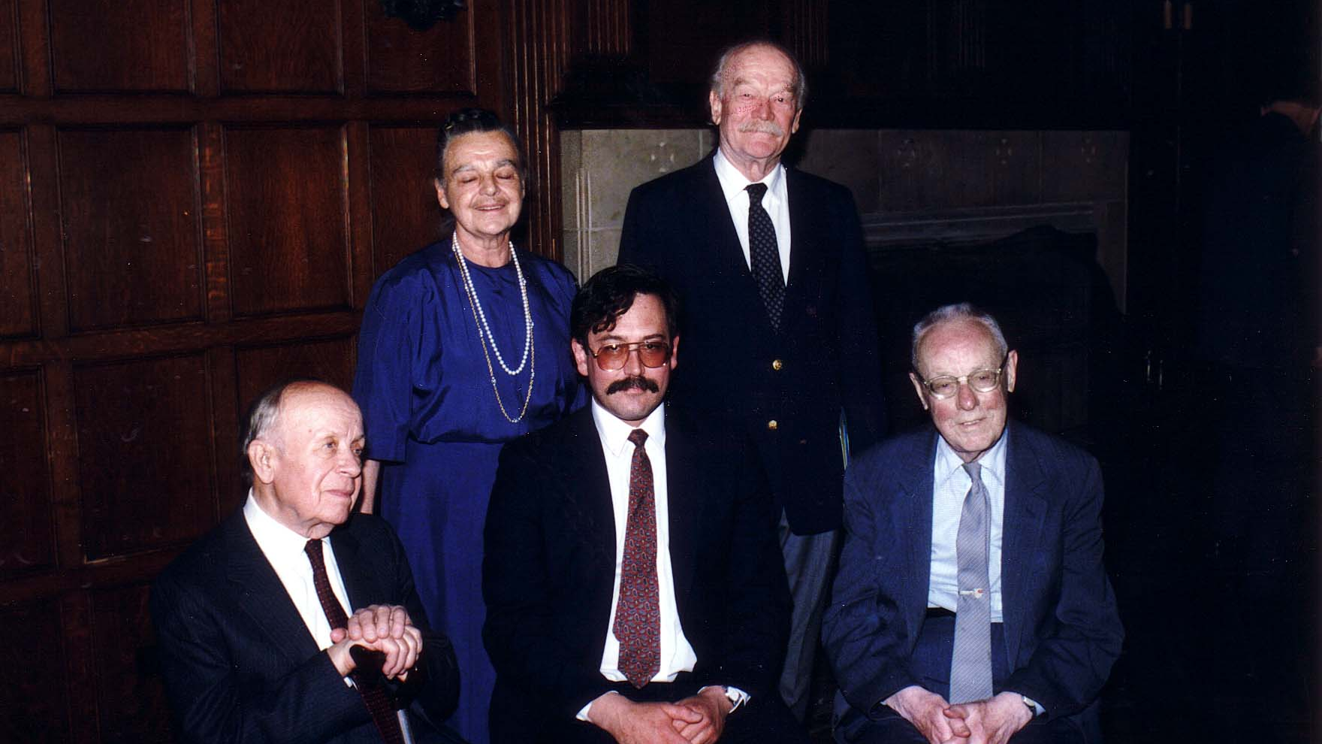
Notes:
TWG_Photo_1989_No_410__May_21__Antonovych_Award_Recipients__Hryhoriy_Kostiuk__John_Paul_Himka__Yuriy_Shevelov__Award_Sponsors_Tetiana_and_Omelian_Antonovych
See 1989 April TWG NEWS, page 1, for event announcement and June TWG NEWS, page 1, for event coverage

Slide 44
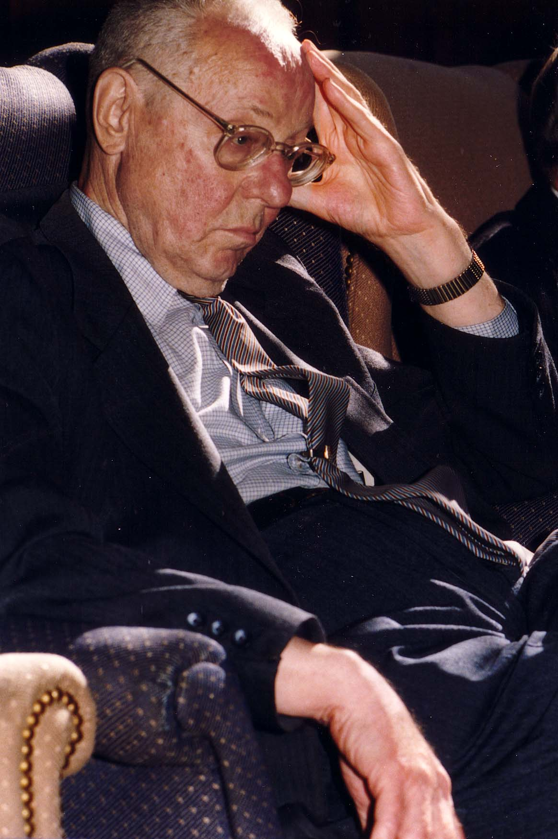
Notes:
TWG_Photo_1989_No_411__May_21__Antonovych_Award_Recipient_Author_Ukrainska_Mova_v_Pershij_Polovyni_Dwadciatoho_Stolittia_Yuriy_Shevelov
See 1989 April TWG NEWS, page 1, for event announcement and June TWG NEWS, page 1, for event coverage

Slide 45
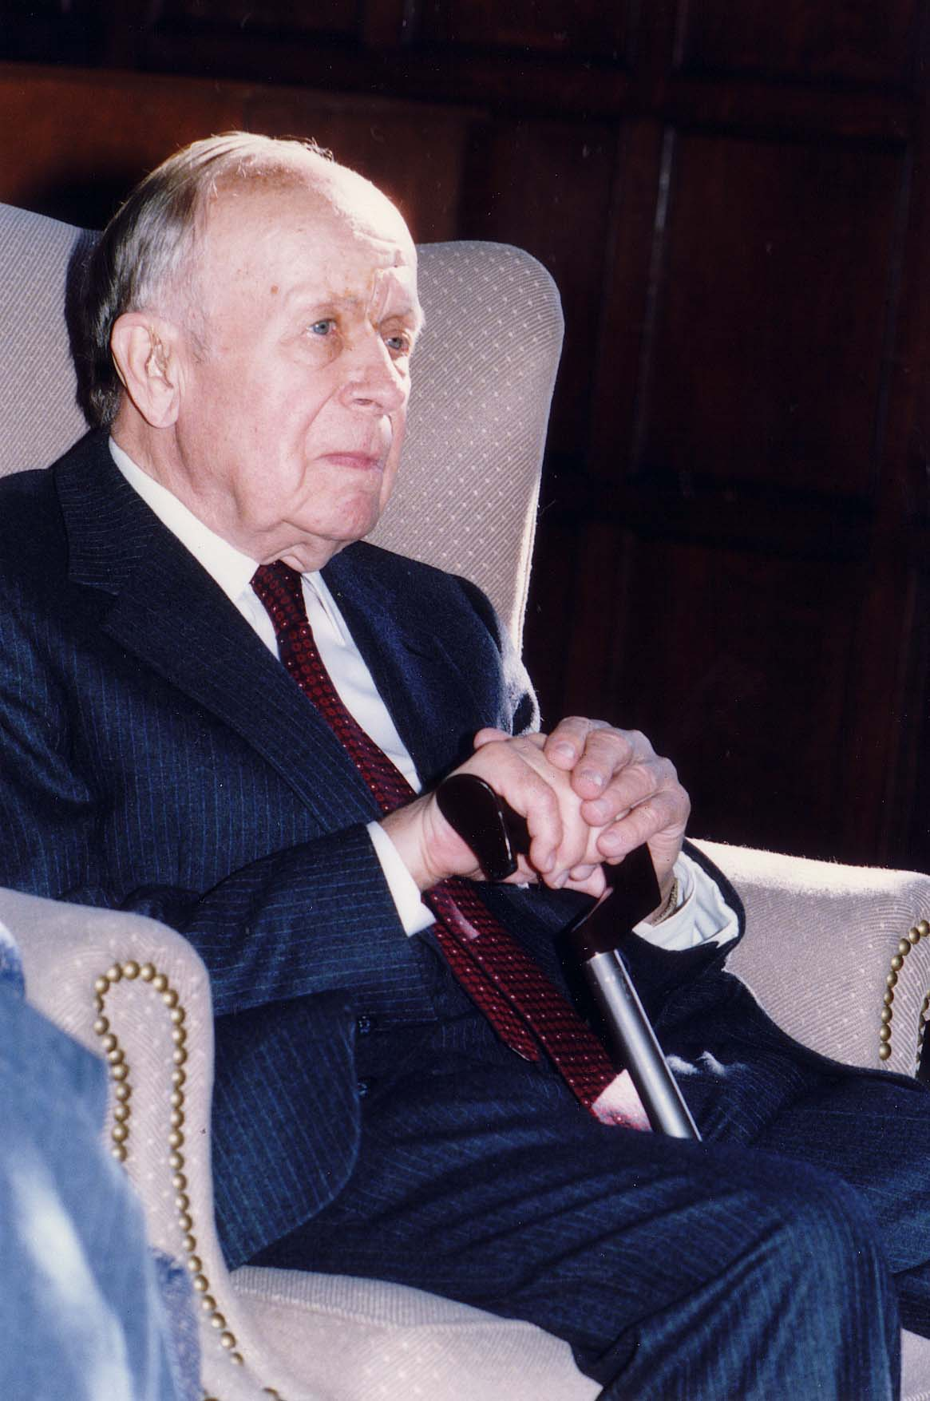
Notes:
TWG_Photo_1989_No_412__May_21__Antonovych_Award_Recipient_Author_Zustrichi_i_Proshchannia_Hryhoriy_Kostiuk
See 1989 April TWG NEWS, page 1, for event announcement and June TWG NEWS, page 1, for event coverage

Slide 46
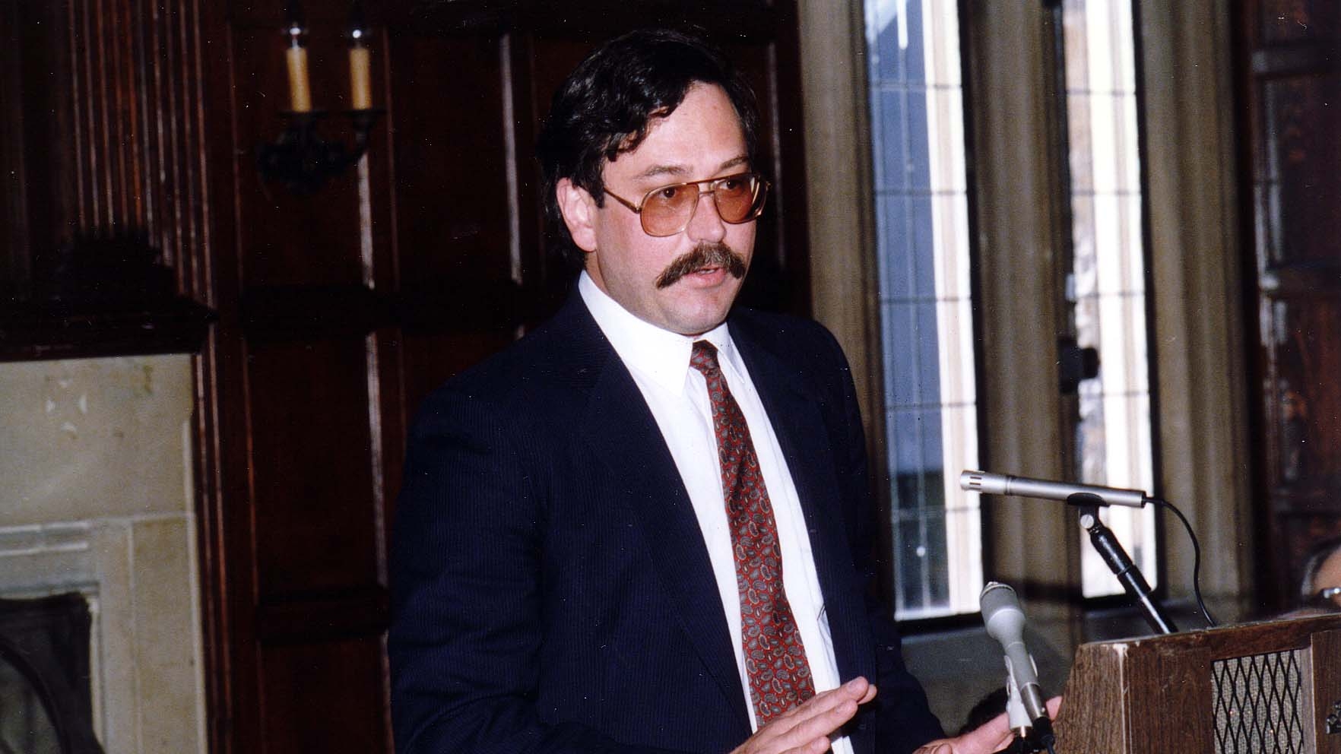
Notes:
TWG_Photo_1989_No_413__May_21__Antonovych_Award_Recipient_Author_Galician_Villagers_and_the_Ukrainian_National_Movement_in_the_Nineteenth_Century_John_Paul_Himka
See 1989 April TWG NEWS, page 1, for event announcement and June TWG NEWS, page 1, for event coverage

Slide 47
1989 600 TWG Tabir Willards MD August 4-6, 1989 Photographs
Yuri Deychakiwsky, Irene Jarosewich, Inna Deychakiwsky, Larysa Kurylas, Olena Dobczanska, Karen Deychakiwsky, Natalie Deychakiwsky, Orysia Pylyshenko, Pat Filipov, Marta Jarosewich, Orest Deychakiwsky, Daria Stec

Slide 48
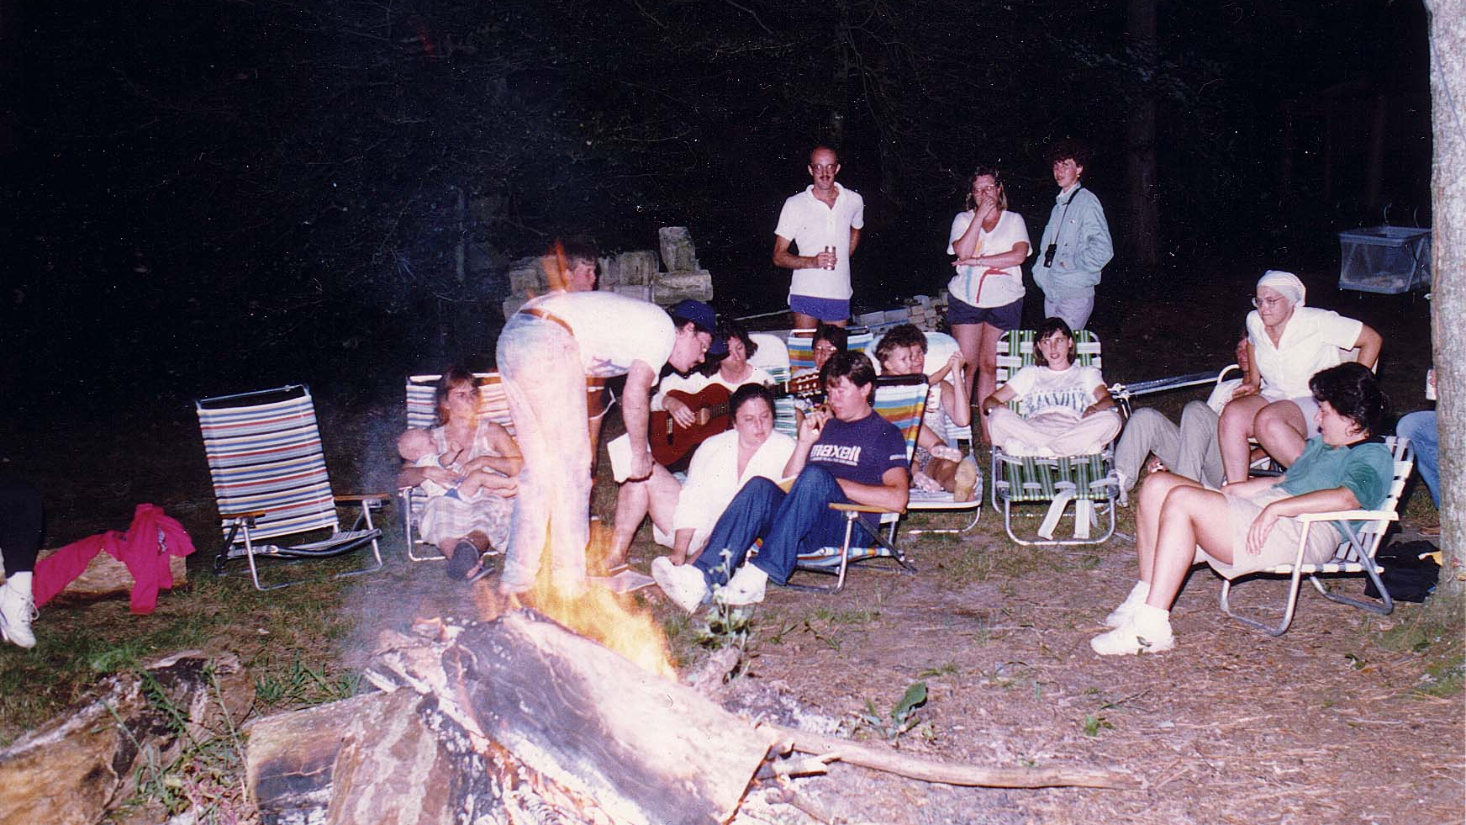
Notes:
TWG_Photo_1989_No_610_1__Aug_5__Tabir__Yuri_Deychakiwsky_talking_to_Irene_Jarosewich_NN_L_to_R_Inna_Deychakiwsky__Larysa_Kurylas__Olena_Dobczanska__Karen_&_Natalie_Deychakiwsky_Orysia_Pylyshenko__NN__Pat_Filipov_scarf__Marta_Jarosewich
See 1989 July-August TWG NEWS for event announcement and September TWG NEWS, page 6, for a “Special Thanks”

Slide 49
Notes:
TWG_Photo_1989_No_610_2__Aug_5__Tabir__Back_Row__Orest_Deychakiwsky__Daria_Stec__NN
See 1989 July-August TWG NEWS for event announcement and September TWG NEWS, page 6, for a “Special Thanks”

