Slide 1
TWG Photos 1990
Created October 24, 2020

Slide 2
1990 100 TWG Meetings
TWG Mid-year Meeting Van Ness East April 27 Photographs
TWG Annual Meeting Van Ness East November 30 Photographs

Slide 3
1990 100 TWG Board Meetings TWG Mid-year Meeting Van Ness East April 27 Photographs TWG Annual Meeting Van Ness East November 30 Photographs
See 1990 April TWG NEWS for TWG semi-annual meeting announcement and May-June TWG NEWS for meeting coverage
See 1990 November TWG NEWS for Annual Meeting planning and December TWG NEWS for Annual Meeting coverage
Elected to the Board: Lydia Chopivsky-Benson – President; Myron Wasylyk – Vice President; Marianne Woloschuk - Secretary; Mykola Babiak – Treasurer; Marusia Drohobycky – Events Director; Marta Zielyk - Public Relations; Adrian Kerod – Membership Director; Oksana Dackiw - Special Projects
Auditing Committee: Halyna Chaikovsky, Ivan Lozowy, Steve Boyduy
Presidium: John Kun, Sophia Sluzar, R.L. Chomiak
Others in Photos: Yaro Bihun, Laryssa Chopivsky, Adrian Karmazyn, Orysia Pylyshenko, Daria Stec

Slide 4
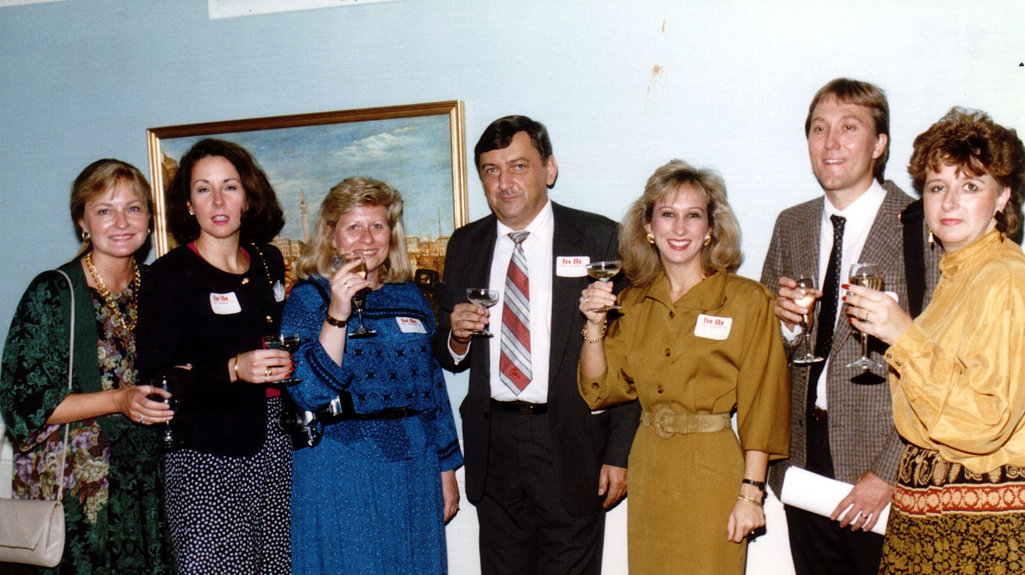
Notes:
TWG_Photo_1990_No_111__Apr_27__Midyear_mtg__Board__Laryssa_Chopivsky__Oksana_Dackiw__Daria_Stec__TWG_President_Yaro_Bihun__Lydia_Chopivsky__Adrian_Karmazyn__Marta_Zielyk
See 1990 April TWG NEWS, page 1, for event announcement and May-June TWG NEWS, page 5, for event coverage

Slide 5
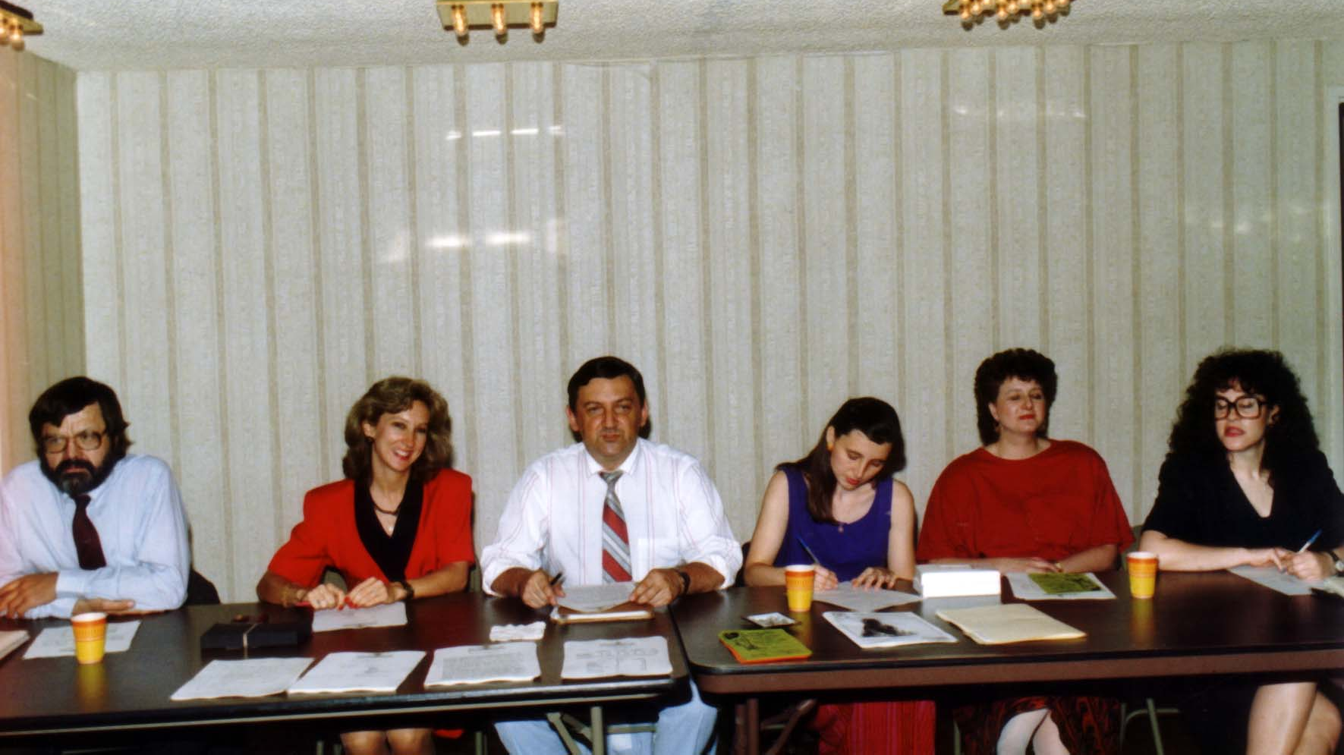
Notes:
TWG_Photo_1990_No_112__Apr_27__Midyear_mtg__Adrian_Kerod__Lydia_Chopivsky__TWG_President_Yaro_Bihun__Orysia_Pylyshenko__Marta_Zielyk__Marianne_Woloschuk
See 1990 April TWG NEWS, page 1, for event announcement and May-June TWG NEWS, page 5, for event coverage

Slide 6
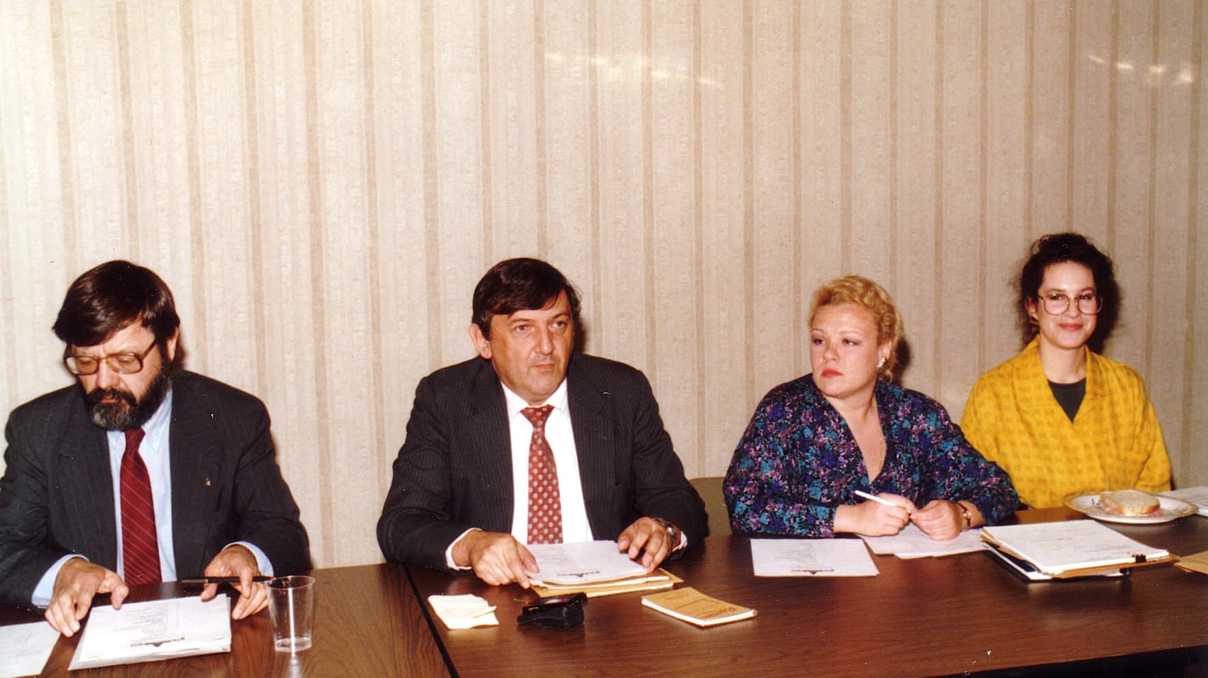
Notes:
TWG_Photo_1990_No_121__Nov_30__Annual_mtg__Adrian_Kerod__Yaro_Bihun__Olia_Holoyda__Marianne_Woloschuk
See 1990 November TWG NEWS, pages 1 and 5, for event announcement and December TWG NEWS, page 1, for event coverage

Slide 7
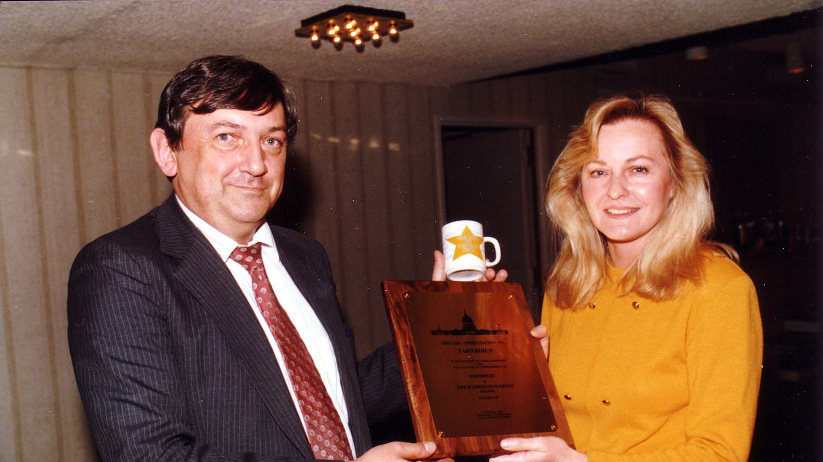
Notes:
TWG_Photo_1990_No_122__Nov_30__Annual_mtg__Award_Recipient_Yaro_Bihun__Laryssa_Chopivsky
See 1990 December TWG NEWS, Page 7

Slide 8
1990 200 TWG Leadership Conference Hotel Washington October 5-7 Photographs
See Leadership Conference Announcement in 1990 March and April TWG NEWS, page 9
See Leadership Conference Planning in 1990 May-June, July-August, and September TWG NEWS
See TWG_1990_Leadership_Conference_Booklet for Conference Program and Speaker Biographies
See 1990 October TWG NEWS for Leadership Conference Coverage
See TWG Leadership Conference coverage by The Ukrainian Weekly: The_Ukrainian_Weekly_1990-44

Slide 9
200 240 Session 1: Laying the Foundation
Roman Popadiuk
Patience Huntwork, Larysa Skoryk

Slide 10
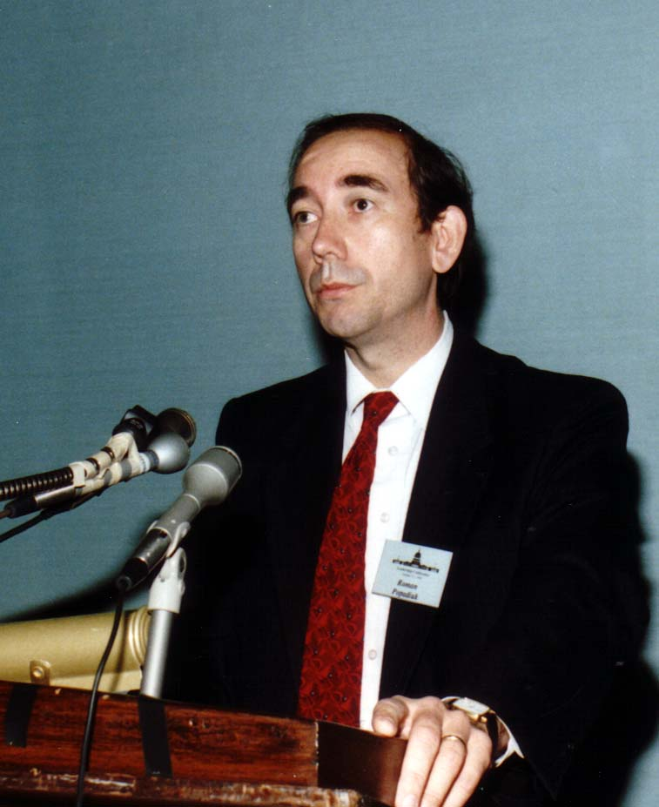
Notes:
TWG_Photo_1990_No_241__Oct_6__Laying_the_Foundation_Panel__Deputy_Assistant_to_the_President_and_Deputy_Press_Secretary_for_Foreign_Affairs_Roman_Popadiuk
See 1990 October TWG NEWS, page 5

Slide 11
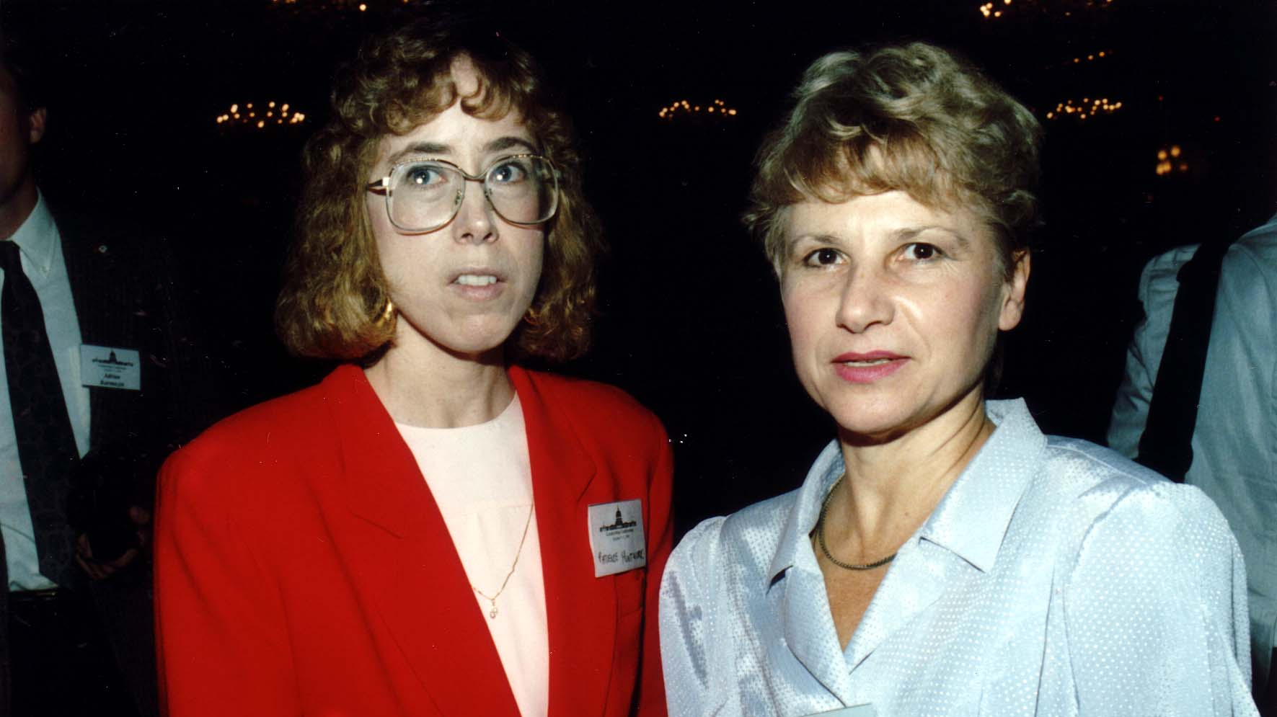
Notes:
TWG_Photo_1990_No_242__Oct_6__Laying_the_Foundation_Panel__Attorney_Patience_Huntwork __Panelist_People's_Deputy_to_the_Supreme_Soviet_of_the_Ukrainian_SSR_and_Co_founder_of_Rukh_Laryssa_Skoryk
See 1990 October TWG NEWS, page 5

Slide 12
1990 300 TWG Events Photographs
Demography: Murray Feshbach
Situation in Ukraine: Rostyslav Bratun
Situation in Ukraine: Viacheslav Briukhovetsky; Reception: Orysia Pylyshenko, Andrij Demidenko, Marta Bohachevsky-Chomiak
Shevchenko Discography: Stefan Maksymjuk
Guides to Donbas: Peter Sawchyn, Tania Chomiak, Marta Pereyma, Marta Zielyk, Adrian Karmazyn
Peacewalkers: Yaro Bihun

Slide 13
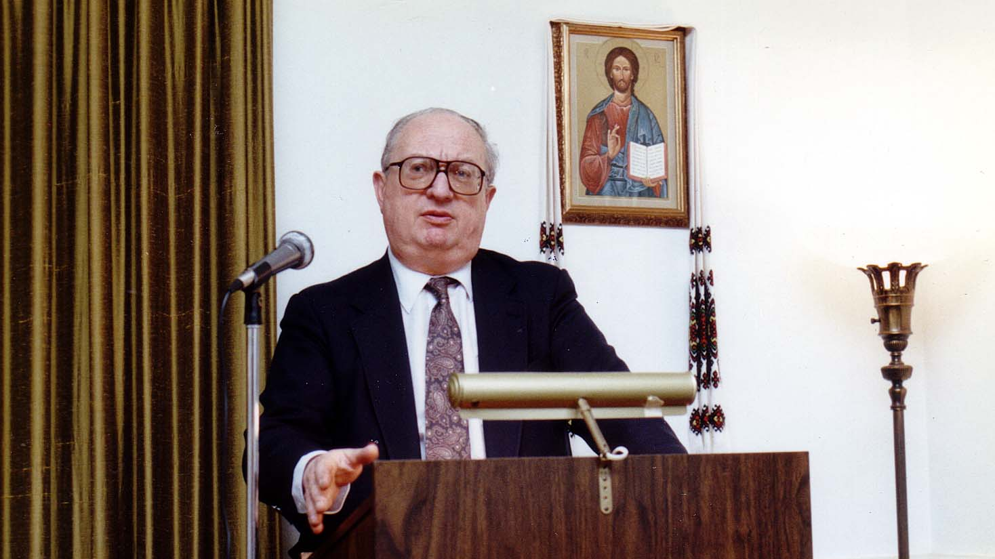
Notes:
TWG_Photo_1990_No_321__Feb_23__St_Sophia_Religious_Association__Soviet_Demographics_Murray_Feshbach
See 1990 February TWG NEWS, Page 1, for event announcement and March TWG NEWS, page 5, for event coverage

Slide 14
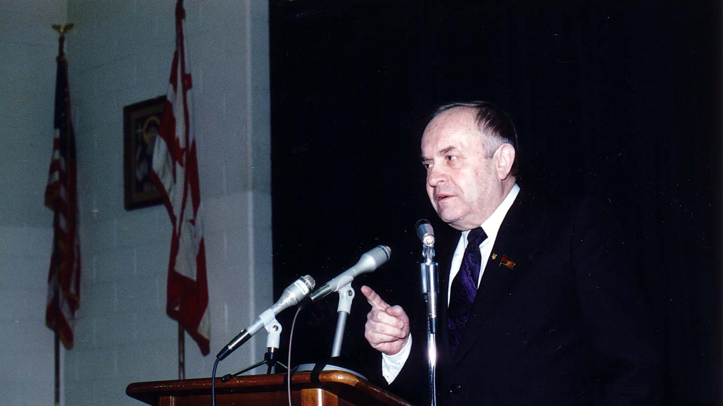
Notes:
TWG_Photo_1990_No_322__Feb_26__Holy_Family_Parish_Center__Representative_from_Lviv_to_the_Congress_of_People's_Deputies_of_the_USSR_Rostyslav_Bratun
See 1990 March TWG NEWS, page 1, for event coverage

Slide 15
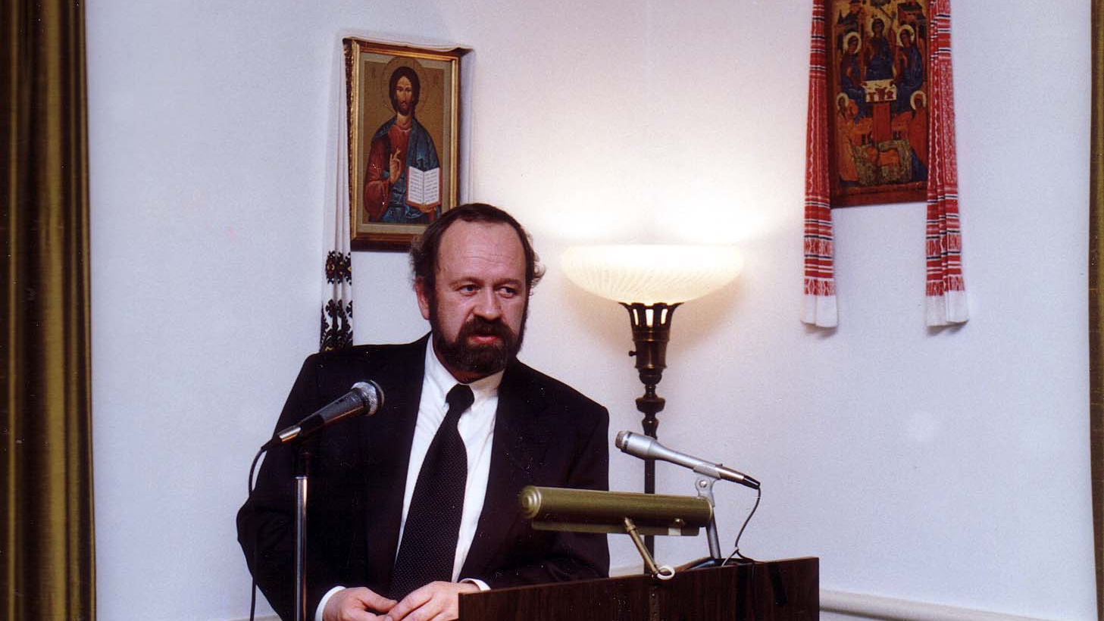
Notes:
TWG_Photo_1990_No_323__Feb_27__St_Sophia_Religious_Association__Fellow__Institute_of_Literature_Ukrainian_Acedemy_of_Sciences_Viacheslav_Briukhovetsky
See 1990 February TWG NEWS, Page 1, for event announcement and March TWG NEWS, page 1, for event coverage

Slide 16
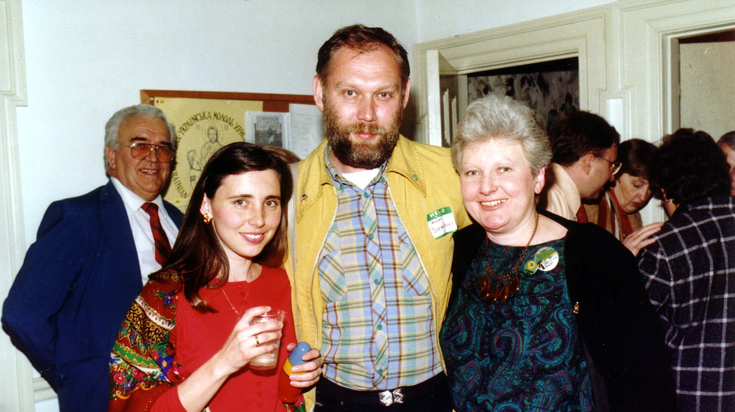
Notes:
TWG_Photo_1990_No_325__Feb_27__St_Sophia_Religious_Association__TWG_Events_Director_Orysia_Pylyshenko_Environmental_Activist_and_future_Member_of_Ukrainian_Ministry_of_Environmental_Protection_Andrij_Demidenko_Historian_Marta_Bohachevsky-Chomiak
(Reception after Viacheslav Briukhovetsky’s presentation)

Slide 17
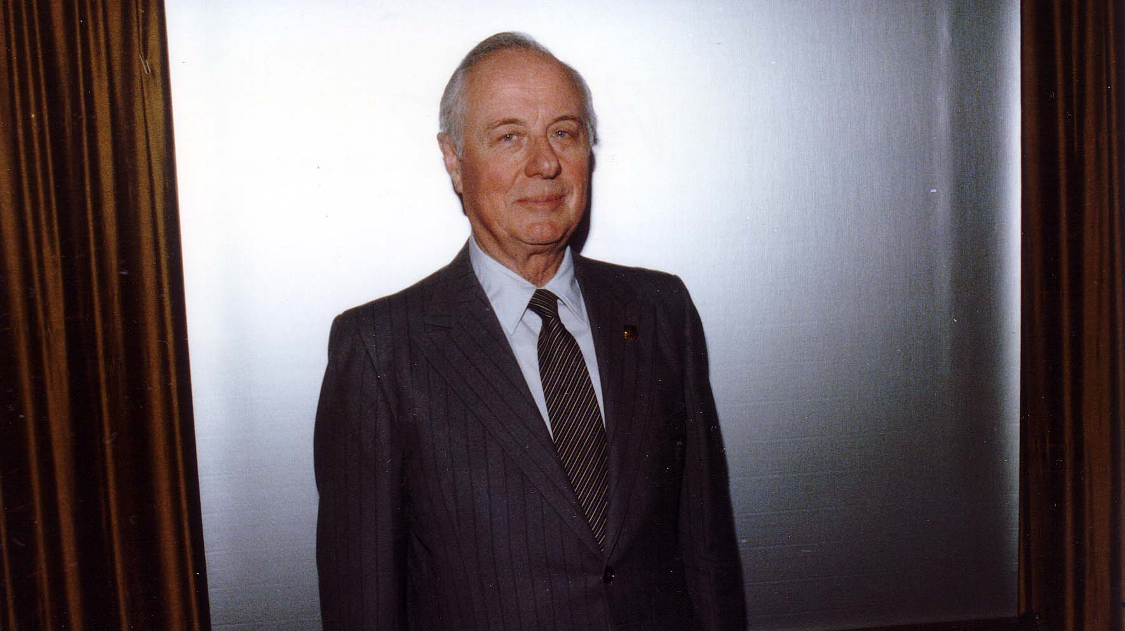
Notes:
TWG_Photo_1990_No_326__March_10__St_Sophia_Religious_Association__Shevchenko_in_early_musical_recordings__Stefan_Maksymjuk
See 1990 February TWG NEWS for event announcement and March TWG NEWS, page 3, for event coverage

Slide 18
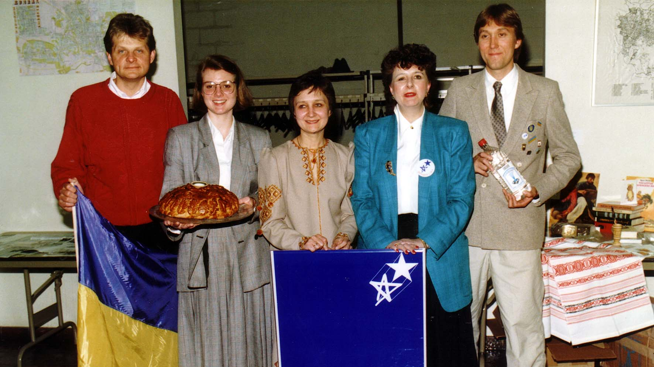
Notes:
TWG_Photo_1990_No_327__May_4__Holy_Family_Parish_Center__Friday_Evening_Forum__Guides_to_USSR_Donbas__Peter_Sawchyn__Tania_Chomiak__Marta_Pereyma__Marta_Zielyk__Adrian_Karmazyn
See 1990 April TWG NEWS for event announcement and May-June TWG NEWS, page 1, for event coverage

Slide 19
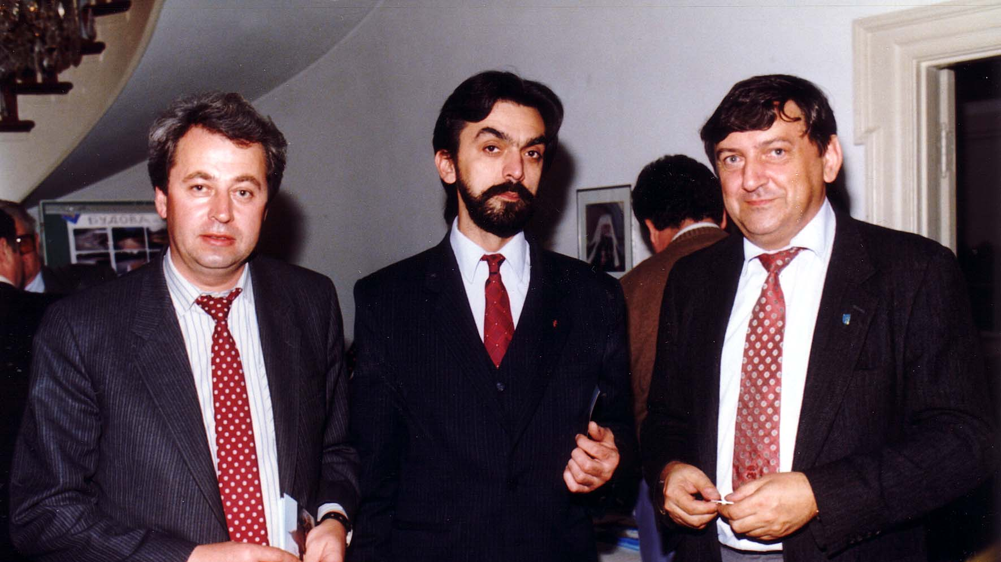
Notes:
TWG_Photo_1990_No_330__Nov_9__St_Sophia_Religious_Association__Peacewalkers__NN_NN__TWG_President_Yaro_Bihun
See 1990 October TWG NEWS, pages 9 and 11 for event announcement and November TWG NEWS, page 3, for event coverage

Slide 20
1990 310 TWG Rudensky Farewell Van Ness East January Photographs
Irene Maksymjuk, Lidia Billon, George Sajewych, Marta Zielyk
Steve Boyduy, Marusia Drohobycky, Laryssa Chopivsky, Maria Rudensky, Ross Chomiak,
Taras Dovbusz, Laryssa Chopivsky, Daria Stec, Marta Bohachevsky-Chomiak, Orysia Pylyshenko, Yaro Bihun
Walter Iwaskiw, Orest Bartoszyk, George Masiuk, Oksana Dackiw, Marta Pereyma, Walter Pechenuk, Sophika Nakonechny, Marta Zielyk, Rick Smith, Irene Maksymjuk, George Sierant

Slide 21
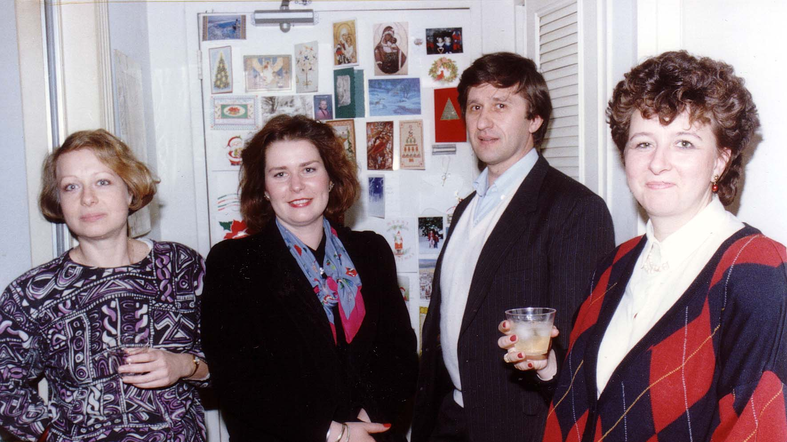
Notes:
TWG_Photo_1990_No_311__Rudensky_Farewell__Irene_Maksymjuk__Lidia_Billon__George_Sajewych__Marta_Zielyk
See 1989 December TWG NEWS, page 13,…Maria Rudensky heading for Haiti

Slide 22
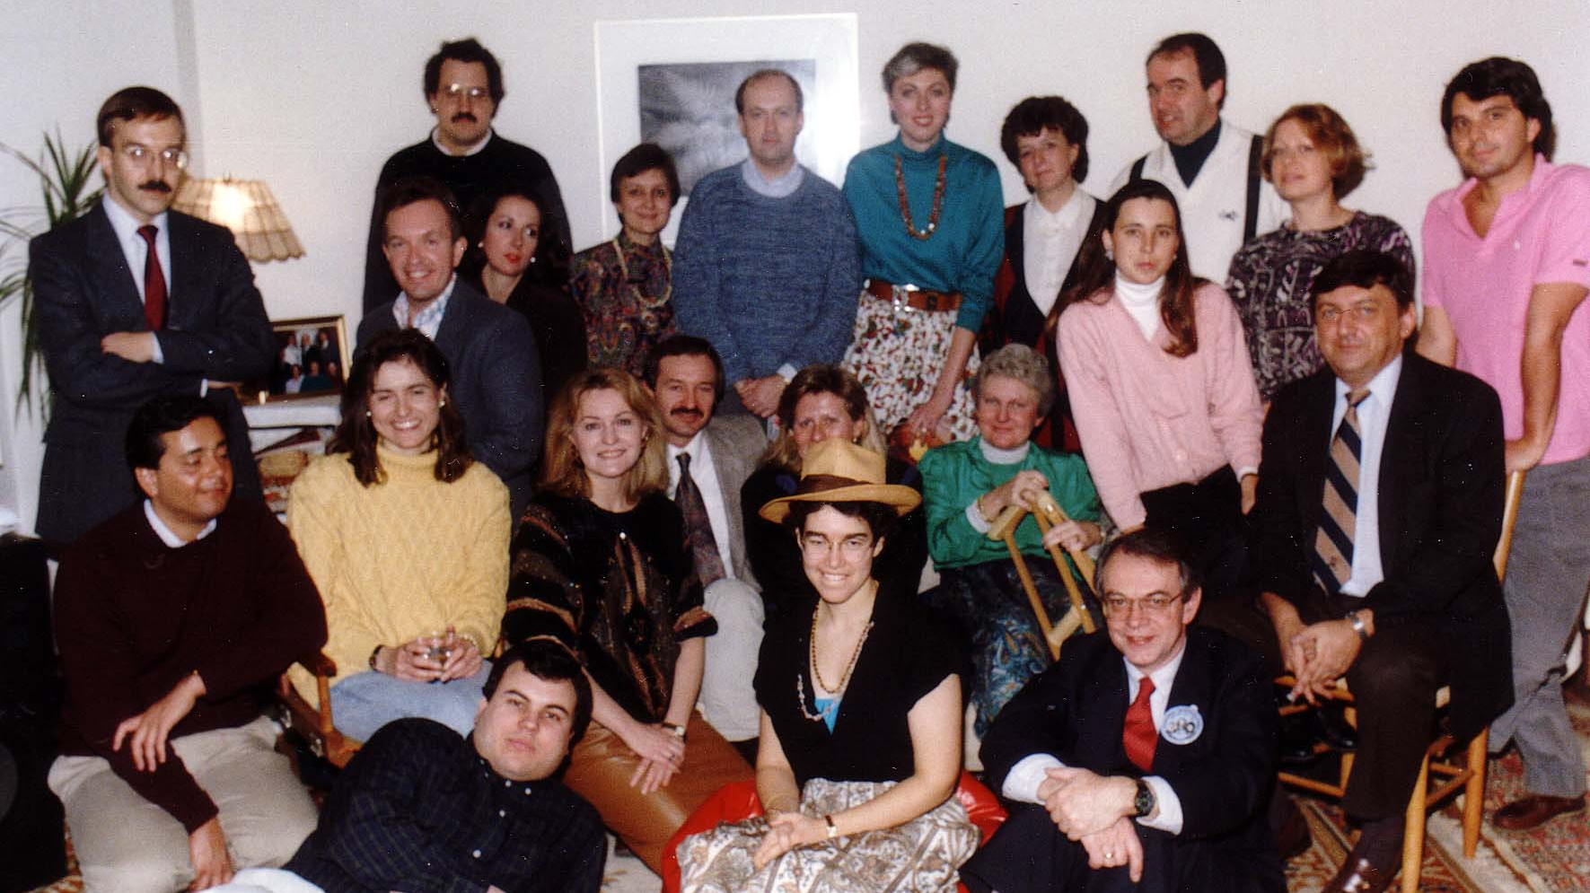
Notes:
TWG_Photo_1990_No_312_1__Rudensky_Farewell_Party__Bottom_Left__Eugene_Kaspruk__First_Row__Steve_Boyduy__Marusia_Drohobycky__Laryssa_Chopivsky__Maria_Rudensky__Ross_Chomiak
See 1989 December TWG NEWS, page 13,…Maria Rudensky heading for Haiti

Slide 23
Notes:
TWG_Photo_1990_No_312_2__Rudensky_Farewell_Party__Second_Row__Taras_Dovbusz_behind_Laryssa_Chopivsky__Daria_Stec__Marta_Bohachevsky_Chomiak__Orysia_Pylyshenko__Yaro_Bihun
See 1989 December TWG NEWS, page 13,…Maria Rudensky heading for Haiti

Slide 24
Notes:
TWG_Photo_1990_No_312_3__Rudensky_Farewell_Party__Third_Row__Walter_Iwaskiw__Orest_Bartoszyk__George_Masiuk__Oksana_Dackiw__Marta_Pereyma__Walter_Pechenuk__Sophika_Nakonechny__Marta_Zielyk__Rick_Smith__Irene_Maksymjuk__George_Sierant
See 1989 December TWG NEWS, page 13,…Maria Rudensky heading for Haiti

Slide 25
1990 400 TWG Co-sponsored Events Photographs
Ukrainian Independence Day Celebration
Antonovych Awards

Slide 26
1990 410 TWG Co-sponsor of Ukrainian-American Army Officers Ukrainian Independence Day Celebration Rayburn House Office Building January 31 Photographs
Wolodymyr Sulzynsky, Canadian Military Attaché Yaromyr Koropecky, Hlib Taran, Inia Yevich, Sandfal, Andrij Bohdan Hetmanskyj, George Turiansky, Jurij Petrenko

Slide 27
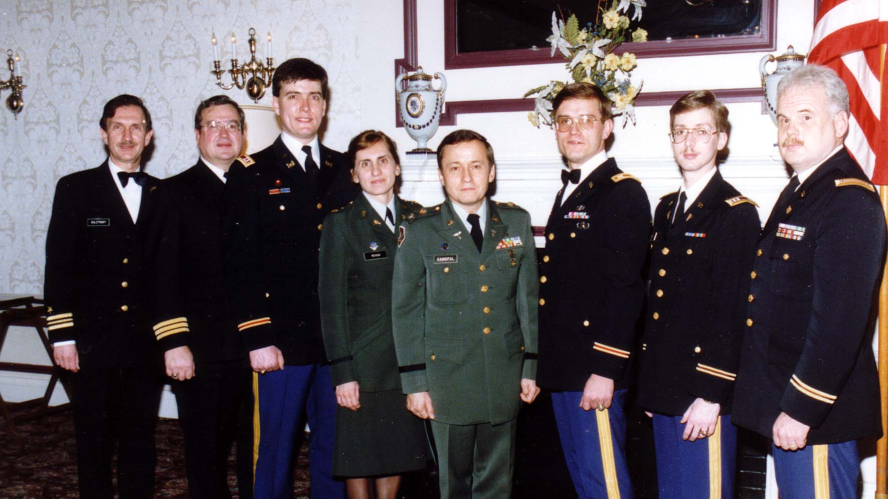
Notes:
TWG_Photo_1990_No_411__Jan_31__Rayburn_House_Office_Building__Ukrainian_Independence_Day__Wolodymyr_Sulzynsky___Canadian_MilAtt_Yaromyr_Koropecky___Hlib_Taran__Inia_Yevich__Sandfal___Andrij_Bohdan_Hetmanskyj___George_Turiansky__Jurij_Petrenko
See 1990 January TWG NEWS for event announcement

Slide 28
1990 420 TWG Co-sponsor of Antonovych Awards Georgetown University March 25 Photographs
Roman Szporluk, Omelian Antonovych, Lina Kostenko, Tetiana Antonovych, John Fizer
Lina Kostenko

Slide 29
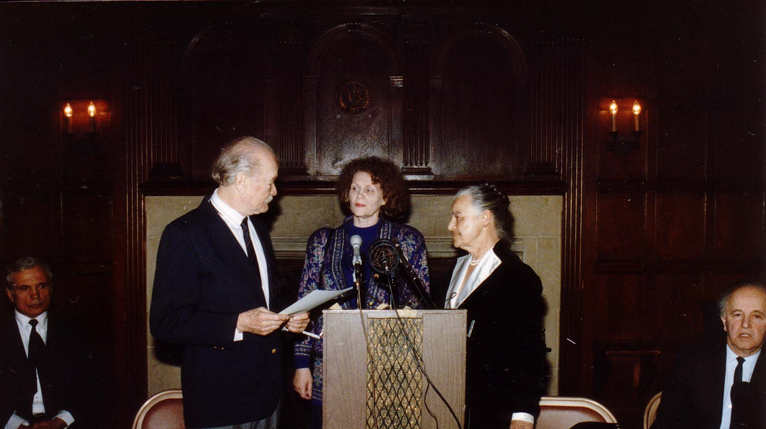
Notes:
TWG_Photo_1990_No_421__March_25__Georgetown_University__Antonovych_Awards__Roman_Szporluk__Omelian_Antonovych___Award_Recipient_Author_Sad_Netanuchnykh_Skulptur_Lina_Kostenko__Tetiana_Antonovych__John_Fizer
See 1990 March TWG NEWS, page 1, for event announcement and April TWG NEWS, page 1, for event coverage

Slide 30
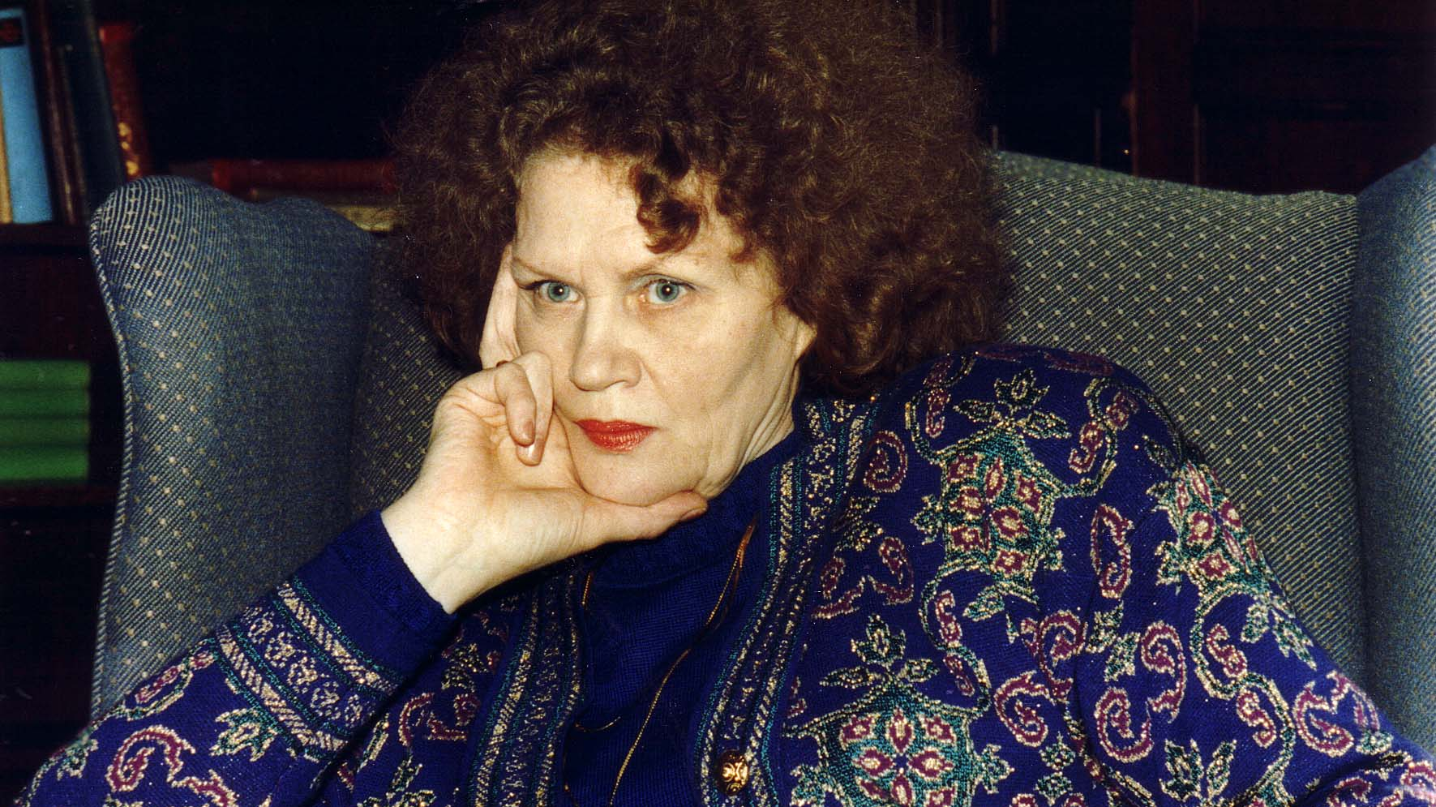
Notes:
TWG_Photo_1990_No_422__March_25__Georgetown_University__Antonovych_Award_Recipient_Author_Sad_Netanuchnykh_Skulptur_Lina_Kostenko
See 1990 March TWG NEWS, page 1, for event announcement and April TWG NEWS, page 1, for event coverage

Slide 31
1990 600 Social Events
Steve Boyduy, Marusia Drohobycky Sloniewsky
Mykola Babiak

Slide 32
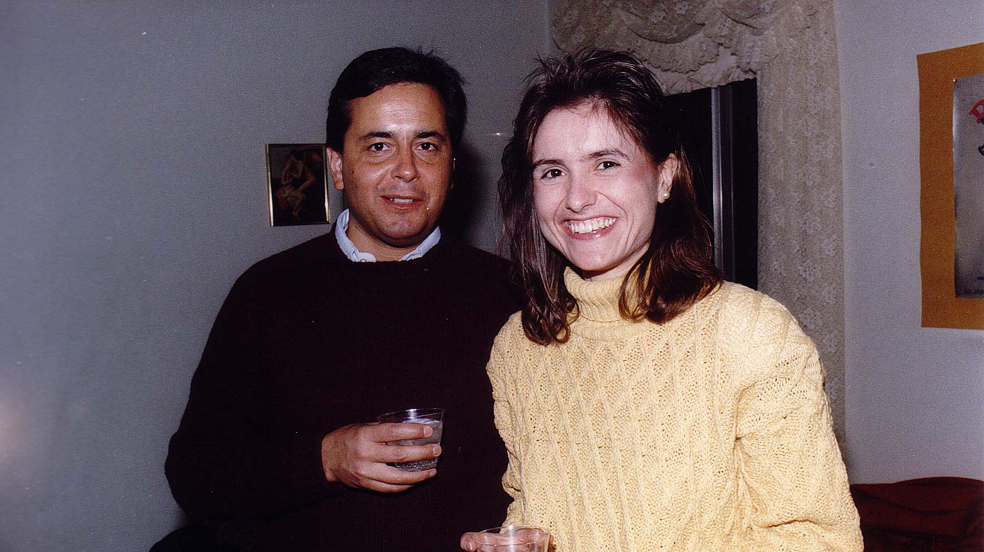
Notes:
TWG_Photo_1990_No_601__Dec_8__Van _Ness_East_Christmas_Party__Steve_Boyduy_Marusia_Drohobycky_Sloniewsky
See 1990 November TWG NEWS, page 1, for event announcement and December TWG NEWS, page 3, for event coverage

Slide 33
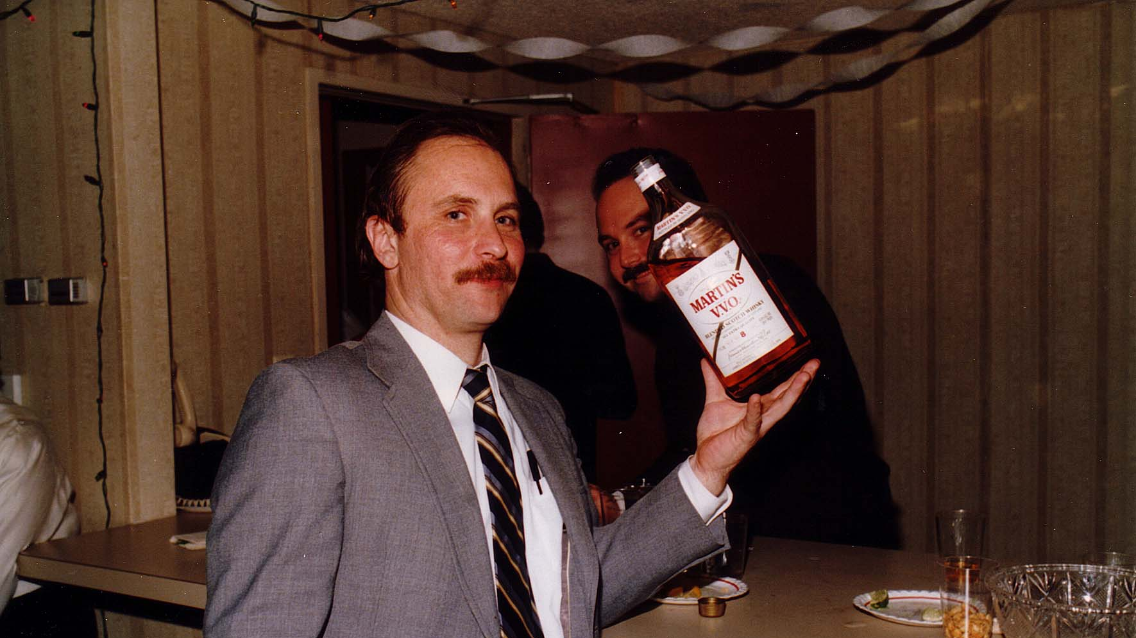
Notes:
TWG_Photo_1990_No_602__Dec_8__Van_Ness_East__Christmas_Party__Mykola_Babiak
See 1990 November TWG NEWS, page 1, for event announcement and December TWG NEWS, page 3, for event coverage

