Slide 1
TWG 1991 Photos
Created October 25, 2020

Slide 2
1991 100 TWG Semi-annual Meeting Sheraton National Hotel October 11
See September TWG NEWS for TWG semi-annual meeting announcement
(Placeholder for photographs)

Slide 3
1991 110 TWG Board Meeting St Sophia Religious Association May 21, 1991 Photographs
Oksana Dackiw, Marta Zielyk, Irene Jarosewich, TWG President Lydia Chopivsky-Benson, Lynn Bush, Laryssa Chopivsky, Mykola Babiak, Marusia Drohobycky, Daria Stec, Adrian Kerod, Orest Diachok, Orest Deychakiwsky, Myron Wasylyk

Slide 4
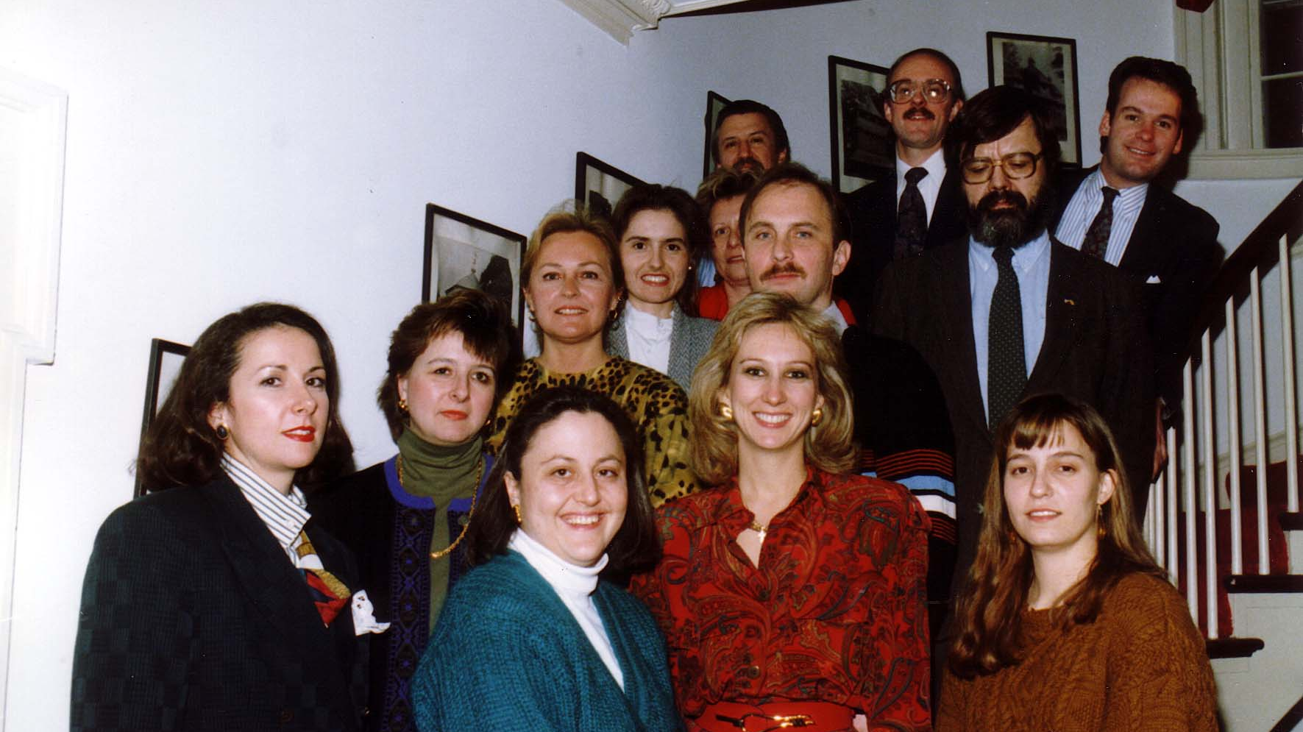
Notes:
TWG_Photo_1991_No_111_May_21_Brd_mtg__Oksana_Dackiw__Marta_Zielyk__Irene_Jarosewich__TWG_President_Lydia_Chopivsky_Benson__Lynn_Bush__Laryssa_Chopivsky__Mykola_Babiak__Marusia_Drohobycky__Daria_Stec__Adrian_Kerod__Orest_Diachok__Orest_Deychakiwsky__Myron_Wasylyk
See 1991 May TWG NEWS for event announcement; See also 1990 December TWG NEWS, page 1 for report on annual meeting

Slide 5
1991 120 TWG Summit Retreat Coolfont Conference Center Berkeley Springs WV June 22-23 Photographs
Peter Sawchyn, Isha Pryshlak, Irene Jarosewich, Halya Duda, Marusia Drohobycky, TWG President Lydia Chopivsky-Benson, Antonina Pipko, Daria Stec, Mykola Babiak, George Masiuk, Steve Boyduy, Yaro Bihun
Halya Duda

Slide 6
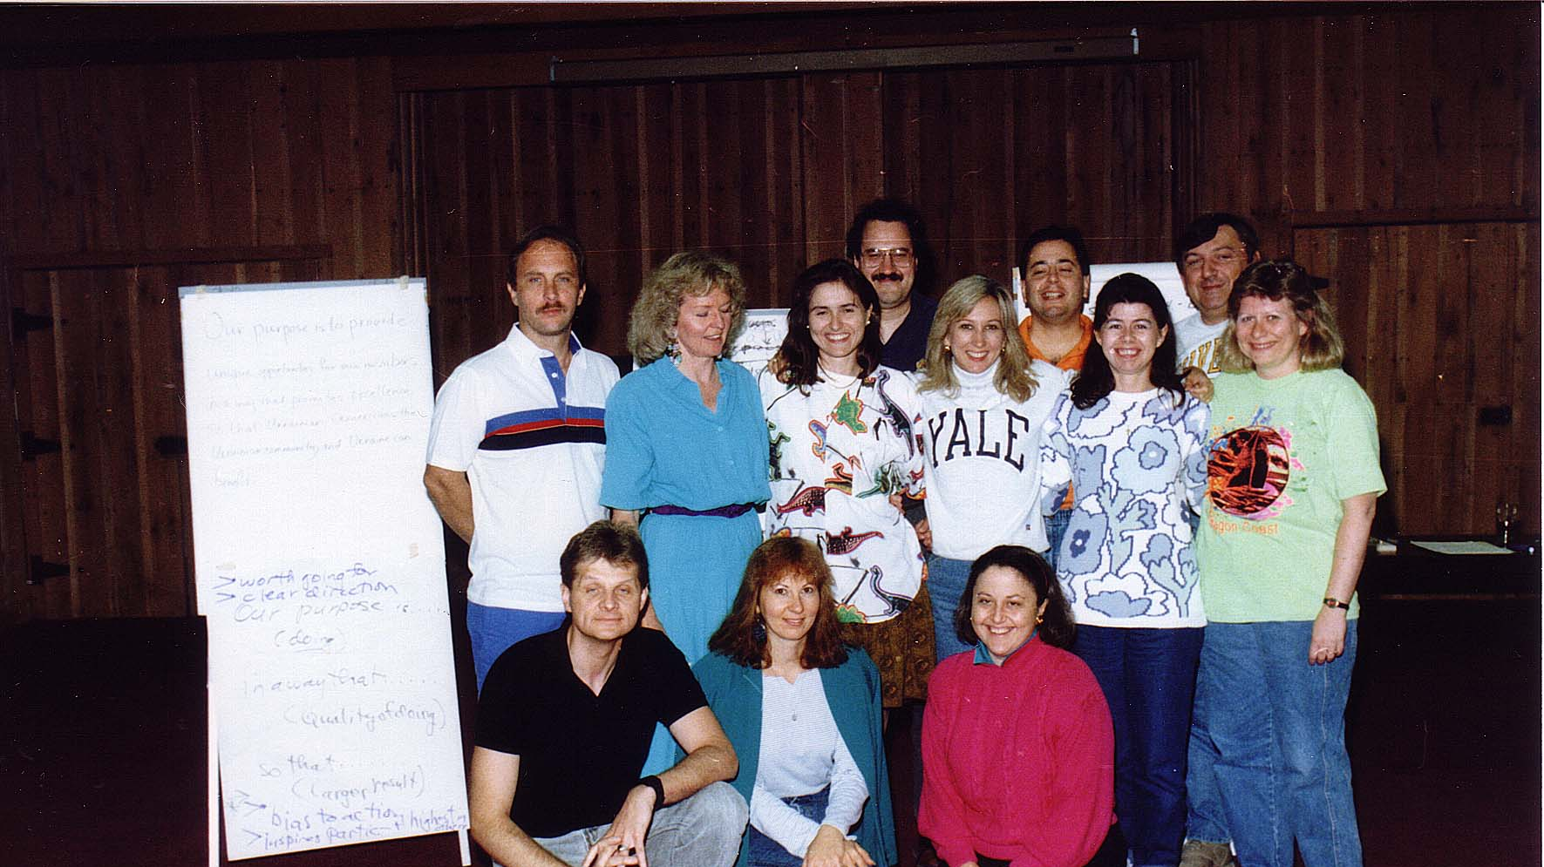
Notes:
TWG_Photo_1991_No_121__Jun_22__Coolfont_Retreat__Peter_Sawchyn__Isha_Pryshlak__Irene_Jarosewich__Halya_Duda__Marusia_Drohobycky__TWG_President_Lydia_Chopivsky_Benson__Antonina_Pipko__Daria_Stec__Mykola_Babiak__George_Masiuk__Steve_Boyduy__Yaro_Bihun
See 1991 May TWG NEWS, pages 1 and 9 for event announcement and July-August TWG NEWS for event coverage

Slide 7
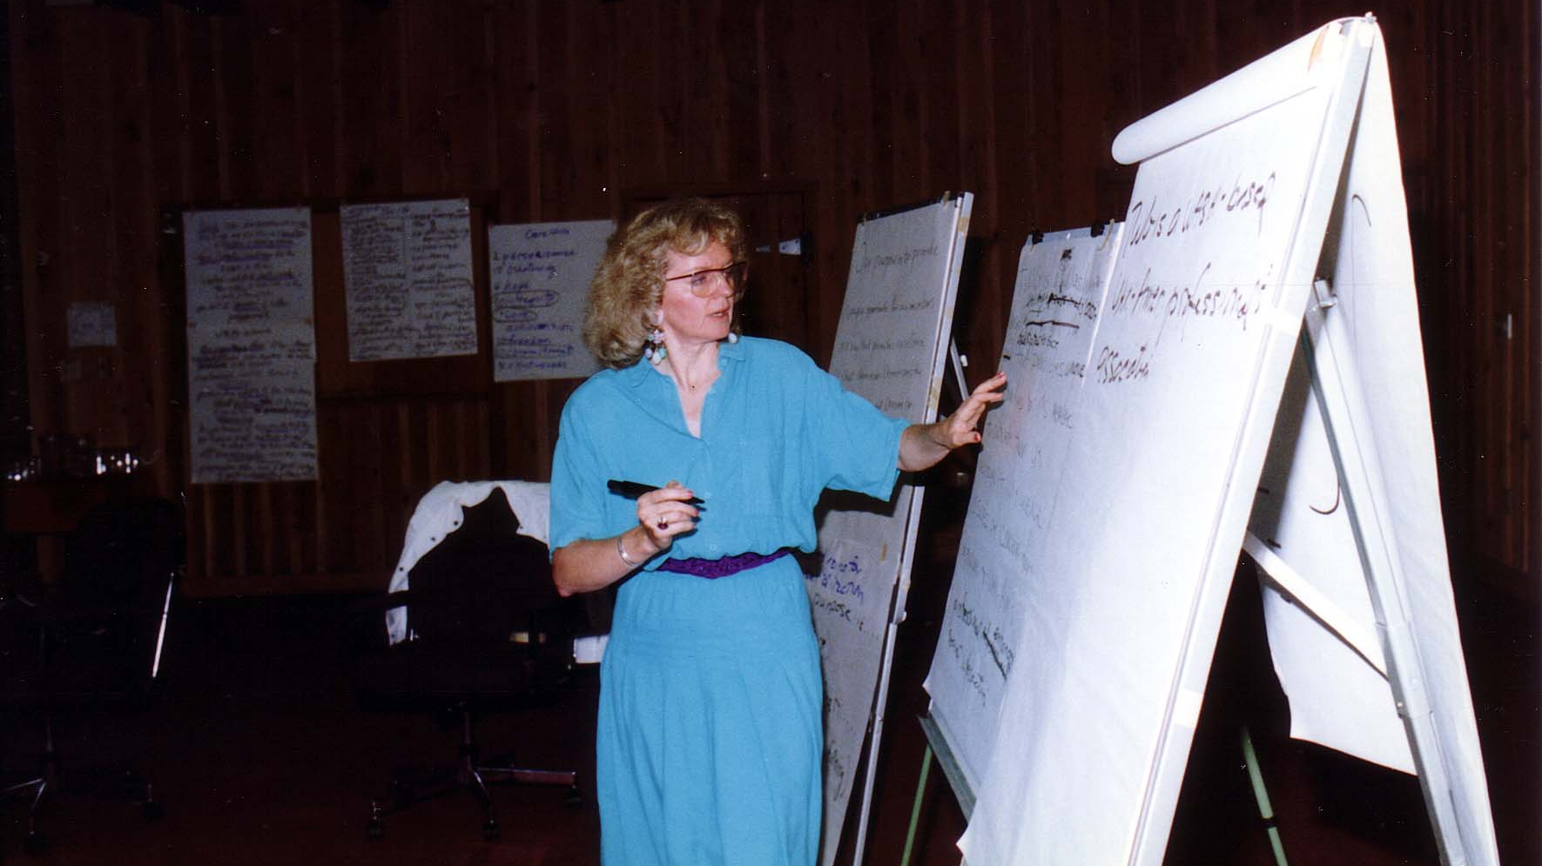
Notes:
TWG_Photo_1991_No_122__Jun_22__Coolfont__TWG_Retreat_Seminar_Leader_Halya_Duda
See 1991 May TWG NEWS, pages 1 and 9 for event announcement and July-August TWG NEWS for event coverage and September TWG NEWS for an executive summary of Halya Duda’s presentation

Slide 8
1991 200 TWG Leadership Conference Sheraton National Hotel Arlington Virginia October 11-13, 1991 Photographs
See Leadership Conference Announcement in 1991 April TWG NEWS, page 9
See Leadership Conference Planning in 1991 May and September TWG NEWS
See TWG_1991_Leadership_Conference_Booklet for Conference Program and Speaker Biographies
See 1991 October TWG NEWS for Leadership Conference Coverage
See TWG Leadership Conference coverage by The Ukrainian Weekly: The_Ukrainian_Weekly_1991-51

Slide 9
1991 210 TWG Leadership Conference Opening Address October 12 Photographs
Carl Gershman

Slide 10
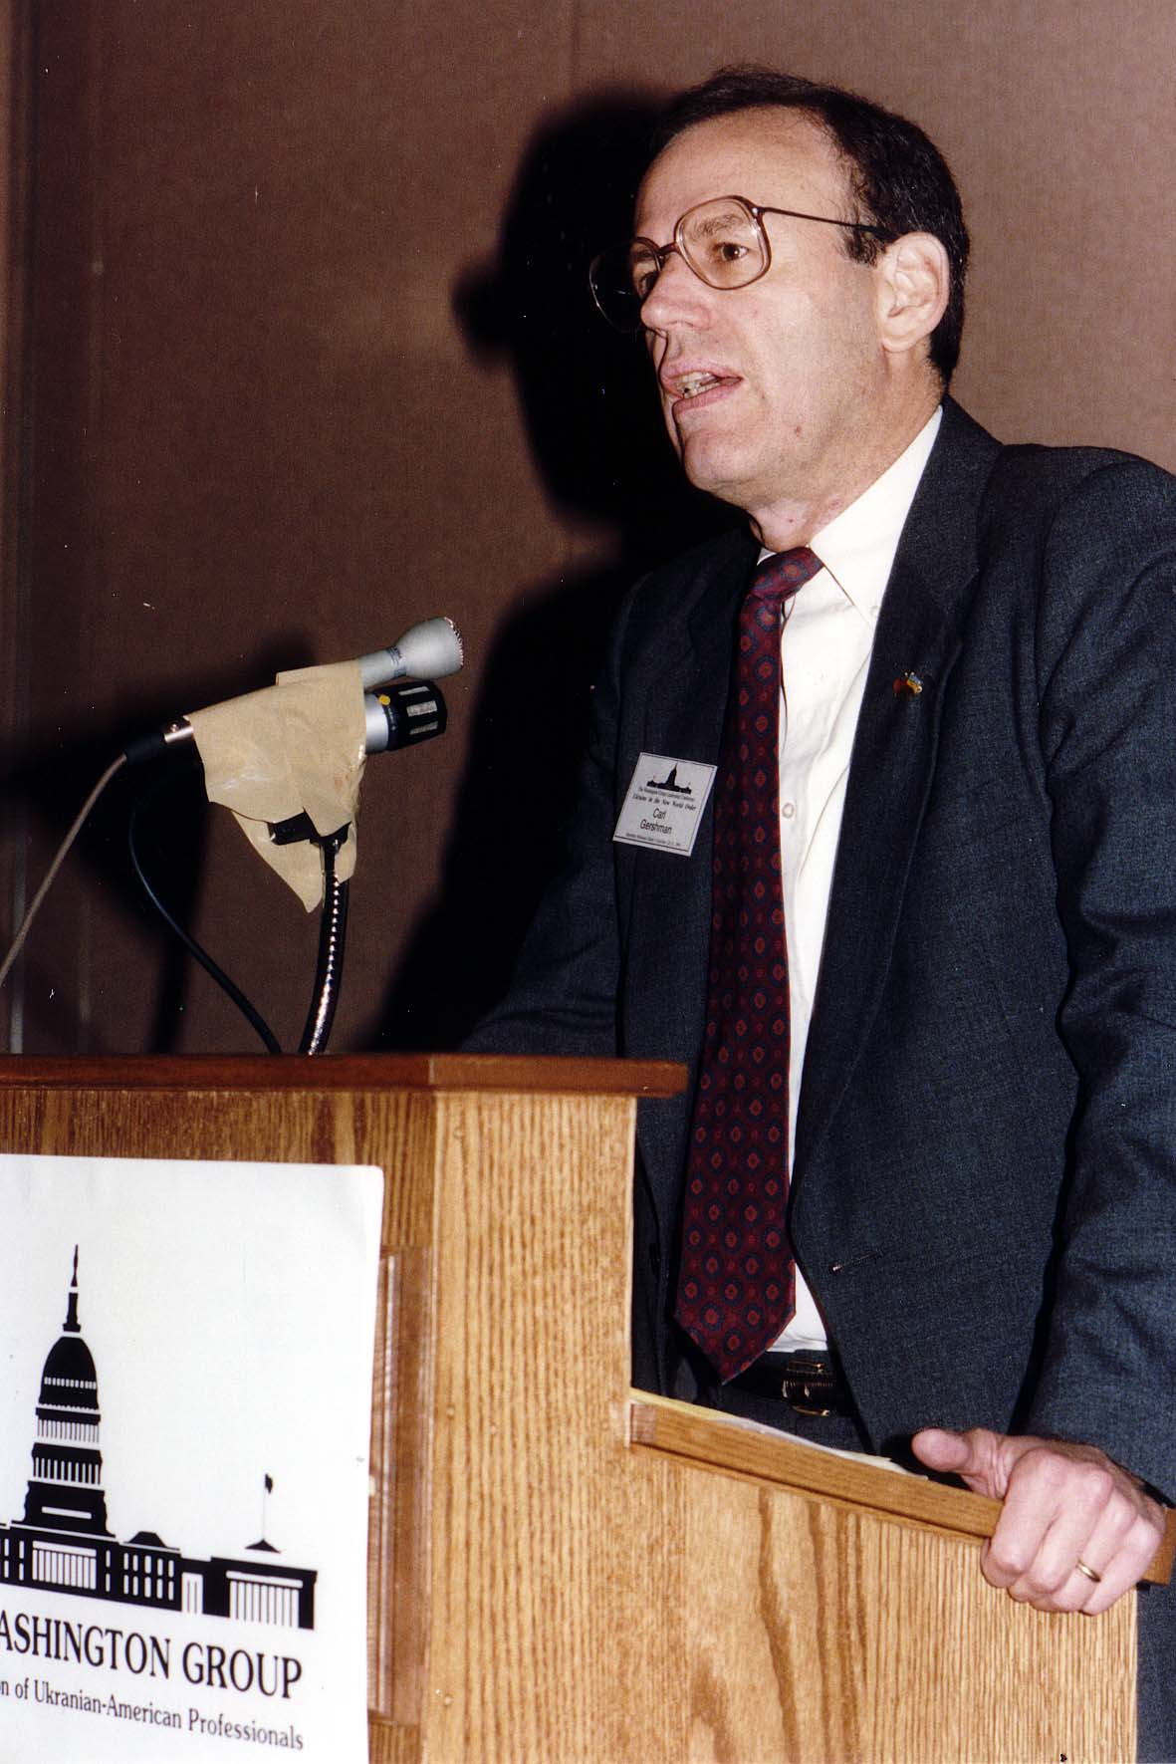
Notes:
TWG_Photo_1991_No_213__Oct_12__Leadership_Conference_Opening_Address__National_Endowment_for_Democracy_President_Carl_Gershman
See 1991 September TWG NEWS, page 1, for event announcement and October TWG NEWS, page 3, for event coverage

Slide 11
1991 220 TWG Leadership Conference Luncheon October 12 Photographs
Valeriy Kuchinsky, Guennadi Oudovenko

Slide 12
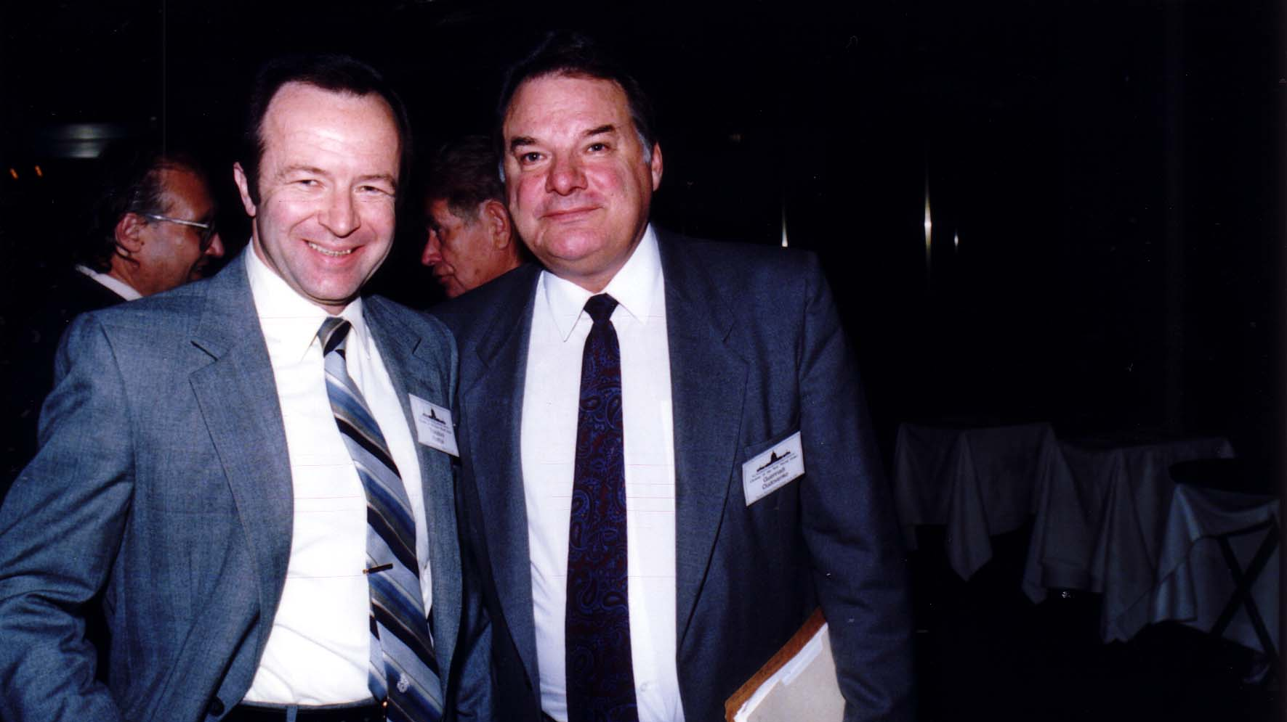
Notes:
TWG_Photo_1991_No_221__Oct_12__Leadership_Conference__Ukrainian_UN_Mission_Official_Valeriy_Kuchinsky__Luncheon_Keynote_Speaker_Ukraine_Deputy_Foreign_Minister_Guennadi_Oudovenko
See 1991 September TWG NEWS, page 1, for event announcement and October TWG NEWS, page 6, for event coverage

Slide 13
1991 250 Session 2 Domestic Political Developments Impact on Ukraine October 12 Photographs
Richard Shriver, Guennadi Oudovenko

Slide 14
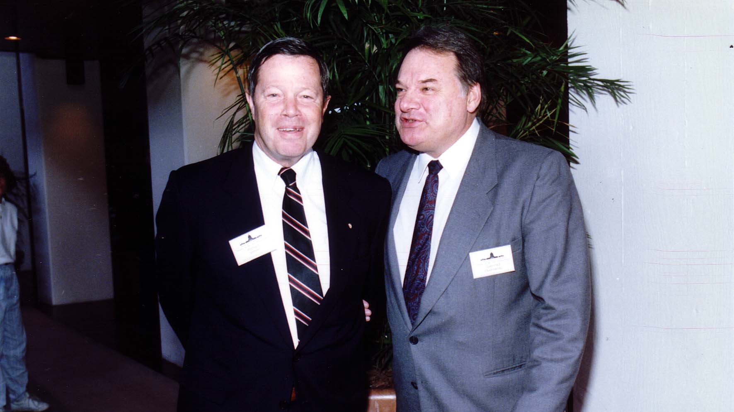
Notes:
TWG_Photo_1991_No_251__Oct_12__Leadership_Conference_Session_2_Domestic_Political_Developments__Former_Under_Secretary_of_Treasury_and_Ukrainian_Business_Digest_Publisher_Richard_Shriver__Luncheon_Speaker_Deputy_Foreign_Minister_Guennadi_Oudovenko
See 1991 September TWG NEWS, page 1, for event announcement and October TWG NEWS, page 10, for event coverage

Slide 15
200 290 Miscellaneous TWG Conference Photographs
Anatoliy Zlenko, Ada Kulyk, Laryssa Chopivsky, Guennadi Oudovenko, Greg Hulka

Slide 16
Notes:
TWG_Photo_1991_No_291_Oct_12__Leadership_Conference__Ukraine’s_Foreign_Minister_Anatoliy_Zlenko__Ada_Kulyk__Laryssa_Chopivsky__Ukraine’s_Deputy_Foreign_Minister_Guennadi_Oudovenko__future_Consul_General_2001_Greg_Hulka_DOS
See 1991 September TWG NEWS, page 1, for event announcement and October TWG NEWS, page 1, for event coverage

Slide 17
1991 300 TWG Events Photographs
U.S. Consul General in Kyiv: Jon Gundersen
Art Show: Ilona Sochynsky
TWG Hosts IMI Students: Lydia Chopivsky-Benson, Roman Shpek, Serhiy Ovcharenko, Mykola Deychakiwsky
Yuriy Shcherbak
Study of Soviet Change: Susan Eisenhower

Slide 18
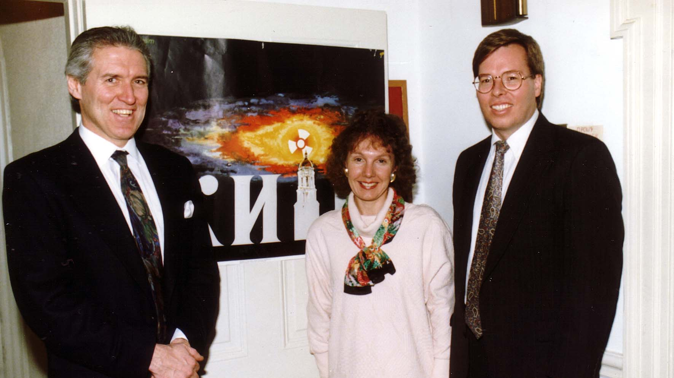
Notes:
TWG_Photo_1991_No_301_Feb_15__St_Sophia_Religious_Association__future_Chargé_d'Affaires_Jon_Gundersen__future_Press_and_Culture_Officer_Mary Kruger__future_Consul_General_2001_Greg_Hulka_DOS
See 1991 February TWG NEWS
Note: Greg Hulka was killed, along with his approximately 10-year-old daughter, in a car accident in Ukraine in late 2001, just months after arriving in Kyiv to assume the post of Consul General

Slide 19
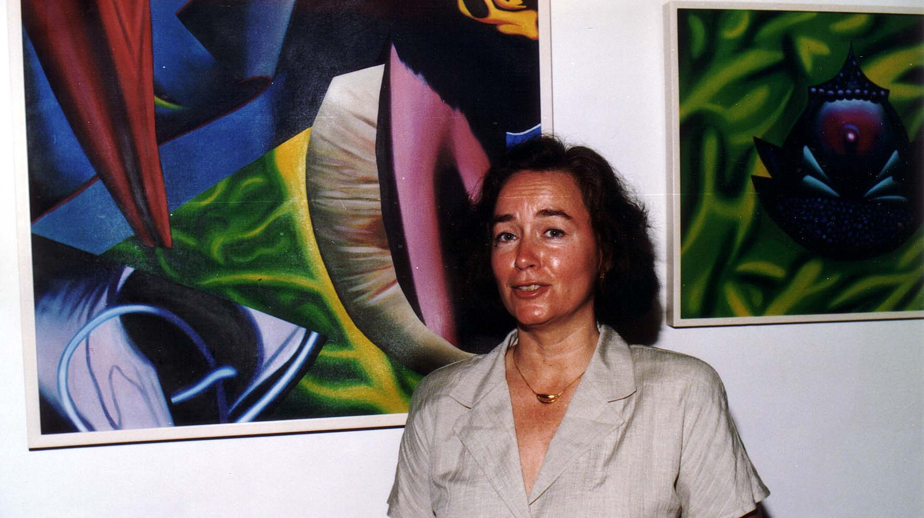
Notes:
TWG_Photo_1991_No_302__May_17__St_Sophia_Religious_Association__Artist_Ilona_Sochynsky
See 1991 April TWG NEWS for event announcement and June TWG NEWS, page 1, for event coverage

Slide 20
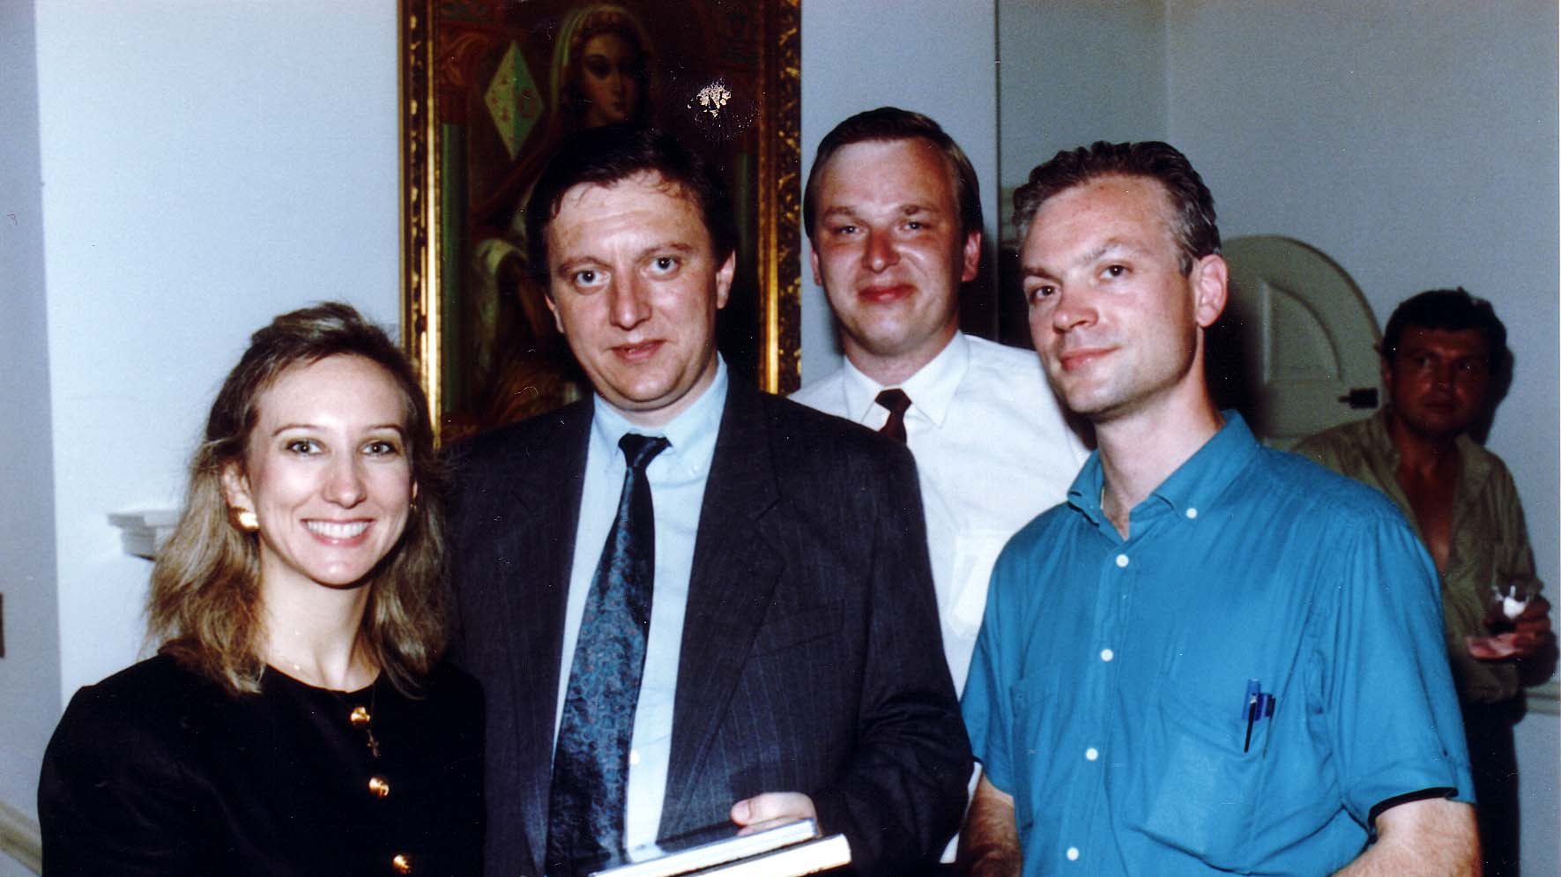
Notes:
TWG_Photo_1991_No_303__Jul_26__St_Sophia_Religious_Association__TWG_Hosts_International_Management_Institute_Students__TWG_President_Lydia_Chopivsky_Benson__Roman_Shpek__Serhiy_Ovcharenko__Mykola_Deychakiwsky
See 1991 July-August TWG NEWS, page 1, for event coverage

Slide 21
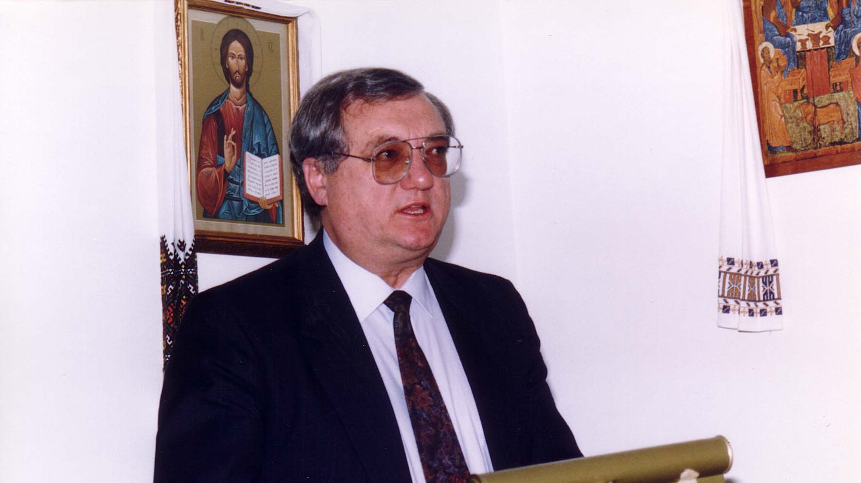
Notes:
TWG_Photo_1991_No_304__Nov_16__St_Sophia_Religious_Association__Minister_of_Environmental_Protection_Yuriy_Shcherbak
See 1992 January TWG NEWS for event coverage

Slide 22
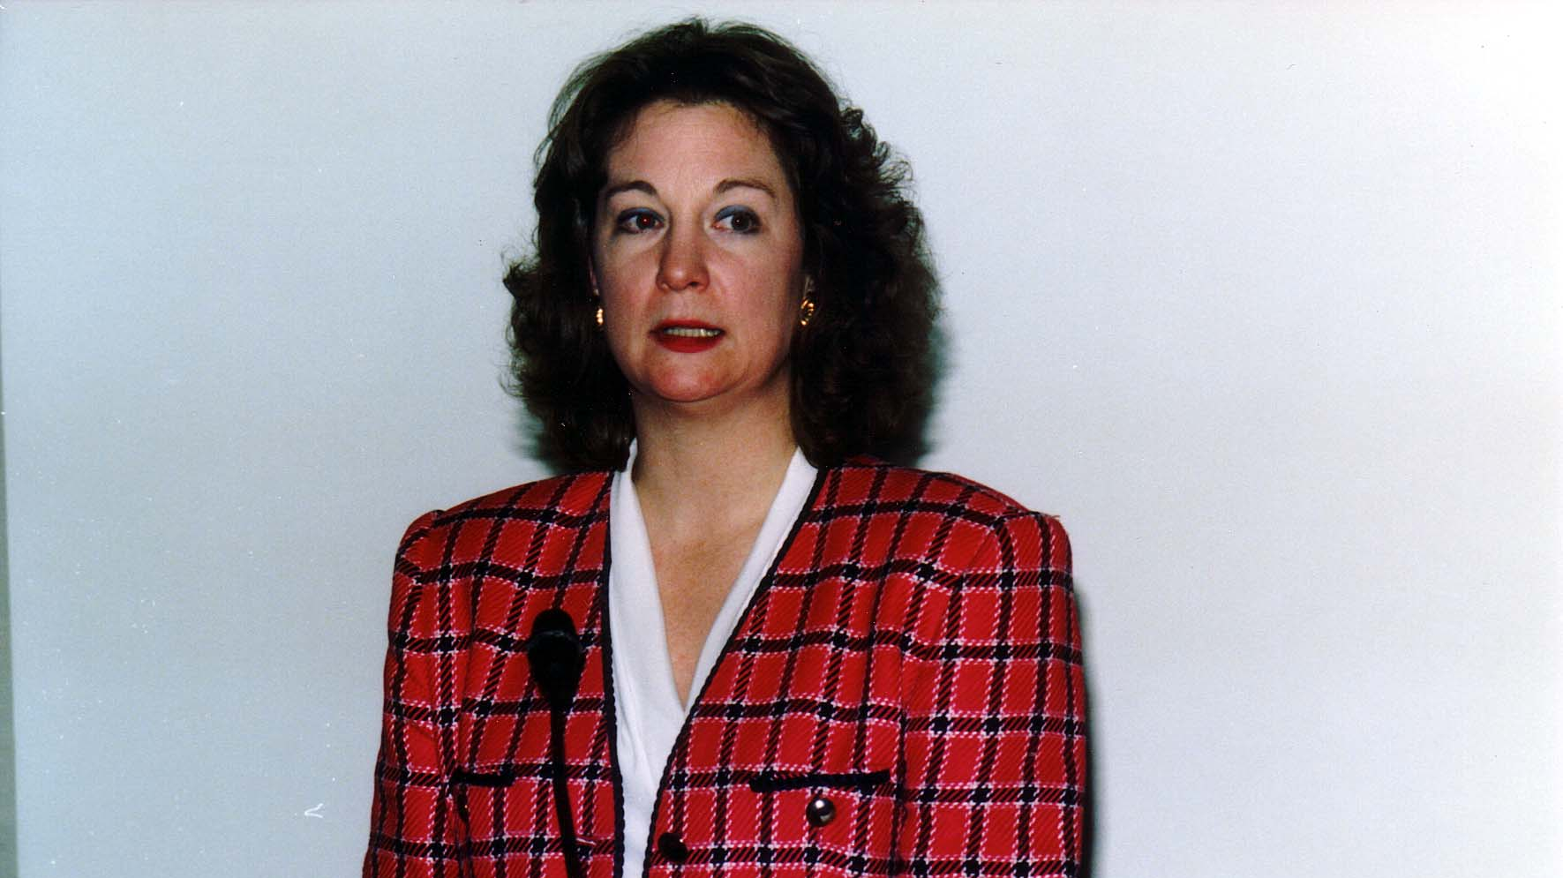
Notes:
TWG_Photo_1991_No_305__Dec_6__Almas_Lodge_of_the_Shriners_14&K__Founder_of_Center_for_the_Study_of_Soviet_Change_Susan_Eisenhower
See 1991 October TWG NEWS, page 15, for event announcement and 1992 January TWG NEWS, page 1, for event coverage

Slide 23
1991 400 TWG Co-sponsored Events Photographs
Ukrainian Independence Day Celebration

Slide 24
1991 410 TWG and Ukrainian-American Army Officers Ukrainian Independence Day Celebration Ft. McNair Officers' Club January 22, 1991 Photographs
LTC Leonid Kondratiuk, Curtis Kamman, TWG President Lydia Chopivsky-Benson

Slide 25
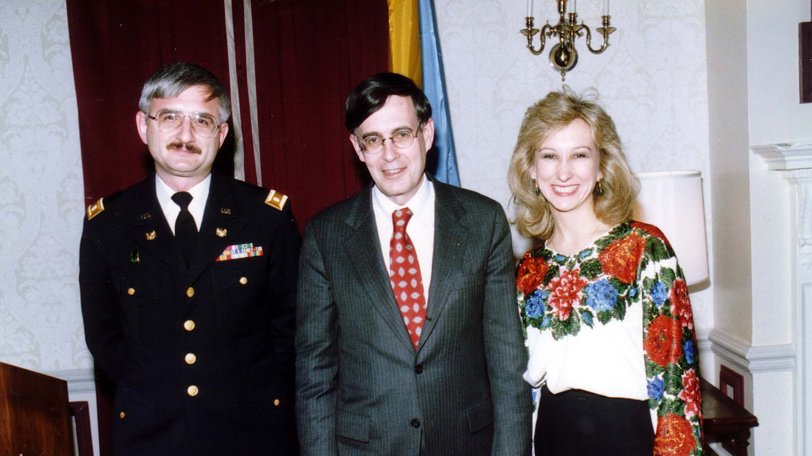
Notes:
TWG_Photo_1991_No_411__Jan_22__Ft_McNair__Ukrainian_Independence_Day__LTC_Leonid_Kondratiuk__Deputy_Assistant_Secretary_of_State_Bureau_of_East_European_and_Soviet_Affairs_Curtis_Kamman__TWG_President_Lydia_Chopivsky_Benson
See 1991 February TWG NEWS for event coverage

Slide 26
1991 420 TWG Sponsored Sovereignty Day Panel Discussion Dirksen Senate Office Building July 16 Photographs
Hlib Hayuk, Zoya Hayuk, Orysia Pylyshenko, Pavlo Movchan, George Chopivsky, Andrij Masiuk, George Masiuk, Andrew Webber
Maxim Kniazkov, Adrian Karatnycky, TWG President Lydia Chopivsky-Benson, Marusia Drohobycky Sloniewsky, Robert McConnell

Slide 27
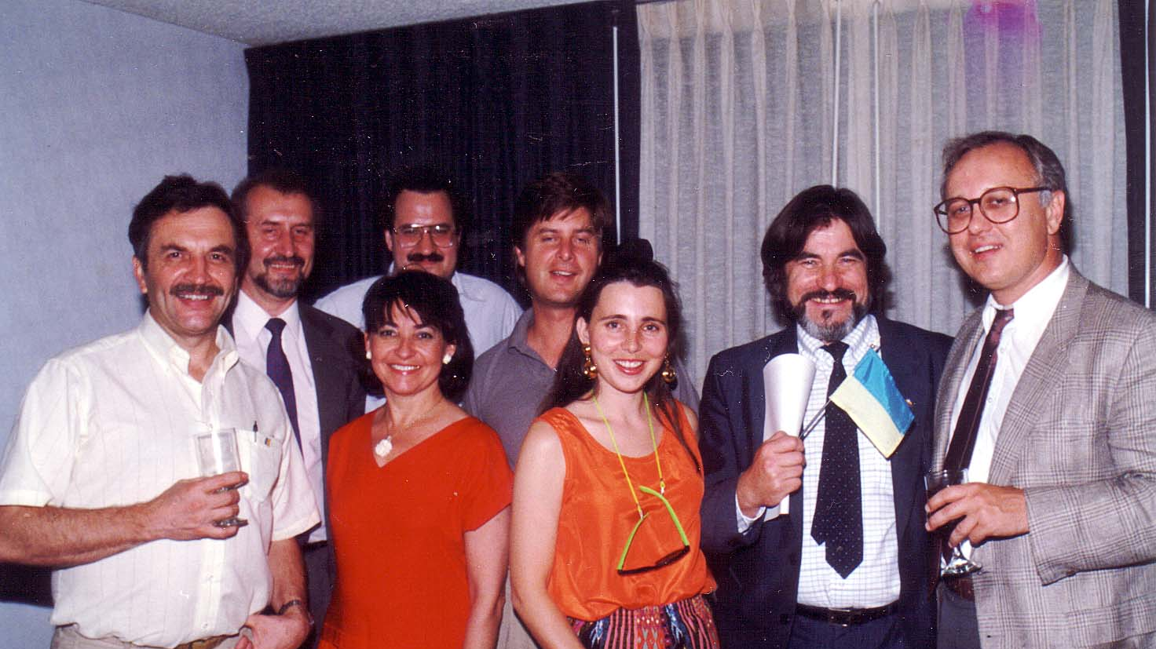
Notes:
TWG_Photo_1991_No_421__July_16__Sovereignty_Day__Dirksen_Senate_Office_Building__Front__Hlib_Hayuk__Zoya_Hayuk__Orysia_Pylyshenko__Ukrainian_Poet_Pavlo_Movchan__George_Chopivsky__Back__Andrij_Masiuk__George_Masiuk__Andrew_Webber
See 1991 June TWG NEWS for event announcement and July-August TWG NEWS for event coverage

Slide 28
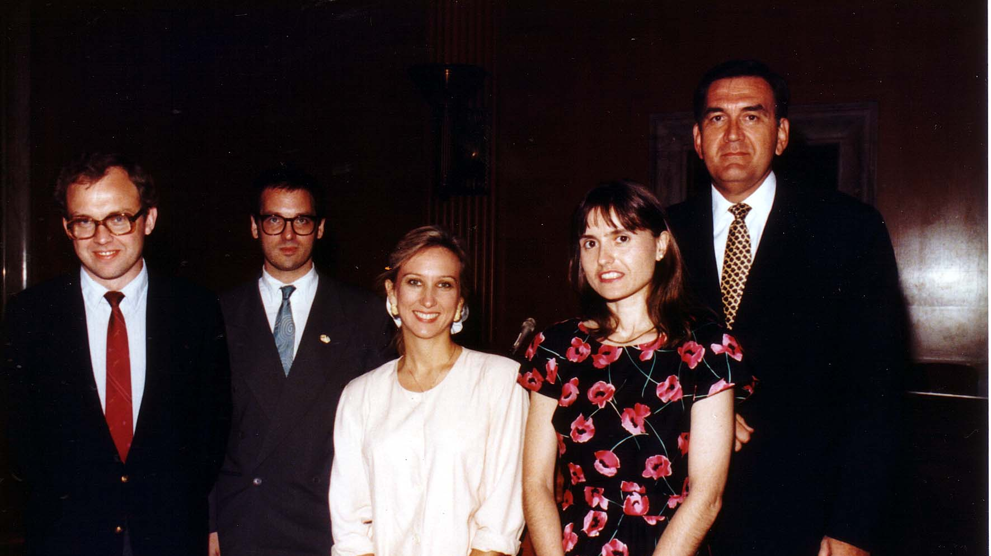
Notes:
TWG_Photo_1991_No_422__July_16__Sovereignty_Day__Dirksen_Senate_Office_Building__Panelists_Maxim_Kniazkov__Adrian_Karatnycky__TWG_President_Lydia_Chopivsky_Benson__Marusia_Drohobycky_Sloniewsky__Robert McConnell
See 1991 June TWG NEWS for event announcement and July-August TWG NEWS for event coverage

Slide 29
1991 600 TWG Social Events Photographs
TWG Christmas Party Gusti's Restaurant 19th and M St WDC:
Chrystyna Babiak, Mykola Babiak, Orest Deychakiwsky, Karen Deychakiwsky
Margarita Hewko, John Hewko, TWG President Lydia Chopivsky-Benson
Michael Kowalysko Isha Pryshlak

Slide 30
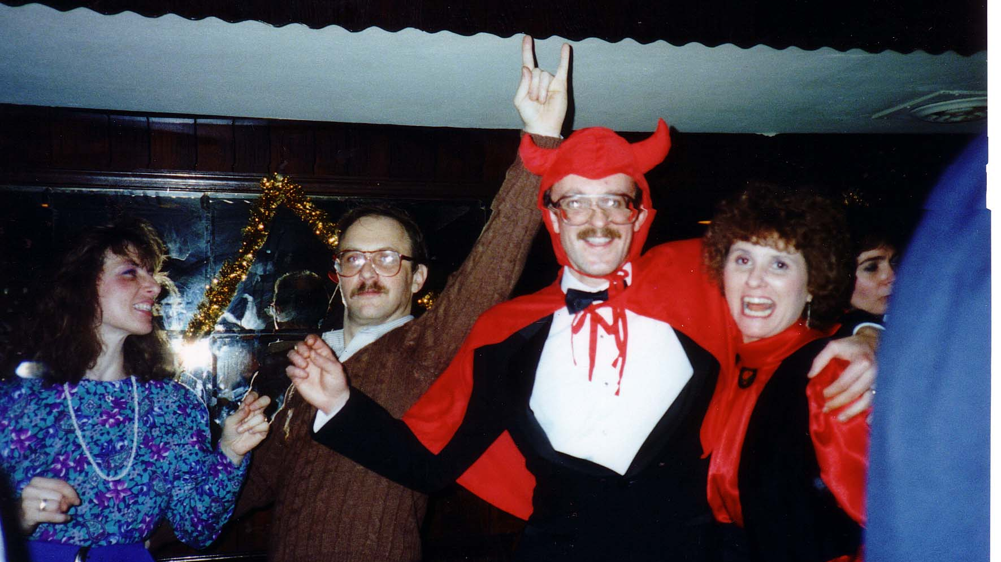
Notes:
TWG_Photo_1991_No_601__Dec_13__Gusti's_Restaurant__Christmas_Party__Chrystyna_Babiak__Mykola_Babiak__Orest_Deychakiwsky__Karen_Deychakiwsky
See 1991 October TWG NEWS, page 1, 9 for event announcement

Slide 31
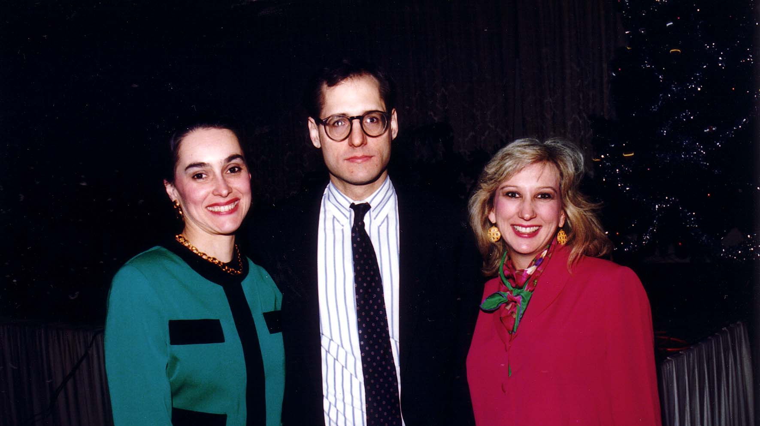
Notes:
TWG_Photo_1991_No_603__Dec_13__Gusti's_Restaurant__Christmas_Party__Margarita_Hewko__John_Hewko__TWG_President_Lydia_Chopivsky_Benson
See 1991 October TWG NEWS, page 1, 9 for event announcement

Slide 32
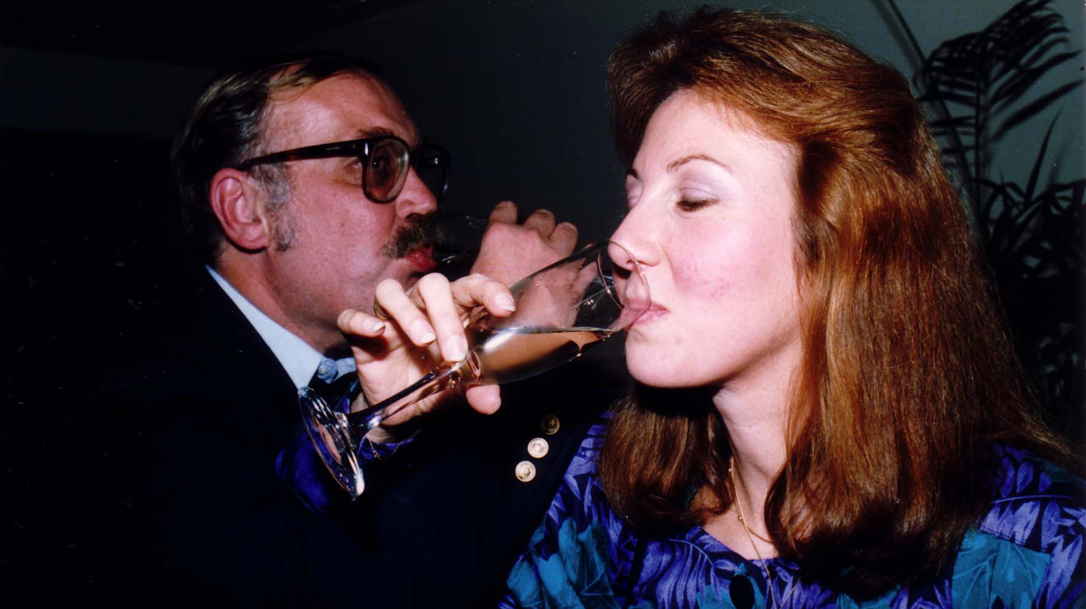
Notes:
TWG_Photo_1991_No_604__Dec_13__Gusti's_Restaurant__Christmas_Party__Michael_Kowalysko__Isha_Pryshlak
See 1991 October TWG NEWS, page 1, 9 for event announcement

