Slide 1
TWG 1992 Photos
Created November 5, 2020

Slide 2
1992 100 TWG Annual Meeting Savoy Suites hotel, Georgetown February 29
See 1992 February TWG NEWS for Annual Meeting planning and March TWG NEWS for Annual Meeting coverage
Elected to the Board: Lydia Chopivsky-Benson – President; Roman Goy – Vice President; Orysia Pylyshenko - Secretary; Mykola Babiak – Treasurer; Natalie Korytnyk – Events Director; Vera Kaczmarsky - Public Relations; George Masiuk – Membership Director; Bohdan Radejko - Special Projects
Members at Large: Yaro Bihun, Sophia Caryk, Laryssa Chopivsky, Orest Deychakiwsky, Marta Jarosewich, Daria Stec, Natalie Sluzar
Auditing Committee: Myron Wasylyk, Steve Boyduy
Presidium: R.L. Chomiak, Orysia Pylyshenko

Slide 3
1992 200 TWG Leadership Conference Washington Court Hotel October 9-11 Photographs
See Leadership Conference Announcement in 1992 April-May TWG NEWS, page 5
See Leadership Conference Planning in 1992 April-May, July-August, and September TWG NEWS
See TWG_1992_Leadership_Conference_Booklet for Conference Program and Speaker Biographies
See 1992 October, November, and December TWG NEWS for Leadership Conference Coverage
See TWG Leadership Conference coverage by The Ukrainian Weekly: The_Ukrainian_Weekly_1992-42

Slide 4
1992 201 TWG Leadership Conference Reception at the Hungarian Embassy October 9 Photographs
Amb. Oleh Bilorus
Amb. Pal Tar; Sophia Caryk, TWG President Lydia Chopivsky-Benson

Slide 5
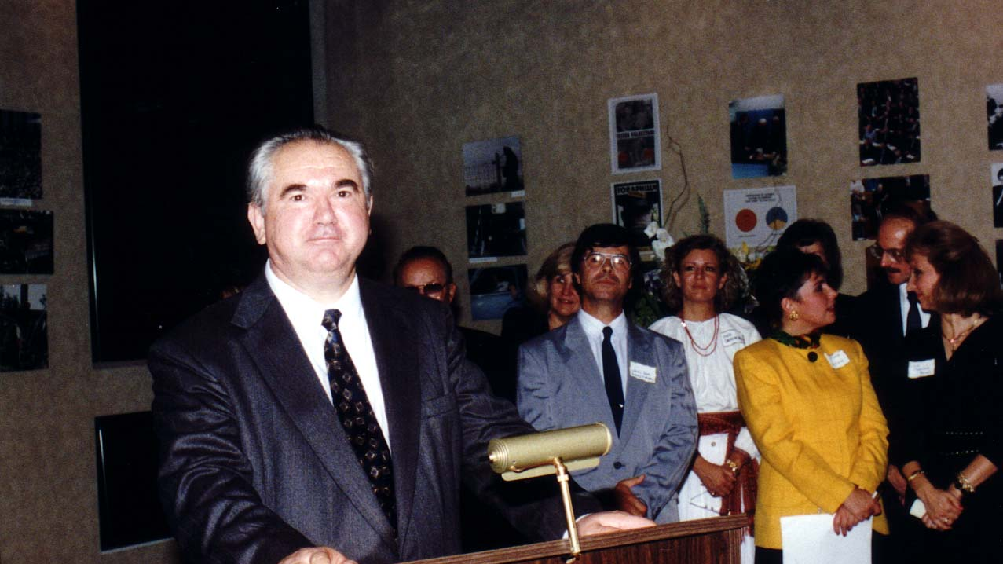
Notes:
TWG_Photo_1992_No_202__Oct_9__Leadership_Conference__Hungarian_Embassy__Ukraine_Ambassador_to_United_States_Oleh_Bilorus
See 1992 October TWG NEWS, page 1, for event coverage

Slide 6
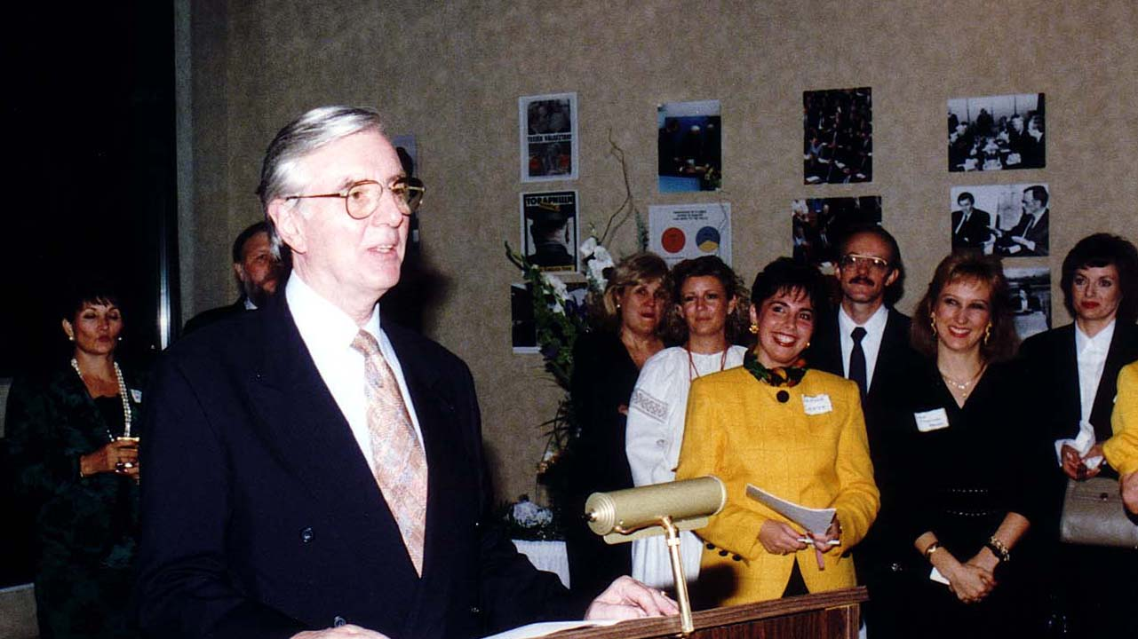
Notes:
TWG_Photo_1992_No_203__Oct_9__Leadership_Conference__Reception_at_Hungarian_Embassy__Hungarian_Ambassador_Pal_Tar__in_yellow_Sophia_Caryk__TWG_President_Lydia_Chopivsky_Benson
See 1992 October TWG NEWS for event coverage

Slide 7
1992 210 TWG Leadership Conference Opening Address October 10 Photographs
Roman Goy

Slide 8
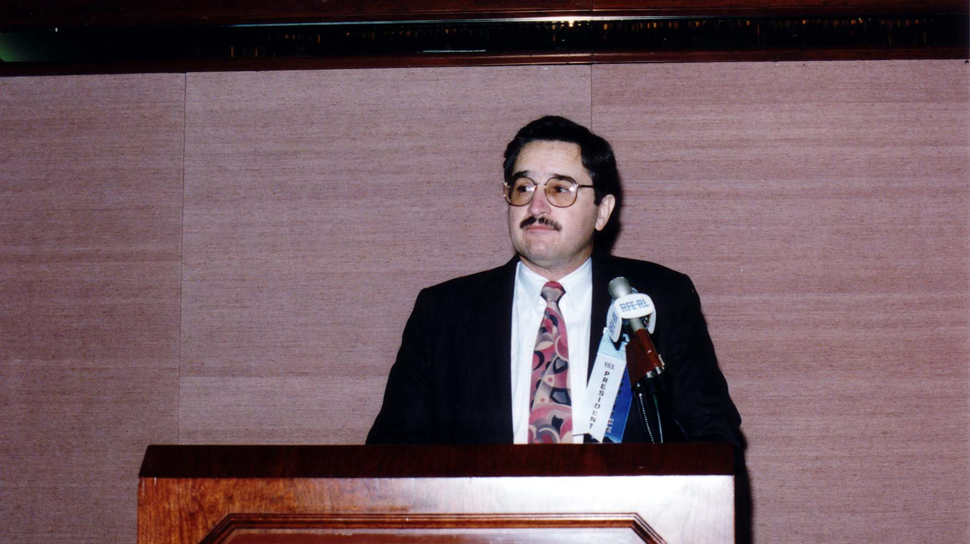
Notes:
TWG_Photo_1992_No_212__Oct_10__Leadership_Conference__Conference_Chairman_Roman_Goy_MD

Slide 9
1992 230 TWG Leadership Conference Banquet October 10 Photographs
Journalism Award: Cord Meyer
Amb. Roman Popadiuk, Amb. Oleh Bilorus

Slide 10
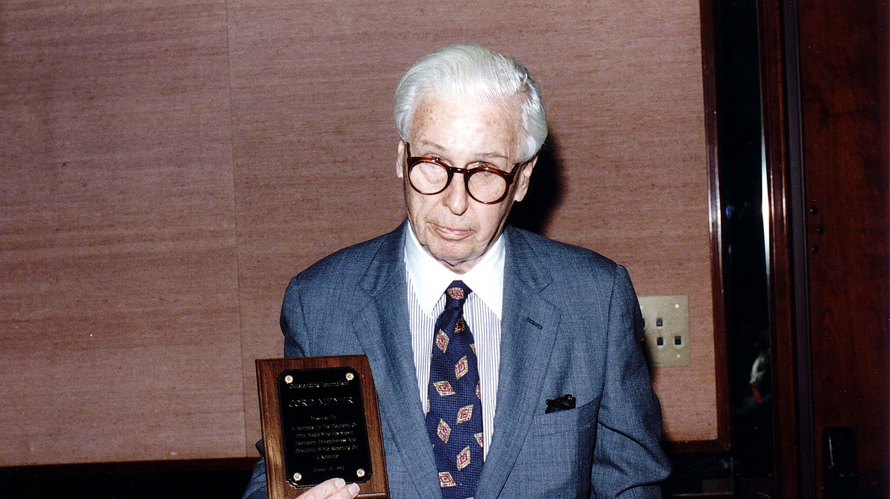
Notes:
TWG_Photo_1992_No_232__Oct_10__Leadership_Conference__Outstanding_Journalism_Award_Recipient_Syndicated_Columnist_Cord Meyer
See 1992 November TWG NEWS, page 9, for event coverage

Slide 11
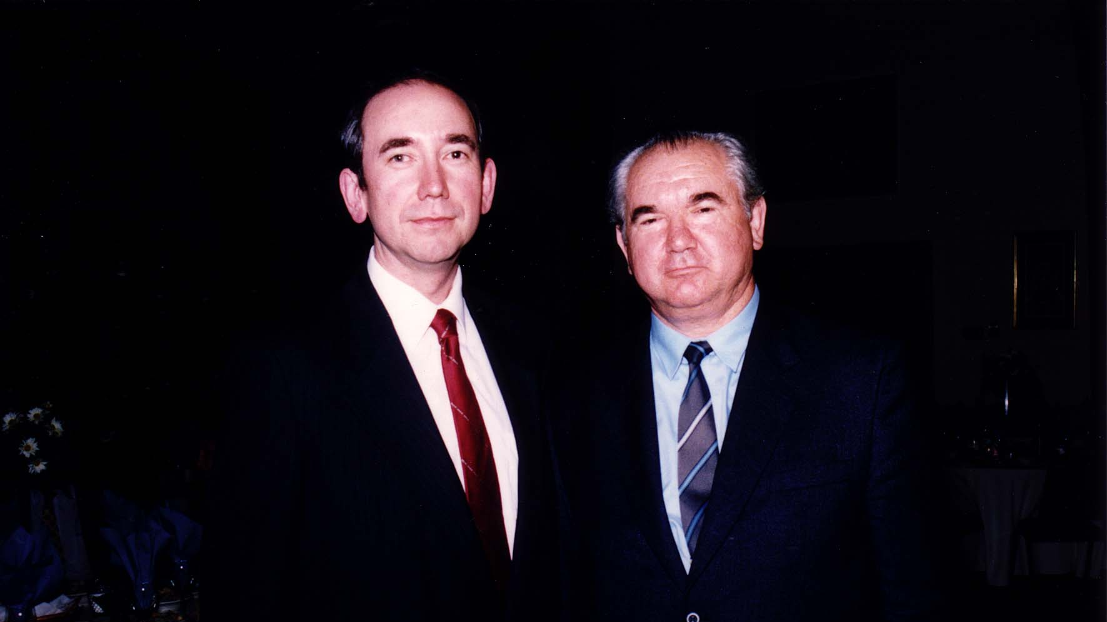
Notes:
TWG_Photo_1992_No_234_Oct_10__Leadership_Conference__United_States_Ambassador_to_Ukraine_Roman_Popadiuk_Ukraine_Ambassador_Oleh_Bilorus
Note: Ambassador Bilorus delivered the Opening Address to the TWG Leadership Conference and its coverage is in 1992 October TWG NEWS, page 4

Slide 12
1992 240 TWG Leadership Conference Session 1: Domestic Issues in Ukraine October 10 Photographs
Adrian Karatnycky

Slide 13
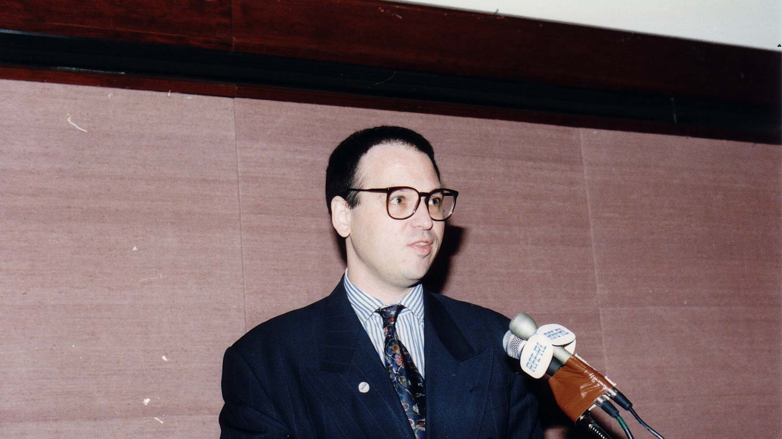
Notes:
TWG_Photo_1992_No_241__Oct_10__Leadership_Conference_Session_1__Assistant_to_President_of_AFL-CIO_Adrian_Karatnycky
See 1992 October TWG NEWS, page 4 and 5 for event coverage

Slide 14
1992 250 TWG Leadership Conference Session 2: International Trade, Investment and Technical Assistance October 10 Photographs
Serhiy Koulyk

Slide 15
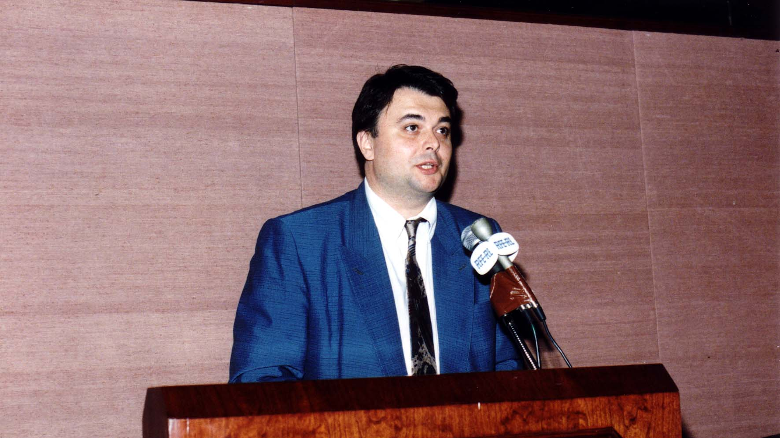
Notes:
TWG_Photo_1992_No_251__Oct_10__Leadership_Conference_Session_2__Ukrainian_Embassy_Principal_Economic_Officer_Serhiy_Koulyk
See 1992 November TWG NEWS, page 4, for event coverage

Slide 16
1992 260 TWG Leadership Conference Science and Technology Base for Modern Infrastructure October 10 Photographs
Marta Cehelsky

Slide 17
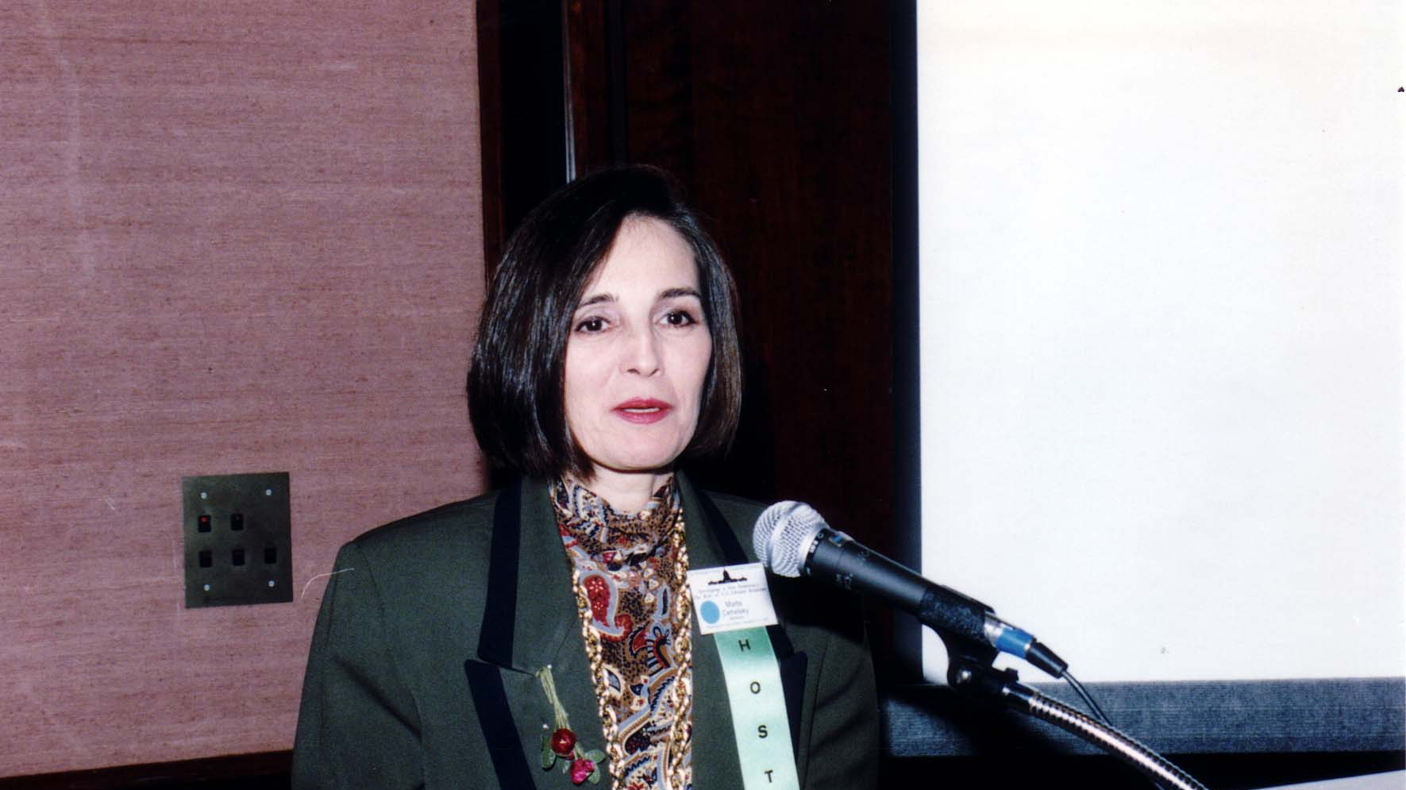
Notes:
TWG_Photo_1992_No_261__Oct_10__Leadership_Conference_Science_and_Technology_Panel__National_Science_Board_Marta_Cehelsky
See 1992 November TWG NEWS, page 6, for event coverage

Slide 18
1992 270 TWG Leadership Conference Ukrainian-American Community October 11 Photographs
Oleh Wolowyna

Slide 19
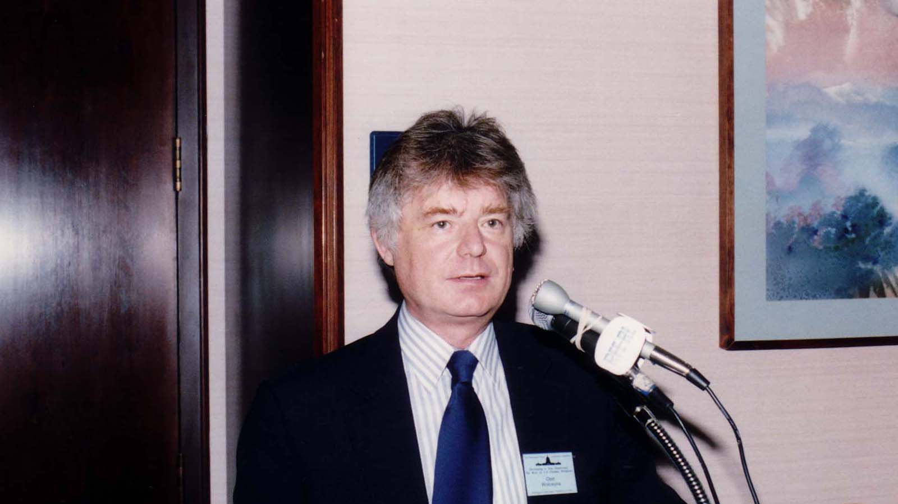
Notes:
TWG_Photo_1992_No_271__Oct_11__Leadership_Conference_Ukrainian-American_Community_Panel__Demographer_Oleh_Wolowyna
See 1992 December TWG NEWS, page 4, for event coverage

Slide 20
1992 300 TWG Events Photographs
Observations on Ukraine:
William Colby
Robert Cullen
Charles Maynes
John Sears
TWG President Lydia Chopivsky-Benson, Amb. Roman Popadiuk

Slide 21
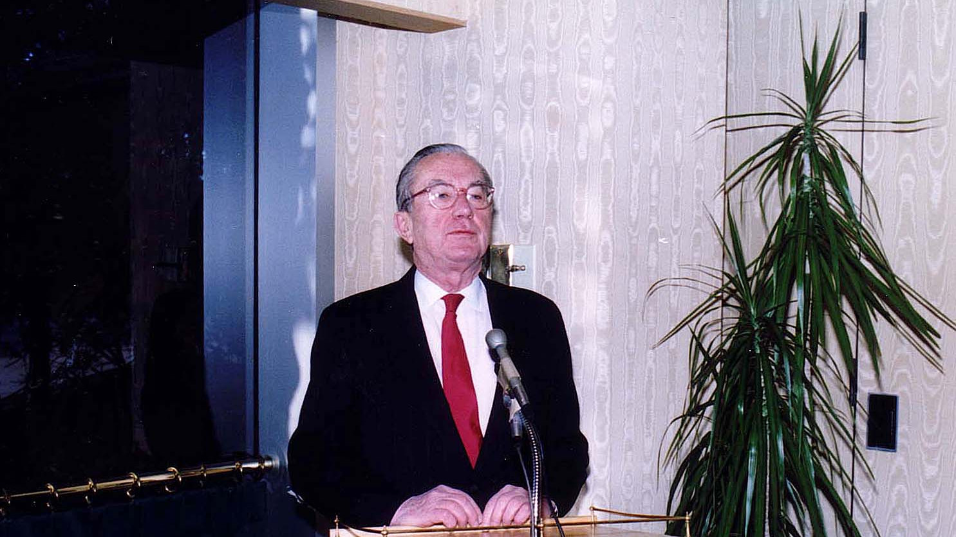
Notes:
TWG_Photo_1992_No_331__Jan_17__TWG_Breakfast__Former_Director_Central_Intelligence_William_Colby
See 1992 January TWG NEWS, page 2, for event announcement and February TWG NEWS, page 1, for event coverage

Slide 22
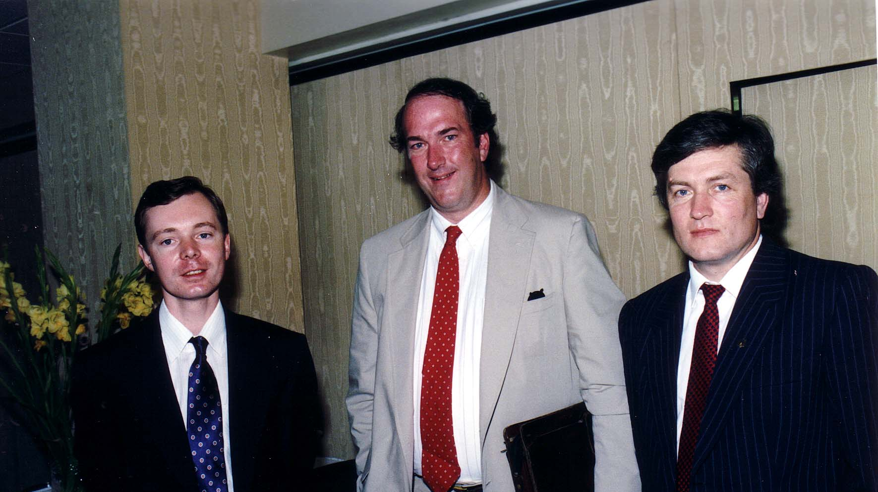
Notes:
TWG_Photo_1992_No_332__May_13__New_Yorker_Journalist_Robert_Cullen_(center)
See 1992 June TWG NEWS, page 1, for event coverage

Slide 23
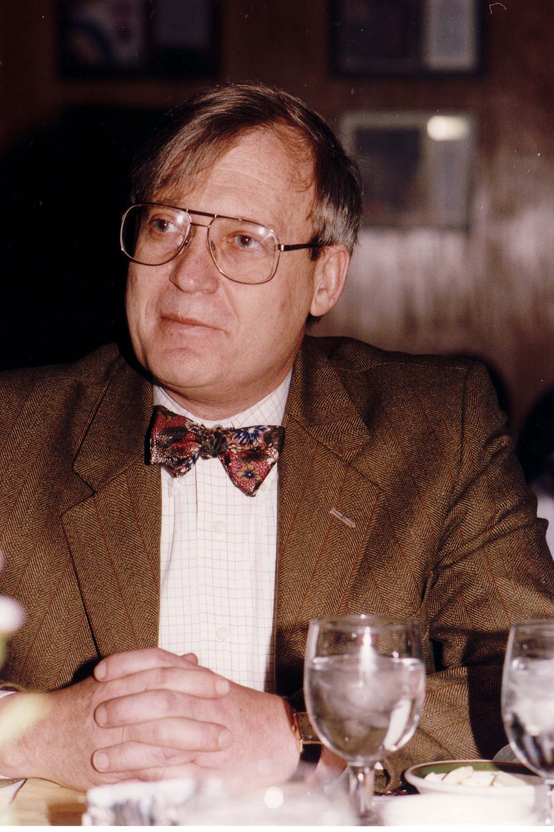
Notes:
TWG_Photo_1992_No_333__Dec_1__La_Colline_Restaurant__TWG_Breakfast_Forum__Editor_of_Foreign_Policy_Charles_Maynes
See 1992 November TWG NEWS, page 1, for event announcement and December TWG NEWS, page 1, for event coverage

Slide 24
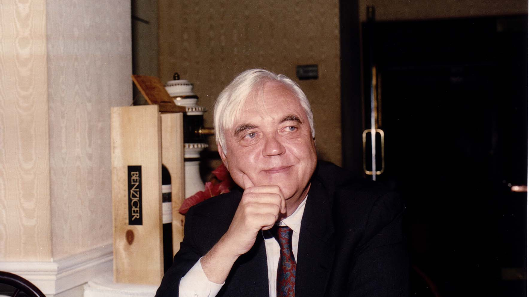
Notes:
TWG_Photo_1992_No_334__Dec_11__La_Colline_Restaurant__Republican_Political_Strategist_John_Sears
See 1992 November TWG NEWS, page 1, for event announcement and 1993 January TWG NEWS, page 1, for event coverage

Slide 25
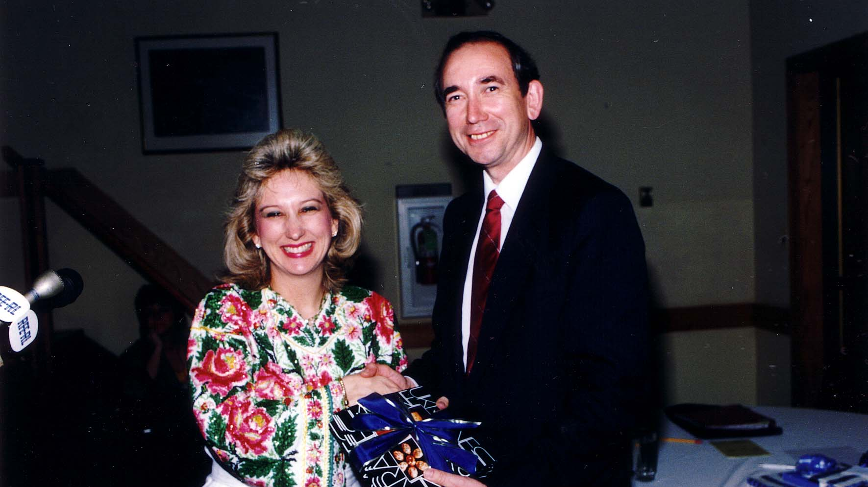
Notes:
TWG_Photo_1992_No_335__May_15__TWG_President_Lydia_Chopivsky_Benson__First_US_Ambassador_to_Ukraine_Roman_Popadiuk
See 1992 June TWG NEWS, page 4, article on Ambassador Popadiuk’s swearing-in ceremony

Slide 26
1992 400 TWG Co-sponsored Events Photographs
Ukrainian Independence Day Celebration
Reception for Peace Corps volunteers

Slide 27
1992 410 TWG and Ukrainian-American Officers Ukrainian Independence Day Fort Myer Officers' Club January 23 Photographs
Richard Cheney
Wolodymyr Sulzynsky, Jurij Petrenko, Richard Cheney, Ihor Kotlarchuk
Eustachiy Derzko, Michael Waris, Theodosia Kichorowsky
Isha Pryshlak, Oleksander Pryshlak, Lydia Jarosewich

Slide 28
Notes:
TWG_Photo_1992_No_411__Jan_23__Fort_Myer_Officers'_Club__Ukrainian_Independence_Day__Secretary_of_Defense_Richard_Cheney
See 1992 February TWG NEWS for event coverage

Slide 29
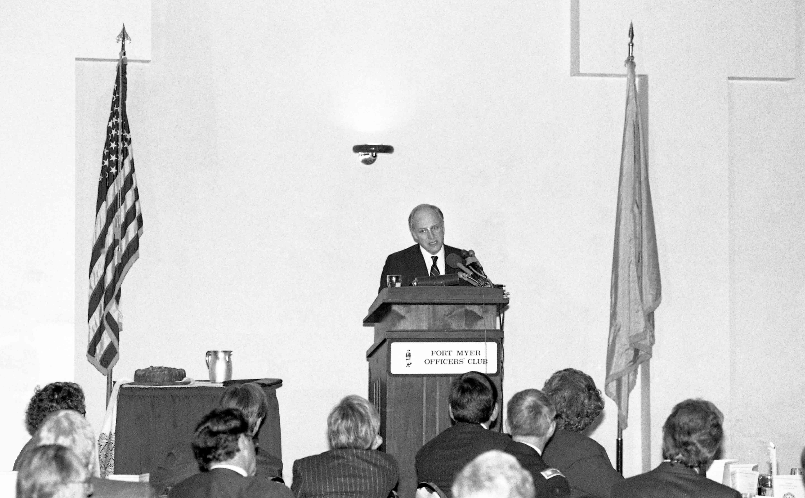
Notes:
TWG_Photo_1992_No_412__Jan_23__Fort_Myer_Officers'_Club__Ukrainian_Independence_Day__Secretary_of_Defense_Richard_Cheney
See 1992 February TWG NEWS for event coverage

Slide 30
Notes:
TWG_Photo_1992_No_413__Jan_23__Fort_Myer_Officers'_Club__Ukrainian_Independence_Day__Secretary_of_Defense_Richard_Cheney
See 1992 February TWG NEWS for event coverage

Slide 31
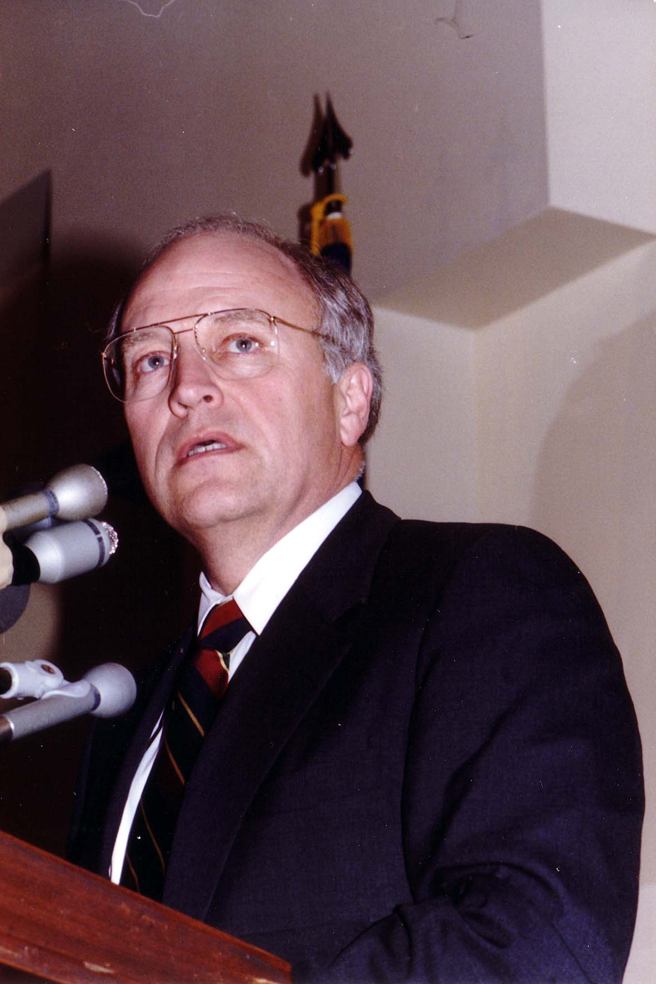
Notes:
TWG_Photo_1992_No_414__Jan_23__Fort_Myer_Officers'_Club__Ukrainian_Independence_Day__Secretary_of_Defense_Richard_Cheney
See 1992 February TWG NEWS for event coverage

Slide 32
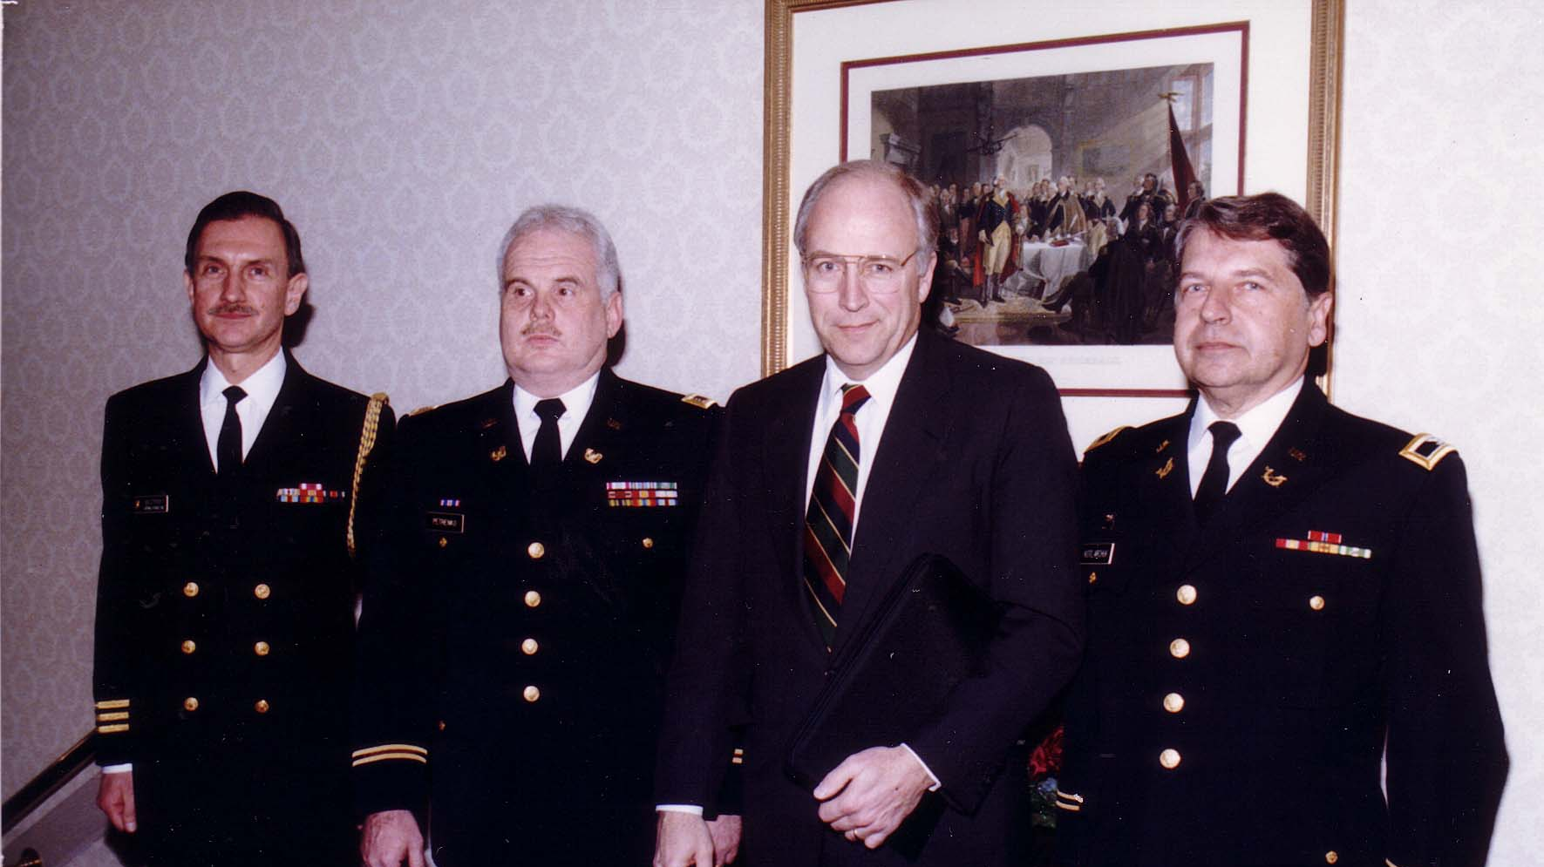
Notes:
TWG_Photo_1992_No_415__Jan_23__Fort_Myer_Officers'_Club__Ukrainian_Independence_Day__Wolodymyr_Sulzynsky__Jurij_Petrenko__Secretary_Of_Defense_Richard_Cheney__Ihor_Kotlarchuk
See 1992 February TWG NEWS for event coverage

Slide 33
Notes:
TWG_Photo_1992_No_416__Jan_23__Fort_Myer_Officers'_Club__Secretary_of_Defense_Richard_Cheney__looking_on_Jurij_Petrenko_and_Anya_Dydyk_Petrenko
See 1992 February TWG NEWS for event coverage

Slide 34
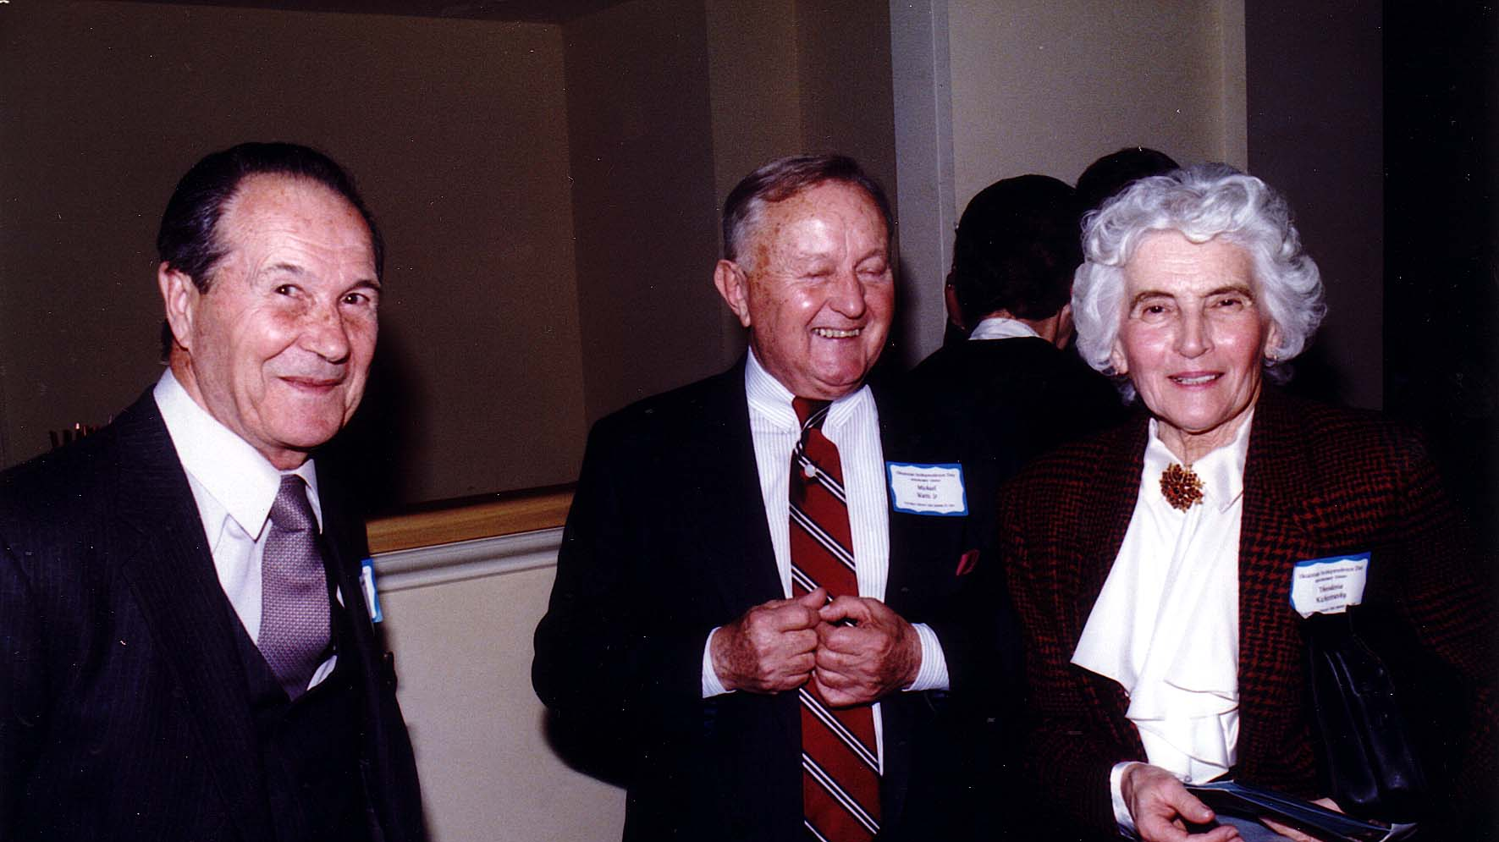
Notes:
TWG_Photo_1992_No_416__Jan_23__Fort_Myer_Officers'_Club__Ukrainian_Independence_Day__TWG_Members__Biophysicist_Eustachiy_Derzko__Attorney_Michael_Waris__Librarian_Theodosia_Kichorowsky
See 1992 February TWG NEWS for event coverage

Slide 35
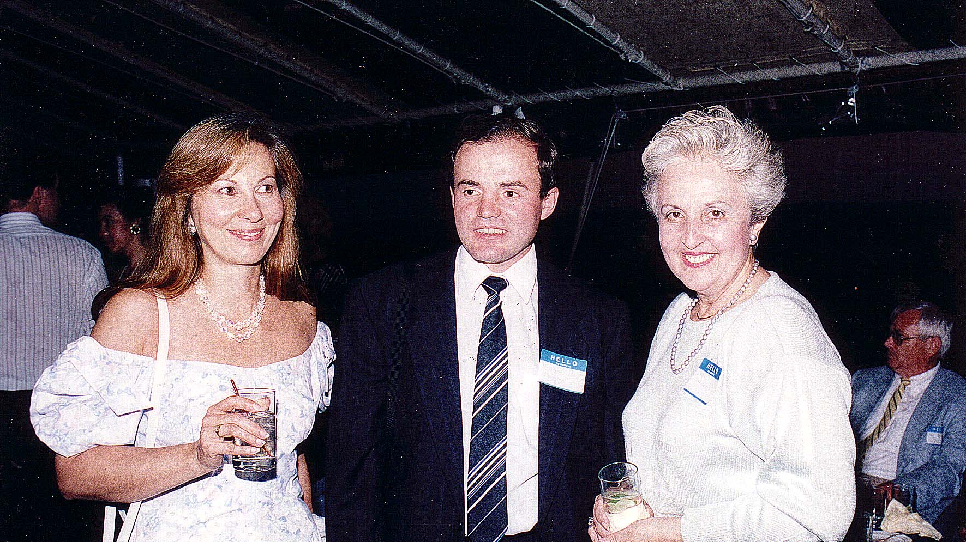
Notes:
TWG_Photo_1992_No_417__Jan_23__Fort_Myer_Officers'_Club__Ukrainian_Independence_Day__Isha_Pryshlak__Oleksander_Pryshlak__Lydia_Jarosewich
See 1992 February TWG NEWS for event coverage

Slide 36
1992 430 TWG Reception for Peace Corps Volunteers headed to Ukraine Grand Hotel Washington DC November 13, Photographs
Jerry Dutkewych, Nadia McConnell
Jerry Dutkewych
Mick Mullaym

Slide 37
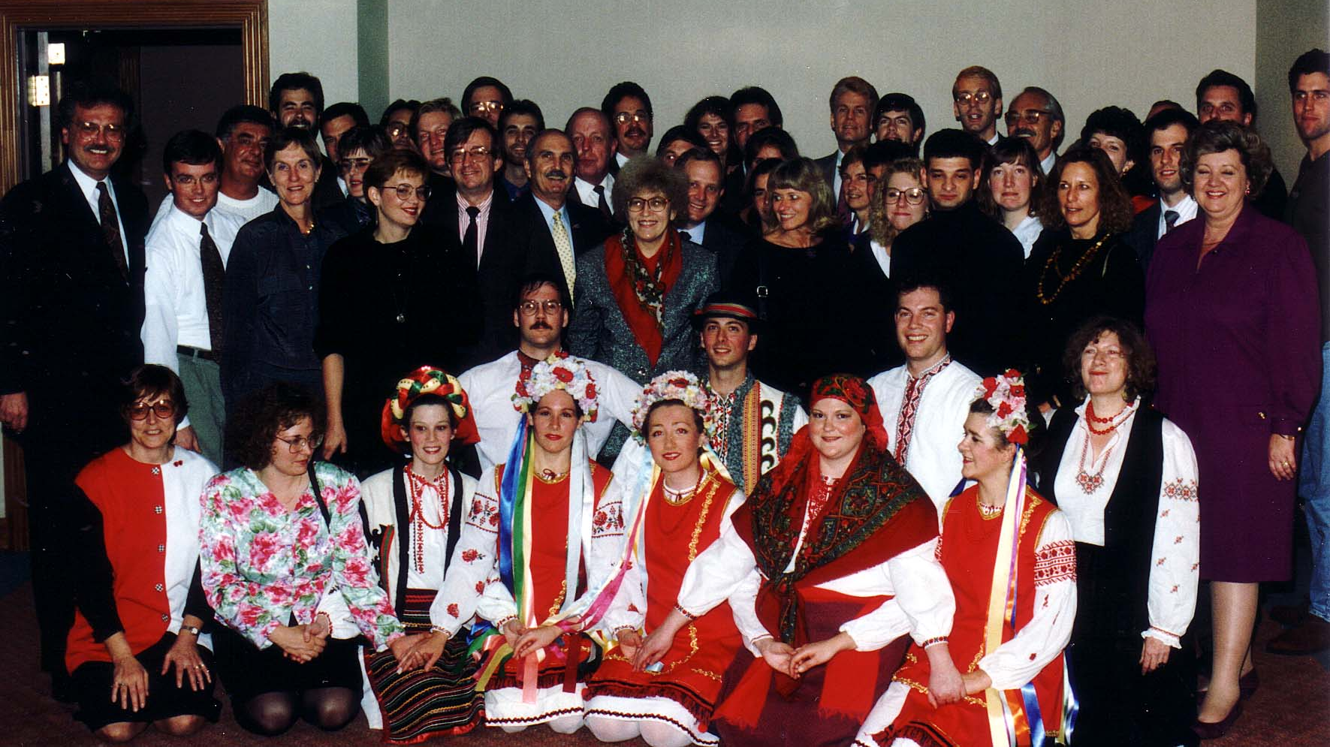
Notes:
TWG_Photo_1992_No_431__Nov_13__First_Peace_Corps__Extreme_left_(suit_jacket)_Peace_Corps_Director_in_Ukraine_Jerry_Dutkewych_Extreme_right_in_purple_Nadia_McConnell
See 1992 December TWG NEWS, page 1, for event coverage

Slide 38
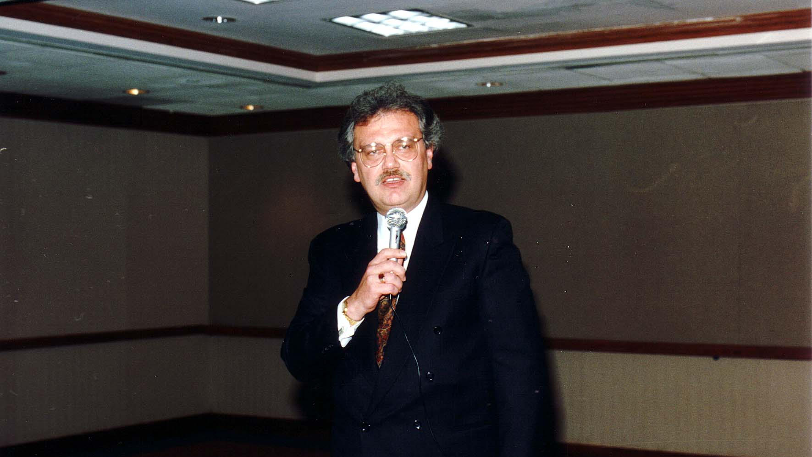
Notes:
TWG_Photo_1992_No_432__Nov_13__Peace_Corps_Director_in_Ukraine_Jerry_Dutkewych
See 1992 December TWG NEWS, page 1, for event coverage

Slide 39
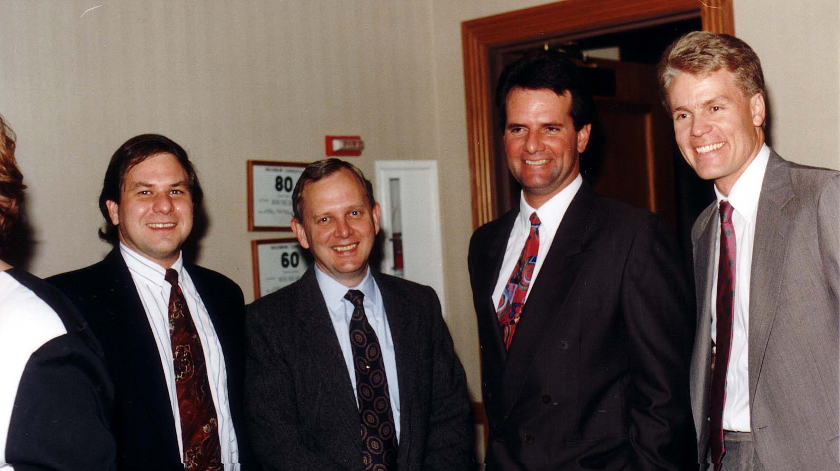
Notes:
TWG_Photo_1992_No_433__Nov_13__Peace_Corps__NN_NN_Mick_Mullaym_NN
See 1992 December TWG NEWS, page 1, for event coverage

Slide 40
1992 500 TWG Cultural Events Photographs
Kennedy Center Opera:
Martha Jarosewich, Larysa Kurylas, Daria Stec, Volodymyr Hryshko, Laryssa Chopivsky, Roman Terleckyj, Hanya Cherniak, Marta Zielyk, Isha Pryshlak, Marika Jurach, Wolodymyr Bilajiw

Slide 41
Notes:
TWG_Photo_1992_No_510_1_Nov_14_Kennedy_Center_Washington_Opera__Left_Side_Martha_Jarosewich__Larysa_Kurylas__Daria_Stec__Tenor_Volodymyr_Hryshko__Laryssa_Chopivsky__Washington_National_Opera_Stage_and_Production_Director_Roman_Terleckyj
See 1992 December TWG NEWS, page 5, for event coverage

Slide 42
Notes:
TWG_Photo_1992_No_510_2_Nov_14_Kennedy_Center_Washigton_Opera__Right_Side__Hanya_Cherniak__Marta_Zielyk__Isha_Pryshlak__Marika_Jurach__Wolodymyr_Bilajiw
See 1992 December TWG NEWS, page 5, for event coverage

Slide 43
1992 700 Prominent Visitors from Ukraine in Washington
The photos in this section are not directly related to specific TWG events, however TWG members played a role in arrangements made for VIPs from Ukraine.

Slide 44
1992 710 Visit by Ukrainian Parliamentarians sponsored by U.S. – Ukraine Foundation and Indiana University TWG Member Mykola Babiak consulting to USUF and TWG Members Marta Pereyma and Yaro Bihun working for United States Information Agency (USIA) Escorted the Kyiv Delegation Photographs
Olexander Charodeyev
Ivan Hopej
Oleksandr Tarasenko, Tatyana Yakheyeva, Marta Pereyma
Valery Cherep
Yaro Bihun, Les Taniuk, Ivan Hopej, Olexander Charodeyev
Les Taniuk

Slide 45
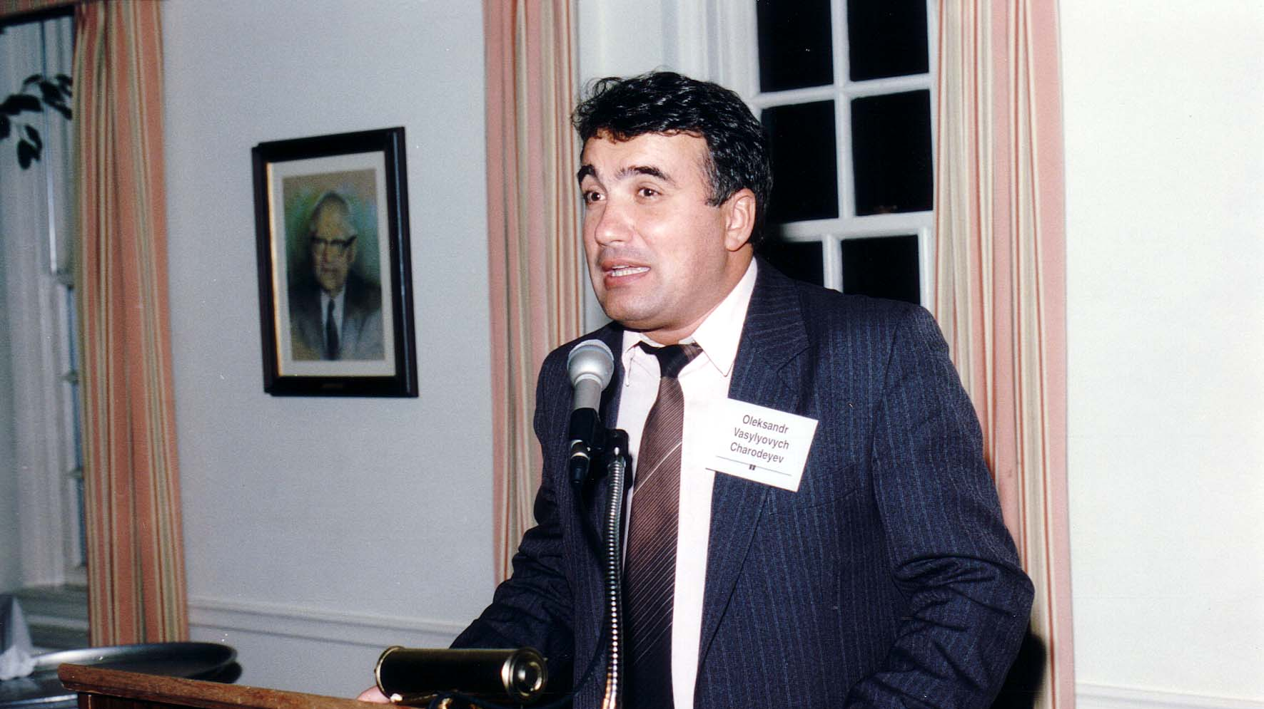
Notes:
TWG_Photo_1992_No_421__Kyiv_Delegation__Ukrainian_Parliamentarian_Member_of_Commission_on_International_Affairs_Olexander_Charodeyev

Slide 46
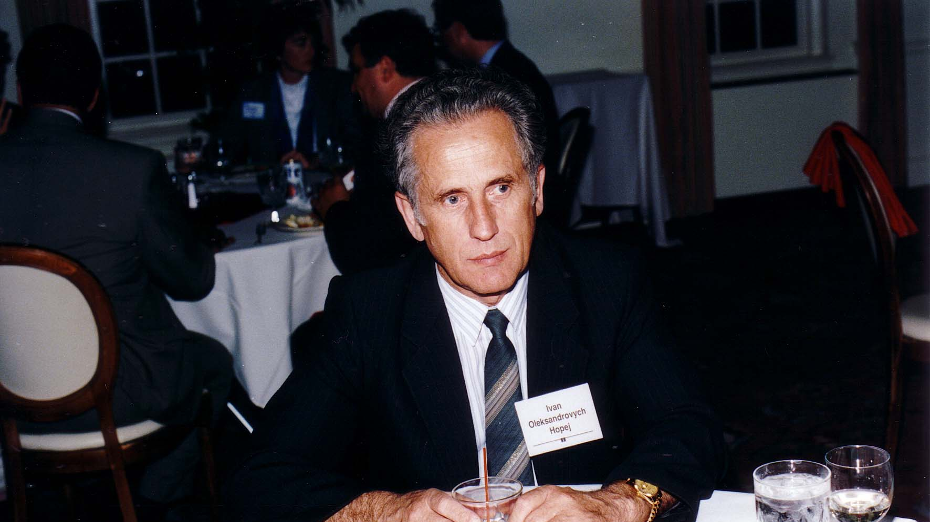
Notes:
TWG_Photo_1992_No_422__Kyiv_Delegation__голова_Полтавської_обласної_Ради_народних_депутатів_Ivan_Hopej

Slide 47
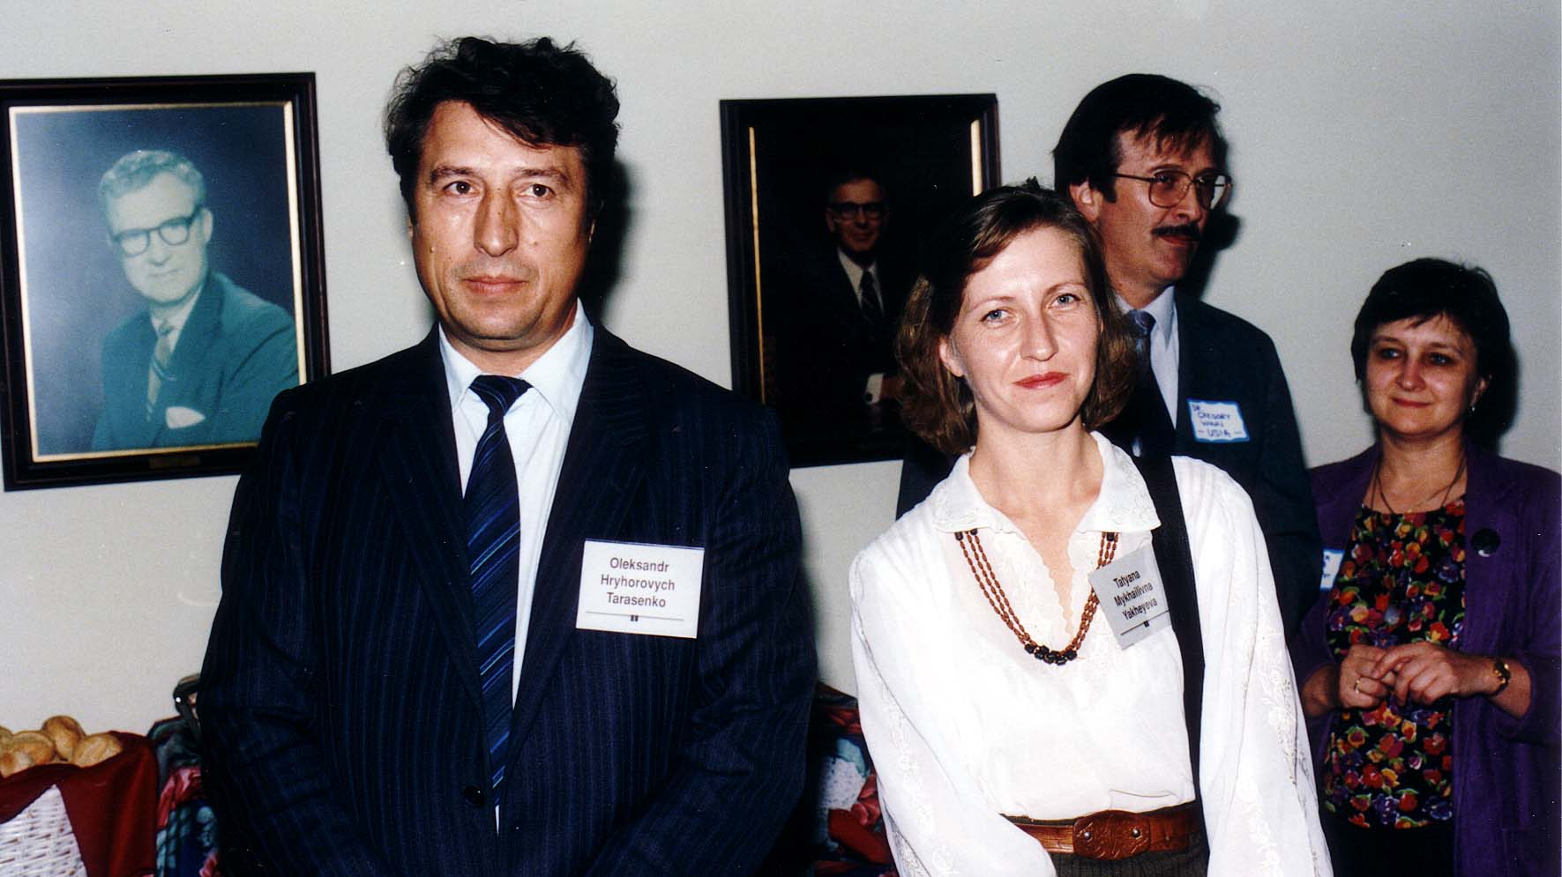
Notes:
TWG_Photo_1992_No_423__Kyiv_Delegation__Secretary_Commission_on_Defense_and_National_Security_Oleksandr_Tarasenko__Member_Commission_on_State_Sovereignty_and_Multinational_ Affairs_Tatyana_Yakheyeva__NN__USIA_Cultural_Exchange_Specialist_Marta_Pereyma

Slide 48
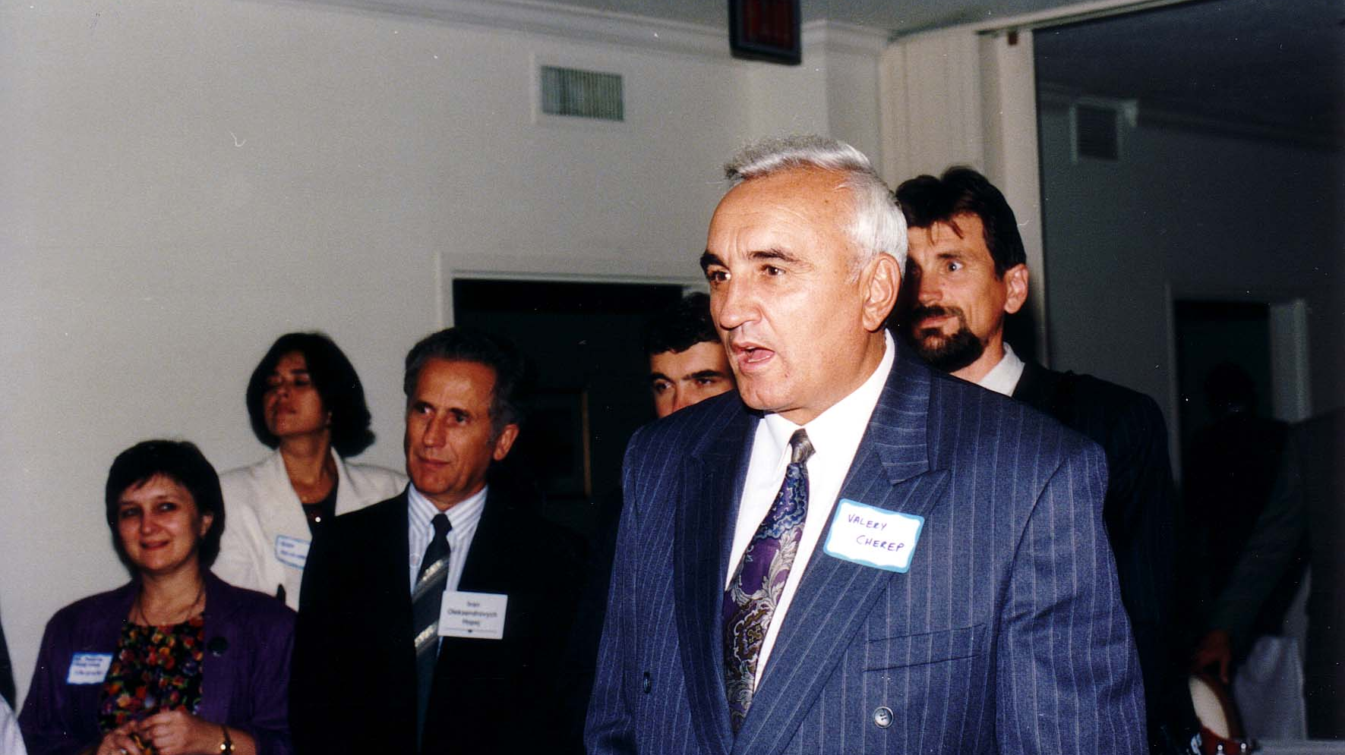
Notes:
TWG_Photo_1992_No_424__Kyiv_Delegation__In_Front___USIA_Cultural_Exchange_Specialist_Marta_Pereyma___голова_Полтавської_обласної_Ради_народних_депутатів_Ivan_Hopej__Chairman_Commission_on_Construction_Architecture_and_Housing_Valery_Cherep

Slide 49
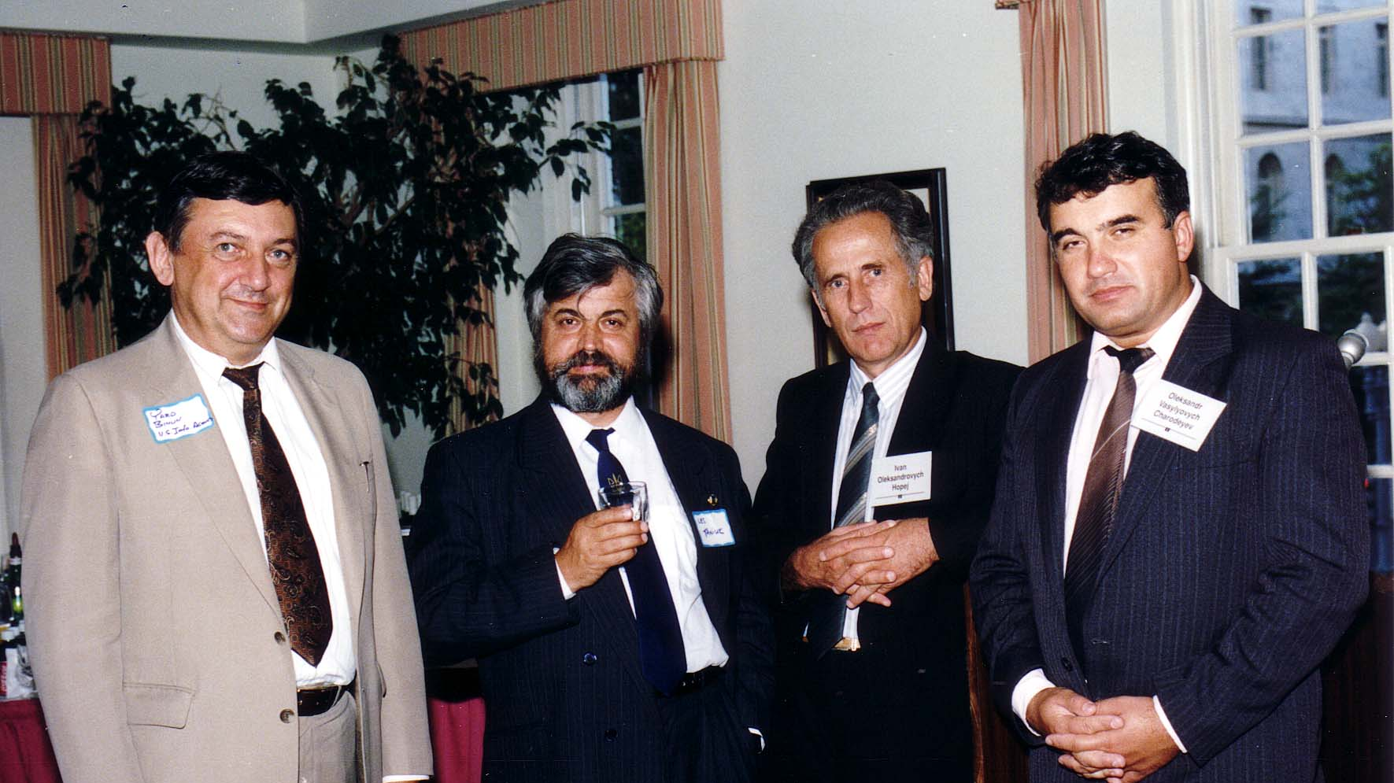
Notes:
TWG_Photo_1992_No_425__Kyiv_Delegation__TWG_Board_Member_Yaro_Bihun__Theater_and_Film_Director_Les_Taniuk__голова_Полтавської_обласної_Ради_народних_депутатів_Ivan_Hopej__Ukrainian_Parliamentarian_Member_of_Commission_on_International_Affairs__Olexander_Charodeyev

Slide 50
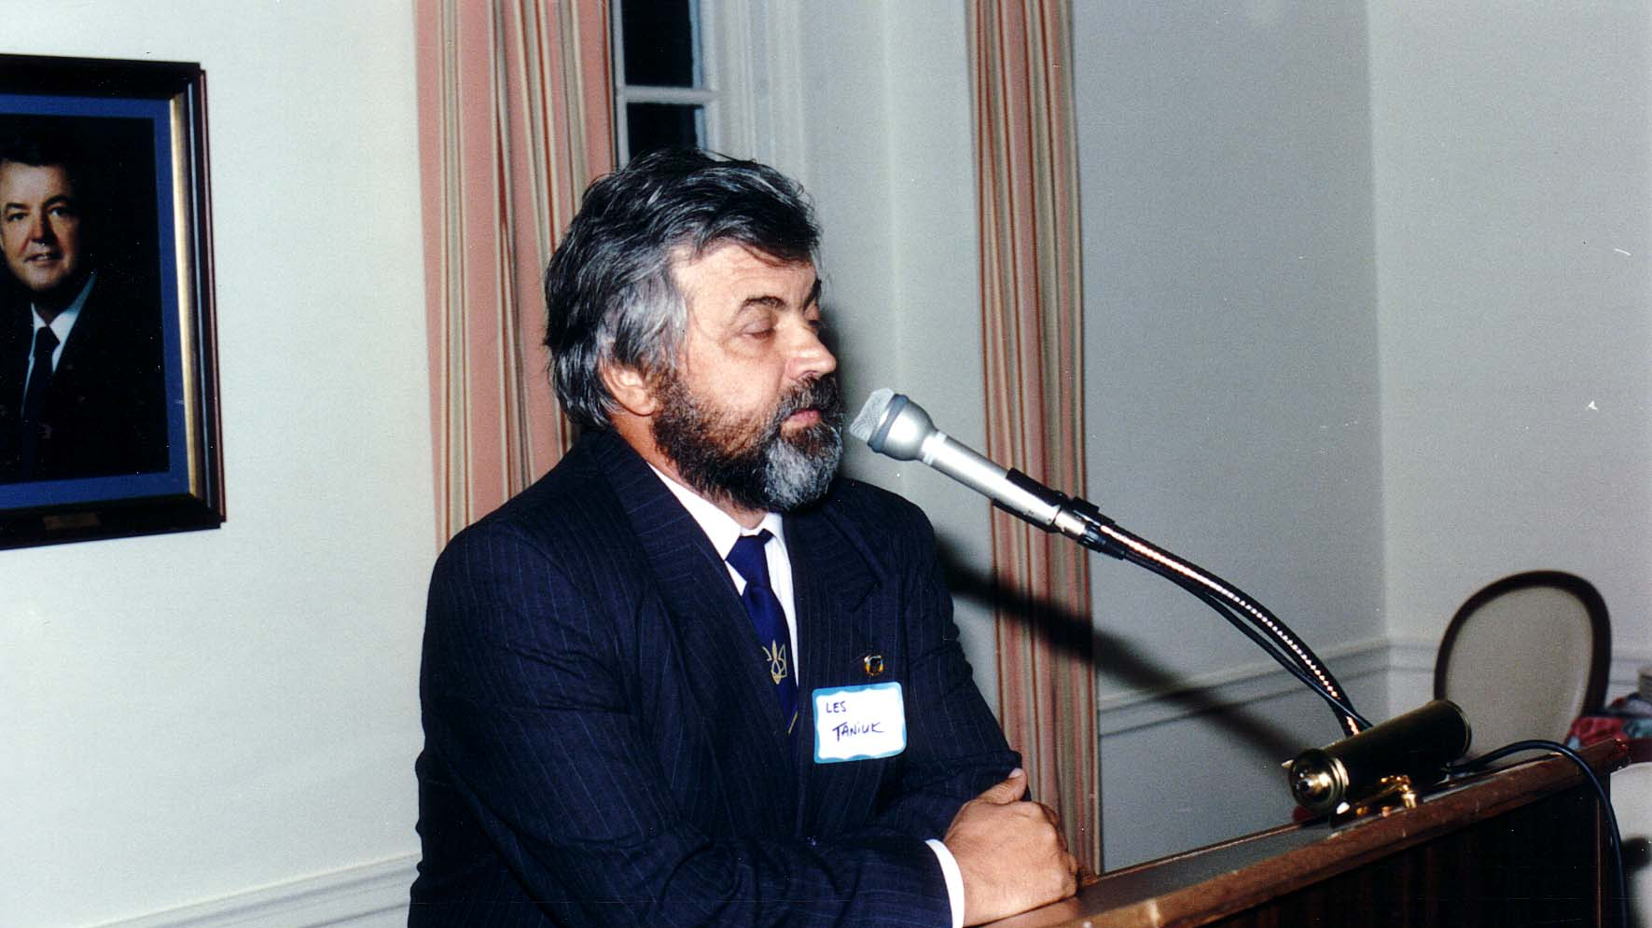
Notes:
TWG_Photo_1992_No_426__Chairman_of_the_Democratic_Bloc_and_Chairman_Commission_on_Cultural_and_Spiritual_Renaissance__Les_Taniuk

Slide 51
1992 720 Ukrainian Parliamentarians in Washington Photographs
Oleksander Yemets, Larisa Bilorus
Ivan Plyusch, Leonid Huebner

Slide 52
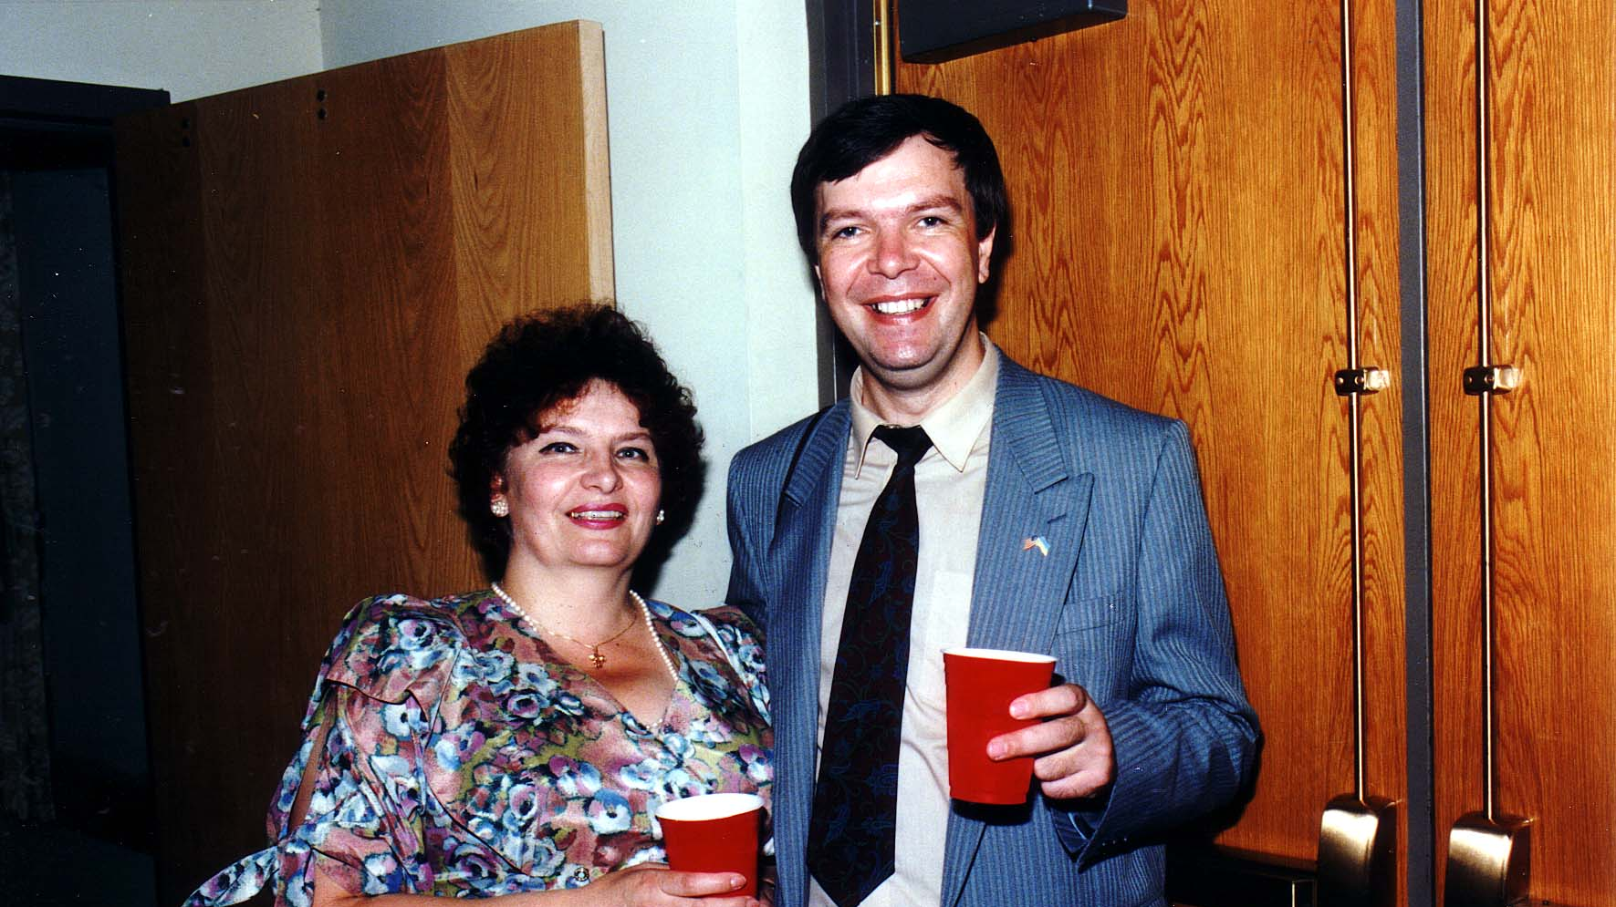
Notes:
TWG_Photo_1992_No_393__Larisa_Bilorus__Member_of_Verkhovna_Rada_Oleksander_Yemets

Slide 53
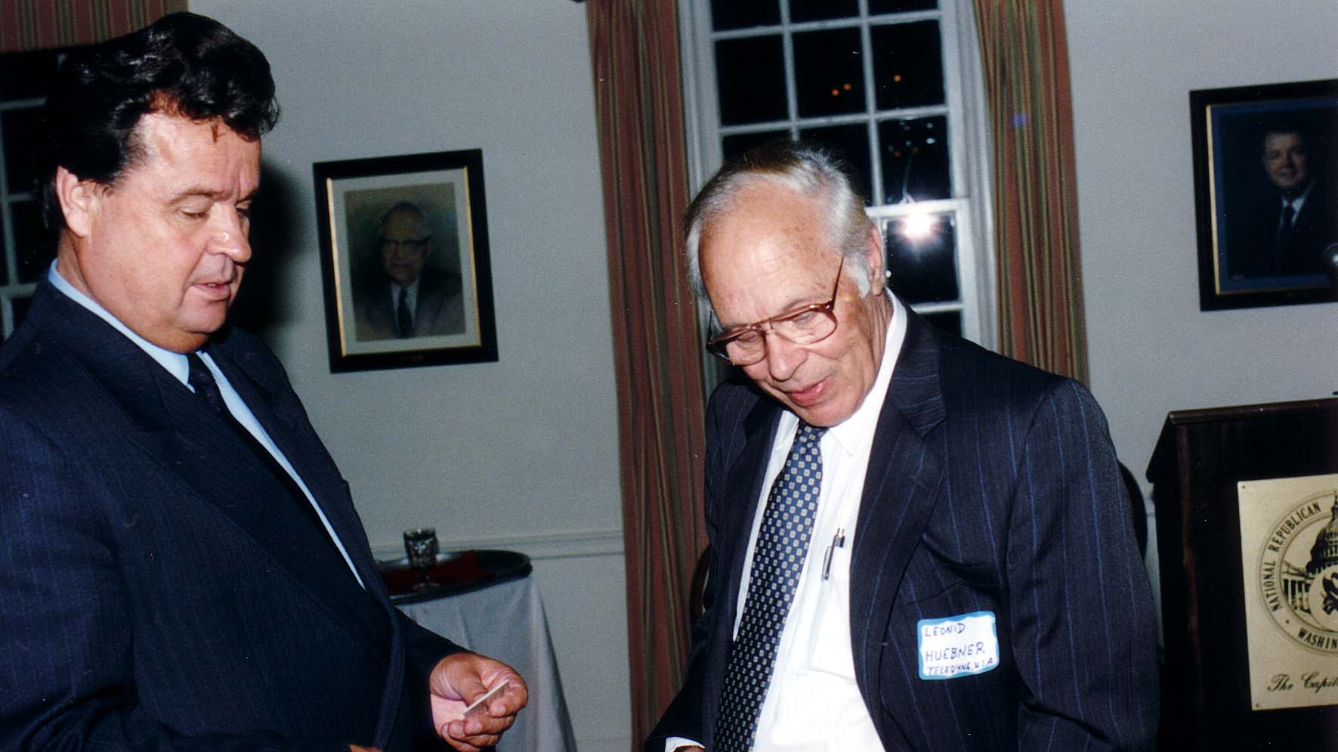
Notes:
TWG_Photo_1992_No_392__Chairman_of_Verkhovna_Rada_Ivan_Plyusch__Radiation_Chemist_Leonid_Huebner

