Slide 1
TWG 1993 Photos
Created October 25, 2020

Slide 2
1993 100 TWG Annual Meeting Holiday Inn Georgetown March 5 Photographs
See 1993 January and February TWG NEWS for Annual Meeting planning and March-April TWG NEWS for Annual Meeting coverage
Elected to the Board: Mykola Babiak – President; Andrew Bihun – Vice President; Orysia Pylyshenko - Secretary; George Masiuk – Treasurer; Sophia Caryk – Events Director; Marta Zielyk - Public Relations; Bohdan Radejko – Membership Director
Members at Large: Laryssa Chopivsky (cultural events), Lydia Chopivsky-Benson, Orest Deychakiwsky, Yurij Holowinsky, Marta Jarosewich, Sophika Nakonechny, Ihor Procinsky, Natalie Sluzar, Richard Smith
Auditing Committee: R.L. Chomiak, Steven Boyduy, John Kun
Others in Photos: Natalie Korytnyk, Christine Korytnyk Dulaney

Slide 3
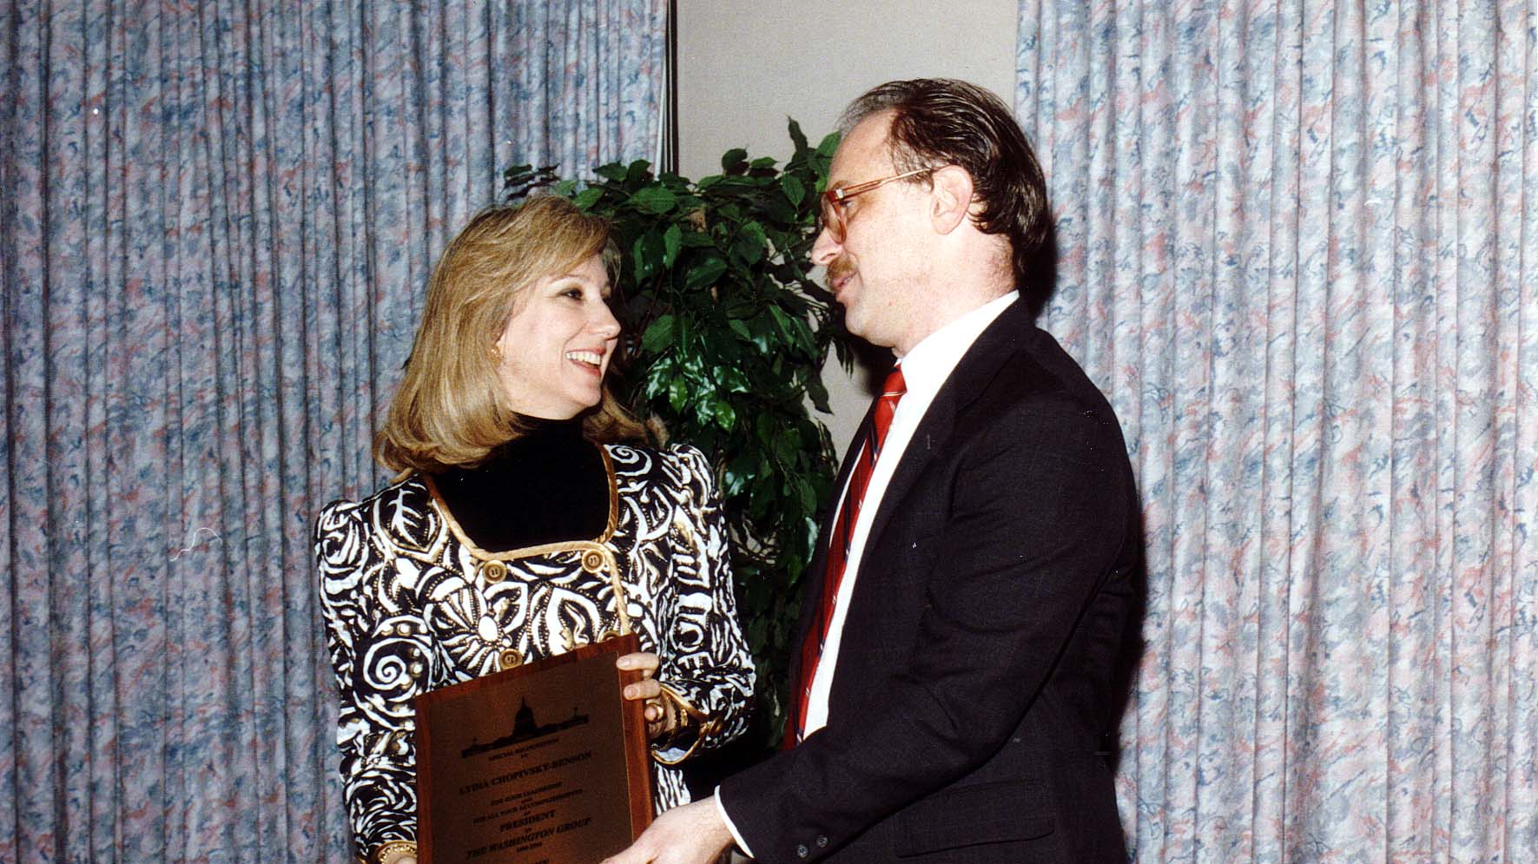
Notes:
TWG_Photo_1993_No_102__Mar_5__Annual_mtg__Immediate_Past_President_Lydia_Chopivsky_Benson__TWG_President_Mykola_Babiak
See 1993 February TWG NEWS, page 1, for event announcement and March-April TWG NEWS, page 1, for event coverage

Slide 4
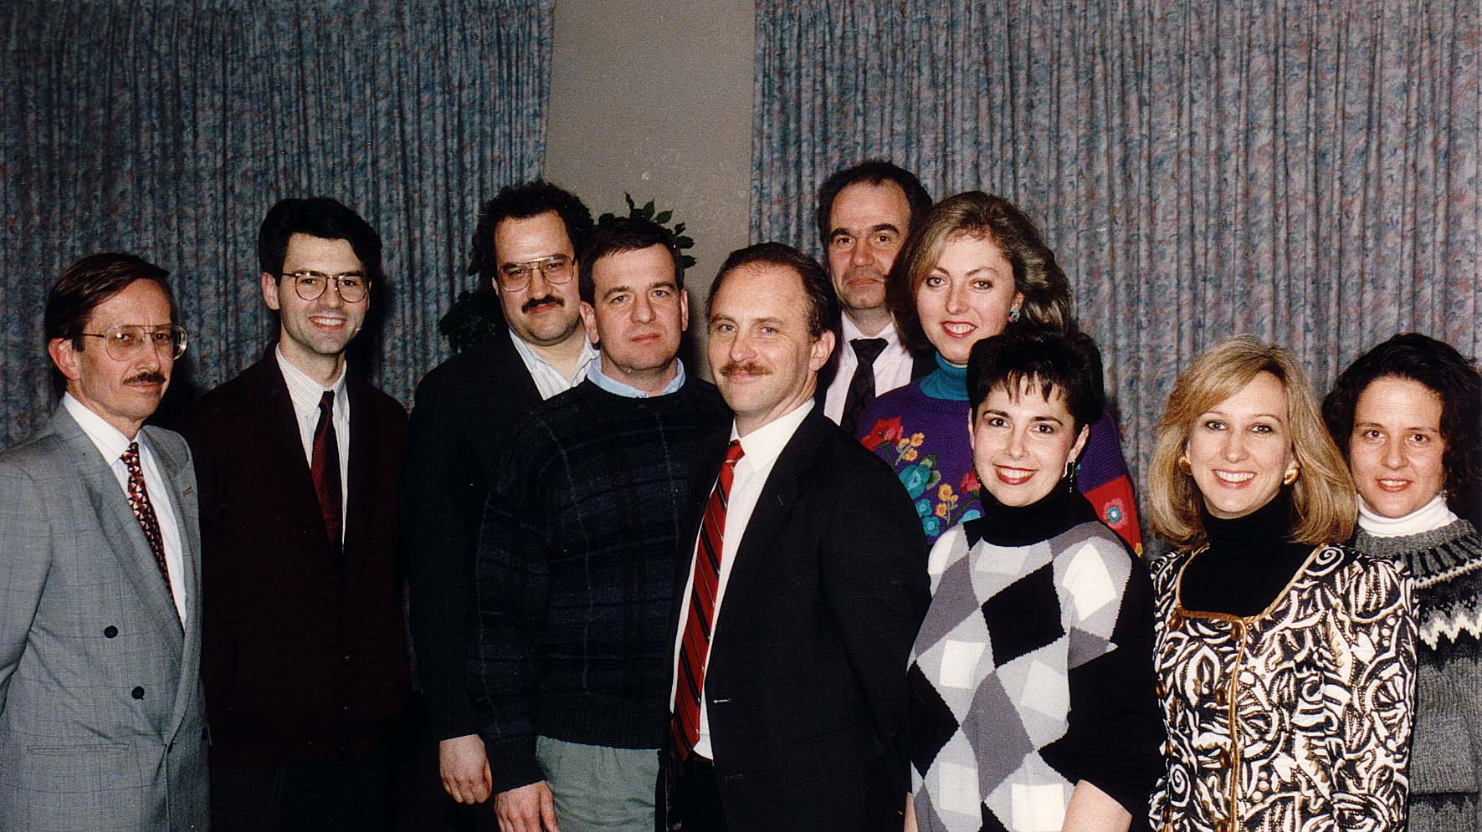
Notes:
TWG_Photo_1993_No_101__Mar_5__Board_of_Directors__Ihor_Procinsky__Bohdan_Radejko__George_Masiuk__Yuriy_Holowinsky__TWG_President_Mykola_Babiak__Rick_Smith__Sophia_Nakonechny__Sophia_Caryk__Lydia_Chopivsky_Benson__Marta_Jarosewich
See 1993 February TWG NEWS, page 1, for event announcement and March-April TWG NEWS, page 1, for event coverage

Slide 5
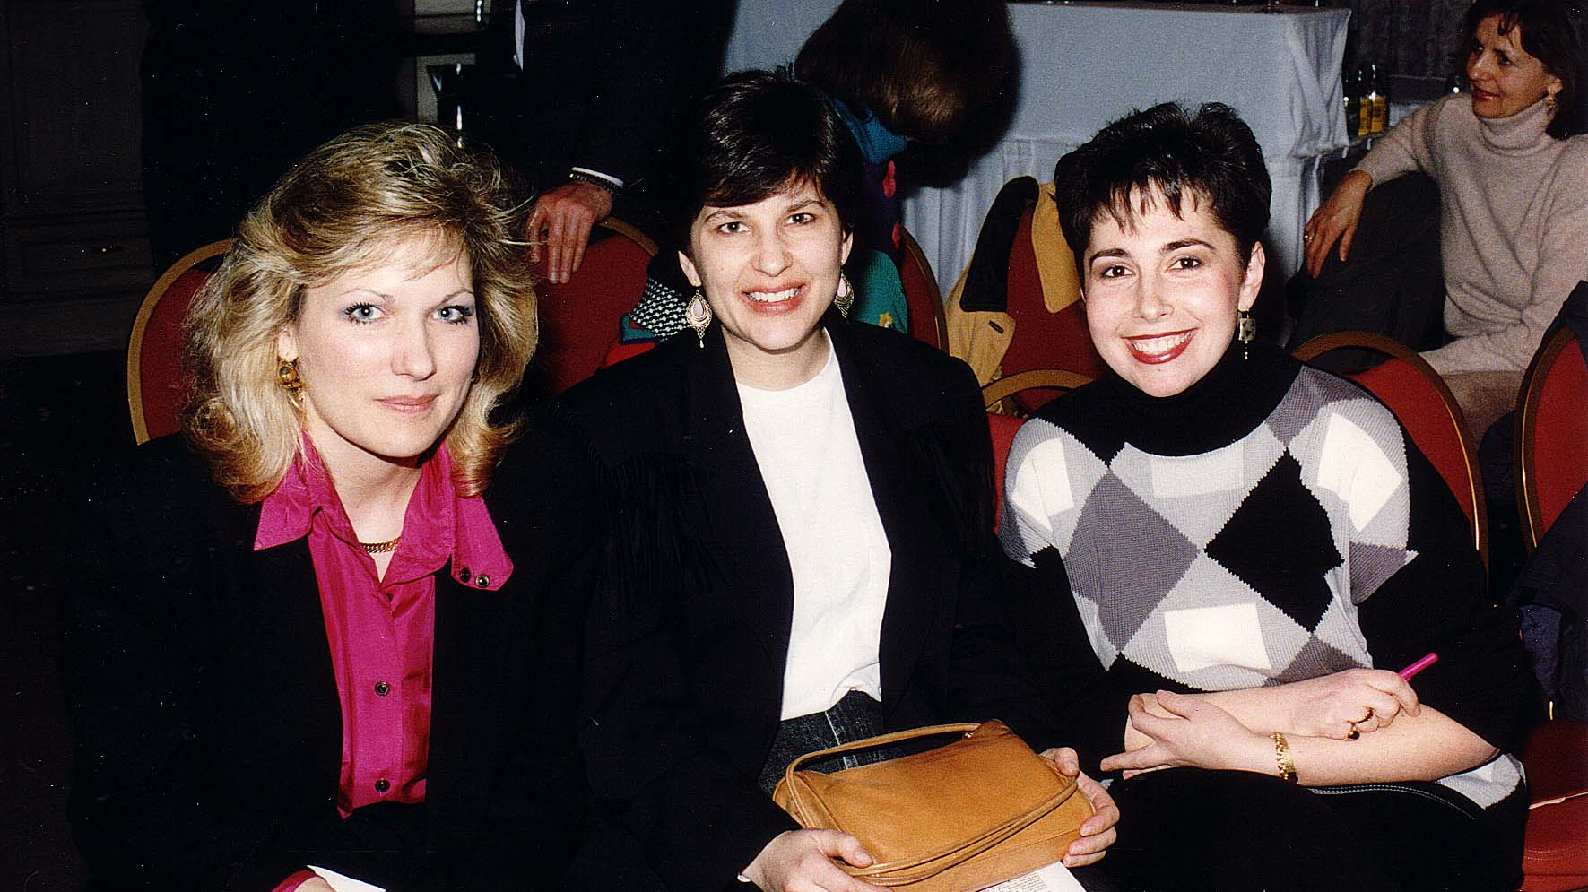
Notes:
TWG_Photo_1993_No_103__Mar_5__Annual_mtg__Natalie_Korytnyk__Christine_Korytnyk_Dulaney__Sophia_Caryk
See 1993 February TWG NEWS, page 1, for event announcement and March-April TWG NEWS, page 1, for event coverage

Slide 6
1993 200 TWG Leadership Conference Georgetown University Conference Center October 8-10 Photographs
See Leadership Conference Announcement and Planning in 1993 Summer TWG NEWS, page 1
See TWG_1993_Leadership_Conference_Booklet for Conference Program and Speaker Biographies
See 1993 November TWG NEWS for Leadership Conference Coverage
See TWG Leadership Conference coverage by The Ukrainian Weekly: The_Ukrainian_Weekly_1993-43

Slide 7
1993 201 TWG Leadership Conference Embassy of Ukraine Reception October 8 Photographs
Zbigniew Brzezinski
Amb. Oleh Bilorus, Laryssa Chopivsky, Yaromyr Oryshkevych
Amb. William Miller, Zbigniew Brzezinski, Amb. Oleh Bilorus

Slide 8
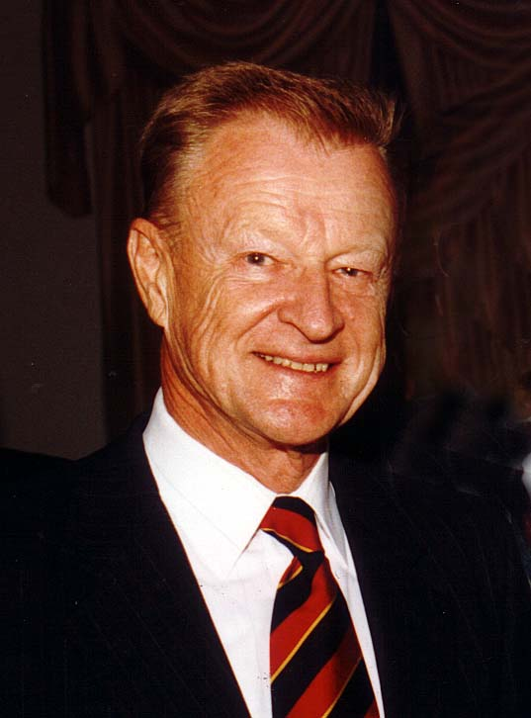
Notes:
TWG_Photo_1993_No_202__Oct_8__Leadership_Conference_Ukrainian_Embassy_Reception__President_Carter's_National_Security_Advisor_Zbigniew_Brzezinski_warned_Ukraine_of_"Dark_Clouds"_gathering_in_the_North
See 1993 November TWG NEWS, pages 1 and 3, for event coverage

Slide 9
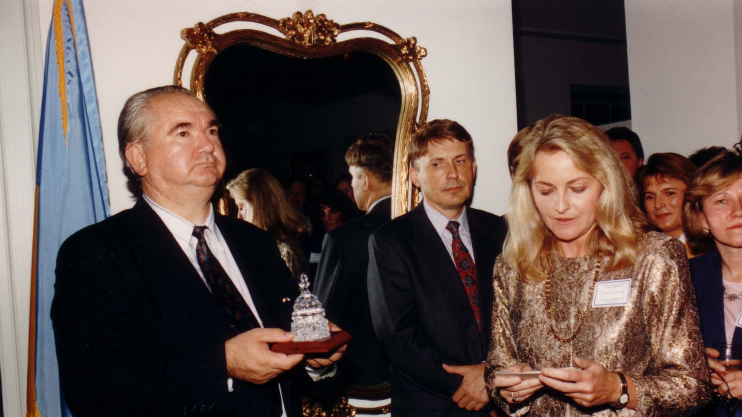
Notes:
TWG_Photo_1993_No_203__Oct_8__Leadership_Conference_Ukrainian_Embassy_Reception__Amb_Oleh_Bilorus_receives_a_crystal_representation_of_the_Capitol_Dome_(TWG_Logo)_from_Chair_of_Reception_Committee_Laryssa_Chopivsky__Yaromyr_Oryshkevych_in_between_Bilorus_and_Chopivsky
See 1993 November TWG NEWS, pages 1, 3, and 18 for coverage of Leadership Conference Reception

Slide 10
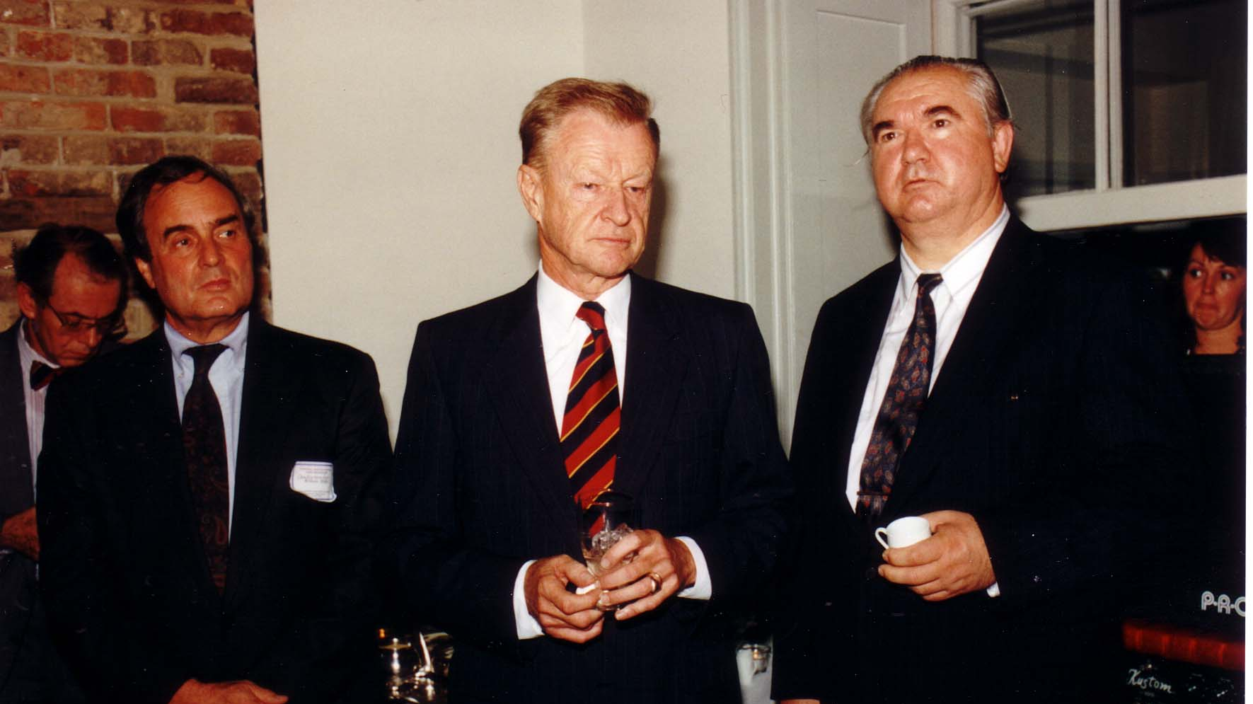
Notes:
TWG_Photo_1993_No_205__Oct_8__Leadership_Conference_Embassy_Reception__Ambassador_William_Miller__President_Carter's_National_Security_Advisor_Zbigniew_Brzezinski__Ambassador_Oleh_Bilorus
See 1993 November TWG NEWS, pages 1, 3, and 18 for coverage of Leadership Conference Reception

Slide 11
1993 220 TWG Leadership Conference Luncheon October 9 Photographs
Ihor Derkach
Eugene Zalucky

Slide 12
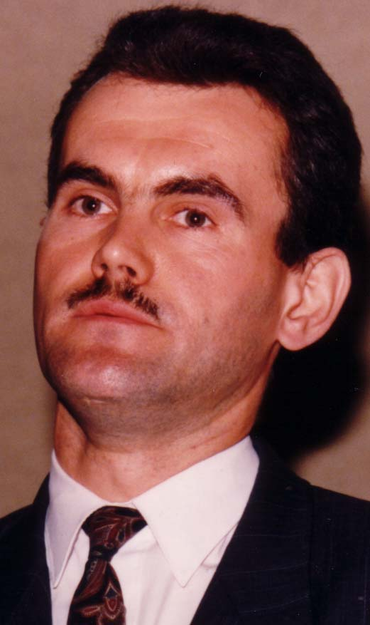
Notes:
TWG_Photo_1993_No_221__Oct_9__Leadership_Conference_Luncheon_Address__Ukrainian_Parliamentarian_Committee_on_National_Security_and_Defense_Ihor_Derkach
See 1993 November TWG NEWS, pages 1 and 9 for event coverage

Slide 13
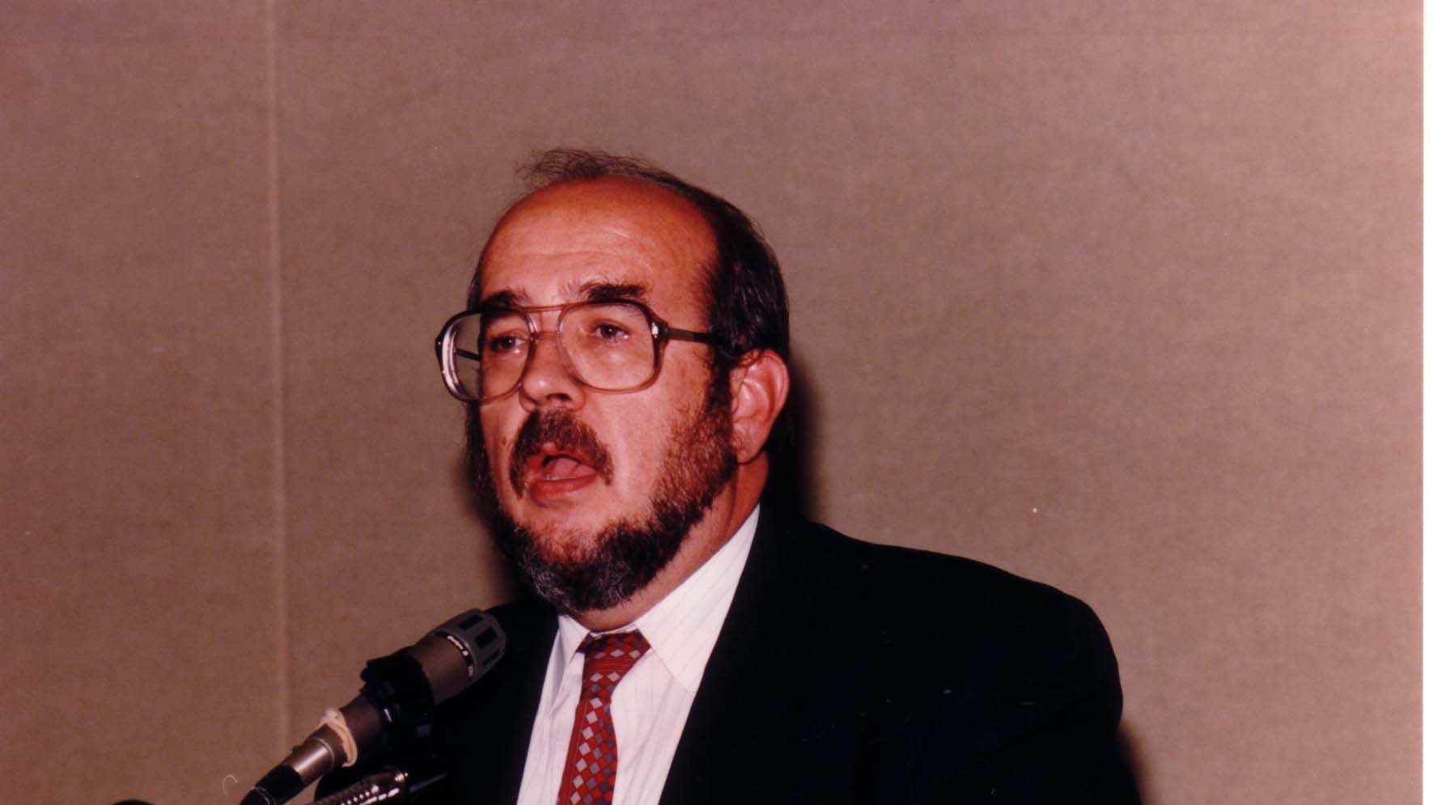
Notes:
TWG_Photo_1993_No_222__Oct_9__Leadership_Conference__Guest_Speaker__National_Council_of_Ethnic_Canadian_Business_and_Professional_Associations_Eugene_Zalucky
See 1993 November TWG NEWS, pages 1 and 12 for event coverage

Slide 14
1993 230 TWG Leadership Conference Banquet October 9 Photographs
Mykola Babiak, Oleh Havrylyshyn
Chrystyna Babiak, TWG President Mykola Babiak
Lydia Chopivsky-Benson, Randy Benson

Slide 15
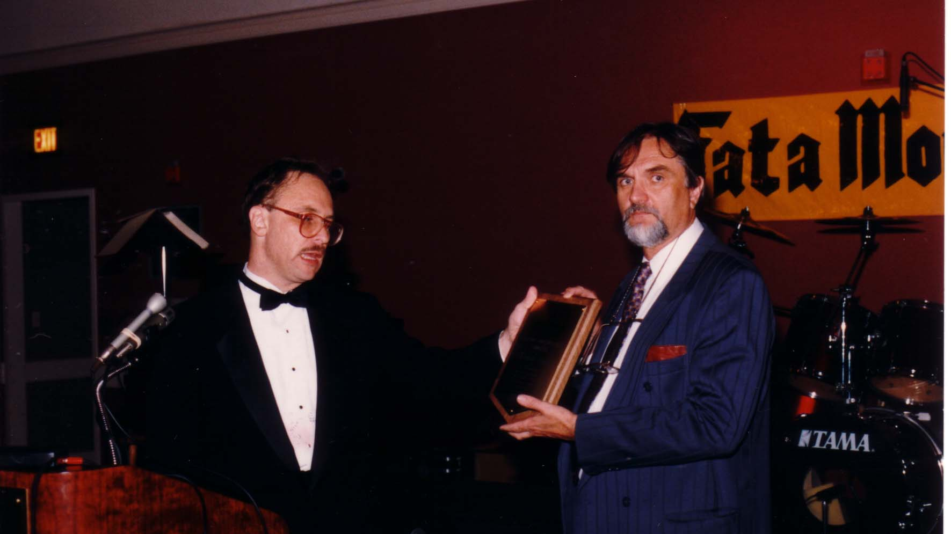
Notes:
TWG_Photo_1993_No_232__Oct_9__Leadership_Conference_Banquet__TWG_President_Mykola_Babiak_Presents_Friend_of_Ukraine_Award_for_George_Soros_to_Oleh_Havrylyshyn_IMF_Executive_Director_for_Ukraine
See 1993 November TWG NEWS, pages 1 and 11 for event coverage

Slide 16
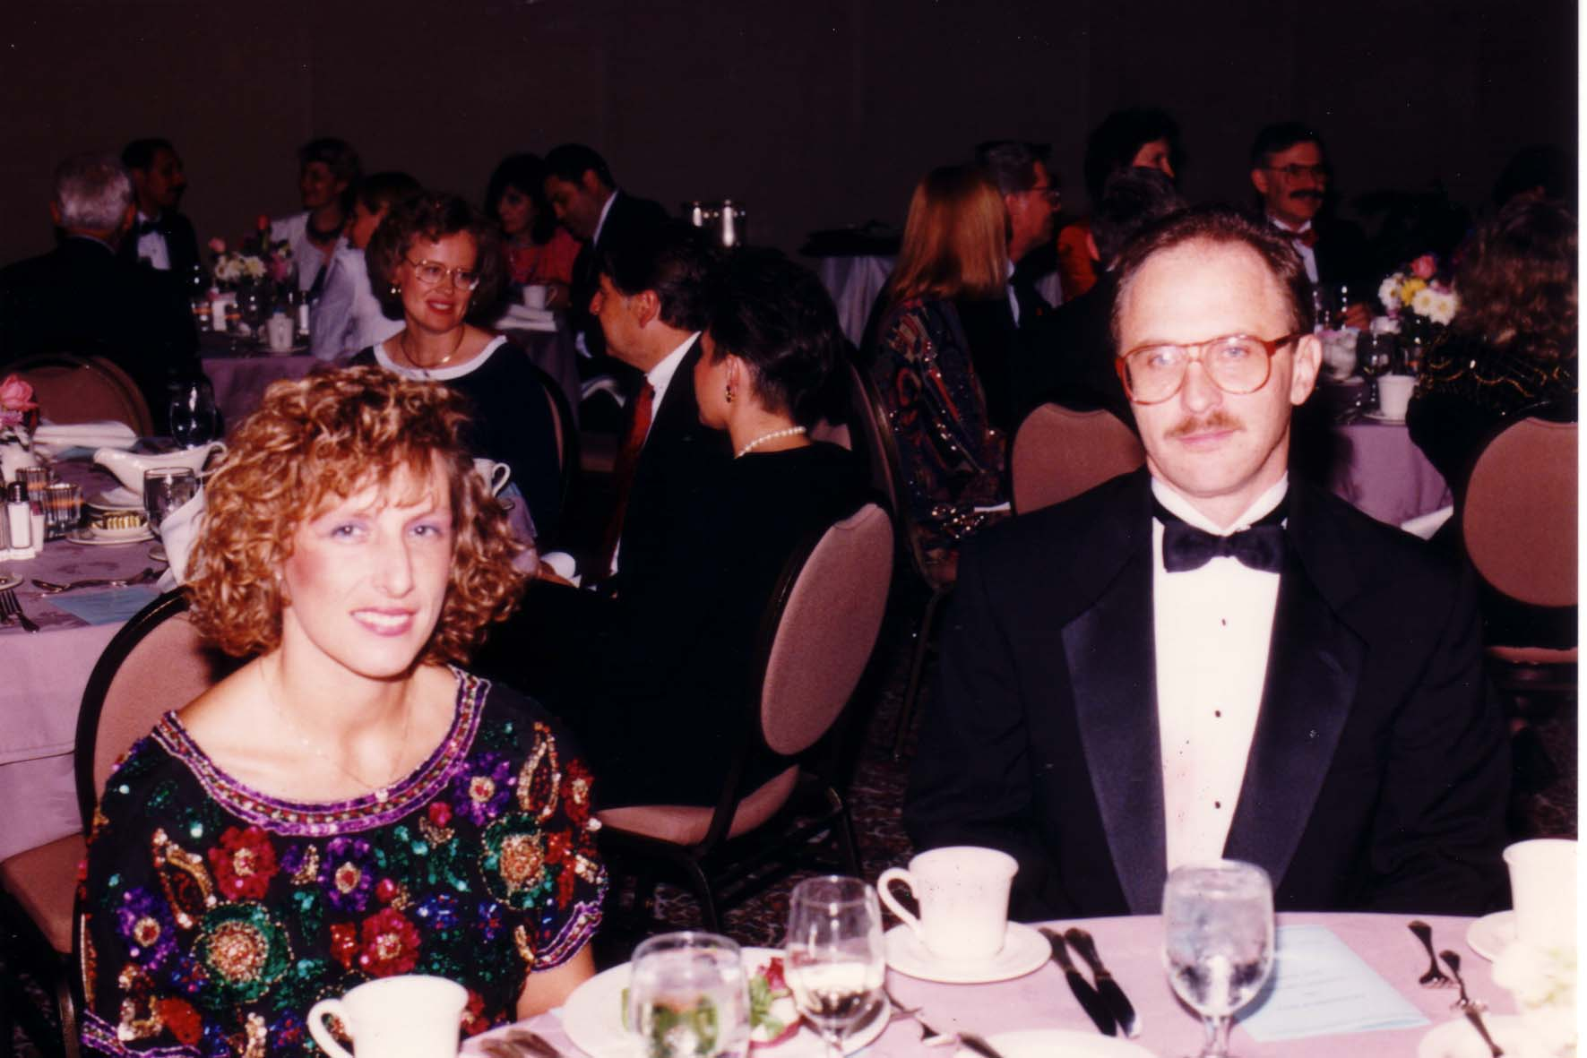
Notes:
TWG_Photo_1993_No_233__Oct_9__Leadership_Conference_Banquet__Chrystyna_Babiak__TWG_President_Mykola_Babiak

Slide 17
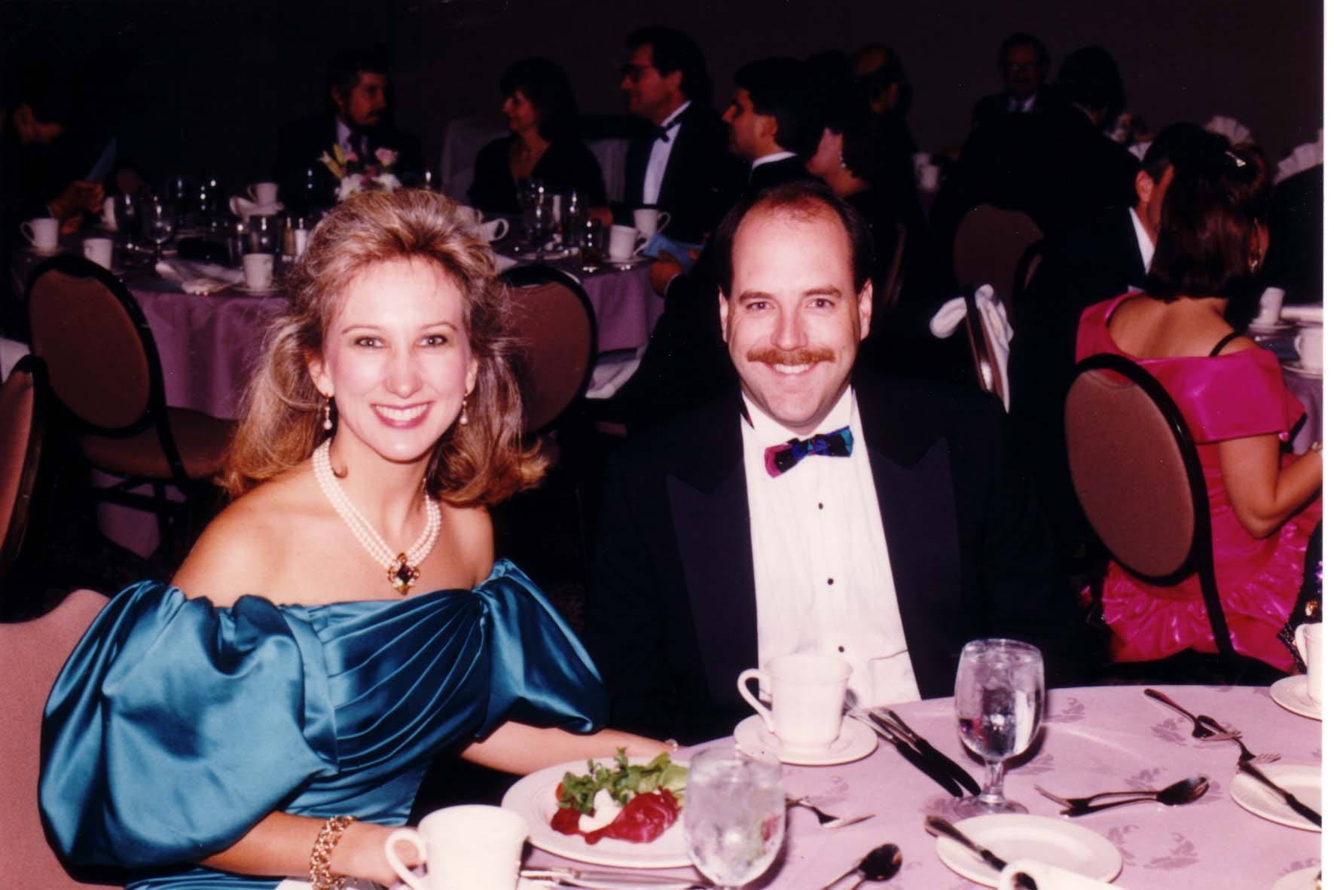
Notes:
TWG_Photo_1993_No_234__Oct_9__Leadership_Conference_Banquet__Lydia_Chopivsky_Benson_and_Randy_Benson

Slide 18
1993 250 TWG Leadership Conference Ukraine Business Climate Panel October 9 Photographs
George Chopivsky
Marijka Helbig
Orest Jejna

Slide 19
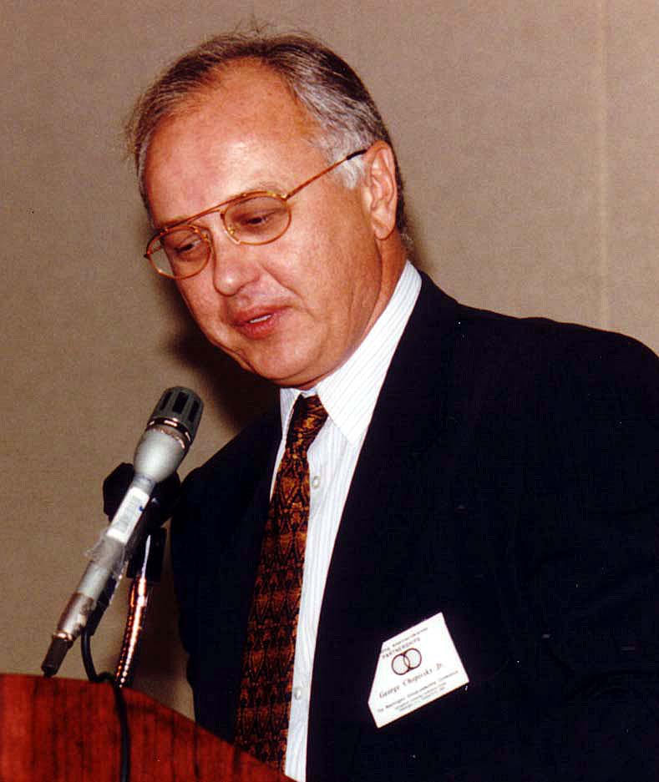
Notes:
TWG_Photo_1993_No_251__Oct_9__Leadership_Conference__Business_Climate_Panel__George_Chopivsky
See 1993 November TWG NEWS, page 5, for event coverage

Slide 20
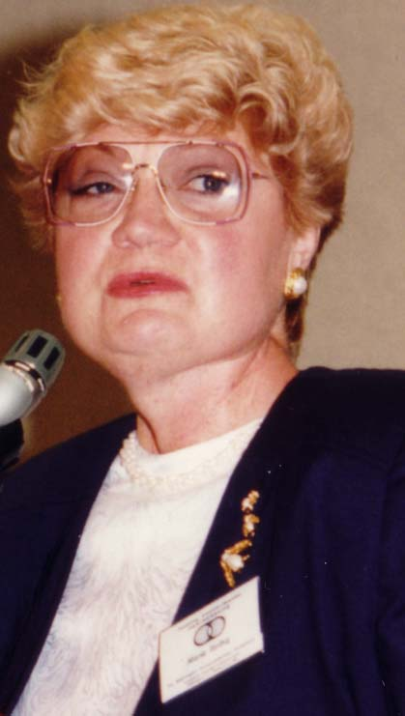
Notes:
TWG_Photo_1993_No_252__Oct_9__Leadership_Conference__Business_Climate_Panel__President_of_Scope_Travel_Marijka_Helbig
See 1993 November TWG NEWS, page 5, for event coverage

Slide 21
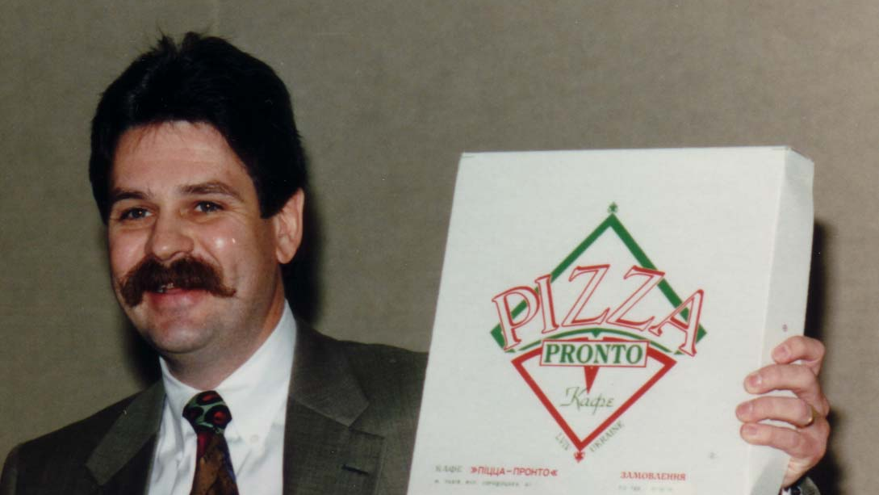
Notes:
TWG_Photo_1993_No_253__Oct_9__Leadership_Conference__Business_Climate_Panel__Jemar_International_Orest_Jejna
See 1993 November TWG NEWS, page 5, for event coverage

Slide 22
1993 260 TWG Leadership Conference Fostering US-Ukrainian Cultural Ties October 9 Photographs
Slavko Nowytski, Roman Terlecky, Laryssa Chopivsky, Douglas Wheeler, Dmitro Markov, Virlana Tkacz
Dmitro Markov
Virlana Tkacz
Douglas Wheeler
Roman Terlecky

Slide 23
Notes:
TWG_Photo_1993_No_265_Oct_9_Leadership_Conference__Fostering_US_Ukraine_Cultural_Ties_Panel___Filmmaker_International_TV_Broadcaster_USIA_Slavko_Nowytski___Director_at_the_Washington_National_Opera_Roman_Terlecky___Moderator_Laryssa_Chopivsky___Managing_Director_Washington_Performing_Arts_Society_Douglas_Wheeler___Cultural_Attaché_Embassy_of_Ukraine_Dmitro_Markov___Artistic_Director_Yara_Arts_Group_Virlana_Tkacz
See 1993 November TWG NEWS, page 10, for event coverage

Slide 24
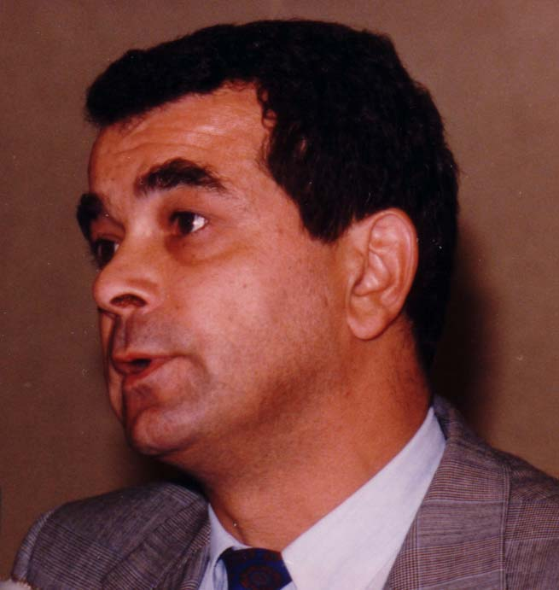
Notes:
TWG_Photo_1993_No_261__Oct_9__Leadership_Conference__Fostering_US-Ukraine_Cultural_Ties_Panel__Cultural_Attaché_Dmitro_Markov
See 1993 November TWG NEWS, page 10, for event coverage

Slide 25
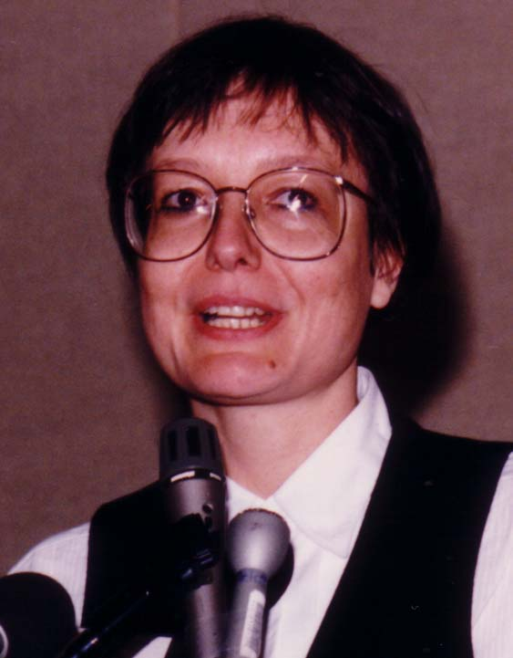
Notes:
TWG_Photo_1993_No_262__Oct_9__Leadership_Conference__Fostering_US_Ukraine_Cultural_Ties_Panel__Artistic_Director_Yara_Arts_Group_Virlana_Tkacz
See 1993 November TWG NEWS, pages 10 and 13, for event coverage

Slide 26
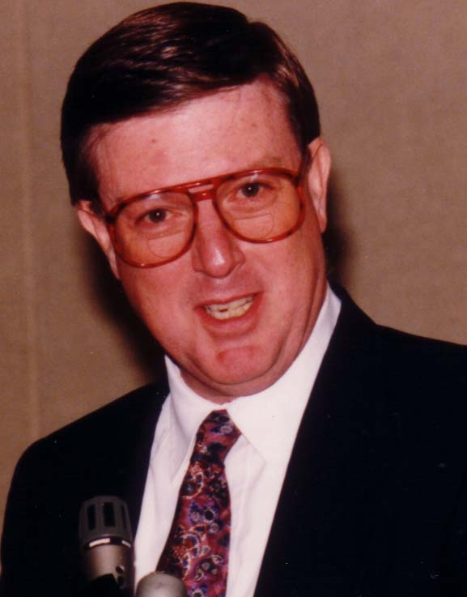
Notes:
TWG_Photo_1993_No_263__Oct_9__Leadership_Conference__Fostering_US_Ukraine_Cultural_Ties_Panel__Managing_Director_Washington_Performing_Arts_Society_Douglas_Wheeler
See 1993 November TWG NEWS, pages 10 and 13, for event coverage

Slide 27
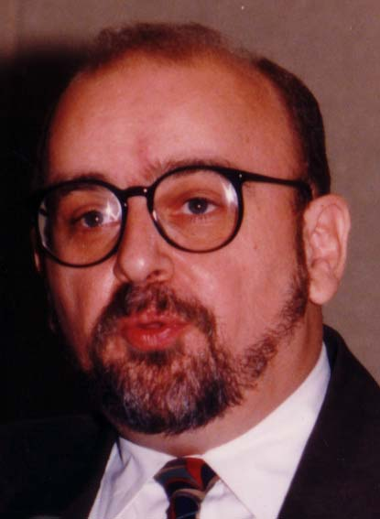
Notes:
TWG_Photo_1993_No_264_Oct_9_Leadership_Conference_Fostering_US_Ukraine_Cultural_Ties_Panel__Director_at_the_Washington_National_Opera_Roman_Terlecky
See 1993 November TWG NEWS, pages 10 and 13, for event coverage

Slide 28
1993 270 TWG Leadership Conference Media Panel October 9 Photographs
Vasyl Zorya

Slide 29
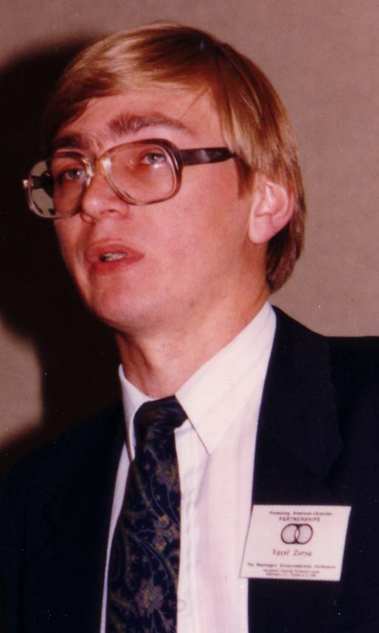
Notes:
TWG_Photo_1993_No_271_Oct_9_Leadership_Conference_Media_Panel__Deputy_Editor_in_Chief_Ukrainian_News_Agency_UNIAN_Vasyl_Zorya
See 1993 November TWG NEWS, page 7 for event coverage

Slide 30
1993 300 TWG Events Photographs
Ukrainian Independence Day Celebration (January 22): Amb. Oleh Bilorus, Larisa Bilorus, Mykola Plawiuk
Ukraine’s Economic Plans: Viktor Pynzenyk
Developments in Ukraine: Valery Sholudko, Oleksander Lavrynovych, Mykola Zaloudiak
Erotic Symbolism in Ukrainian Songs: Orysia Tracz
Ukrainian-American Military Medical Team: LTC Leonid Kondratiuk, Dr. Inia Yevich, Dr. Yaromyr Oryshkevych, Dr. Askold Mosijczuk

Slide 31
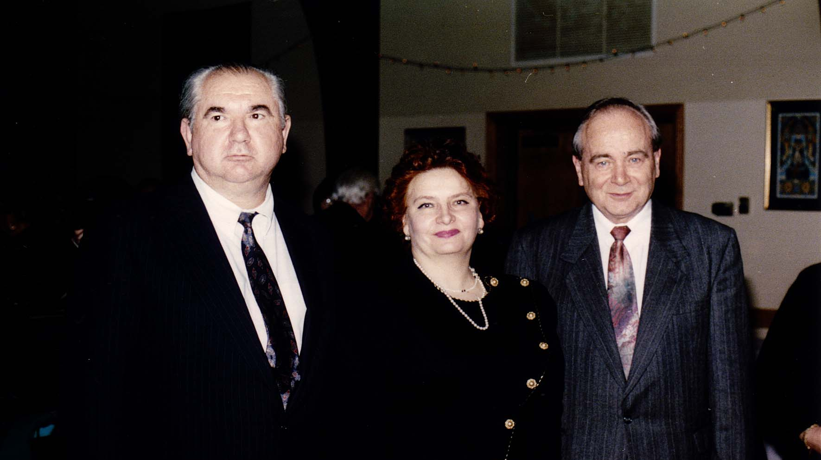
Notes:
TWG_Photo_1993_No_321__January_22__St_Andrew's_Hall__Amb_Oleh_Bilorus__Larisa_Bilorus__President_of_the_Ukrainian_People's_Republic_in_Exile_Mykola_Plawiuk
See 1993 February TWG NEWS, page 1, for event coverage

Slide 32
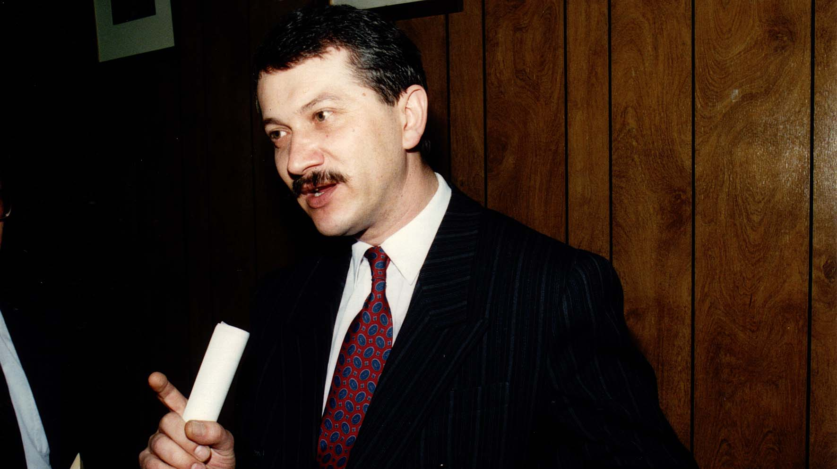
Notes:
TWG_Photo_1993_No_322__March_21__TWG_Sunday_Evening_Forum__Ukraine_Deputy_Prime_Minister_Viktor_Pynzenyk
See 1993 March-April TWG NEWS, page 1, for event coverage

Slide 33
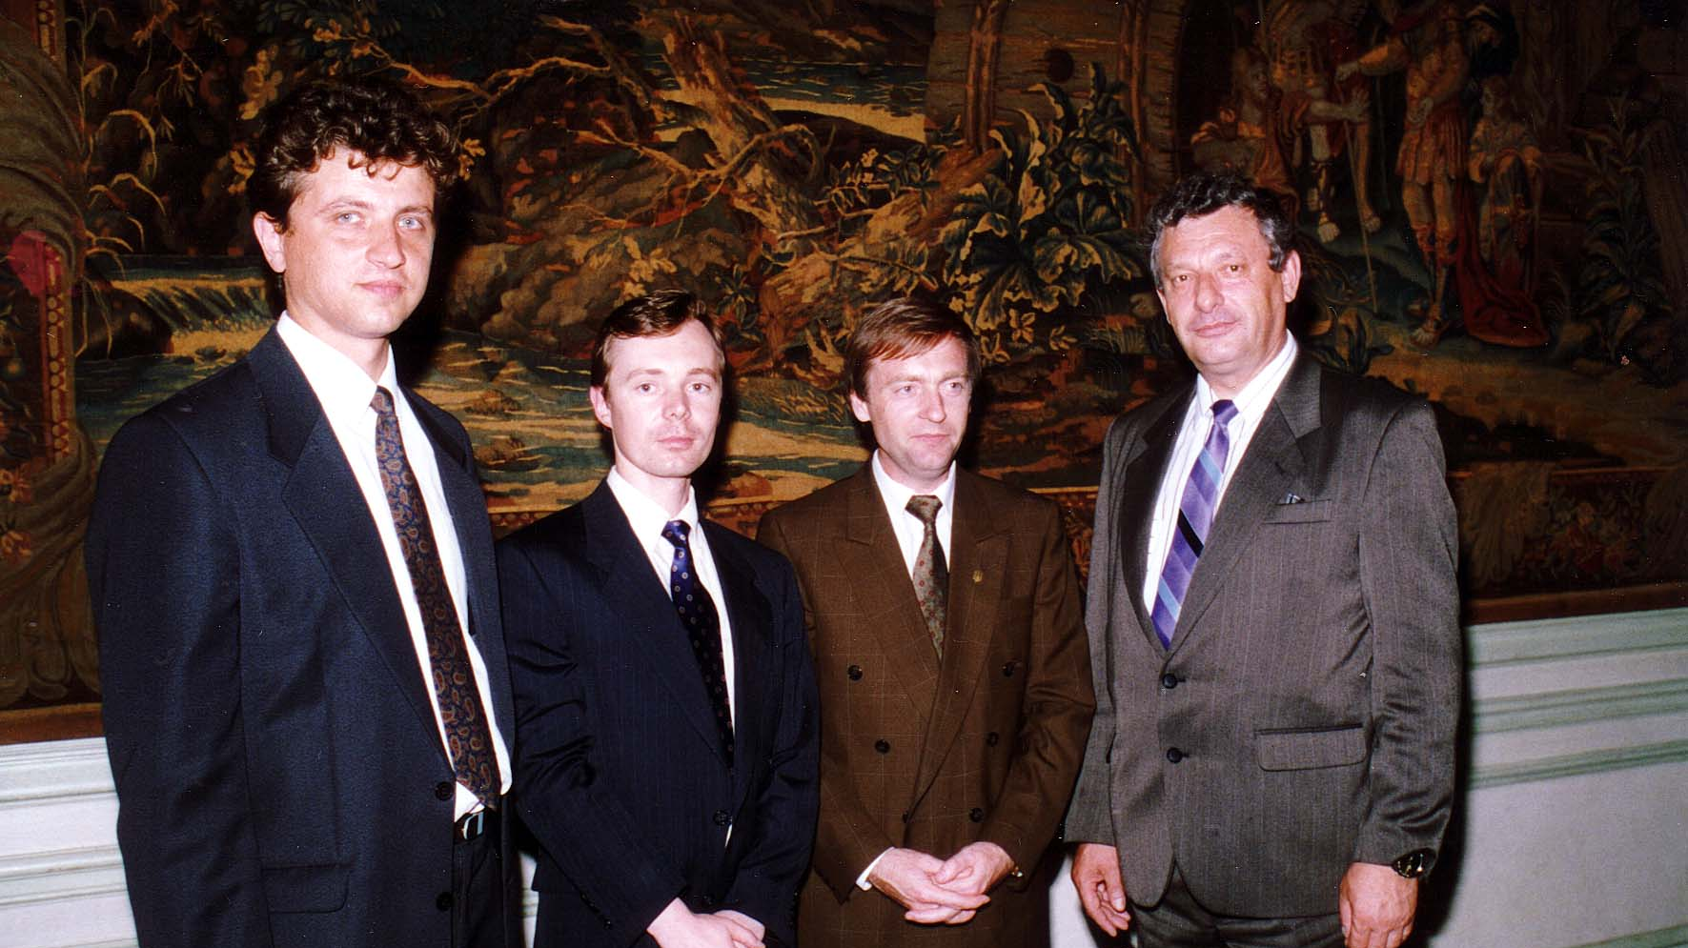
Notes:
TWG_Photo_1993_No_323__June_30__Meridian_International_Center__Assistant_to_Prosecutor_General_of_Ukraine_Valery_Sholudko__DOS_Escort__Rukh_Vice_Chairman_Oleksander_Lavrynovych__Head_of_Poltava_Regional_Administration_Mykola_Zaloudiak
See 1993 Summer TWG NEWS, page 1, for event coverage

Slide 34
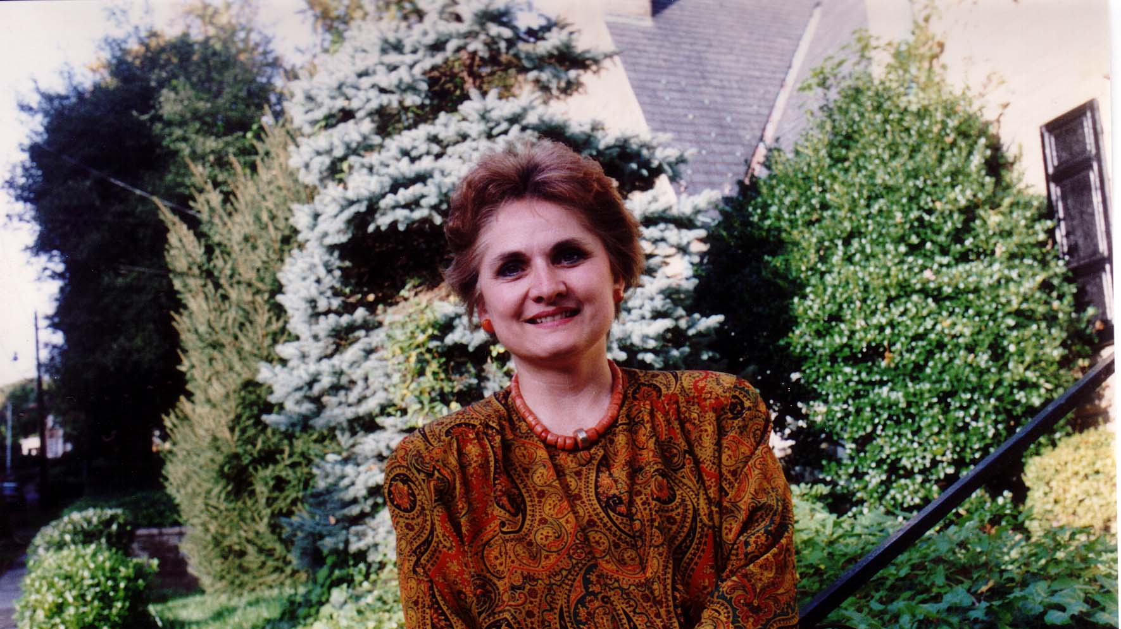
Notes:
TWG_Photo_1993_No_324__Oct_24__Audio_Lecture__Erotic_Symbolism_in_Ukrainian_Songs__Orysia_Tracz

Slide 35
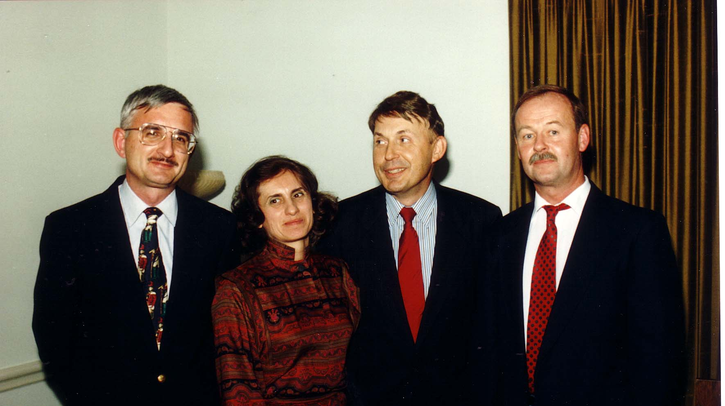
Notes:
TWG_Photo_1993_No_325__Dec_3__Health_Crises_in_Ukraine__Ukrainian_Medical_Team__LTC_Leonid_Kondratiuk__Dr_Inia_Yevich__Dr_Yaromyr_Oryshkevych__Dr_Askold_Mosijczuk
See 1994 March TWG NEWS, page 6

Slide 36
1993 310 TWG Meeting with Goethe Institute Washington DC April 25 Photographs
Countess Ute Baudissin, Count Baudissin, Dr. Friederike Fruhwirth
Dr. Friederike Fruhwirth

Slide 37
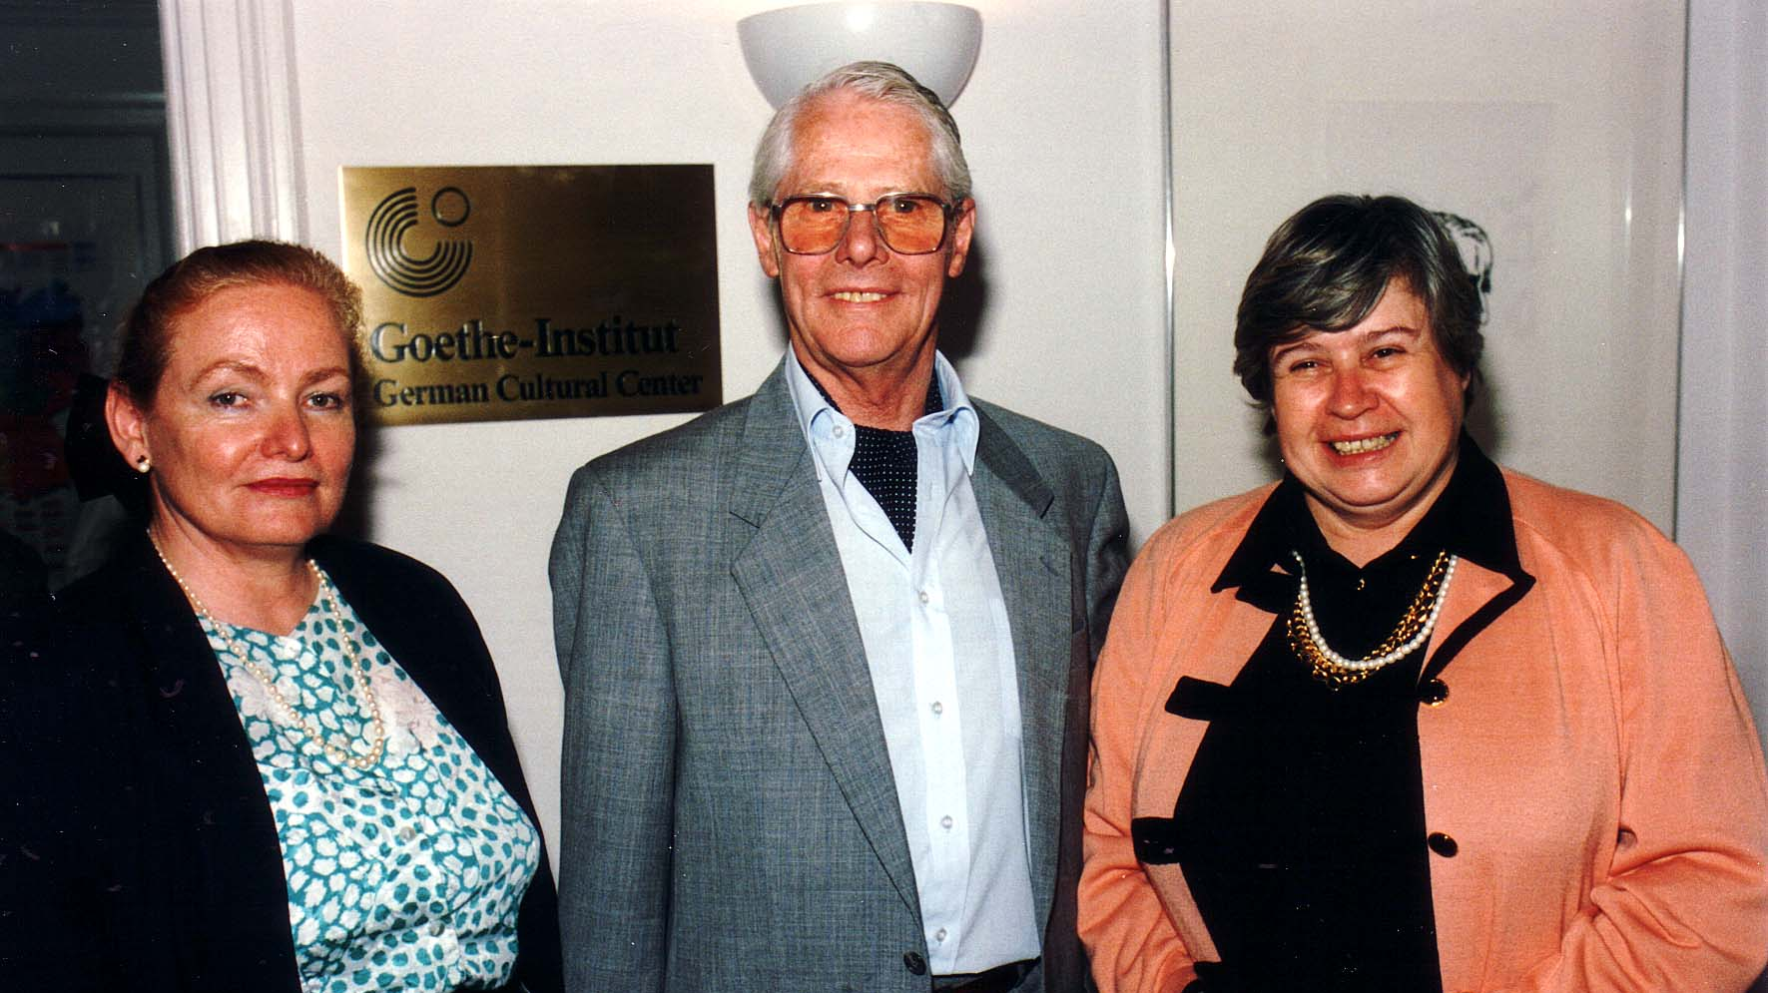
Notes:
TWG_Photo_1993_No_311_April_25_Goethe_Institute_Kiev_First_Director_Countess_Ute_Baudissin_Count_Baudissin_Dr_Friederike_Fruhwirth
See 1993 March-April TWG NEWS, page 1, for event announcement and May TWG NEWS, page 1, for event coverage

Slide 38
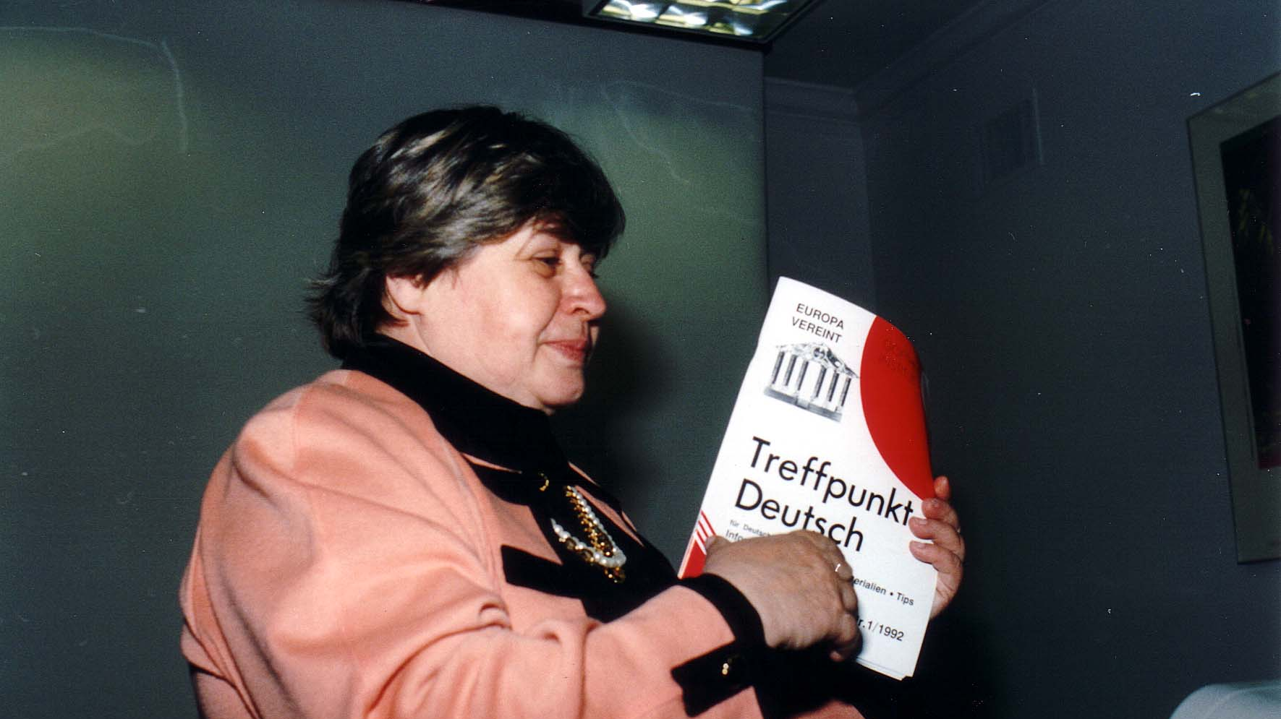
Notes:
TWG_Photo_1993_No_312_April_25_Goethe_Institute_Kiev_Language_Teaching_Department_Dr_Friederike_Fruhwirth
See 1993 March-April TWG NEWS, page 1, for event announcement and May TWG NEWS, page 1, for event coverage

