Slide 1
TWG 1994 Photos
October 25, 2020

Slide 2
1994 100 TWG Annual Meeting February 25 Photographs
See 1994 March TWG NEWS for Annual Meeting coverage
Elected to the Board: Mykola Babiak – President; Andrew Bihun – Vice President; (rotational)- Secretary; Roman Stelmach – Treasurer; (rotational)– Events Director; Maria Kulczycky - Public Relations; Michael Terpak – Membership Director
Members at Large: Laryssa Chopivsky (cultural events), Adrian Karmazyn (Fellowship Fund), Lydia Chopivsky-Benson, Orest Deychakiwsky, Michael Drabyk, Yurij Holowinsky, Ksenia Kuzmycz
Auditing Committee: Steven Boyduy, Andrew Charchalis
Guest speakers: Myron Wasylyk, Ian Brzezinski

Slide 3
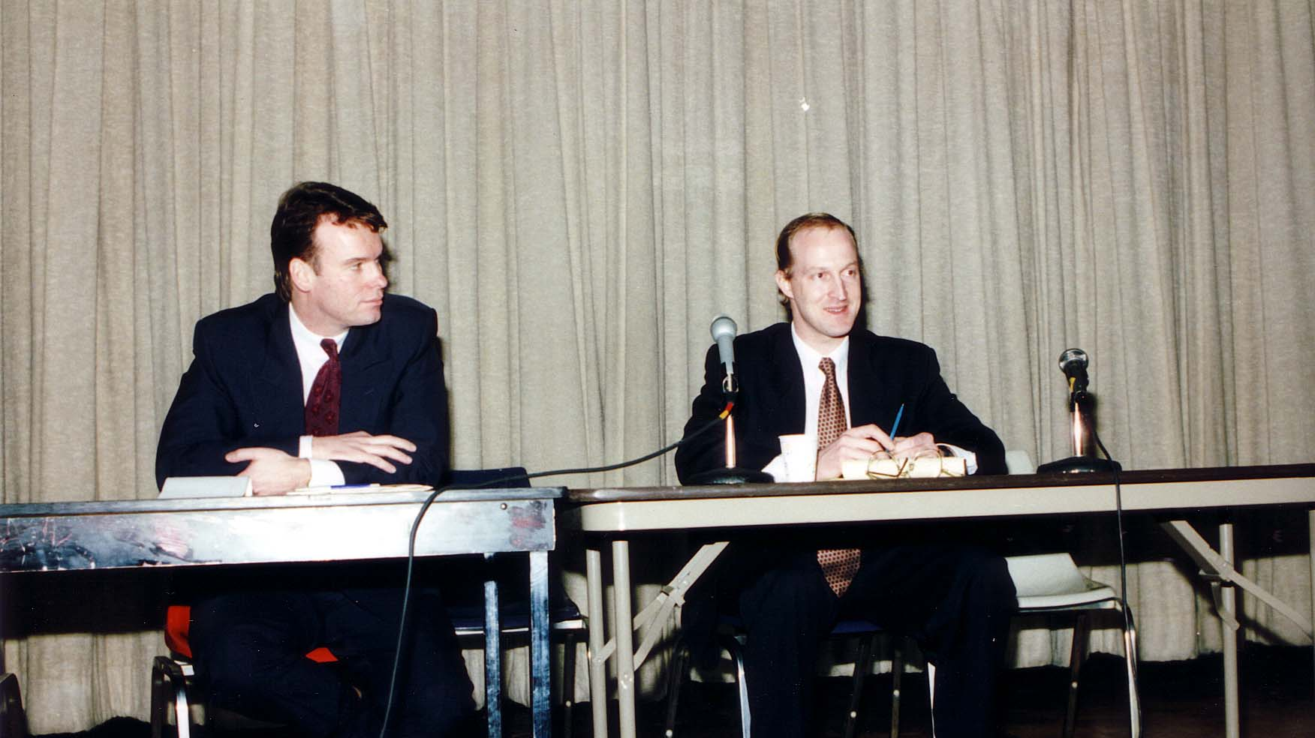
Notes:
TWG_Photo_1994_No_101__Feb_25__TWG_Annual_Meeting__Guest_Speakers__Director_Council_of_Advisors_to_Ukrainian_Parliament_Kyiv_Myron_Wasylyk__Director_National_Security_Programs_Council_of_Advisors_Kyiv_Ian_Brzezinski
See 1994 March TWG NEWS, page 1, for event coverage

Slide 4
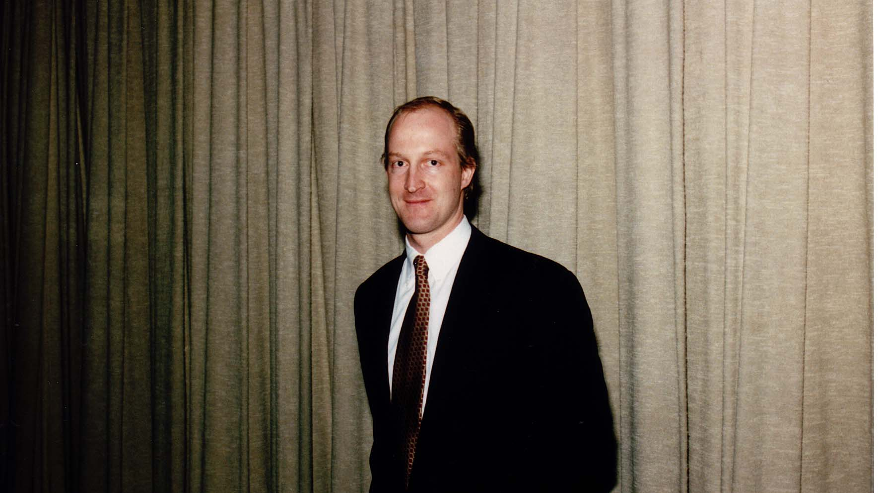
Notes:
TWG_Photo_1994_No_102__Feb_25__TWG_Annual_Meeting__Guest_Speaker__Director_National_Security_Programs_Council_of_Advisors_Kyiv_Ian_Brzezinski
See 1994 March TWG NEWS, page 1, for event coverage

Slide 5
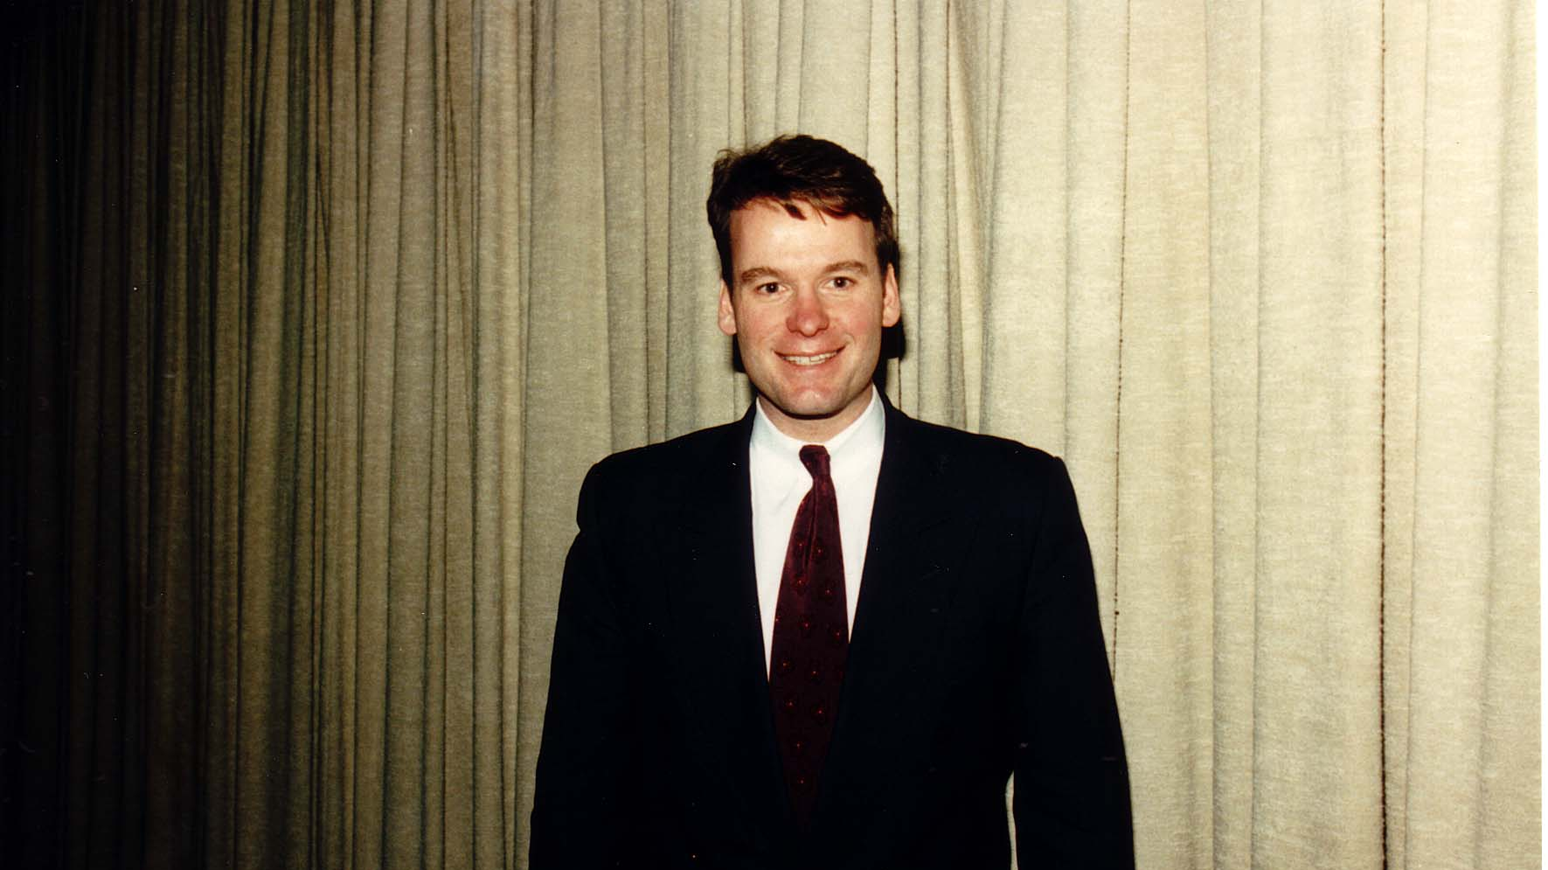
Notes:
TWG_Photo_1994_No_103__Feb_25__TWG_Annual_Meeting__Guest_Speaker__Director_Council_of_Advisors_to_Ukrainian_Parliament_Kyiv_Myron_Wasylyk
See 1994 March TWG NEWS, page 1, for event coverage

Slide 6
1994 200 TWG Leadership Conference Georgetown University Conference Center October 14-16 Photographs
See Leadership Conference Announcement and Planning in 1994 March TWG NEWS, page 1
See Leadership Conference Planning in 1994 June-July and August-September TWG NEWS, page 3
See TWG_1994_Leadership_Conference_Booklet for Conference Program and Speaker Biographies
See 1994 November-December TWG NEWS for Leadership Conference Coverage

Slide 7
1994 210 TWG Leadership Conference Opening Address October 15 Photographs
James Collins

Slide 8
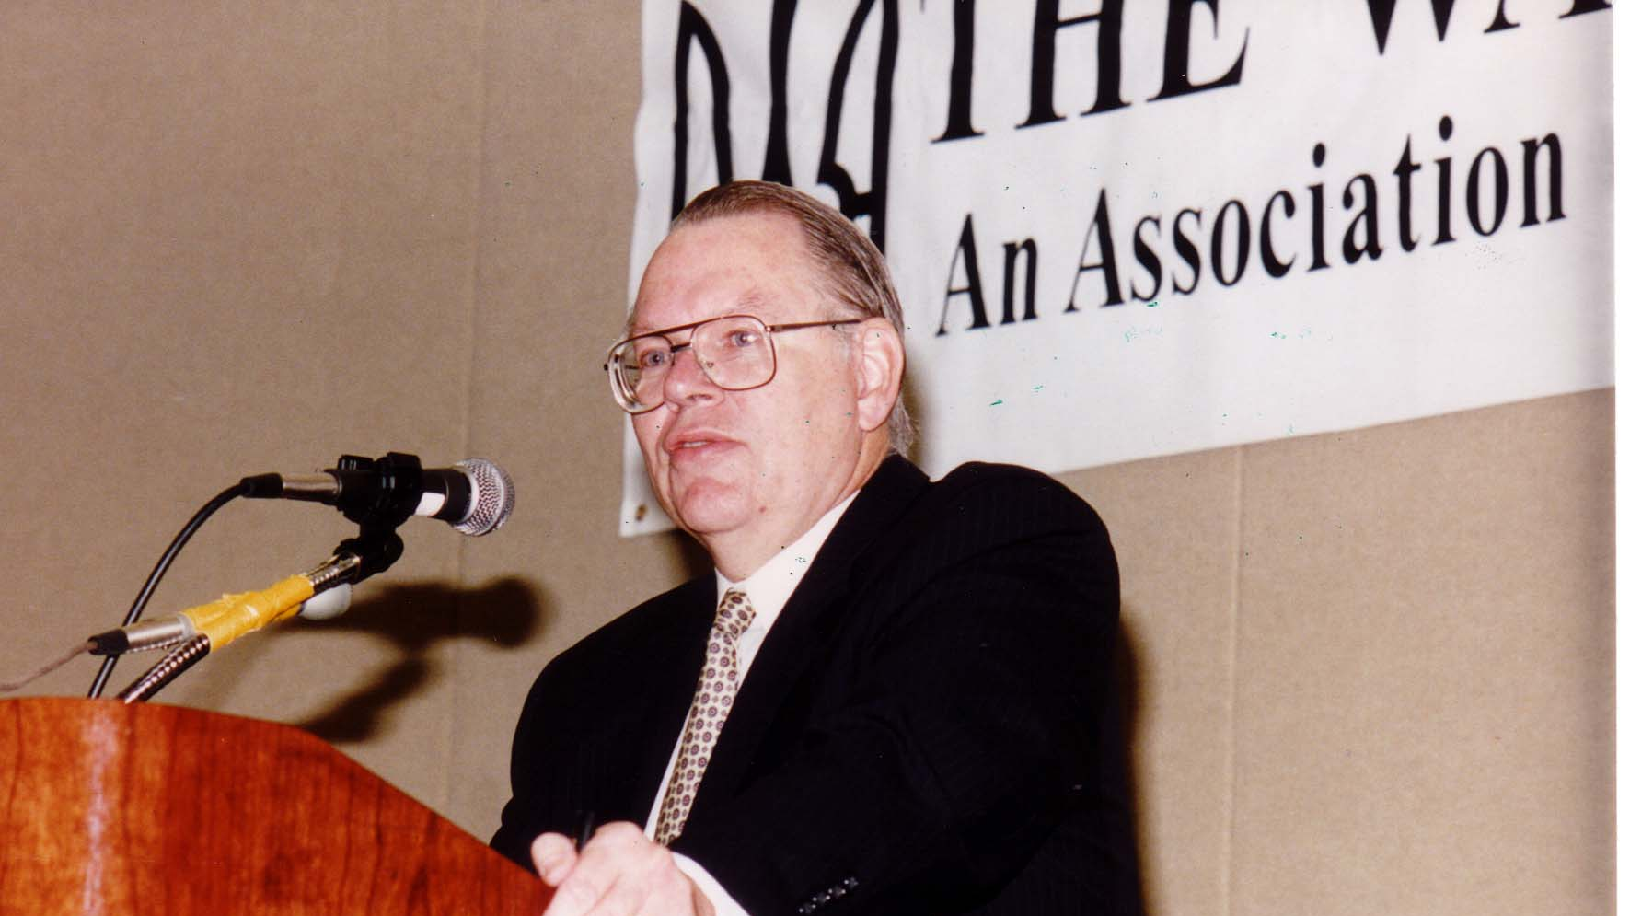
Notes:
TWG_Photo_1994_No_216__Oct_15__Leadership_Conference_Keynote_Address__State_Department_Coordinator_for_Newly_Independent_States_James_Collins
See 1994 November-December TWG NEWS, page 7, for event coverage
Note: James Collins was United States ambassador to Russia 1997-2001

Slide 9
1994 220 TWG Leadership Conference Luncheon October 15 Photographs
Kostyantyn Morozov, James Collins

Slide 10
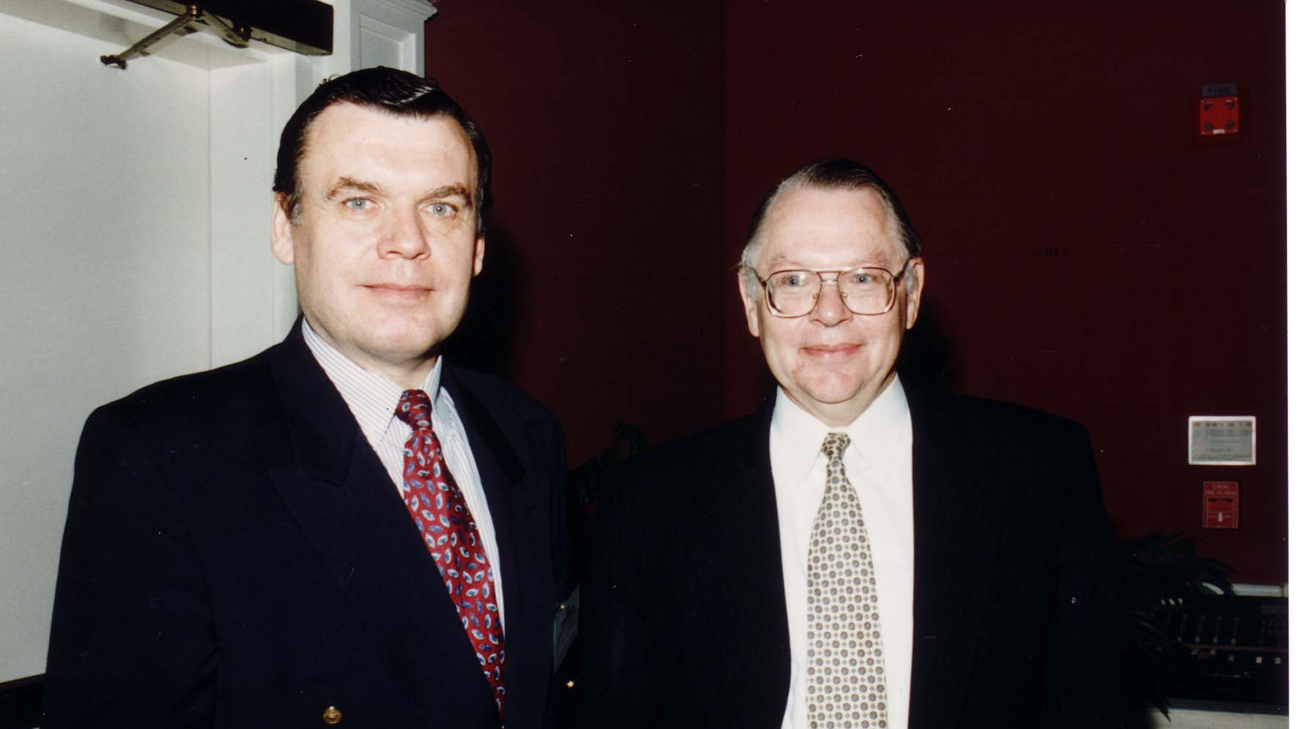
Notes:
TWG_Photo_1994_No_221__Oct_15__Leadership_Conference_Luncheon_Speaker__Ukraine's_First_Minister_of_Defense_Kostyantyn_Morozov__Keynote_Speaker_Coordinator_for_Newly_Independent_States_James_Collins
See 1994 November-December TWG NEWS, page 1, for Gen. Morozov’s remarks

Slide 11
1994 230 TWG Leadership Conference Banquet October 15 Photographs
Roma Hadzewycz, TWG President Mykola Babiak

Slide 12
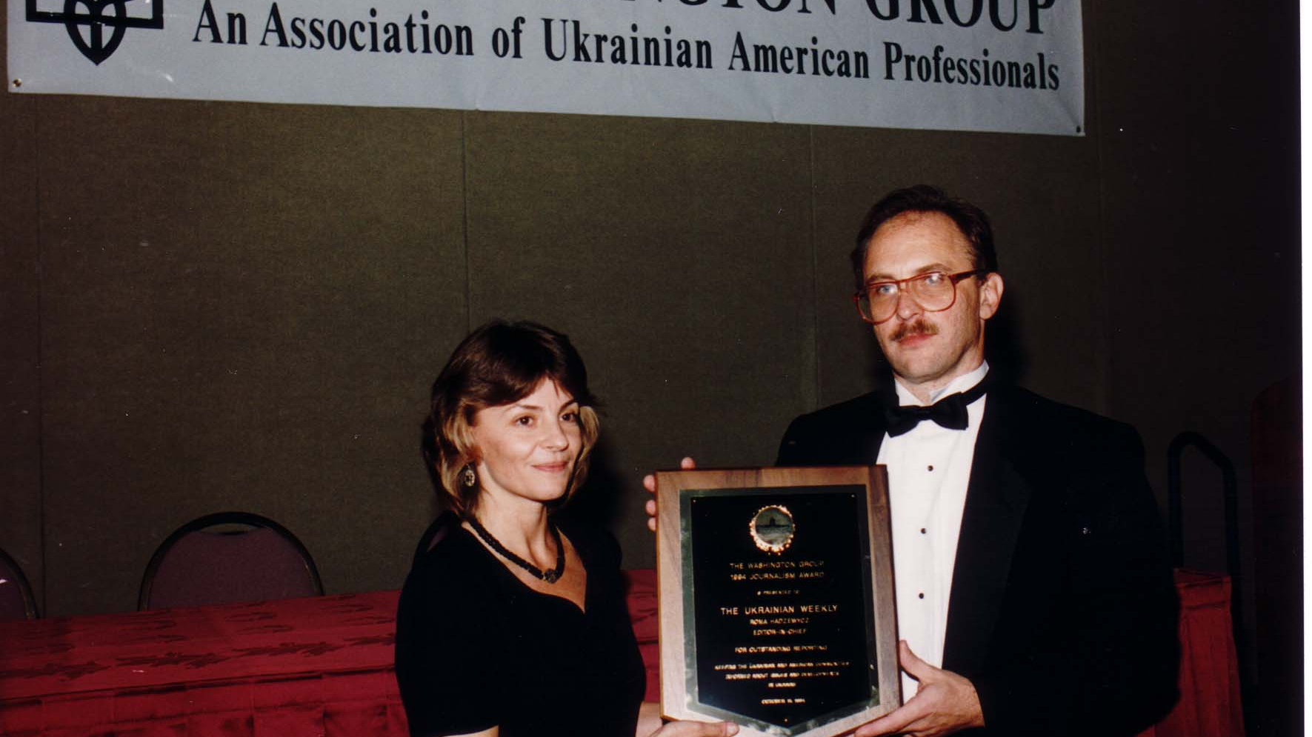
Notes:
TWG_Photo_1994_No_232__Oct_15__Leadership_Conference__Journalism_Award_Recipient_Ukrainian_Weekly_Editor_in_Chief_Roma_Hadzewycz__TWG_President_Mykola_Babiak
See 1994 November-December TWG NEWS, pages 6 and 9, for event coverage

Slide 13
1994 240 TWG Leadership Conference Global Ukrainian Professional Activities Panel October 15 Photographs
Bohdan Watral
Christine Demkovych

Slide 14
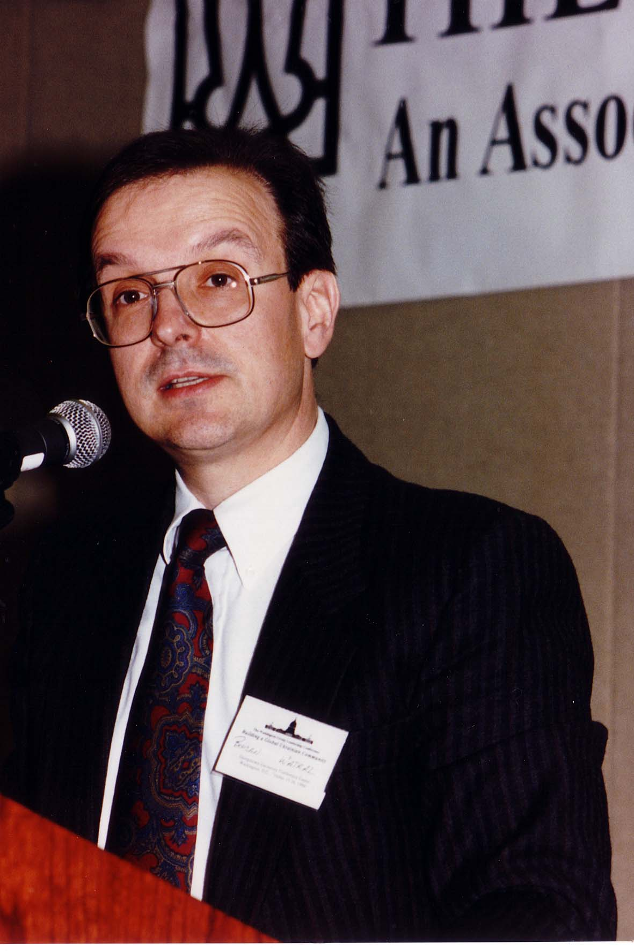
Notes:
TWG_Photo_1994_No_241__Oct_15__Leadership_Conference__Global_Ukrainian_Professional_Activities_Panel__World_Council_of_Ukrainian_Cooperatives_Treasurer_Bohdan_Watral
See 1994 November-December TWG NEWS, pages 7 and 8, for event coverage

Slide 15
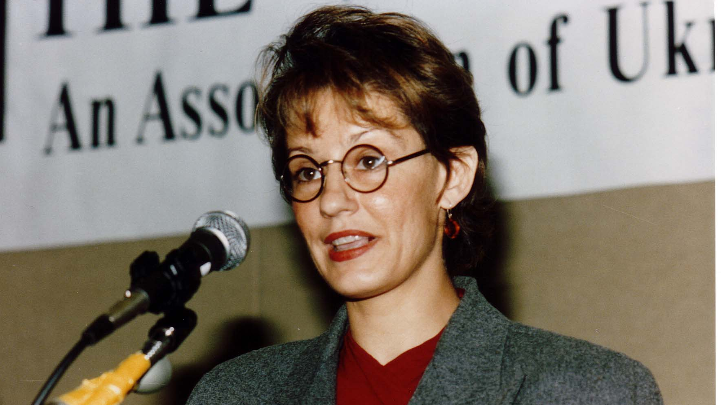
Notes:
TWG_Photo_1994_No_242__Oct_15__Leadership_Conference__Global_Ukrainian_Professional_Activities_Panel__Intelnews_Publisher_Christine_Demkovych
See 1994 November-December TWG NEWS, pages 7 and 8, for event coverage

Slide 16
1994 250 TWG Leadership Conference Electronic Highway Panel October 15 Photographs
Jurij Klufas

Slide 17
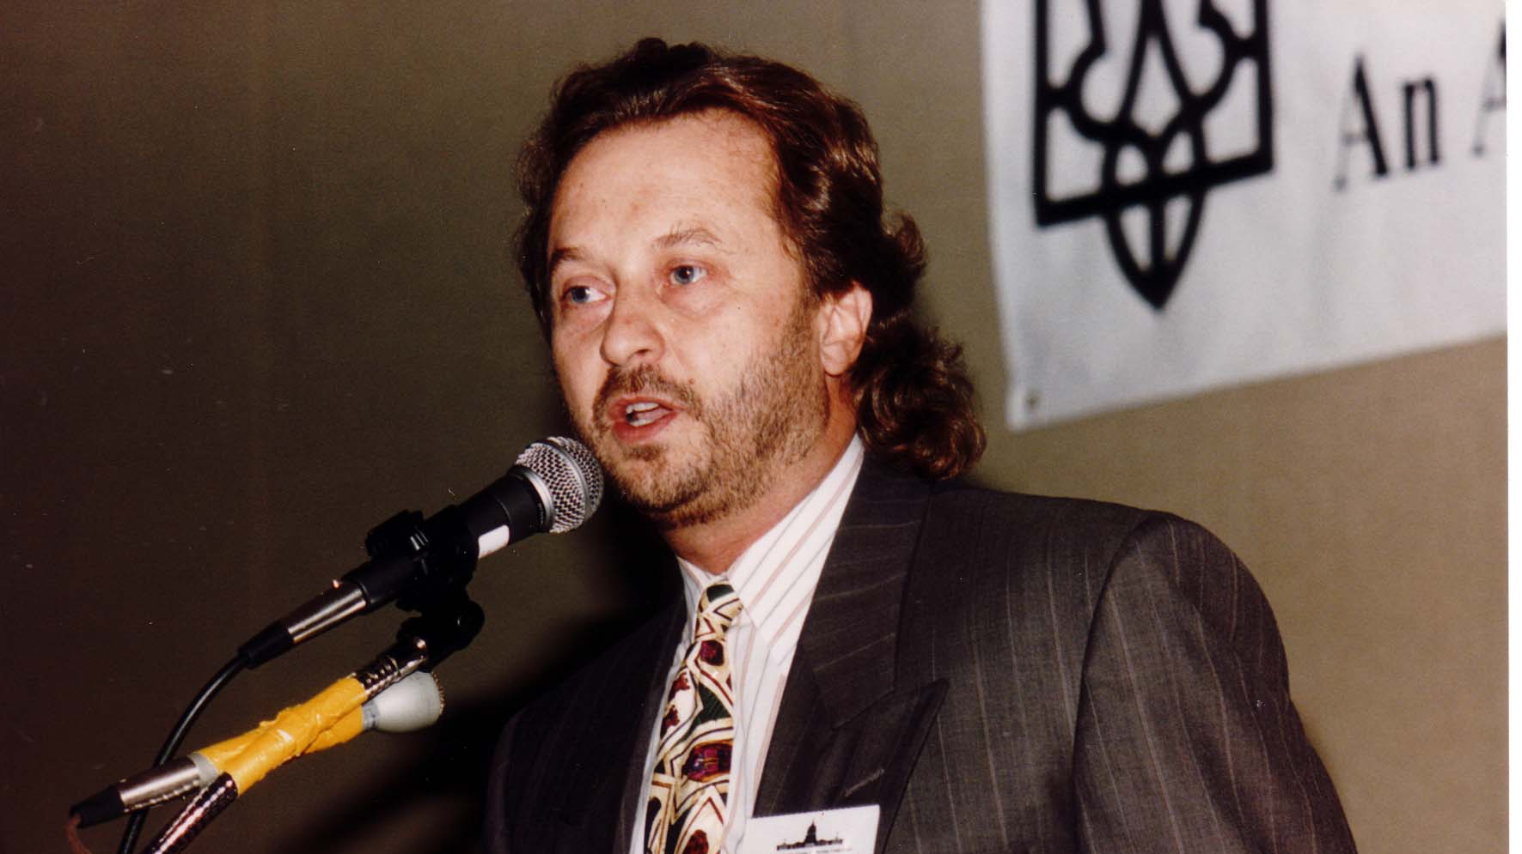
Notes:
TWG_Photo_1994_No_251__Oct_15__Leadership_Conference__Electronic_Highway_Panel__Executive_Producer_of_"KONTAKT"_Jurij_Klufas
See 1994 November-December TWG NEWS, page 8, for event coverage

Slide 18
1994 260 TWG Leadership Conference Effective Organizational Management Panel October 15 Photographs
Lubomyr Kwasnycia, Yuri Blanarovich, Halya Duda, Andrew Bihun

Slide 19
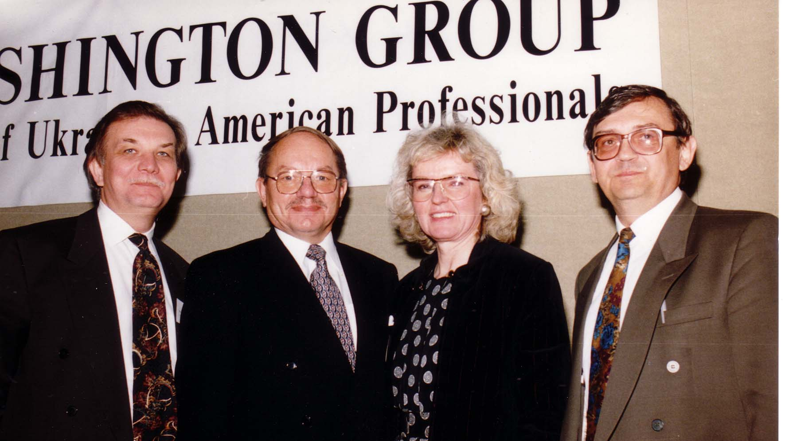
Notes:
TWG_Photo_1994_No_261__Oct_15__Leadership_Conference__Organizational_Management_Panel__President_of_Romyr_&_Associates_Lubomyr_Kwasnycia_President_of_Computeradio_Yuri_Blanarovich_Director_of_Executive_Management_with_KMPG_Halya_Duda_TWG_VP_Andrew_Bihun
See 1994 November-December TWG NEWS, page 6 and 9, for event coverage

Slide 20
1994 292 TWG Leadership Conference Ukrainian Embassy Recital October 16 Photograph
Volodymyr Vynnytsky, Vagram Saradjian, Valeriy Kuchinsky

Slide 21
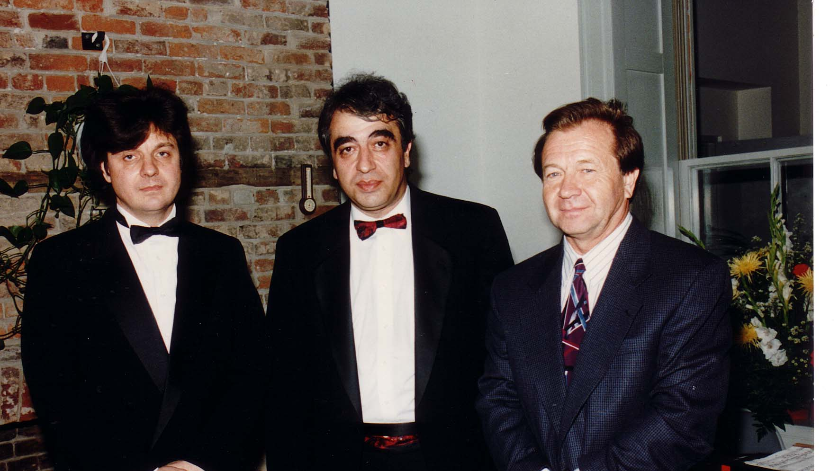
Notes:
TWG_Photo_1994_No_293__Oct_16__Ukrainian_Embassy__Leadership_Conference__Pianist_Volodymyr_Vynnytsky__Cellist_Vagram_Saradjian__Ukrainian_Embassy_Chargé_d'Affaires_Valeriy_Kuchinsky
See 1994 November-December TWG NEWS, page 6 and 9, for event coverage

Slide 22
1994 298 TWG Leadership Conference Special Guests October 15 Photographs
Lviv Institute of Management Students

Slide 23
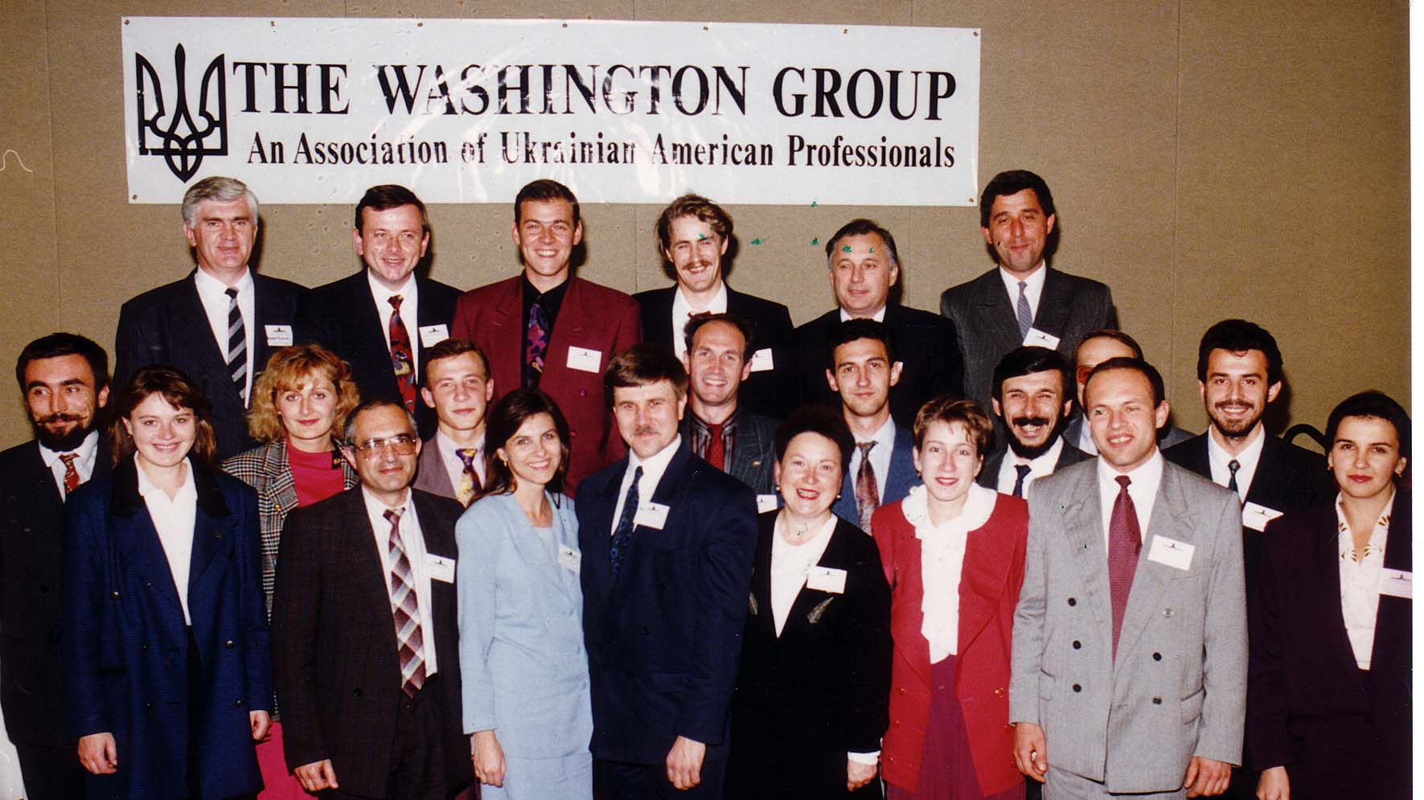
Notes:
TWG_Photo_1994_No_299__Oct_15__Leadership_Conference__Lviv_Institute_of_Management_Students
See 1994 November-December TWG NEWS, page 8, for event coverage

Slide 24
1994 300 TWG Events Photographs
Reflections of TWG Members in Kyiv: Mykola Deychakiwsky, Katya Bowers
Joint Venture Business Presentation: Marijka Helbig, Anatolii Popadiuk
Honorary Membership to Amb. Bilorus: TWG President Mykola Babiak, Amb. Oleh Bilorus, Larisa Bilorus
Reception for Congressman Maurice Hinchey
Reception for Dmytro Tabachnyk

Slide 25
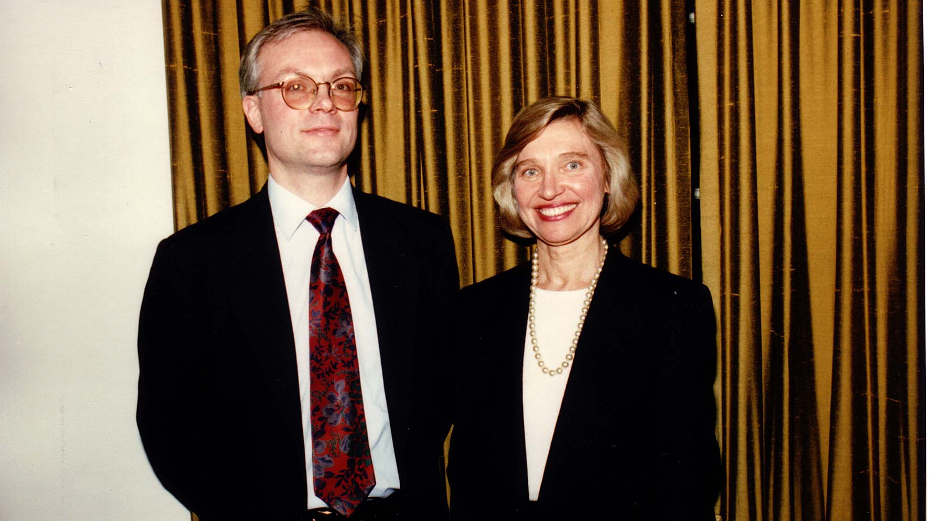
Notes:
TWG_Photo_1994_No_331__Jan_10__Holy_Trinity_Ukrainian_Catholic_Church__Reflections_of_TWG_Members_in_Kyiv__Deputy_Director_Renaissance_Foundation-Kyiv_Mykola_Deychakiwsky__Director_of_Counterpart_Service_Center-Kyiv_Katya_Bowers
See 1994 March TWG NEWS, page 7, for event coverage

Slide 26
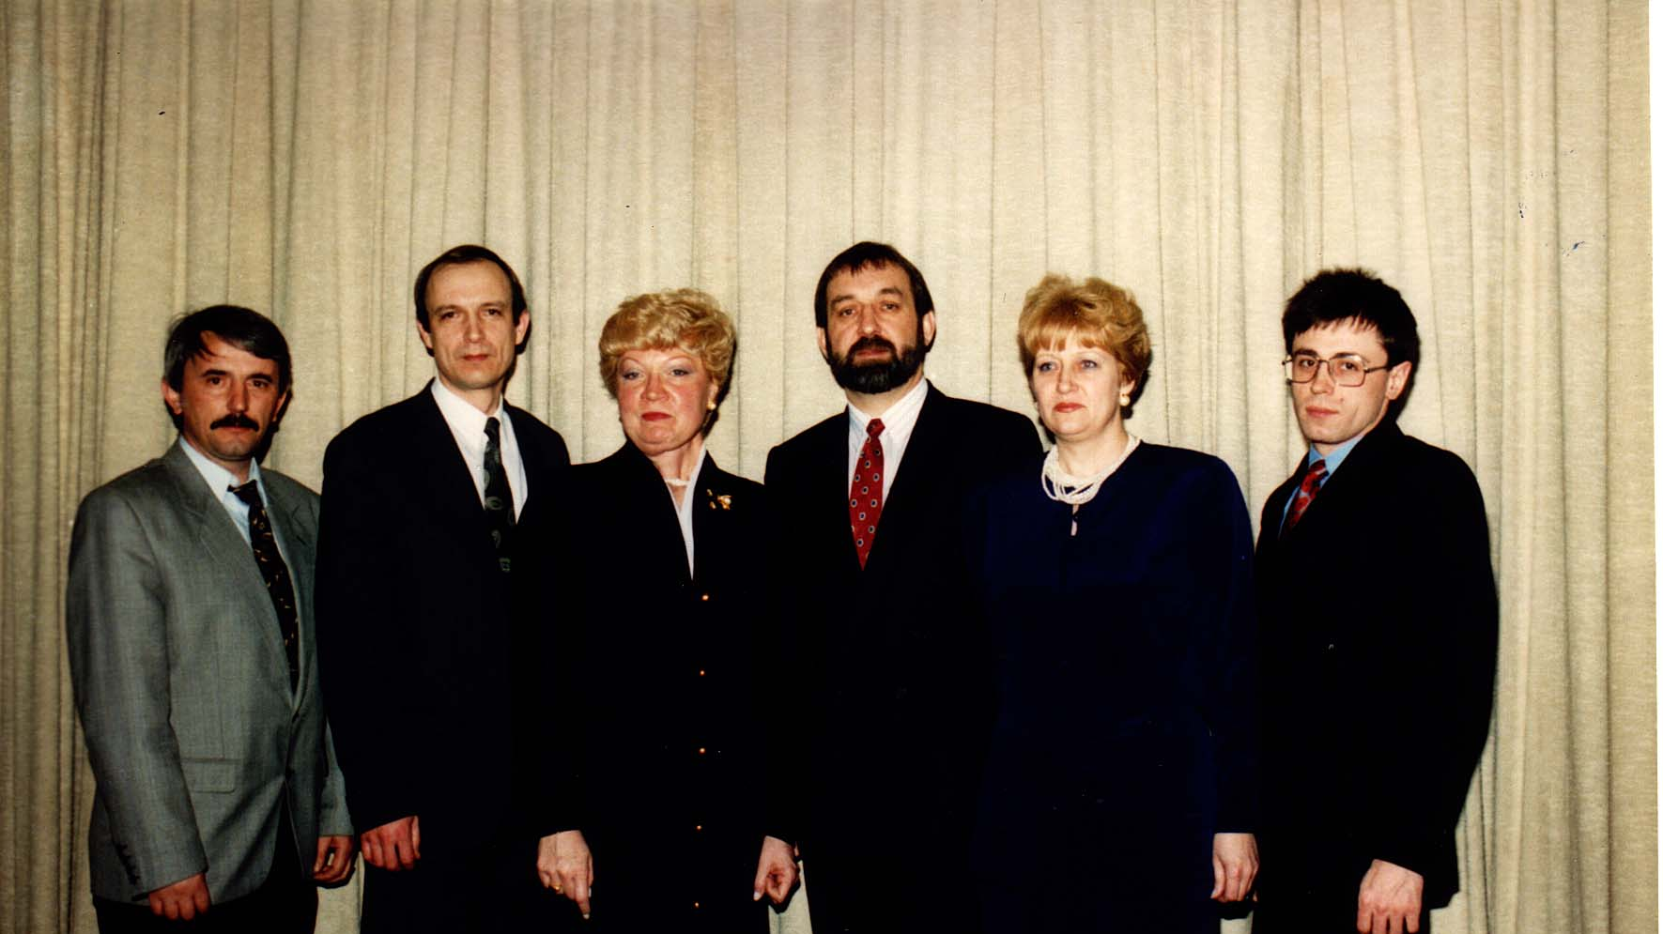
Notes:
TWG_Photo_1994_No_332__Feb_7__Joint_Venture_Business_Presentation__3rd_&_4th_from_left__Marijka_Helbig__Anatolii_Popadiuk
See 1994 March TWG NEWS, page 4

Slide 27
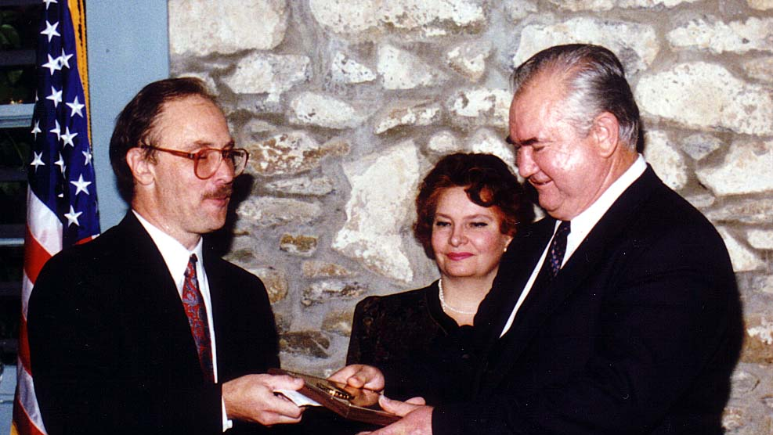
Notes:
TWG_Photo_1994_No_333__Sep_8__Ukrainian_Embassy__Farewell_and_Presentation_of_TWG_Honarary_Membership_to_Amb_Bilorus__TWG_President_Mykola_Babiak__Ukrainian_Ambassador_Oleh_Bilorus__Larisa_Bilorus
See 1994 August-September TWG NEWS, page 1, for event coverage

Slide 28
1994 310 TWG Reception for Congressman Maurice Hinchey Chinatown Restaurant March 16 Photographs
Marta Chomiak, Theodor Kostiuk, George Masiuk, Dmitro Markov, Maurice Hinchey, TWG President Mykola Babiak, Raymond Arent
Theodor Kostiuk, Ross Chomiak, Dmitro Markov, Maurice Hinchey, TWG President Mykola Babiak, Marta Chomiak, George Sierant, Roman Stelmach, George Masiuk, Mike Drabyk, Raymond Arent

Slide 29
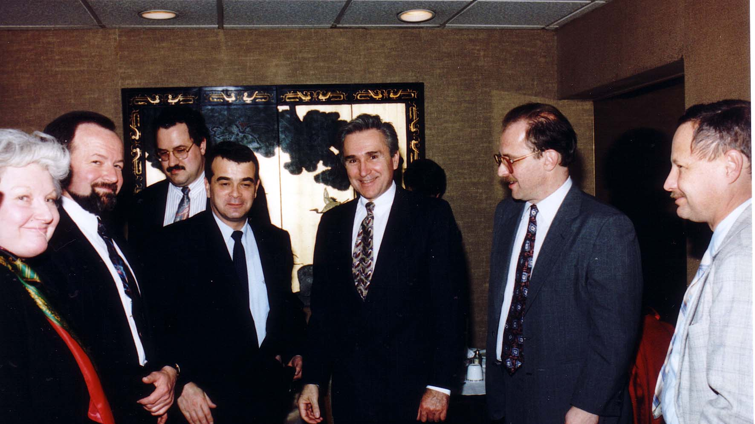
Notes:
TWG_Photo_1994_No_311__Mar_16__Chinatown__Marta_Chomiak__Theodor_Kostiuk__George_Masiuk__Dmitro_Markov__US_Representative_Maurice_Hinchey__TWG_President__Mykola_Babiak__Raymond_Arent
See 1994 May TWG NEWS, page 6, for event coverage

Slide 30
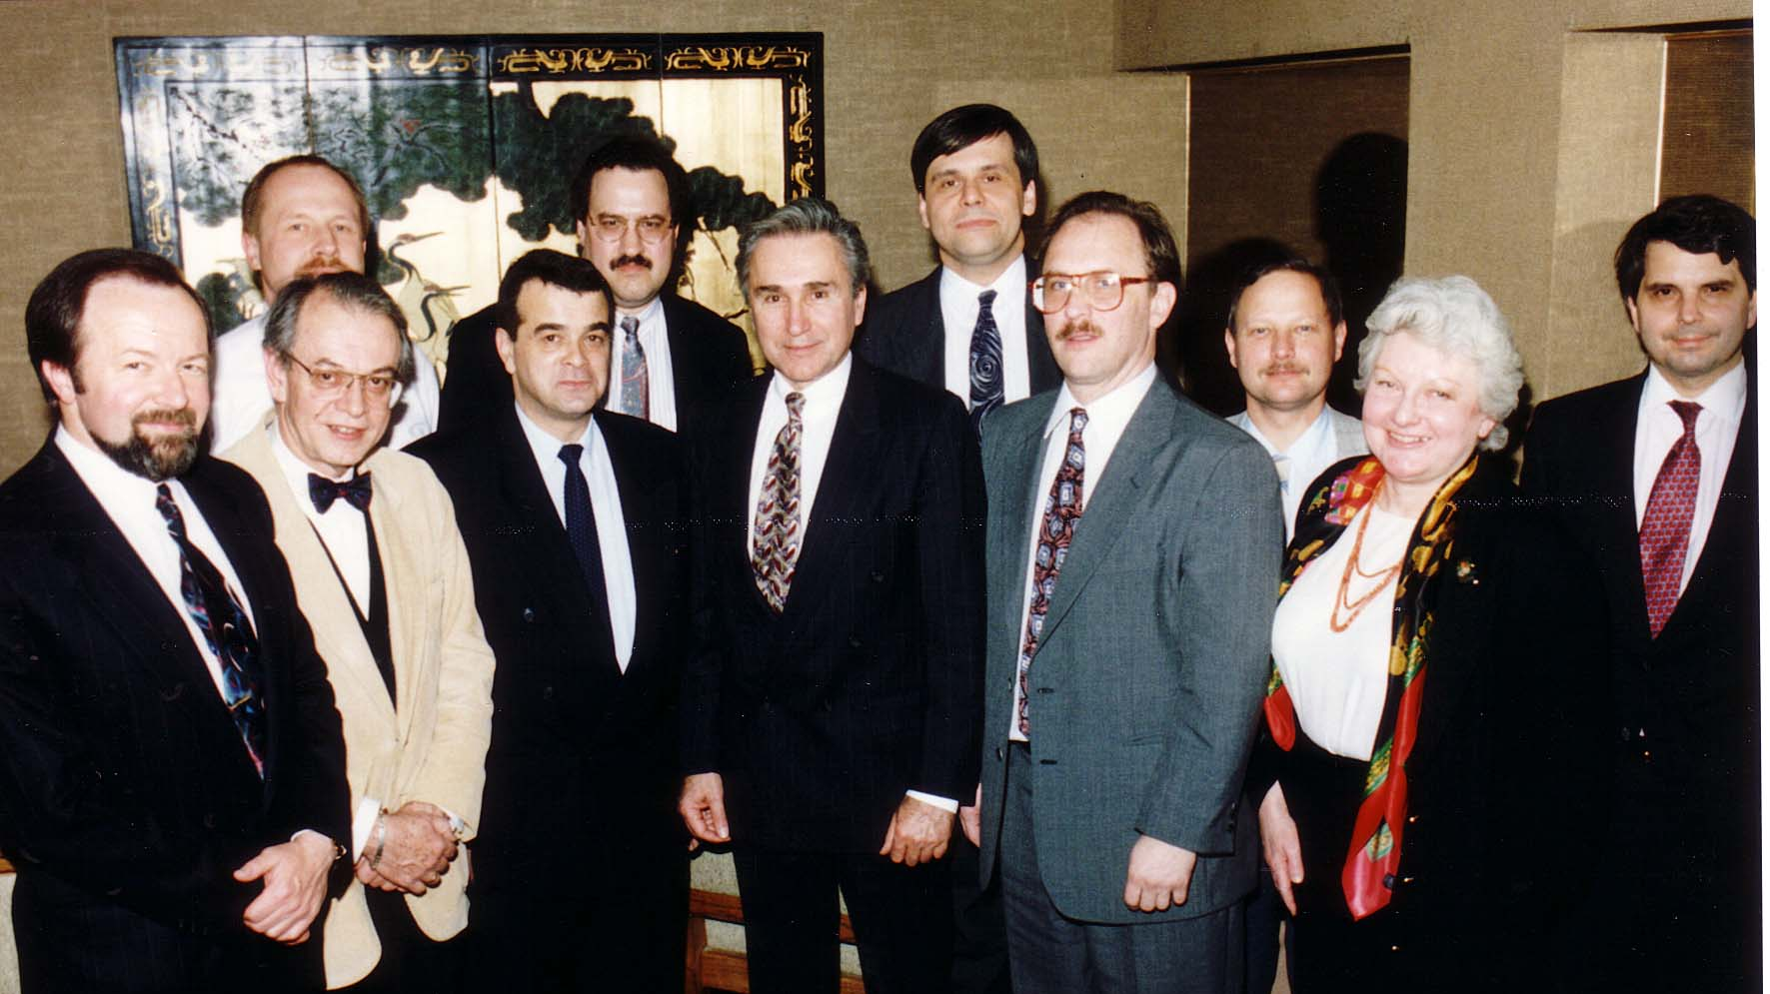
Notes:
TWG_Photo_1994_No_312__Mar_16__Chinatown__Front__Theodor_Kostiuk__Ross_Chomiak__Dmitro_Markov__US_Representative_Maurice_Hinchey__TWG_President_Mykola_Babiak__Marta_Chomiak__George_Sierant__Back__Roman_Stelmach__George_Masiuk__Mike_Drabyk__Raymond_Arent
See 1994 May TWG NEWS, page 6, for event coverage

Slide 31
1994 320 TWG Meeting with Dmytro Tabachnyk La Brasserie Restaurant 239 Massachusetts Ave NE WDC August 29 Photographs
TWG President Mykola Babiak, Andrew Bihun, Dmytro Tabachnyk
Andrew Bihun, TWG President Mykola Babiak, Dmytro Tabachnyk

Slide 32
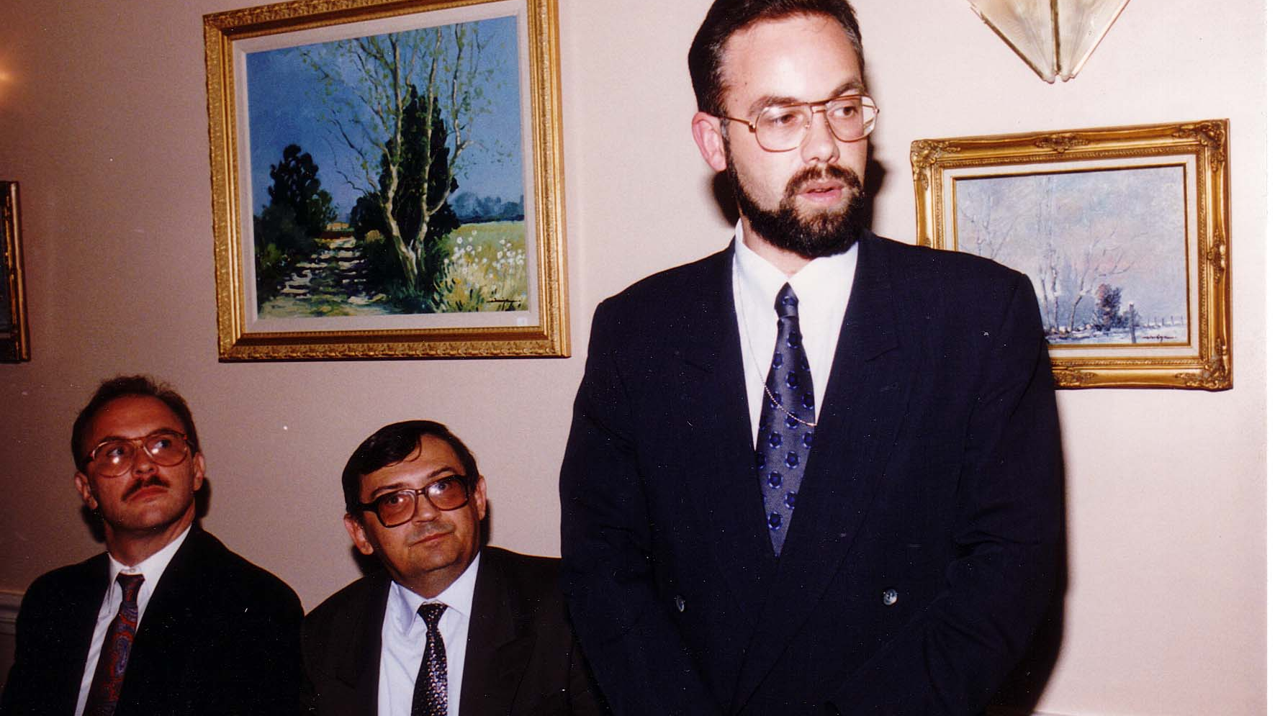
Notes:
TWG_Photo_1994_No_321__August_29__La_Brasserie_Restaurant__TWG_President_Mykola_Babiak__Andrew_Bihun__Leonid_Kuchma's_Chief_of_Staff_Dmytro_Tabachnyk
See 1995 February TWG NEWS, pages 4 and 5, and 2004 Leadership Conference Booklet, pages 27 and 28, for event coverage

Slide 33
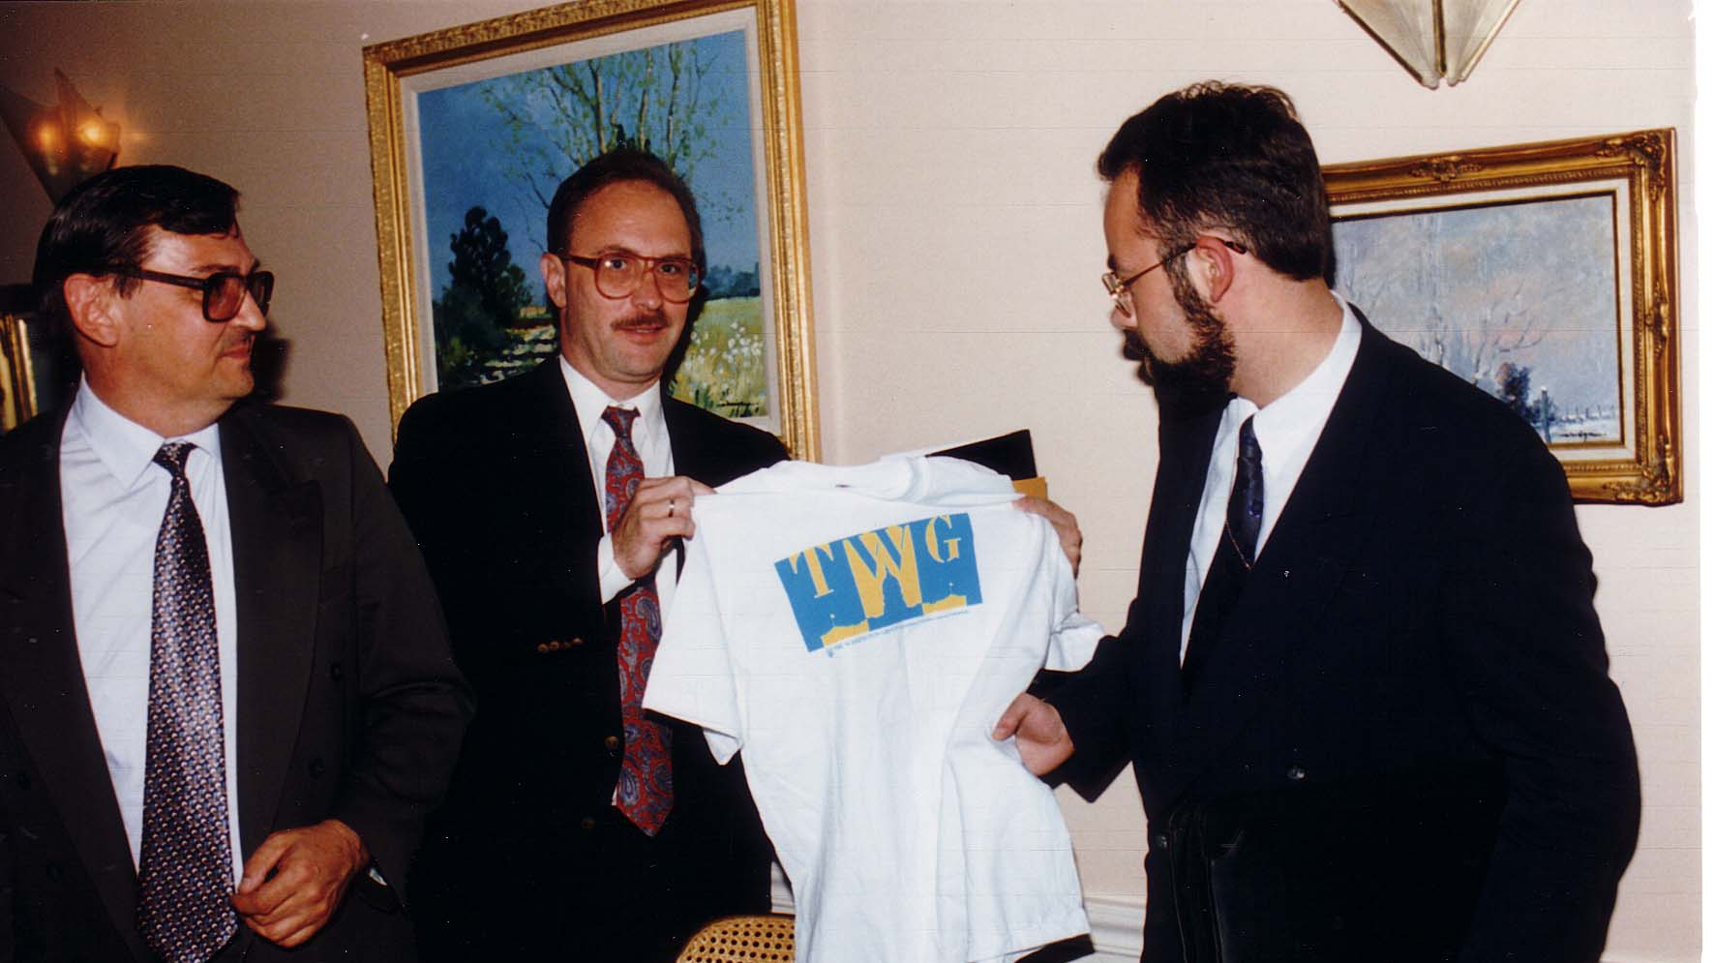
Notes:
TWG_Photo_1994_No_322__August_29__La_Brasserie_Restaurant__Andrew_Bihun__TWG_President_Mykola_Babiak__President_Leonid_Kuchma's_Chief_of_Staff_Dmytro_Tabachnyk
See 1995 February TWG NEWS, pages 4 and 5, and 2004 Leadership Conference Booklet, pages 27 and 28, for event coverage

Slide 34
1994 400 TWG Co-sponsored Events Photographs
Ukrainian American Business and Professional Associations meeting
Johns Hopkins University School of Advanced International Studies (SAIS) Economic Delegation

Slide 35
1994 410 TWG a Member of Federation of Ukrainian American Business and Professional Associations Photograph
TWG President Mykola Babiak, Anna Mostovych, Areta Pawlynsky, Christine Hoshowsky, Ihor Havryluk, Rosalie Kapustij, Emil Bandriwsky, Federation President Lydia Chopivsky-Benson, Bohdan Vitvitsky

Slide 36
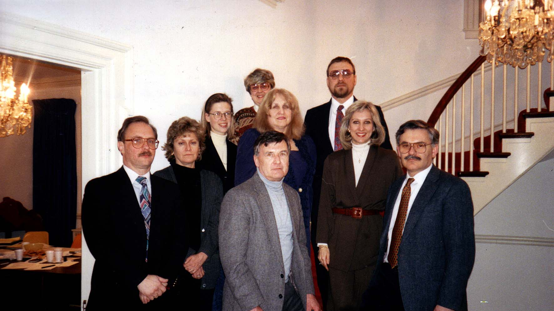
Notes:
TWG_Photo_1994_No_411_1__Feb_26__WDC__Federation_Organizational_mtg__First_Column_against_the_wall__Mykola_Babiak__Anna_Mostovych__Areta_Pawlynsky__Christine_Hoshowsky__Second_Column__Ihor_Havryluk__Rosalie_Kapustij__Emil_Bandriwsky
See 1994 March TWG NEWS, page 1, for event coverage

Slide 37
Notes:
TWG_Photo_1994_No_411_2__Feb_26__WDC__Federation_Organizational_mtg__On_the_right_side_of_photograph__Federation_President_Lydia_Chopivsky_Benson__Bohdan_Vitvitsky
See 1994 March TWG NEWS, page 1, for event coverage

Slide 38
1994 420 TWG Co-sponsored with Johns Hopkins University School of Advanced International Studies (SAIS) Economic Delegation at SAIS January 26 Photographs
Anton Buteyko, Victor Yushchenko, Roman Shpek, Amb. Oleh Bilorus, Bohdan Hawrylyshyn, Andrew Bihun
Victor Yushchenko
Anton Buteyko
Roman Shpek
Bohdan Hawrylyshyn

Slide 39
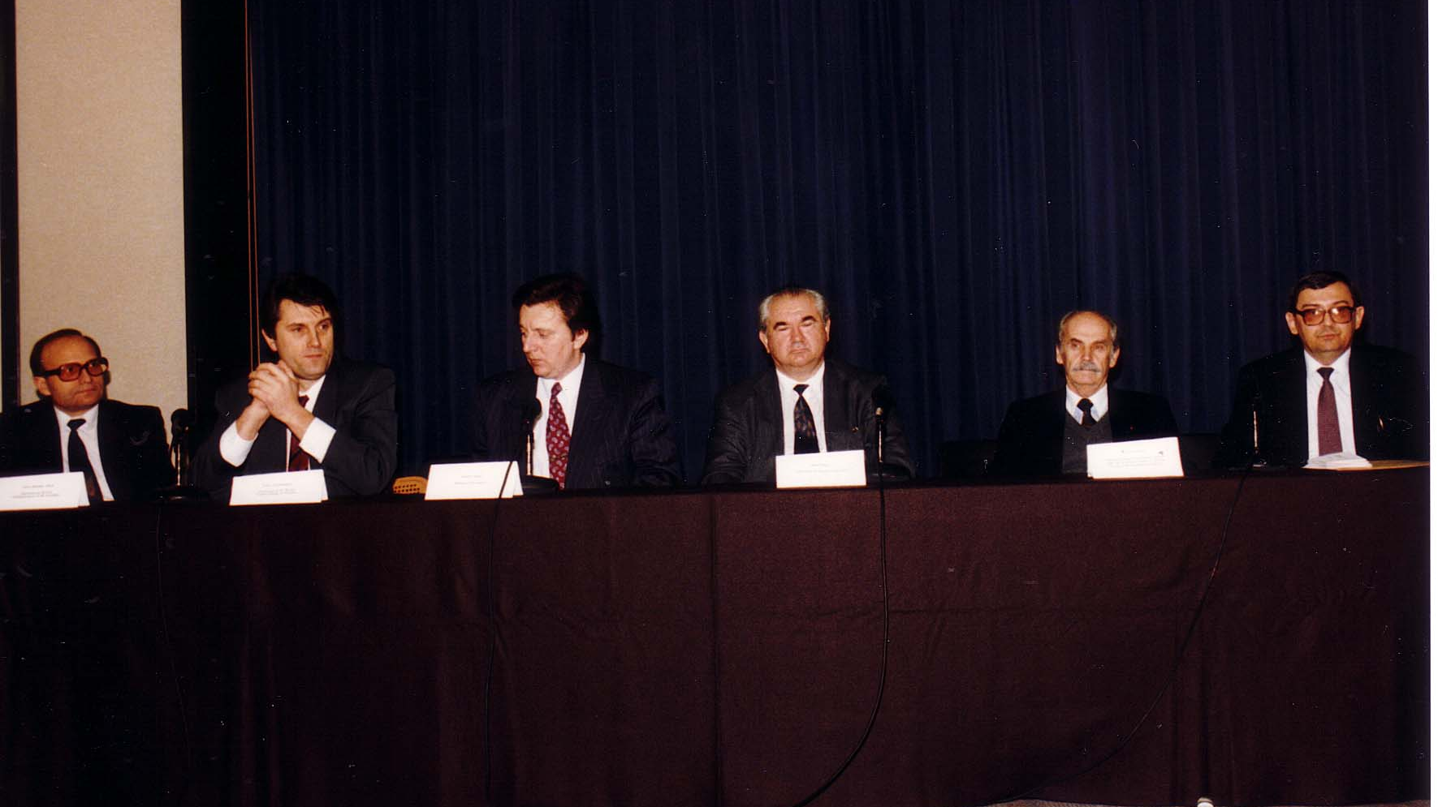
Notes:
TWG_Photo_1994_No_421_Jan_26_SAIS_Economic_Delegation__Presidential_Advisor_Anton_Buteyko__National_Bank_Chairman_Victor_Yushchenko__Minister_of_Economy_Roman_Shpek__Amb_Oleh_Bilorus__Presidential_Advisor_Bohdan_Hawrylyshyn__TWG_VP_Andrew_Bihun
See 1994 March TWG NEWS, page 7, for event coverage

Slide 40
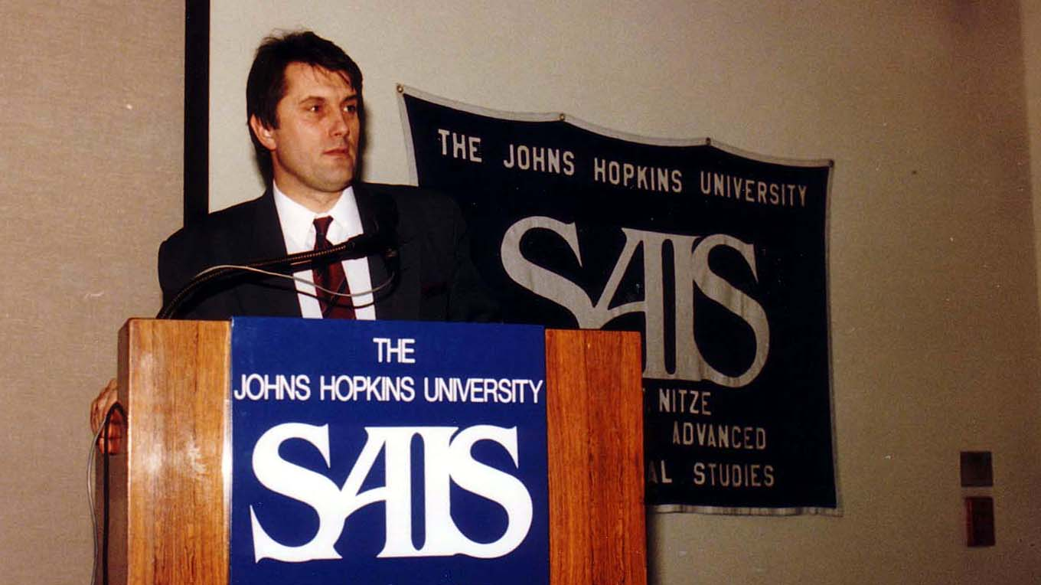
Notes:
TWG_Photo_1994_No_422__Jan_26__SAIS__Economic_Delegation__National_Bank_Chairman_Victor_Yushchenko
See 1994 March TWG NEWS, page 7, for event coverage

Slide 41
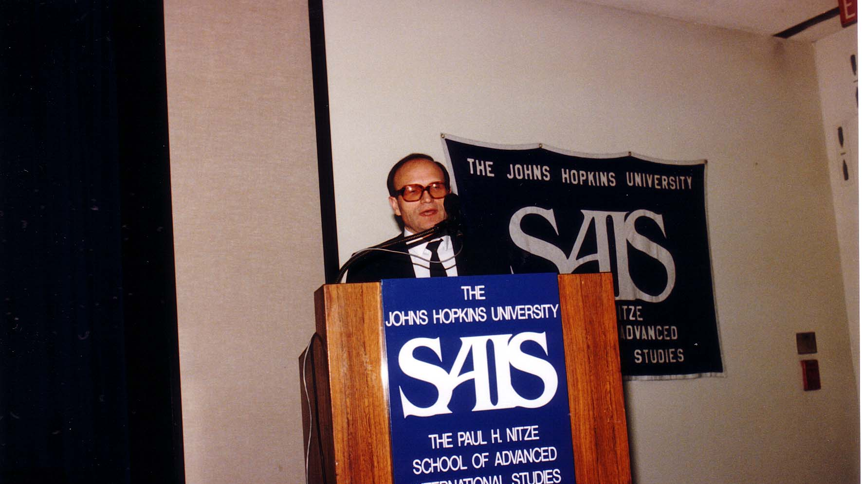
Notes:
TWG_Photo_1994_No_423__Jan_26__SAIS__Economic_Delegation__Presidential_Advisor_Anton_Buteyko
See 1994 March TWG NEWS, page 7, for event coverage

Slide 42
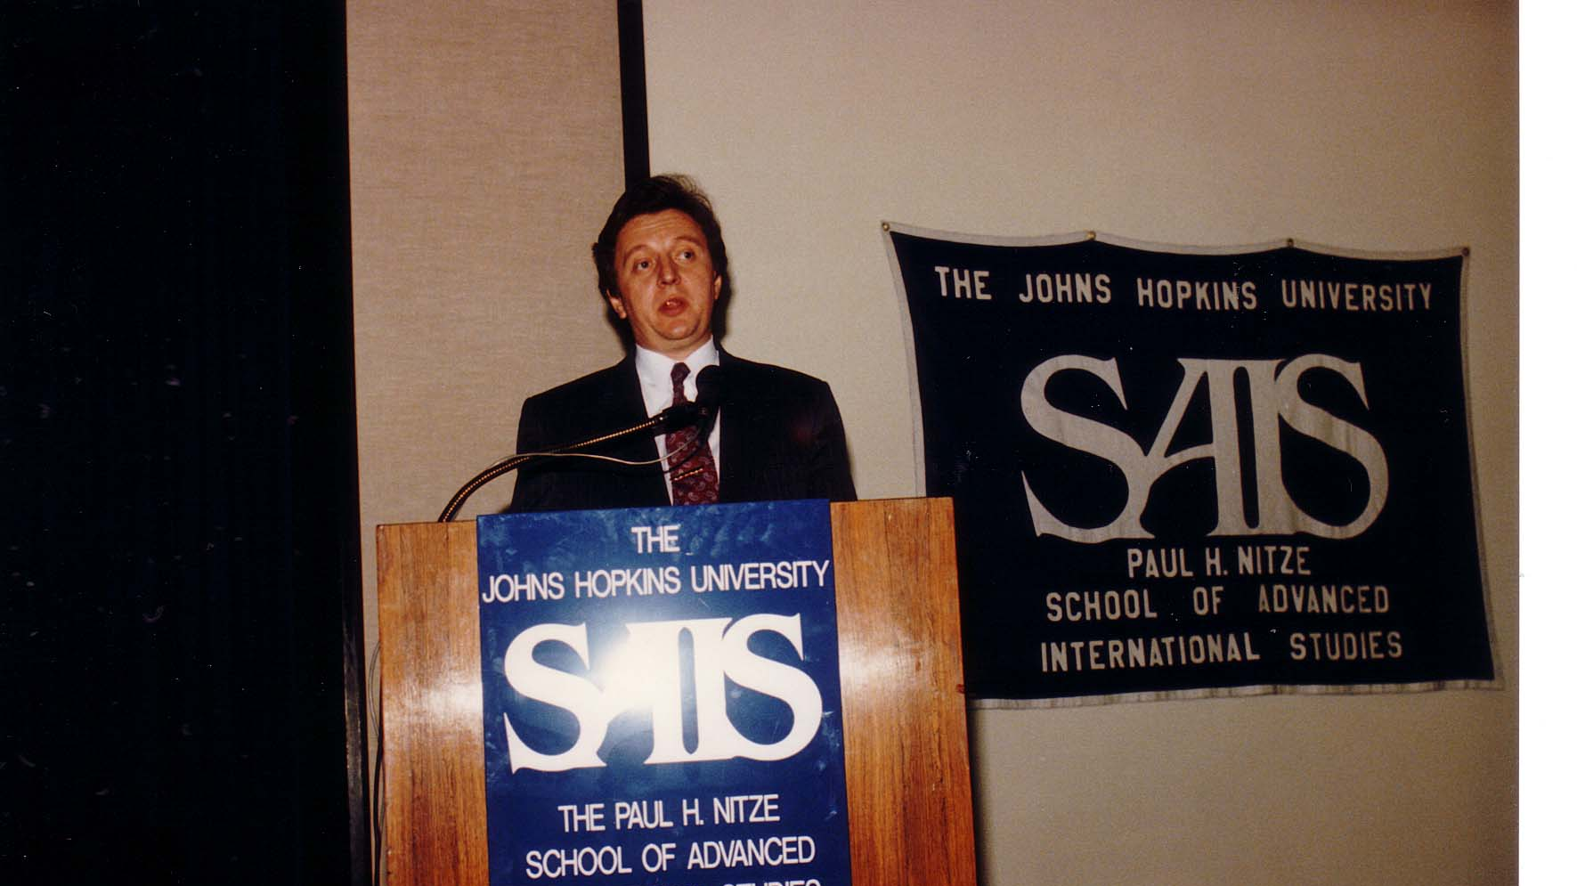
Notes:
TWG_Photo_1994_No_424__Jan_26__SAIS__Economic_Delegation__Minister_of_Economy_Roman_Shpek
See 1994 March TWG NEWS, page 7, for event coverage

Slide 43
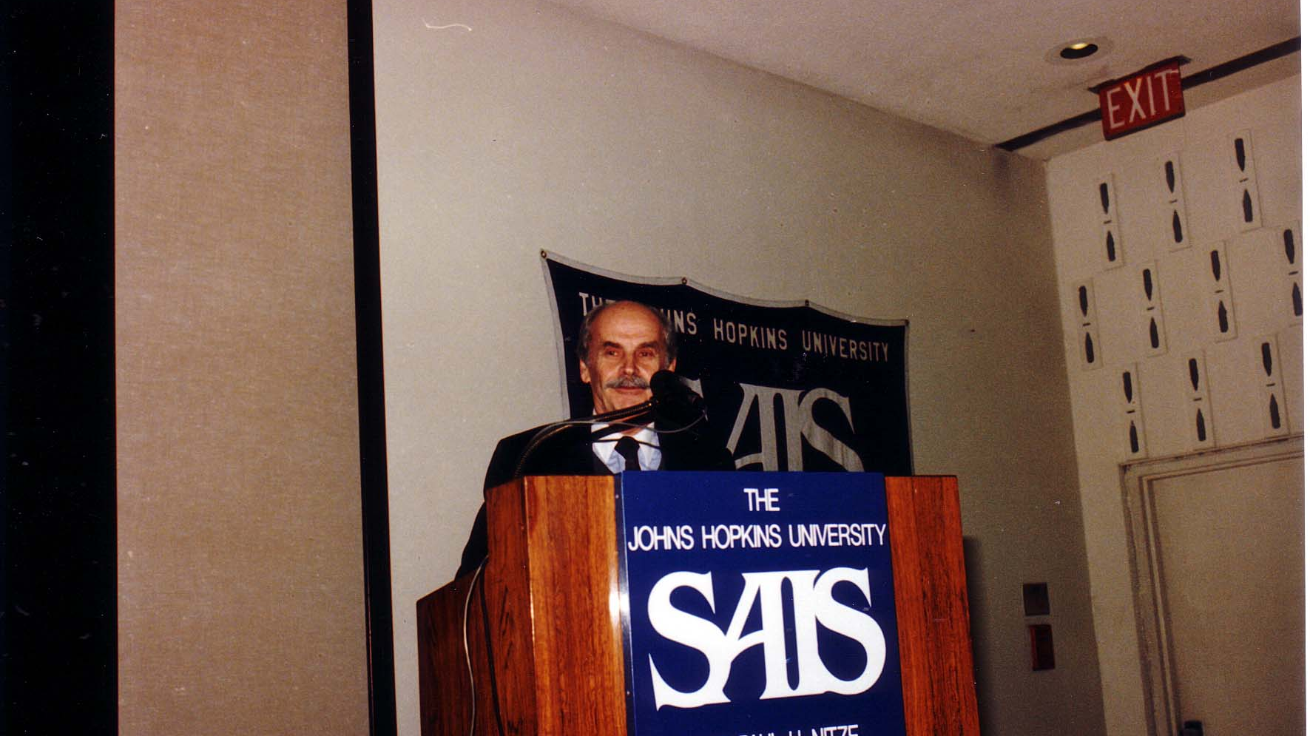
Notes:
TWG_Photo_1994_No_425__Jan_26__SAIS__Economic_Delegation__Presidential_Advisor_Bohdan_Hawrylyshyn
See 1994 March TWG NEWS, page 7, for event coverage

Slide 44
TWG Social Events
Ukrainian Independence Day Celebration: Yurij Holowinsky, Sophia Caryk, Jane Kunka, Eugene Iwanciw

Slide 45
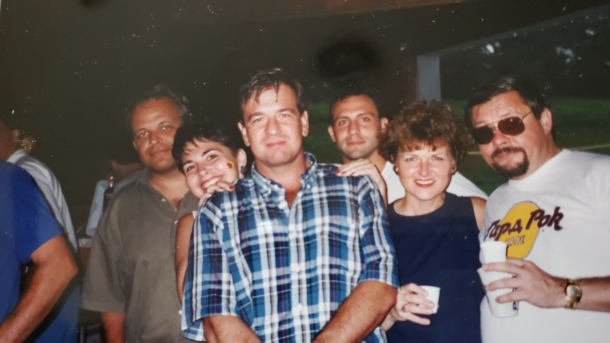
Notes:
TWG_Photo_1994_No_610__Aug_21__Columbia_MD__TWG_Independence_Day_Picnic__Yurij_Holowinsky__Sophia_Caryk_ (on_Holowinsky's_shoulder)__Jane_Kunka__Eugene_Iwanciw
See 1994 August-September TWG NEWS, page 7, for event coverage

Slide 46
See TWGCF Photo Album for 1994 Cultural Events
TWGCF Inaugural Reception
Les Kurbas Young Theater of Lviv
Skoryk and Chmyr
Leadership Conference Reception
Leadership Conference Recital
Olga Hirshhorn

