Slide 1
1995 TWG Photos
Created October 25, 2020

Slide 2
1995 100 TWG Annual Meeting St. Sophia Religious Association February 24
See 1995 January TWG NEWS for Annual Meeting announcement and February TWG NEWS for Annual Meeting coverage
Elected to the Board: George Masiuk – President; Marta Zielyk – Vice President; Orest Deychakiwsky - Secretary; Roman Stelmach – Treasurer; Jane Kunka - Public Relations; Michael Drabyk – Membership Director
Cultural Fund Director: Laryssa Chopivsky
Members at Large: Mykola Babiak, Lydia Chopivsky-Benson, Yurij Holowinsky, Oleh Jerschkowsky, Maria Kulczycky, Sonia Melnyk, Ihor Procinsky
Auditor: Andrew Charchalis
Fellowship Fund: Adrian Karmazyn
TWG NEWS Editor: Yaro Bihun

Slide 3
1995 200 TWG Leadership Conference Key Bridge Marriott Rosslyn Virginia October 6-8 Photographs
See Leadership Conference Announcement in 1995 May TWG NEWS, page 7
See Leadership Conference Planning in 1995 Summer TWG NEWS, page 1, and September TWG NEWS, page 1
See TWG_1995_Leadership_Conference_Booklet for Conference Program and Speaker Biographies
See 1995 October TWG NEWS for Leadership Conference Coverage
See TWG Leadership Conference coverage by The Ukrainian Weekly: The_Ukrainian_Weekly_1995-43

Slide 4
1995 220 TWG Leadership Conference Saturday Luncheon October 7 Photographs
Melanne Verveer, Jane Kunka, TWG President George Masiuk, Yaro Bihun
Melanne Verveer, Jane Kunka

Slide 5
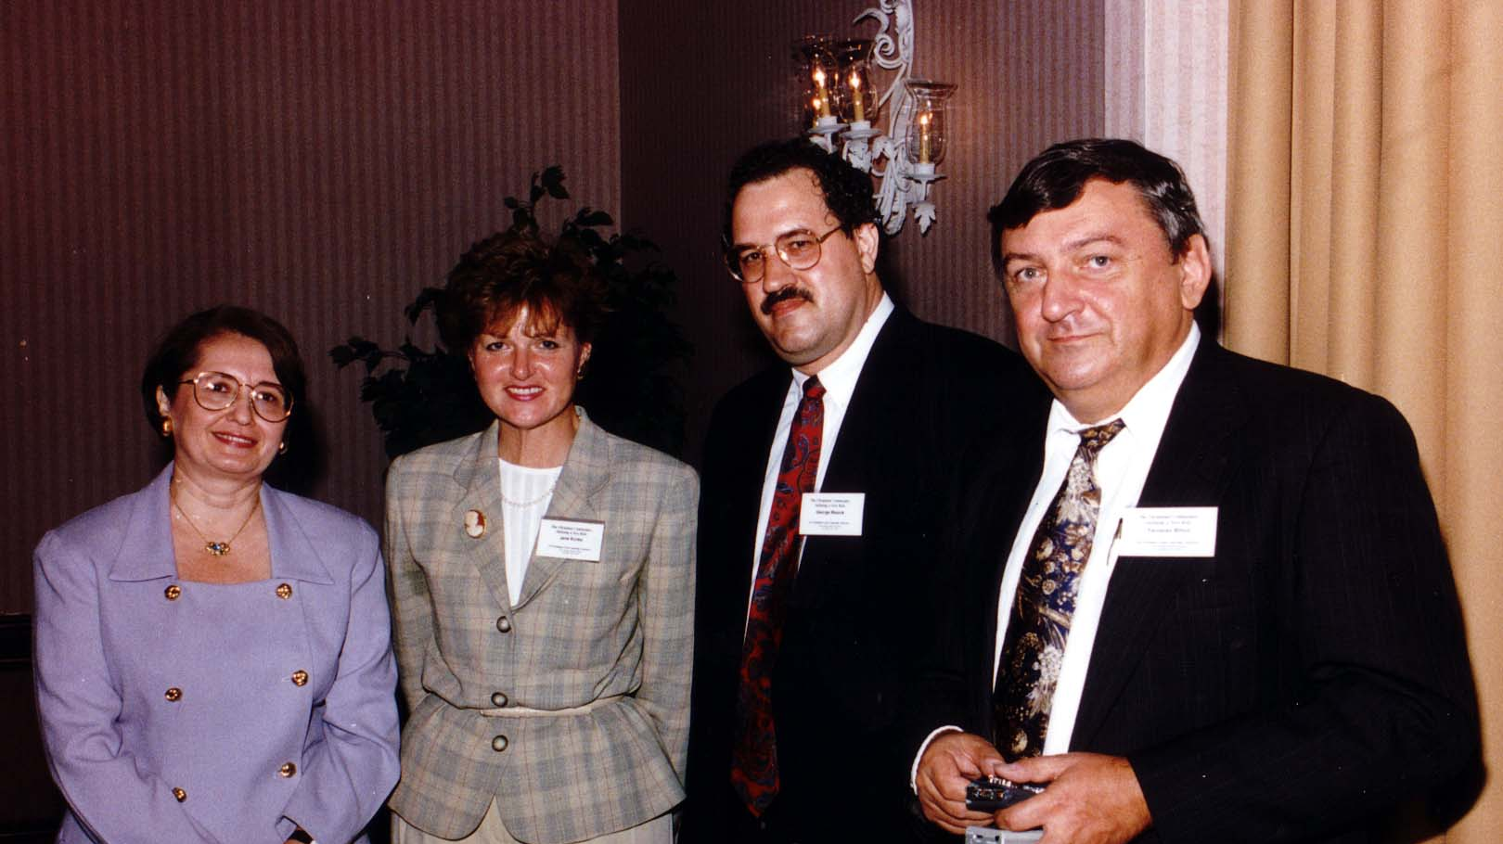
Notes:
TWG_Photo_1995_No_221__Oct_7__Leadership_Conference_Luncheon_Speaker__Assistant_to_President_&_Chief_of_Staff_to_First_Lady_Melanne_Verveer__TWG_Public_Relations_Jane_Kunka__TWG_President_George_Masiuk__TWG_NEWS_Editor_Yaro_ Bihun
See 1995 October TWG NEWS, page 4

Slide 6
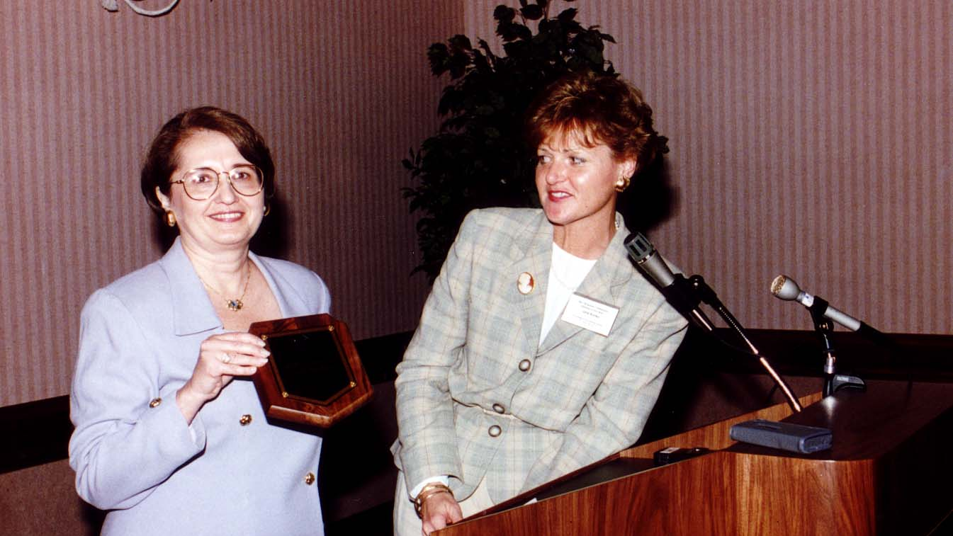
Notes:
TWG_Photo_1995_No_222__Oct_7__Leadership_Conference__Luncheon_Speaker__Assistant_to_President_&_Chief_of_Staff_to_First_Lady_Melanne_Verveer_TWG_Public_Relations_Jane_Kunka
See 1995 October TWG NEWS, page 4

Slide 7
1995 230 TWG Leadership Conference Banquet October 7 Photographs
Journalism Awards: Wolodymyr Bilajiw, Geoffrey Cowan, Michael Terpak, Mykola Francuzenko
Slavko and Darka: Slavko Halatyn, Darka Konopada

Slide 8
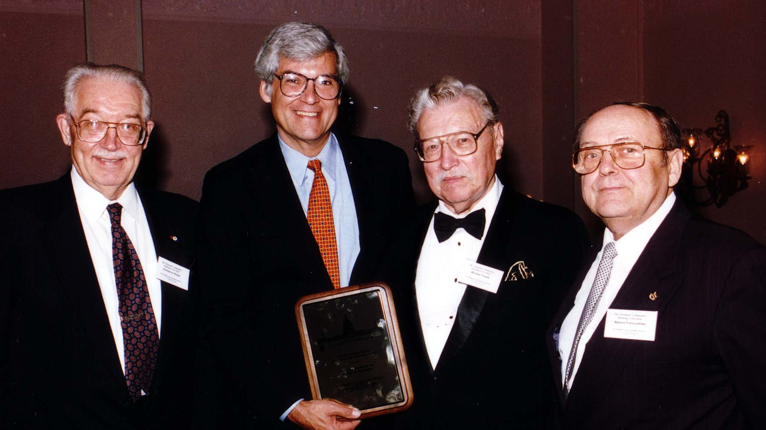
Notes:
TWG_Photo_1995_No_232__Oct_7__Leadership_Conference__TWG_Journalism_Awards__VOA_Ukrainian_Service_Chief_Wolodymyr_Bilajiw__VOA_Director_Geoffrey_Cowan__Former_Ukrainian_Service_Chiefs_Michael_Terpak_and_Mykola_Francuzenko
See 1995 October TWG NEWS, page 5

Slide 9
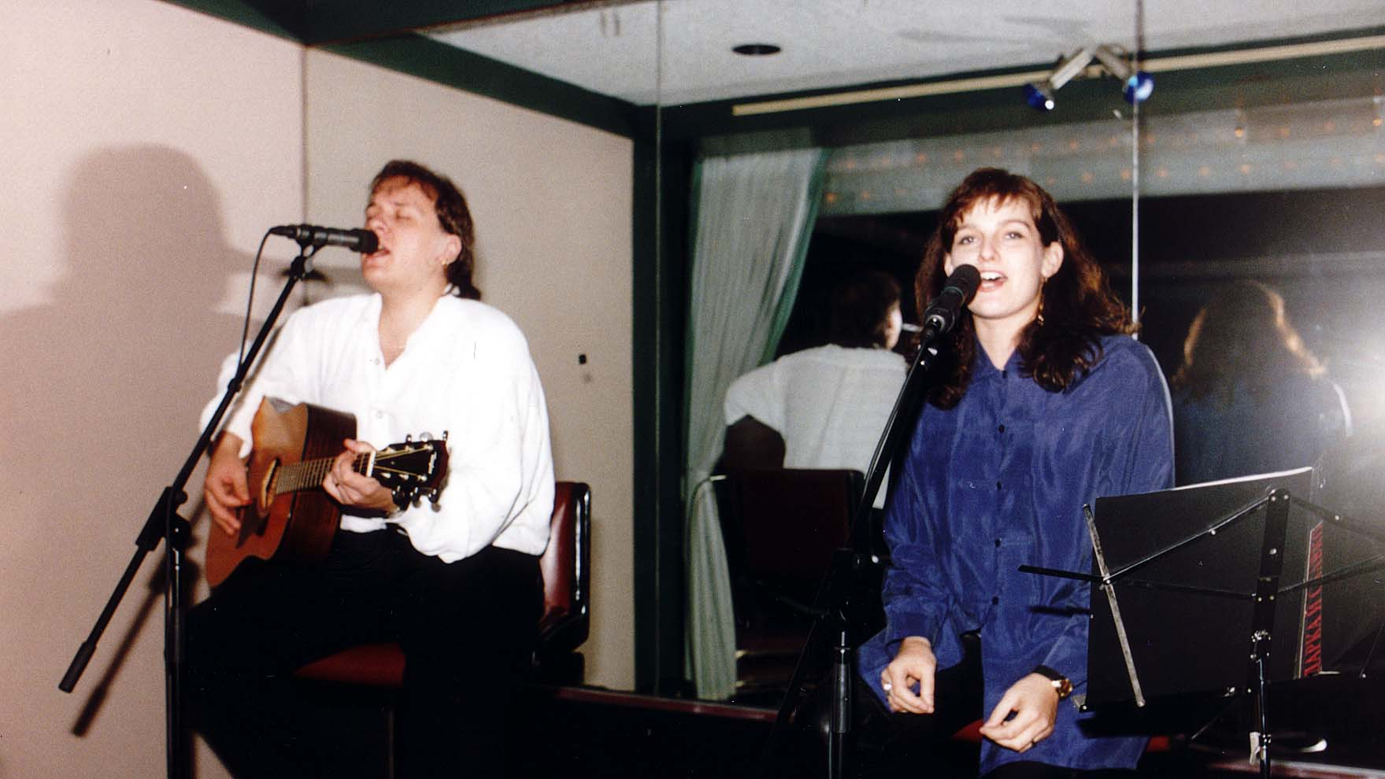
Notes:
TWG_Photo_1995_No_234__Oct_7__Leadership_Conference__Saturday_Evening_Cabaret_and_Dance__Slavko_and_Darka__Slavko_Halatyn__Darka_Konopada
See October TWG NEWS, page 5

Slide 10
1995 240 TWG Leadership Conference 1st Panel: Developing a Consensus on Ukrainian Community Goals October 7 Photographs
Andrij Masiuk, Orest Subtelny, TWG President George Masiuk

Slide 11
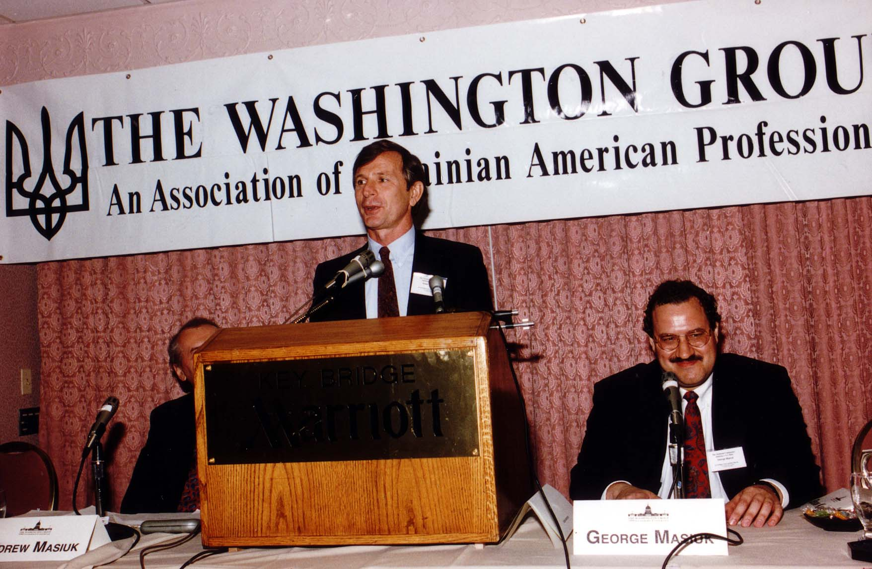
Notes:
TWG_Photo_1995_No_241__Oct_7__Leadership_Conference__Developing_Consensus_on_Community_Goals_Panel__Professor_of_History_York_University_Toronto_Orest_Subtelny__International_Management_Institute_Director_Andrij_Masiuk__TWG_President_George_Masiuk
See October TWG NEWS, page 6

Slide 12
1995 250 TWG Leadership Conference 2nd Panel: Providing Services to the Ukrainian-American Community October 7 Photographs
See October TWG NEWS, page 7

Slide 13
1995 260 TWG Leadership Conference 3rd Panel: Getting our Message Out to the Broader Community October 7 Photographs
See October TWG NEWS, page 8

Slide 14
1995 270 TWG Leadership Conference 4th Panel: Financing the Ukrainian-American Community's Projects October 7 Photographs
Nadia McConnell

Slide 15
Notes:
TWG_Photo_1995_No_271__Oct_7__Leadership_Conference__US_Ukraine_Foundation_President_Nadia_McConnell
See 1995 October TWG NEWS, page 9

Slide 16
1995 290 TWG Leadership Conference Brunch October 8 Photographs
Amb. Yuriy Shcherbak

Slide 17
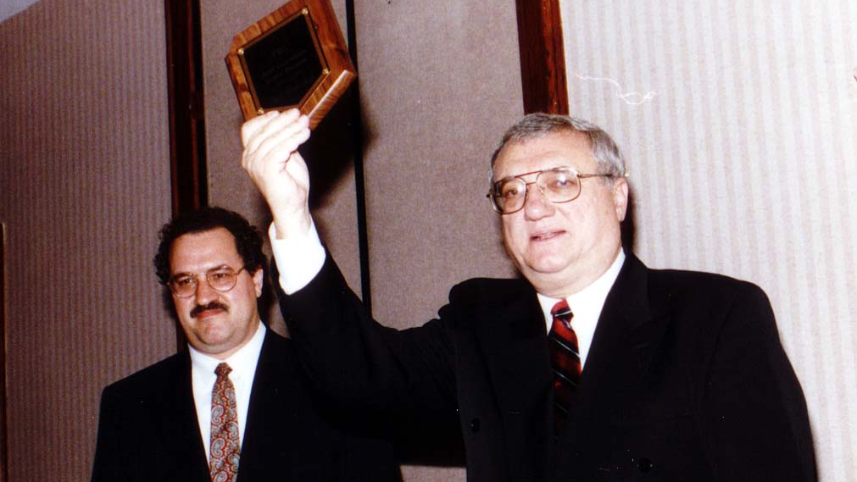
Notes:
TWG_Photo_1995_No_291__Oct_8__Leadership_Conference__TWG_President_George_Masiuk__Ukrainian_Ambassador_Yuriy_Shcherbak
See October TWG NEWS, page 1, and transcript on page 3

Slide 18
1995 292 TWG Leadership Conference Sunday Brunch Jazz Concert October 8 Photographs
John Stetch
John Stetch, TWG Cultural Fund Director Laryssa Chopivsky

Slide 19
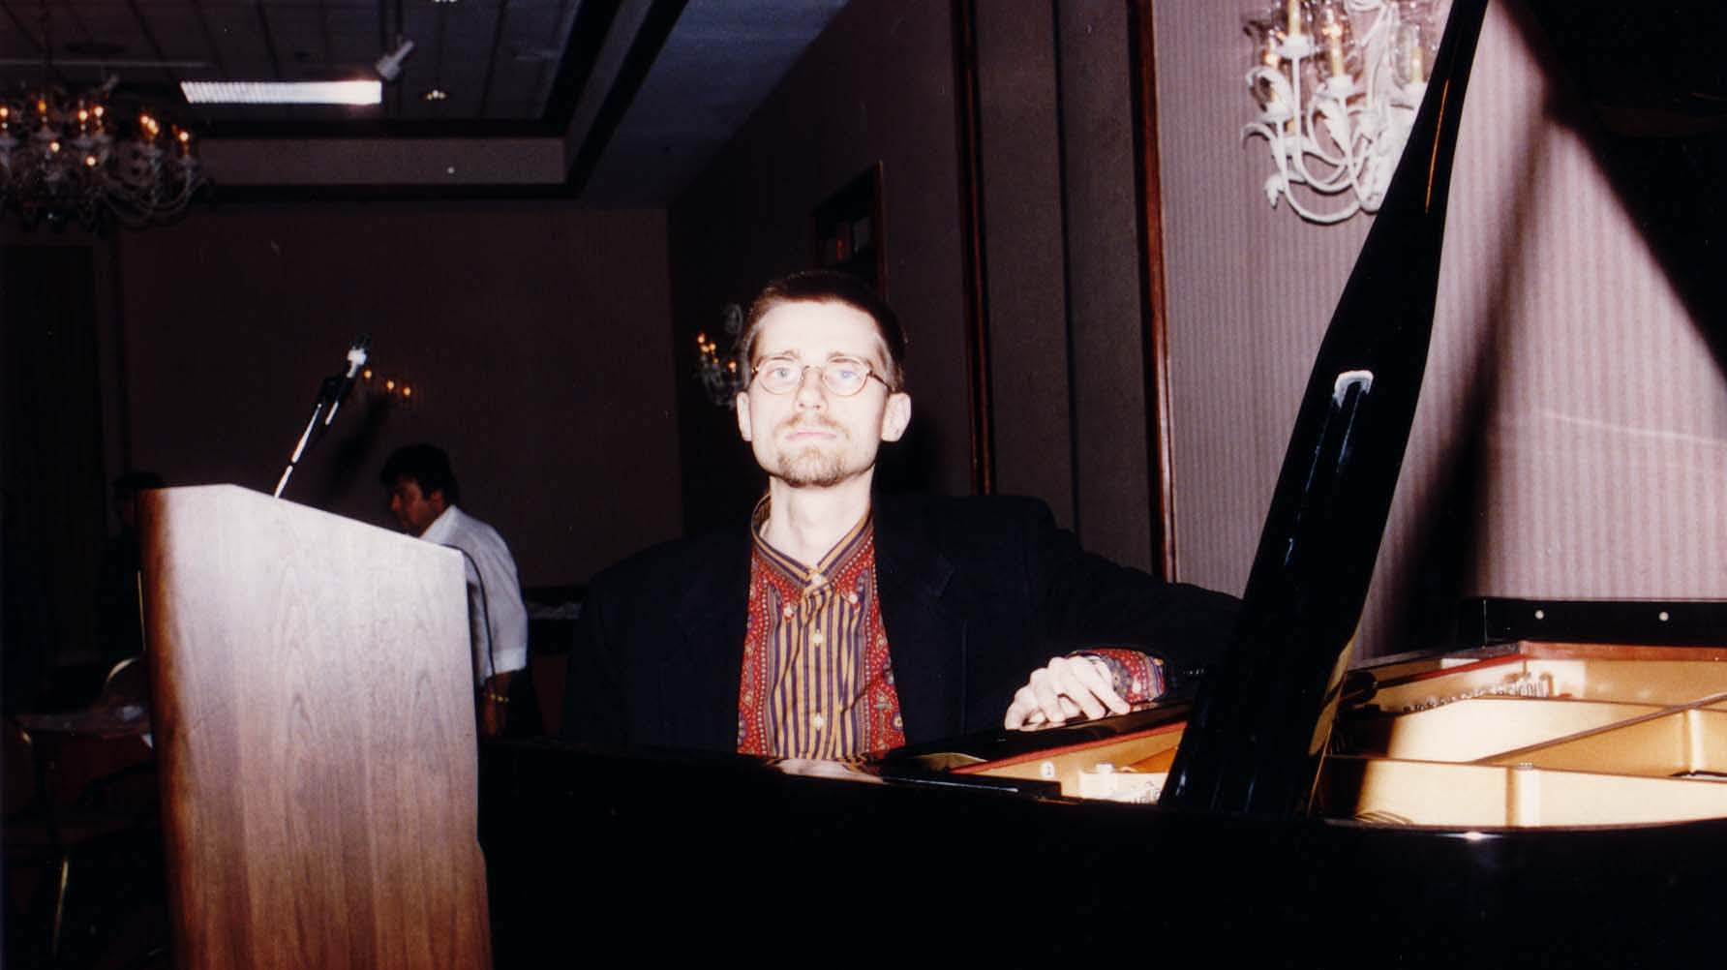
Notes:
TWG_Photo_1995_No_294__Oct_8__Leadership_Conference__Pianist_John_Stetch
See 1995 Summer TWG NEWS, page 5, for event announcement and October TWG NEWS, page 12, for event coverage

Slide 20
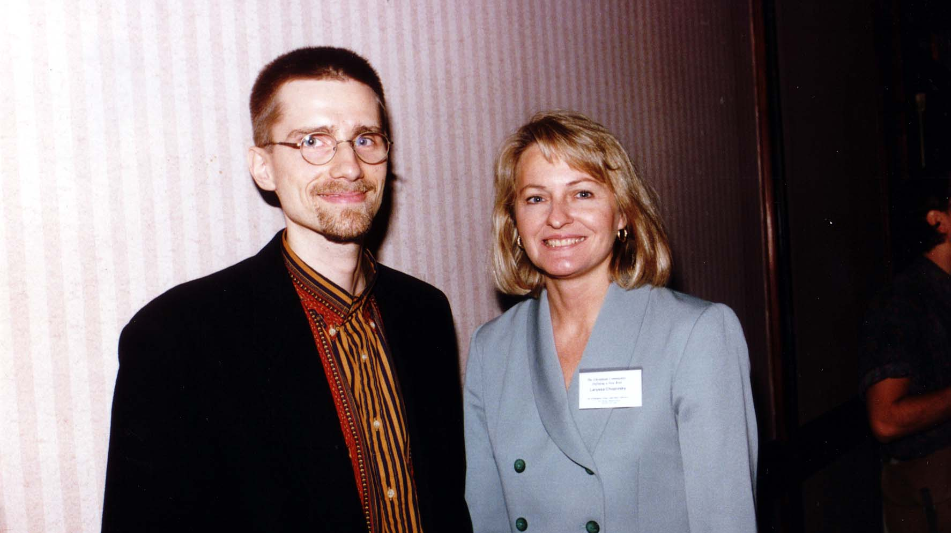
Notes:
TWG_Photo_1995_No_533__Oct_8__Leadership_Conference__Pianist_John_Stetch__TWG_Cultural_Fund_Director_Laryssa_Lapychak_Chopivsky
See 1995 Summer TWG NEWS, page 5, for event announcement and October TWG NEWS, page 12, for event coverage

Slide 21
1995 300 TWG Events Photographs
Gen. Kostyantyn Morozov
Parliamentary Development Project: Bohdan Radejko, Markian Bilynskyj

Slide 22
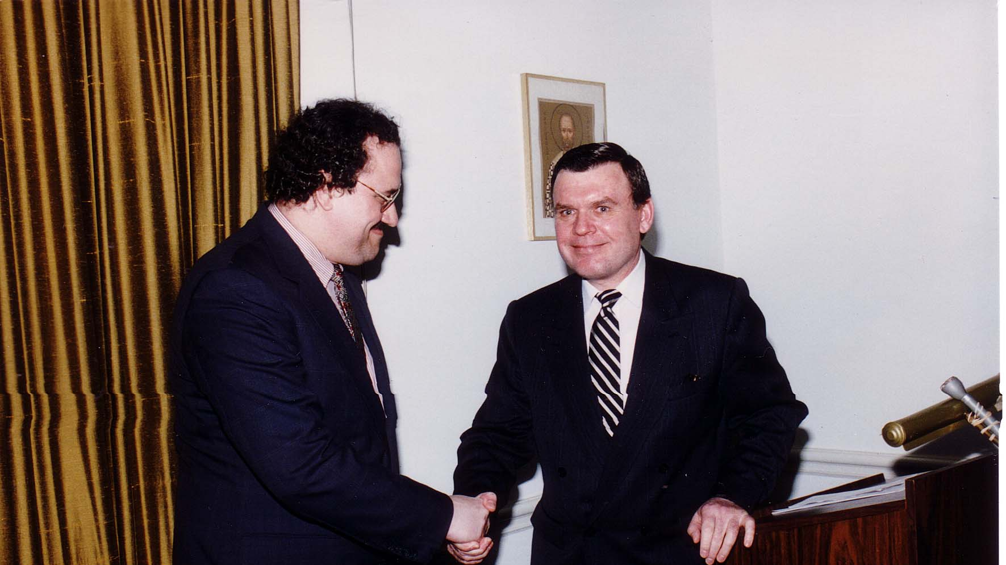
Notes:
TWG_Photo_1995_No_305__Mar_30__St_Sophia_Religious_Association__TWG_Event__General_Kostyantyn_Morozov_Addresses_Washington_Community
See 1995 February TWG NEWS, pages 1 and 11, for event announcement and March-April TWG NEWS, page 1, for event coverage

Slide 23
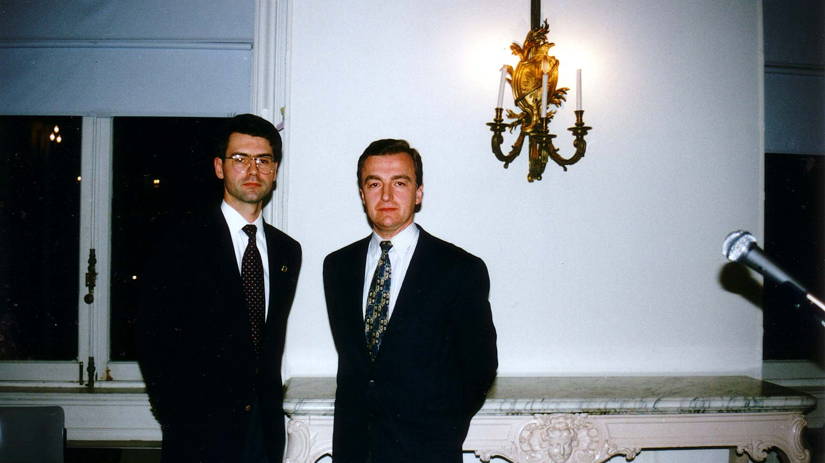
Notes:
TWG_Photo_1995_No_310__Nov_17__Freedom_House__TWG_Event__Parliamentary_Development_Project_Director_Bohdan_Radejko_and_Pylyp_Orlyk_Institute_Director_Markian_Bilynskyj
See 1996 January TWG NEWS, page 4, for event coverage

Slide 24
1995 400 Events involving TWG Members
Former Ukraine President Leonid Kravchuk, TWG President Mykola Babiak, President of Federation of Ukrainian American Business and Professional Associations Lydia Chopivsky-Benson

Slide 25
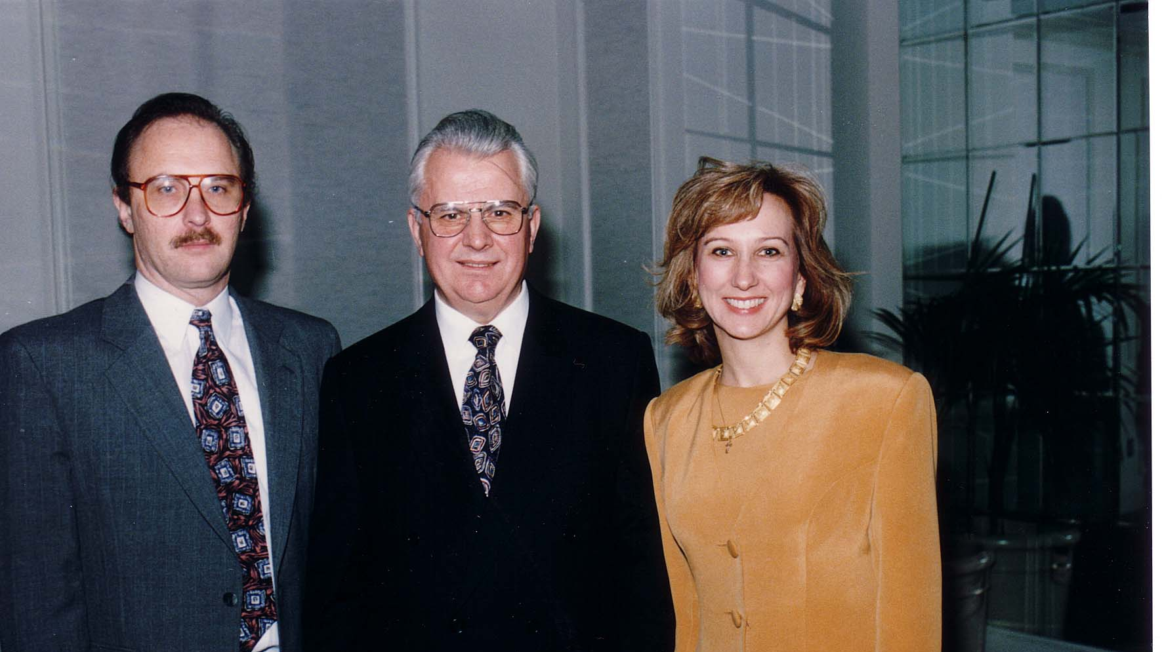
Notes:
TWG_Photo_1995_No_401__Jan_20__International_Club_of_Washington__Former_Ukraine_President_Leonid_Kravchuk__flanked_by__TWG_President_Mykola_Babiak__and__President_Federation_of_Ukr_Am_Business_and_Professional_Associations_Lydia_Chopivsky_Benson
See 1995 January TWG NEWS, page 1, for event coverage

Slide 26
See TWGCF Photo Album for 1995 Cultural Events
Shevchenko Celebration
Berkeley Chamber Chorus
Leadership Conference - John Stetch
Juliana Osinchuk

