Slide 1
1996 TWG Photos
October 25, 2020

Slide 2
1996 100 TWG Annual Meeting U.S. Botanic Garden Conservatory February 16
See 1996 January TWG NEWS for Annual Meeting announcement and February TWG NEWS for Annual Meeting coverage
Elected to the Board: George Masiuk – President; Marta Zielyk – Vice President; Orest Deychakiwsky - Secretary; Roman Stelmach – Treasurer; Jane Kunka - Public Relations; Michael Drabyk – Membership Director
Cultural Fund Director: Laryssa Chopivsky
Scholarship Fund: Adrian Karmazyn
Members at Large: Mykola Babiak, Taras Bazyluk, Roman Goy, Oleg Jerschkowsky, Bohdan Kantor, Maria Kulczycky, Theresa Markiv, Sonia Melnyk, Dick Murphy, Ihor Procinsky, Natalie Sluzar, Paulina Kotlyar Smith, Maria Zmurkewycz
Auditor: Andrew Charchalis
TWG NEWS Editor: Yaro Bihun

Slide 3
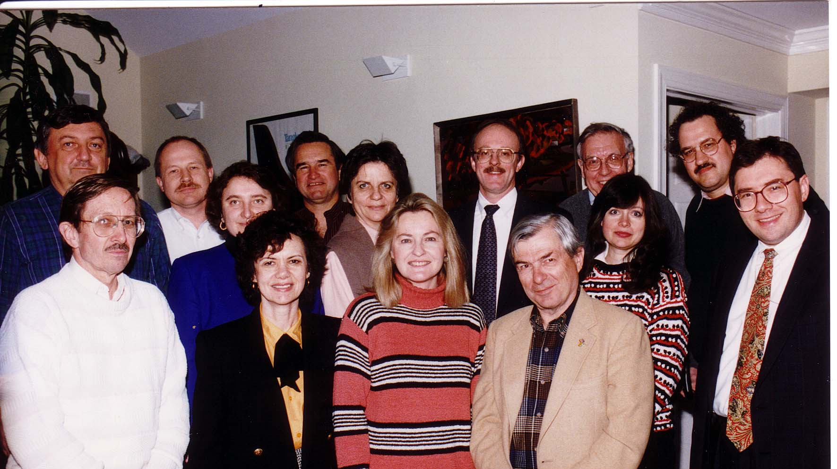
Notes:
TWG_Photo_1996_No_102_1__First_Board_Meeting__1st_Row__Ihor_Procinsky__Natalie_Sluzar__Laryssa_Chopivsky__Oleg_Jerschkowsky__2nd_Row__Sonia_Melnyk__Maria_Kulczycky__Teresa_Markiw__Taras_Bazyluk
See 1996 February TWG NEWS, page 1, for article on TWG Annual Meeting and first Board Meeting

Slide 4
Notes:
TWG_Photo_1996_No_102_2__First_Board_Meeting__3rd_Row__Yaro_Bihun__Roman_Stelmach__Roman_Goy__Orest_Deychakiwsky__Dick_Murphy__TWG_President_George_Masiuk
See 1996 February TWG NEWS, page 1, for article on TWG Annual Meeting and first Board Meeting

Slide 5
1996 200 TWG Leadership Conference Key Bridge Marriott, Rosslyn Virginia October 11-13 Photographs
See Leadership Conference Announcement in 1996 March-April TWG NEWS, page 6
See Leadership Conference Planning in 1996 July-August, TWG NEWS, page 1, and September TWG NEWS, page 1
See TWG_1996_Leadership_Conference_Booklet for Conference Program and Speaker Biographies
See 1996 October-November TWG NEWS for Leadership Conference Coverage
See TWG Leadership Conference coverage by The Ukrainian Weekly: The_Ukrainian_Weekly_1996-42

Slide 6
1996 201 TWG Leadership Conference Ukrainian Embassy Reception October 11 Photographs
Strobe Talbott, John Deutch
Strobe Talbott, Melanne Verveer
John Deutch, Maria Shcherbak, Yuli Vorontsov
John Deutch, TWG President George Masiuk
Yaroslav Voitko
Andrij Masiuk, Juliana Osinchuk
Michael Waris, Mary Waris

Slide 7
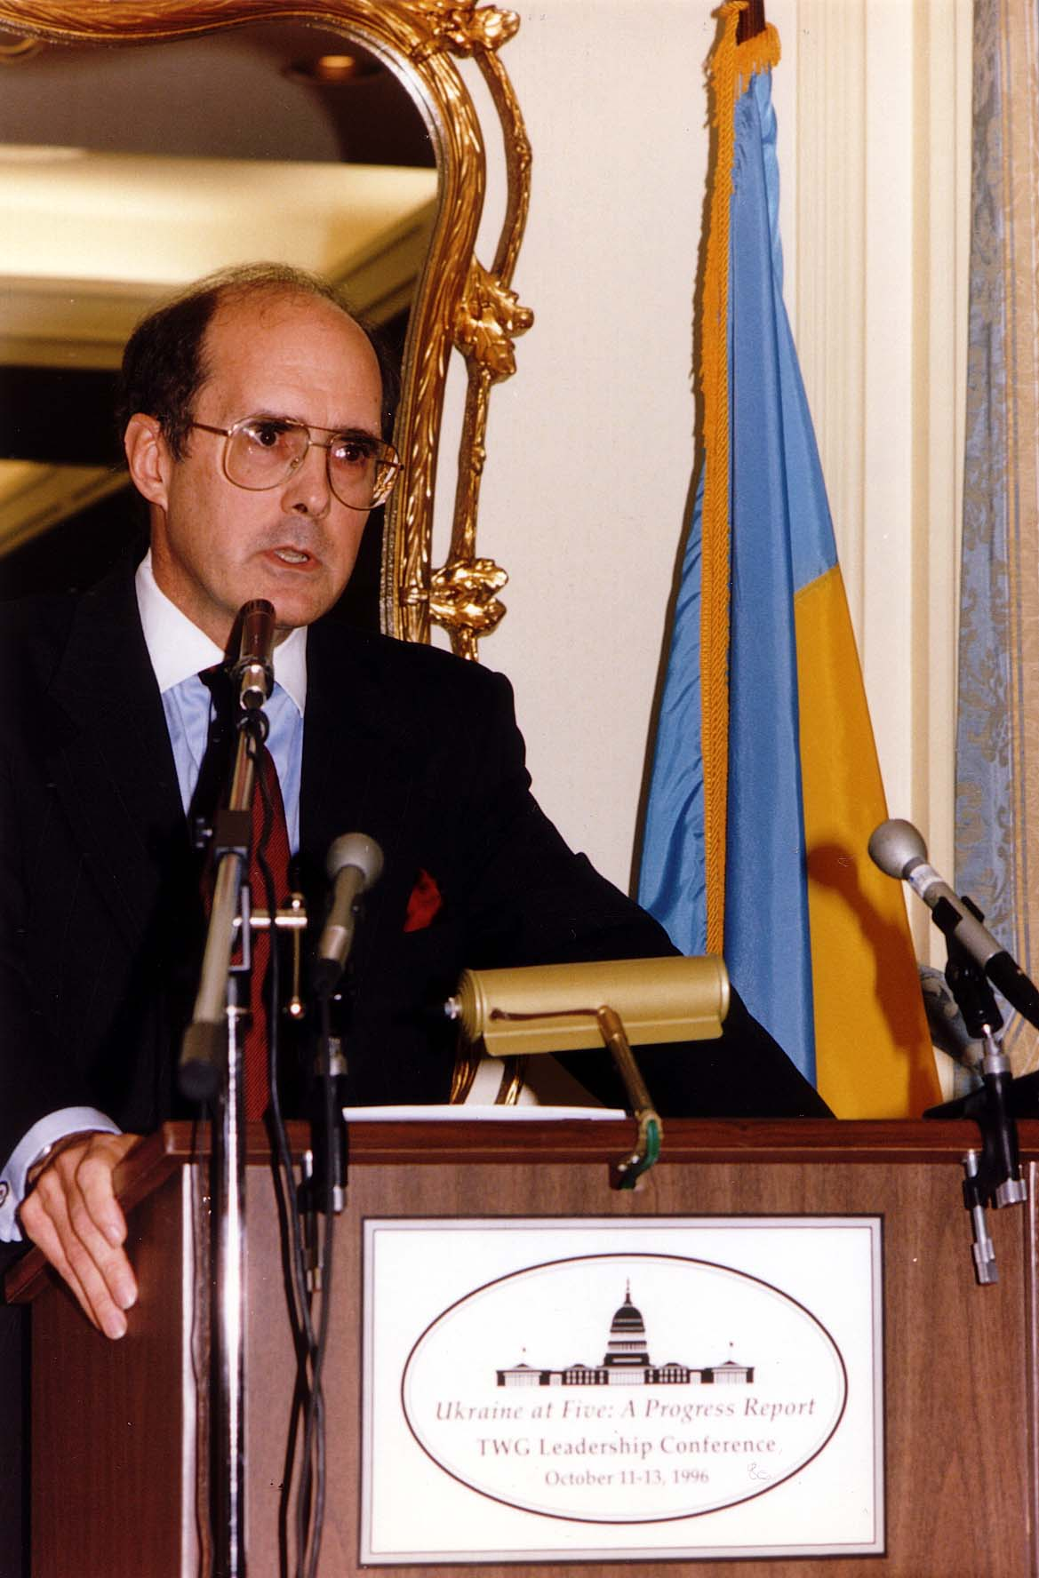
Notes:
TWG_Photo_1996_No_202__Oct_11__Ukrainian_Embassy__Leadership_Conference_Reception__Deputy_Secretary_of_State_Strobe_Talbott__Podium
See 1996 September TWG NEWS for event announcement and October-November TWG NEWS, page 3, for event coverage and page 4 for transcript of Strobe Talbott’s address

Slide 8
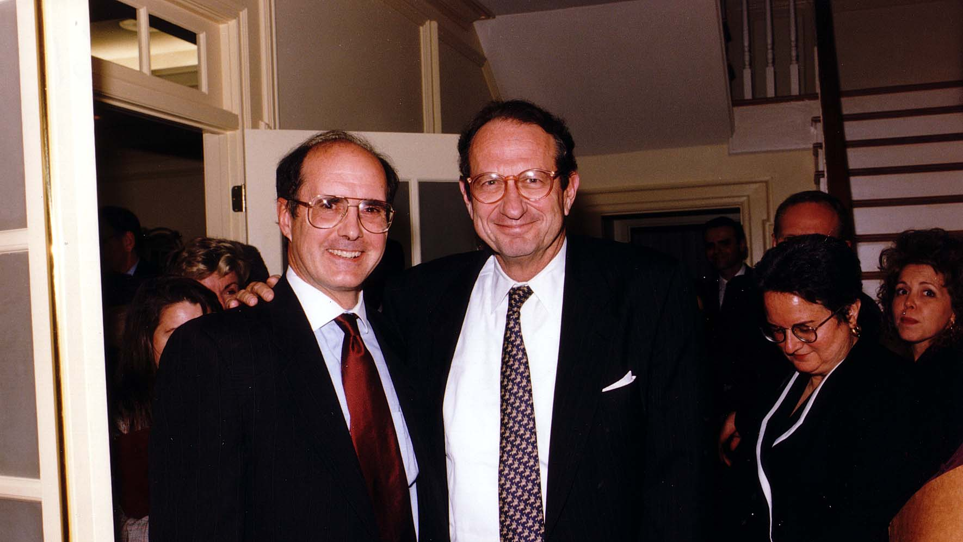
Notes:
TWG_Photo_1996_No_204__Oct_11__Ukrainian_Embassy__Leadership_Conference_Reception__Deputy_Secretary_of_State_Strobe_Talbott__Director_Central_Intelligence_John_Deutch__Library_of_Congress_Program_Coordinator_Oxana_Horodecka
See 1996 October-November TWG NEWS

Slide 9
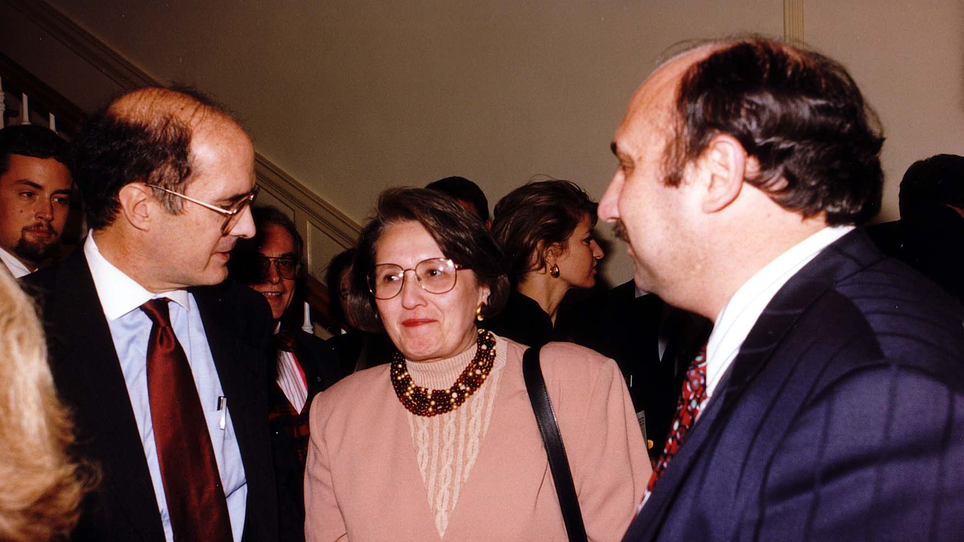
Notes:
TWG_Photo_1996_No_205__Oct_11__Ukrainian_Embassy__Leadership_Conference_Reception__Deputy_Secretary_of_State_Strobe_Talbott__Assistant_to_President_and_Chief_of_Staff_to_the_First_Lady_Melanne_Verveer
See 1996 October-November TWG NEWS

Slide 10
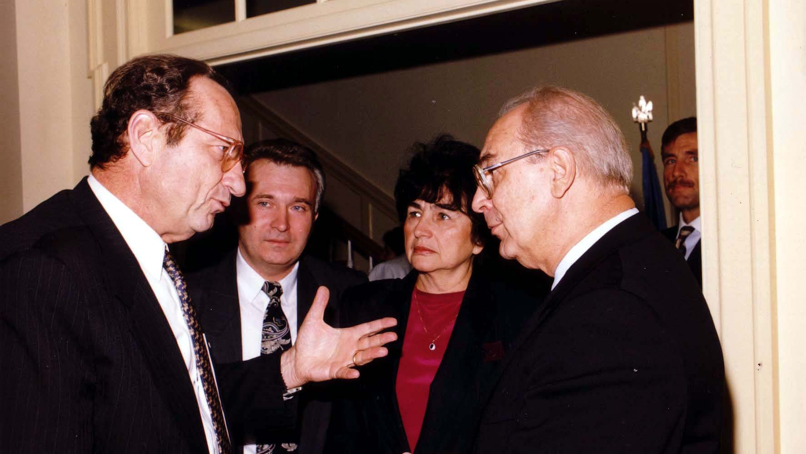
Notes:
TWG_Photo_1996_No_206__Oct_11__Ukrainain_Embassy__Leadership_Conference_Reception__Director_Central_Intelligence_John_Deutch__Unknown__Maria_Shcherbak__Russian_Ambassador_Yuli_Vorontsov
See 1996 October-November TWG NEWS

Slide 11
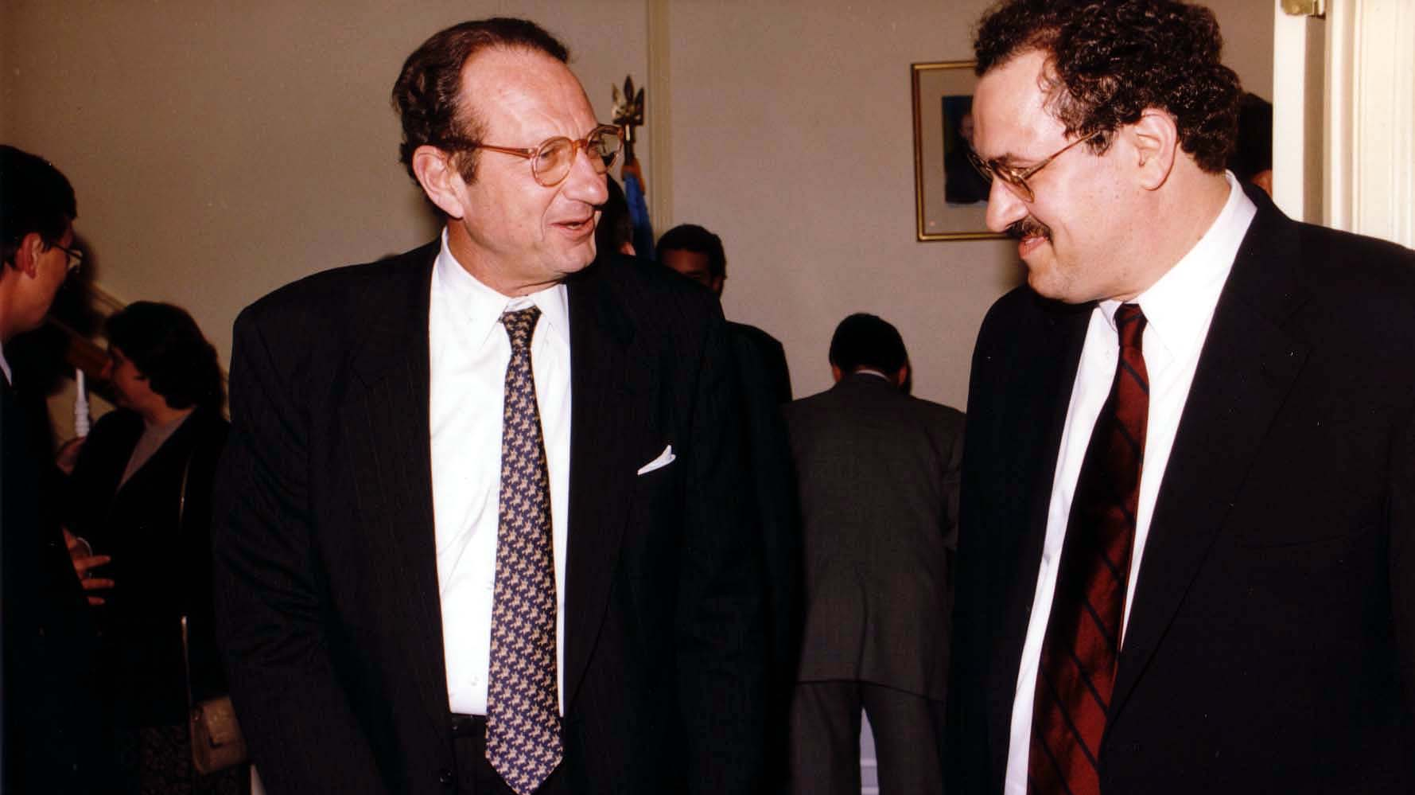
Notes:
TWG_Photo_1996_No_207__Oct_11__Ukrainian_Embassy__Leadership_Conference_Reception__Director_Central_Intelligence_John_Deutch__TWG_President_George_Masiuk
See 1996 October-November TWG NEWS

Slide 12
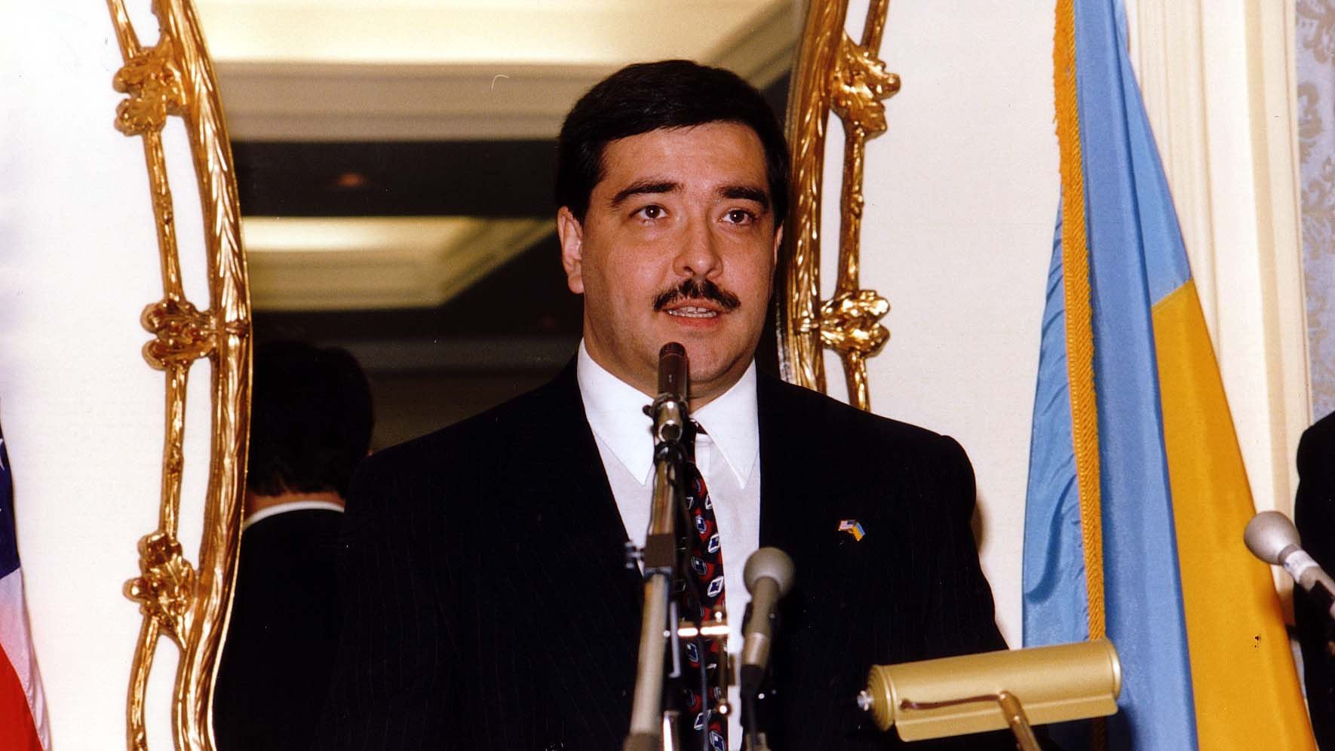
Notes:
TWG_Photo_1996_No_208__Oct_11__Ukrainian_Embassy__Leadership_Conference_Reception__First_Secretary_Yaroslav_Voitko
See 1996 October-November TWG NEWS

Slide 13
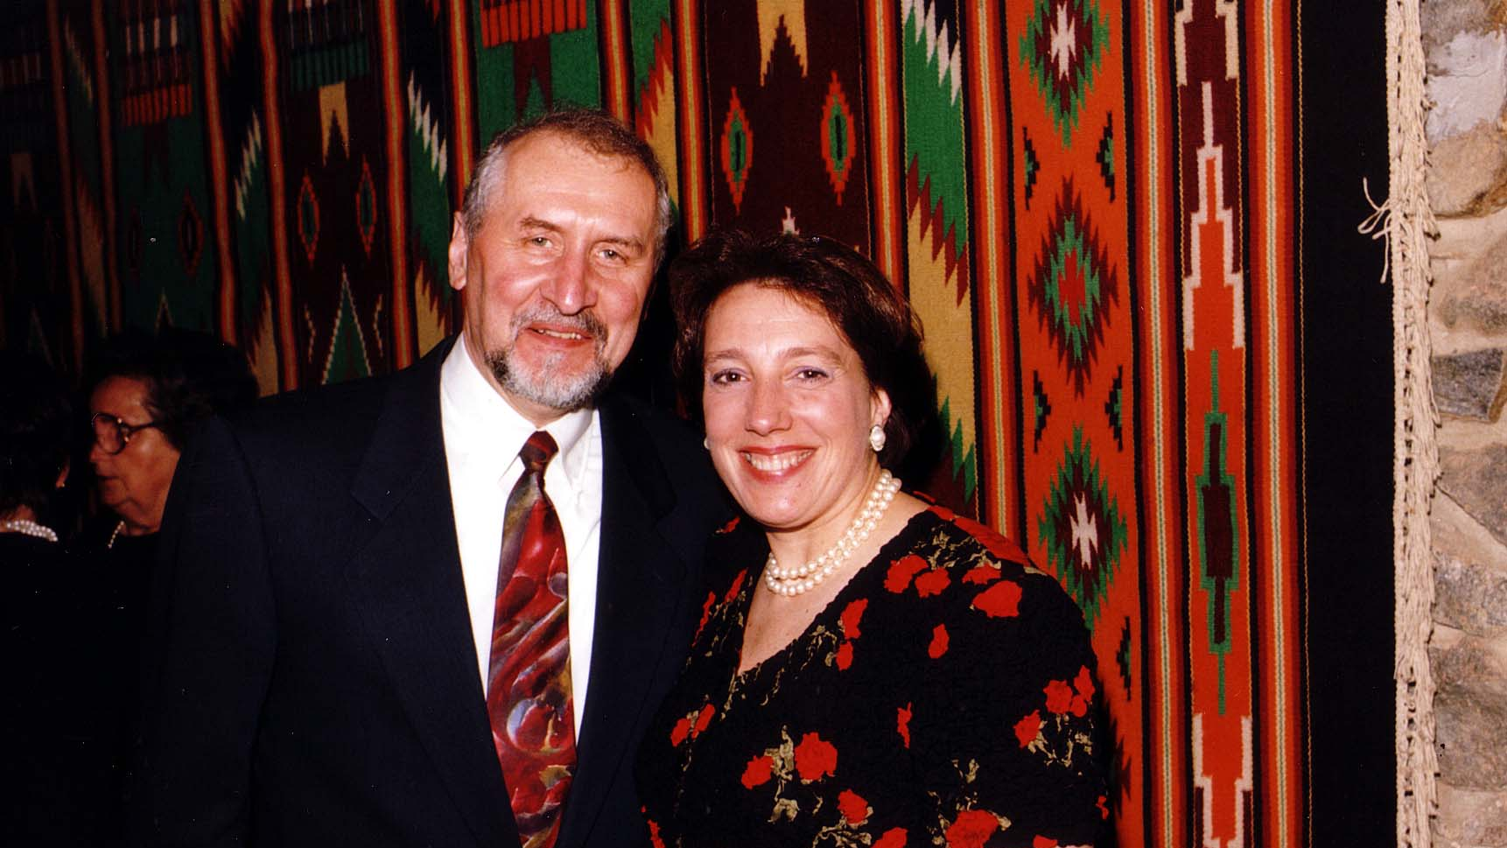
Notes:
TWG_Photo_1996_No_209__Oct_11__Ukrainian_Embassy__Leadership_Conference_Reception__International_Management_Institute_(Kyiv)_Director_Andrij_Masiuk__Pianist_Juliana_Osinchuk
See 1996 October-November TWG NEWS

Slide 14
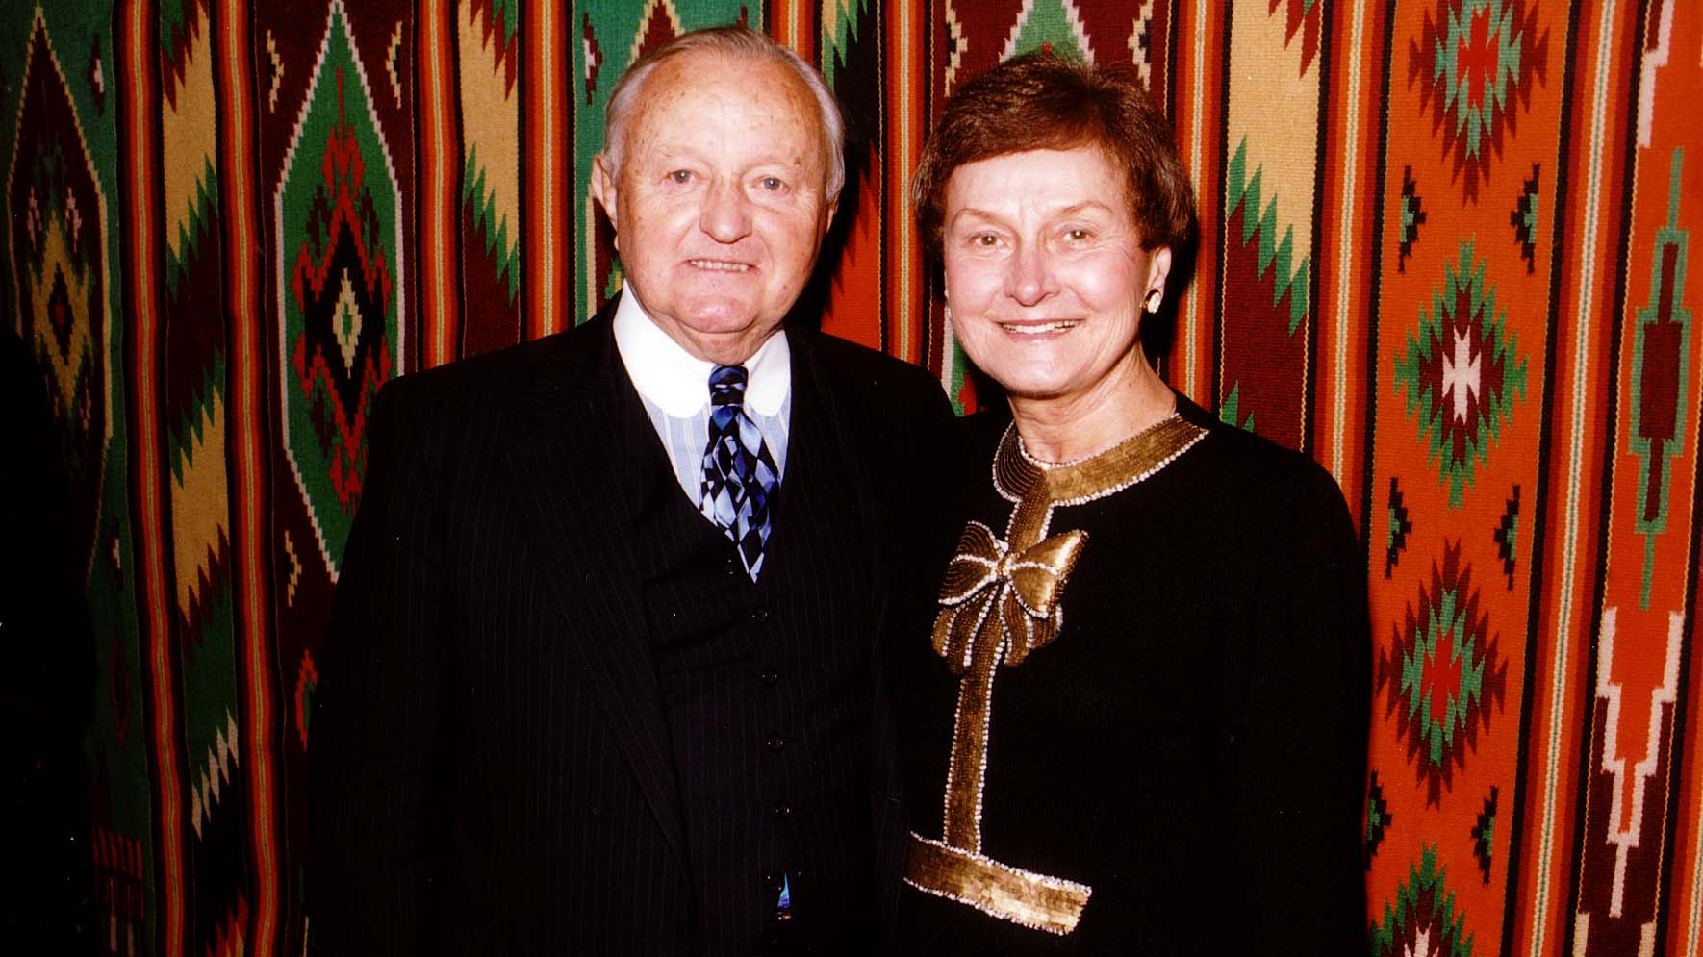
Notes:
TWG_Photo_1996_No_209.1__Oct_11__Ukrainian_Embassy_TWG_Leadership_Conference_Reception__Attorney_Michael_Waris_and_Mary_Waris
See 1996 October-November TWG NEWS

Slide 15
1996 210 TWG Leadership Conference Opening Address October 12 Photograph
Oleksander Volkov

Slide 16
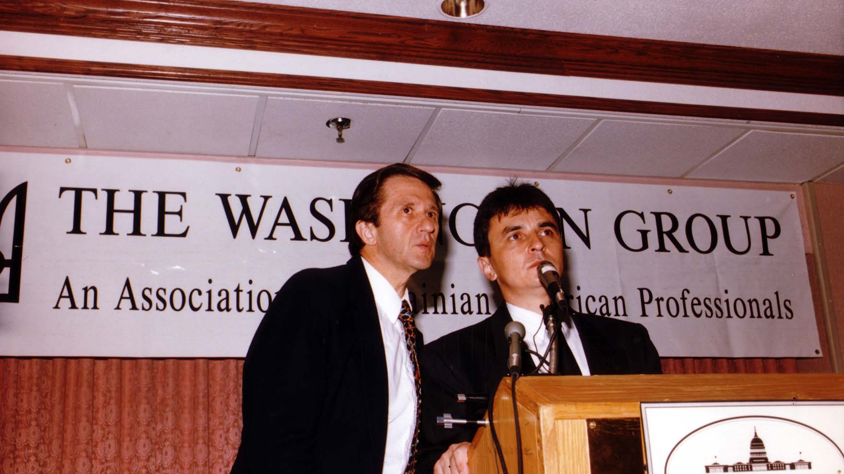
Notes:
TWG_Photo_1996_No_216__Oct_12__Leadership_Conference__Interpreter_George_Sajewych__Ukrainian_Supreme_Court_Justice_Olexander_Volkov
See 1996 October-November TWG NEWS, page 5, for event coverage

Slide 17
1996 220 TWG Leadership Conference Luncheon October 12 Photograph
Jeane Kirkpatrick
Jane Kunka, Jeane Kirkpatrick, TWG President George Masiuk
Dr. Mykola Deychakiwsky Sr, Adrian Karmazyn

Slide 18
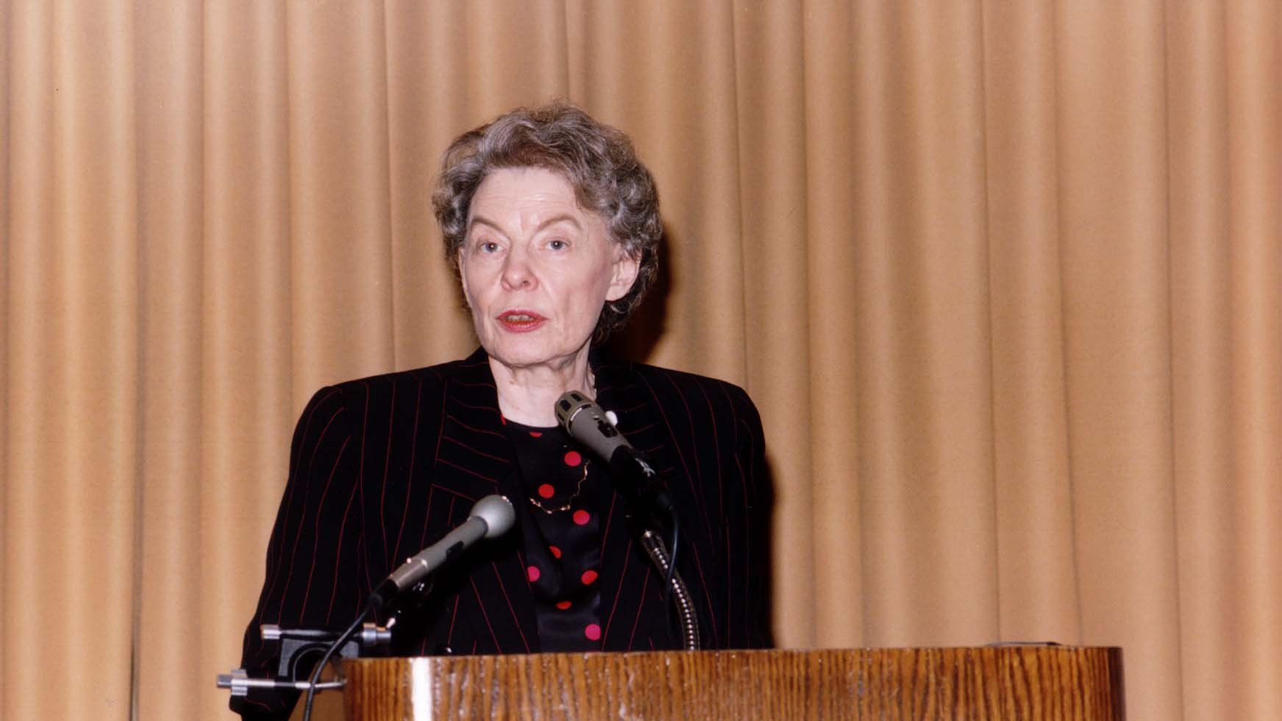
Notes:
TWG_Photo_1996_No_221__Oct_12__Leadership_Conference__Former_UN_Ambassador_and_Dole_Campaign_Representative_Jeane_Kirkpatrick
See 1996 October-November TWG NEWS, page 1, for event coverage and page 6 for transcript of Jeanne Kirkpatrick’s address

Slide 19
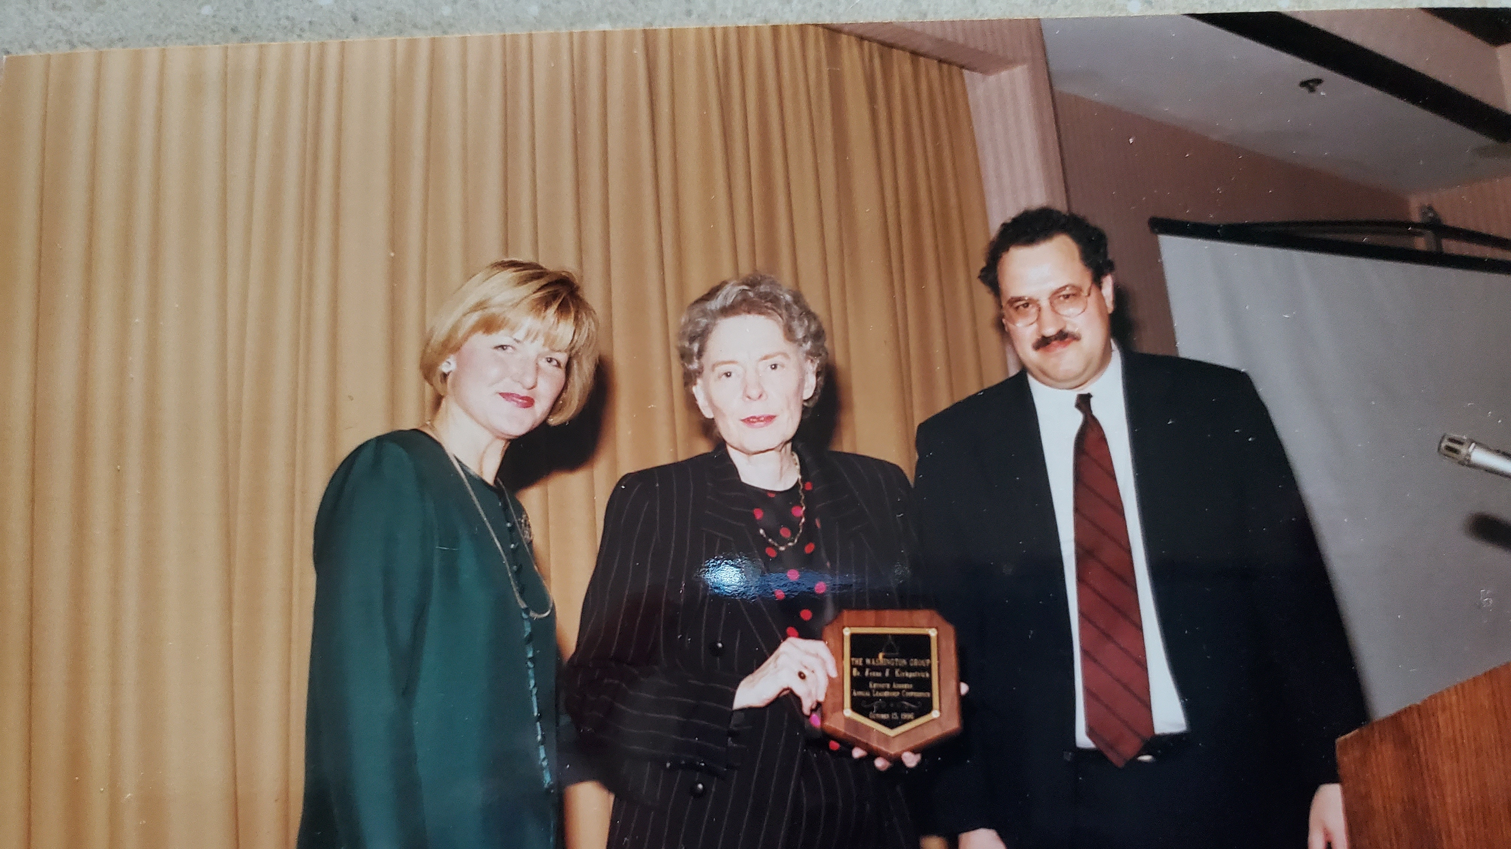
Notes:
TWG_Photo_1996_No_221__Oct_12__Leadership_Conference__Former_UN_Ambassador_and_Dole_Campaign_Representative_Jeane_Kirkpatrick_flanked_by_Public_Relations_Director_Jane_Kunka_and_TWG_President_George_Masiuk
See 1996 October-November TWG NEWS, page 1, for event coverage and page 6 for transcript of Jeanne Kirkpatrick’s address

Slide 20
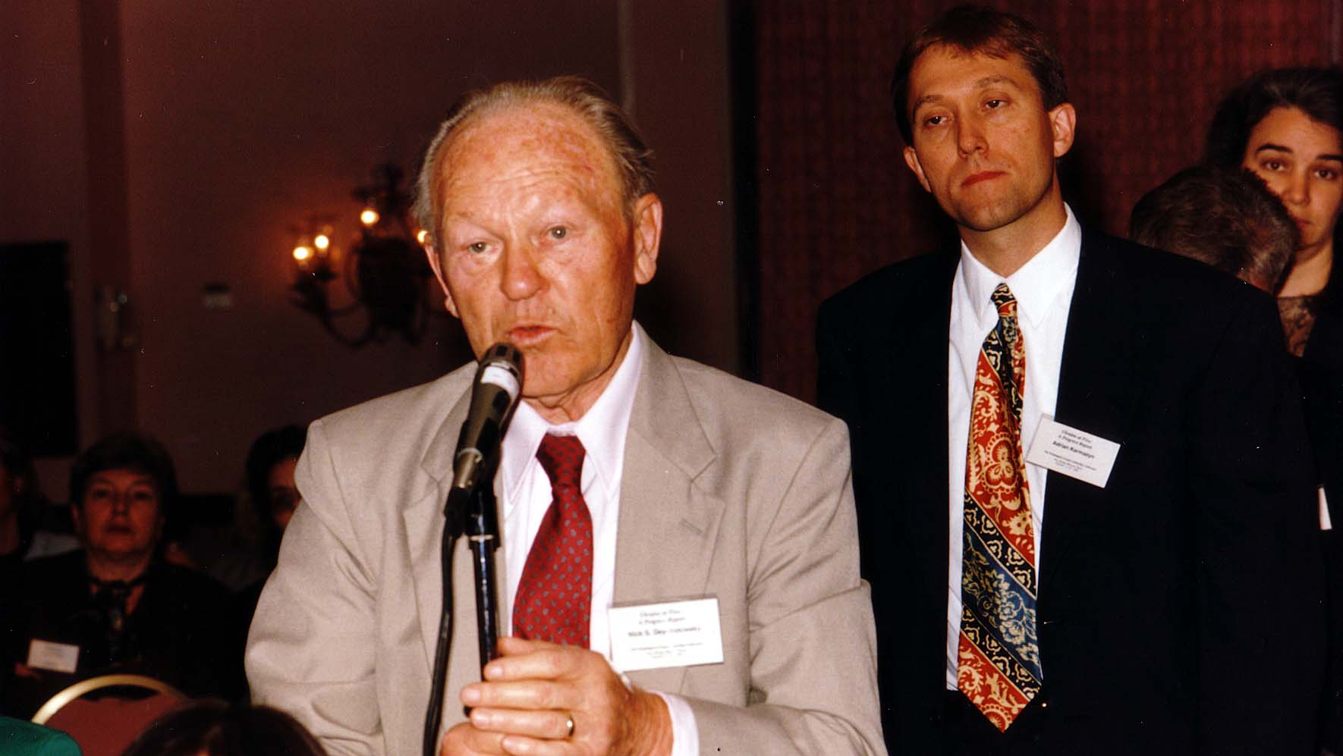
Notes:
TWG_Photo_1996_No_223__Oct_12__Leadership_Conference__Jeane_Kirkpatrick_speech__Dr_Mykola_Deychakiwsky_Sr__waiting_his_turn_Voice_of_America_International_Broadcaster_Adrian_Karmazyn
See 1996 October-November TWG NEWS, page 1, for event coverage and page 6 for transcript of Jeanne Kirkpatrick’s address

Slide 21
1996 230 TWG Leadership Conference Banquet October 12 Photographs
Hobart Earle, Cultural Fund Director Laryssa Chopivsky
Maria Shcherbak, Hobart Earle, Margarita Hewko, Vasyl Zorya
Michael Waris, Mary Waris

Slide 22
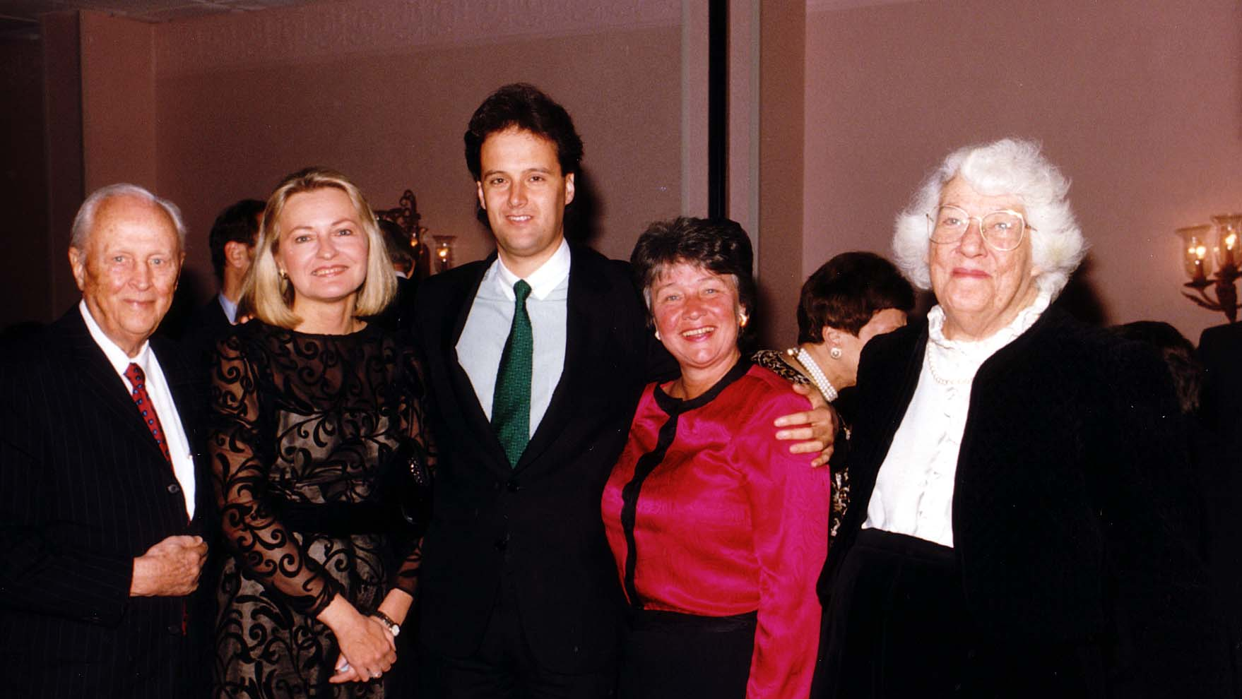
Notes:
TWG_Photo_1996_No_234__Oct_12__Leadership_Conference_Banquet___Hobart_Earle_Recipient_of_TWG's_Friend_of_Ukraine_Award___with_his_parents_sister_and_Cultural_Fund_Director_Laryssa_Chopivsky
See 1996 October-November TWG NEWS, page 13, for event coverage

Slide 23
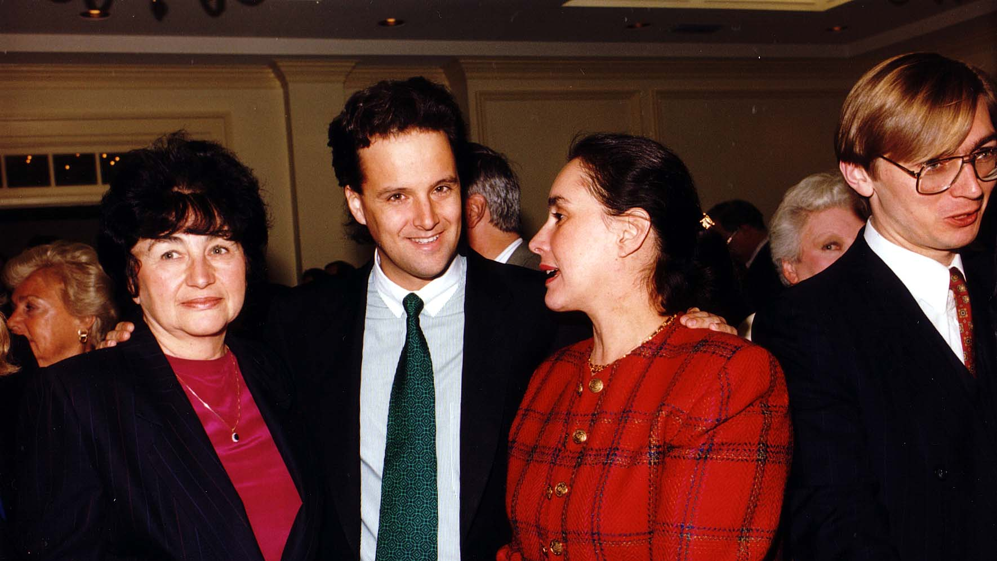
Notes:
TWG_Photo_1996_No_235__Oct_12__Leadership_Conference_Banquet__Maria_Shcherbak__Odessa_Philharmonic_Conductor_Hobart_Earle__Margarita_Hewko__Ukrainian_Embassy_Secretary_for_Culture_Vasyl_Zorya
See 1996 October-November TWG NEWS, page 13, for event coverage

Slide 24
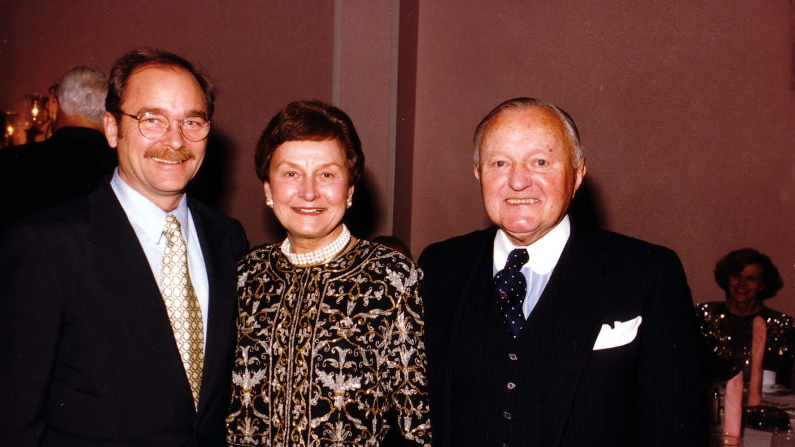
Notes:
TWG_Photo_1996_No_239__Oct_12__Leadership_Conference_Banquet__Stephen_Holder_Mary_and_Michael_Waris

Slide 25
1996 240 TWG Leadership Conference Ukraine's Geostrategic Position Panel October 12 Photograph
Volodymyr Belashov, Ilya Prizel, Amb. Roman Popadiuk, Sherman Garnett
Ilya Prizel

Slide 26
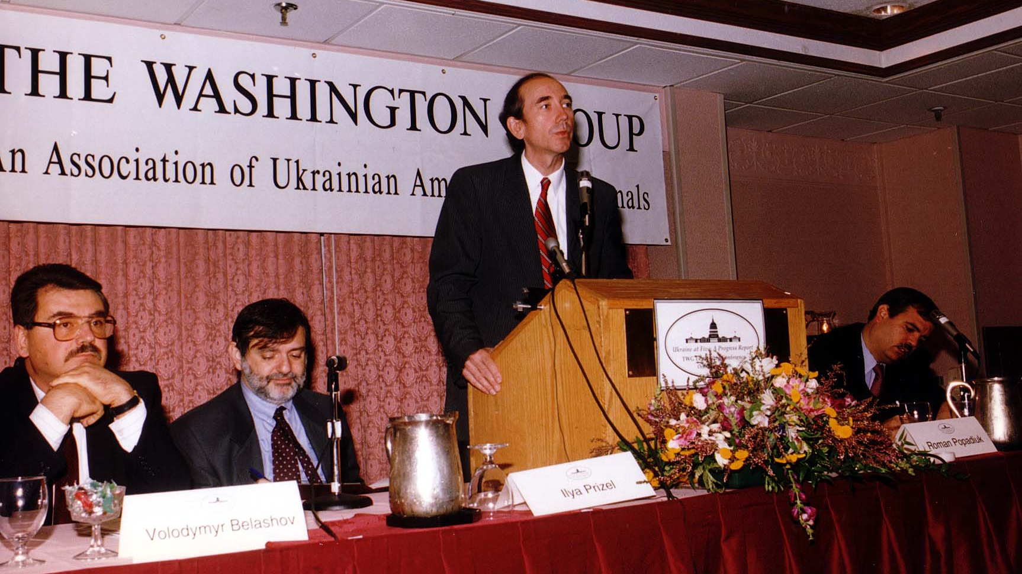
Notes:
TWG_Photo_1996_No_241_Oct_12__Leadership_Conference__Ukraine_Geostrategic_Position_Panel__Political_Secretary_Volodymyr_Belashov__Professor_Ilya_Prizel__US_First_Ambassador_to_Ukraine_Roman_Popadiuk__Carnegie_Endowment_Senior_Associate_Sherman_Garnett
See 1996 October-November TWG NEWS, page 7, for event coverage

Slide 27
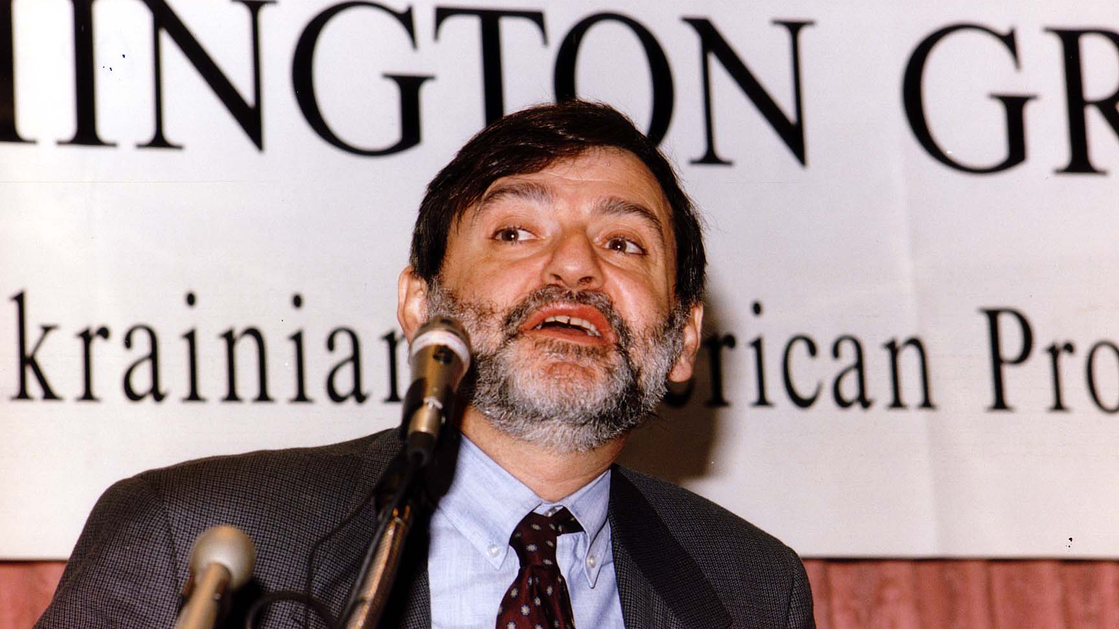
Notes:
TWG_Photo_1996_No_242__Oct_12__Leadership_Conference__Ukraine_Geostrategic_Position_Panel__Professor_Ilya_Prizel
See 1996 October-November TWG NEWS, page 7, for event coverage

Slide 28
1996 250 TWG Leadership Conference Economic Reform Panel October 12 Photographs
Yuriy Yakusha
Laryssa Chopivsky, Kathryn Karol, Andrij Masiuk
Andrij Masiuk

Slide 29
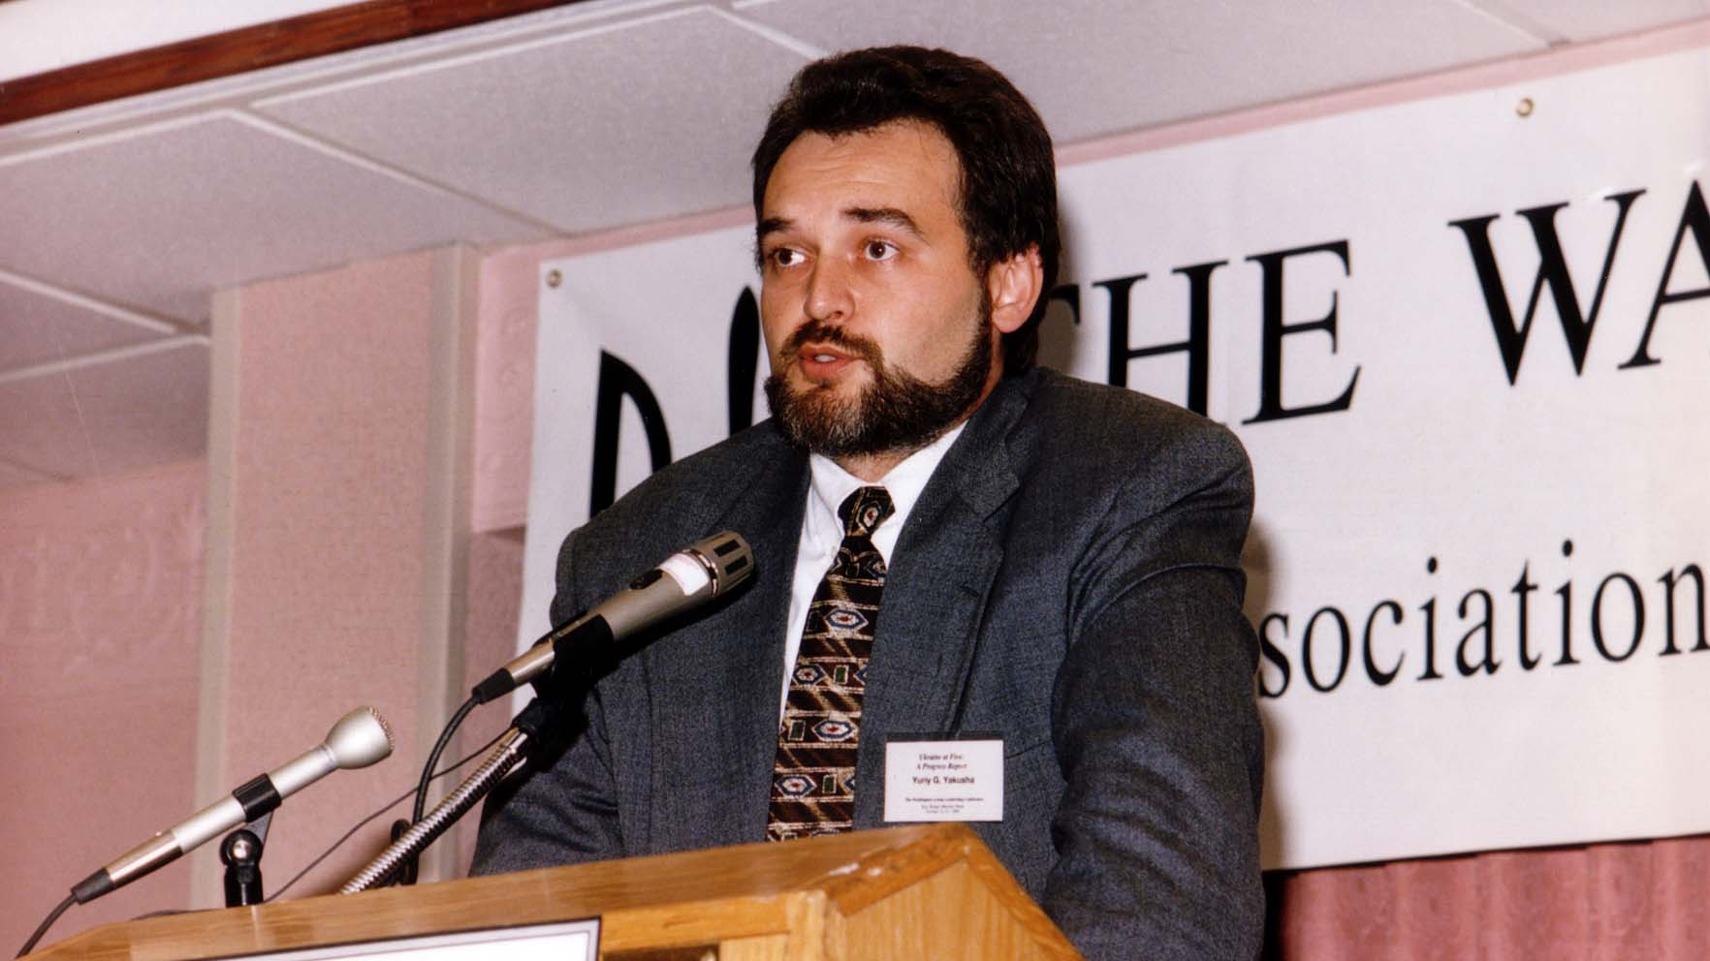
Notes:
TWG_Photo_1996_No_251__Oct_12__Leadership_Conference__Economic_Reform_Panel__Alternate_Executive_Director_For_Ukraine_at_IMF_Yuriy_Yakusha
See 1996 October-November TWG NEWS, page 8, for event coverage

Slide 30
Notes:
TWG_Photo_1996_No_252__Oct_12__Leadership_Conference__TWGCF_Director_Laryssa_Chopivsky___Economic_Reform_Panelists:__Eli_Lilly_Director_of_International_Operations_Kathryn_Karol__Director_General_International_Management_Institute_Andrij_Masiuk
See 1996 October-November TWG NEWS, page 8, for Economic Reform Panel coverage

Slide 31
1996 260 TWG Leadership Conference Democracy Building Panel October 12 Photographs
Ross Chomiak

Slide 32
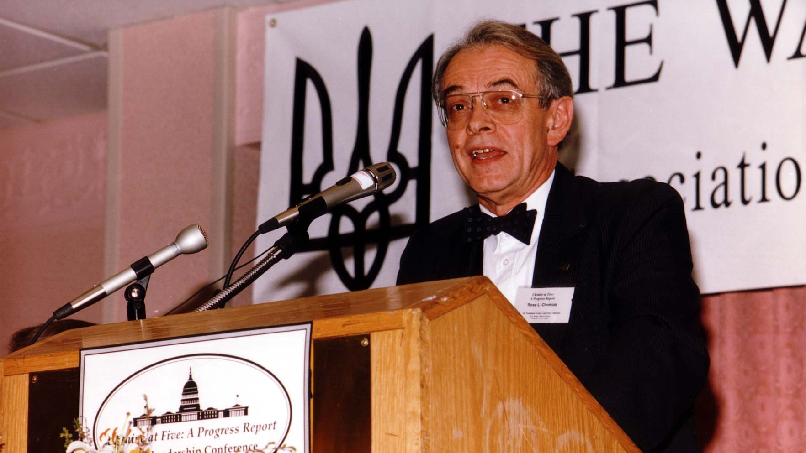
Notes:
TWG_Photo_1996_No_261__Oct_12__Leadership_Conference__Progress_in_Building_Democracy_Panel__Ross_Chomiak
See 1996 October-November TWG NEWS, page 9, for event coverage

Slide 33
1996 270 TWG Leadership Conference Health Care Reform Panel October 12 Photographs
Roman Goy

Slide 34
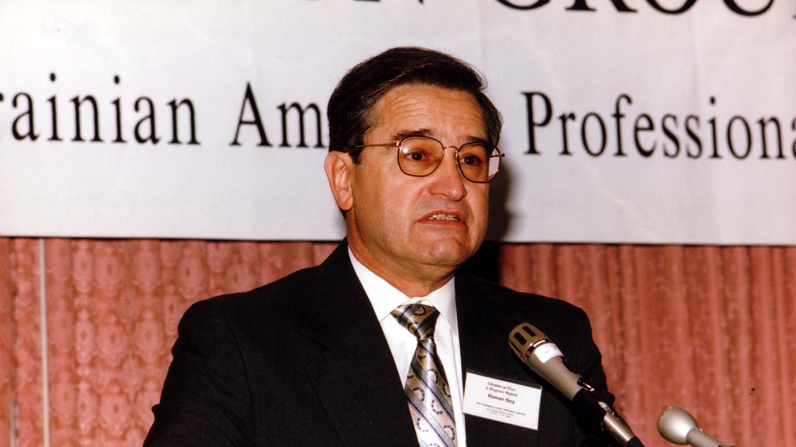
Notes:
TWG_Photo_1996_No_271__Oct_12__Leadership_Conference__Health_Care_Reform_Panel__Dr_Roman_Goy
See 1996 October-November TWG NEWS, page 10, for event coverage

Slide 35
1996 280 TWG Leadership Conference Energy Panel October 12 Photographs
Carlos Pascual, Laszlo Lovei, Markian Bilynskyj, Robert Archer

Slide 36
Notes:
TWG_Photo_1996_No_281__Oct_12__LC__Energy_Panel__Director_for_Russian_Ukrainian_and_Eurasian_affairs_at_NSC_Carlos_Pascual__World_Bank_Economist_for_Infrastructure_Laszlo_Lovei__Director_Pylyp_Orlyk_Institute_Markian_Bilynsky__USAID_Robert_Archer
See 1996 October-November TWG NEWS, page 11, for event coverage

Slide 37
1996 290 TWG Leadership Conference Sunday Brunch October 13 Photographs
Yara Arts Group: Tom Lee, Cecelia Arana, Katie Takahashi, Olga Shuhan

Slide 38
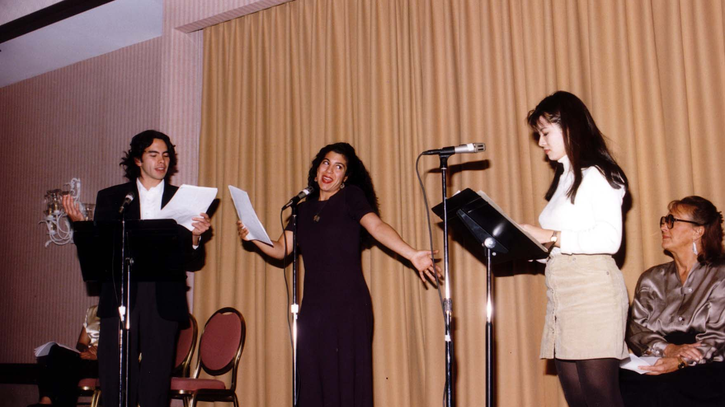
Notes:
TWG_Photo_1996_No_292__Oct_13__Leadership_Conference__Yara_Group__"Tale_of_Paper_Lantern"__Tom_Lee__Cecelia_Arana__Katie_Takahashi__Olga_Shuhan
See 1996 October-November TWG NEWS, page 12, for event coverage

Slide 39
1996 300 TWG Events Photographs
Ukrainian Scientists Reception: George Gamota, Vitalij Pokhodenko, Mykola Honcharenko, Marta Cehelsky, TWG President George Masiuk, Victor Pylypenko, Volodymyr Andreev, Slobodyanyuk, Theodor Kostiuk, Volodymyr Savitsky
Washington Post Correspondent: James Rupert
Shcherbak, Kruger, Kuchinsky

Slide 40
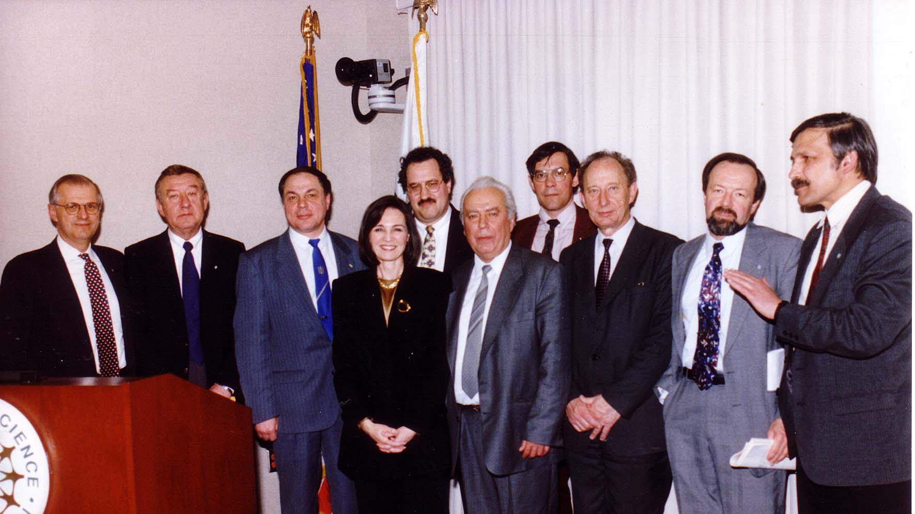
Notes:
TWG_Photo_1996_No_310__Apr_6__National_Science_Foundation_Arlington__Ukrainian_Scientists__George_Gamota__Vitaliy_Pokhodenko__Mykola_Honcharenko__Marta_Cehelsky__TWG_President_George_Masiuk__Victor_Pylypenko__Volodymyr_Andreev__Slobodyanyuk__Theodor_Kostiuk__Volodymyr_Savitsky
See 1996 March-April TWG NEWS, page 3, for event coverage

Slide 41
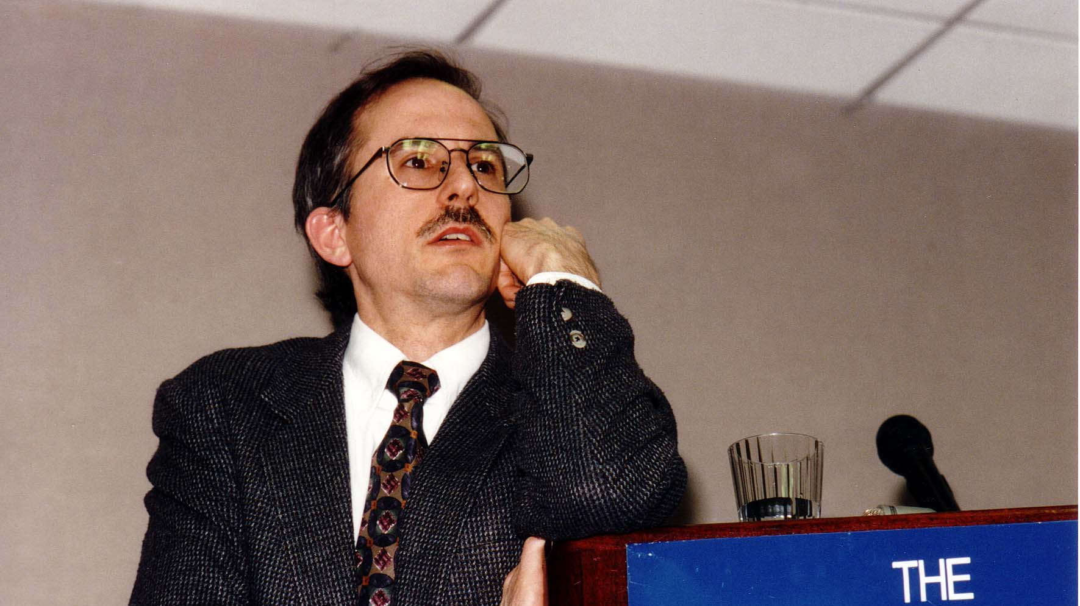
Notes:
TWG_Photo_1996_No_320__Jan_19__Johns_Hopkins_University_School_for_Advanced_International_Studies_(SAIS)__Washington_Post_Kyiv_Correspondent_James_Rupert
See 1996 January TWG NEWS, page 1, for event coverage

Slide 42
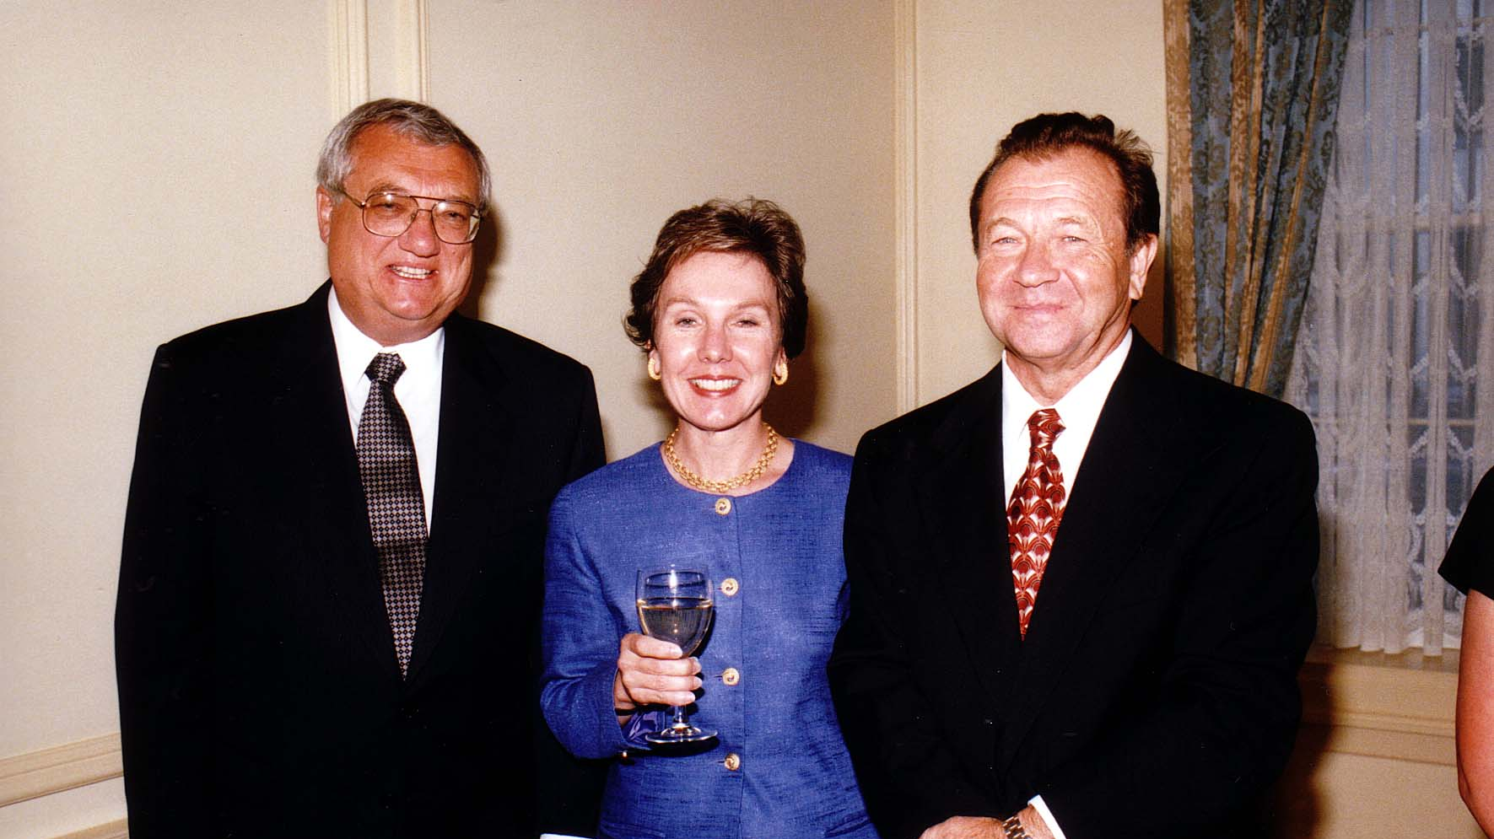
Notes:
TWG_Photo_1996_No_390_Ukrainian_Embassy__Ambassador_Yuriy_Shcherbak__Public_Affairs_Officer_Mary_Kruger__Chargé_d'Affaires_Valeriy_Kuchinsky

Slide 43
See TWGCF Photo Album for 1996 Cultural Events
Horowitz Competition Winners
Chornobyl Commemoration Concert Reception
Chornobyl Commemoration White House Reception

