Slide 1
TWG 1997 Photos
Created October 25, 2020

Slide 2
1997 100 TWG Annual Meeting U.S. Botanic Garden Conservatory February 15 Photographs
See 1997 January TWG NEWS for Annual Meeting announcement and February TWG NEWS for Annual Meeting coverage
Elected to the Board: George Masiuk – President; Marta Zielyk – Vice President; Orysia Pylyshenko - Secretary; Roman Stelmach – Treasurer; John Kun - Public Relations; Michael Drabyk – Membership Director
Cultural Fund Director: Laryssa Chopivsky
Fellowship Fund: Adrian Karmazyn
Members at Large: Katya Bowers, Tanya Chomiak, Orest Deychakiwsky, Roman Goy, Oleg Jerschkowsky, Maria Kulczycky, Jane Kunka, Theresa Markiv, Sonia Melnyk, Dick Murphy, Ihor Procinsky, Anya Silecky, Natalie Sluzar, Maria Zmurkewycz
Auditor: Andrew Charchalis
TWG NEWS Editor: Yaro Bihun
Others in photo: Jurij Dobczansky, Ross Chomiak

Slide 3
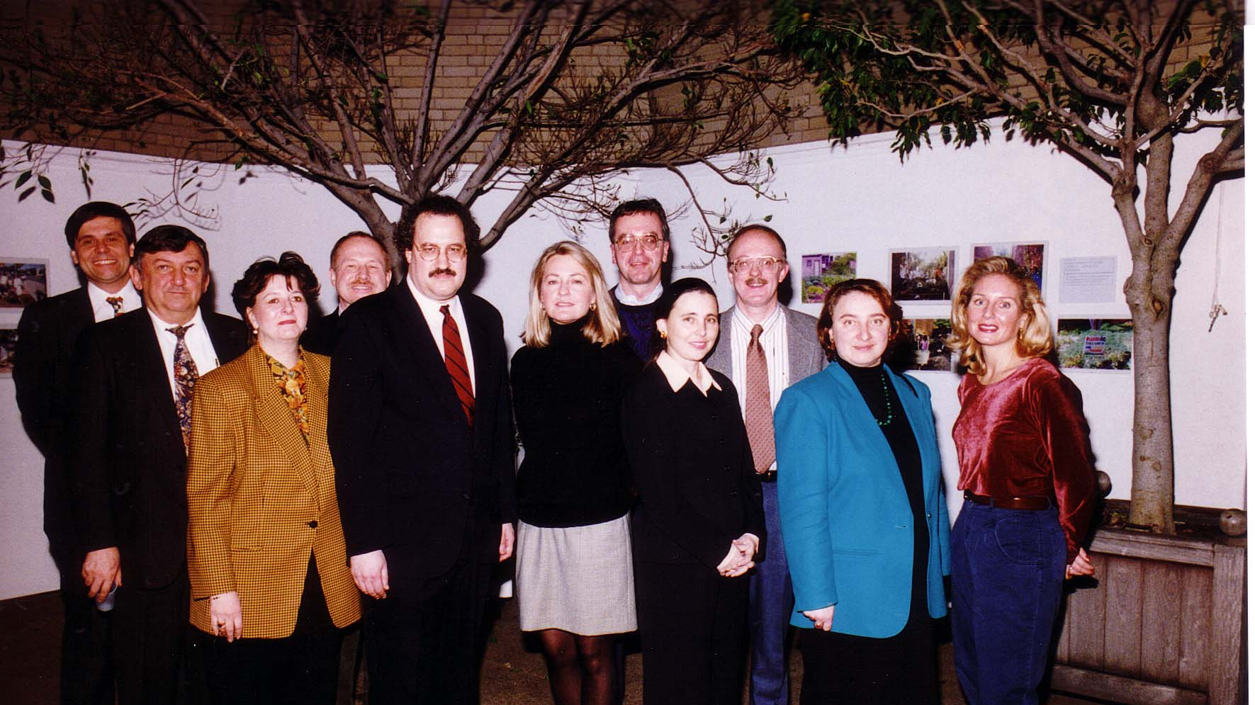
Notes:
TWG_Photo_1997_No_101_Feb_15_US_Botanic_Garden_Annual_Mtg_Mike_Drabyk_Yaro_Bihun_Marta_Zielyk_Roman_Stelmach_TWG_President_George_Masiuk_TWGCF_Director_Laryssa_Lapychak_Chopivsky_John_Kun_Orysia_Pylyshenko_Orest_Deychakiwsky_Sonia_Melnyk_Anya_Silecky
See 1997 January TWG NEWS, page 1, for event announcement, and February TWG NEWS, page 1, for event coverage

Slide 4
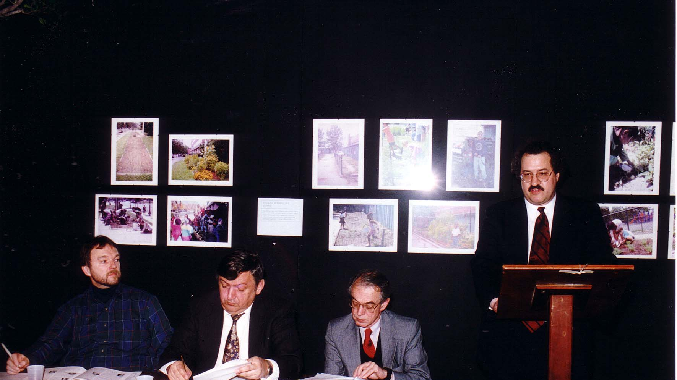
Notes:
TWG_Photo_1997_No_102__Feb_15__US_Botanic_Garden__Annual_Mtg__Jurij_Dobczansky__Yaro_Bihun__Ross_Chomiak__TWG_President_George_Masiuk
See 1997 January TWG NEWS, page 1, for event announcement, and February TWG NEWS, page 1, for event coverage

Slide 5
1997 200 TWG Leadership Conference Georgetown University Conference Center October 10-12 Photographs
See Leadership Conference Announcement in 1997 May-June TWG NEWS, page 4
See Leadership Conference Planning in 1997 July-August, TWG NEWS, page 1,
See TWG_1997_Leadership_Conference_Booklet for Conference Program and Speaker Biographies
See 1997 September-October TWG NEWS for Leadership Conference Coverage
See TWG Leadership Conference coverage by The Ukrainian Weekly: The_Ukrainian_Weekly_1997-42, page 3

Slide 6
1997 201 TWG Leadership Conference Ukrainian Embassy Reception October 10 Photographs
TWG President George Masiuk, Amb. Yuriy Shcherbak

Slide 7
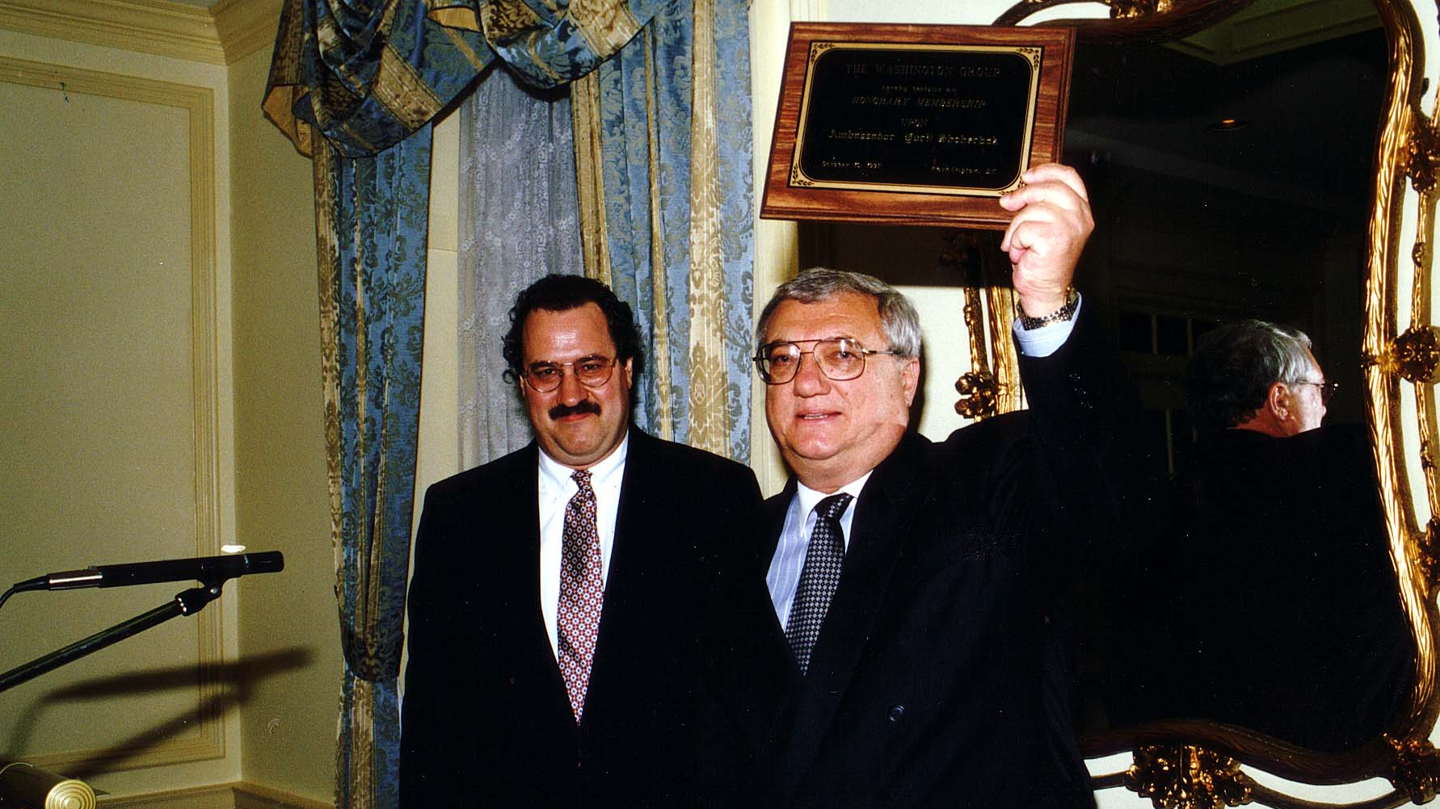
Notes:
TWG_Photo_1997_No_202__Oct_10__Leadership_Conference_Embassy_Reception_TWG_President_George_Masiuk_presents_Award_of_Honorary_Membership_to_Ukraine_Ambassador_Yurij_Shcherbak
See September-October TWG NEWS, page 1; also see page 3 for transcript of Amb. Shcherbak’s keynote address on October 11

Slide 8
1997 230 TWG Leadership Conference Banquet October 11 Photographs
Roma Pryma Bohachevsky, Marta Zielyk, Lidia Krushelnytsky

Slide 9
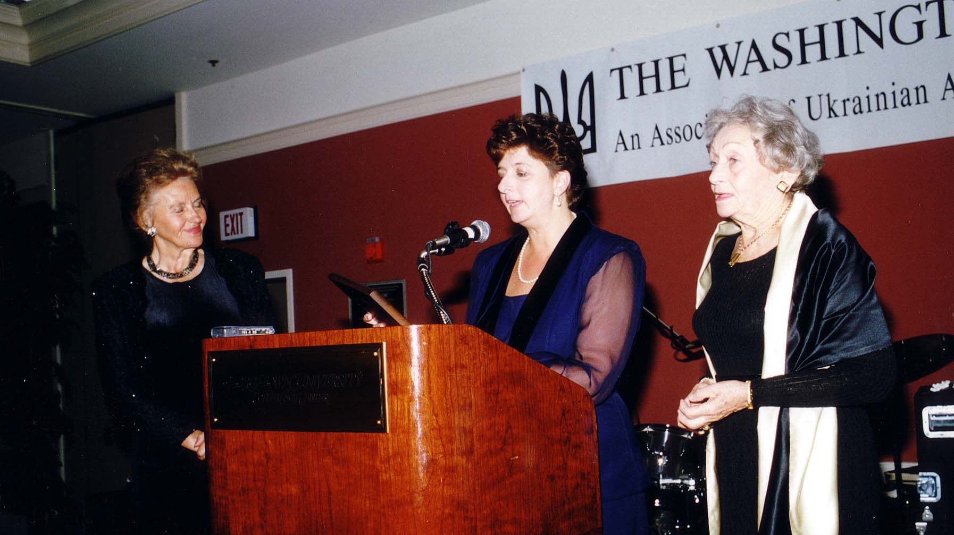
Notes:
TWG_Photo_1997_No_232_Oct__11__Leadership_Conference__TWG_VP_Marta_Zielyk_presents_Award_to_Roma_Pryma_Bohachevsky_(on_the_left)_and_to_Lidia_Krushelnytsky
See September-October TWG NEWS, page 7

Slide 10
1997 240 TWG Leadership Conference Panel 1: Creating a Model of a Successful Community October 11 Photographs
Ewa Matuszewski

Slide 11
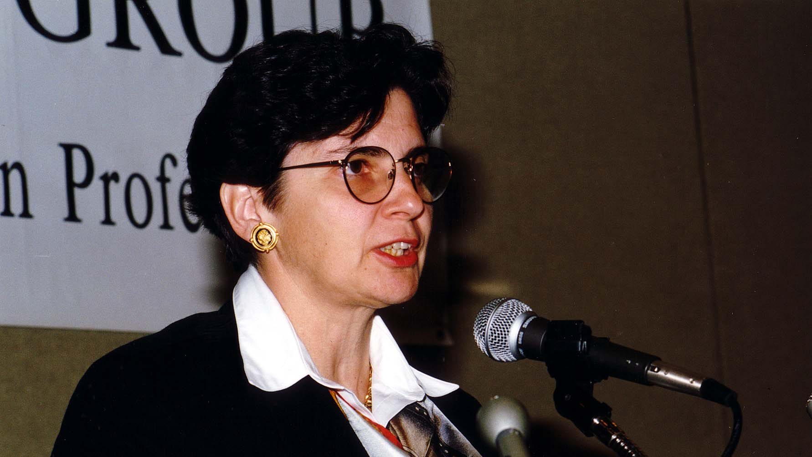
Notes:
TWG_Photo_1997_No_242__Oct_11__Leadership_Conference__Diaspora_Panel__Polish_American_Congress_Ewa_Matuszewski
See 1997 September-October TWG NEWS, page 8

Slide 12
1997 250 TWG Leadership Conference Panel 2: How are Ukrainian-American Organizations Doing October 11 Photographs
Roma Hayda, Bohdan Vitvitsky, Myron Kuropas, Bohdan Watral, Rev. Stefan Zencuch
Bohdan Vitvitsky
Myron Kuropas

Slide 13
Notes:
TWG_Photo_1997_No_251__Oct_11__Leadership_Conference__Ukrainian_Organizations_Panel__Roma_Hayda__Bohdan_Vitvitsky__Myron_Kuropas_Bohdan_Watral__Rev_Stefan_Zencuch
See September-October TWG NEWS, page 9

Slide 14
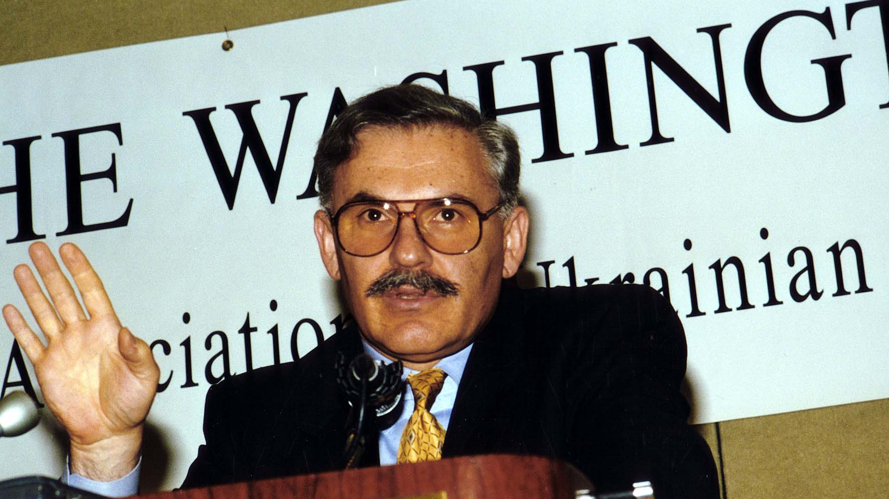
Notes:
TWG_Photo_1997_No_253__Oct_11__Leadership_Conference__Diaspora_Panel__NY-NJ_Ukrainian-American_Professionals_Association_Bohdan_Vitvitsky
See September-October TWG NEWS, page 9

Slide 15
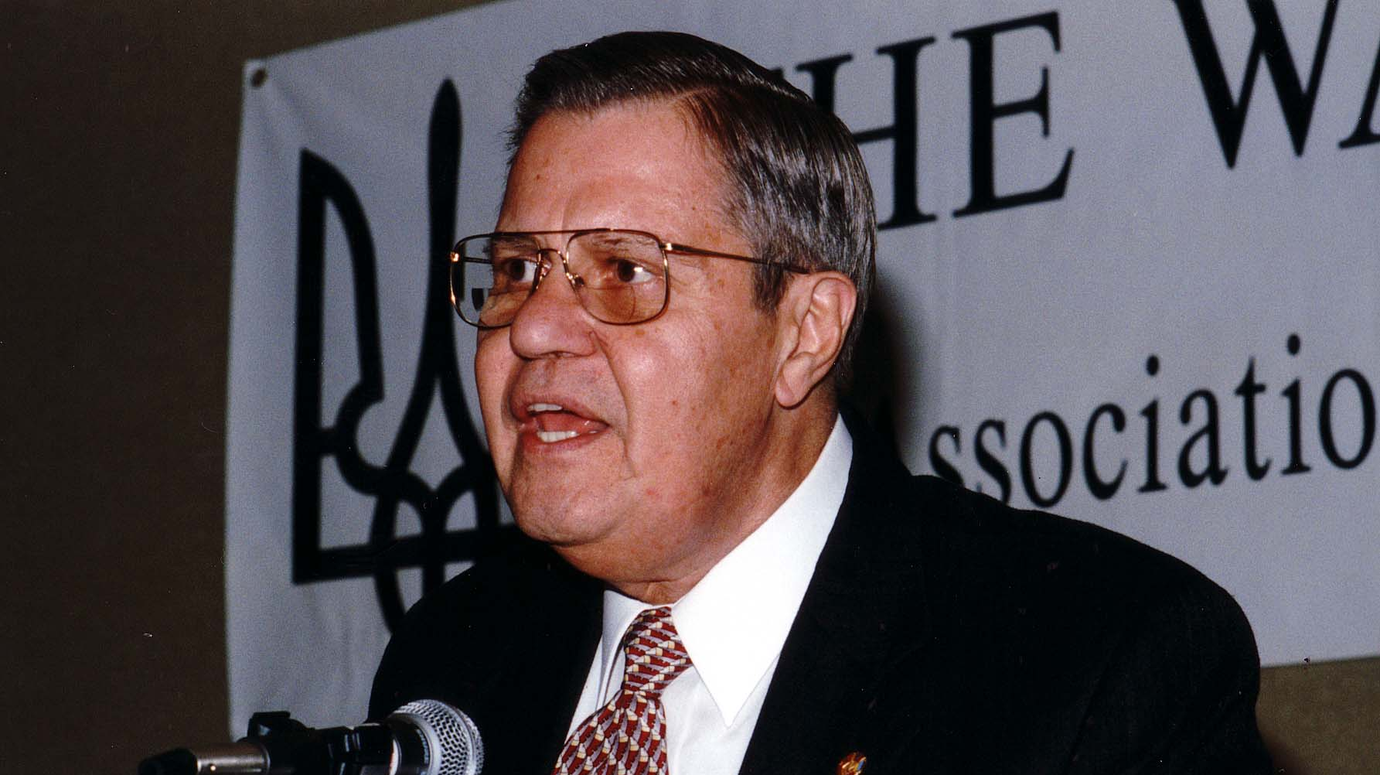
Notes:
TWG_Photo_1997_No_252__Oct_11__Leadership_Conference__Ukrainian_American_Organizations_Panel__Ukrainian_Weekly_Columnist_Myron_Kuropas
See September-October TWG NEWS, page 9

Slide 16
1997 260 TWG Leadership Conference Panel 3: Exercising Influence within American Society October 11 Photographs
Andrew Fedynsky

Slide 17
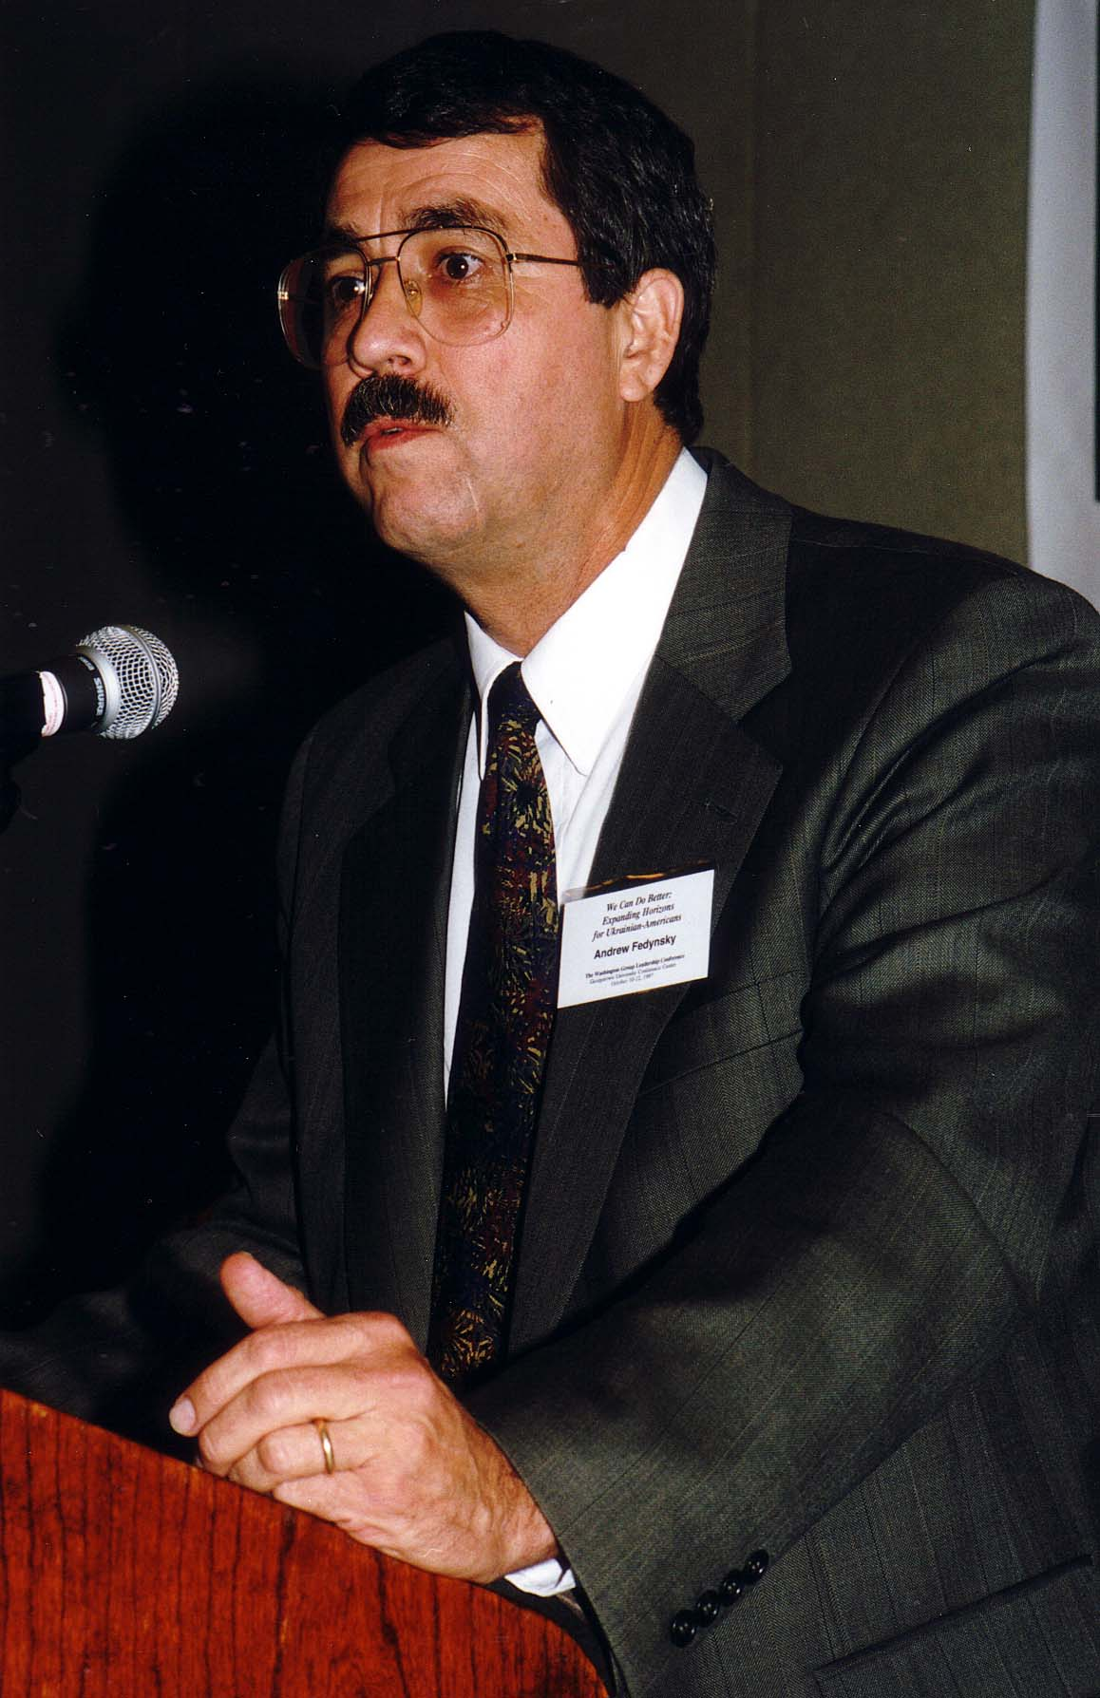
Notes:
TWG_Photo_1997_No_261__Oct_11__Leadership_Conference__Exercising_Influence_Panel__Government_Consultant_Andrew_Fedynsky
See September-October TWG NEWS, page 10

Slide 18
1997 270 TWG Leadership Conference Panel 4: Building Connections to Ukraine October 11 Photographs
Jaroslav Dutkewych

Slide 19
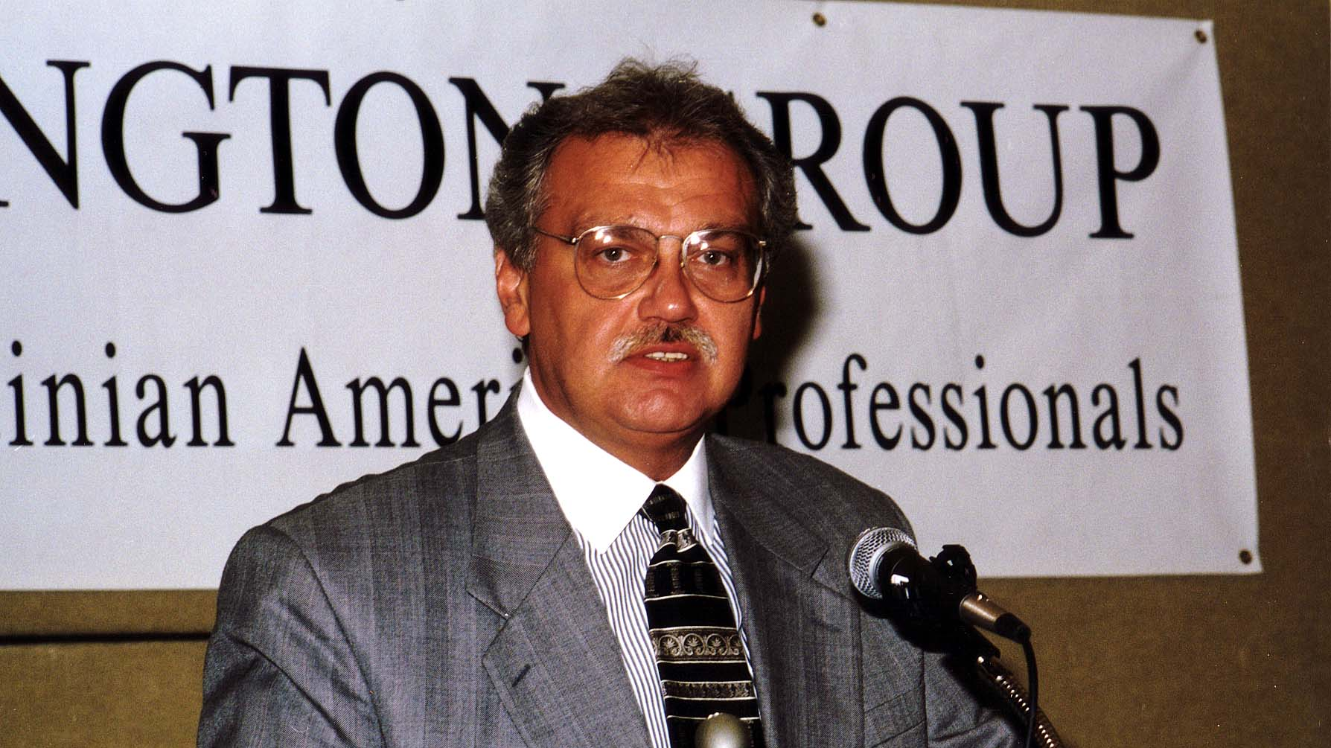
Notes:
TWG_Photo_1997_No_271__Oct_11__Leadership_Conference__Building_Connections_to_Ukraine_Panel__Ukraine_Peace_Corps_Director_Jaroslav_Dutkewych
See September-October TWG NEWS, page 10

Slide 20
1997 280 TWG Leadership Conference Panel 5: US - Ukraine Foundation October 11 Photographs
Joyce Warner, Nadia McConnell, John Kun

Slide 21
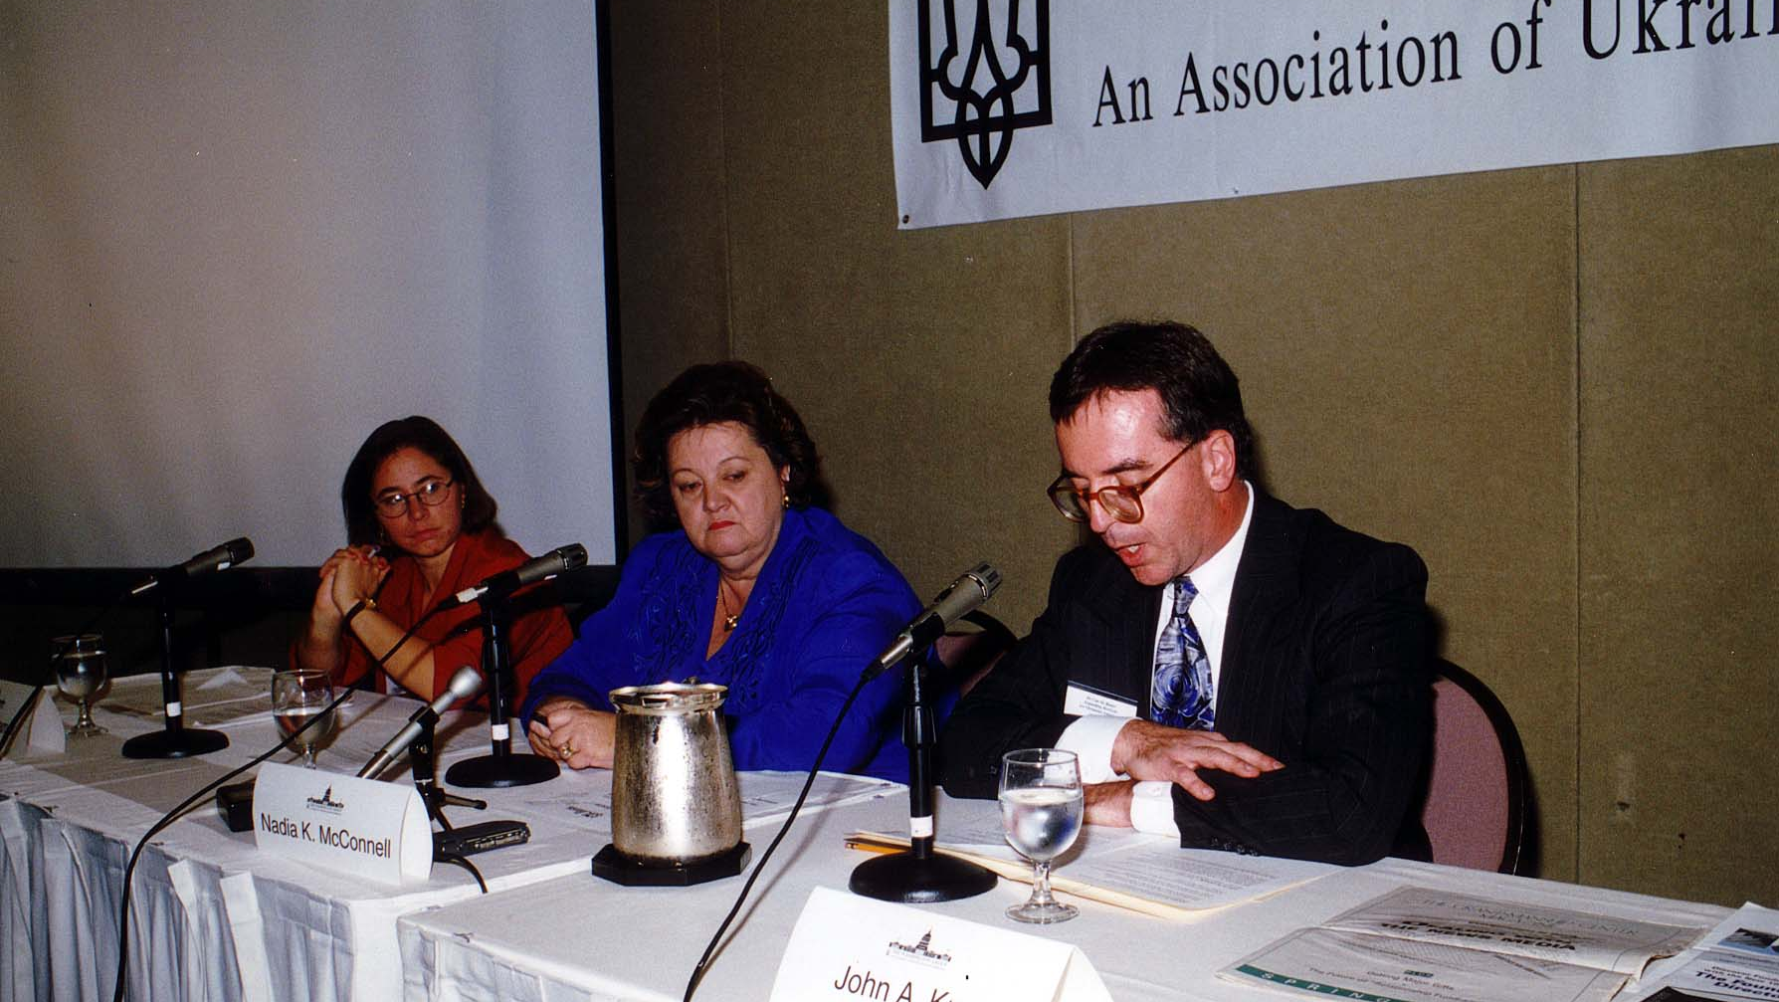
Notes:
TWG_Photo_1997_No_281__Oct_11__Leadership_Conference__US_Ukraine_Foundation__Joyce_Warner__USUF_President_Nadia_McConnell__John_Kun
See September-October TWG NEWS, page 11

Slide 22
1997 290 TWG Leadership Conference Brunch October 12 Photographs
Dean Magraw
Peter Ostroushko

Slide 23
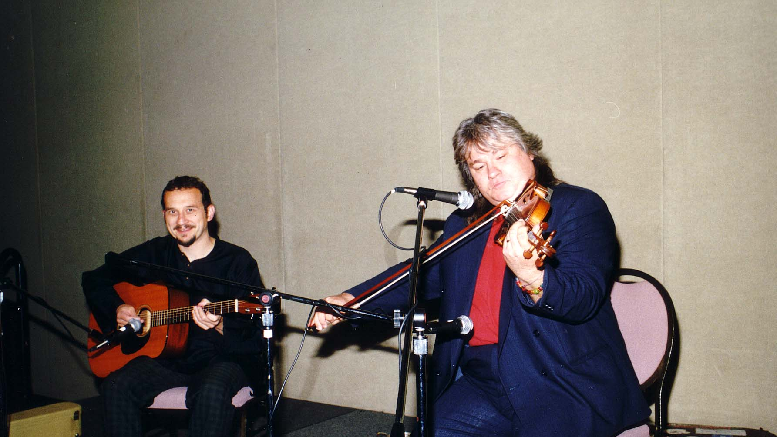
Notes:
TWG_Photo_1997_No_292__Oct_12__Leadership_Conference__Brunch_Entertainment__Dean_Magraw__Peter_Ostroushko

Slide 24
1997 300 TWG Events Photographs
Jack Segal
Winery Tour: Jaroslaw Martyniuk, Myron Teluk, Lida Teluk, Eva Bauer, Ed Wizniak, Simon Roman, Lamar Brantley, Mike Drabyk, Roberta Drabyk, Ross Chomiak, Maria Kulczycky, TWG President George Masiuk, Natalie Sluzar

Slide 25
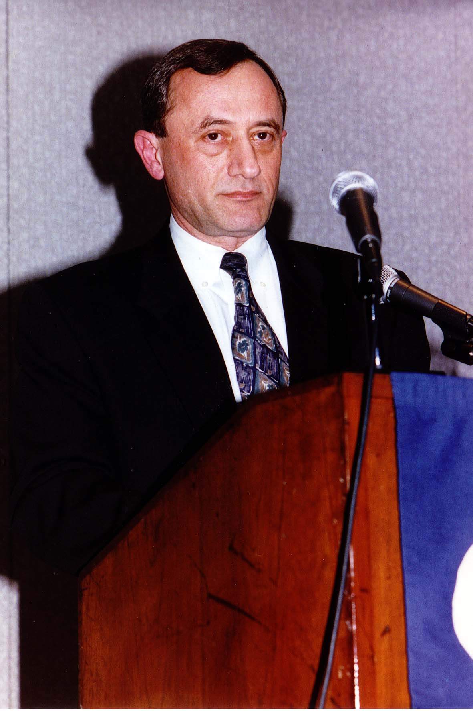
Notes:
TWG_Photo_1997_No_321__Mar_21__at_CSIS__Director_State_Department_Office_of_Ukrainian_Belorusian_Moldovan_Affairs_Jack_Segal
See 1997 February TWG NEWS, page 1, for event announcement, and March-April TWG NEWS, page 1 for event coverage

Slide 26
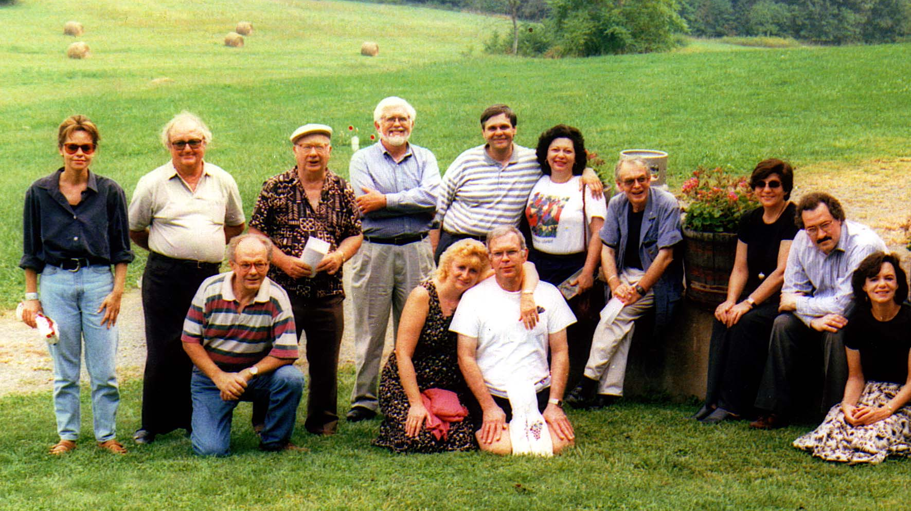
Notes:
TWG_Photo_1997_No_323__Sep_20__Markham_VA__Winery_Tour__Front__Jaroslaw_Martyniuk_Myron&Lida_Teluk__Back__Eva_Bauer__Ed_Wizniak_Simon_Roman_Lamar_Brantley_Mike&Roberta_Drabyk_Ross_Chomiak_Maria_Kulczycky_George_Masiuk_Natalie_Sluzar
See 1997 July-August TWG NEWS, page 9, for event announcement and November-December TWG NEWS, page 7, for event coverage…also see 1998 January-February for correction to picture caption

Slide 27
1997 310 TWG Ukrainian Journalists Photographs
Ukrainian Journalists

Slide 28
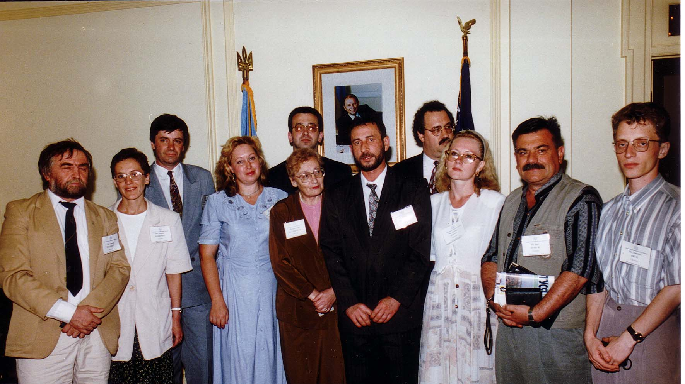
Notes:
TWG_Photo_1997_No_311__July_23__Embassy_Reception__Ukrainain_Journalists
See 1997 July-August TWG NEWS, page 7, for event coverage

Slide 29
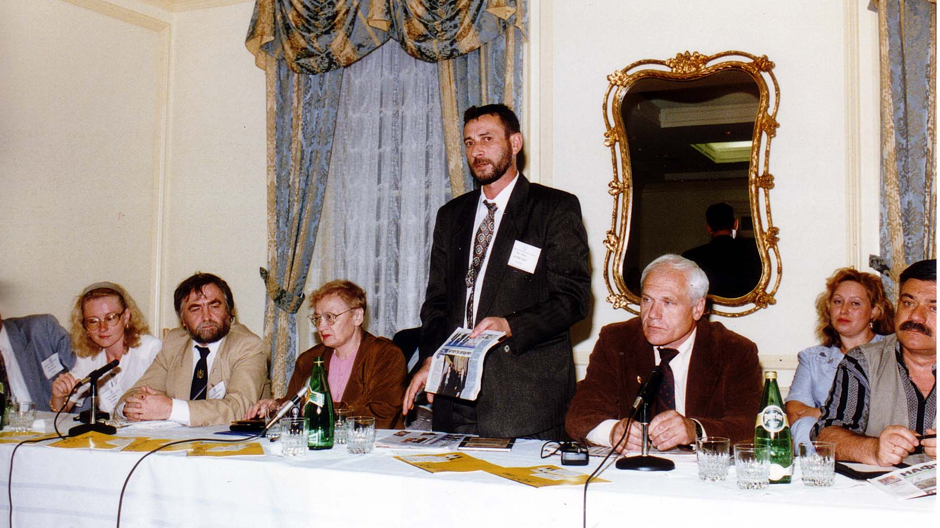
Notes:
TWG_Photo_1997_No_312__July_23__Embassy_Reception__Ukrainian_Journalists
See 1997 July-August TWG NEWS, page 7, for event coverage

Slide 30
1997 700 TWG Intern Photographs
Lesia Richardson

Slide 31
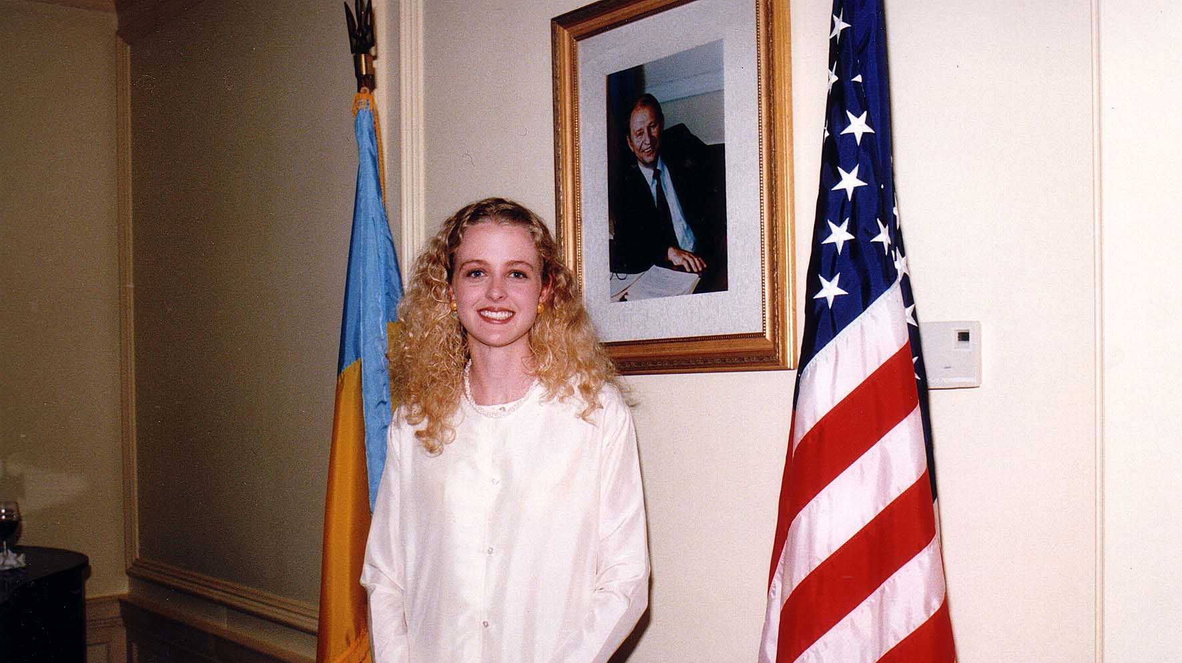
Notes:
TWG_Photo_1997_No_710__July_August__Ukrainian_Embassy__Ukrainian_Embassy_Intern_Lesia_Richardson
See 1997 July-August TWG NEWS, pages 1 and 3, for event coverage

Slide 32
See TWGCF Photo Album for 1997 Cultural Events
Bandura Chorus
Horowitz Competition Winners

