Slide 1
TWG 1998 Photos
October 25, 2020

Slide 2
1998 100 TWG Annual Meeting Van Ness East May 29 Photographs
See 1998 March-April TWG NEWS for Annual Meeting announcement and May-June TWG NEWS for Annual Meeting coverage
Elected to the Board: Orest Deychakiwsky – President; Tanya Stasiuk – Vice President; Michael Drabyk - Secretary; Roman Stelmach – Treasurer; Ihor Kotlarchuk - Public Relations; Adrian Pidlusky – Membership Director
Cultural Fund Director: Laryssa Chopivsky
Fellowship Fund: Adrian Karmazyn
Members at Large: Steven Boyduy, Oleg Jerschkowsky, Maria Kulczycky, John Kun, Anya Silecky, Natalie Sluzar, Marta Zielyk, Maria Zmurkewycz
Auditor: Andrew Charchalis, Ihor Procinsky
TWG NEWS Editor: Yaro Bihun
Others in photo: Ihor Vitkovitsky, Ross Chomiak, George Masiuk

Slide 3
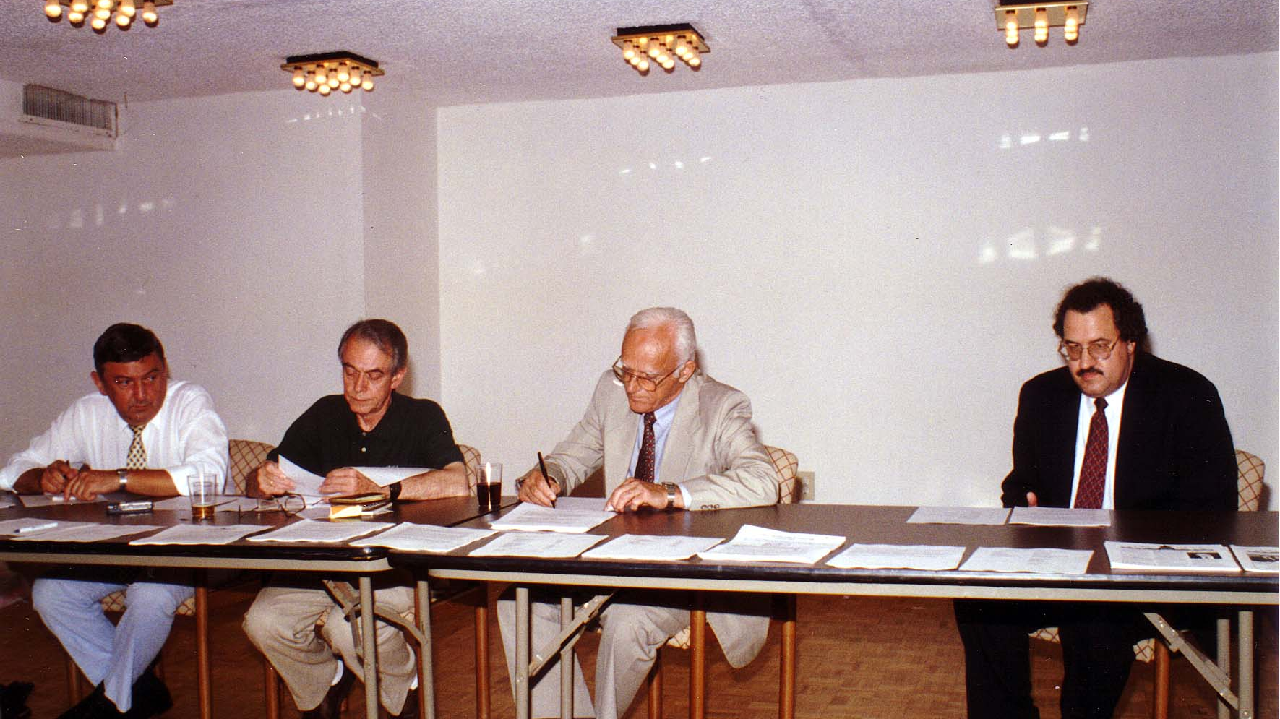
Notes:
TWG_Photo_1998_No_101__May_29__Annual_mtg__Yaro_Bihun__Ross_Chomiak__Ihor_Vitkovitsky__TWG_Outgoing_President_George_Masiuk
See 1998 March-April TWG NEWS, page 1, for event announcement and May-June TWG NEWS, page 1, for event coverage

Slide 4
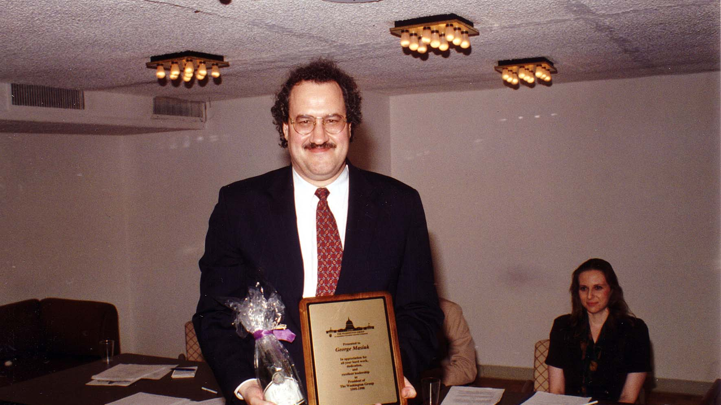
Notes:
TWG_Photo_1998_No_102__May_29__Annual_mtg__George_Masiuk__Award__Outgoing_President_George_Masiuk__newly_elected_TWG_VP_Tanya_Stasiuk
See 1998 March-April TWG NEWS, page 1, for event announcement and May-June TWG NEWS, page 1, for event coverage

Slide 5
1998 300 TWG Events Photographs
Honorary Membership for Amb. Miller: Amb. William Miller, George Masiuk
TWG and IREX Hosting Amb. Pifer:
TWG President Orest Deychakiwsky, Amb. Steven Pifer
Amb. Steven Pifer, Daniel Matuszewski

Slide 6
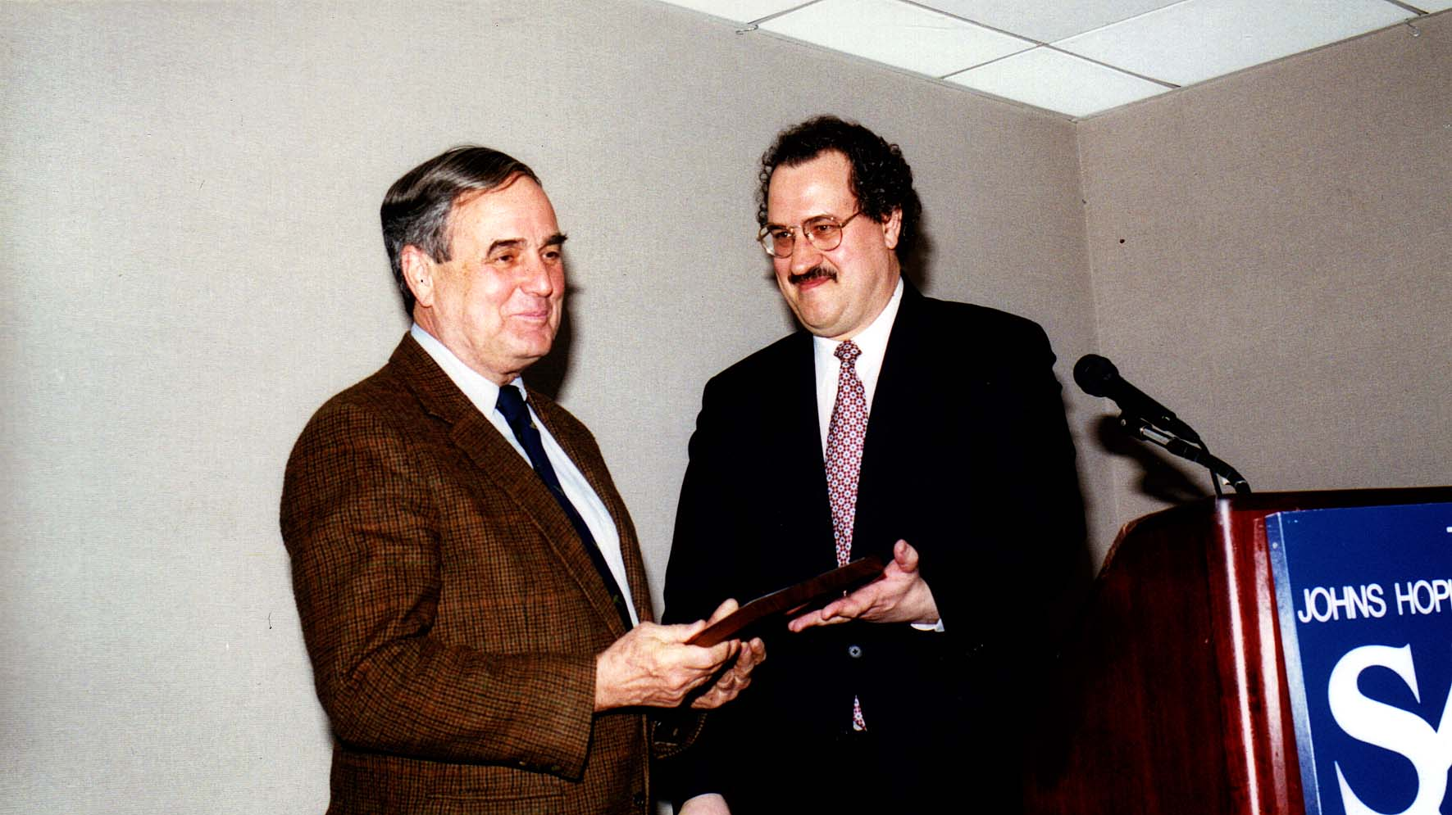
Notes:
TWG_Photo_1998_No_310__Mar_23__Johns_Hopkins_School_for_Advanced_International_Studies_(SAIS)__Honorary_Membership_Award_to_Ambassador_William_Miller__TWG_President_George_Masiuk
See 1998 January-February TWG NEWS, page 1, for event announcement and March-April TWG NEWS, page 1, for event coverage

Slide 7
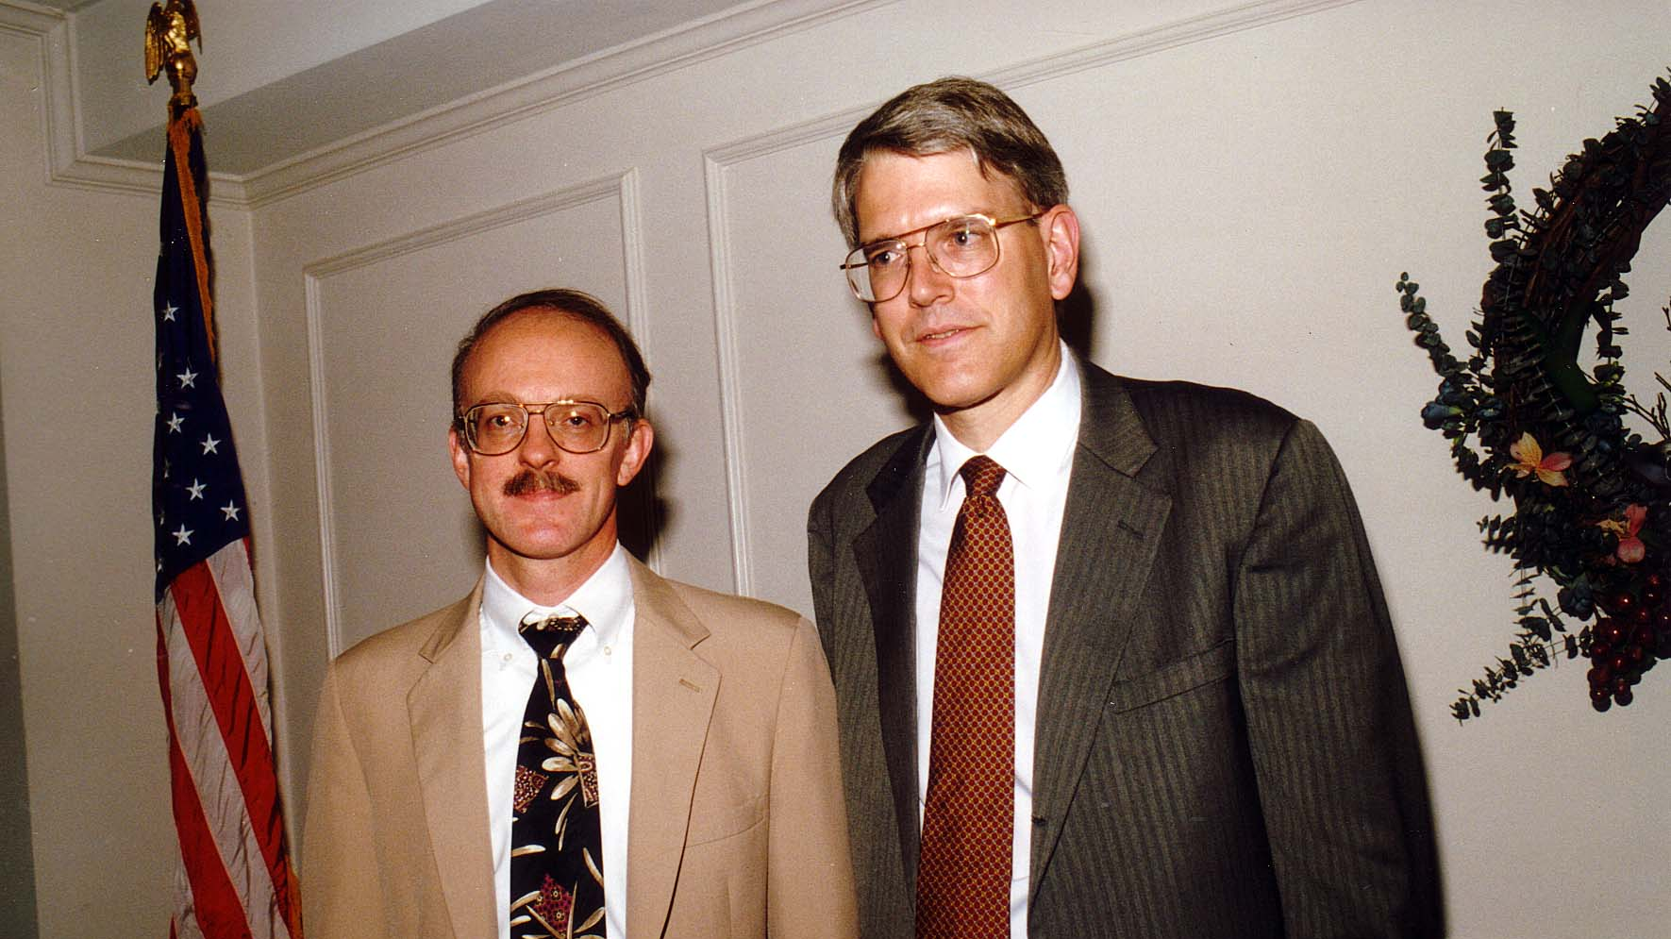
Notes:
TWG_Photo_1998_No_320__Jun_26__TWG_and_IREX_hosting_Ambassador_Pifer__TWG_President_Orest_Deychakiwsky__Ambassador_Steven_Pifer
See 1998 May-June TWG NEWS, page 1, for event coverage

Slide 8
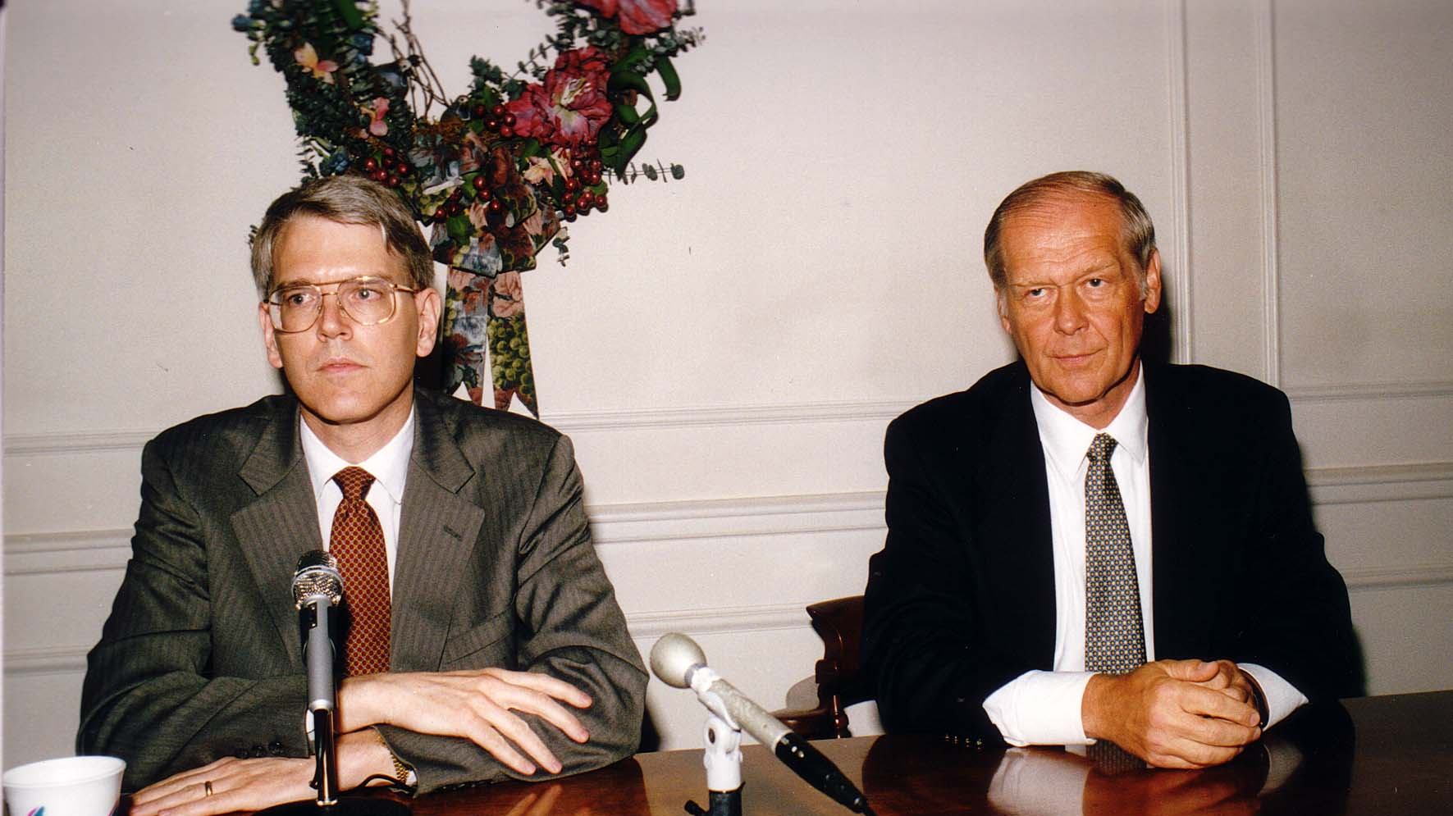
Notes:
TWG_Photo_1998_No_321__Jun_26__at_IREX__Amb_Steven_Pifer__International_Research_and_Exchanges_Board_(IREX)_President_Daniel_Matuszewski

Slide 9
See TWGCF Photo Album for 1998 Cultural Events
Juliana Osinchuk
Kyiv Camerata
Volodymyr Makarenko
Myroslav Skoryk

