Slide 1
TWG 1999 Photos
October 25, 2020

Slide 2
1999 100 TWG Annual Meeting Van Ness East March 26 Photographs
See 1999 January-February TWG NEWS for Annual Meeting announcement and May-June TWG NEWS for Annual Meeting coverage
Elected to the Board: Orest Deychakiwsky – President; Tanya Stasiuk – Vice President; Michael Drabyk - Secretary; Roman Stelmach – Treasurer; Ihor Kotlarchuk - Public Relations; Adrian Pidlusky – Membership Director; Oles Berezhny - Special Projects; Larysa Obleshchuk – Events Director; George Masiuk - Immediate Past President
Cultural Fund Director: Laryssa Chopivsky
Fellowship Fund: Adrian Karmazyn
Members at Large: Steven Boyduy, Jim Fedorko, Oleg Jerschkowsky, Maria Kulczycky, Anya Silecky, Natalie Sluzar, Andy Szul, Marta Zielyk
Auditor: Andrew Charchalis, Ihor Procinsky
TWG NEWS Editor: Yaro Bihun

Slide 3
1999 200 TWG Leadership Conference Part of Joint Conferences of Ukrainian-American Organizations Hyatt Regency Crystal City Hotel, Arlington Virginia June 23-27 Photographs
See Leadership Conference Announcement in 1999 January-February TWG NEWS, page 1
See Leadership Conference Planning in 1999 March-April, TWG NEWS, page 7
See TWG_1999_Leadership_Conference_Booklet for Conference Program and Speaker Biographies
See Joint Conferences of Ukrainian-American Organizations booklet
See 1999 Summer TWG NEWS for Leadership Conference Coverage
See TWG Leadership Conference coverage by The Ukrainian Weekly: The_Ukrainian_Weekly_1999-27 and 1999-28

Slide 4
1999 240 TWG Leadership Conference Panel 1: U.S. - Ukraine Military Cooperation June 26 Photograph
Ukrainian-American and Ukrainian Officers: Askold Mosijczuk, Ihor Kotlarchuk, Oleksandr Galaka, Yurij Holowinsky, Sergiy Nechiporenko, Vadym Yakhno, Valeriy Kondratiuk

Slide 5
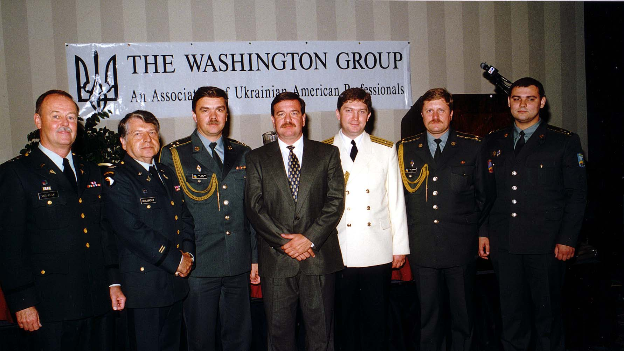
Notes:
TWG_Photo_1999_No_241__Jun_26__Leadership_Conference_Panel_1__US_Ukraine_Military_Cooperation__Askold_Mosijczuk__Ihor_Kotlarchuk__Oleksandr_Galaka__Yurij_Holowinsky__Sergiy_Nechiporenko__Vadym_Yakhno__Valeriy_Kondratiuk
See Summer TWG NEWS, page 5, for event coverage

Slide 6
1999 250 TWG Leadership Conference Panel 2: Ukraine's Role in International Space Programs June 26 Photographs
Roald Sagdeyev
Michael Yarymovych

Slide 7
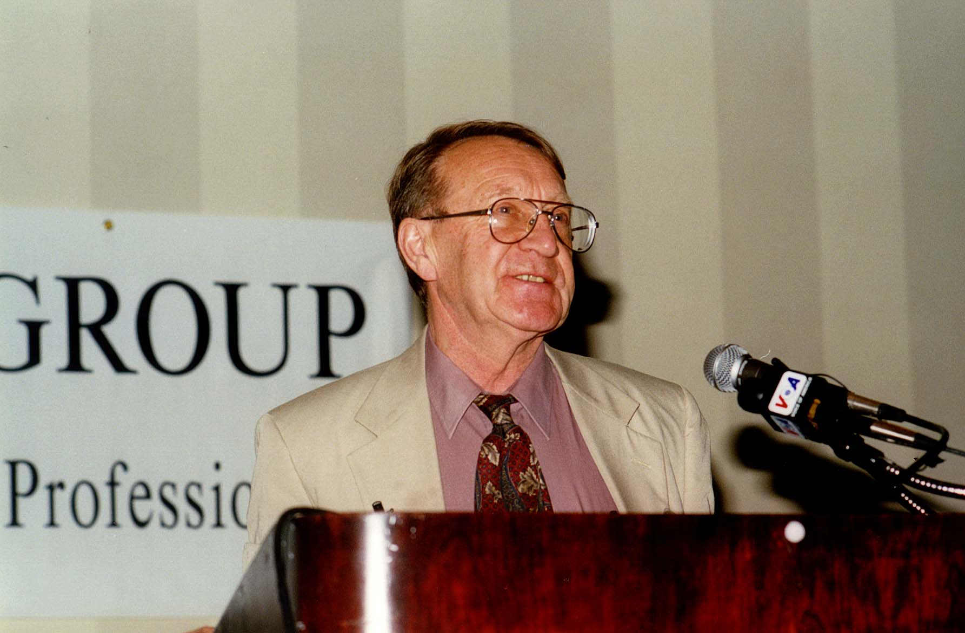
Notes:
TWG_Photo_1999_No_251__Jun_26__Leadership_Conference_Panel_2__Ukraine's_Role_in_International_Space_Programs__Physicist_&_Former_Director_of_Space_Research_Institute_of_USSR_Roald_Sagdeyev
See Summer TWG NEWS, page 6, for event coverage

Slide 8
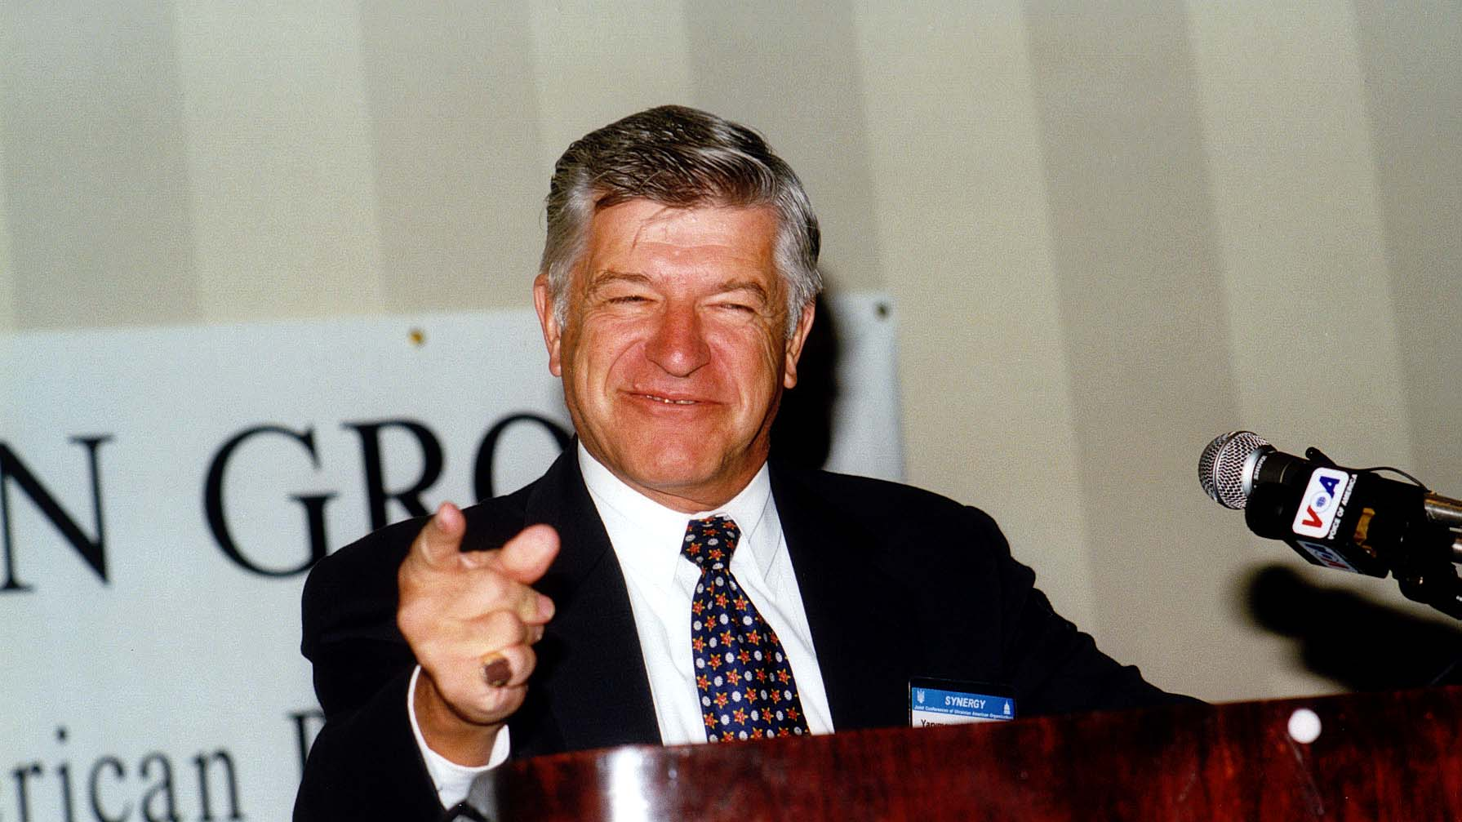
Notes:
TWG_Photo_1999_No_252__Jun_26__Leadership_Conference_Panel_2__Ukraine's_Role_in_International_Space_Programs__President_International_Academy_of_Astronautics_Michael_Yarymovych
See Summer TWG NEWS, page 6, for event coverage

Slide 9
1999 260 TWG Leadership Conference Panel 3: Ukraine on the Eve of Presidential Elections June 26 Photographs
Amb. William Miller, Nadia Diuk, John Tedstrom, Sherman Garnett

Slide 10
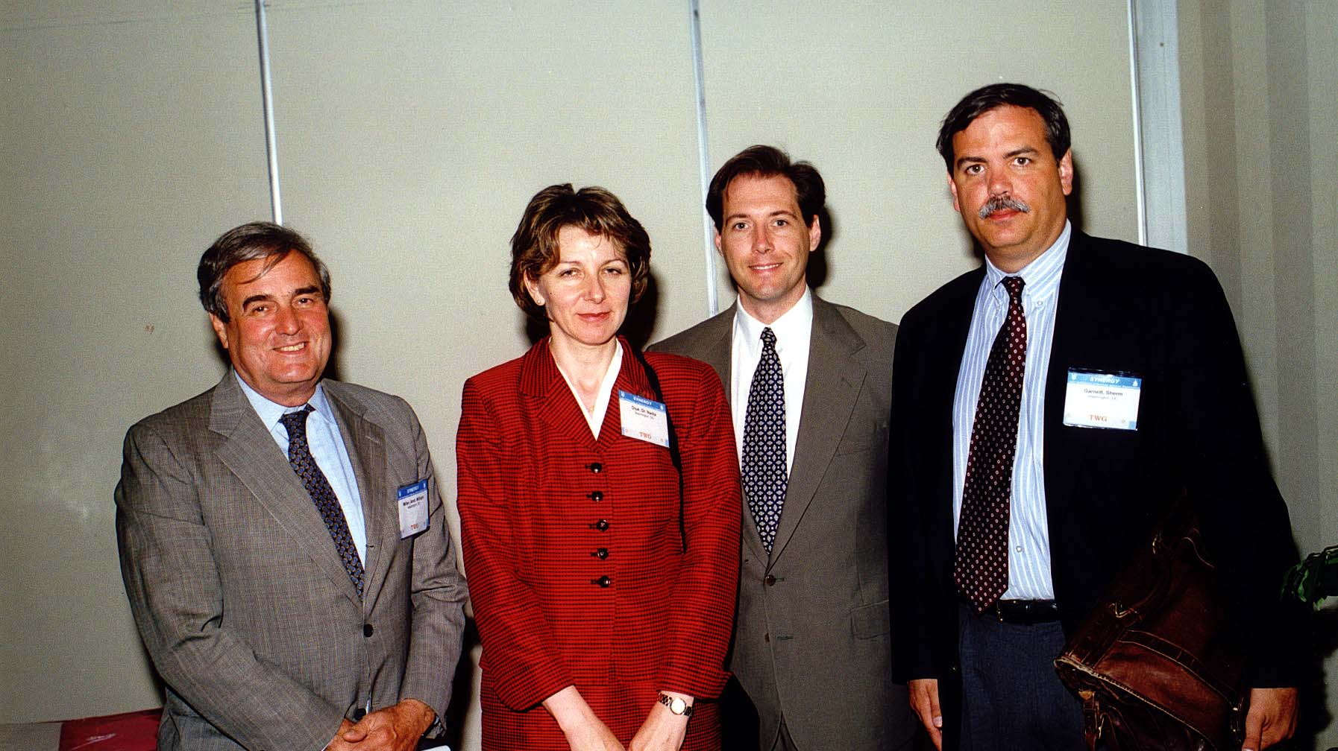
Notes:
TWG_Photo_1999_No_261__Jun_26__Leadership_Conference_Panel_3__Ukrainian_Elections__Former_US_Ambassador_William_Miller__National_Endowment_For_Democracy_Nadia_Diuk__National_Security_Council_John_Tedstrom__Carnegie_Endowment_Sherman_Garnett
See Summer TWG NEWS, page 6, for event coverage

Slide 11
1999 290 TWG Leadership Conference Brunch June 27 Photograph
Pikkardiyska Tertsia

Slide 12
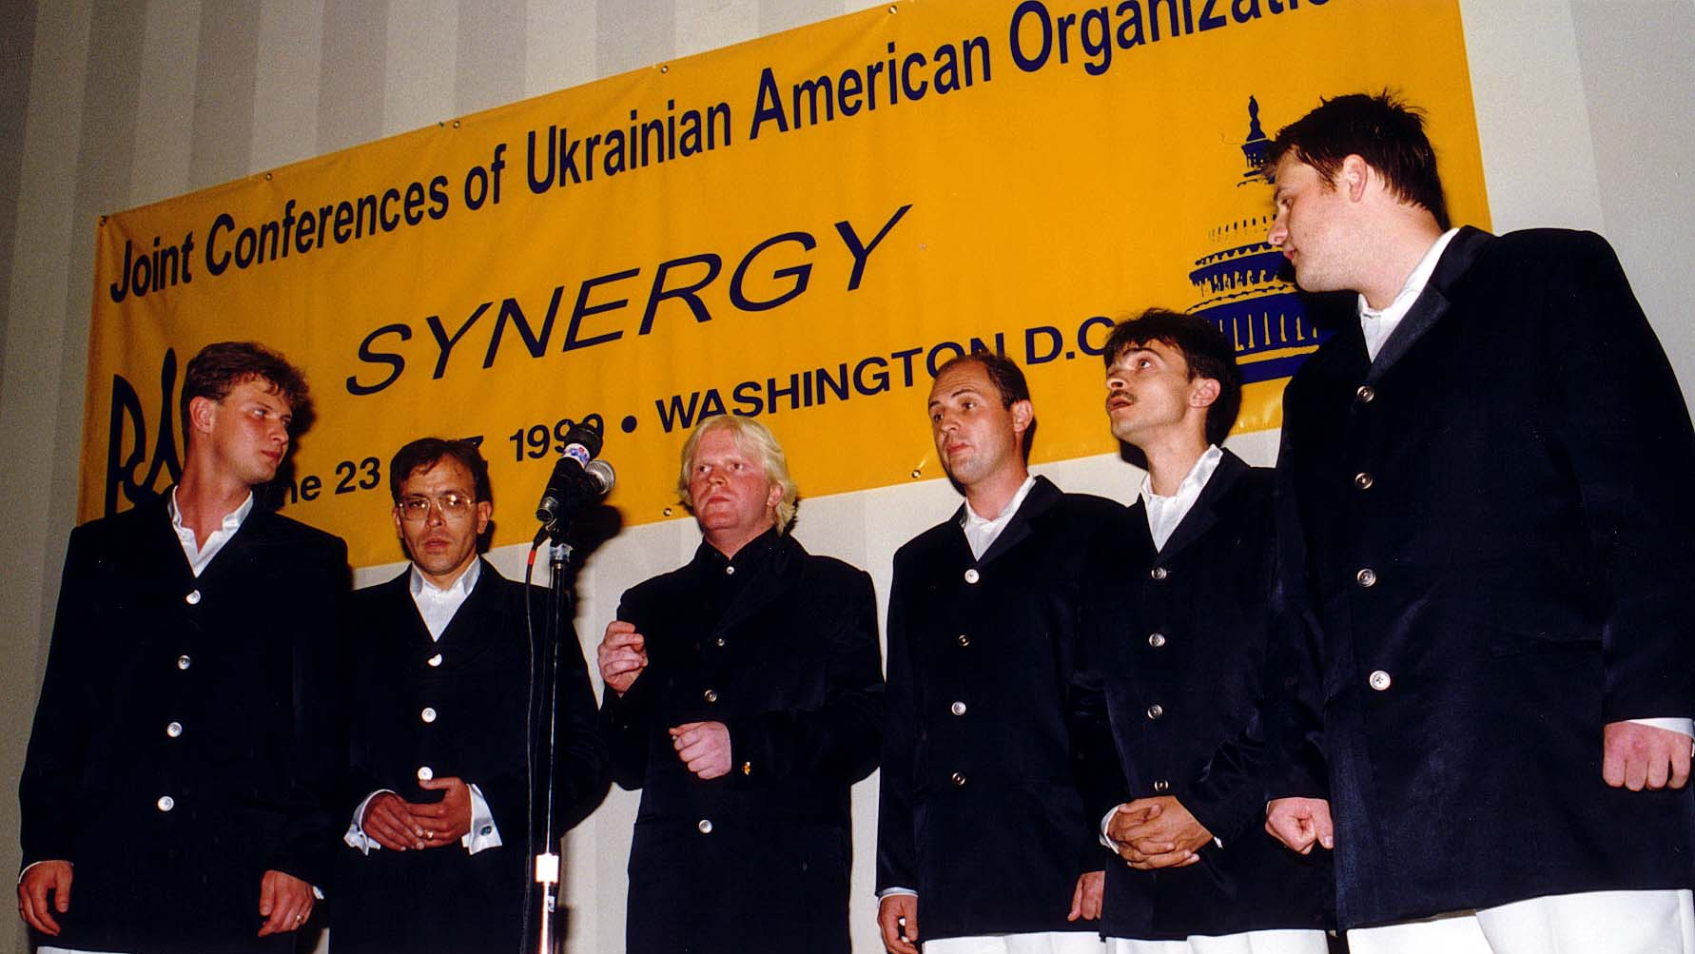
Notes:
TWG_Photo_1999_No_292__Jun_27__Leadership_Conference__Brunch_Entertainment__Pikkardiyska_Tertsia
See Summer TWG NEWS, page 13, for event coverage

Slide 13
1999 299 non-TWG but Part of Joint Conferences of Ukrainian-American Organizations Photographs
Tamara Denysenko
Amb. Anton Buteyko
Leonid Derkach, Don Bonker
Julian Kulas
Ihor Dliaboha, Amb. Steve Sestanovich, Amb. Anton Buteyko, Dr. Roman Goy
Yaro Bihun, Ivan Zayats, Amb. William Miller
Amb. William Miller, Judge Bohdan Futey

Slide 14
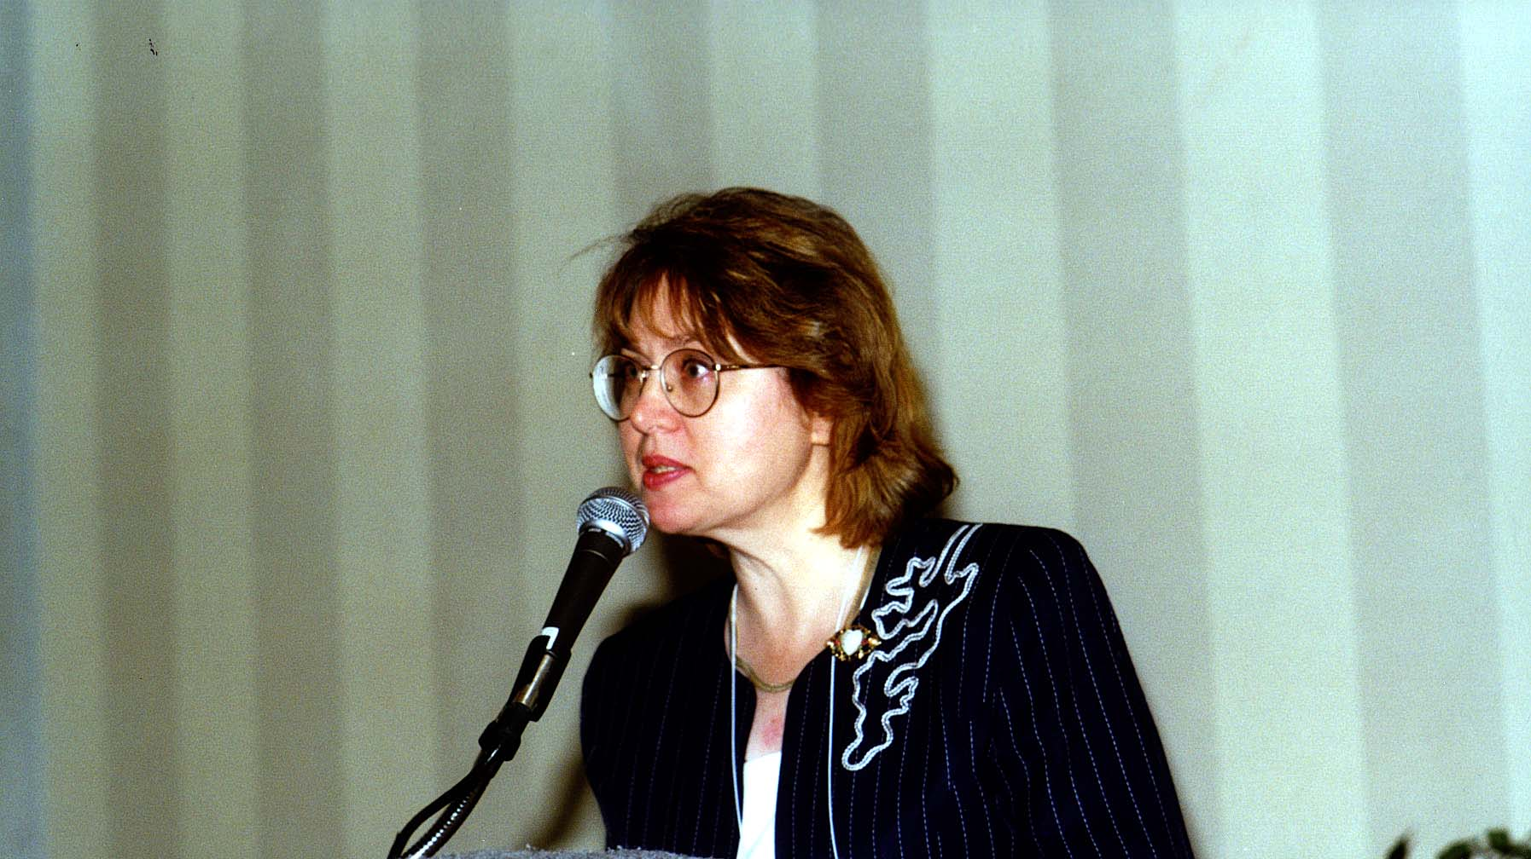
Notes:
TWG_Photo_1999_No_299-1__Joint_Conferences__Ukrainian_National_Credit_Union_Association_Conference__CEO_Rochester_Ukrainian_Federal_Credit_Union_Tamara_Denysenko

Slide 15
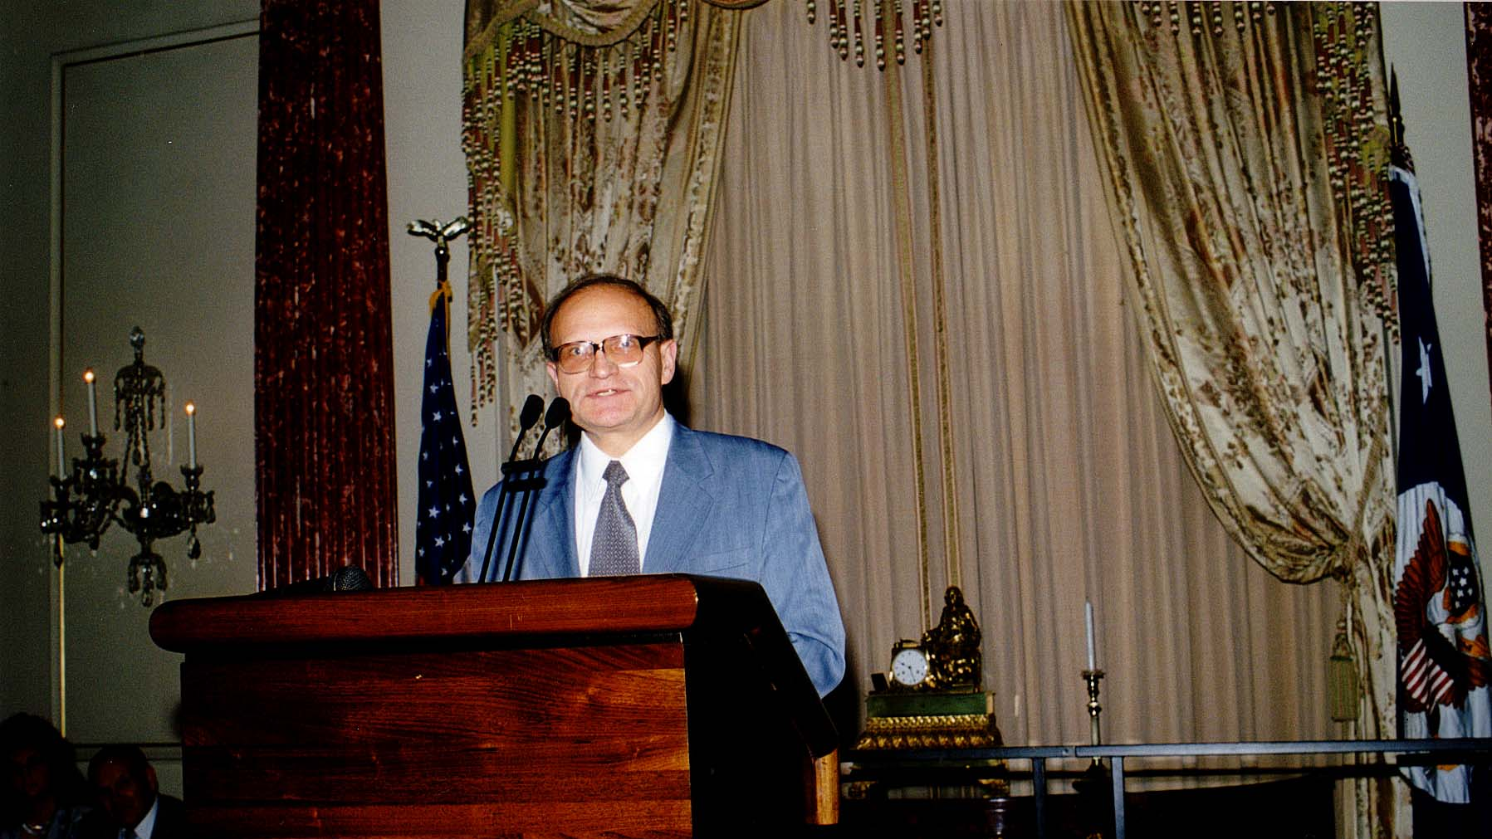
Notes:
TWG_Photo_1999_No_299-2__Joint_Conferences__Ukrainian_Engineers_Society_of_America_Conference__Keynote_Address__Ambassador_Anton_Buteyko

Slide 16
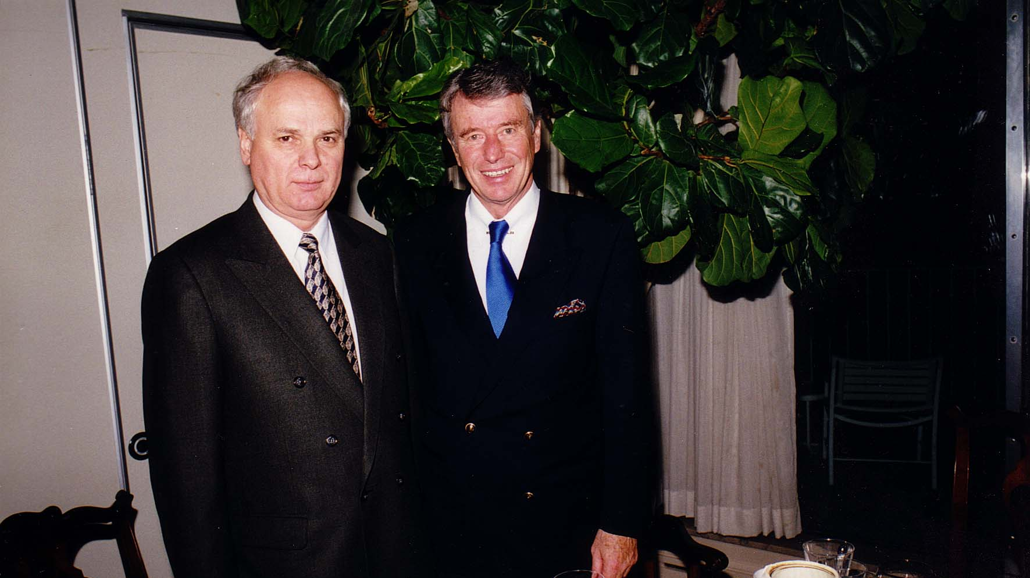
Notes:
TWG_Photo_1999_No_299-3_Joint_Conferences__Director_of_Security_Service_of_Ukraine_Leonid_Derkach__former_United_States_Congressman_Don_Bonker

Slide 17
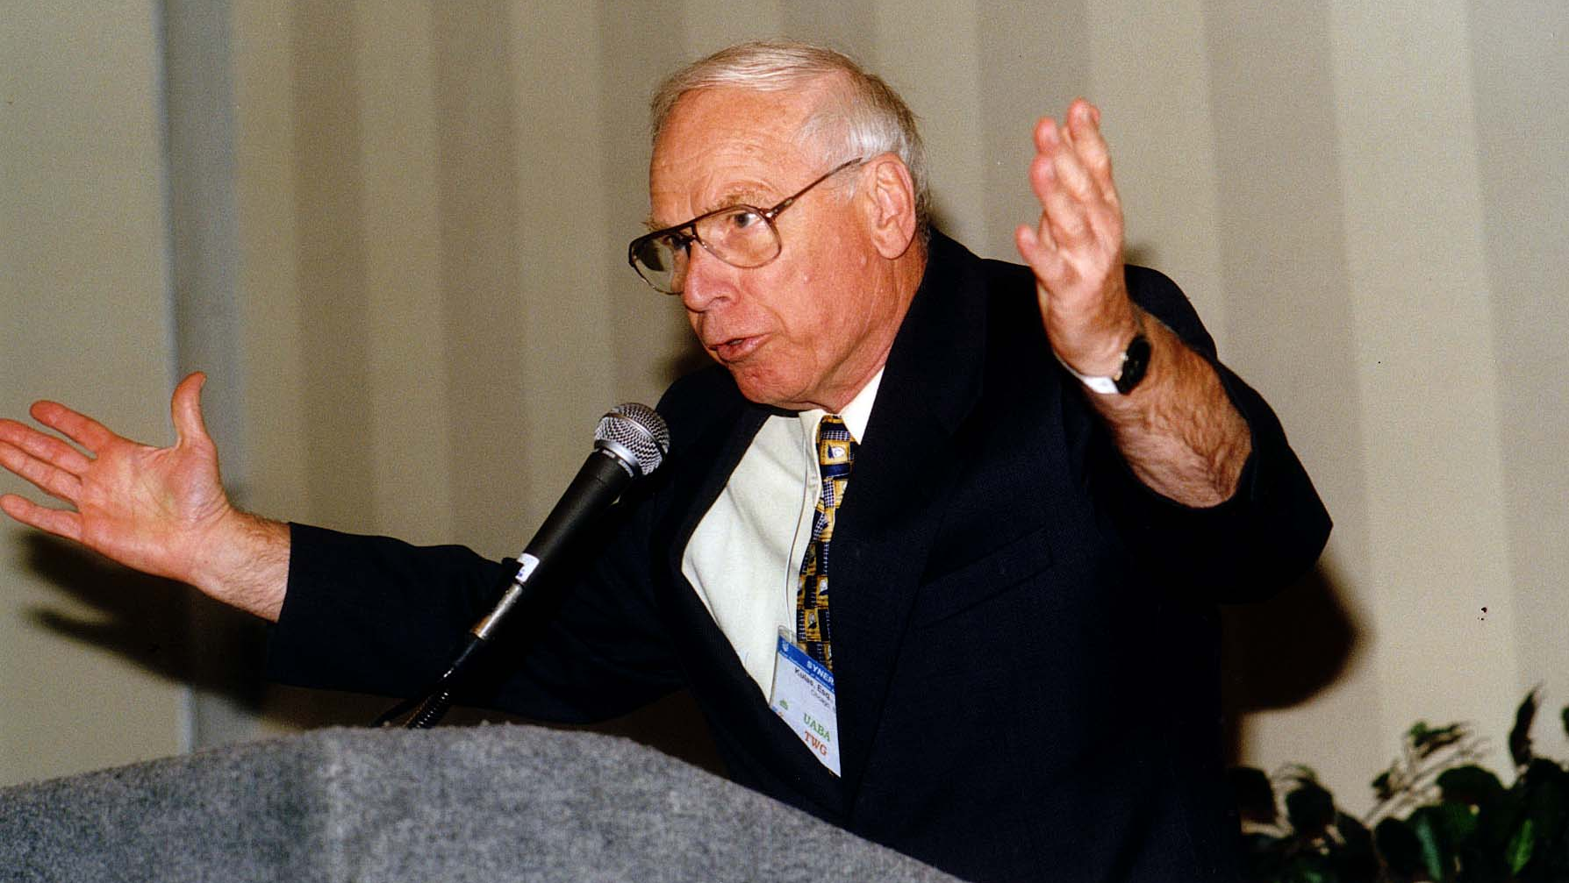
Notes:
TWG_Photo_1999_No_299-4__Joint_Conferences___Ukrainian_American_Bar_Association_Conference___Lawyer_Banker_Philanthropist_President_of_Ukrainian_American_Heritage_Foundation_Julian_Kulas

Slide 18
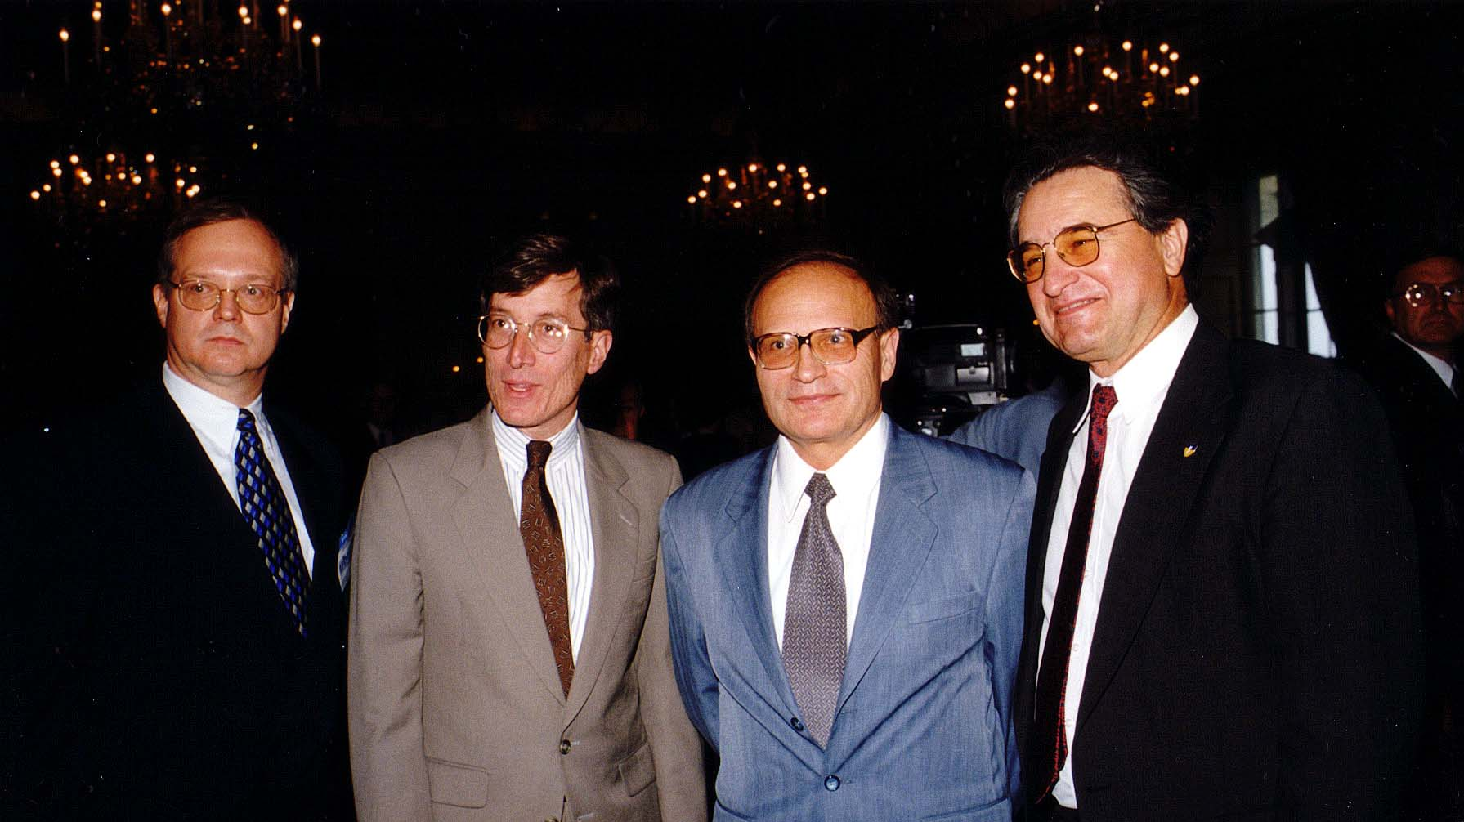
Notes:
TWG_Photo_1999_No_299-5__Joint_Conferences__Ukrainian_Broadcast_Network_Executive_Ihor_Dliaboha__Amb_at_Large_for_Newly_Independent_States_Steve_Sestanovich__Amb_Anton_Buteyko__Conference_Organizer_Dr_Roman_Goy

Slide 19
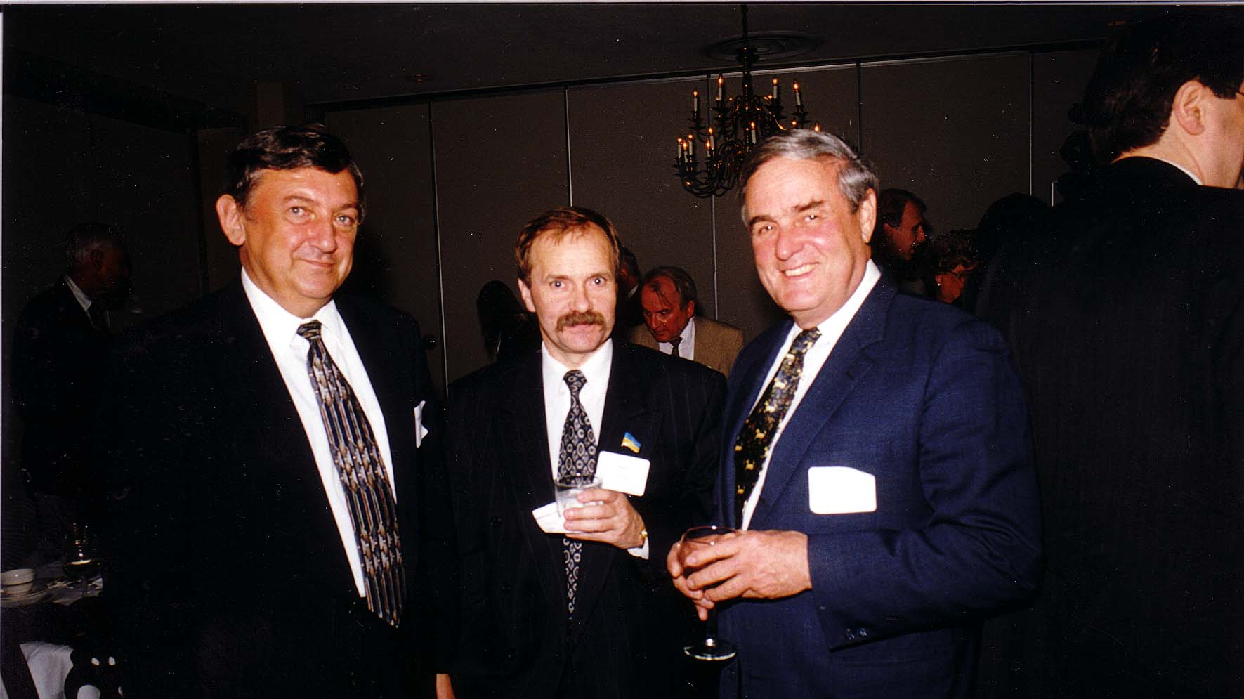
Notes:
TWG_Photo_1999_No_299-6__Joint_Conferences__Former_TWG_President_and_TWG_NEWS_Editor_Yaro_Bihun__Verkhovna_Rada_Deputy_Ivan_Zayats__Ambassador_William_Miller__in_background_Journalist_Roman_Ferencevych

Slide 20
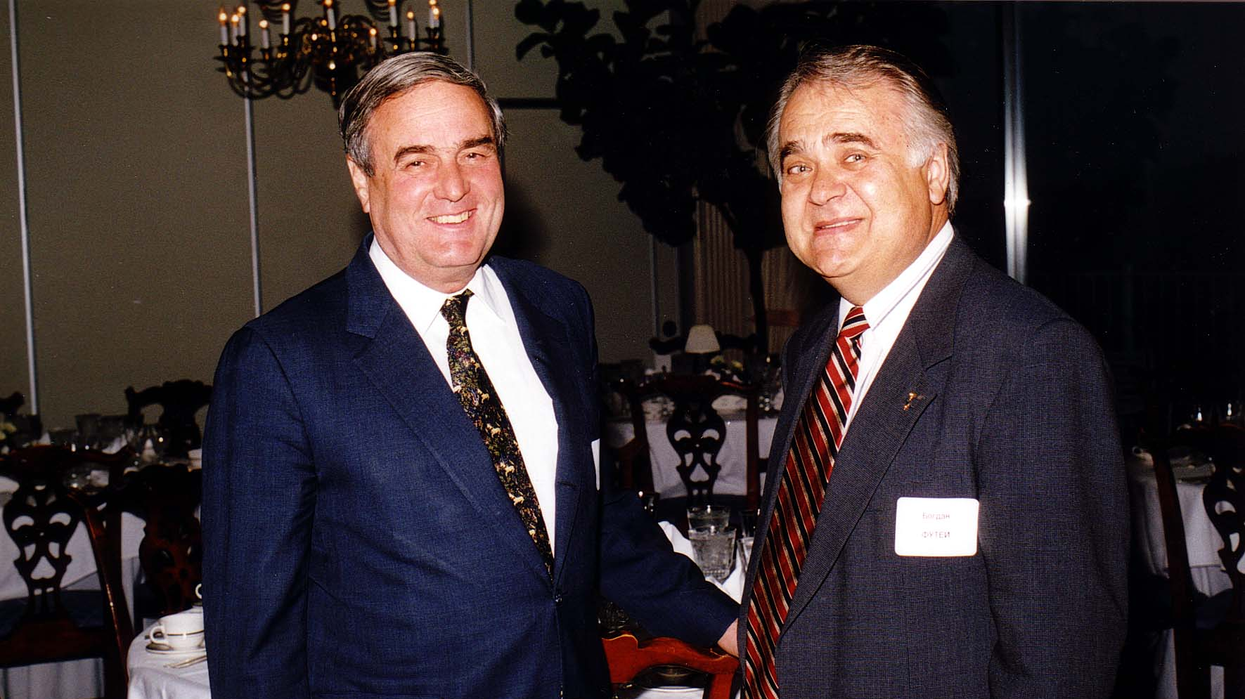
Notes:
TWG_Photo_1999_No_299-7__Joint_Conference__Ambassador_William_Miller__Judge_Bohdan_Futey

Slide 21
1999 300 TWG Events Photographs
Placeholder

Slide 22
1999 600 TWG Social Events Photographs
Winery Tour: Marina Lomacky, Oles Lomacky, Roberta Drabyk, Michael Drabyk, Ksenia Lutz, Bohdana Gott, John Gott, baby Andrijko Gott, Andrew Mostovych, Marta Mostovych, Lida Teluk, Myron Teluk, Natalie Sluzar

Slide 23
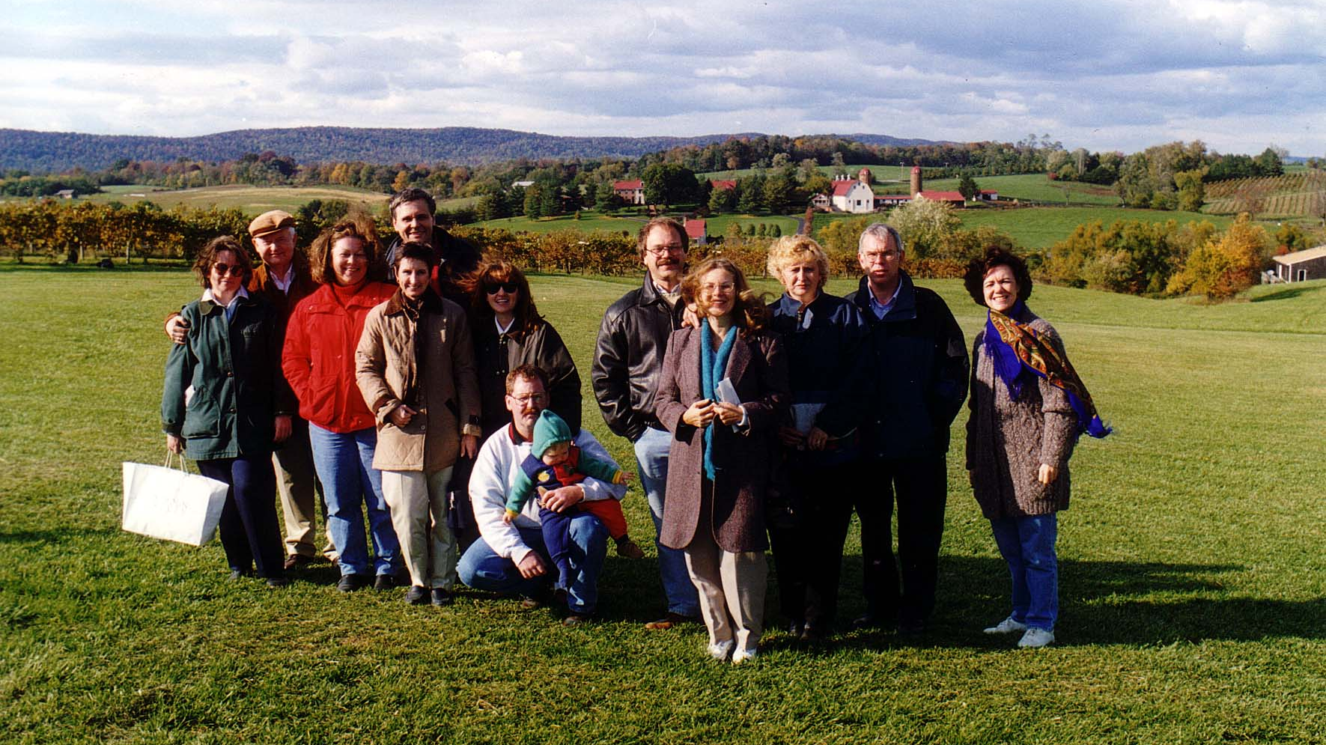
Notes:
TWG_Photo_1999_No_601__Oct_23__Virginia_Winery_Tour__Left_Group__Marina_and_Oles_Lomacky_Roberta_and_Michael_Drabyk_Ksenia_Lutz_Bohdana_and_John_Gott_and_baby_Andrijko__Right_Group__Andrew_and_Marta_Mostovych_Lida_and_Myron_Teluk_Natalie_Sluzar
See 1999 September-October TWG NEWS, page 7, for event announcement and November-December TWG NEWS, page 9, for event coverage

Slide 24
1999 700 TWG Interns Photographs
Valentina Yarr

Slide 25
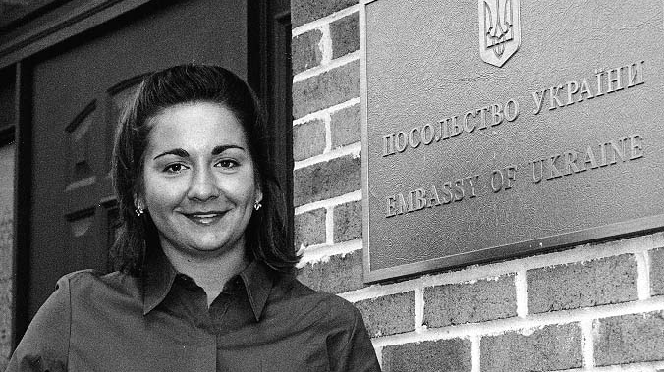
Notes:
TWG_Photo_1999_No_701__TWG_Intern_Valentina_Yarr
See 1999 September-October TWG NEWS, page 1, for event coverage

Slide 26
See TWGCF Photo Album for 1999 Cultural Events
Kochan and Kytasty
Horowitz Competition Winners
Icon Exhibit

