Slide 1
TWG 2000 Photos
October 25, 2020

Slide 2
2000 100 TWG Annual Meeting Van Ness East May 17
See 2000 January-February TWG NEWS for Annual Meeting announcement and Summer TWG NEWS for Annual Meeting coverage
Elected to the Board: Ihor Kotlarchuk – President; Anya Silecky – Vice President; Michael Drabyk - Secretary; Roman Stelmach – Treasurer; Andy Szul - Public Relations; Juliana Kinal – Membership Director; Oles Berezhny - Special Projects; Tanya Stasiuk – Events Director; Orest Deychakiwsky - Immediate Past President
Cultural Fund Director: Laryssa Chopivsky
Fellowship Fund: Adrian Karmazyn
Business Development: Andrew Bihun
Members at Large: Mykola Babiak, Arthur Belendiuk, Steven Boyduy, Oleg Jerschkowsky, Tatyana Kramska, Maria Kulczycky, George Masiuk, Adrian Pidlusky, Volodymyr Yakymets, Marta Zielyk
Auditor: Andrew Charchalis, Ihor Procinsky, Michael Kowalysko
TWG NEWS Editor: Yaro Bihun

Slide 3
2000 200 TWG Leadership Conference Key Bridge Marriott Hotel Arlington VA October 6-8 Photographs
See Leadership Conference Announcement and Conference Planning in 2000 Summer TWG NEWS, page 1
See TWG_2000_Leadership_Conference_Booklet for Conference Program and Speaker Biographies
See 2000 November-December TWG NEWS for Leadership Conference Coverage
See TWG Leadership Conference coverage by The Ukrainian Weekly: The_Ukrainian_Weekly_2000-43

Slide 4
2000 201 TWG Leadership Conference Reception October 6 Photographs
TWG President Ihor Kotlarchuk, Oleksii Berezhnyi

Slide 5
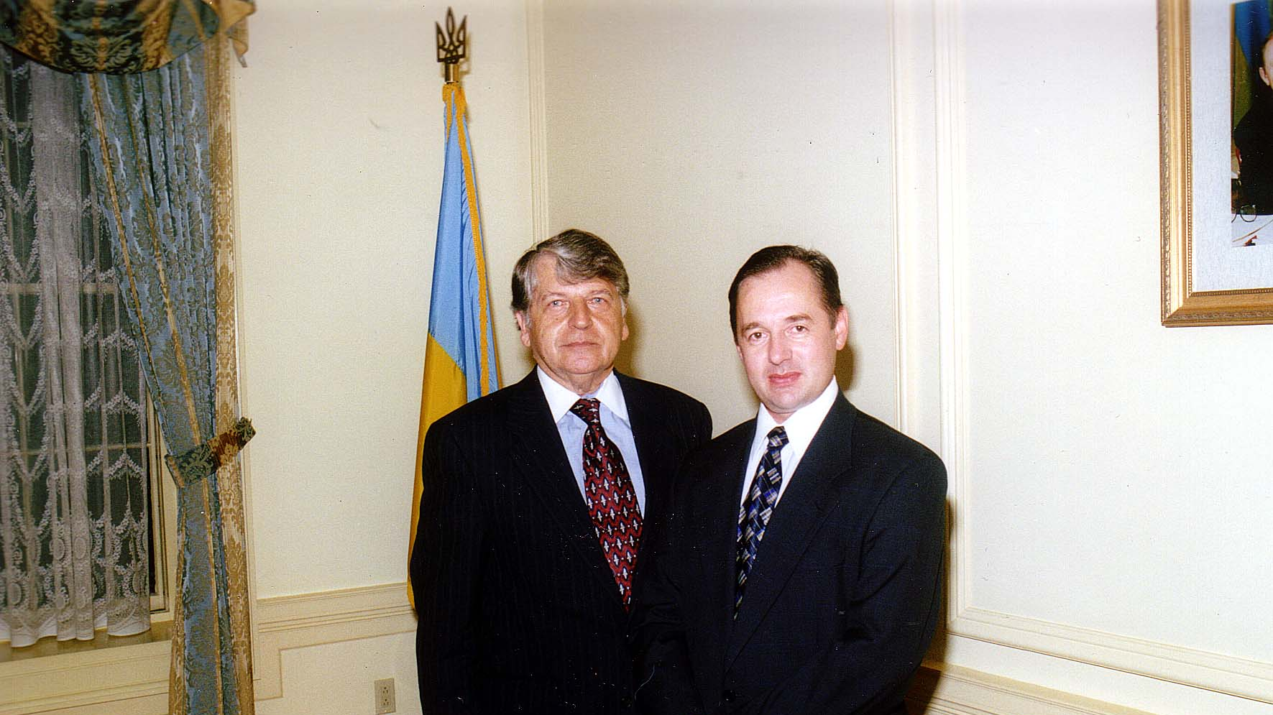
Notes:
TWG_Photo_2000_No_203__Oct_6__Ukrainian_Embassy__TWG_Leadership_Conference_Reception__TWG_President_Ihor_Kotlarchuk__Ukraine_Embassy_Chargé_d'Affaires_Oleksii_Berezhnyi
See 2000 November-December TWG NEWS, page 4, for event coverage

Slide 6
2000 220 TWG Leadership Conference Luncheon October 7 Photographs
Amb. Carlos Pascual; Lubomyr Zielyk, Larysa Zielyk, Marta Zielyk, Olena Gaponenko

Slide 7
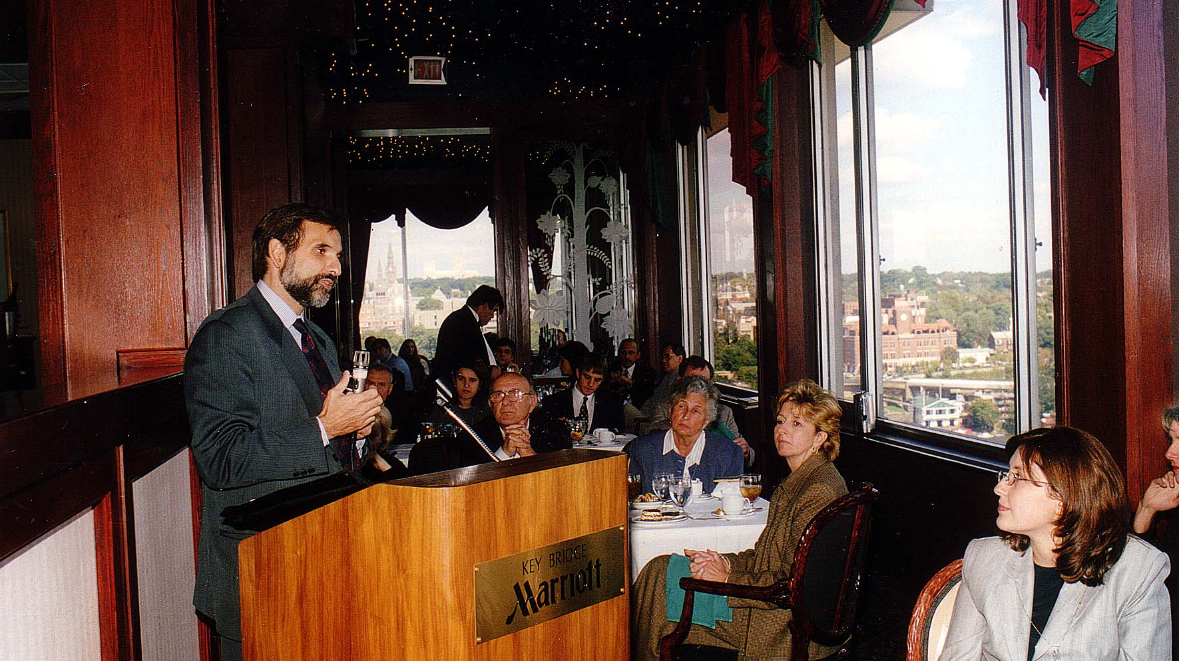
Notes:
TWG_Photo_2000_No_221__Oct_7__Leadership_Conference_Luncheon_Speaker__US_Ambassador_to_Ukraine_Carlos_Pascual___looking_on__Lubomyr_Zielyk__Larysa_Zielyk__Marta_Zielyk_and_on_bottom_right_Olena_Gaponenko
See 2000 November-December TWG NEWS, page 1, for event coverage

Slide 8
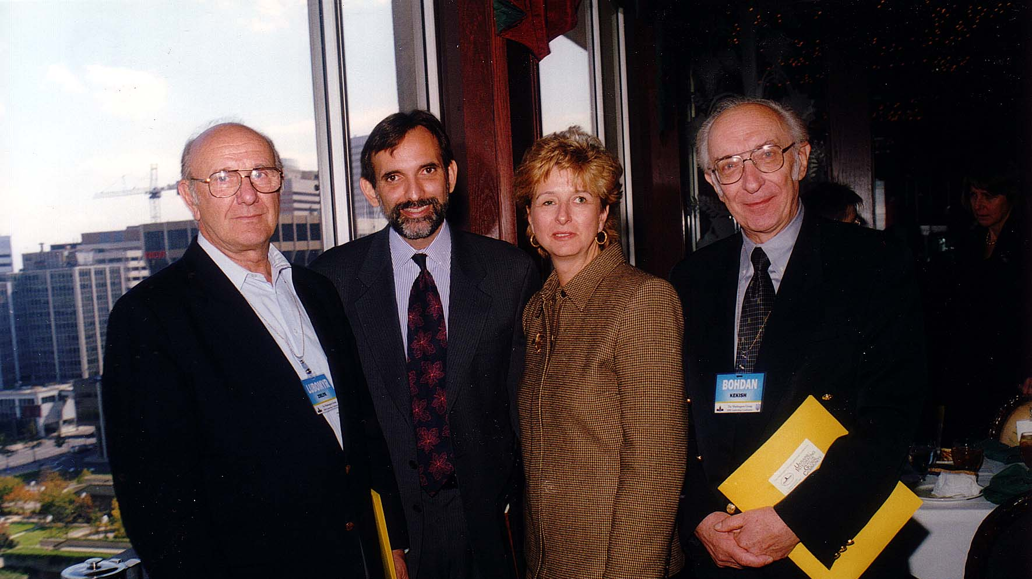
Notes:
TWG_Photo_2000_No_223__Oct_7__Leadership_Conference__New_York_SelfReliance_FCU_Lubomyr_Zielyk__Ambassador_Carlos_Pascual__State_Department_Ukrainian_Language_Interpreter_and_TWG_VP_Marta_Zielyk__Rochester_Ukrainian_FCU_ Bohdan_Kekish
See 2000 November-December TWG NEWS, page 1, for event coverage

Slide 9
2000 230 TWG Leadership Conference Banquet October 7 Photographs
George Masiuk
Orest Deychakiwsky
Frank Piazza and Anya Piazza
John Ballard and Juliana Ballard
Maria Kulczycky and Lamar Brantley
Roman Stelmach and Donna Pochoday

Slide 10
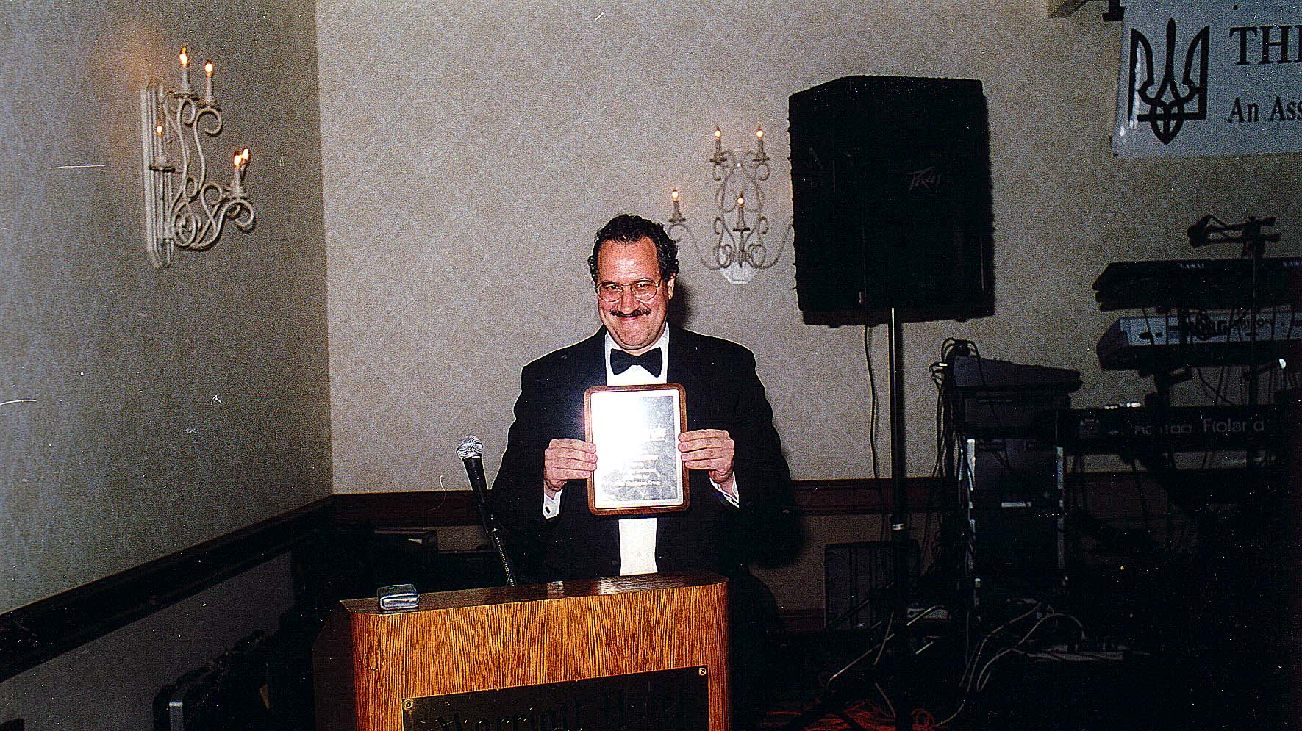
Notes:
TWG_Photo_2000_No_232__Oct_7__Leadership_Conference_Banquet__Award_to_George_Masiuk_for_helping_organize_TWG_Leadership_Conferences
See 2000 November-December TWG NEWS, pages 9 and 10, for event coverage

Slide 11
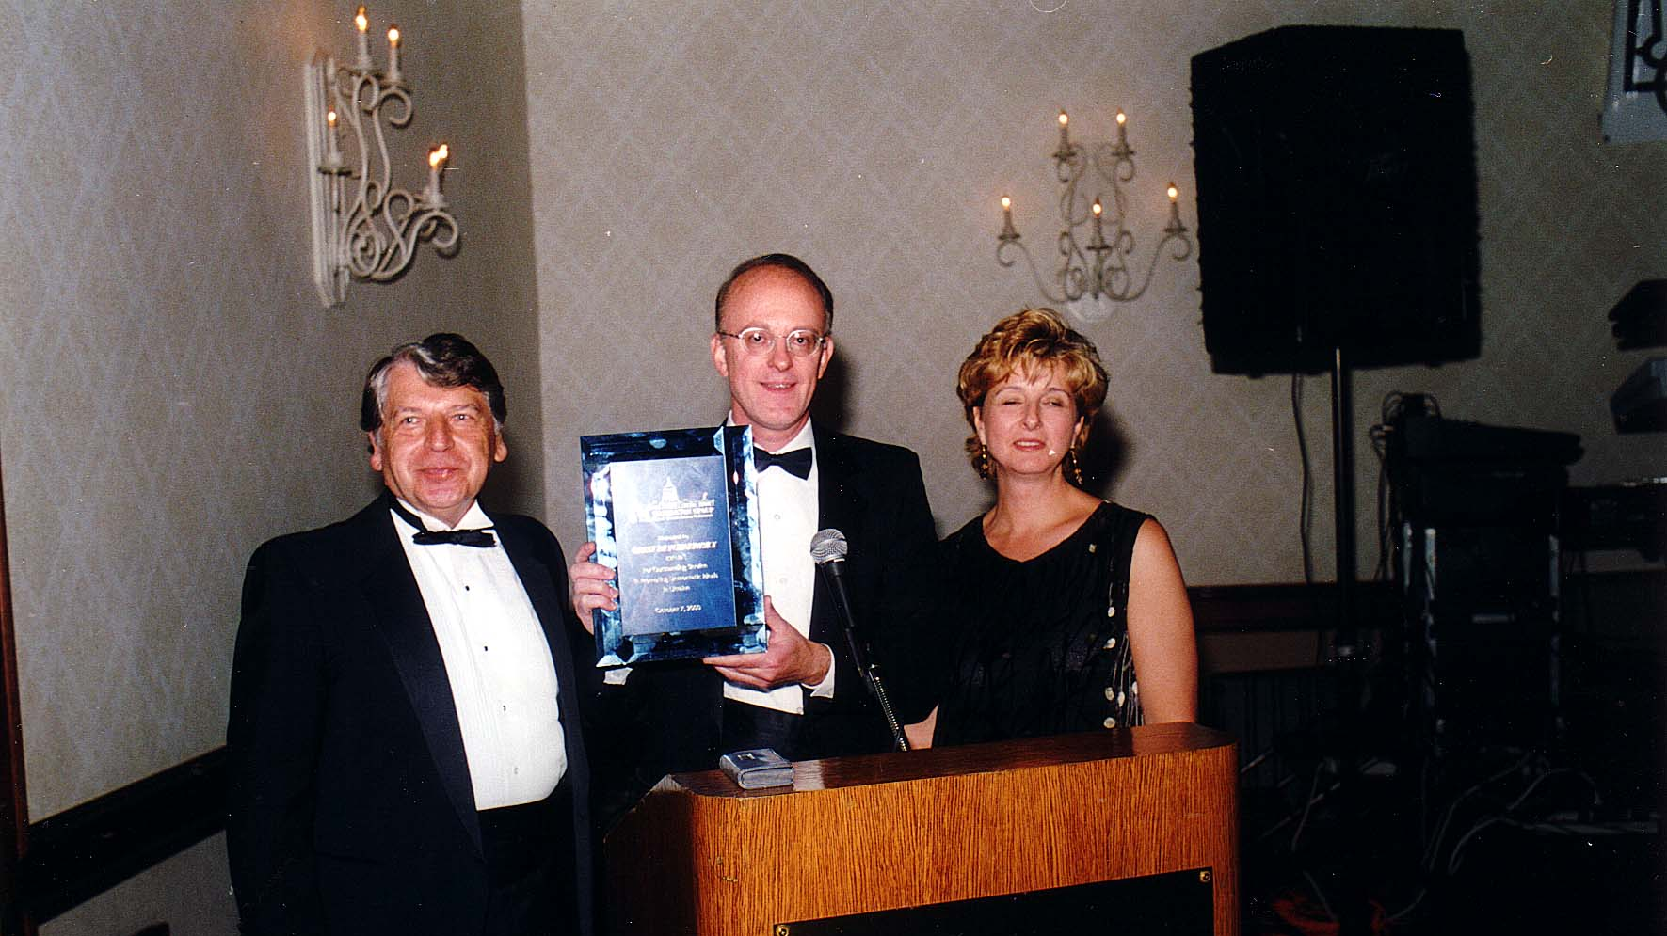
Notes:
TWG_Photo_2000_No_233__Oct_7__Leadership_Conference_Banquet_Award__TWG_President_Ihor_Kotlarchuk___Award_Recipient_for_fostering_Human_Rights_and_Democracy_in_Ukraine_Former_TWG_President_Orest_Deychakiwsky___TWG_VP_Marta_Zielyk
See 2000 November-December TWG NEWS, page 9, for event coverage

Slide 12
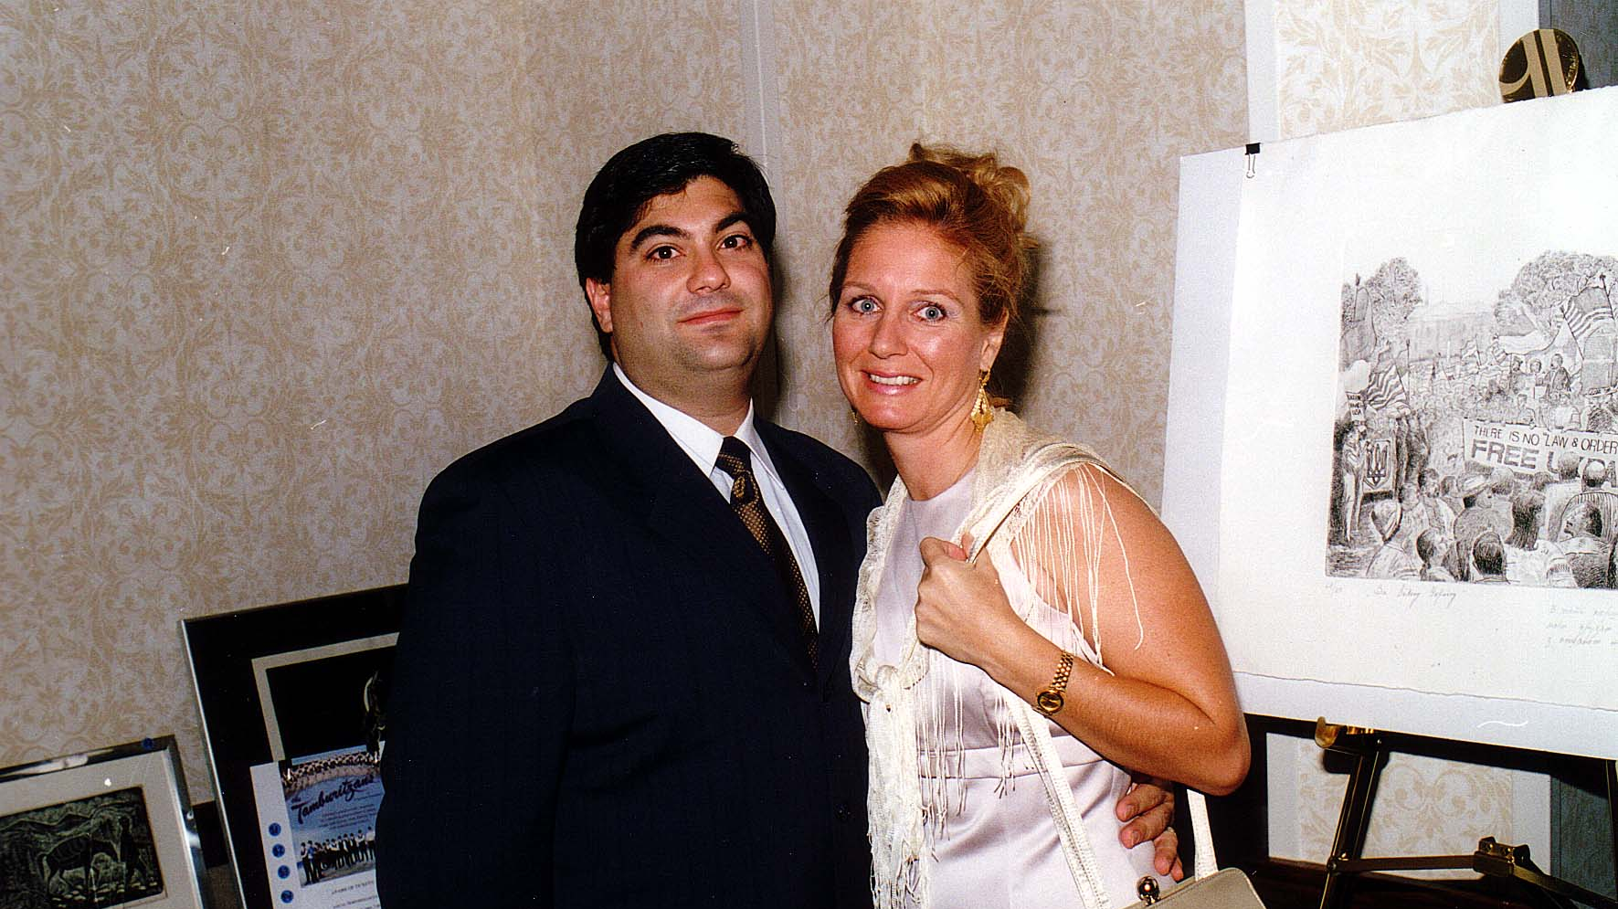
Notes:
TWG_Photo_2000_No_234__Oct_7__Leadership_Conference_Banquet__Frank_and_Anya_(Silecky)_Piazza

Slide 13
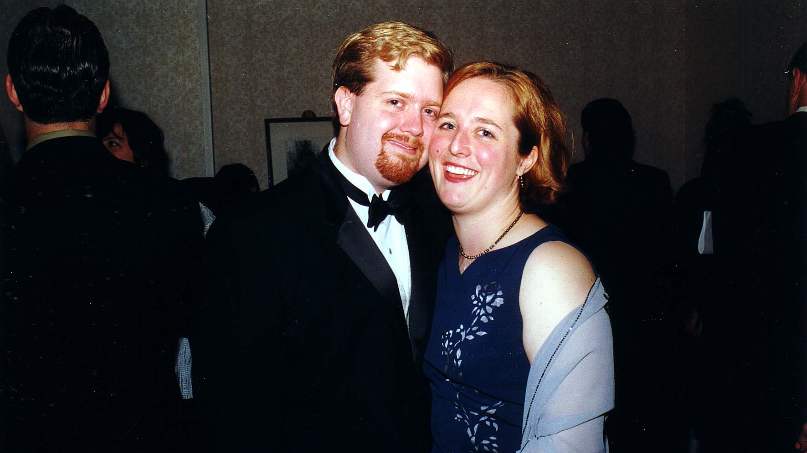
Notes:
TWG_Photo_2000_No_235__Oct_7__Leadership_Conference_Banquet__John_and_Juliana_(Kinal)_Ballard

Slide 14
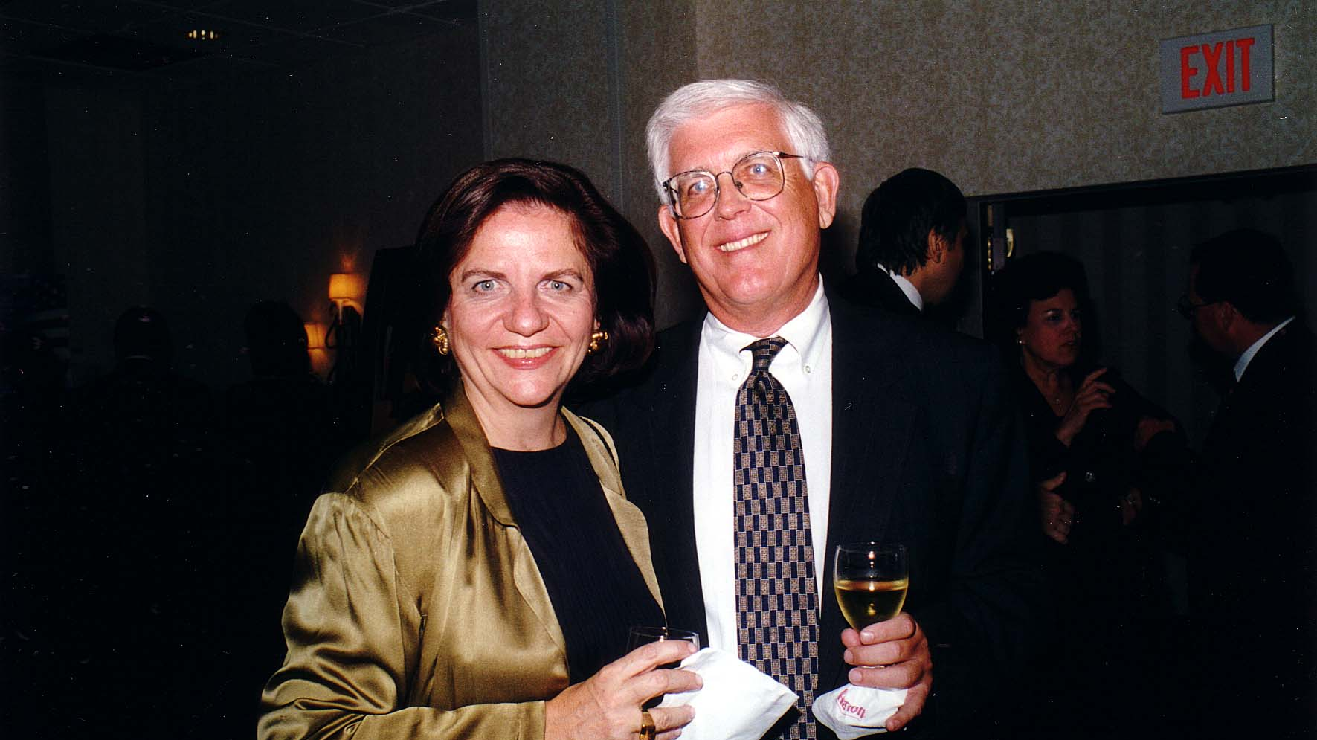
Notes:
TWG_Photo_2000_No_236__Oct_7__Leadership_Conference_Banquet__Maria_Kulczycky_with_husband_Lamar_Brantley

Slide 15
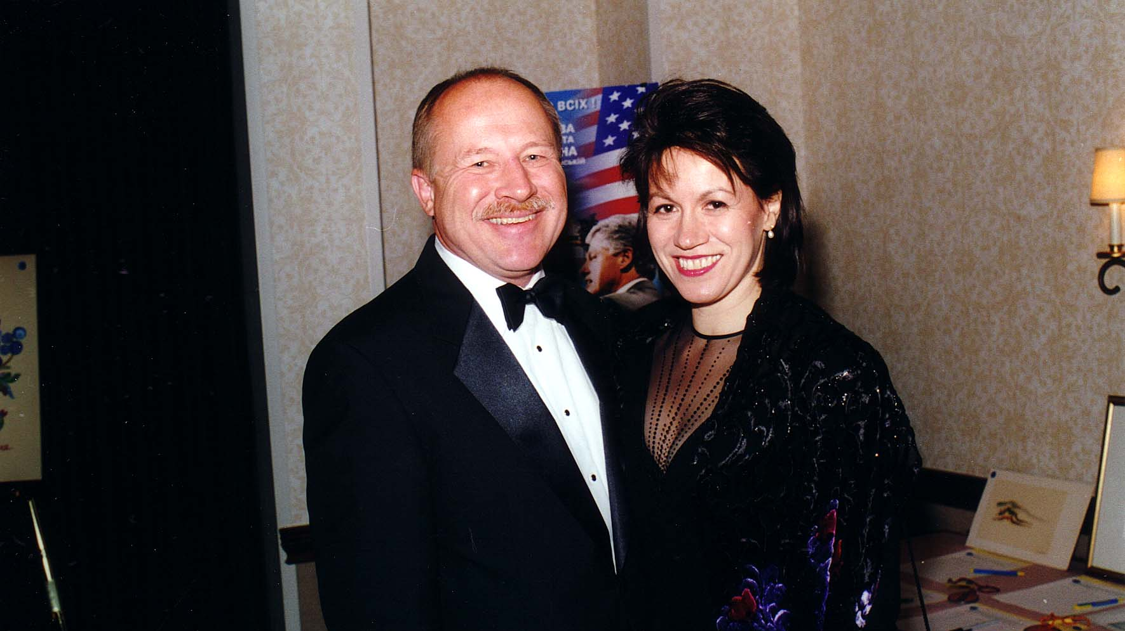
Notes:
TWG_Photo_2000_No_237__Oct_7__Leadership_Conference__Roman_Stelmach_with_wife_Donna_Pochoday

Slide 16
2000 240 TWG Leadership Conference Panel 1: The Future of the Nation-State and its Implications for Ukraine October 7 Photographs
Andrij Masiuk, Roman Solchanyk, Oleh Havrylyshyn

Slide 17
Notes:
TWG_Photo_2000_No_241__Oct_7__Leadership_Conference__Future_of_Nation_State__Former_Director_International_Management_Institute_Kyiv_Andrij_Masiuk__RAND_Corporation_Analyst_Roman_Solchanyk__Senior_Advisor_IMF_Oleh_Havrylyshyn
See 2000 November-December TWG NEWS, page 4, for event coverage

Slide 18
2000 250 TWG Leadership Conference Panel 2: Developments in Contemporary Ukraine October 7 Photographs
Oleksander Potiekhin, George Grabowicz, Anders Aslund, Andrew Bihun

Slide 19
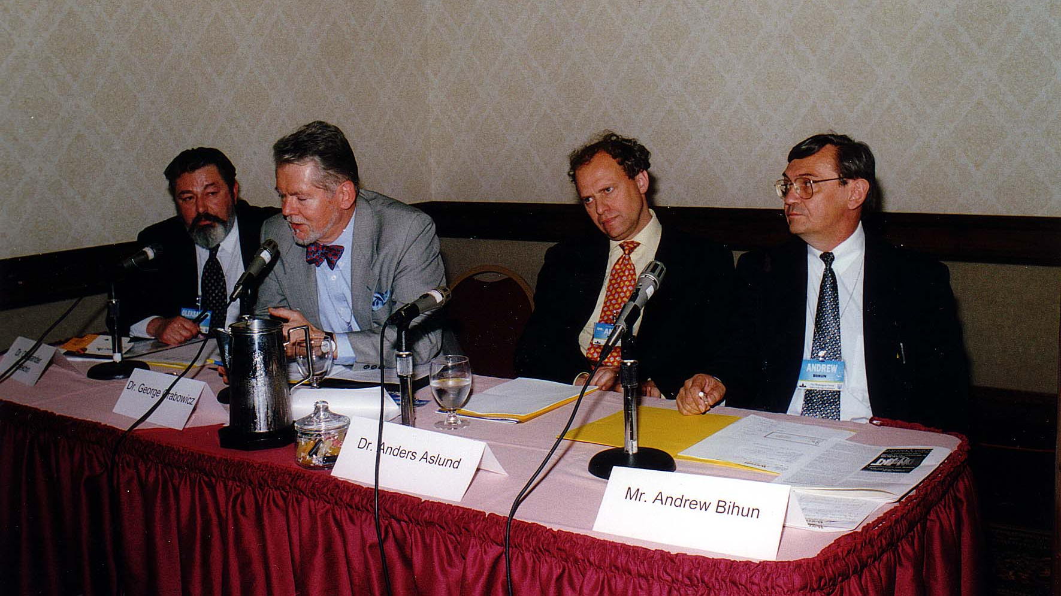
Notes:
TWG_Photo_2000_No_251__Oct_7__Leadership_Conference__Developments_in_Ukraine_Panel__Ukr_Embassy_Olexander_Potiekhin__Harvard_Professor_George_Grabowicz__Carnegie_Endowment_for_International_Peace_Anders_Aslund__Moderator_Andrew_Bihun
See 2000 November-December TWG NEWS, page 6, for event coverage

Slide 20
2000 260 TWG Leadership Conference Panel 3: Building a Civil Society in Ukraine October 7 Photographs
Katie Fox, Judy van Rest, Orest Deychakiwsky, William Taylor

Slide 21
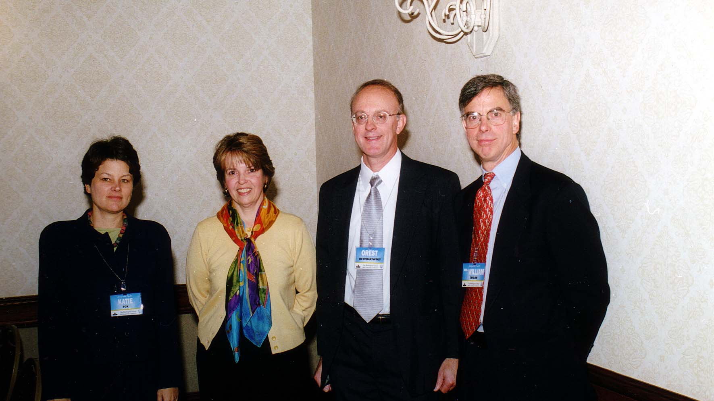
Notes:
TWG_Photo_2000_No_261__Oct_7__Leadership_Conference__National_Democratic_Institute_Katie_Fox__International_Republican_Institute_Judy_Van_Rest__Helsinki_Commission_Orest_Deychakiwsky__DOS_Coordinator_Assistance_Programs_to_NIS_Amb_William_Taylor
See 2000 November-December TWG NEWS, page 8, for event coverage

Slide 22
2000 290 TWG Leadership Conference Sunday Brunch Entertainment October 8 Photographs
Yurij Fedynsky, Julian Kytasty, Michael Andrec

Slide 23
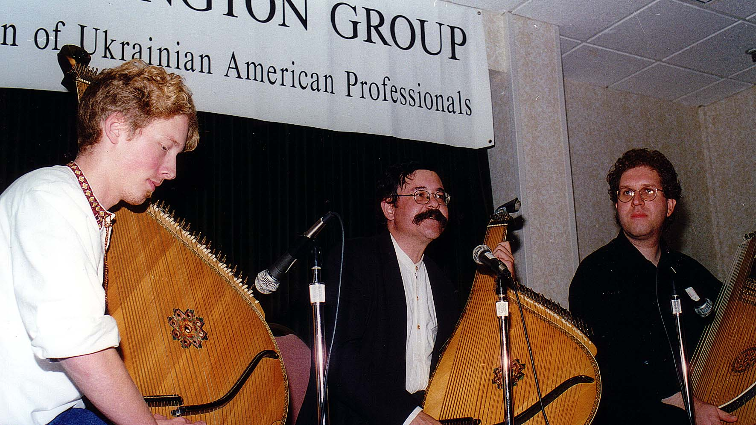
Notes:
TWG_Photo_2000_No_292__Oct_8__Leadership_Conference_Brunch_Entertainment__Experimental_Bandura_Trio__Yurij_Fedynsky__Julian_Kytasty__Michael_Andrec
See 2000 November-December TWG NEWS, page 10, for event coverage

Slide 24
2000 295 TWG Leadership Conference Arts, Vendors, Silent Auction October 7 Photographs
Sofika Zielyk, Maria Baczynskyj, Oleg Jerschkowsky

Slide 25
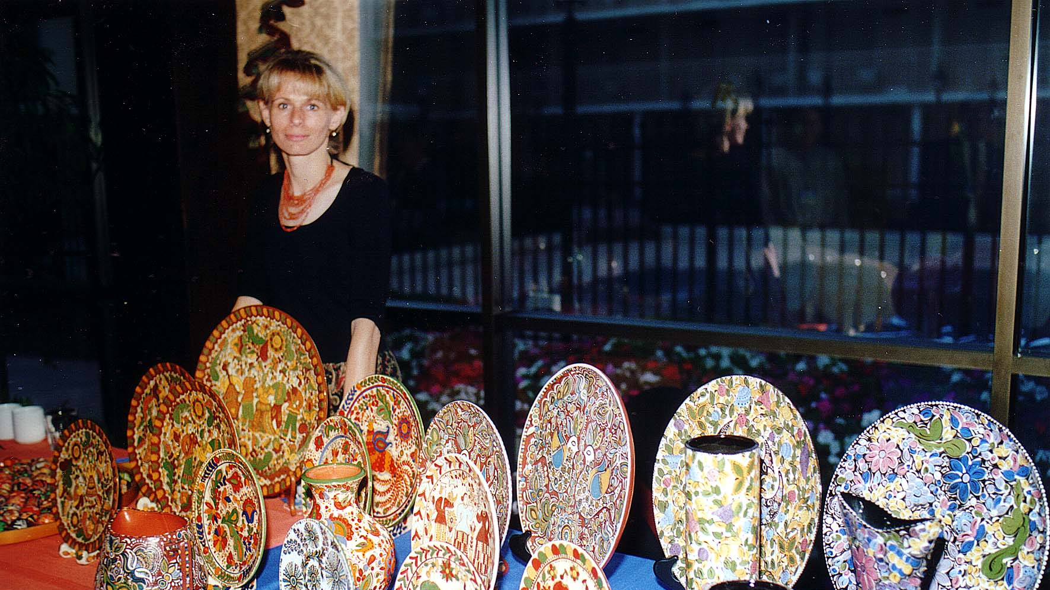
Notes:
TWG_Photo_2000_No_296__Oct_7__Leadership_Conference__Sofika_Arts__Sofika_Zielyk
See 2000 November-December TWG NEWS for Conference coverage

Slide 26
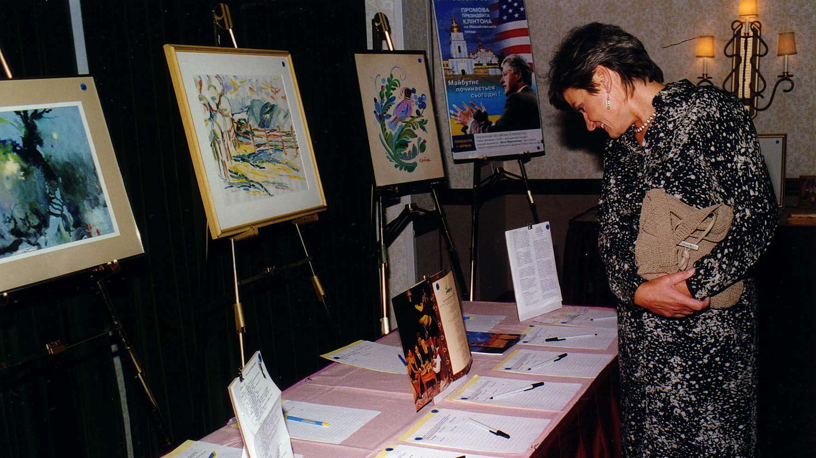
Notes:
TWG_Photo_2000_No_297__Oct_7__Leadership_Conference__Silent_Auction_participating_Maria_Baczynskyj
See 2000 Summer TWG NEWS, page 6, for event coverage

Slide 27
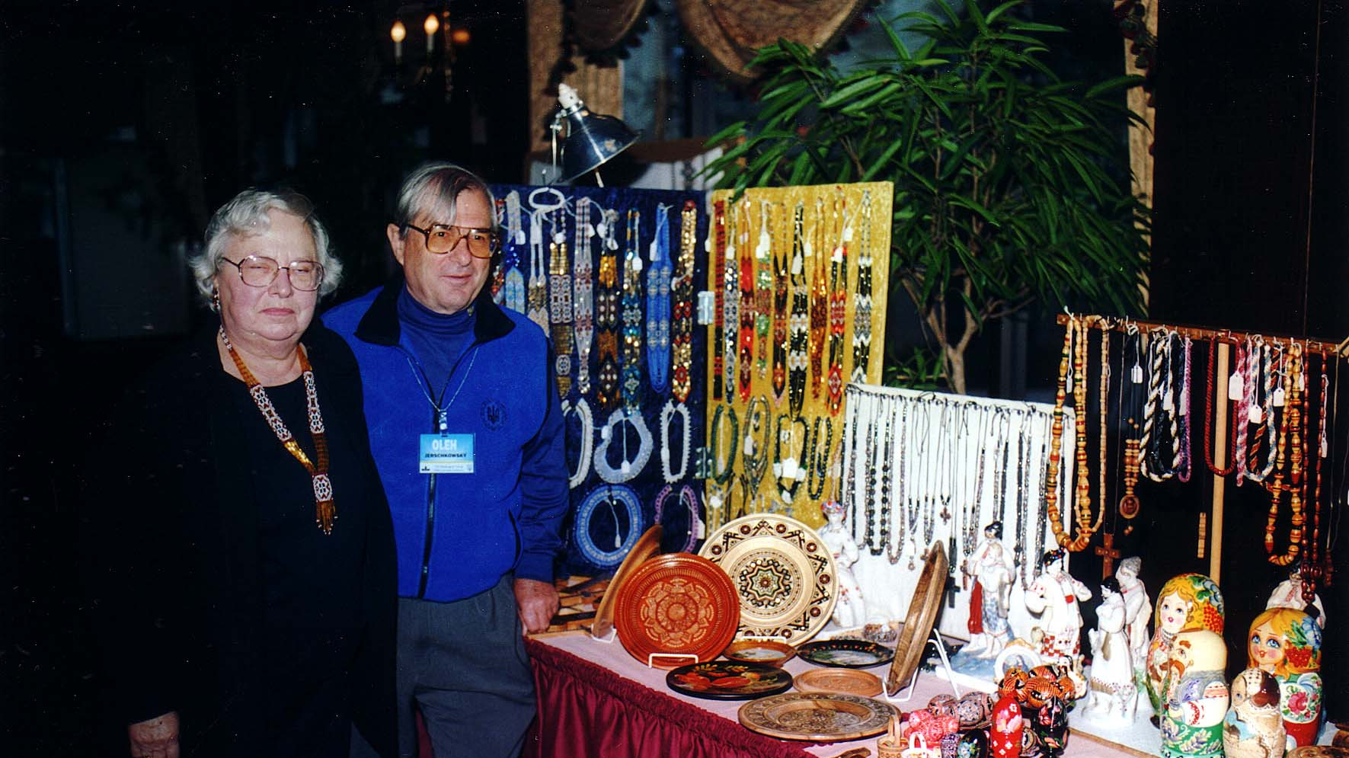
Notes:
TWG_Photo_2000_No_298__Oct_7__Leadership_Conference_Vendors__Oleg_Jerschkowsky_and_Wife
See 2000 November-December TWG NEWS for Conference coverage

Slide 28
See TWGCF Photo Album for 2000 Cultural Events
Solomiya Soroka
Volodymyr Vynnytsky
Solomiya Ivakhiv
TWGCF Cultural Committee

