Slide 1
TWG 2001 Photos
October 25, 2020

Slide 2
2001 100 TWG Annual Meeting
See 2001 Fall-Winter TWG NEWS for Annual Meeting coverage
Elected to the Board: Ihor Kotlarchuk – President; Anya Silecky – Vice President; Volodymyr Yakymets - Secretary; Roman Stelmach – Treasurer; Andy Szul - Public Relations; Adrian Pidlusky – Membership Director; Oles Berezhny - Special Projects; Olena Gaponenko – Events Director; Orest Deychakiwsky - Immediate Past President
Cultural Fund Director: Laryssa Chopivsky
Fellowship Fund: Adrian Karmazyn
Business Development: Andrew Bihun
Members at Large: Mykola Babiak, Arthur Belendiuk, Yaro Bihun, Steven Boyduy, Michael Drabyk, Oleg Jerschkowsky, Tatyana Kramska, Maria Kulczycky, George Masiuk, Jurij Mojsiak, Natalie Sluzar, Tanya Stasiuk, Marta Zielyk
Auditor: Andrew Charchalis, Ihor Procinsky, Michael Kowalysko
TWG NEWS Editor: Andy Szul

Slide 3
2001 200 TWG Leadership Conference Key Bridge Marriott Hotel Arlington VA October 19-21 Photographs
See Leadership Conference Announcement and Conference Planning in TWG_NEWS_2001_Leadership_Conference_Announcement issue
See Leadership Conference Coverage in TWG_NEWS_Special_Issue_2001_Leadership_Conference

Slide 4
2001 201 TWG Leadership Conference Embassy Reception October 20 Photographs
Borys Tarasyuk
Amb. William Miller
Amb. Kostyantyn Gryshchenko

Slide 5
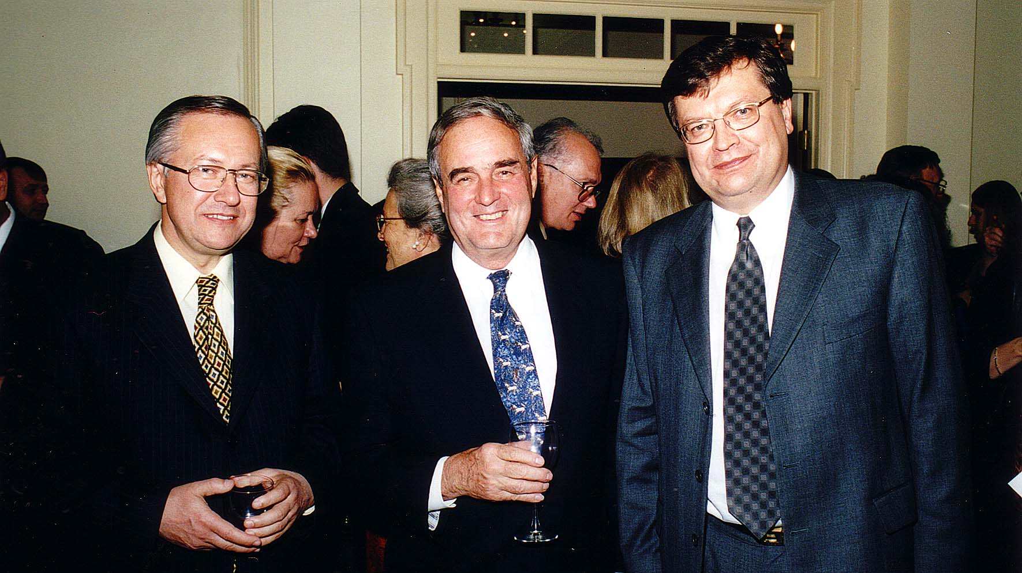
Notes:
TWG_Photo_2001_No_202__Oct_19__Ukrainian_Embassy__Leadership_Conference_Reception__Former_Ukraine_Foreign_Minister_Borys_Tarasyuk__Former_US_Ambassador_to_Ukraine_William_Miller__Ukrainian_Ambassador_Kostyantyn_Gryshchenko
See TWG_NEWS_Special_Issue_2001, page 1, for event coverage

Slide 6
2001 220 TWG Leadership Conference Luncheon Address October 20 Photographs
Borys Tarasyuk
Ambassadors’ Table: Myroslava Gongadze, TWG President Ihor Kotlarchuk, Borys Tarasyuk, George Masiuk, Nadia Diuk, Slovak Amb. Martin Butora, Hungarian Amb. Geza Jeszenszky, Volodymyr Yatsenkiwsky
Yara Zubalskyj, Maria Pryshlak, Rev. Borys Gudziak, Olga Hirshhorn

Slide 7
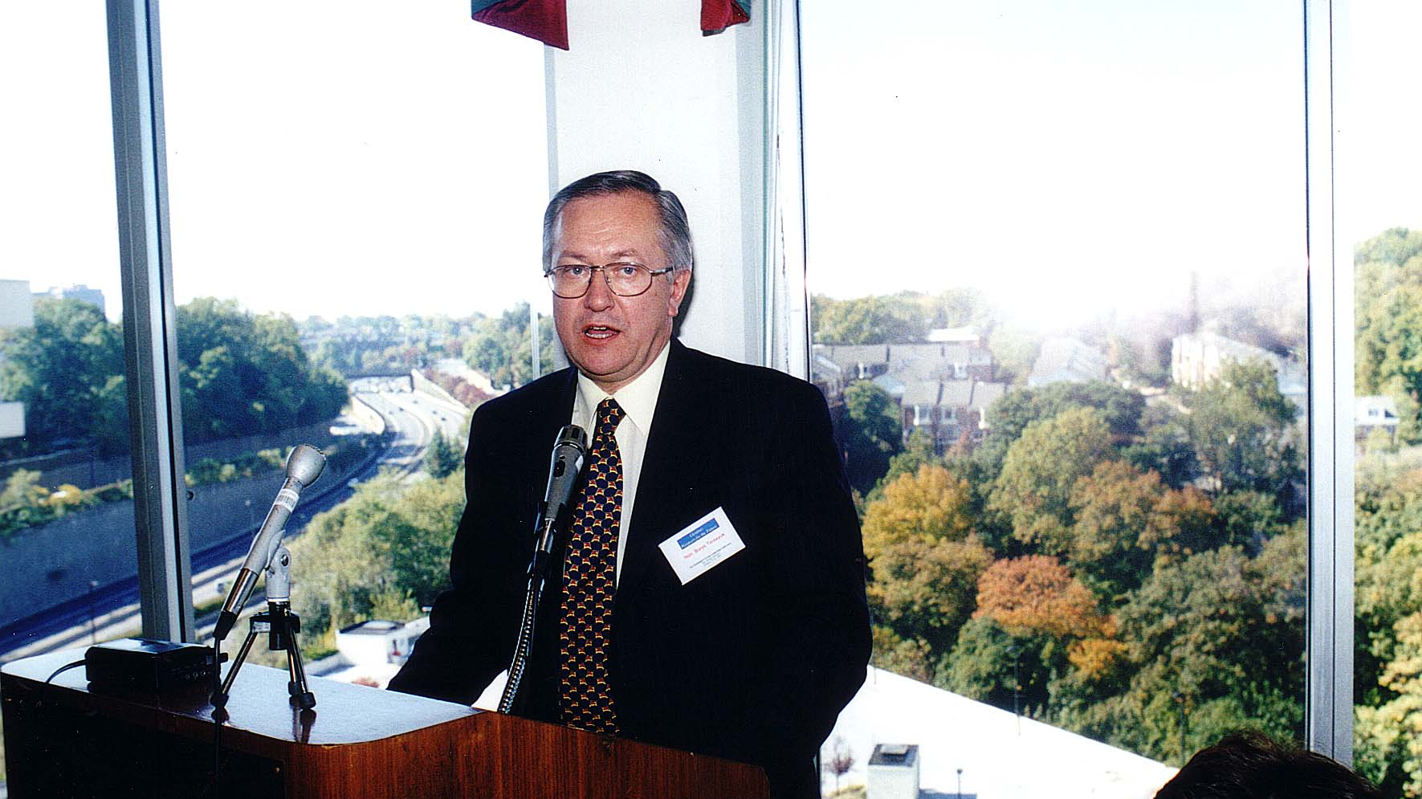
Notes:
TWG_Photo_2001_No_221__Oct_20__Leadership_Conference__Ukraine_Former_Foreign_Minister_Borys_Tarasyuk
See TWG_NEWS_2001_Leadership_Conference_Announcement issue, page 1, and TWG_NEWS_Special_Issue_2001, page 3, for Foreign Minister Borys Tarasyuk’s conference address

Slide 8
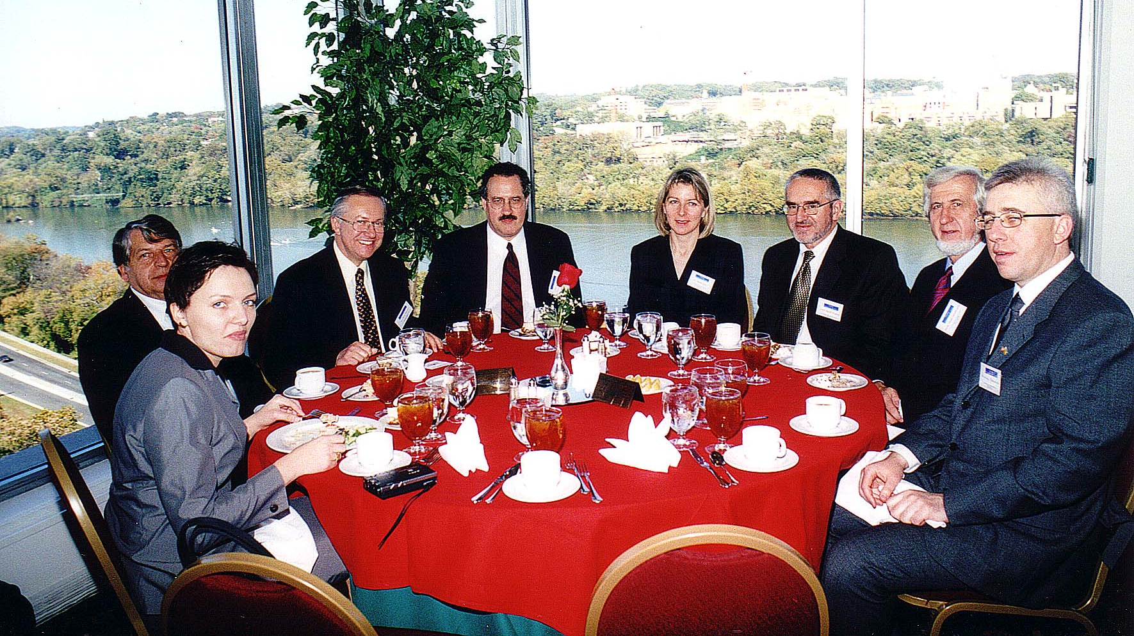
Notes:
TWG_Photo_2001_No_222__Oct_20__Leadership_Conference__Ambassadors'_Table__Myroslava_Gongadze__TWG_President_Ihor_Kotlarchuk__Borys_Tarasyuk__George_Masiuk__Nadia_Diuk__Slovak_Amb_Martin_Butora__Hungarian_Amb_Geza_Jeszenszky__Volodymyr_Yatsenkiwsky
See TWG_NEWS_Special_Issue_2001, page 7, for Ambassadors’ Forum coverage

Slide 9
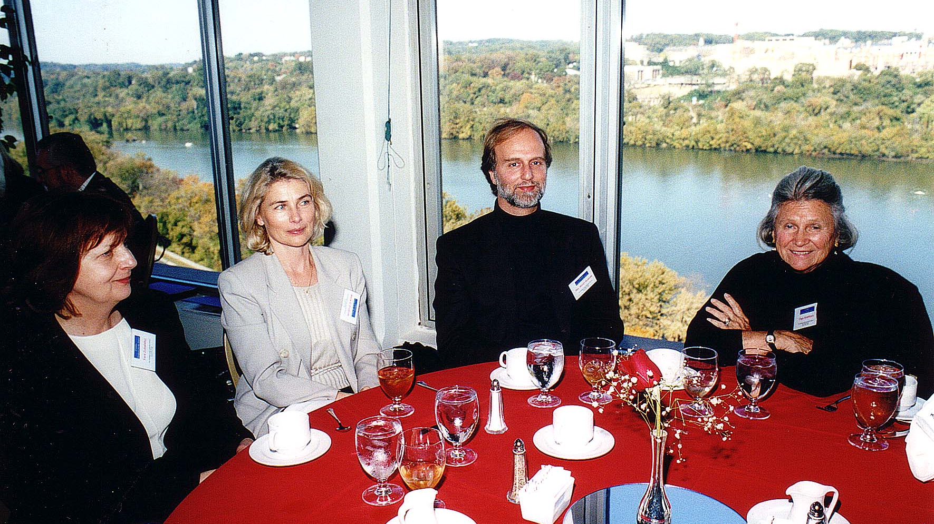
Notes:
TWG_Photo_2001_No_223__Oct_20__Leadership_Conference__Yara_Zubalskyj__Maria_Pryshlak__Rev_Borys_Gudziak__Modern_Art_Collector_Olga_Hirshhorn
See TWG_NEWS_2001_Leadership_Conference_Announcement issue, page 1, and TWG_NEWS_Special_Issue_2001, page 4, for Rev. Borys Gudziak’s conference address

Slide 10
2001 230 TWG Leadership Conference Banquet October 20 Photographs
TWG President Ihor Kotlarchuk, Gen. Nicholas Krawciw

Slide 11
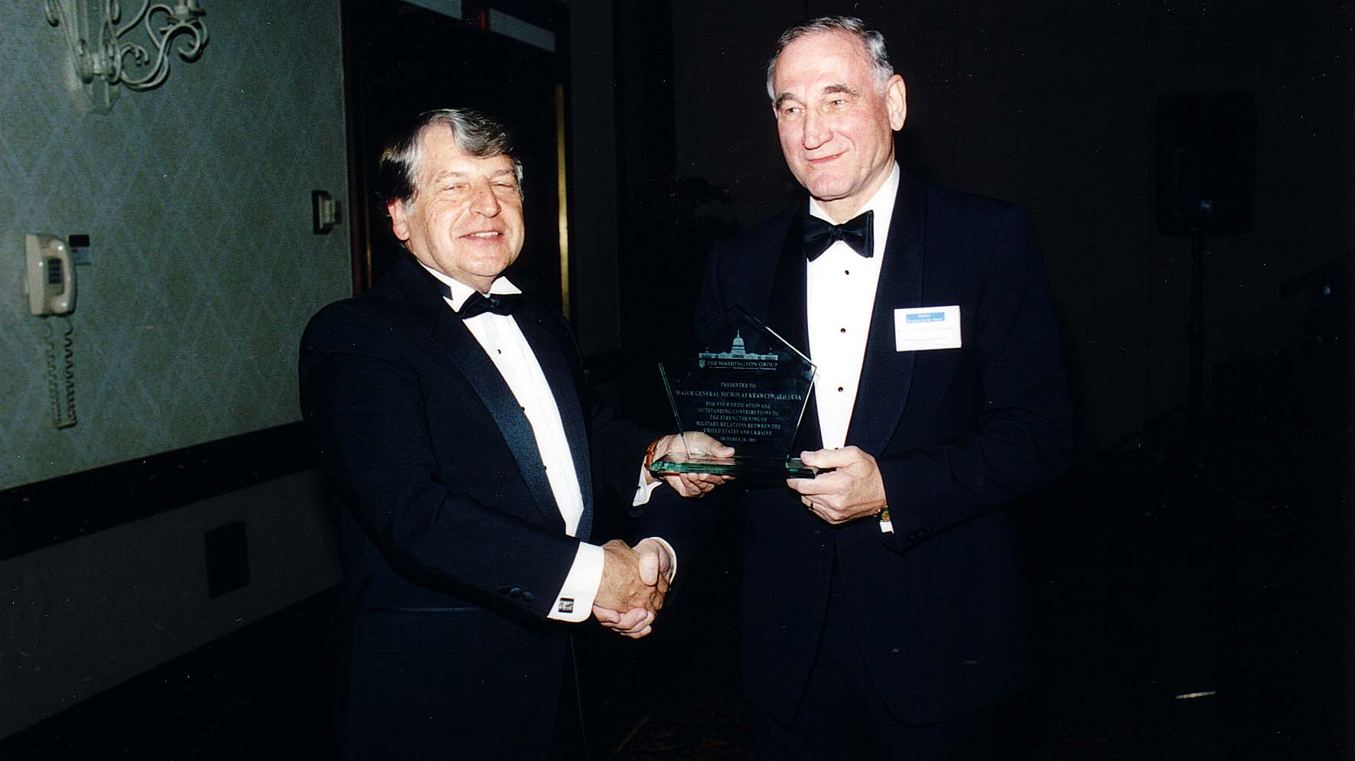
Notes:
TWG_Photo_2001_No_232_Oct__20__Leadership_Conference_Banquet__TWG_President_Ihor_Kotlarchuk_presents_award_to__General_Nicholas_Krawciw
See TWG_NEWS_2001_Leadership_Conference_Announcement issue, page 1, and TWG_NEWS_Special_Issue_2001, page 10, for event coverage

Slide 12
2001 240 TWG Leadership Conference Panel 1: United States Policy Toward Ukraine October 20 Photographs
Lida Wolansky, Gregory Perrett, Christine Lucyk, George Masiuk, Stacy Closson

Slide 13
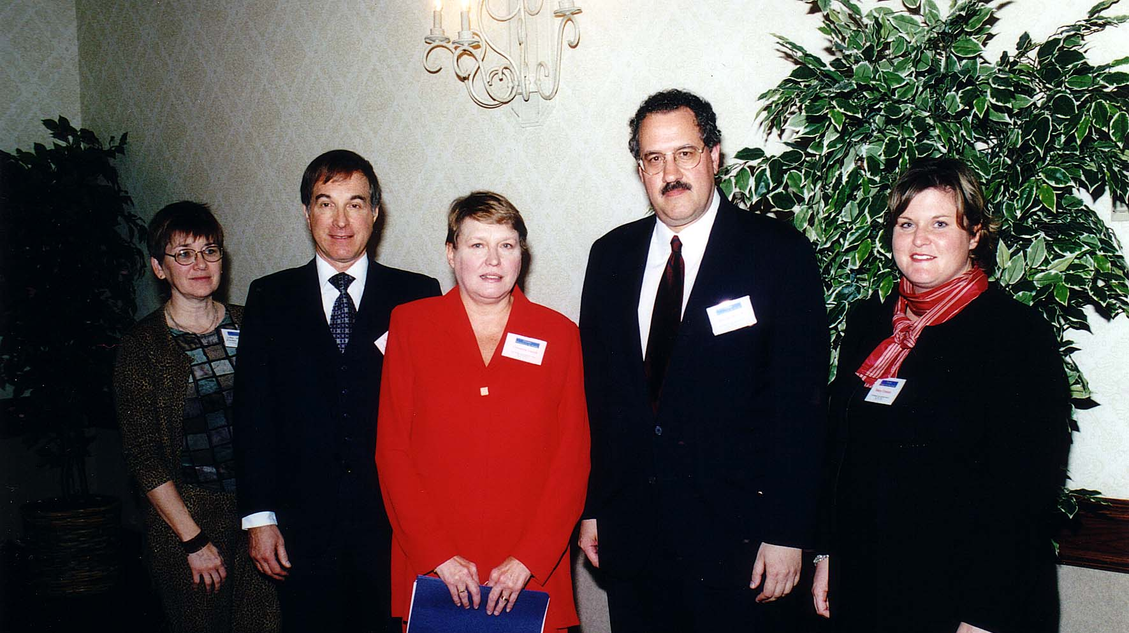
Notes:
TWG_Photo_2001_No_241_Leadership_Conference__US_Policy_Toward_Ukraine__Publisher_Eastern_Economist_Lida_Wolansky__DOS_Director_of_Ukrainian_Moldovan_Belarusian_Affairs_Gregory_Perrett__Commerce_Department_Advisor_Christine_Lucyk__George_Masiuk__DoD_Ukraine_Office_Stacy_Closson
See TWG_NEWS_Special_Issue_2001, page 5, for event coverage

Slide 14
2001 250 TWG Leadership Conference Panel 2: Ambassadors' Forum October 20 Photographs
Amb. Kostyantyn Gryshchenko, TWG President Ihor Kotlarchuk, Nadia Diuk, Amb. Martin Butora, Amb. Geza Jeszenszky, George Masiuk, Amb. Philip Dmitrov

Slide 15
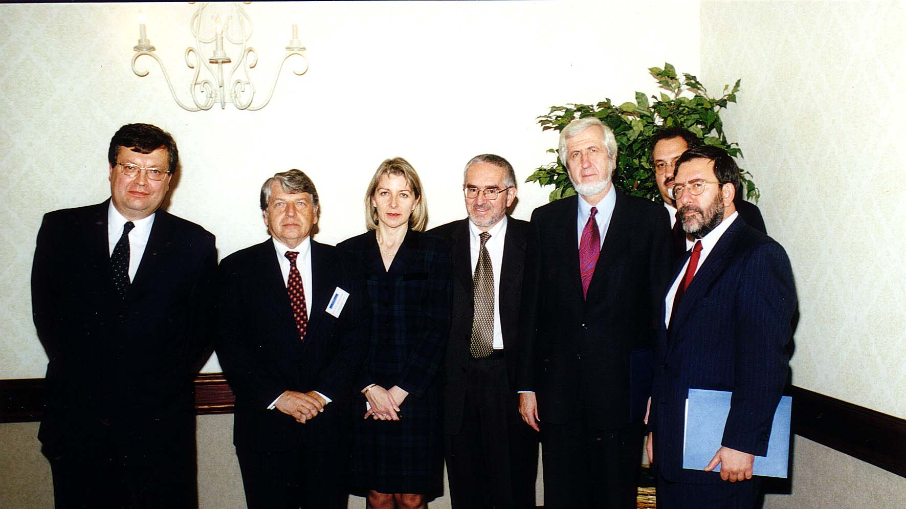
Notes:
TWG_Photo_2001_No_251_Leadership_Conference__Ambassador_Panel__Ukraine_Amb_Kostyantyn_Gryschenko__TWG_President_Ihor_Kotlarchuk__Moderator_Nadia_Diuk__Slovak_Amb_Martin_Butora__Hungarian_Amb_Geza_Jeszenszky__Conf_Chair_George_Masiuk__Bulgarian_Amb_Philip_Dmitrov
See TWG_NEWS_Special_Issue_2001, page 7, for Ambassadors’ Forum coverage

Slide 16
2001 260 TWG Leadership Conference Panel 3: Women and Ukrainian Society October 20 Photographs
Alexandra Hrycak, Vera Andrushkiw, Robert de Lossa, Iryna Kurowycky, George Masiuk, Amy Heyden

Slide 17
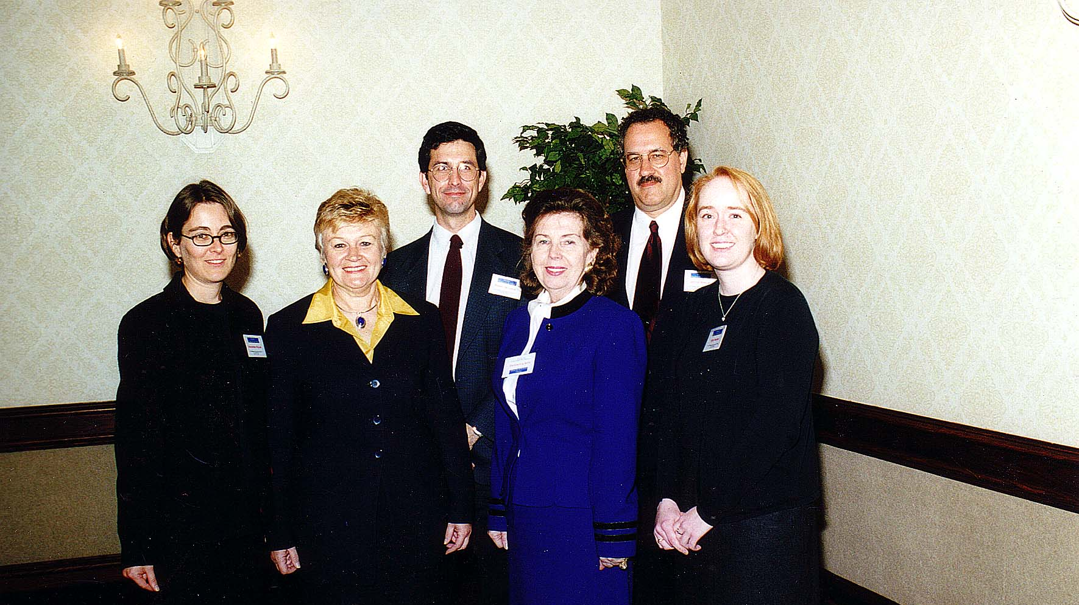
Notes:
TWG_Photo_2001_No_261__Oct_20__Leadership_Conference__Women_and_Ukr_Society_Panel__Sociologist_Alexandra_Hrycak__Community_Projects_Director_Vera_Andrushkiw__Moderator_Robert_de_Lossa__President_Ukr_Womens_League_Iryna_Kurowycky__George_Masiuk__Winrock_International_Amy_Heyden
See TWG_NEWS_Special_Issue_2001, page 9, for event coverage

Slide 18
2001 290 TWG Leadership Conference Sunday Brunch October 20 Photographs
Volodymyr Vynnytsky, TWGCF Director Laryssa Chopivsky, Mariana Vynnytsky, Andrij Vintsersky

Slide 19
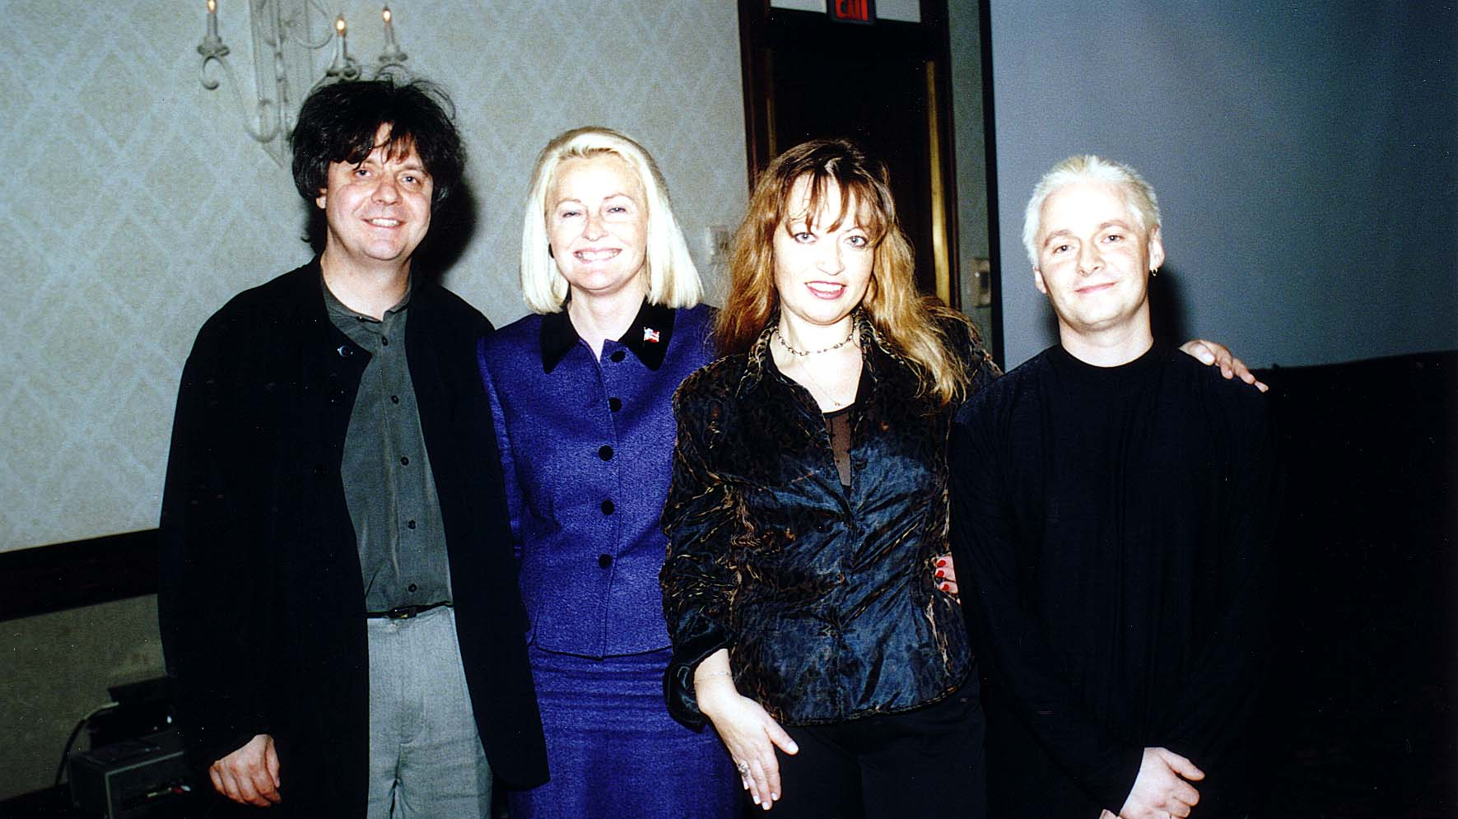
Notes:
TWG_Photo_2001_No_292__Oct_21__Leadership_Conference_Sunday_Brunch__Pianist_Volodymyr_Vynnytsky__TWGCF_Director_Laryssa_Courtney__Singer_Marianna_Vynnytsky__Keyboardist-Percussionist_Andrij_Vintsersky
See TWG_NEWS_2001_Leadership_Conference_Announcement issue, page 1, and TWG_NEWS_Special_Issue_2001, page 4, for event coverage

Slide 20
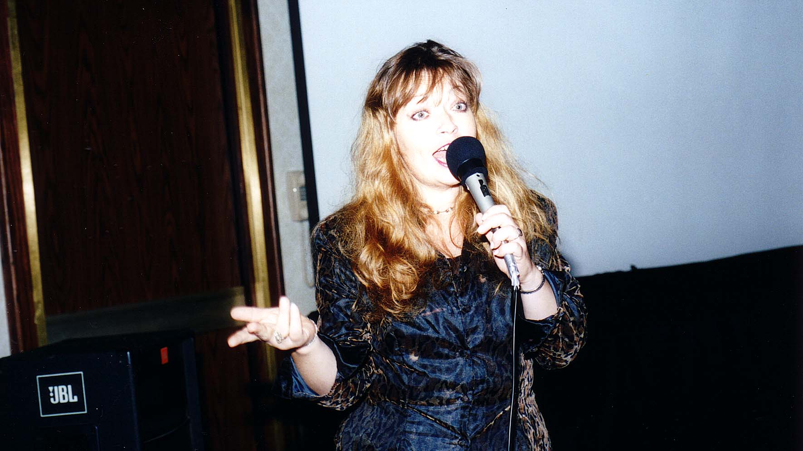
Notes:
TWG_Photo_2001_No_293__Oct_21__Leadership_Conference_Sunday_Brunch__Marianna_Vynnytsky
See TWG_NEWS_2001_Leadership_Conference_Announcement issue, page 1, and TWG_NEWS_Special_Issue_2001, page 4, for event coverage

Slide 21
See TWGCF Photo Album for 2001 Cultural Events
Oksana Krovytska and Volodymyr Vynnytsky
Stefania Dovhan
Olga Hirshhorn

