Slide 1
Chornobyl 10th Anniversary Concert Program Chornobyl Challenge ‘96
Kennedy Center April 28, 1996

Slide 2
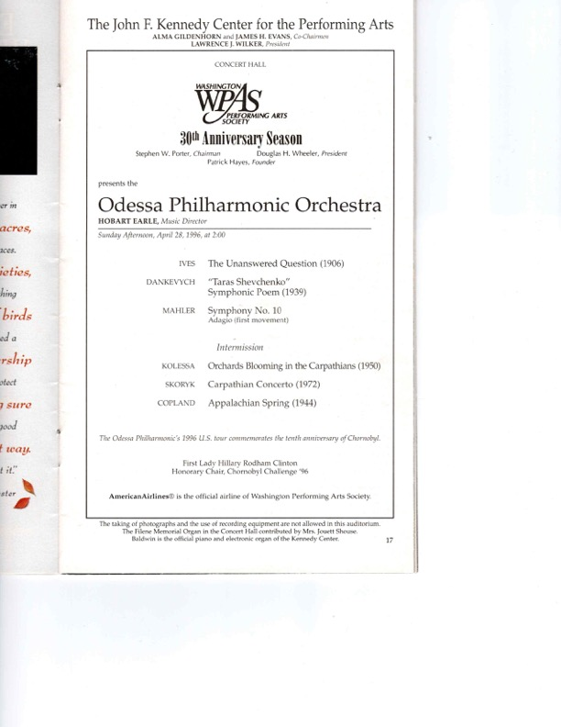

Slide 3
