Slide 1
Chornobyl 10th Anniversary Concert Program Notes, Artist’s Biography and Concert Review
Kennedy Center April 28, 1996

Slide 2
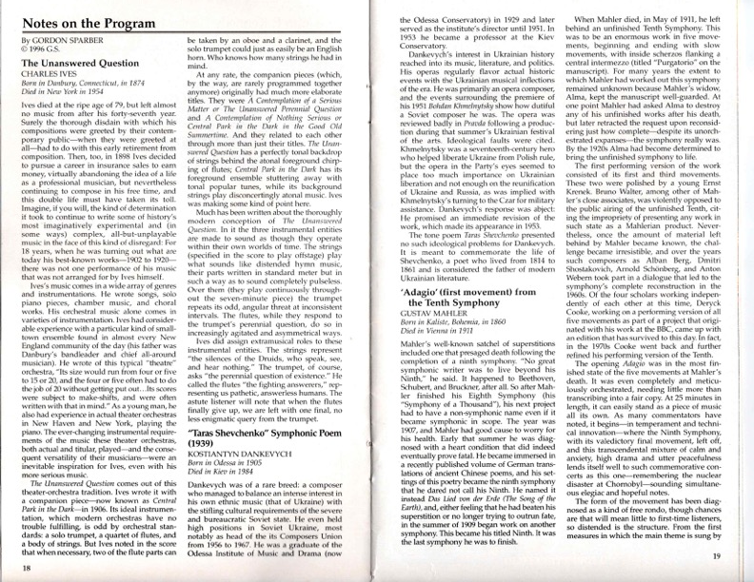

Slide 3
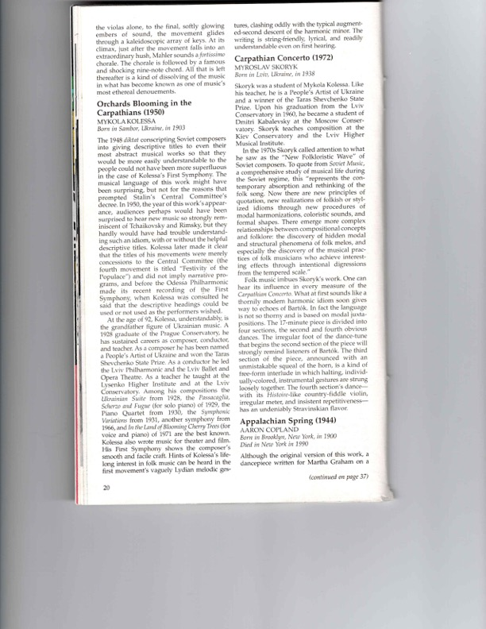
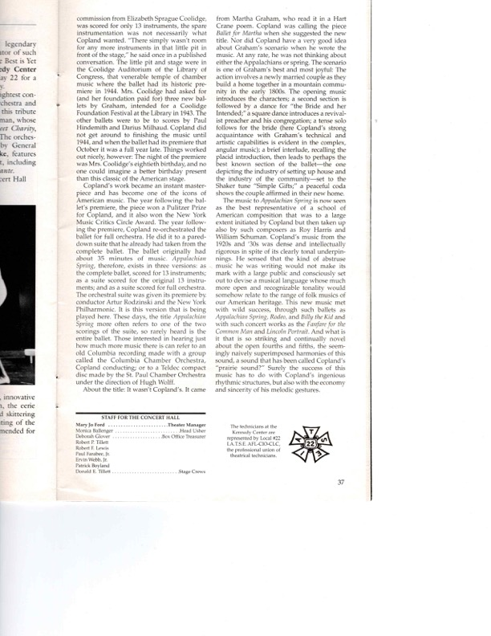

Slide 4
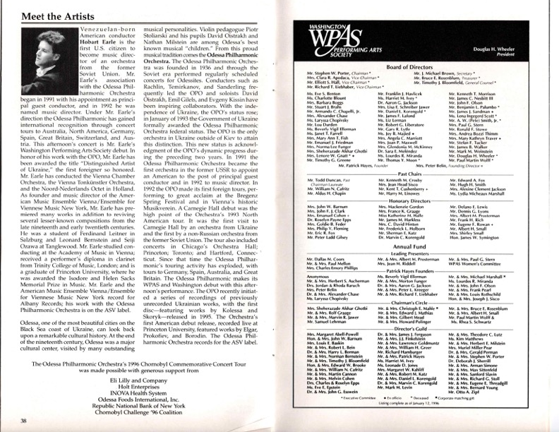

Slide 5
