Slide 1
TWG Leadership Conference 2004 “The Washington Group at Twenty”
June 11 -13
Key Bridge Marriott, Arlington, VA

Slide 2
Preliminaries
The Slides with photos are annotated.
If you are using “Powerpoint,” to see the annotation you must select the “Normal” mode (under the “View” menu).
If you are using Apple’s software “Keynote,” you must select “Show presenter notes” under the “View” menu.
If you want to checkout the “Links” on the next slide you must switch to the “Slideshow” mode in ”Powerpoint.” Then when you want to resume seeing the slides with annotations switch back to the “Normal” mode.
If using Apple’s “Keynote” just click on the link and then click on “go to page.”

Slide 3
Supporting Materials
2004 Conference Booklet (Link 1)
TWG NEWS --- 2004 Winter (Link 2)
TWG NEWS --- Leadership Conference Issue (Link 3)
Ukrainian Weekly, Sunday October 10, 2004 (Link 4)
Note: For the Links to work you must be in the “Slideshow” mode in Powerpoint

Slide 4
TWG Leadership Conference Reception
Embassy of Ukraine
June 11, 2004
TWG President Ihor Kotlarchuk, General Kostyantyn Morozov
Natalia Holub, Ihor Kotlarchuk
Ambassador Mykhailo Reznik, Myroslava Futey, Iryna Reznik, Bohdan Futey
Natalie Korytnyk, Jerry Fenzel

Slide 5
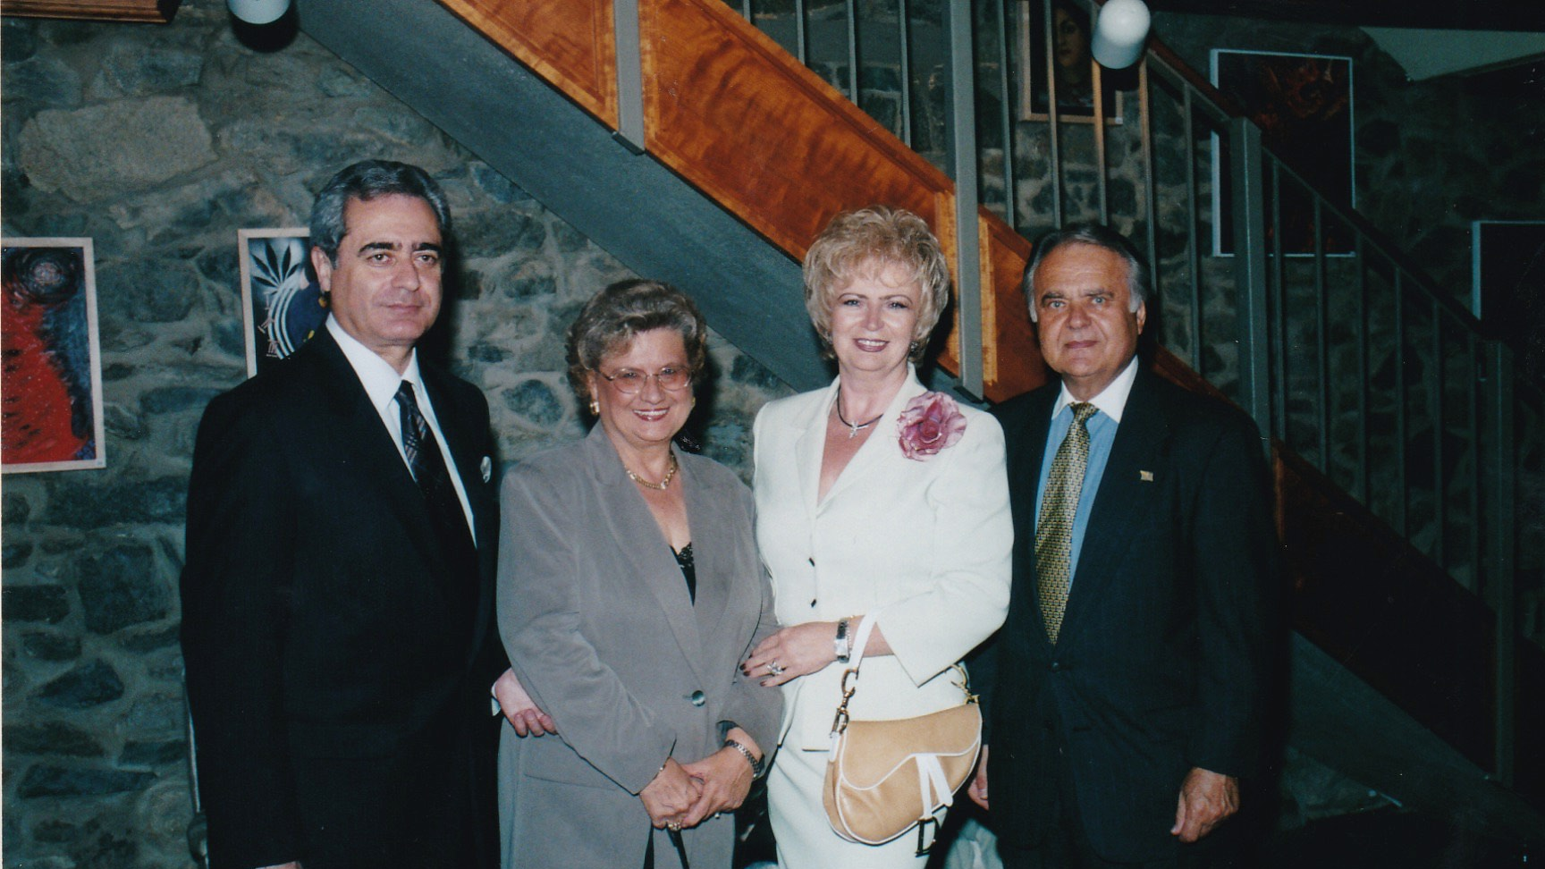
Notes:
The Washington Group Leadership Conference Reception – 6/11/2004 – Embassy of Ukraine: Ambassador Mykhailo Reznik, Myroslava Futey, Iryna Reznik, Bohdan Futey

Slide 6
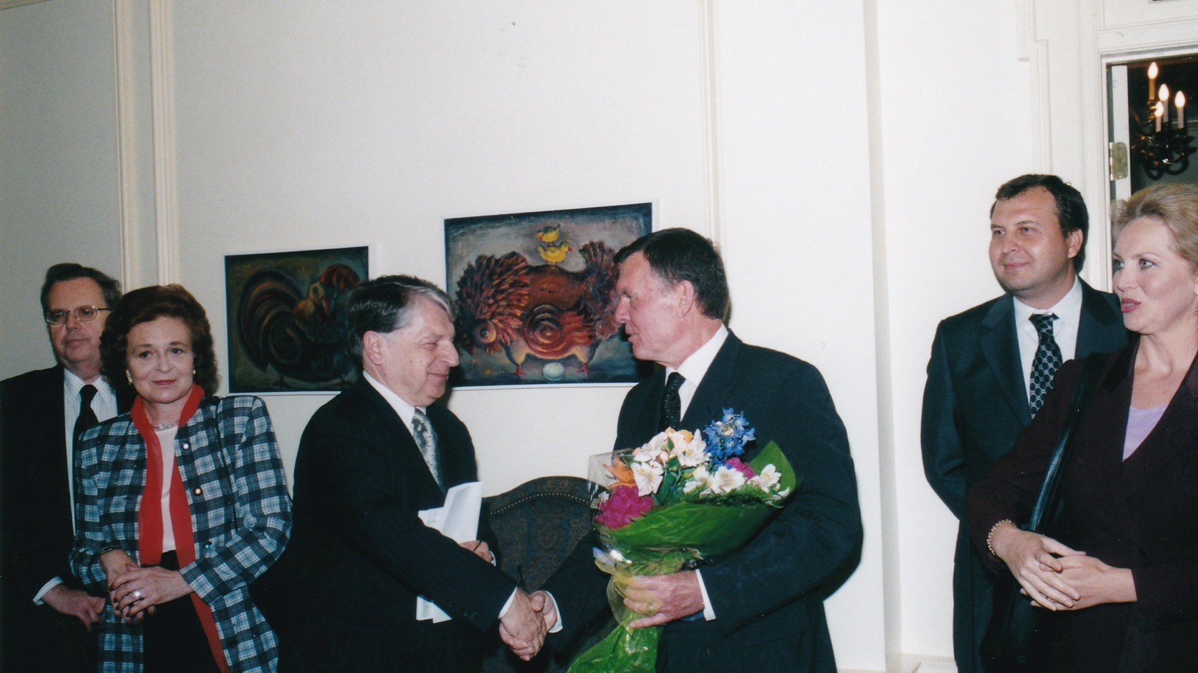
Notes:
The Washington Group Leadership Conference Reception – 6/11/2004 – Embassy of Ukraine: TWG President Ihor Kotlarchuk, General Kostyantyn Morozov

Slide 7
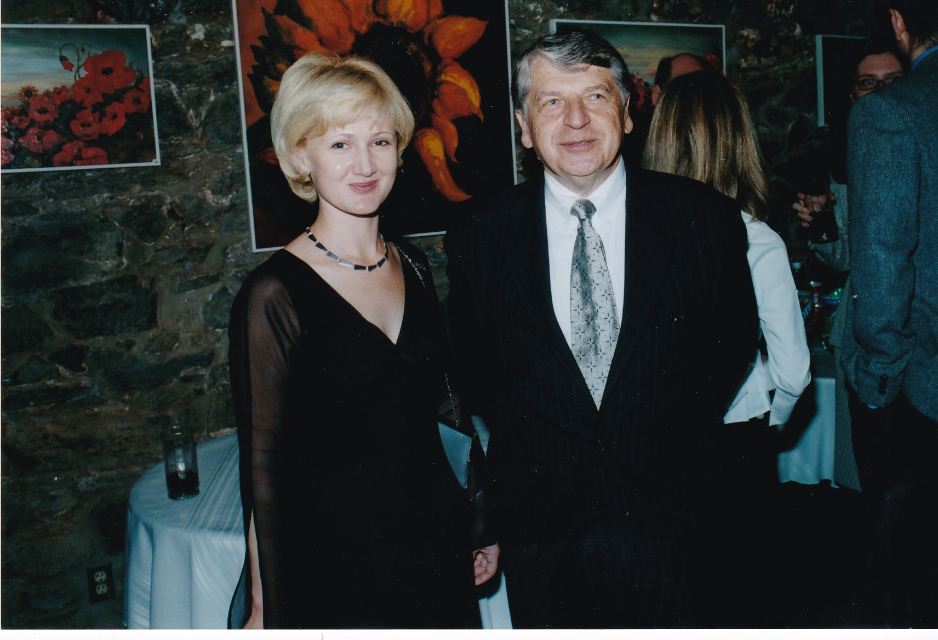
Notes:
The Washington Group Leadership Conference Reception – 6/11/2004 – Embassy of Ukraine: Natalia Holub, TWG President Ihor Kotlarchuk

Slide 8
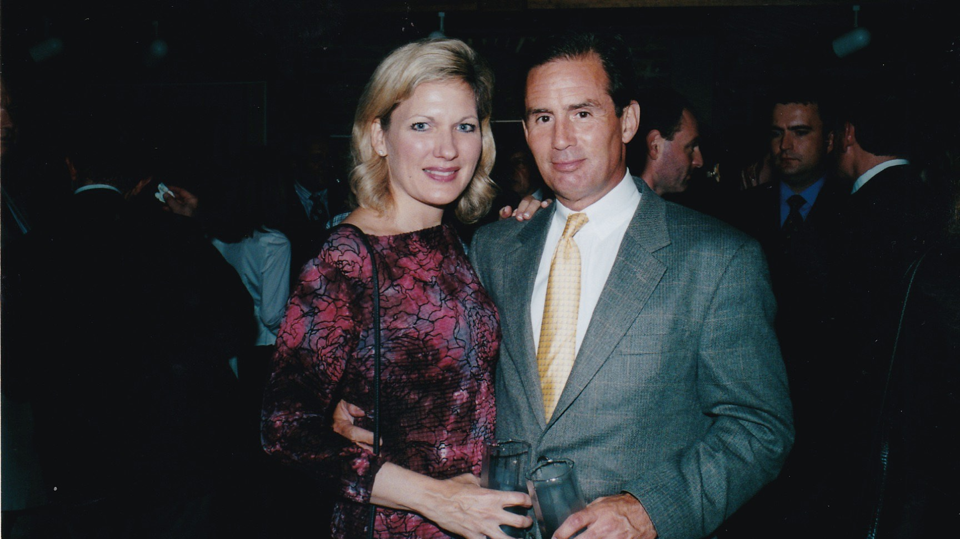
Notes:
The Washington Group Leadership Conference Reception – 6/11/2004 – Embassy of Ukraine: Natalie Korytnyk, Jerry Fenzel

Slide 9
TWG Leadership Conference
Introductory Remarks
Key Bridge Marriott
June 12, 2004
George Masiuk, Conference Chairman
Ihor Kotlarchuk, TWG President

Slide 10
Notes:
The Washington Group Leadership Conference Introductory Remarks – 6/12/2004 – Key Bridge Marriott: Conference Chairman George Masiuk

Slide 11
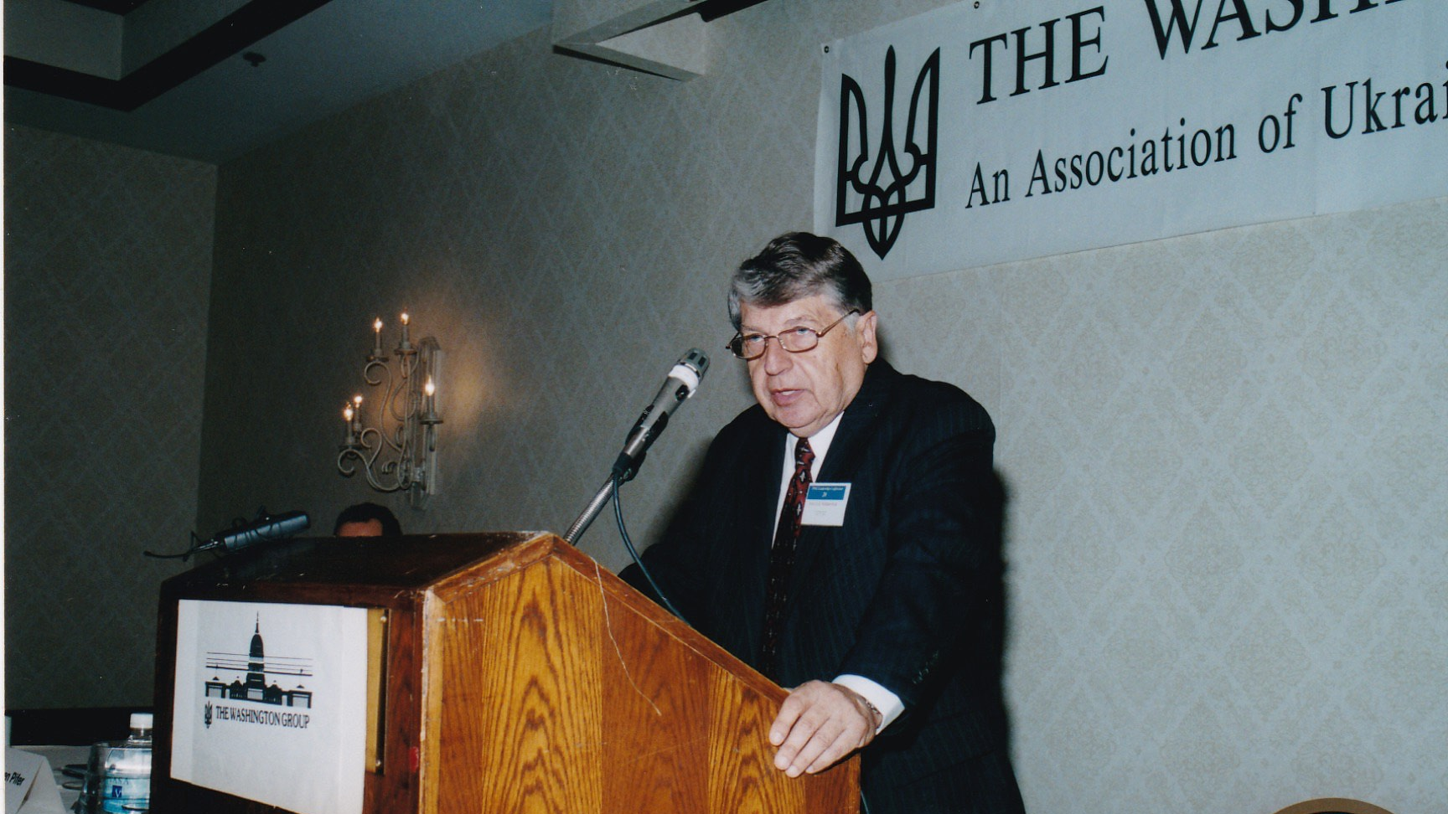
Notes:
The Washington Group Leadership Conference Introductory Remarks – 6/12/2004 – Key Bridge Marriott: TWG President Ihor Kotlarchuk

Slide 12
TWG Leadership Conference
Ambassadors’ Forum
Key Bridge Marriott
June 12, 2004
Ambassador William G. Miller, Ambassador Steven Pifer, TWG President Ihor Kotlarchuk, Ambassador Oleh Bilorus
Ambassador William G. Miller
Ambassador Steven Pifer
Ambassador Steven Pifer, TWG President Ihor Kotlarchuk
Ambassador Oleh Bilorus
Conference Chairman George Masiuk, Ambassador William G. Miller, Ambassador Steven Pifer, TWG President Ihor Kotlarchuk, Ambassador Oleh Bilorus

Slide 13
Notes:
The Washington Group Leadership Conference Ambassadors’ Forum– 6/12/2004 – Key Bridge Marriott: United States Ambassador to Ukraine (1993-1998) William Miller, United States Ambassador to Ukraine (1998-2000) Steven Pifer, TWG President Ihor Kotlarchuk, Ambassador of Ukraine to the United States (1992-1994) Oleh Bilorus

Slide 14
Notes:
The Washington Group Leadership Conference Ambassadors’ Forum– 6/12/2004 – Key Bridge Marriott: United States Ambassador to Ukraine (1993-1998) William Miller

Slide 15
Notes:
The Washington Group Leadership Conference Ambassadors’ Forum– 6/12/2004 – Key Bridge Marriott: United States Ambassador to Ukraine (1998-2000) Steven Pifer

Slide 16
Notes:
The Washington Group Leadership Conference Ambassadors’ Forum– 6/12/2004 – Key Bridge Marriott: United States Ambassador to Ukraine (1998-2000) Steven Pifer receives honorary TWG Membership from TWG President Ihor Kotlarchuk

Slide 17
Notes:
The Washington Group Leadership Conference Ambassadors’ Forum– 6/12/2004 – Key Bridge Marriott: Ukraine’s First Ambassador to the United States Oleh Bilorus (1992-1994)

Slide 18
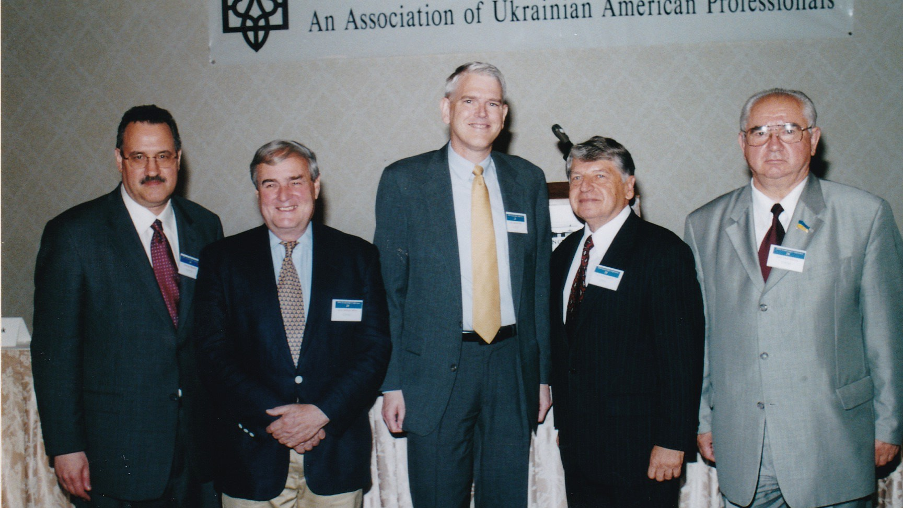
Notes:
The Washington Group Leadership Conference Ambassadors’ Forum– 6/12/2004 – Key Bridge Marriott: Conference Chairman George Masiuk, United States Ambassador to Ukraine (1993-1998) William Miller, United States Ambassador to Ukraine (1998-2000) Steven Pifer, TWG President Ihor Kotlarchuk, Ambassador of Ukraine to the United States (1992-1994) Oleh Bilorus

Slide 19
TWG Leadership Conference
Luncheon Address by
Ambassador Mykhailo Reznik
June 12, 2004
Ambassador Mykhailo Reznik
Ambassador Mykhailo Reznik, TWG President Ihor Kotlarchuk
Natalia Holub, George Masiuk, Andrew Bihun, General Kostyantyn Morozov, Amb. Oleh Bilorus, Suzanne Miller, Amb. Miller, Ihor Kotlarchuk, Amb. Mykhailo Reznik
Inia Tunstall, Alexander Kuzma

Slide 20
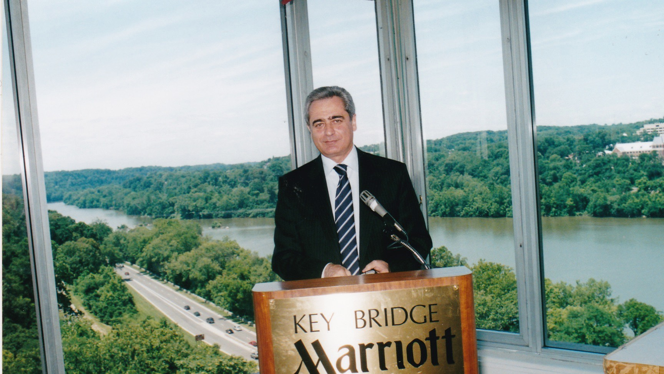
Notes:
The Washington Group Leadership Conference Luncheon – 6/12/2004 – Key Bridge Marriott: Ambassador Mykhailo Reznik

Slide 21
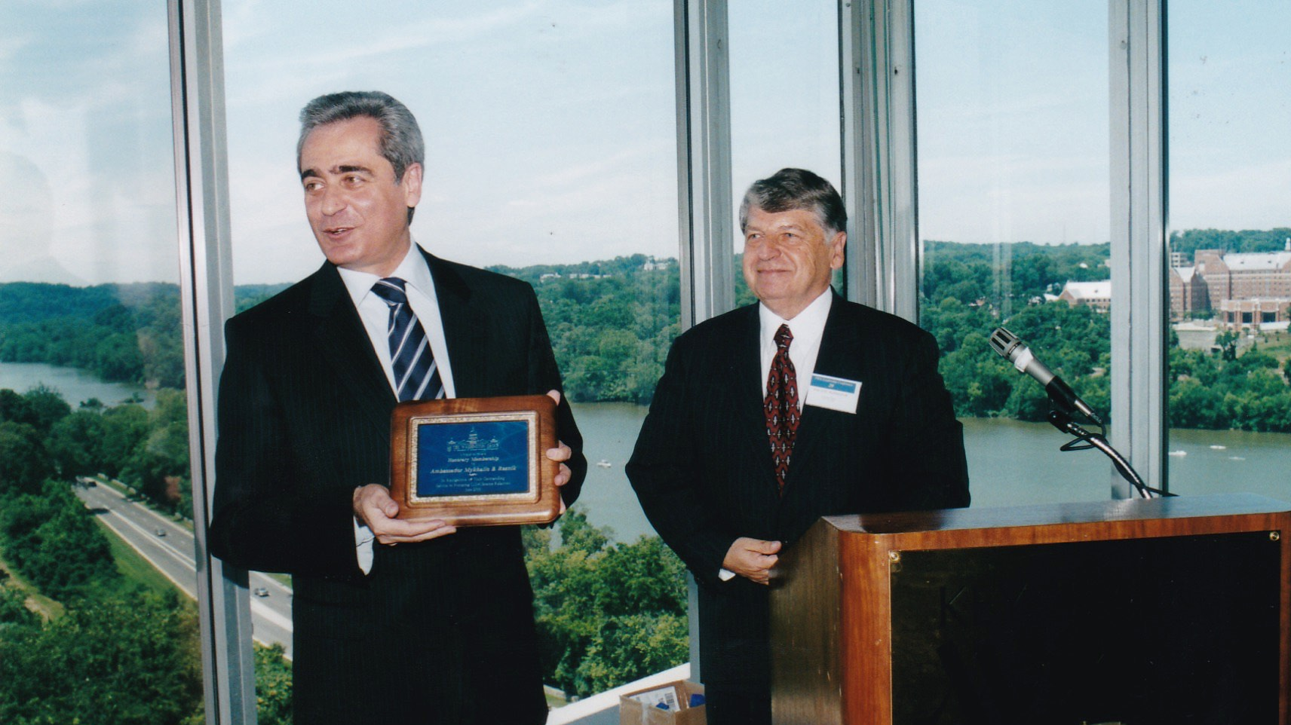
Notes:
The Washington Group Leadership Conference Luncheon – 6/12/2004 – Key Bridge Marriott: Ambassador Mykhailo Reznik receives TWG Honorary Membership from TWG President Ihor Kotlarchuk

Slide 22
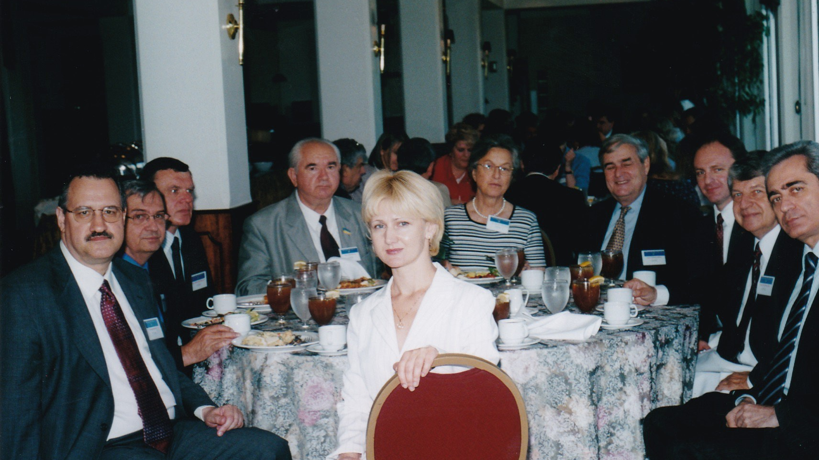
Notes:
The Washington Group Leadership Conference Luncheon – 6/12/2004 – Key Bridge Marriott: Natalia Holub, George Masiuk, Andrew Bihun, General Kostyantyn Morozov, Amb. Oleh Bilorus, Suzanne Miller, Amb. Miller, Ihor Kotlarchuk, Amb. Mykhailo Reznik

Slide 23
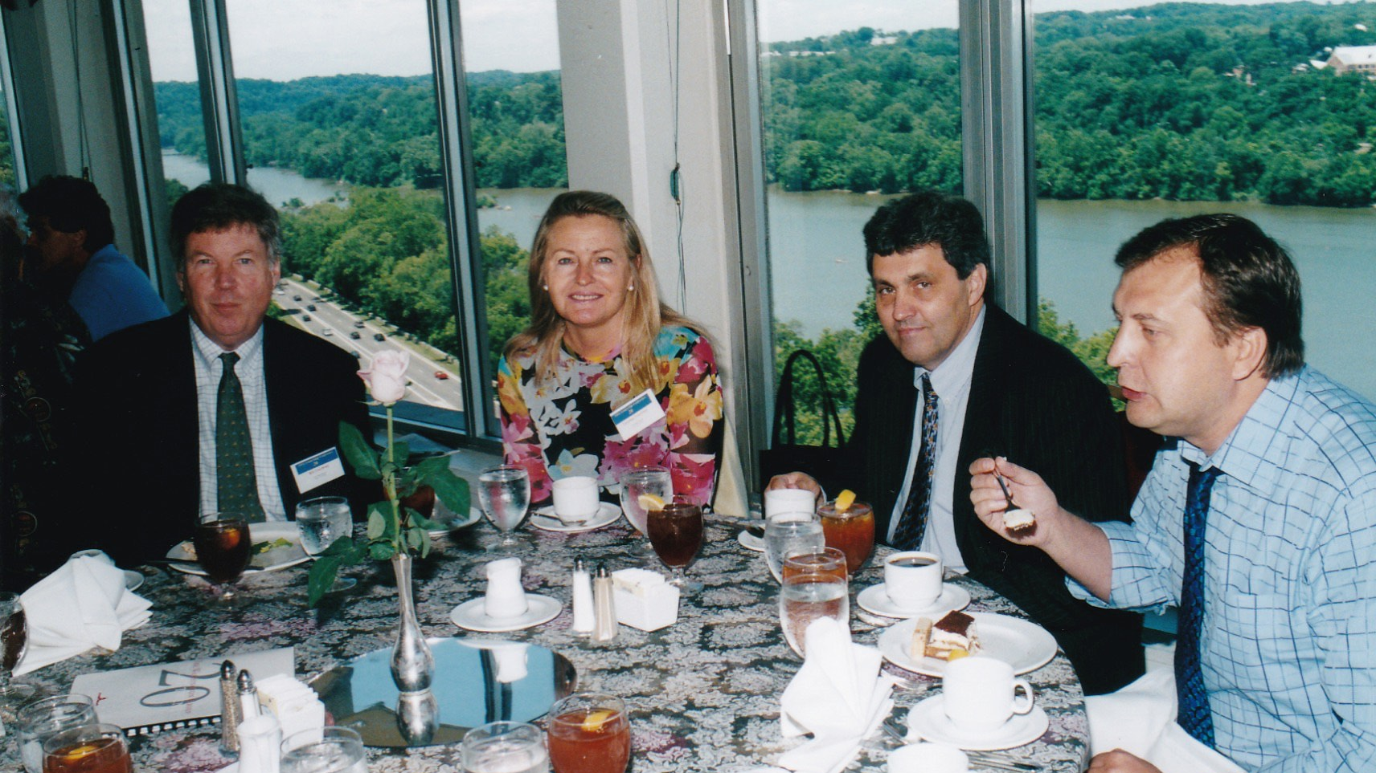
Notes:
The Washington Group Leadership Conference Luncheon – 6/12/2004 – Key Bridge Marriott: Ambassador William Courtney and Laryssa Courtney, Ukrainian Diplomats

Slide 24
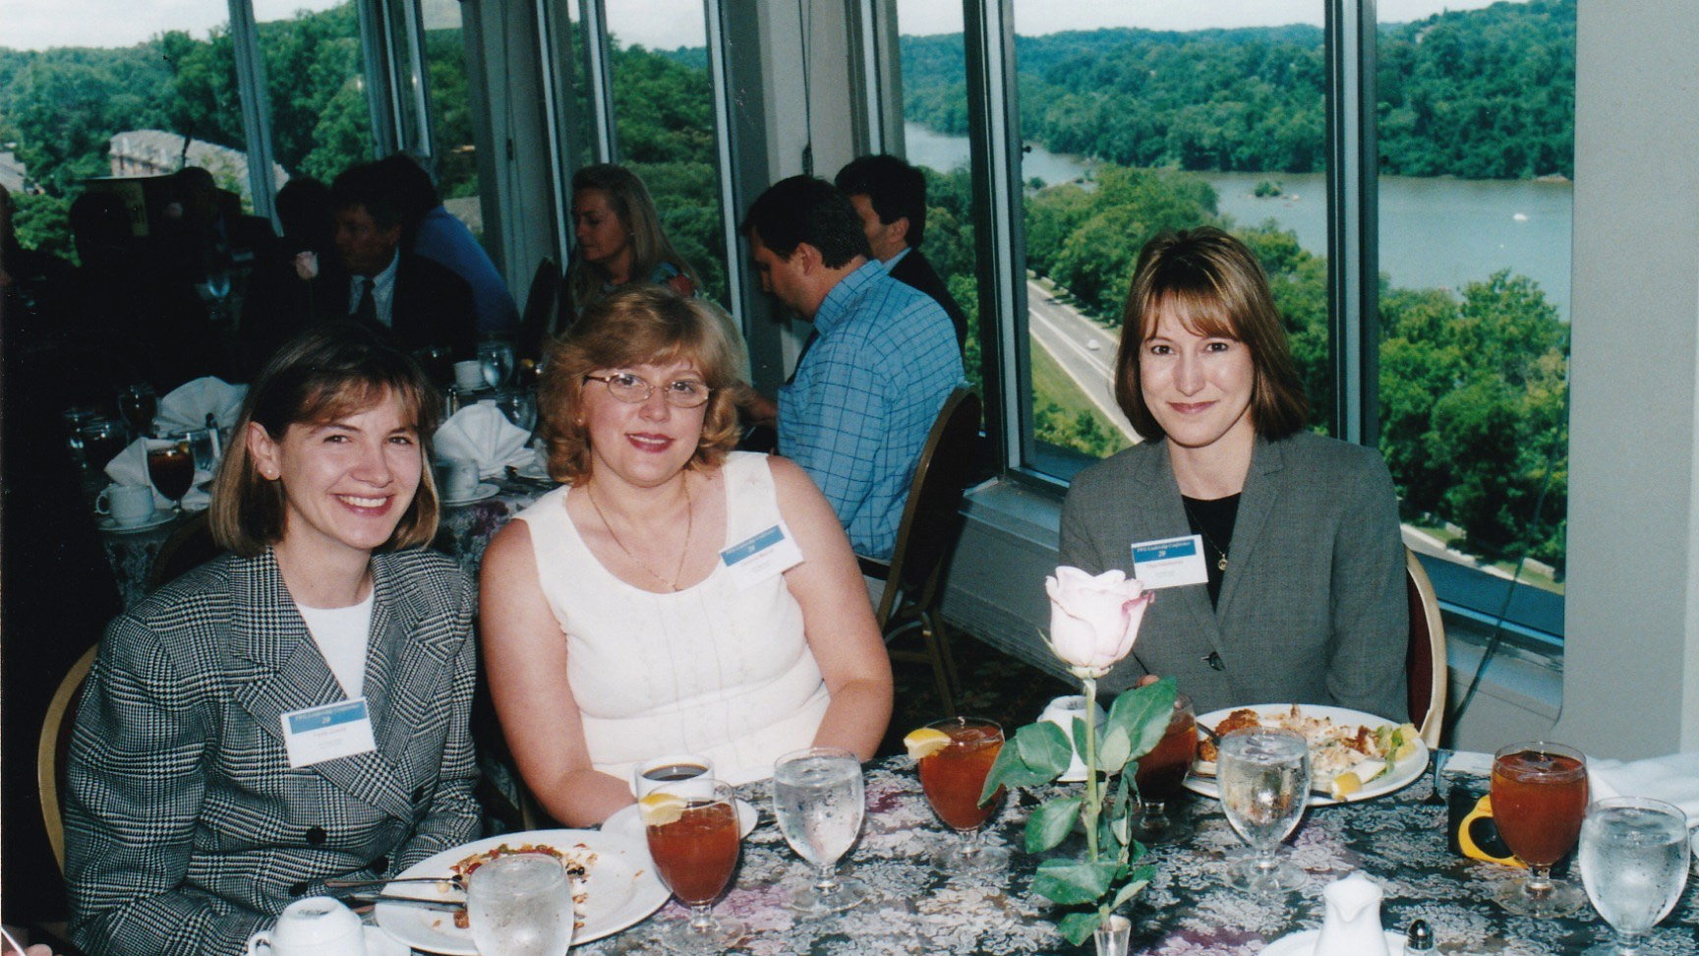
Notes:
The Washington Group Leadership Conference Luncheon – 6/12/2004 – Key Bridge Marriott: Iryna Goula, Oksana Maziar, Olga Halaburda

Slide 25
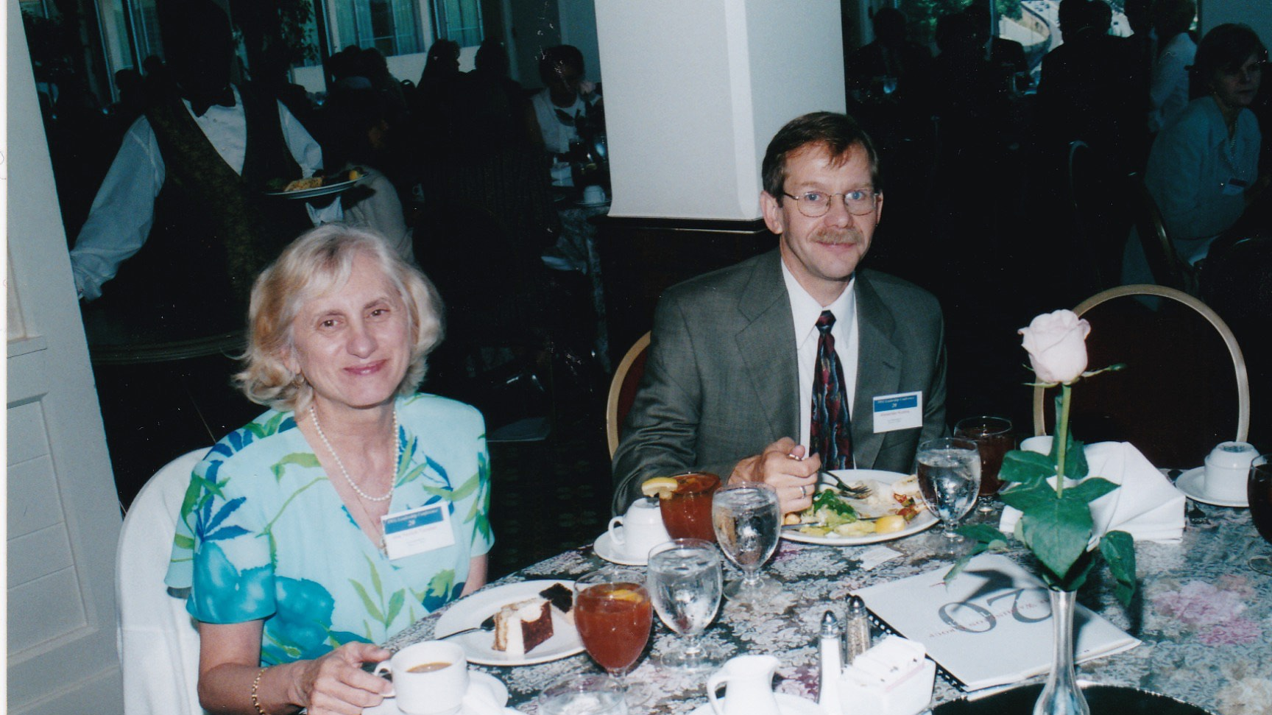
Notes:
The Washington Group Leadership Conference Luncheon – 6/12/2004 – Key Bridge Marriott: Inia Tunstall, Alexander Kuzma

Slide 26
TWG Leadership Conference
Panel: Ukraine on the Eve of Elections
Key Bridge Marriott
June 12, 2004
Orest Deychakiwsky, Amb. Nelson Ledsky, Nadia Diuk, Marta Kolomayets, Taras Kuzio, Eugene Fishel
Orest Deychakiwsky
Amb. Nelson Ledsky
Nadia Diuk
Marta Kolomayets
Taras Kuzio
Eugene Fishel

Slide 27
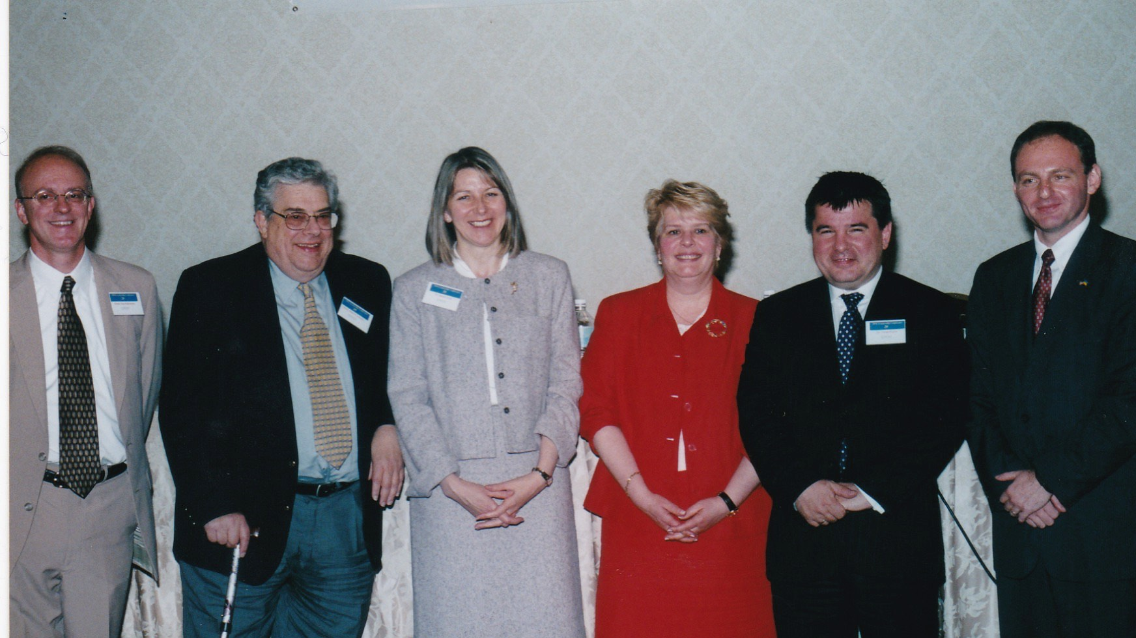
Notes:
The Washington Group Leadership Conference “Ukraine on Eve of Elections” – 6/12/2004 – Key Bridge Marriott: Orest Deychakiwsky, Amb. Nelson Ledsky, Nadia Diuk, Marta Kolomayets, Taras Kuzio, Eugene Fishel

Slide 28
Notes:
The Washington Group Leadership Conference “Ukraine on Eve of Elections” – 6/12/2004 – Key Bridge Marriott: Orest Deychakiwsky, Commission on Security and Cooperation in Europe (CSCE) - Moderator

Slide 29
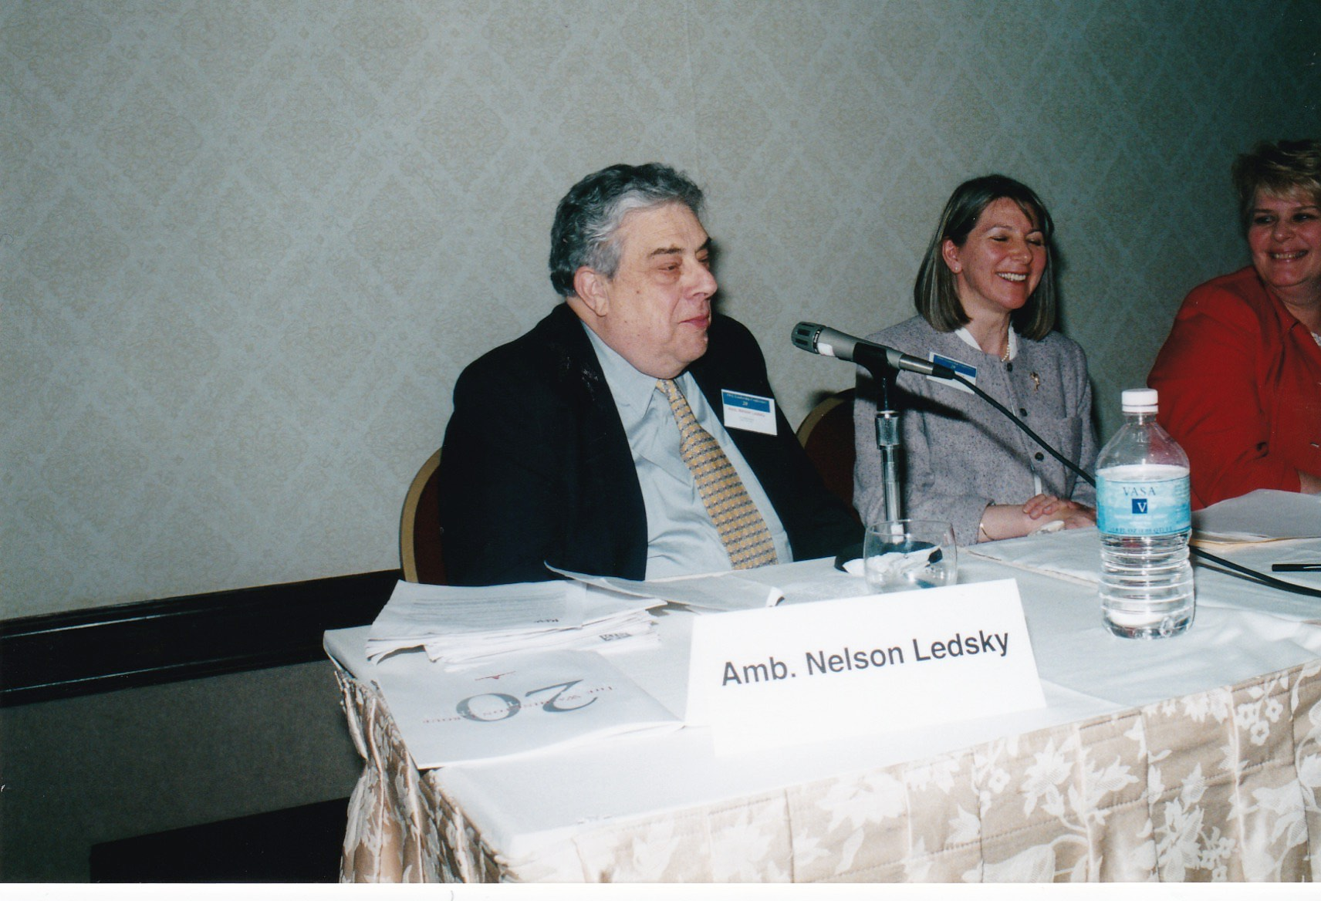
Notes:
The Washington Group Leadership Conference “Ukraine on Eve of Elections” – 6/12/2004 – Key Bridge Marriott: Amb. Nelson Ledsky, National Democratic Institute (NDI)

Slide 30
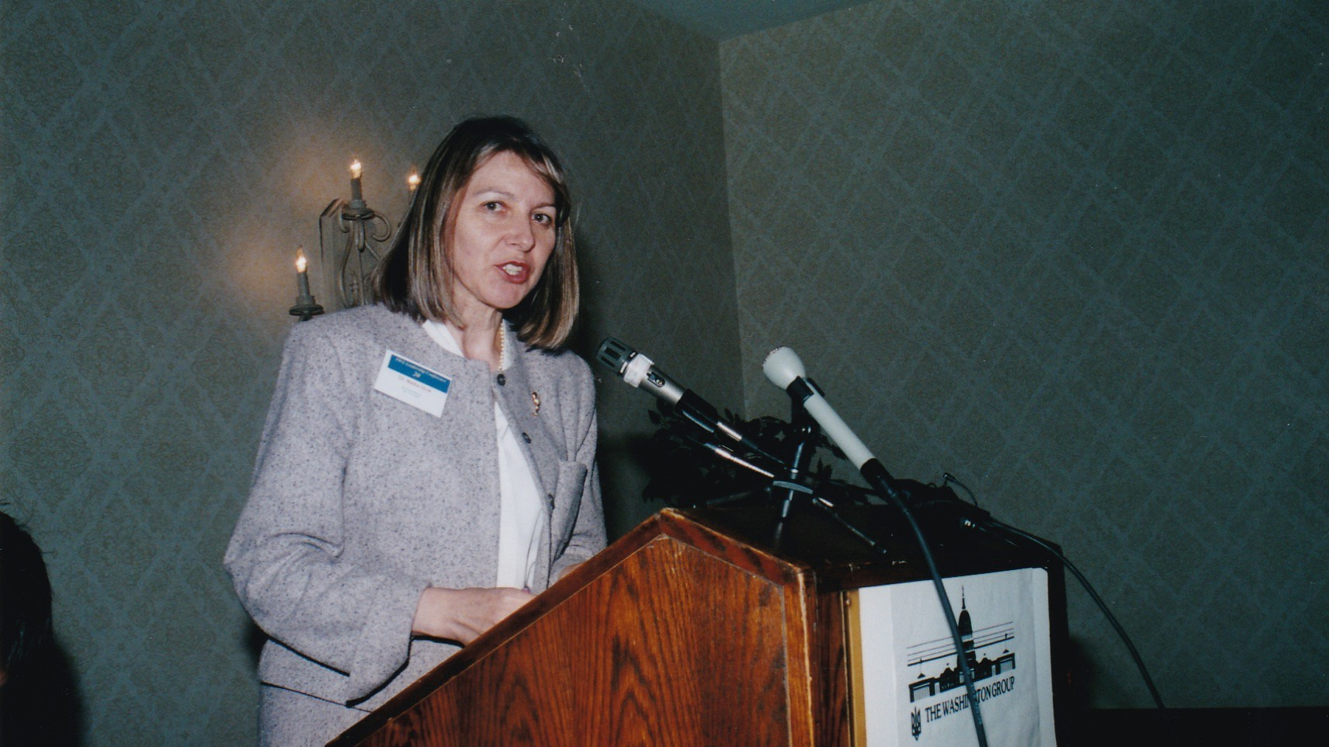
Notes:
The Washington Group Leadership Conference “Ukraine on Eve of Elections” – 6/12/2004 – Key Bridge Marriott: Nadia Diuk, National Endowment for Democracy (NED)

Slide 31
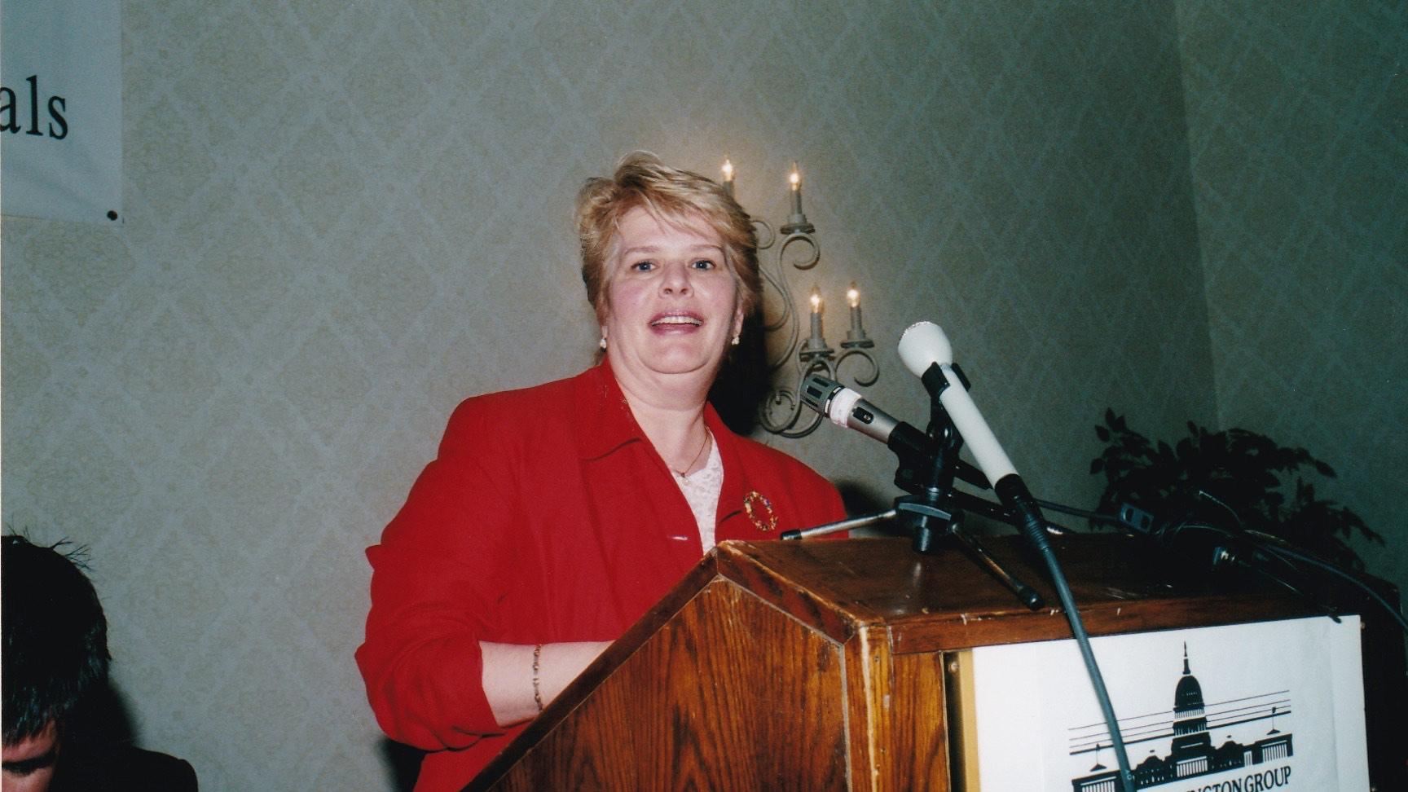
Notes:
The Washington Group Leadership Conference “Ukraine on Eve of Elections” – 6/12/2004 – Key Bridge Marriott: Marta Kolomayets, Director of Partnership for a Transparent Society

Slide 32
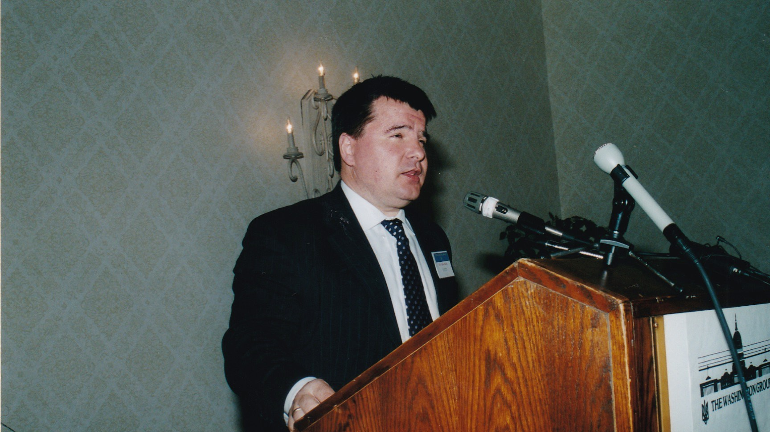
Notes:
The Washington Group Leadership Conference “Ukraine on Eve of Elections” – 6/12/2004 – Key Bridge Marriott: Taras Kuzio, Resident Fellow, University of Toronto

Slide 33
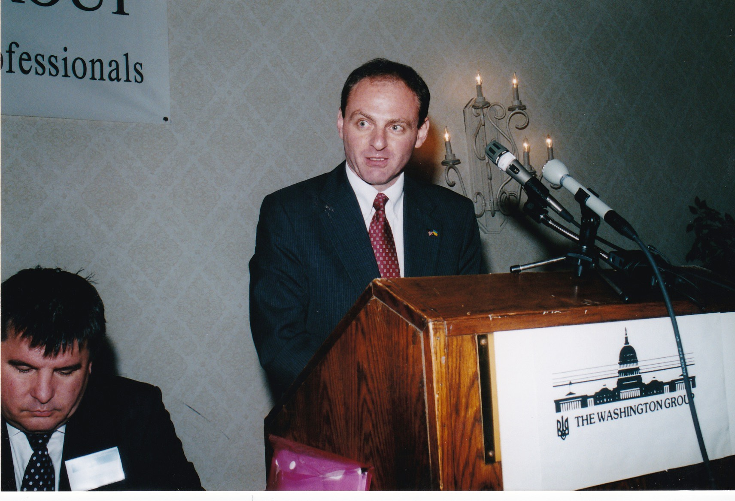
Notes:
The Washington Group Leadership Conference “Ukraine on Eve of Elections” – 6/12/2004 – Key Bridge Marriott: Eugene Fishel, United States Department of State

Slide 34
TWG Leadership Conference
Banquet
June 12, 2004
Ivanna Richardson, Vera Szerszen, Jaroslaw Martyniuk
Christine Hoshowsky, NN, NN
Serhiy Korsunskyi, Eugene Fishel, Olga Prokhorova
Taras Kuzio, Myroslava Gongadze, Serhiy Korsunskyi
TWG Presidents: Orest Deychakiwsky (1998-200), Daria Stec (1986-1988), Ihor Kotlarchuk (2000-2005), George Masiuk (1995-1997), Mykola Babiak (1993-1995)
Brian and Inia Tunstall
Ihor and Tamara Vitkovitsky
Iryna Reznik, William and Laryssa Courtney
Orysia Voronin and Orest Deychakiwsky
Marta Zielyk and Ed Gay
Daria Stec, George Masiuk, Isha Pryshlak

Slide 35
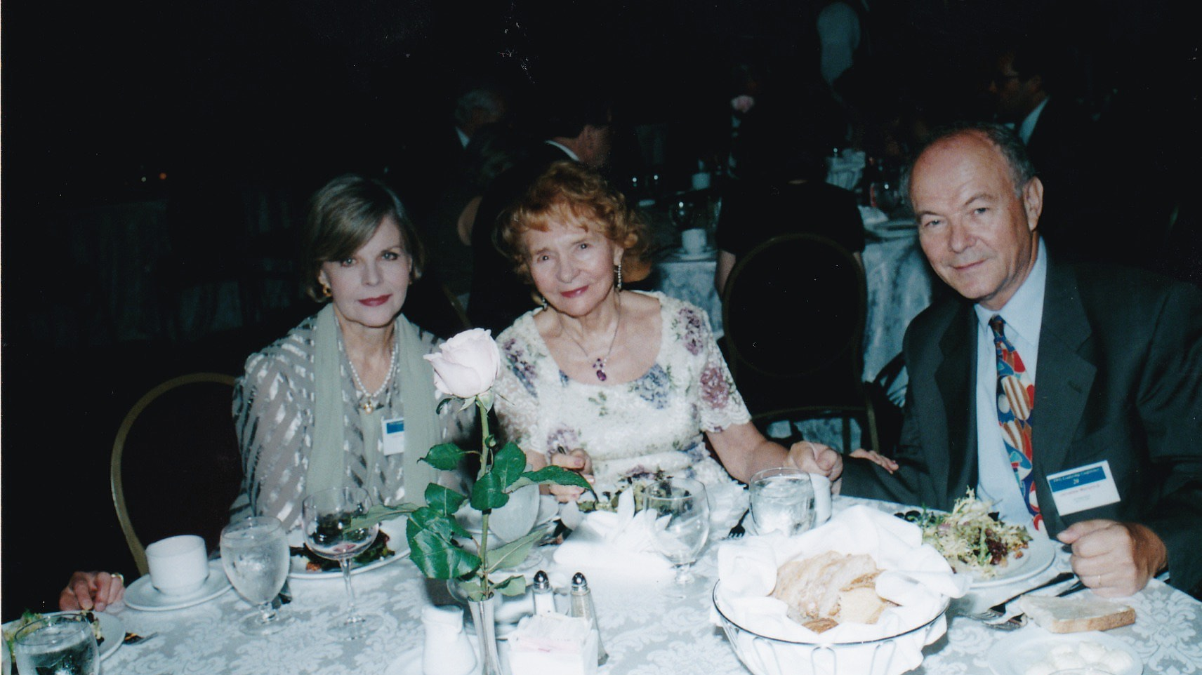
Notes:
The Washington Group Leadership Conference Banquet – 6/12/2004 – Key Bridge Marriott: Ivanna Richardson, Vera Szerszen, Jaroslaw Martyniuk

Slide 36
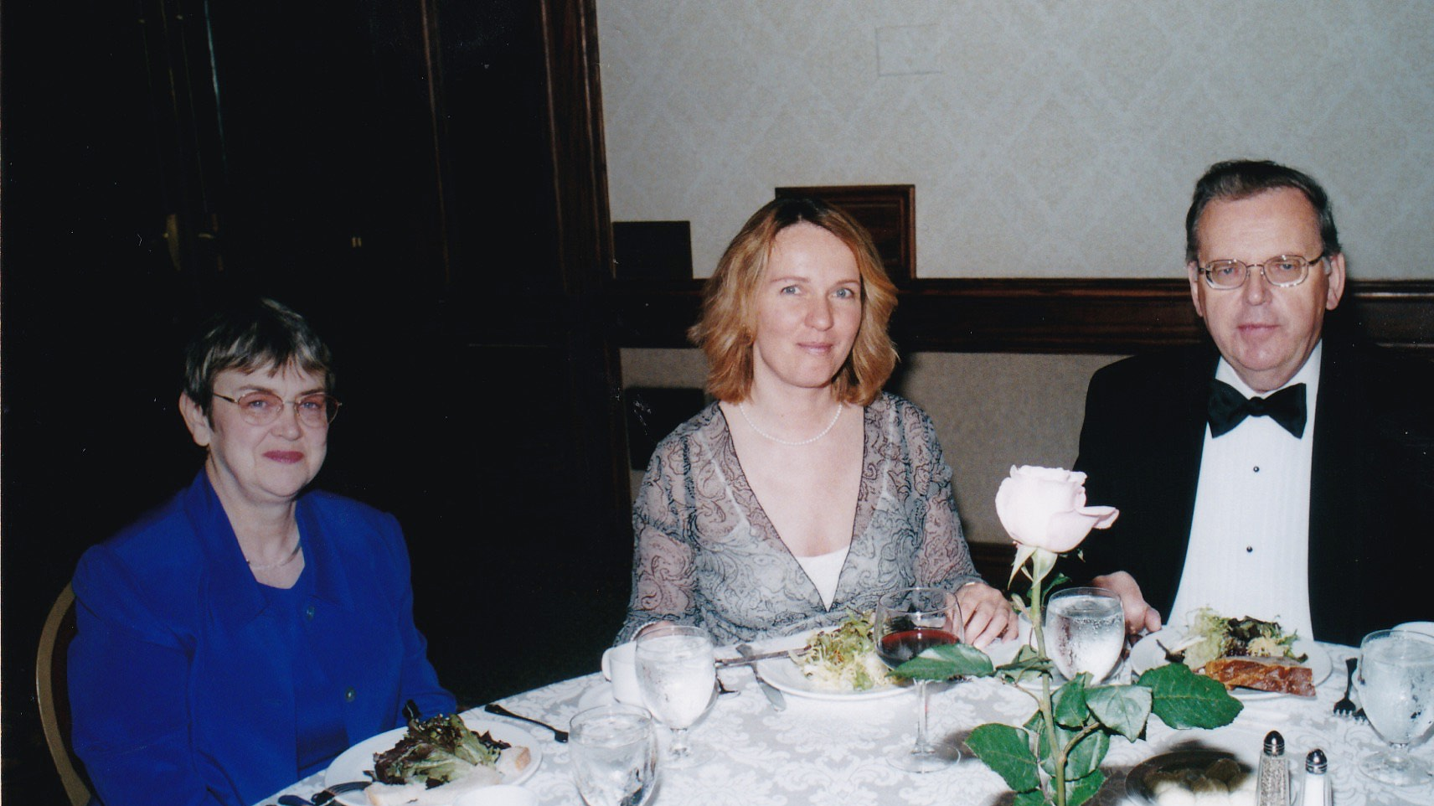
Notes:
The Washington Group Leadership Conference Banquet – 6/12/2004 – Key Bridge Marriott: Christine Hoshowsky, Natalia Shulga, NN

Slide 37
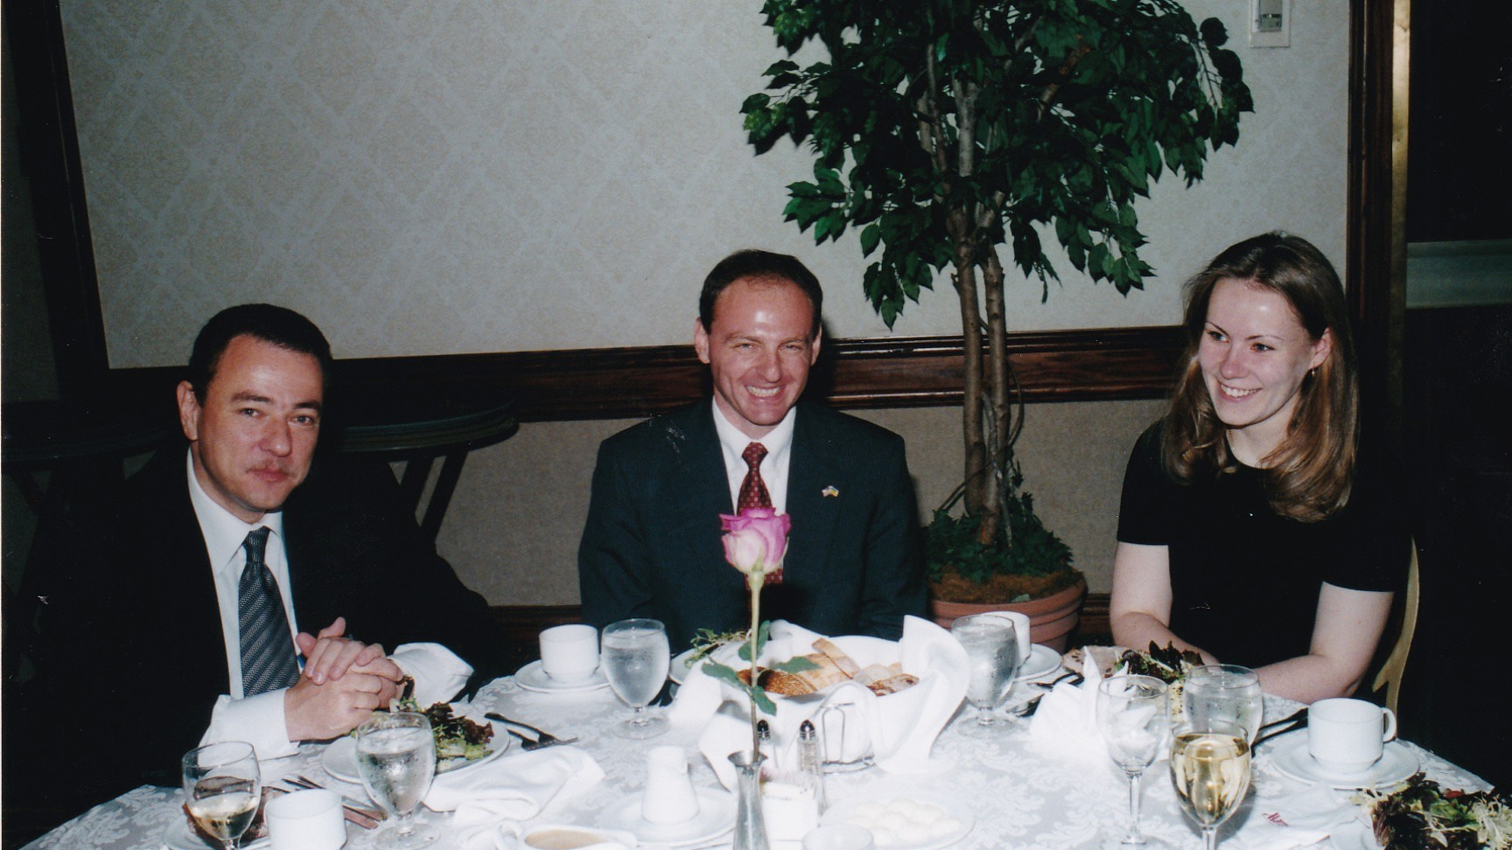
Notes:
The Washington Group Leadership Conference Banquet – 6/12/2004 – Key Bridge Marriott: Serhiy Korsunskyi, Eugene Fishel, Olga Prokhorova

Slide 38
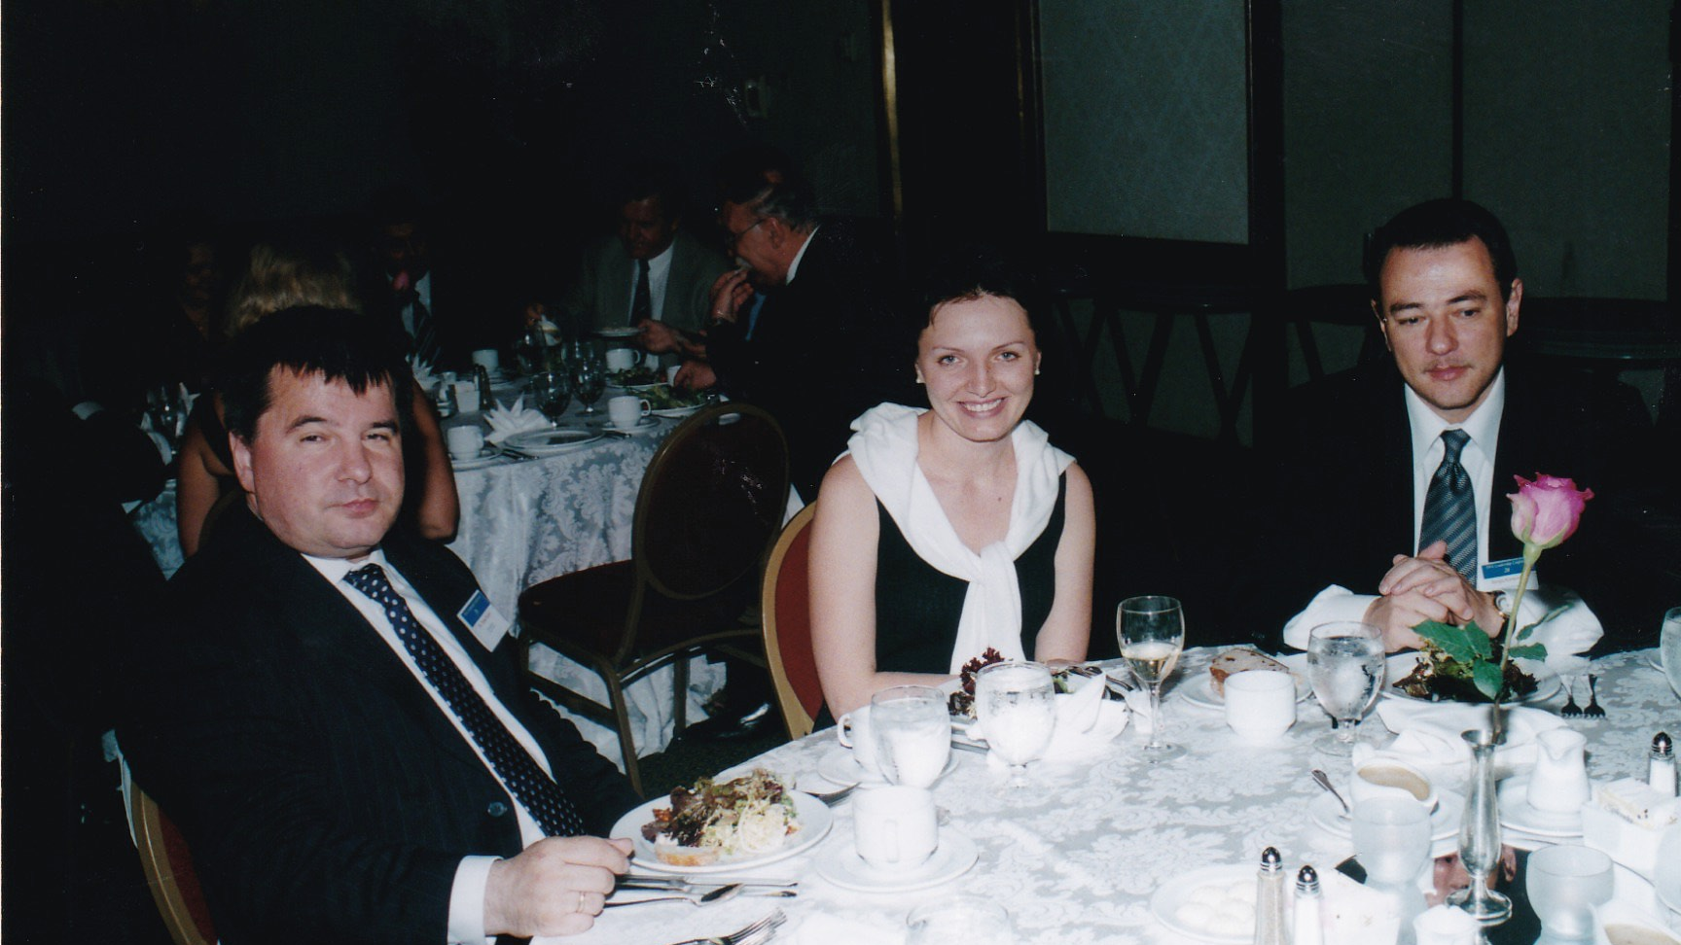
Notes:
The Washington Group Leadership Conference Banquet – 6/12/2004 – Key Bridge Marriott: Taras Kuzio, Myroslava Gongadze, Serhiy Korsunskyi

Slide 39
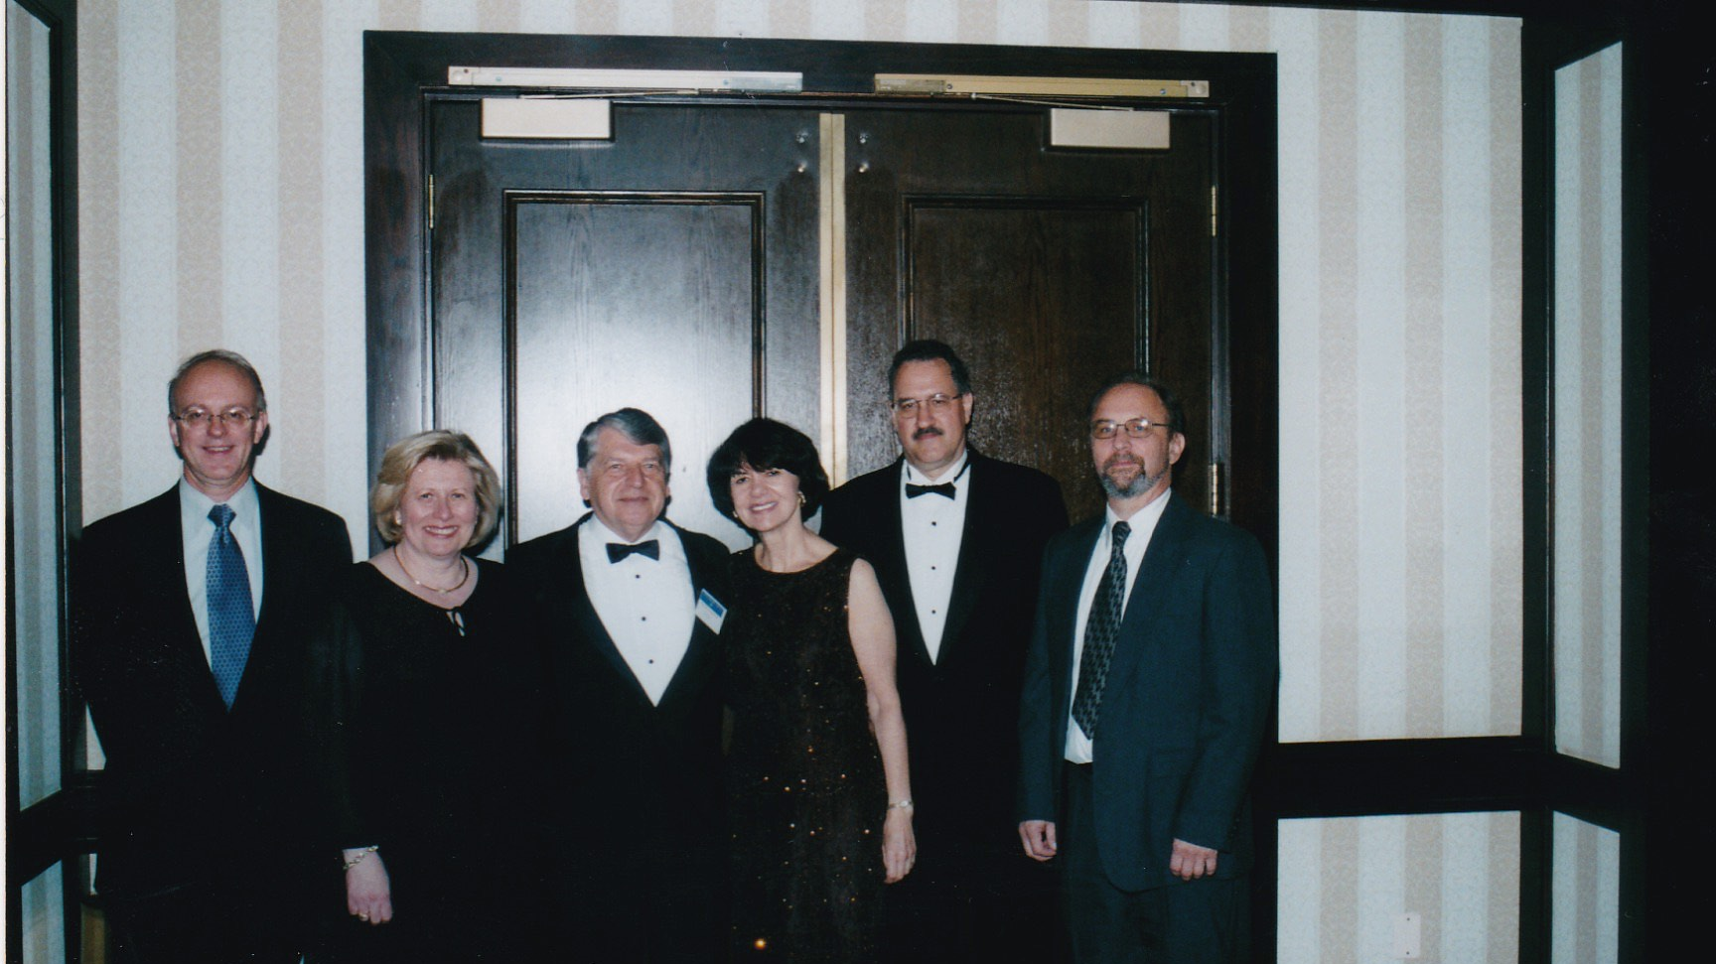
Notes:
The Washington Group Leadership Conference Banquet – 6/12/2004 – Key Bridge Marriott: TWG Presidents: Orest Deychakiwsky (1998-2000), Daria Stec (1986-1988), Ihor Kotlarchuk (2000-2005), George Masiuk (1995-1997), Mykola Babiak (1993-1995)

Slide 40
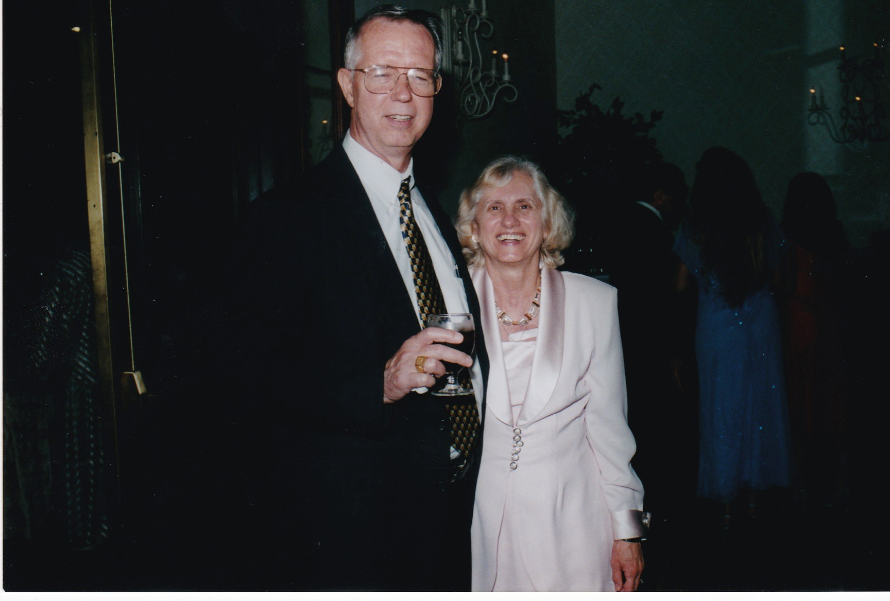
Notes:
The Washington Group Leadership Conference Banquet – 6/12/2004 – Key Bridge Marriott: Brian Tunstall, Inia Tunstall

Slide 41
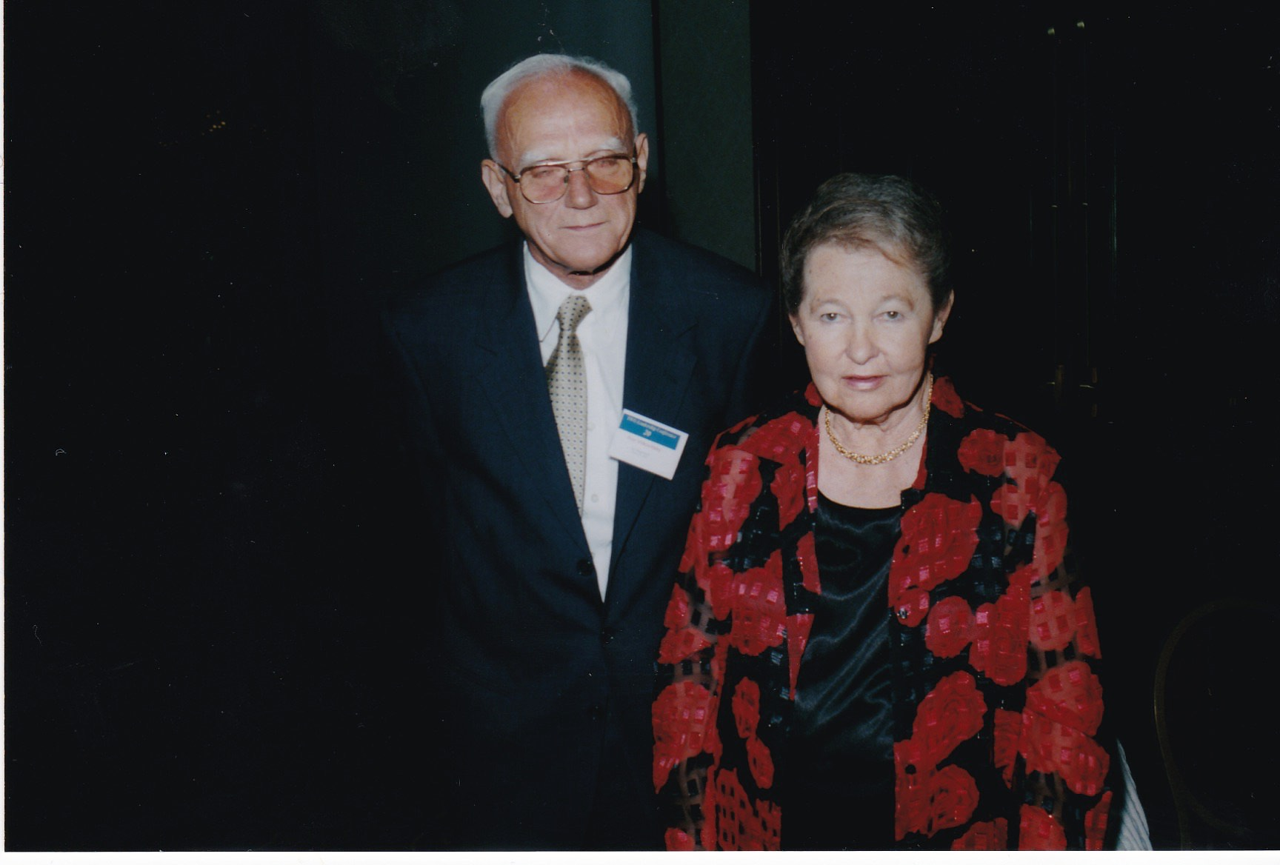
Notes:
The Washington Group Leadership Conference Banquet – 6/12/2004 – Key Bridge Marriott: Ihor and Tamara Vitkovitsky

Slide 42
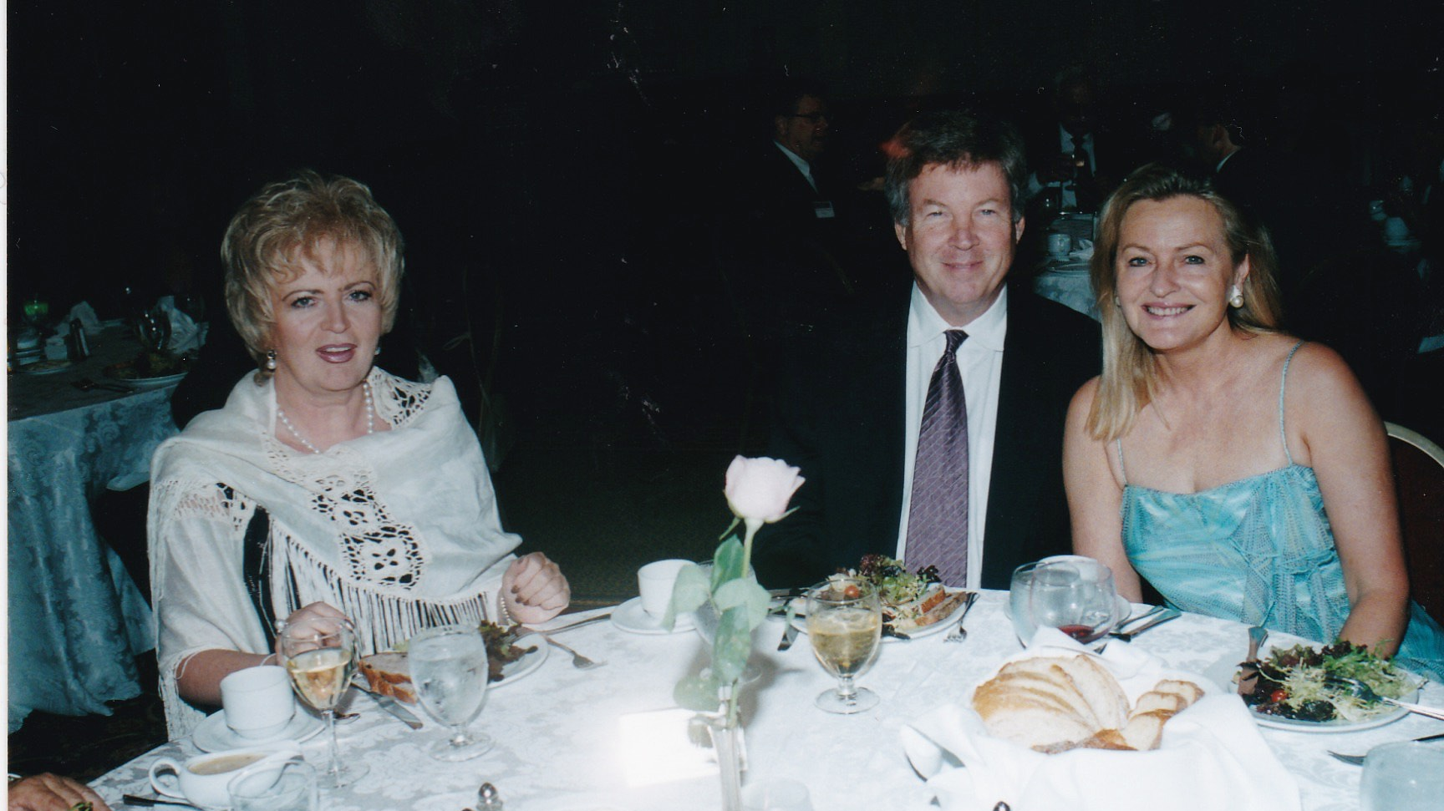
Notes:
The Washington Group Leadership Conference Banquet – 6/12/2004 – Key Bridge Marriott: Iryna Reznik, William and Laryssa Courtney

Slide 43
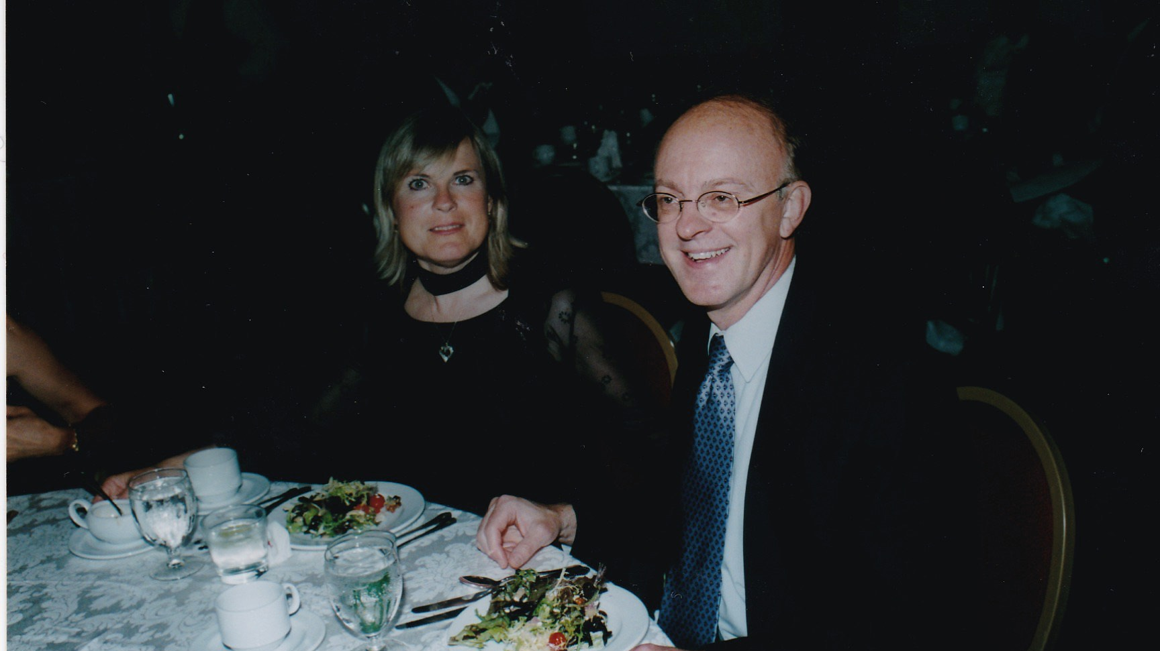
Notes:
The Washington Group Leadership Conference Banquet – 6/12/2004 – Key Bridge Marriott: Orysia Voronin Deychakiwsky and Orest Deychakiwsky

Slide 44
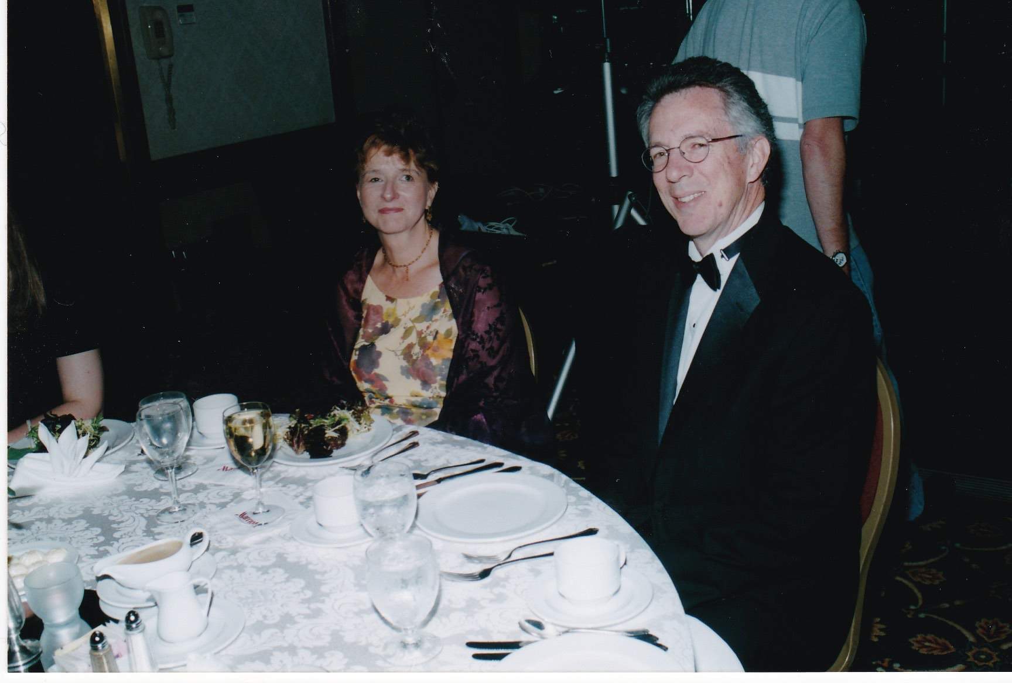
Notes:
The Washington Group Leadership Conference Banquet – 6/12/2004 – Key Bridge Marriott: Marta Zielyk and Ed Gay

Slide 45
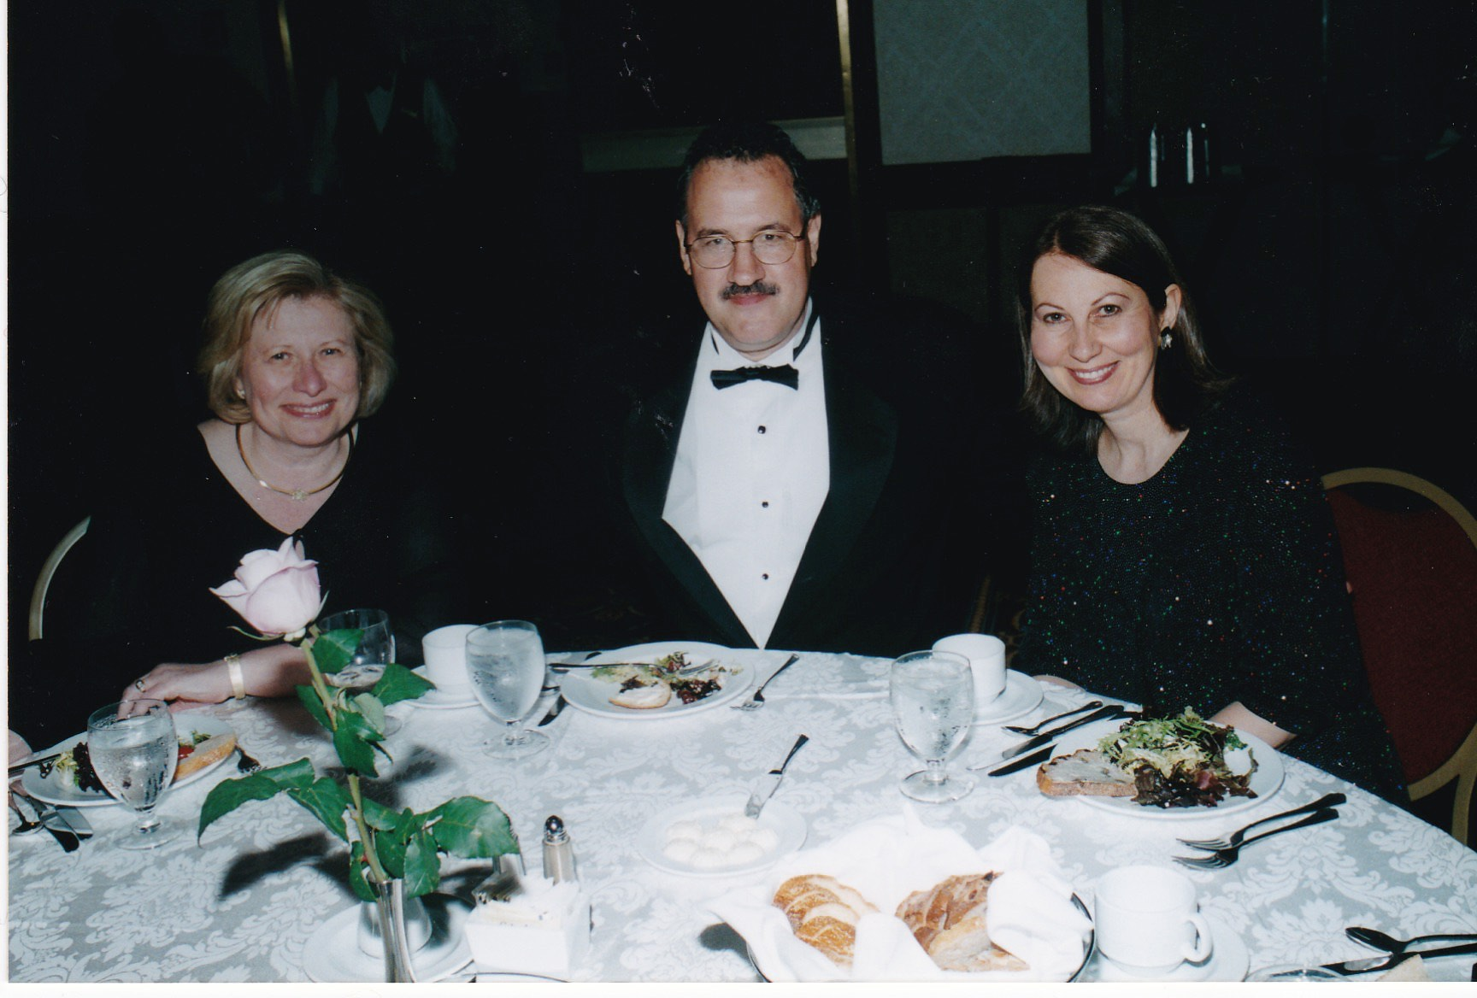
Notes:
The Washington Group Leadership Conference Banquet – 6/12/2004 – Key Bridge Marriott: Daria Stec, George Masiuk, Isha Pryshlak

Slide 46
TWG Leadership Conference
Panel: Improving Our Professionals’ Organizations
June 13, 2004
Nancy Medwid, Andrij Wowk, Oksana Xenos, George Masiuk, Dr. George Hrycelak
Nancy Medwid
Andrij Wowk
Oksana Xenos
George Masiuk
George Hrycelak

Slide 47
Notes:
The Washington Group Leadership Conference “Improving Our Organizations” – 6/12/2004 – Key Bridge Marriott: Nancy Medwid, Andrij Wowk, Oksana Xenos, George Masiuk, Dr. George Hrycelak

Slide 48
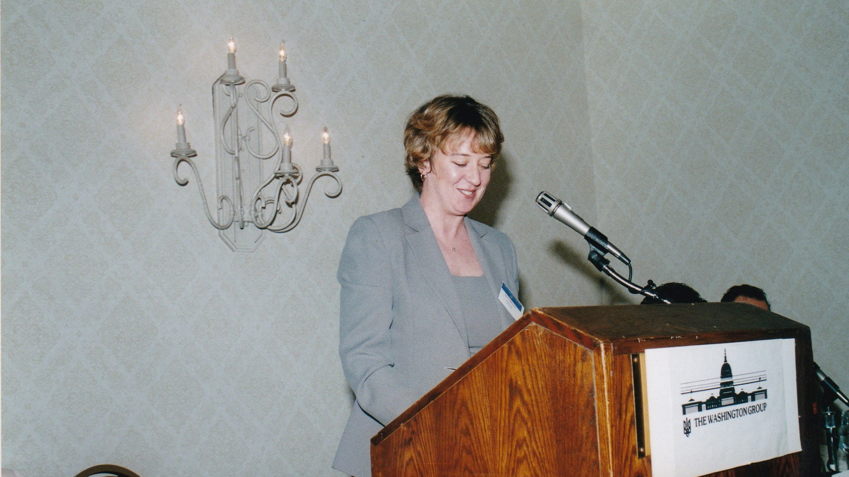
Notes:
The Washington Group Leadership Conference “Improving Our Organizations” – 6/12/2004 – Key Bridge Marriott: Nancy Medwid - Ukrainian American Bar Association (UABA)

Slide 49
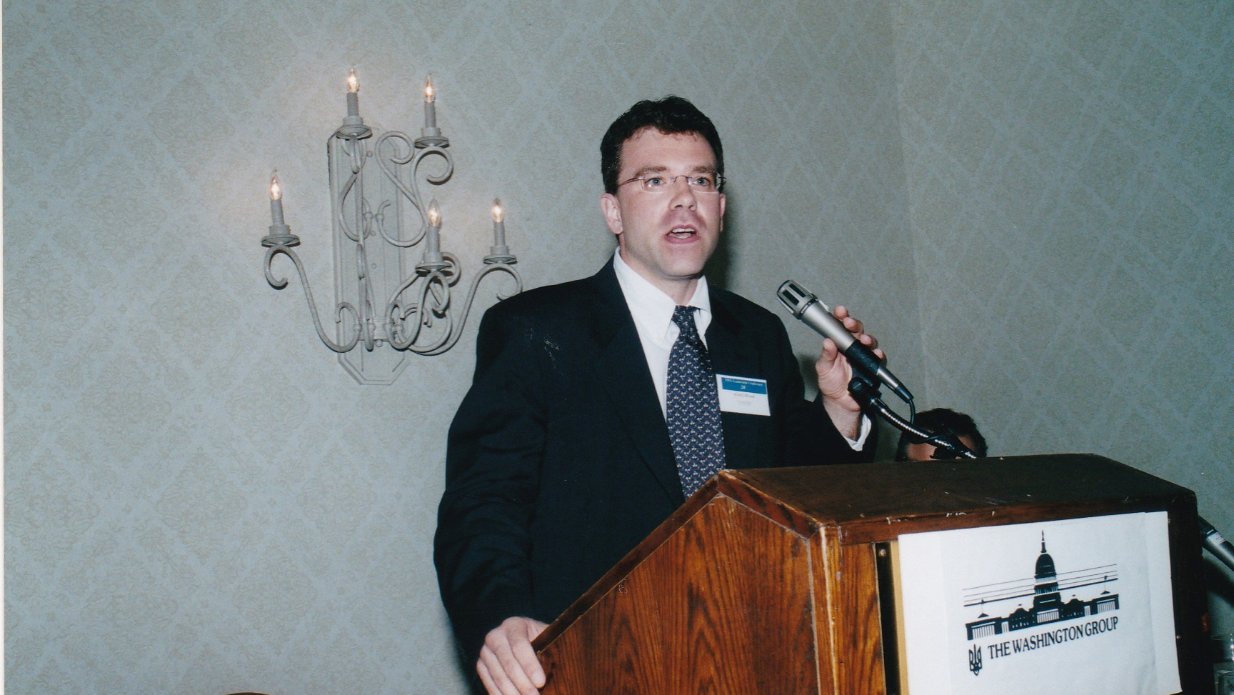
Notes:
The Washington Group Leadership Conference “Improving Our Organizations” – 6/12/2004 – Key Bridge Marriott: Andrij Wowk – Ukrainian Engineering Society of America (UESA)

Slide 50
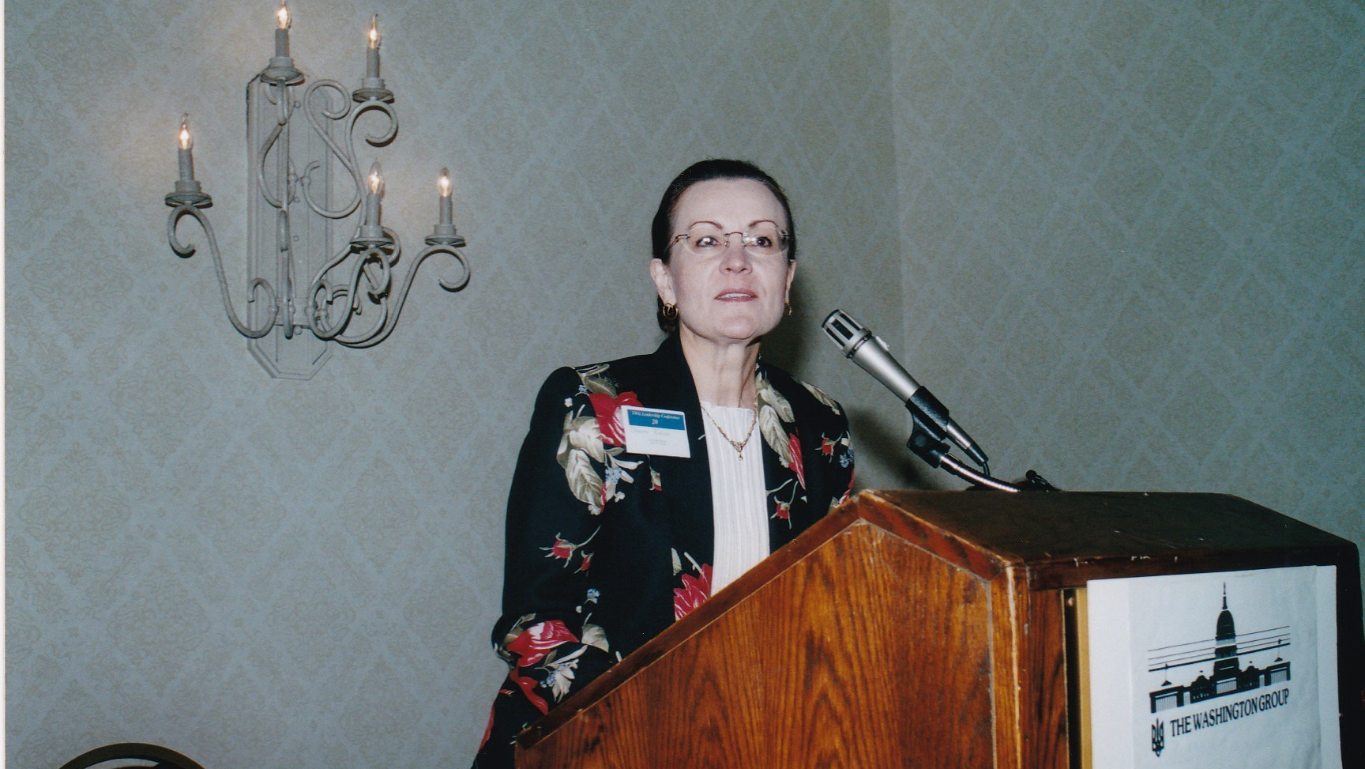
Notes:
The Washington Group Leadership Conference “Improving Our Organizations” – 6/12/2004 – Key Bridge Marriott: Oksana Xenos – Ukrainain National Womens’ League of America (UNWLA)

Slide 51
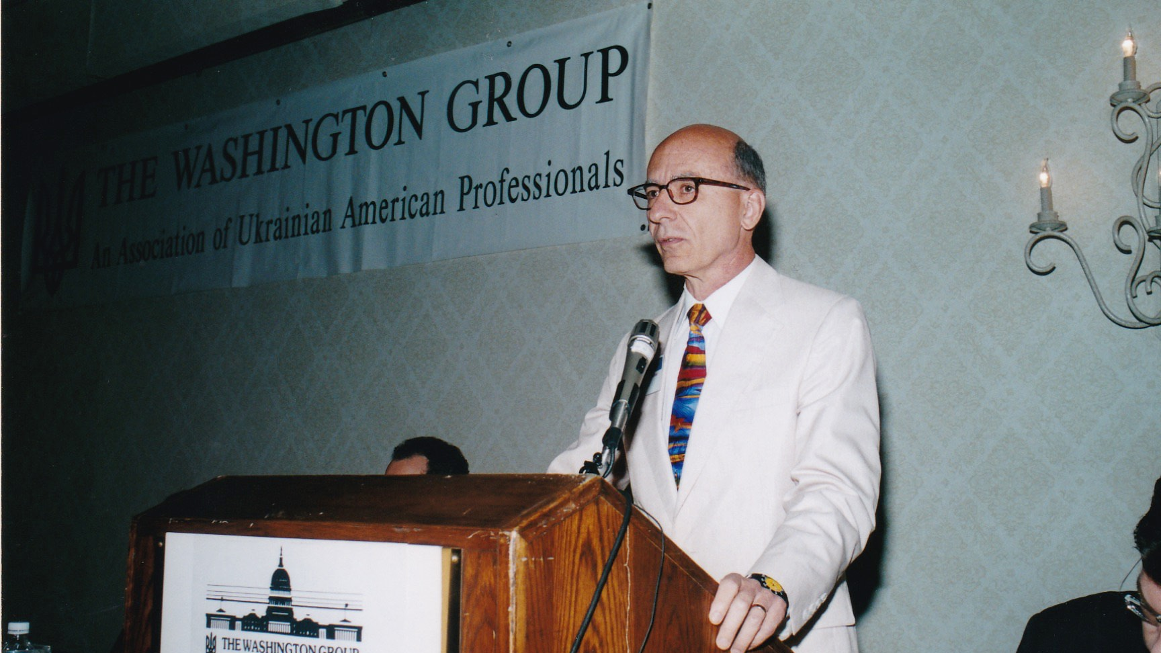
Notes:
The Washington Group Leadership Conference “Improving Our Organizations” – 6/12/2004 – Key Bridge Marriott: Dr. George Hrycelak – Ukrainian Medical Association of North America (UMANA)

Slide 52
TWG Leadership Conference
Brunch Speaker: General Morozov
June 13, 2004

Slide 53
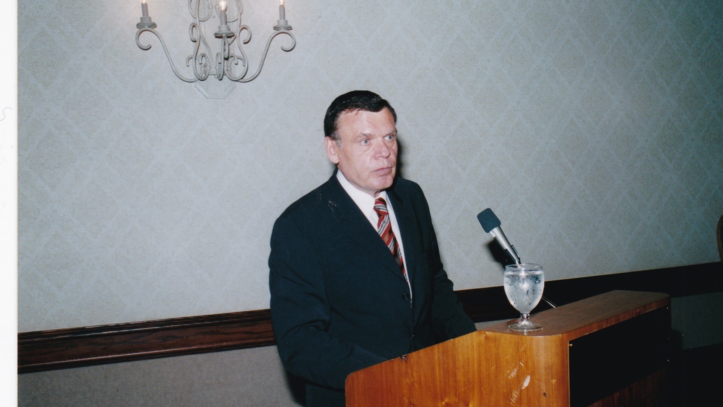
Notes:
The Washington Group Leadership Conference Brunch Speaker– 6/13/2004 – Key Bridge Marriott: General Kostyantyn Morozov

Slide 54
TWG Leadership Conference
Entertainment
June 13, 2004
Josef Janis, Alexander Fedoriouk, Beata Salak

Slide 55
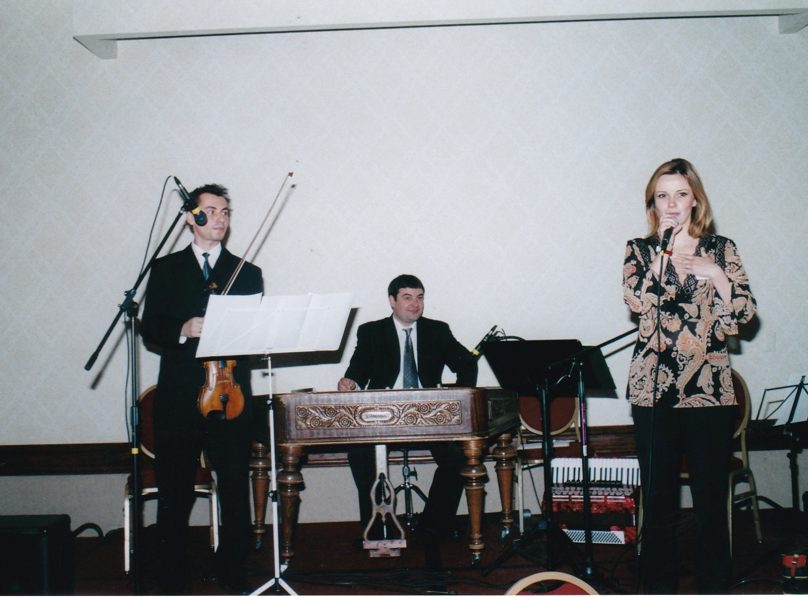
Notes:
The Washington Group Leadership Conference Brunch Entertainment – 6/13/2004 – Key Bridge Marriott: Traditional East European Folk Music - Josef Janis, violinist – Alexander Fedoriouk, cimbalom – Beata Salak, vocalist

Slide 56
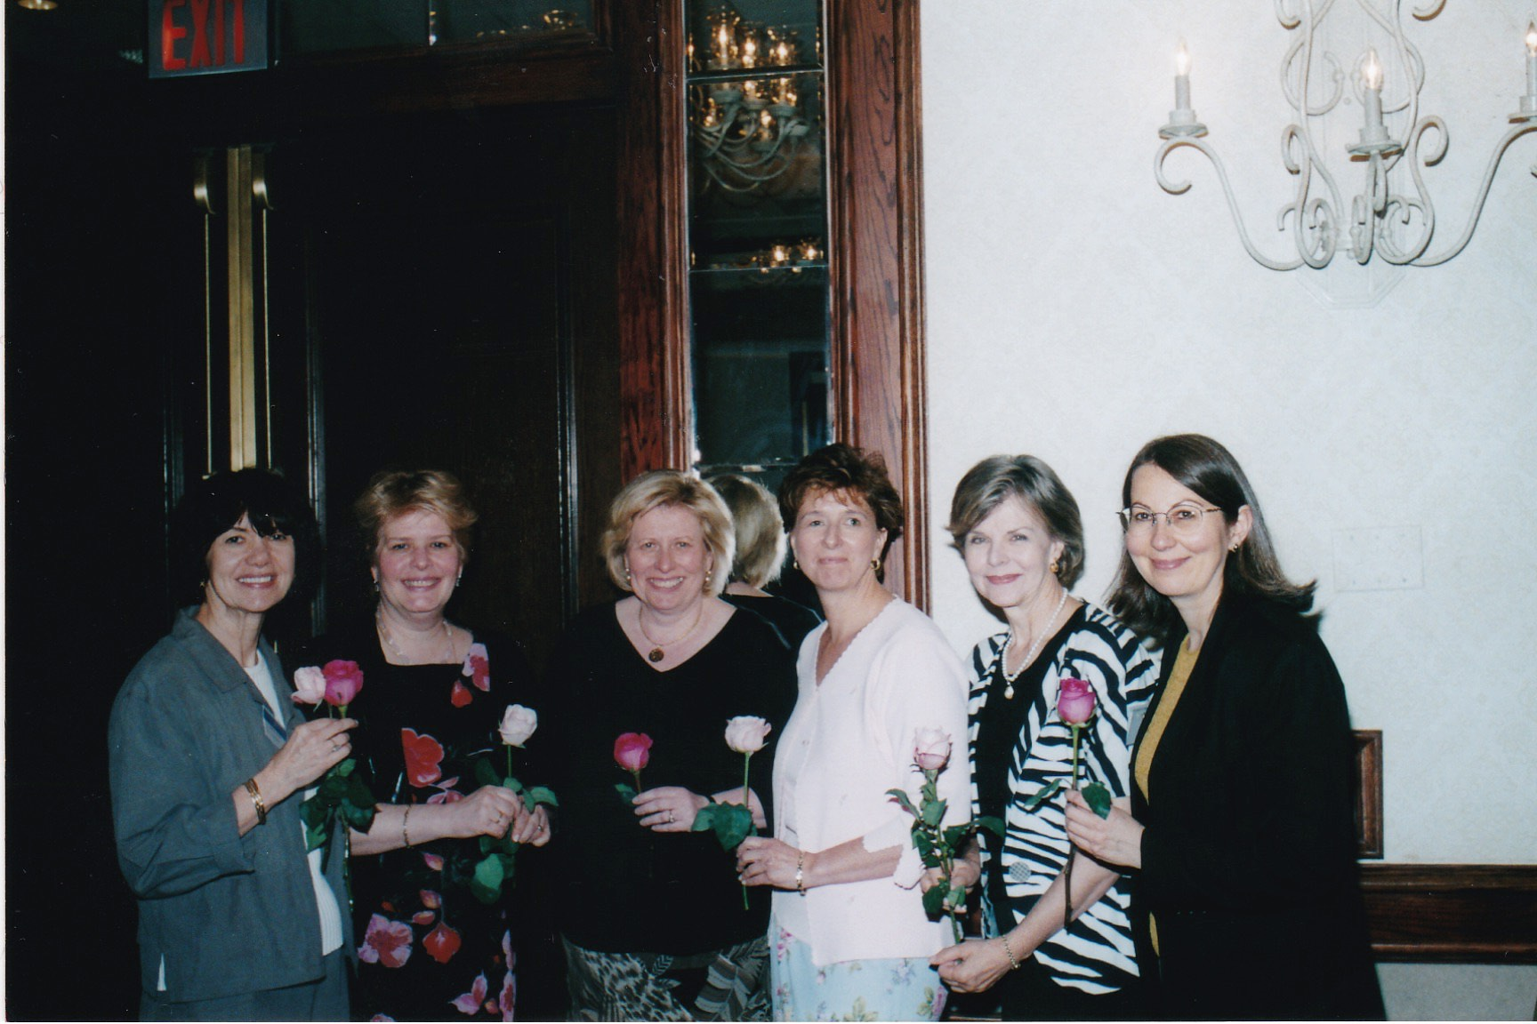
Notes:
The Washington Group Leadership Conference – 6/13/2004 – Key Bridge Marriott: Natalie Sluzar, Marta Kolomayets, Daria Stec, Marta Zielyk, Ivanna Richardson, Isha Pryshlak

